Slide 1
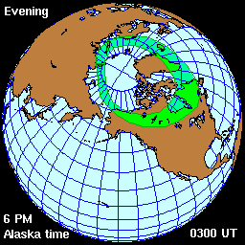
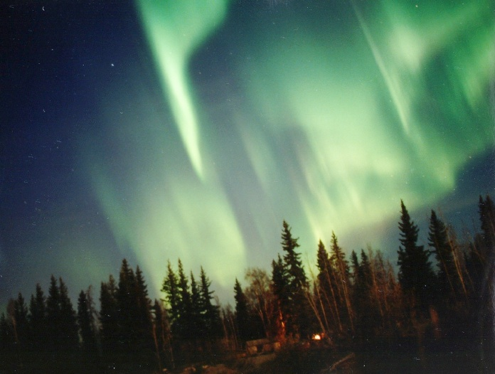
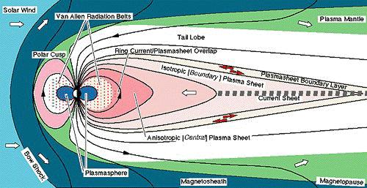
Seventh Annual Huntsville 2000 Workshop , Callaway Gardens, Pine Mountain, Georgia
October 30 -November 3, 2000
Establishing a Magnetospheric-Ionospheric Roadmap
Harlan E. Spence
Boston University
Department of Astronomy and
Center for Space Physics

Slide 2
Approaches to Establish A Roadmap – Representative Examples
Empirical Magnetic field mapping
Detailed spectral particle mapping
Distinct features in auroral Emission/particle precipitation associated with distinct magnetospheric phenomena
Morphological particle population mapping
Global ionospheric convection observations compared With global magnetospheric simulation flows

Slide 3
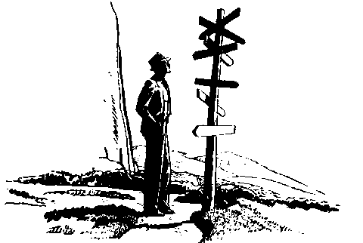
Where are we?
The magnetosphere-ionosphere system is vast, dynamic, and complex
Ultimately, dense arrays of satellites simultaneously measuring the important state variables of the plasma are needed to understand the coupled MI system – a future direction
The ionosphere already provides a convenient location where synoptic studies (flows, precipitation, currents, aurora, etc.) are conducted.
However, basic uncertainties remain on how to relate these globally-measured features with associated magnetospheric processes.
Here I review some of the strategies aimed at establishing these linkages
Successes and limitations will be highlighted.

Slide 4
Establishing a Magnetospheric-Ionospheric Roadmap
A Richly historic topic that would be difficult to review comprehensively in this talk – I’ll discuss mostly recent ideas instead and use representative examples (so my apologies in advance)
A critically important but elusive issue, elusive owing to the complexities of the mapping and the inherent time-dependencies that complicate associations
A problem that grows more imperative as we seek understanding of the intimately coupled global ionosphere-magnetosphere as a system
Progress is being made on many fronts and that is helping to define the next class of major missions

Slide 5
Some Problems Associated with MI Cartography
The ionospheric Resistive scale length Inherently limits visibility of magnetospheric features – It defines the minimum Magnetospheric feature in auroral features (~!00km)
The auroral accelerator decouples the M-I system just when it gets interesting! – Strong parallel potentials form in regions of strong parallel current– the ionospheric “screen” can be distorted and field lines can be far from equipotentials; auroral emissions can also be misleading
Inductive electric fields are significant and also confound mappings – It is extremely dangerous to ignore time variations of the magnetic field
Incomplete particle observations in angle and/or energy can lead to unresolvable ambiguities; multipoint observations help resolve the other difficulty of space/time separation

Slide 6
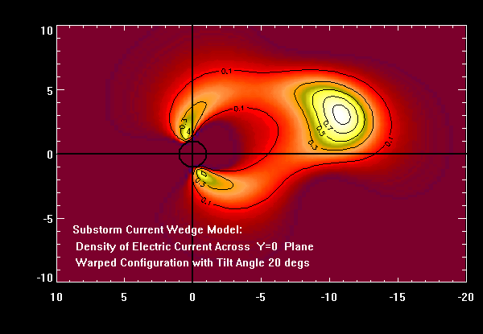
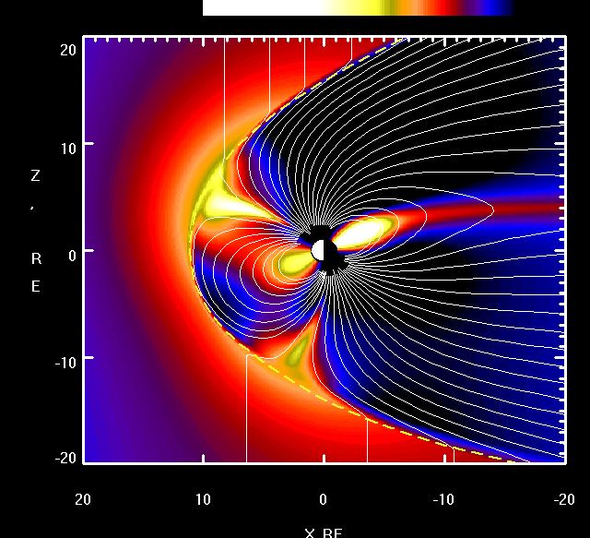
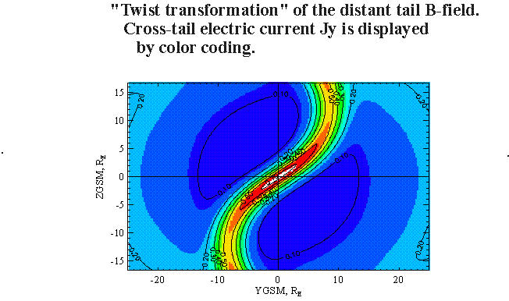
Empirical Global Magnetic Field Mapping
Tsygnanenko 96 Model
w/ diamagnetic cusp and tilt

Slide 7
Particle Mapping – Spectral Matching and UBK Analysis
Linkages can be determined by virtue of Energetic particles guided by magnetic field lines between two locations - Mappings of detailed spectral shapes have been explored between lEO and GEO and between MEO and HEO – these techniques effectively test empirical magnetic field models
At lower particle energies, UBK analysis is required to establish interspacecraft mappings owing to the importance of electric drifts– Comparisons of particle distributions between HEO spacecraft (I.e., Whipple et al.) can be used in conjunction with UBK to extract electric fields with a presumed magnetic configuration; this is a powerful tool that has only recently been fully exploited – more work is called for!

Slide 8
MI Connections Through Associations of Distinct Features
Specific gross features in the ionosphere and magnetosphere can be exploited to establish linkages - Examples include:
  velocity-dispersed ions in the cusp associated with reconnection
  north-south aligned arcs in the aurora associated with Bursty bulk flows
  identification of the open-closed boundaries in the magnetosphere and ionosphere

Slide 9
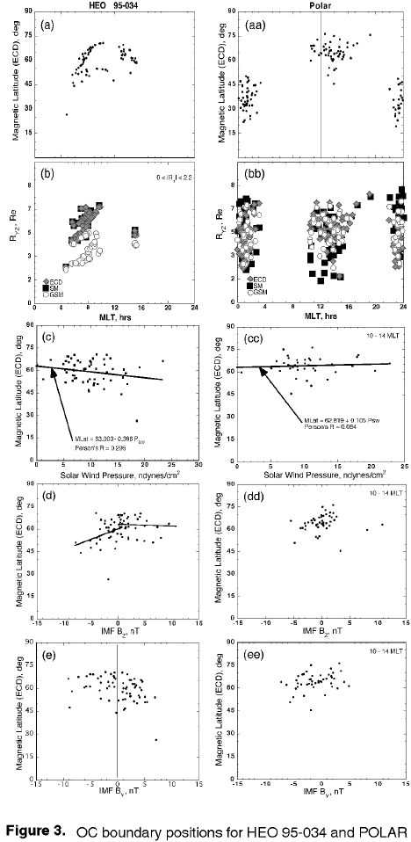
HEO/MEO Comparisons of the OCB Location
From Fennell et al., 1999

Slide 10
Particle Precipitation Region Identification
Newell and Meng have provided the most modern Statistical roadmap of ionospheric precipitation to its magnetospheric source Using DMSp; the statistical picture provides rich insights into event analysis

Slide 11
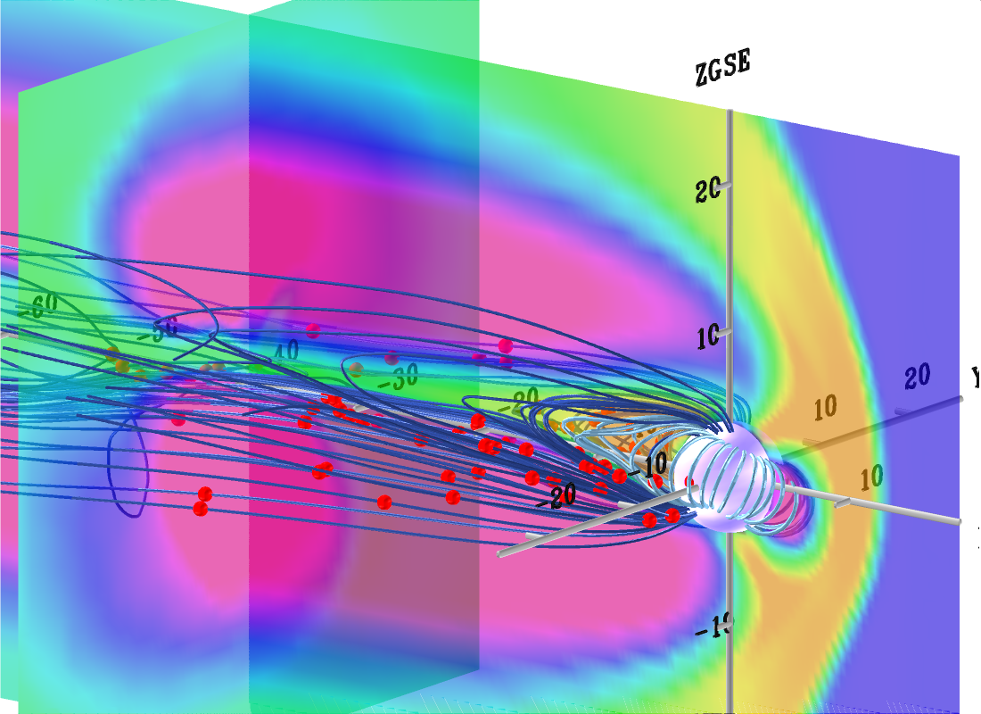
Global Numerical Simulation/Global Ionospheric Comparisons
Global MHD models can provide a time-dependent, global roadmap; but how do we test such models?
Synoptic Ionospheric observations (ground magnetometer arrays and radars) provide movies of evolving convective flows that are of the appropriate size scale for MHD – this is just one approach for validation
Growing use of this data/model comparison holds the promise of truly global context, at least in some limited cases and in some limited senses

Slide 12
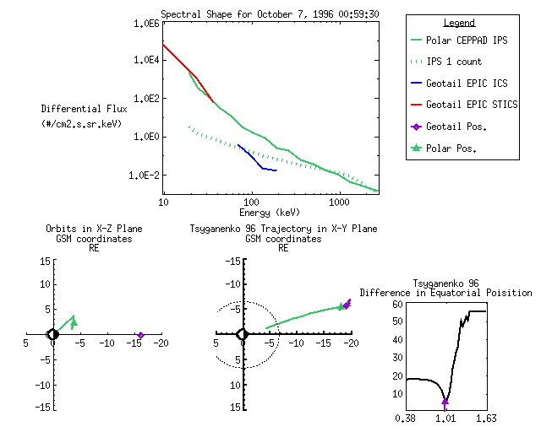
Particle Mapping Between Two High-Altitude Spacecraft:
Polar/Geotail Comparisons

Slide 13
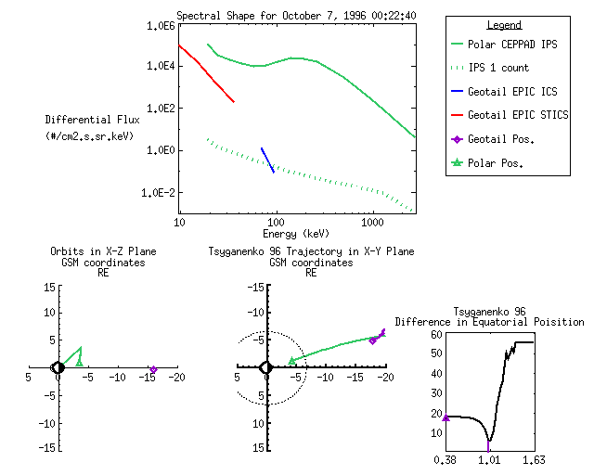
Particle Mapping Between Two High-Altitude Spacecraft:
Polar/Geotail Comparisons

Slide 14
Establishing a Magnetospheric-Ionospheric Roadmap
A Richly historic topic that would be difficult to review comprehensively in this talk – I’ll discuss mostly recent ideas instead and use representative examples (so my apologies in advance)
A critically important but elusive issue, elusive owing to the complexities of the mapping and the inherent time-dependencies that complicate associations
A problem that grows more imperative as we seek understanding of the intimately coupled global ionosphere-magnetosphere as a system
Progress is being made on many fronts and that is helping to define the next class of major missions

