Slide 1
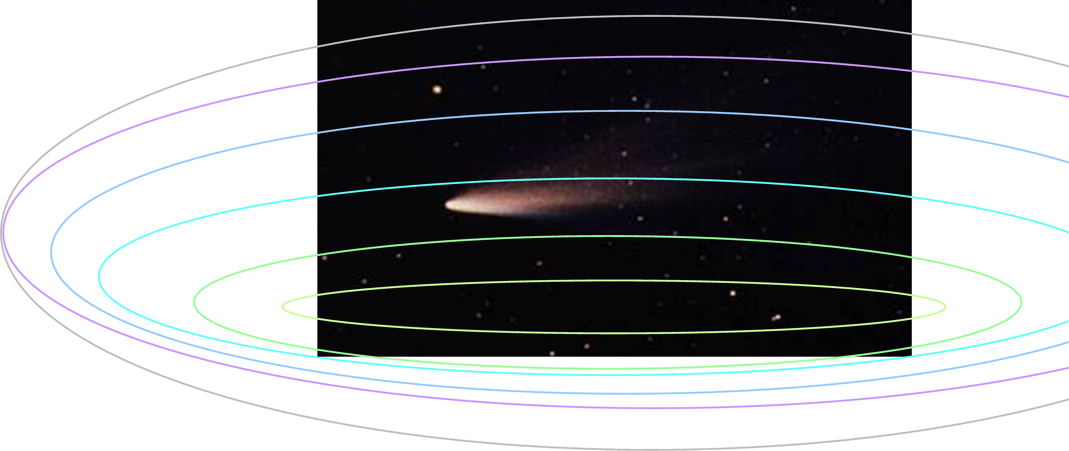
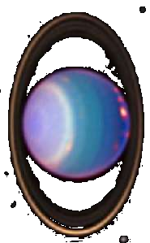
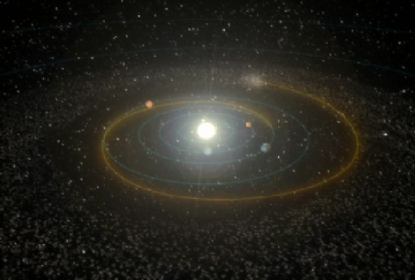
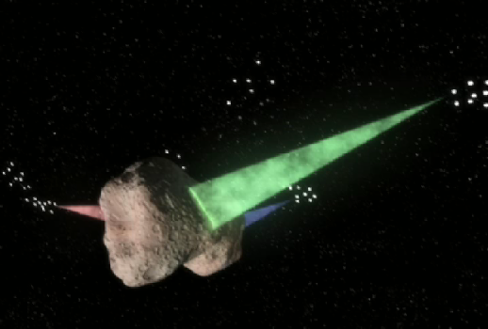
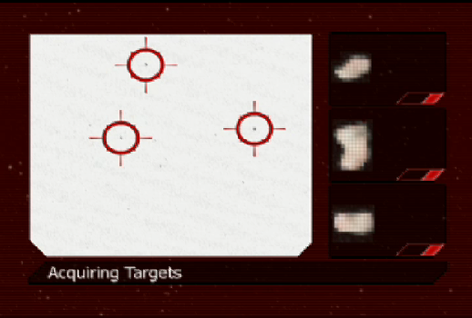
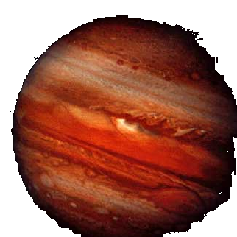
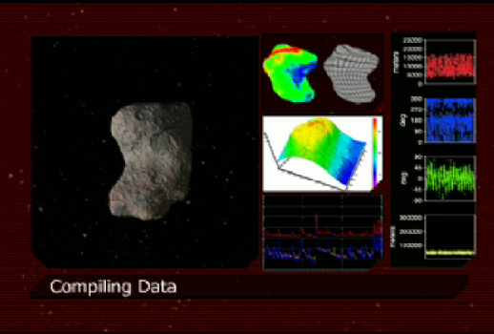
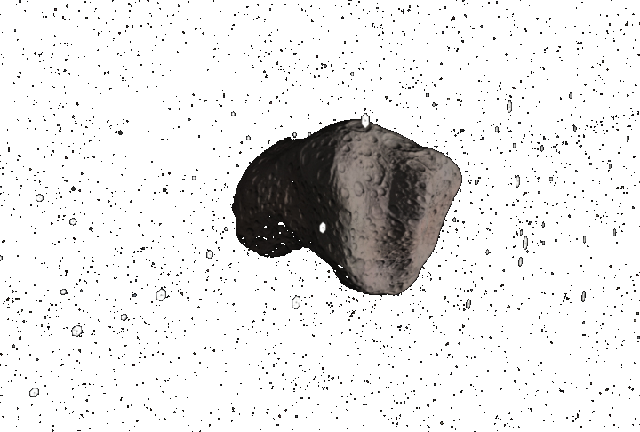
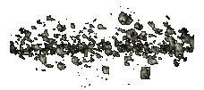

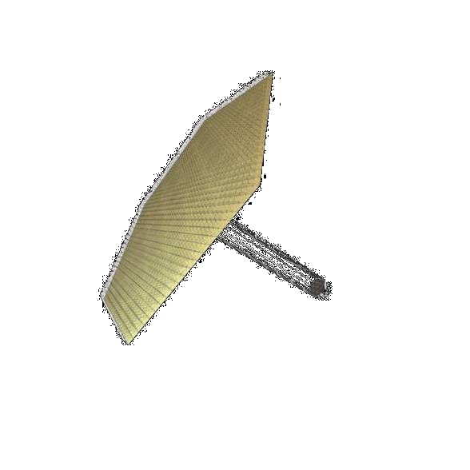
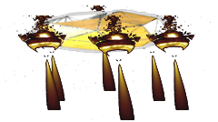
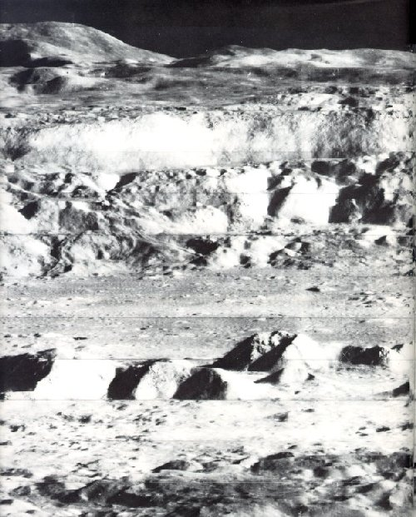
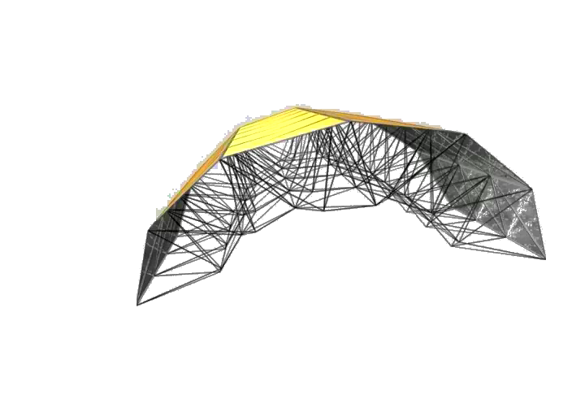
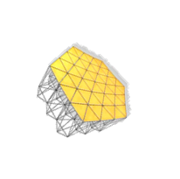
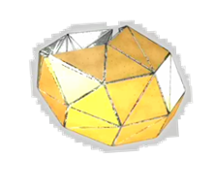
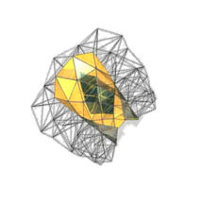
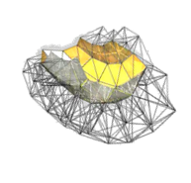
ANTS: An Architecture for Remote Operations Based on Real-time Addressable, Reconfigurable Structures
P.E. Clark, M.L. Rilee, L3 Communications GSI; S.A. Curtis, C.Y. Cheung, W. Truszkowski, NASA/GSFC; J.E. Sams, NASA/LARC
Definition of ANTS: Autonomous NanoTechnology Swarm
A generic mission architecture based on spatially distributed units consisting of autonomous, redundant components with high plasticity, organized as hierarchical (multilevel, dense heterarchy) and inspired by success of social insect colonies where within their specialties, individuals outperform generalists and with sufficiently efficient social interaction and coordination, groups of specialists outperform groups of generalists.
PAM: Prospecting Asteroid Mission
An ANTS application for survey of a large dynamic populations
  1000 spacecraft swarm travel to asteroid belt (1)
  10 types of ‘specialists’ with common spacecraft bus (2)
  10 subswarms, ~100 spacecraft each, ~10 each specialist
  Asteroids not preselected but ‘targets of opportunity’ (3)
  Solar sail propulsion system requiring no expendables
  Small nuclear batteries for 100’s of milliwatt power requirement
  Designs applicable to low G environments <3.5 AU
  Primary objective is the exploration of the asteroid belt
  in search of resources and material with astrobiologically
  relevant origins and signatures (4)
1
Abstract: The Autonomous NanoTechnology Swarm (ANTS) Architecture is well suited to remote space or ground operations. It can be implemented on a near term basis, using Addressable Reconfigurable Technology (ART). Components are highly modular, addressable arrays of robust nodes, from which highly morphable struts, acting as supports or tethers, or even forming 2D mesh or 3D fabric, can be reversibly deployed/stowed. Each autonomous unit is capable of adapting itself for its mission. The ANTS approach harnesses the effective skeletal/ muscular system of the frame itself to enable amoeboid-like movement, more ‘natural’ than wheels, effectively allowing ‘flow’ across a surface or into a particular morphological form. ANTS structures, operating continuously or on demand, are a promising approach for reconnaissance, communication or transportation, which would protect human crews and facilitate their work.
2
ANTS Application: PAM, Prospecting Asteroid Mission
Time Frame: 2020-2025. MEMS-NEMS
Environment: Space, Low G, Low density dynamic population
Power: 100 mWatt Solar or Nuclear Battery Energy Source
Material: 1 kg, 100 m²/kg
Locomotion: Solar Sail
Challenges: Rapid reconfigurability of sails and subsystems for attitude control required for science operations for 10 dynamic objects simultaneously
3
4
ANTS Application: Lunar Base Activities, 2010-2015
Time Frame: Near Term, MEMS
Environment: Space and Rugged Surface
Power: Watts, Solar or Nuclear Battery Energy Source
Material: 10 kg, 1 m²/kg
Locomotion: Chemical Propulsion flight/Solar or Battery ground
Challenges: Maximum adaptability for range of forms required to support lunar base unmanned/human activity.
landers
ANTS architecture for Lunar or other Surface Applications
Could provide autonomous units (landers) arrive by space or air, launched from remote manned or unmanned locations.
Could allow locomotion of autonomous units (rovers) on the ground, non-specific amoeboid-like motion including rolling, slithering, creeping for exploring, monitoring, building, transporting materials.
Could provide autonomous units to act as multi-platform instruments, antenna arrays or beacons for communication, navigation, or observation.
Could provide autonomous units to act as specialized equipment nodes for construction, maintenance, industrial, or raw material recovery operations.
storage
rovers
Antenna array

