Slide 1
Neonatal Antidepressant Effects
Katherine L. Wisner, M.D., M.S.
Professor of Psychiatry, Obstetrics and Gynecology and Reproductive Sciences and Epidemiology
Director, Women’s Behavioral HealthCARE
Western Psychiatric Institute and Clinic/University of Pittsburgh Medical Center

Slide 2
Goals
Risk-benefit decision making for treatment of depression during pregnancy
Conceptualization of diagnosis and criteria for classifying neonatal effects after in-utero exposure to SSRI
Assessment strategies; NIMH R01 60335: Antidepressant Use during Pregnancy

Slide 3
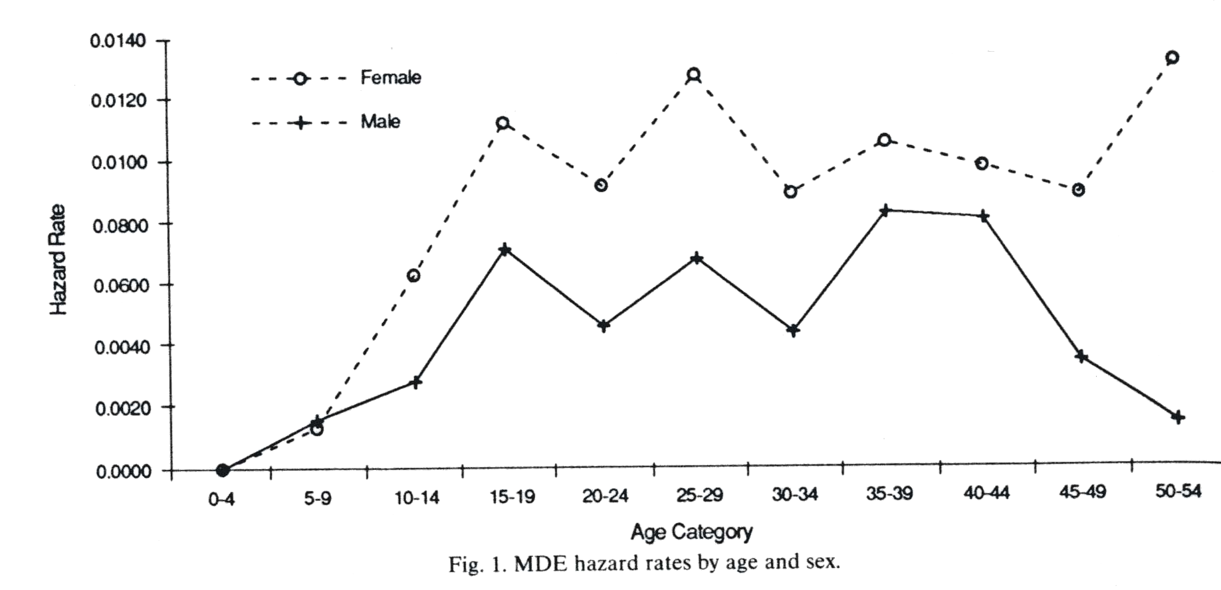
Gender Differences in Prevalence of Major Depression
Women have 1.5-2.5 x the rate of depression relative to men between ages 15-54
Kessler et al (1993) Journal of Affective Disorders
Notes:
Women are approximately 1.7 times as likely as men to report a lifetime history of MDE. Sex difference begins in early adolescence (age 10) and persists through the mid-50s. The sharp divergence in the 50’s is based upon a small sample size and not thought to be reliable.
Sex difference in depression is most pronounces among early adolescents, with the highest relative hazard of first onset (OR=2.3) in the age range 10-14.
This is a consistent finding throughout the world, regardless of how depression is diagnosed.
Since women are no more likely than men to be chronically depressed or to have ana acute recurrence in the past year – therefore higher prevalence is due to higher risk of 1st onset.
The NCS was a congressionally mandated survey with the specific goal of studying the comorbidity of psychiatric disorders. 8000 individuals, ages 15-54 interviewed. Used a supplemental nonresponse survey, with financial incentive, based on previous evidence that survey nonresponders tend to have higher rates of psychiatric d/o.
A structured psychiatric interview (DIS-diagnositc interiew schedule – can be administered by trained interviewers who are not clinicians) was administered to a representative US sample. Based on results that respondents underreport stem questions once they recognize that positive responses lead to more detailed questions, they used a life review section before probing any positive stem responses and to facilitate active memory search for lifetime episodes.
Anxiety d/o have an approximately 5% 1-yr prevalence form the same study

Slide 4
Risk-Benefit Decision-Making for Depression during Pregnancy:
A Framework
Wisner et al: Risk-benefit decision-making for treatment of depression during pregnancy. Am J Psych 157: 1933, 2000
Healthy outcomes for mother and baby are the rule rather than the exception!

Slide 5
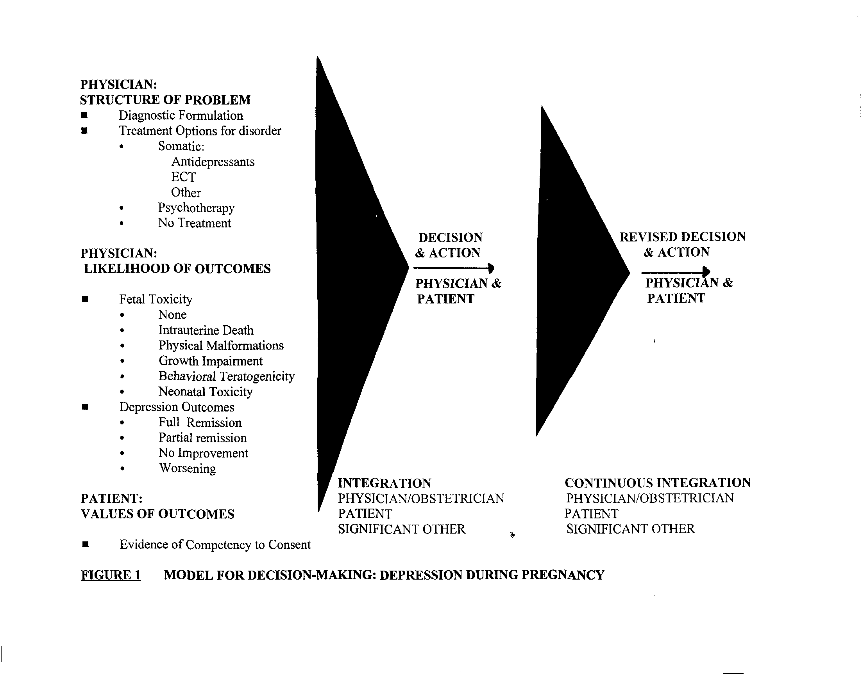

Slide 6
Prospective Data for Application to Model
Wisner et al, JAMA 1999;282:1264-1269
SSRI are not major morphological teratogens; therefore, they are commonly used and other reproductive outcomes have been observed
Poor neonatal adaptation in 31.5% of infants in late-exposed group, 8.9% in early-exposure group for fluoxetine (Chambers et al, NEJM)

Slide 7
Maternal Mental Health and Obstetric Complications
Association of maternal depression OR 2.5 (1.1-5.4) & anxiety OR 3.2 (1.4-7.4) with preeclampsia (Kurki et al 2000; Obstetrics and Gynecology)
Significant association between uterine artery resistance index and Spielberger state/trait anxiety scores (Teixeira et al 1999; British Medical Journal)
  Fetal growth restriction
  Preeclampsia

Slide 8
Association of Maternal Stress, Anxiety, and Depression, with Altered Fetal Behavior
Increased CRH during pregnancy was associated with decreased fetal responses to a novel stimulus (Sandman et al 1999; Ann NY Acad Sciences)
Simulated and real stress was associated with altered fetal HR variability
  Suggestive of increased sympathetic activation
  Delayed return of HR to baseline (Monk 2001; Psychiatric Quarterly)
Infants of depressed mothers are irritable and difficult to console

Slide 9
Depression and its Concomitants Affect Multiple Domains of Perinatal Health
Symptoms of Depression=physiological dysregulation
Appetite changes/food choice
Cognitive changes/educational needs
Psychosocial relationships
Prenatal care compliance
Use of other drugs/smoking
Choice of feeding methods

Slide 10
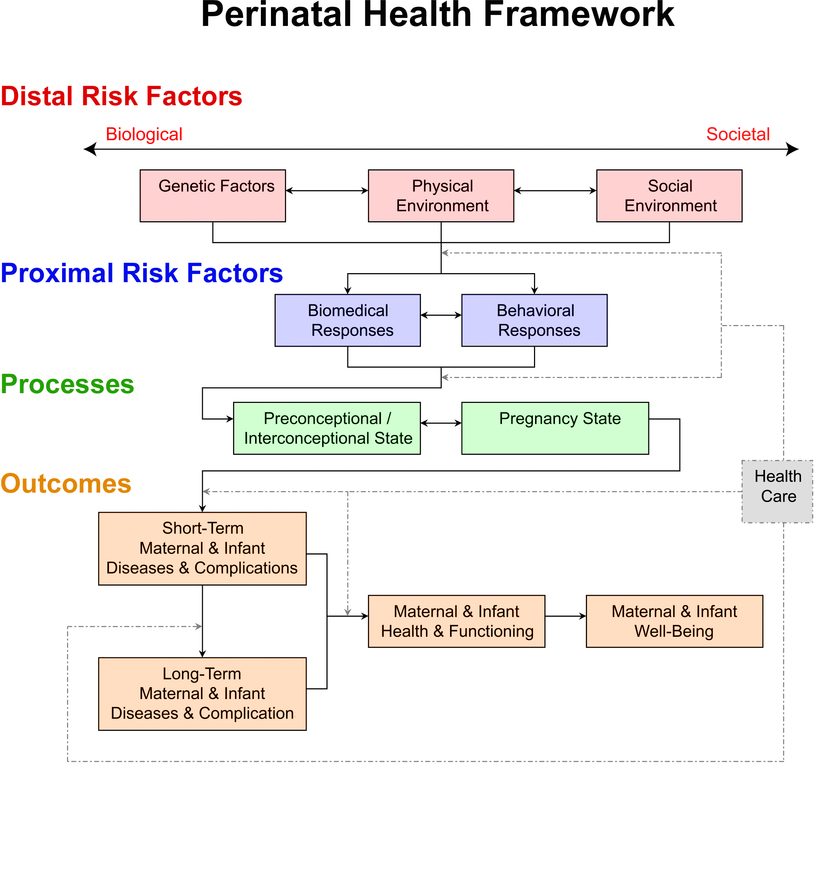
Misra, Am J Prev Med 25:65, 2003

Slide 11

Toon

Slide 12
Do all SSRIs Increase Risk for Neonatal Complications?
Fluoxetine
  4-fold increased rate
  Likely to develop by 4 hours of life [Long half-life (7 days; active metabolite with longer half-life)]
Paroxetine
  Most commonly identified in the case reports
  High variability in time of onset (birth – 5 days postpartum)
  Anticholinergic – thus potentially associated with cholinergic overdrive
Sertraline, citalopram, fluvoxamine
  Make inferences based on pharmacology

Slide 13
Placental Passage of SSRIs
Placental passage = [SSRI] umbilical vein
        [SSRI] maternal serum
        Potency of serotonin
        Placental Passage inhibition (IC50)
Sertraline, paroxetine 0.29 (lowest) 0.19; 0.29
Citalopram, fluoxetine 0.89 1.8; 6.8
Hendrick et al 2003; AJP

Slide 14
Neonatal SSRI Pharmacology
High interindividual variability
  Preterm/full term status
  Exposures to additional drugs (CYP inducers/inhibitors)
  Overall health of newborn
  Genetic polymorphisms
    8% of Caucasians and 2% African Americans are poor metabolizers due to CYP 2D6 genotype
  Activity of serotonin catabolic and synthetic enzymes
  Availability of serotonin nutritional precursors

Slide 15
“Poor Perinatal adaptation”
(Chambers et al 1996)
“Serotonin overstimulation”
(Laine et al 2003)
Myoclonus
Restlessness
Tremor
Shivering
Hyperreflexia
Nausea
Involuntary movements
Rigidity
Tachypnea/ respiratory distress/ desaturation on feeding
Hypoglycemia
Poor tone
Weak/absent cry
Jitteriness
Hypo-thermia

Slide 16
Symptom Domains in Neonates Exposed to SSRI
Feeding/Digestive disturbance
Sleep disturbance
Temperature regulation disturbance
Respiratory disturbance
Tone disturbance
Metabolic disturbance
Nonspecific symptoms

Slide 17
Current Questions
What symptoms characterize this syndrome(s)?
What is the incidence of this syndrome(s)?
Is the neonatal behavioral syndrome consistent with drug withdrawal or intoxication (and when does neurobehavioral teratology begin)?
Are all SSRIs equally likely to cause a neonatal behavioral syndrome?
Because the risks of not treating depression often outweigh the risks of treatment, what strategies can prevent, minimize, or treat these symptoms in order to improve maternal and infant health outcomes?

Slide 18
Finnegan Scale Modification for Gestational SSRI Exposure
Addition of items described in SSRI literature review
Removal of items specific for narcotic withdrawal
Research is needed to establish time course-symptom set relationships, and clinical severity thresholds which dictate specific interventions

Slide 19
NIMH R01 60335
Antidepressant Use During Pregnancy
Naturalistic Study-Pregnancy and 24 months post-birth; multiple outcomes assessed
1- pregnant women with depression, not medicated (+dep/-drug)
2- not depressed, taking antidepressants (-dep/+drug)
3- normal controls (-dep/-drug)
4- [+dep/+drug]

Slide 20
Substudy Design
At week 36: risk benefit discussion, mothers choose: 1) to taper drug 2 weeks before EDC (or d/c fluoxetine) and re-start immediately after birth, or 2) continue drug through the remainder of pregnancy.
Weekly SIGH-ADS monitoring from weeks 36-birth for depression assessment in mothers.
Outcomes in mothers and infants (Birth, 2 wk; 3,6,12,18 and 24 mo) will be compared across the groups.

Slide 21
Current Questions
Does taper regimen (or d/c Fluox) affect the near-term fetus in utero?
Does the behavior of infants born to mothers who taper compare to unexposed infants?
Do mothers become symptomatic during the taper phase?
Does re-starting medication at birth prevent recurrence of the depressive episode?
Does breastfeeding provide any protection by exposure through breastmilk?

Slide 22
Assessment Strategies
Rater is blind to exposure status/hypotheses
Maternal serum/Cord blood antidepressant level; mother breastfeeding baby level wk 3
Cry analysis (B, 2 week)
Pediatric neuro exam/neurobehavioral assessment (B, 2 week)
Modified Finnegan Scale (B, 2 week)

Slide 23
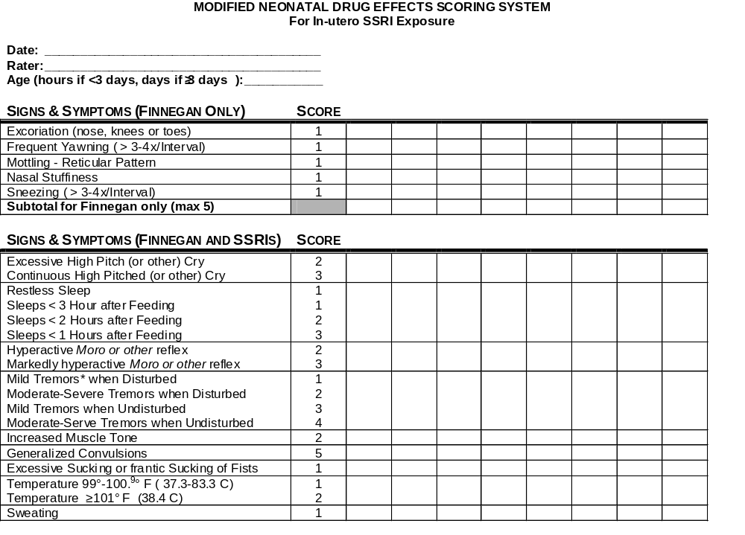
b

Slide 24
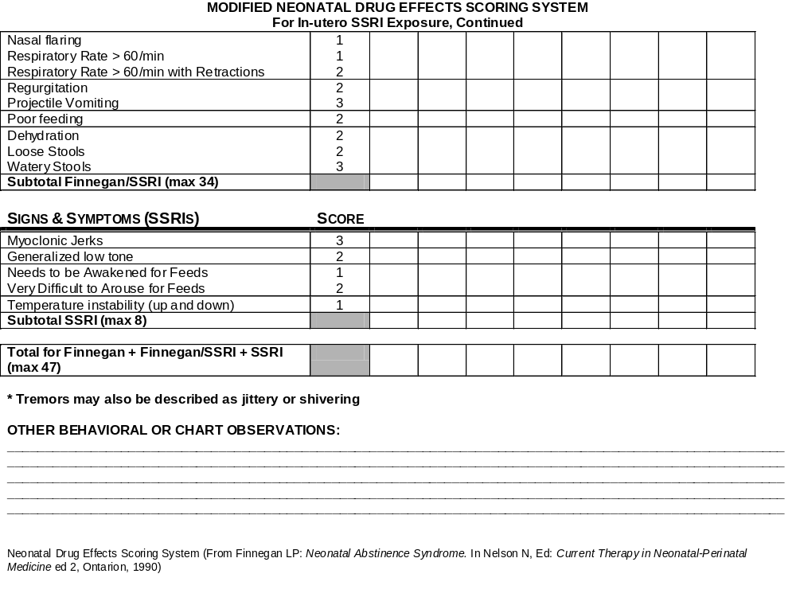
b

Slide 25
Potential Strategies to Manage Toxicity
  Parental education/cognitive strategies
  Taper/stop maternal drug prior to due date if risk of maternal illness doesn’t outweigh risk of complications
  Conservative management strategies
    Frequent small feedings /high calorie
    Swaddling
  Severe symptoms (Hypothetical only, dose ranging safety and efficacy study and clinical trial needed)
    Cyproheptadine?
      Add back low doses of fluoxetine if withdrawal symptoms emerge

Slide 26
Potential Strategies to Manage Withdrawal
Lactation may provide minimal additional dose to reduce rapid drug concentration drop
Conservative management strategies Frequent small feedings/high calorie
    Swaddling
Pharmacologic treatment with same drug, lower concentrations; hypothetical, requires dose ranging safety/efficacy study and clinical trial

Slide 27

Mental Health is Fundamental to
Health
David Satcher, M.D.

