Slide 1
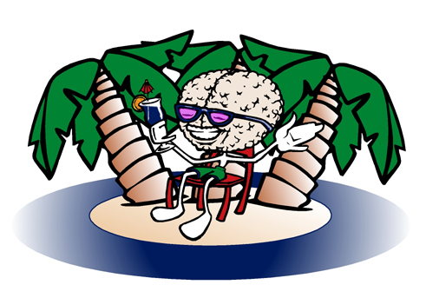
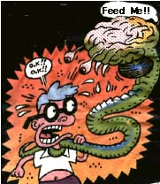
Transition to Addiction
Good to Bad
Increased Energy “It sustains and refreshes both body and brain...... in the same space of time more than double the amount of work could be undergone...” Sears, Roebuck, and Co. Consumers Guide, 1900
Euphoria “.....exhilarating and lasting euphoria.... You perceive increase in self-control and possess more vitality and capacity for work.” Sigmund Freud, 1884
Replace Natural Reward "A coke shot...it's like... injectable sex, an orgasm in every cell.”
Craving “I found I was taking money meant to buy presents for my children.”
Paranoia “He thought he was being forcibly electrocuted and could see electric wires leading to his body.”

Slide 2
Searching for the Neurobiological Basis of Addiction
Molecular site of action
Physiology of neuronal plasticity
Environmental influence

Slide 3
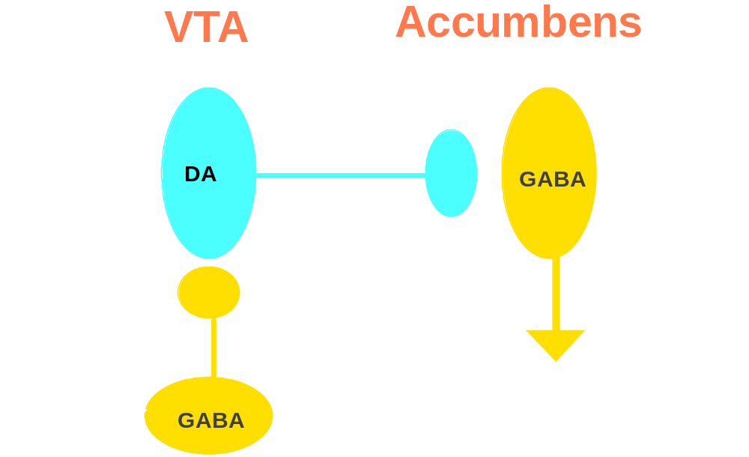
Drugs of Abuse Stimulate Mesoaccumbens Dopamine

Slide 4
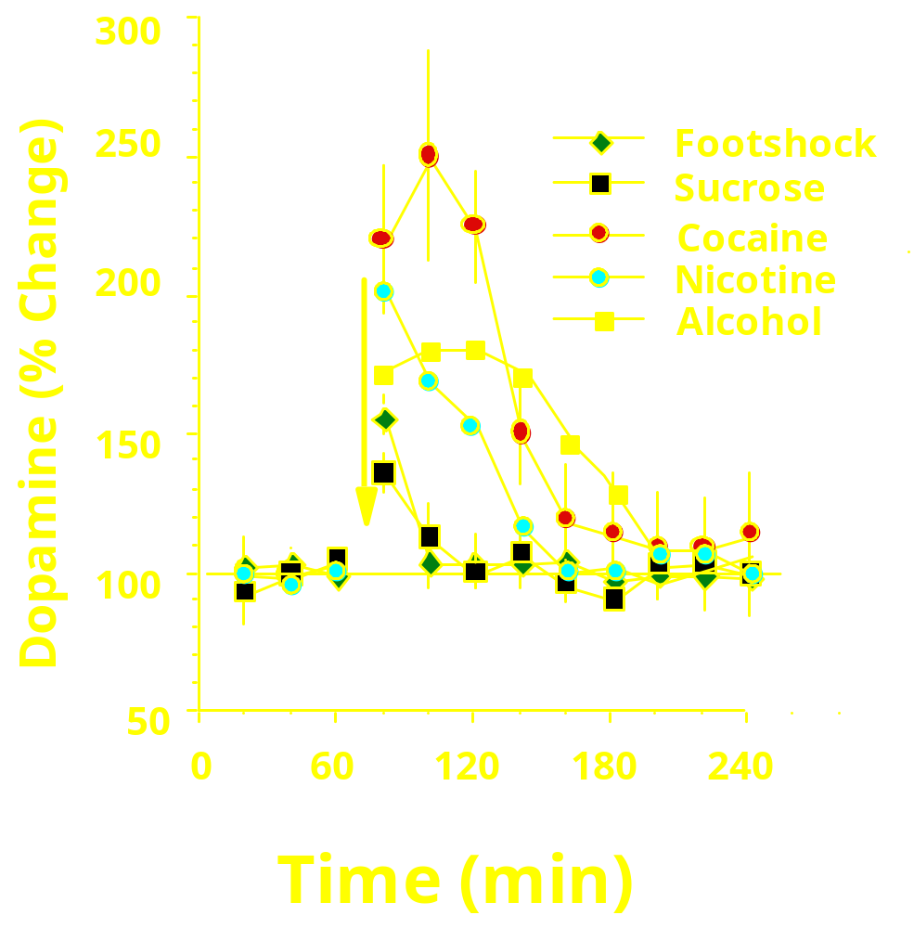
Aphysiologic Release of Dopamine

Slide 5


Motivation to Action

Slide 6
Physiological Activation of Dopamine
Novel stimulus regardless of valence
Changes in intensity of a known stimulus regardless of valence
Tolerance develops upon repeated exposure of a given stimulus.
Promotes neural plasticity to establish adaptive responses

Slide 7
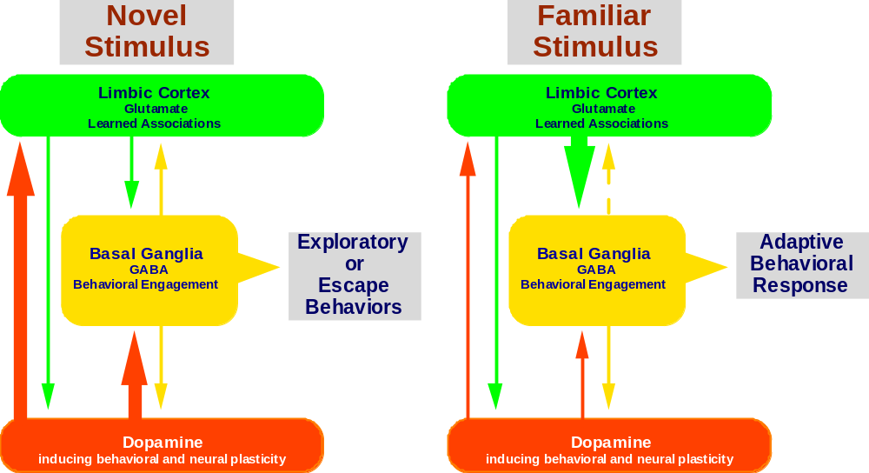
Dopamine Establishes Adaptive Behavioral Responses
Effect of a Novel versus a Familiar Stimulus

Slide 8
Searching for the Neurobiological Basis of Transition to Addiction
Molecular site of action
Physiology of neuronal plasticity
Environmental influence

Slide 9
Neuroplasticity in Dopamine Transmission
Dopamine
Cocaine
Calcium
DAT
Homer1a
PPD
PKA
D1
CaMKII
CREB
NAC-1
fos/fra
VDCC
Increased releasability of dopamine (depends on calcium transduction)
Increased post-synaptic dopamine signals (D1 receptors)
Morphological changes to increase synaptic contact
Long-term changes in gene expression

Slide 10
Cocaine Alters Gene Expression Causing Changes in Glutamate Transmission
Increased GluR1 (enhances Ca conductance at AMPA receptors)
Increased Narp (enhances AMPA signaling)
Increased Homer1a (inhibits mGluR1,5 signaling)
Decreased Homer1bc and mGluR5 (inhibits mGluR1,5 signaling)
Increased PPD (dynorphin inhibits glutamate release)

Slide 11
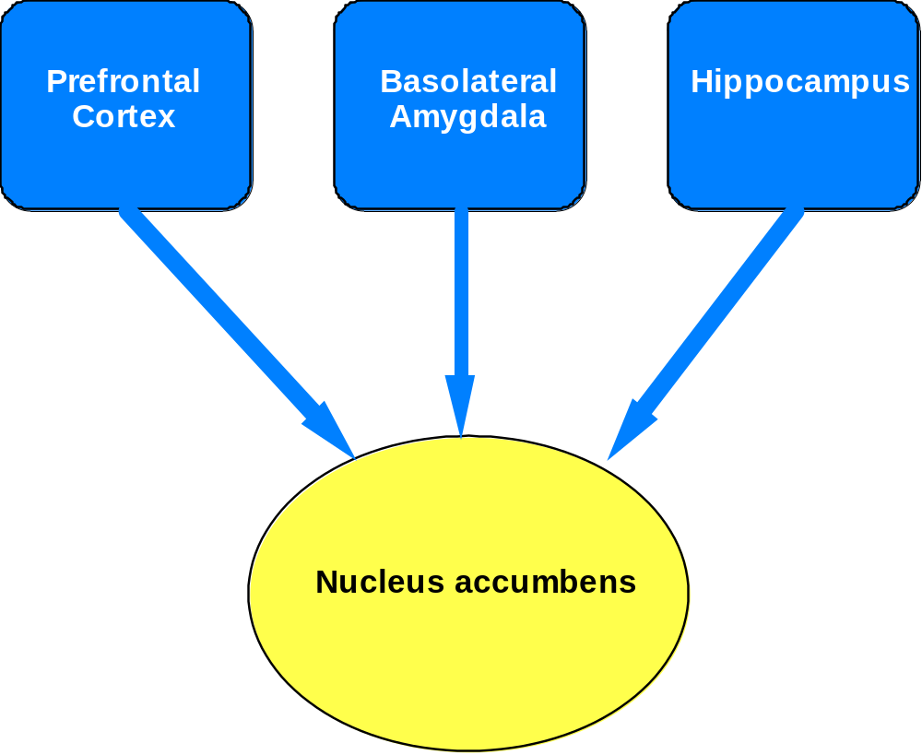
Glutamatergic
Afferents to the
Accumbens

Slide 12
Searching for the Neurobiological Basis of Transition to Addiction
Molecular site of action
Physiology of neuronal plasticity
Environmental influence

Slide 13
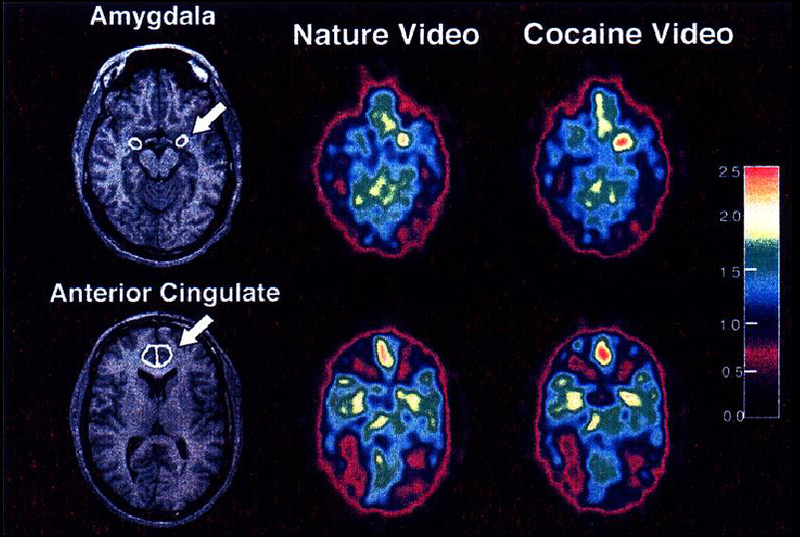
PET/fMRI of Cocaine Craving
Childress et al., 1999; Am.J.Psychiat

Slide 14
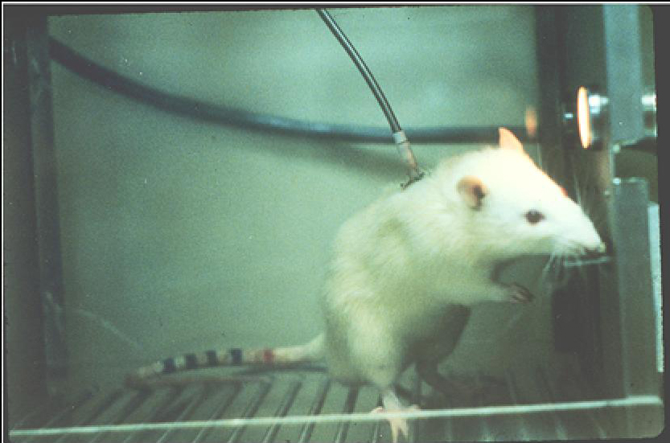
Self-administration of Cocaine

Slide 15
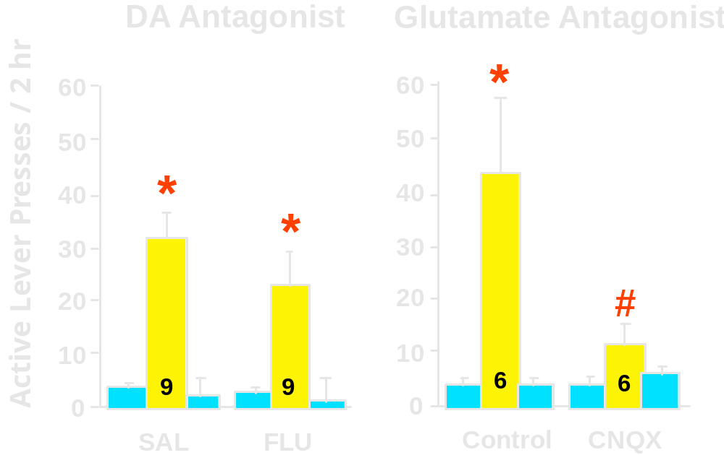
Glutamate receptor antagonism in the accumbens blocks cocaine-induced relapse

Slide 16
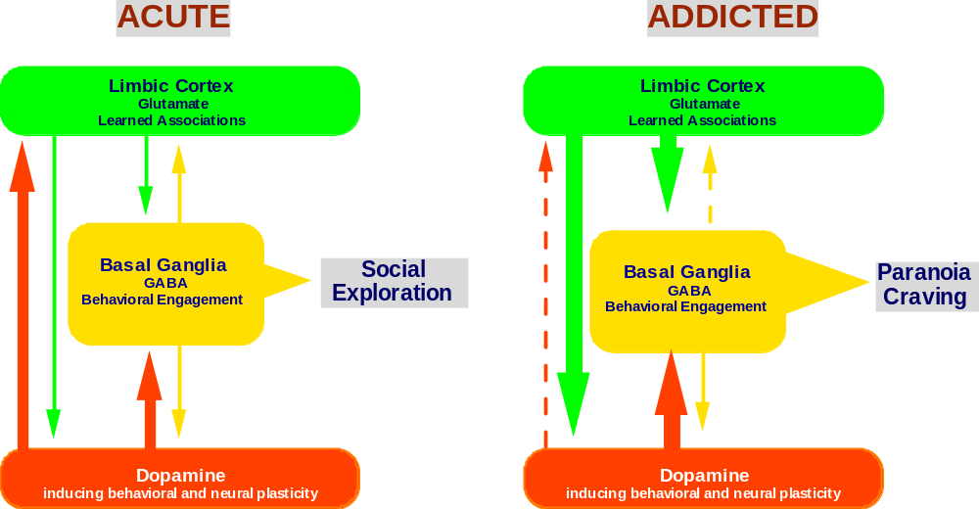
Effect of Acute versus Chronic Cocaine

Slide 17
How does all of this help?
Molecular site of action
Manipulate dopamine transmission (dopamine agonist/antagonist; transport blockers; calcium conductance)
Physiology of neural plasticity
Biological markers for vulnerability to addiction (gene expression altered by challenge)
Inoculate against addiction related neuroplasticity (vector mediated inhibition or promotion of gene expression)
Environmental influence
Modulate circuitry adjacent to dopamine synapses (glutamate antagonists or GABA agonists)

