Slide 1
TRECVID 2004 Search Task by NUS PRIS
Tat-Seng Chua, et al.
National University of Singapore

Slide 2
Outline
Introduction and Overview
Query Analysis
Multi-Modality Analysis
Fusion and Pseudo Relevance Feedback
Evaluations
Conclusions

Slide 3
Introduction
Our emphasis is three-fold:
  Fully automated pipeline through the use of a generic query analysis module
  The use of of query-specific models
  The fusion of multi-modality features like text, OCR, visual concepts, etc
Our technique is similar to that employed in text-based definition question-answering approaches

Slide 4
Overview of our System
Text Query Processing
Video Retrieval
Multi-Class Analyzer
Constraints Detection
Text Retrieval based on Speaker level information
Ranking of Shots based on Textual features
Multimedia
Query
Query
Expansion
Query Formulation
Ranking of Shots based on Audio Visual features
Fusion of Results
Video Query Processing
Speaker Verification
Pseudo Relevance Feedback using OCR and ASR
Output
Shots
Face Detection and Recognition
Re-ranking by Pseudo Relevance Feedback
Video Content Processing
Speaker Level
Segmentation
Shot
Classification
Shot Boundary
Video OCR
Video
Speech
Recognition
Speaker Verification
Face Detection
Visual Concepts
Feature Database

Slide 5
Multi-Modality Features Used
ASR
Shot Classes
Video OCR
Speaker Identification
Face Detection and Recognition
Visual Concepts

Slide 6
Outline
Introduction and Overview
Query Analysis
Multi-Modality Analysis
Fusion and Pseudo Relevance Feedback
Evaluations
Conclusions

Slide 7
Query Analysis
NLP Analysis
(pos, np, vp, ne)
WordNet, keywords list
Query
Key Core Query Terms
Query-class
Constraints
Morphological analysis to extract:
  Part-of-Speech (POS)
  Verb-phrase
  Noun-phrase
  Named entities
Extract main core-terms (NN and NP)

Slide 8
Query analysis – 6 query classes
PERSON: queries looking for a person. For example: “Find shots of Boris Yeltsin”
SPORTS: queries looking for sports news scenes. For example: “Find more shots of a tennis player contacting the ball with his or her tennis racket.”
FINANCE: queries looking for financial related shots such as stocks, business Merger & Acquisitions etc.
WEATHER: queries looking for weather related shots.
DISASTER: queries looking for disaster related shots. For example: “Find shots of one or more building with flood waters around it/them”
GENERAL: queries that do not belong to any of the above categories. For example: “Find one or more people and one or more dogs walking together”

Slide 9
Examples of Query Analysis
Topic | Query-class | Constraints | Core terms | Class
0125 | Find shots of a street scene with multiple pedestrians in motion and multiple vehicles in motion somewhere in the shot. | in motion somewhere | street | GENERAL
0126 | Find shots of one or more buildings with flood waters around it/them. | with flood waters around it/them | Buildings, flood | DISASTER
0128 | Find shots of US Congressman Henry Hyde's face, whole or part, from any angle. | whole or part, from any angle | Henry Hyde | PERSON
0130 | Find shots of a hockey rink with at least one of the nets fully visible from some point of view. | one of the nets fully visible | hockey | SPORTS
0135 | Find shots of Sam Donaldson's face - whole or part, from any angle, but including both eyes. No other people visible with him | whole or part, from any angle, but including both eyes. No other people visible with him | Sam Donaldson | PERSON

Slide 10
Corresponding Target Shot Class
for each query class
Pre-defined Shot Classes: General, Anchor-Person, Sports, Finance, Weather
Query-class | Target Shot Categories
PERSON | General
SPORTS | Sports
FINANCE | Finance
WEATHER | Weather
DISASTER | General
GENERAL | General

Slide 11
Query Model -- Determine the Fusion of Multi-modality Features
Weights obtained from labeled training corpus
Class | Weight of NE in Expanded terms | Weight of OCR | Weight of Speaker Identifica- tion | Weight of Face Recogni -zer | Weight of Visual Concepts (total of 10 visual concepts used)
 |  |  |  |  | People | Basket- ball | Hockey | water- body | fire | Etc
PERSON | High | High | High | High | High | Low | Low | Low | Low | .
SPORTS | High | Low | Low | Low | Low | High | High | Low | Low | .
FINANCE | Low | High | Low | High | Low | Low | Low | Low | Low | .
WEATHER | Low | High | Low | High | Low | Low | Low | Low | Low | .
DISASTER | Low | Low | Low | Low | Low | Low | Low | High | High | .
GENERAL | Low | Low | Low | Low | High | Low | Low | Low | Low | .

Slide 12
Outline
Introduction and Overview
Query Analysis
Multi-Modality Analysis
Fusion and Pseudo Relevance Feedback
Evaluations
Conclusions

Slide 13
Text Analysis
ASR of Sample video
Query
ASR
WordNet
Speaker level segments
K₁
K₂
Based on class of query to assign weights
Based on tf.idf retrieval with weighted terms
K₃
Document retrieval by Google news
K₁ → query terms expanded using its Synset (and/or glossary) from WordNet
K₂ → ASR (terms with high MI) from sample video clips
K₃ → Web expansion (terms with high MI) union K₁ & K₂

Slide 14
Other Modalities
Video OCR
  Based on featured donated by CMU, with error corrections using minimum edit distance during matching
Face Recognition
  Based on 2DHMM
Speaker Identification
  HMM model using MFCC and Log of Energy
Visual Concepts
  Using our concept-annotation approach for feature extraction

Slide 15
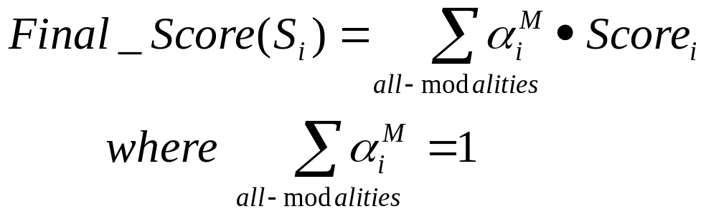
Fusion of Features
Note for those features that have low confidence values, their weights will be re-distributed to other features
Pseudo Relevance Feedback
Treat top 10 returned shots as positive instances
Perform PRF using text features only to extract additional keywords K₄
Similarity- based retrieval of shots using K₃ U K₄
Re-rank shots

Slide 16
Outline
Introduction and Overview
Query Analysis
Multi-Modality Analysis
Fusion and Pseudo Relevance Feedback
Evaluations
Conclusions

Slide 17
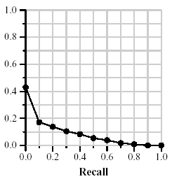
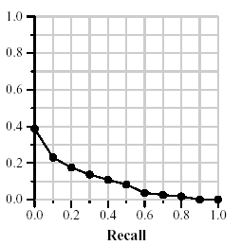
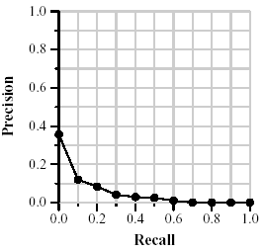
Evaluations
We Submitted 6 runs:
Run1 (MAP=0.038)
Text only
Run2 (MAP=0.071)
Run1 +
External Resource (Web + WordNet)
Run3 (MAP=0.094)
Run2 + OCR, Visual concepts, shot Classes and Speaker Detector

Slide 18
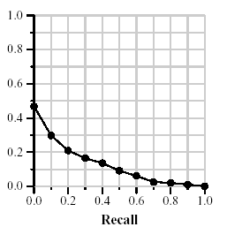
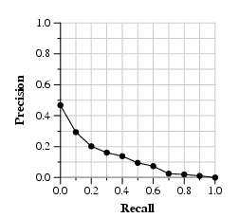
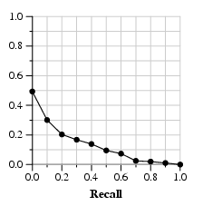
Evaluations -2
Run4 (MAP=0.119)
Run3 +
Face Recognizer
Run5 (MAP=0.120)
Run4 +
More emphasis on OCR
Run6 (MAP=0.124)
Run5 +
Pseudo Relevance Feedback

Slide 19
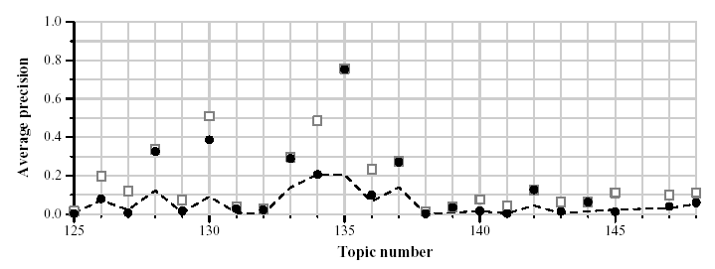
Overall Performance
Run6: mean average precision (MAP) of 0.124

Slide 20
Conclusions
Actually an automatic system – We focused on using general purpose query analysis to analyze queries
Focused on the use of query classes to associate different retrieval models for different query classes
Observed successive improvements in performance with use of more useful features, and with pseudo relevance feedback
We did a further run (equivalent to Run 5) but use AQUANT (news of 1998) corpus to perform feature extraction, lead to some improvement in performance (MAP 0.120 -> 0.123)
Main findings:
  text feature effective in finding the initial ranked list, other modality features help in re-ranking the relevant shots
  Use of relevant external knowledge is worth exploring

Slide 21
Current/Future Work
Employ dynamic Baynesian and other GM models for perform fusion of multi-modality features, learning of query models, and relevance feedback
Explore contextual models for concept annotations and face recognizer etc.

Slide 22
Acknowledgments
Participants of this project:
Tat-Seng Chua, Shi-Yong Neo, Ke-Ya Li, Gang Wang, Rui Shi, Ming Zhao and Huaxin Xu
The authors would also like to thanks Institute for Infocomm Research (I2R) for the support of the research project “Intelligent Media and Information Processing” (R-252-000-157-593), under which this project is carried out.

Slide 23
Question-Answering

