Slide 1
RECENT PRECIPITATION INDEX* (PI) IMPROVEMENTS
David H. Staelin and Frederick W. Chen
AIRS/AMSU/HSB Team Meeting
February 25-27, 2003
Added 13-km resolution precipitation product to JPL software
Made code more robust
Developed 4-quadrant precipitation taxonomy predicting accuracy
Performed preliminary PI assessment in three taxonomy quadrants:
  Ice-topped convection, icy stratiform, warm rain precipitation

Slide 2
PRECIPITATION INDEX TAXONOMY
 | Ice Aloft > 100 microns | Other cases
Convective Precipitation (vertical velocity > ~4 ms⁻¹) | Rain and snow retrievals Good accuracies expected and observed (vs NEXRAD) Two journal papers (2000, 2003) Extensive evaluation planned Significant improvement planned | Rain retrievals Uncommon Usable accuracies expected Searching for examples
Stratiform Precipitation (vertical velocity < ~4 ms⁻¹) | Rain and snow retrievals Poorer accuracies expected and observed (BALTEX, polar snow, U.S. snow) Journal papers planned Collaboration using MM5 model | Rain retrievals (warm rain) Poorer accuracies expected Evaluation beginning Physics to be added

Slide 3
BALTRAD COMPARISONS WITH PRECIPITATION INDEX (PI)
Sarah Franquet, PhD thesis completed
Storms in summer and winter compared with all working BALTRAD radars (bordering Baltic Sea; latitude > ~55N)
BALTRAD calibration varies significantly day-to-day and site-to-site
General tendency to overestimate Baltic BALTRAD summer precipitation rates using U.S.-tuning, and to underestimate winter storm rates (after September); reasons being studied

Slide 4
POLAR SNOW
Several storms studied
Care required to distinguish precipitation from “dry-air holes” over reflective ice
Excellent morphological agreement with MM5 precipitation predictions based on ECMWF initialization (Le-Sheng Bai and David H. Bromwich, personal communication)

Slide 5
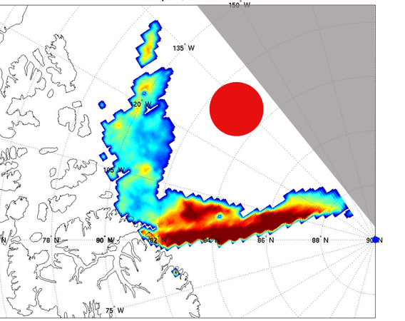
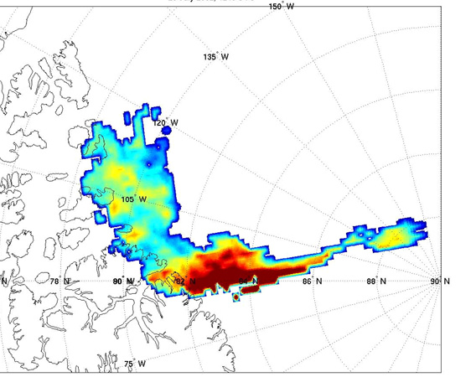
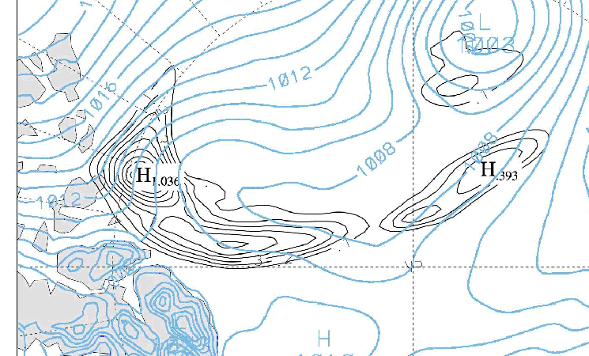
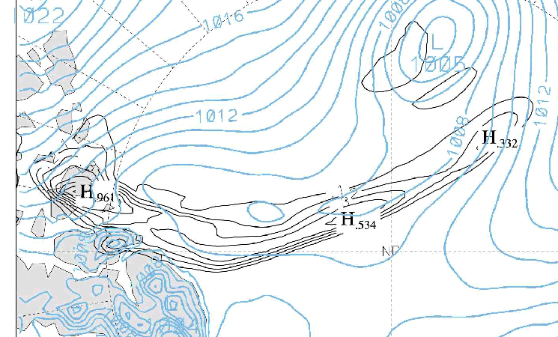
AIRS/AMSU/HSB vs PREDICTED MM5* PRECIPITATION
No Data
~220 km
Aqua
North Pole
1118 UTC
1248 UTC
20-km cells
28 σ levels
ECMWF 00 UTC
MM5
(V3.5)
North Pole
1000-1100 UTC
1300-1400 UTC
*Le-Sheng Bai and David H. Bromwich, personal communication, July 20, 2002 snow storm

