Slide 1



Medical Library Association
Washington DC
May 2004
Carolyn B. Tilley
Jan Willis
National Library of Medicine, NIH
Department of Health & Human Services
Notes:
Welcome to the UMLS Basics class.
This course, with hands-on computer exercises, is certified for 7.5 hours of Medical Library Association CEU’s.

Slide 2
UMLS
Collection of tools and resources to enable systems to link biomedical information from different sources
Improves the ability of computer programs to understand biomedical meaning; to integrate and retrieve relevant information

Slide 3
UMLS Knowledge Sources
Metathesaurus
  Concepts that include various names representing the same meaning from over 100 controlled vocabularies and classifications; includes HIPAA and CHI standard vocabularies
Semantic Network
135 Semantic Types (broad categories)
54 semantic relationships (between types)
SPECIALIST Lexicon
  and other lexical tools used in natural language processing
Notes:
There are 100 sources currently in the 2003AA Metathesaurus annual UMLS release. There are 15 different languages represented, although English is predominant. Foreign language translations of NLM’s Medical Subject Headings predominate. There are 8 sources that contribute relationships for terms and attributes but do not have an associated language. There are over 875,000 concepts included and over 2.14 Million different ways of saying or naming those 875,000 concepts or meanings. The Metathesaurus and Semantic Network have been components of the UMLS since the beginning. From 1991 to 1998, NLM also produced a UMLS Knowledge Source called the Information Sources Map that described the scope, content, and access coditions for many publically available biomedical databases. The development of the World Wide Web offered other promising approaches to addressing the problem of determining which of many information sources contain content relevant to a particular inquiry. The SPECIALIST Lexicon and other lexical programs became part of the UMLS more recently.

Slide 4
Genesis of the UMLS Project
The objective of this program. . .is to solve what is the
most fundamental barrier to the application of computers
in medicine; namely, the lack of a standard language in
medicine. We will attempt to build that vocabulary, a
language that will cross between the biomedical literature
and the observations on the patient, as well as the
educational applications in the school, a language which
allows those areas to be interrelated.
--Donald A. B. Lindberg, M.D., March 19, 1985
Hearings before House Committee on Appropriations,
99th Cong., 1st Session, Part 4B (857), 1985.
Notes:
Over the past 18 years, the UMLS has captured the time, talent, and attention of many informatics researchers from a broad range of disciplines. The words on this screen introduced the UMLS project to the U.S. Congress at the National Library of Medicine’s FY 1986 budget appropriations hearings in the spring of 1985. The statement reflects the first level of refinement of a concept that Dr. Lindberg brought with him when he assumed NLM’s directorship in August 1984. The “nuts and bolts” that formed the actual UMLS approach to helping in solving the terminology problem would evolve over the next few years. In March 1985, NLM was seeking Congressional support to begin this long term research and development program targeted at one underlying cause of the difficulties encountered by medical informaticians in their attempts to integrate advanced computer-based decision support into routine patient care. The task of building the UMLS—and especially of maintaining it—exceeded what any academic department or collection of short-term research grants could be expected to achieve. So, the initiation, funding, and ultimately the maintenance of such a system were therefore proposed as being a reasonable undertaking for such a federal agency as the NLM.

Slide 5
UMLS Uses
Information retrieval
Thesaurus construction
Natural language processing
Automated indexing
Electronic patient records
Notes:
A requirement of the license agreement for the UMLS is to provide feedback. The UMLS components are currently employed in a wide variety of applications. Here is a list of most of them, ranked in order by what we currently know are the most prevalent uses.

Slide 6
UMLS Metathesaurus
2004AA release, May 2004
  Concepts: 1,020,866
  Concept names : 2,812,545
  Souces contributing concept names: 116
  Languages: 17
Preserves original content and adds new information
Organized by concept or meaning
Notes:
The Metathesaurus statistics for the most current version are included here. The Metathesaurus is the central component of the UMLS and contains the information on the concepts whose names appear in ore or more of a number of different vocabulary sources used in the field of biomedicine. The scope of the Metathesaurus is determined by the combined scope of its source vocabularies. It preserves the meanings, hierarchical connections, and other relationships between terms in its sources while adding certain other basic information about each of the concepts and establishing new relationships between the concepts and terms. It is organized by concept or meaning.

Slide 7
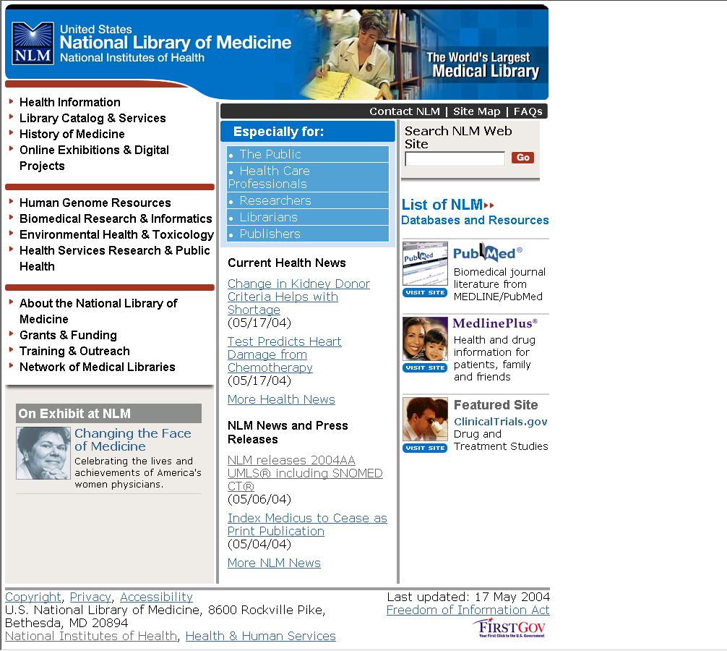

Slide 8
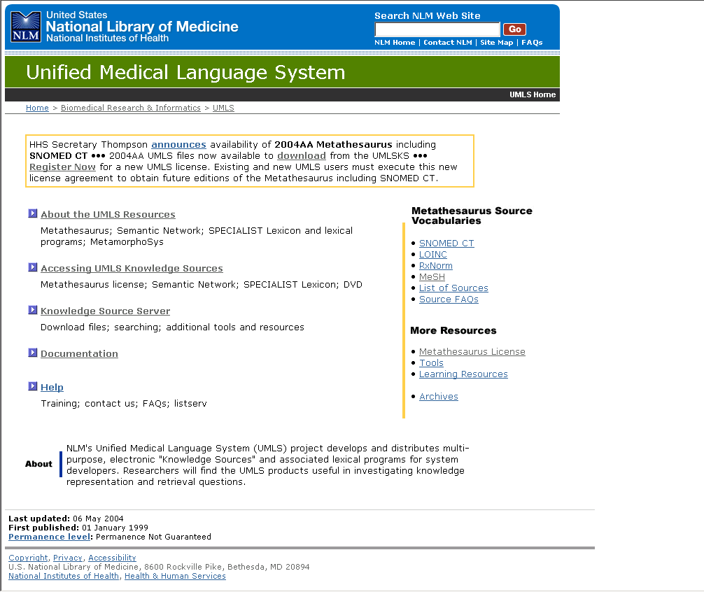

Slide 9
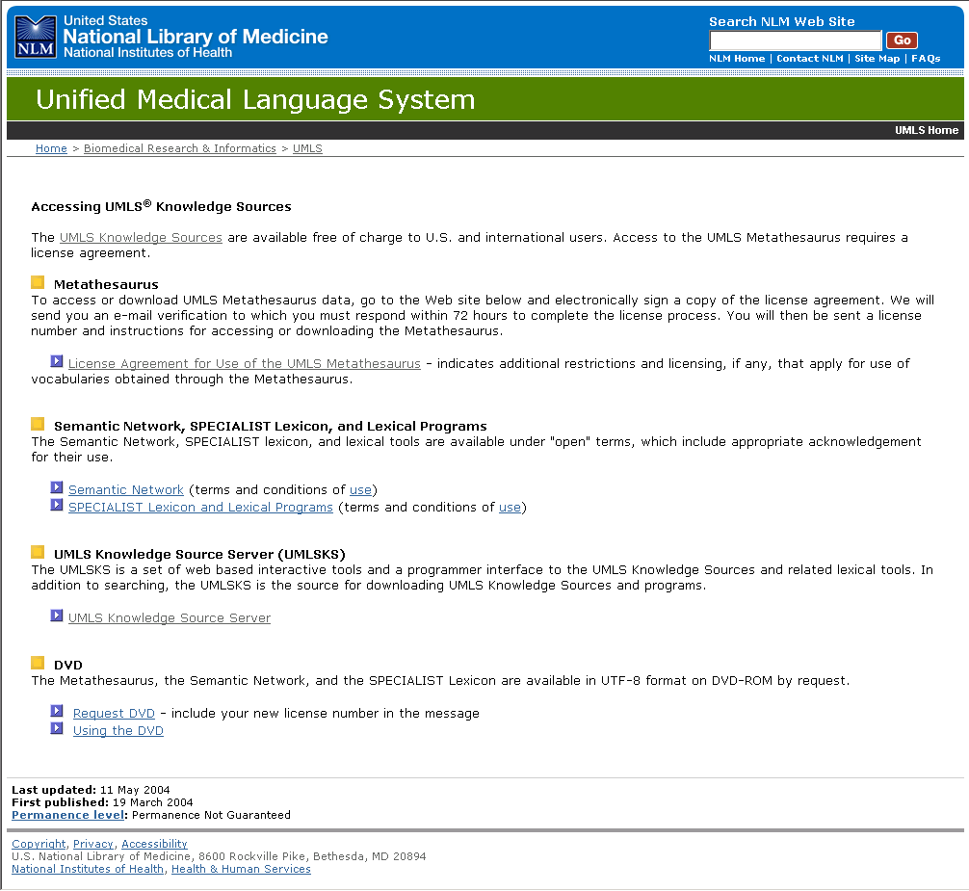

Slide 10
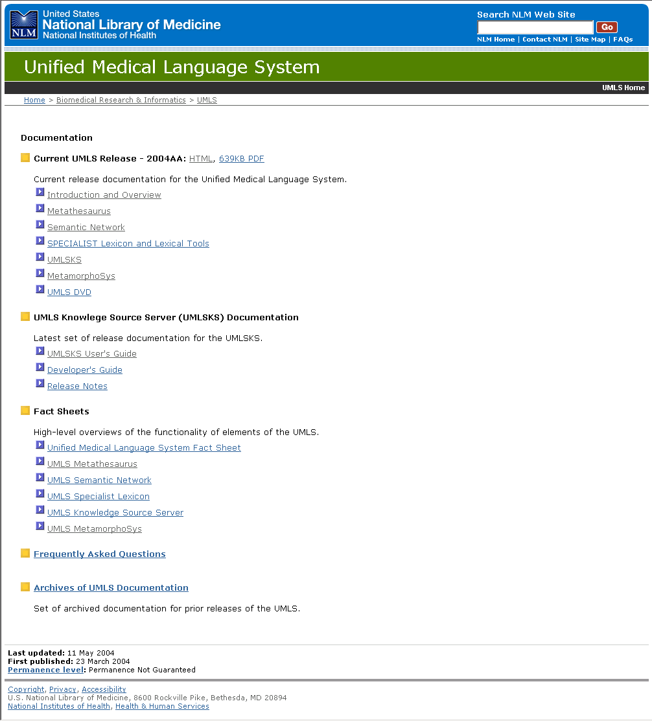

Slide 11
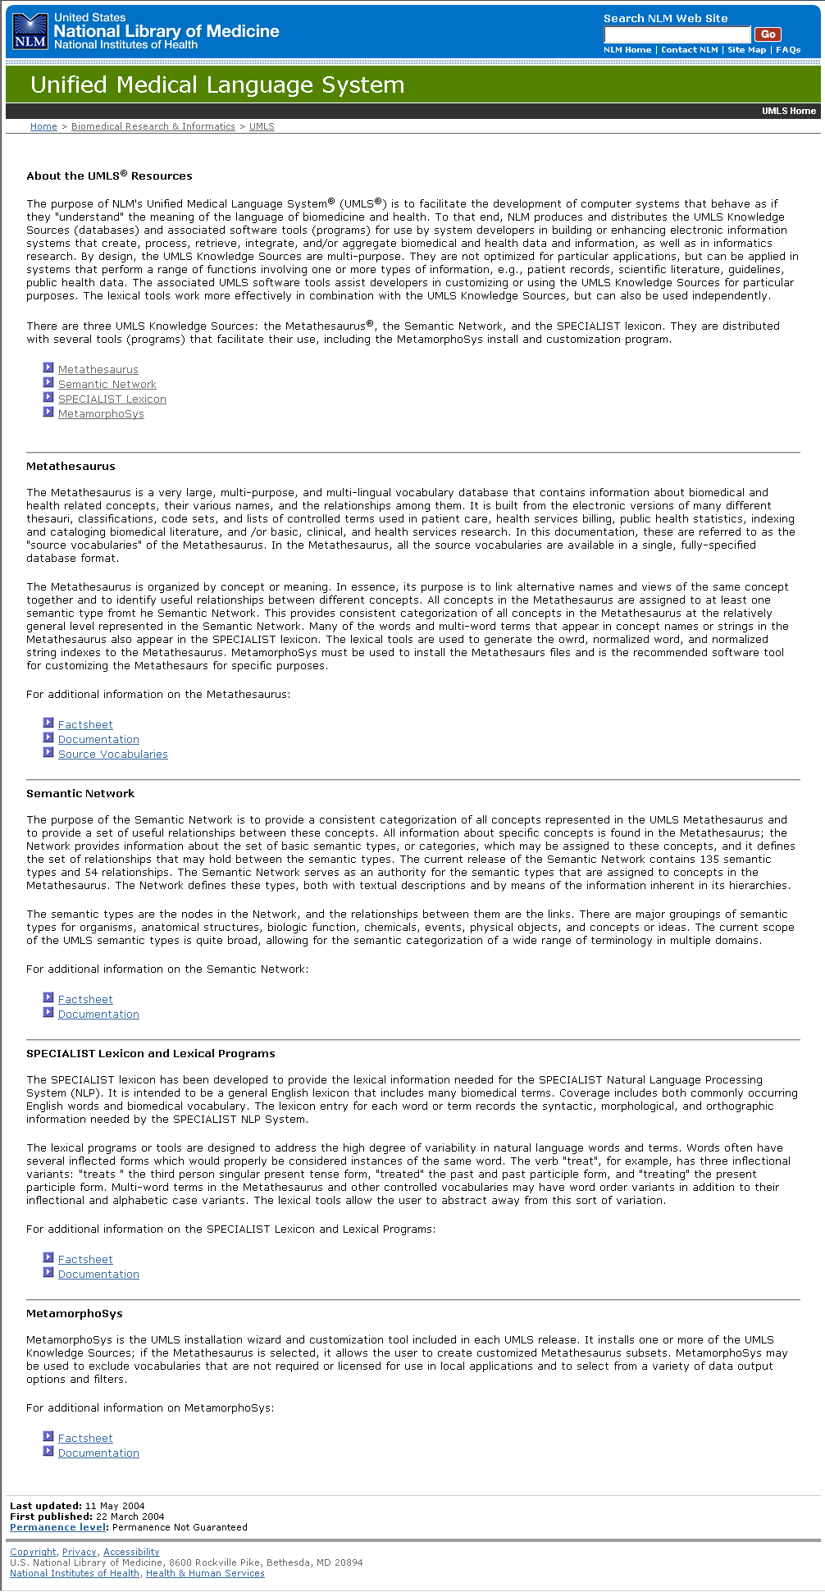

Slide 12
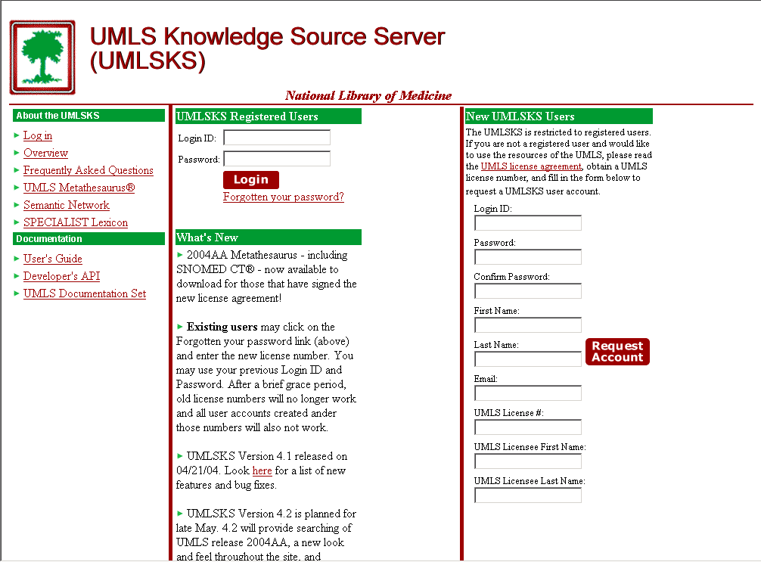
http://umlsks.nlm.nih.gov/
Notes:
This is a screen shot of the UMLS Knowledge Source Server. This is actually a group of powerful client server machines located at NLM that provide access to the UMLS data. Some of the producers of the vocabulary sources place restrictions beyond the basic UMLS license on the use of their sources so licensing is required to get the data beyond product development, studying a particular vocabulary, or for statistical purposes. Therefore, a user login ID code and password connected to the license number is required to access the server and UMLS data. When one has their license number they create a server account by registering (see “New UMLSKS Users”). After an account has been established, subsequent accesses are made with the user’s login ID and password.

Slide 13
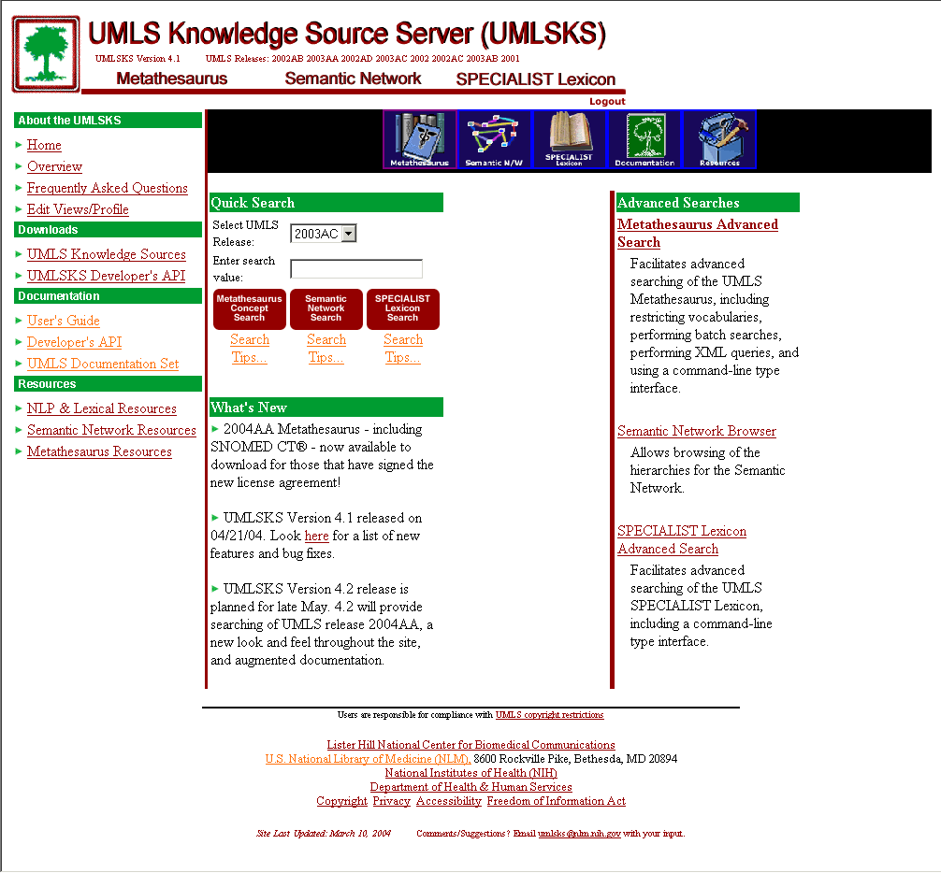

Slide 14
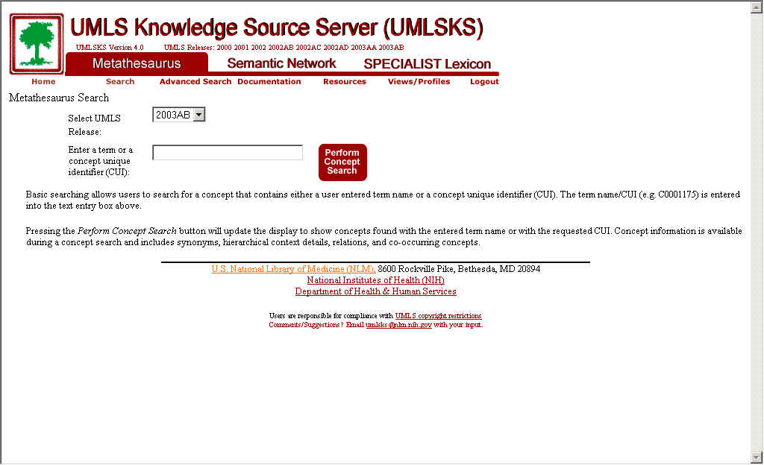
Notes:
This is the basic search screen for the Metathesaurus. A searcher navigates by typing in either a term or, if known, the Concept Unique Identifier assigned by NLM. Either click on the “Perform Concept Search” button or press the Enter key on the personal computer keyboard. The current release is always the default for the data to be searched, but other releases can be specified in the pull down window area labeled “Select UMLS Release”.

Slide 15
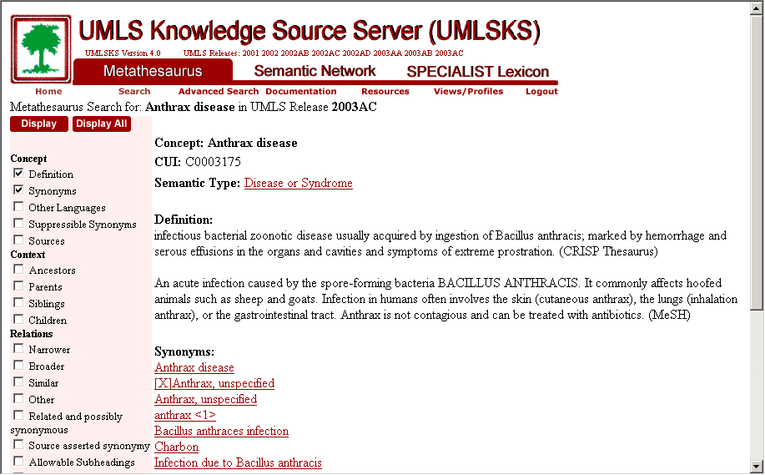
Notes:
Here is the basic display of information from the Metathesaurus for the anthrax search. Note the Concept Unique Identifier, the Semantic Type assigned, and that there are two definitions—one from the CRISP Thesaurus that is used to index and retrieve NIH research grants and the other from NLM’s Medical Subject Headings (MESH). Notice also the different names or synonyms for the concept (Anthrax, [X]Anthrax, unspecified, Anthrax unspecified, Bacillus anthraces infection, and so on. Only synonyms that are preferred terms in a source are listed here (and so there may be other variants available in the UMLS).

Slide 16
Semantic Network
135 Semantic Types provide a consistent categorization of all Metathesaurus concepts
For example: Disease or Syndrome
Body System
Clinical Drug
54 semantic relationships provide the links between the Semantic Types
  For example:
  Clinical Drug TREATS Disease or Syndrome
Notes:
Remember that each Metathesaurus concept is assigned at least one Semantic Type to describe it and allow for groupings of associated concepts. The Semantic Network is tied verylosely to the content of the Metathesaurus. In general, semantic networks attempt to impart common sense knowledge to computers allowing them to “reason” in a manner of speaking and to draw conclusions about entities by virtue of the categories to which they have been assigned.

Slide 17
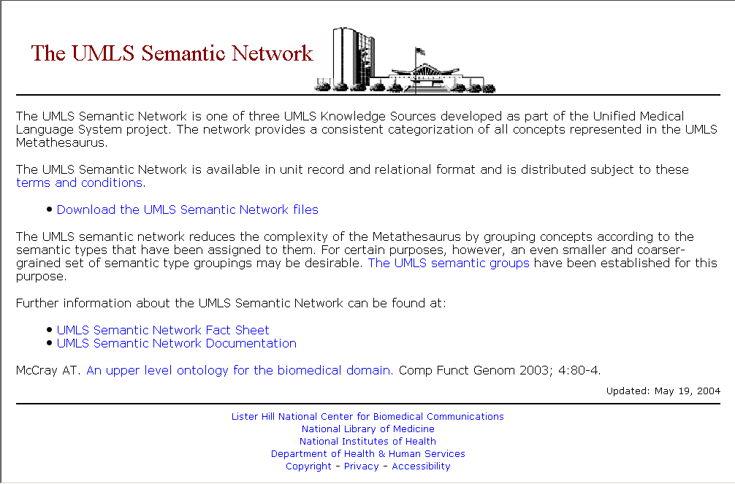

Slide 18
SPECIALIST Lexicon
General English lexicon of biomedical terms and common words
Provides the lexical information needed for the SPECIALIST Natural Language Processing System
Lexical entry for each word or term records syntactic (the way words are put together in phrases and sentences), morphological (usually includes inflection, derivation, and compounding), and orthographic (spelling) information
Notes:
The SPECIALIST Lexicon is the third component of the UMLS. It is a general, English language-only lexicon containing many biomedical terms and common words. There is an entry for each term that records syntax (the way words are put together), morphology (such things as inflection, derivation, and how to form compounds), and orthography (or, spelling) elements.

Slide 19
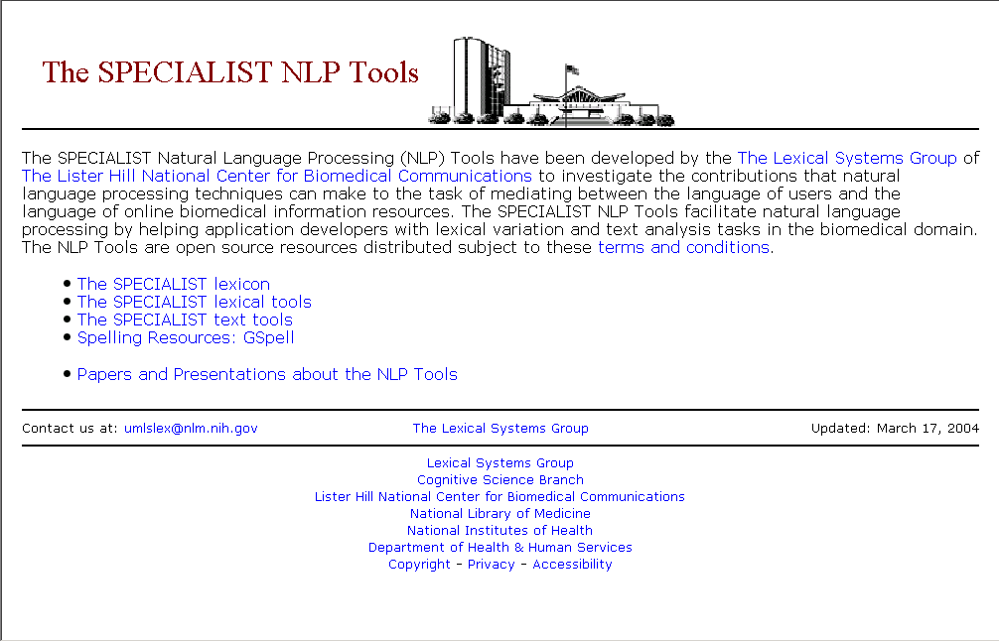

Slide 20
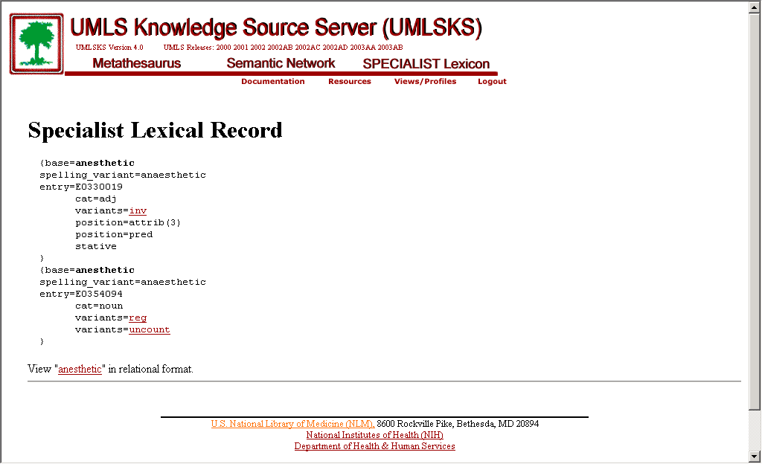
Notes:
This is an example of the record retrieved for the search term anesthetic. More information will be provided later. The record is made up of what are called slots and fillers. You can see on the second line down that there is a spelling variant for British English. The first occurrence is anesthetic as an adjective. The position described at attitbutive means that it can appear in predicate grammar position and includes things like red hair, or anestheic gases. In the information provided for anesthetic as a noun, we see by the “reg” entry that it undergoes regular rules in English for forming plurals. The “uncount” value refers to the fact that it does not take a number as a noun. That is, you can’t have 6 anesthetics.

Slide 21
Lexical Tools
Lexical software programs, indexes, and databases
lexical variant generation (lvg) programs
indexes: word index, normalized word index, and normalized string
lexical databases
  derivational variants (e.g., aphasic/aphasia)
  closely related terms (hepatocellular/liver cells)
  spelling differences (e.g., color/colour)
  combining forms (e.g., heart/cardi(o))

Slide 22
License Agreement
Use and access is free, but requires a License Agreement
4 levels of source restrictions exist
Annual User Report with feedback to NLM is required
License Agreement is available in documentation and on the Web:
http://www.nlm.nih.gov/research/umls/license.html

Slide 23
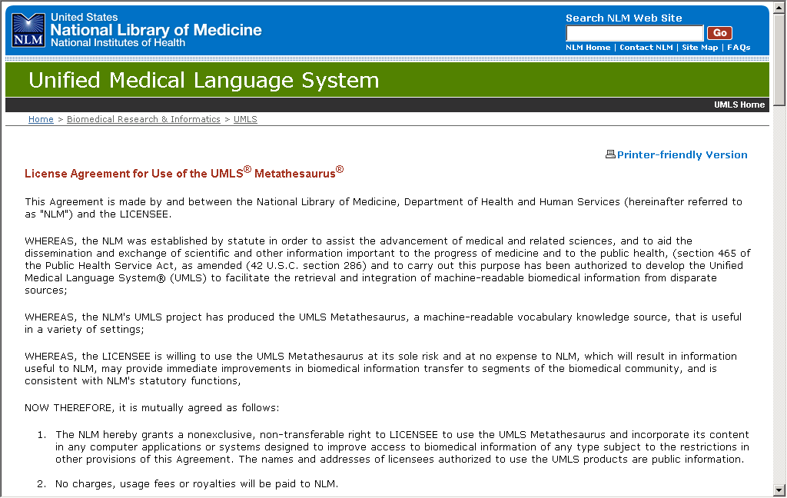

Slide 24
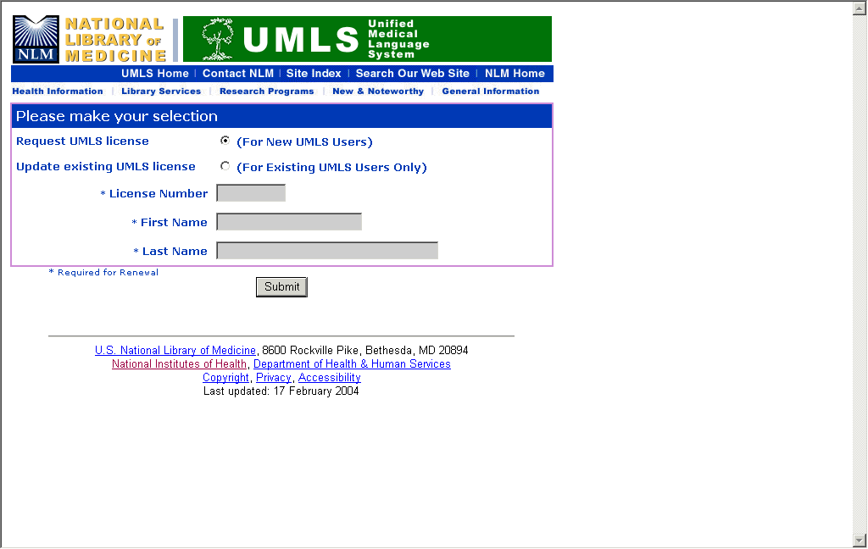

Slide 25
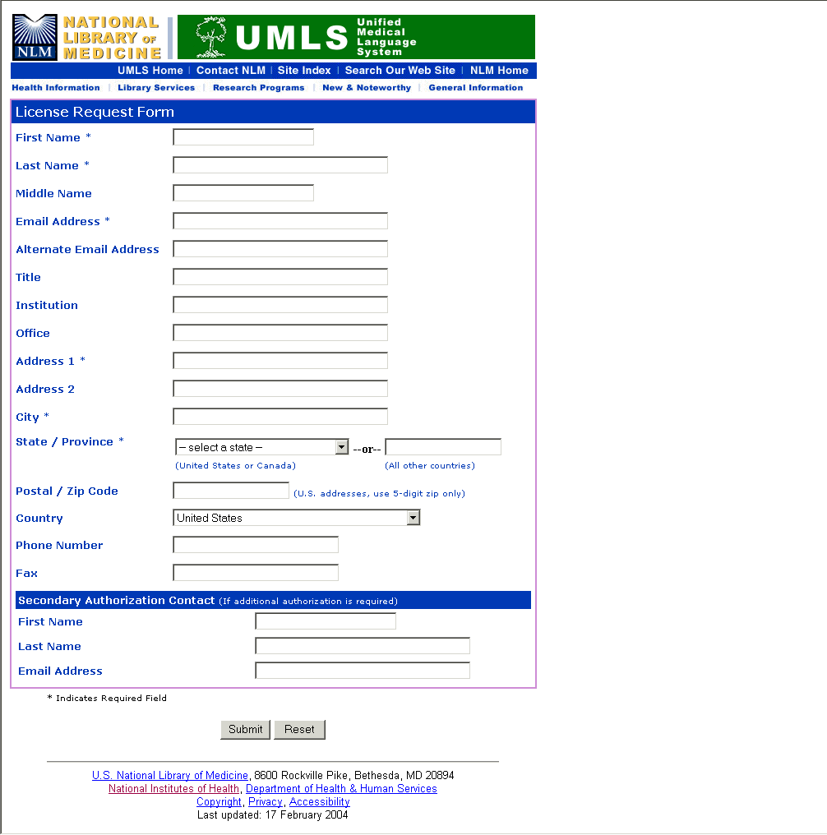

Slide 26
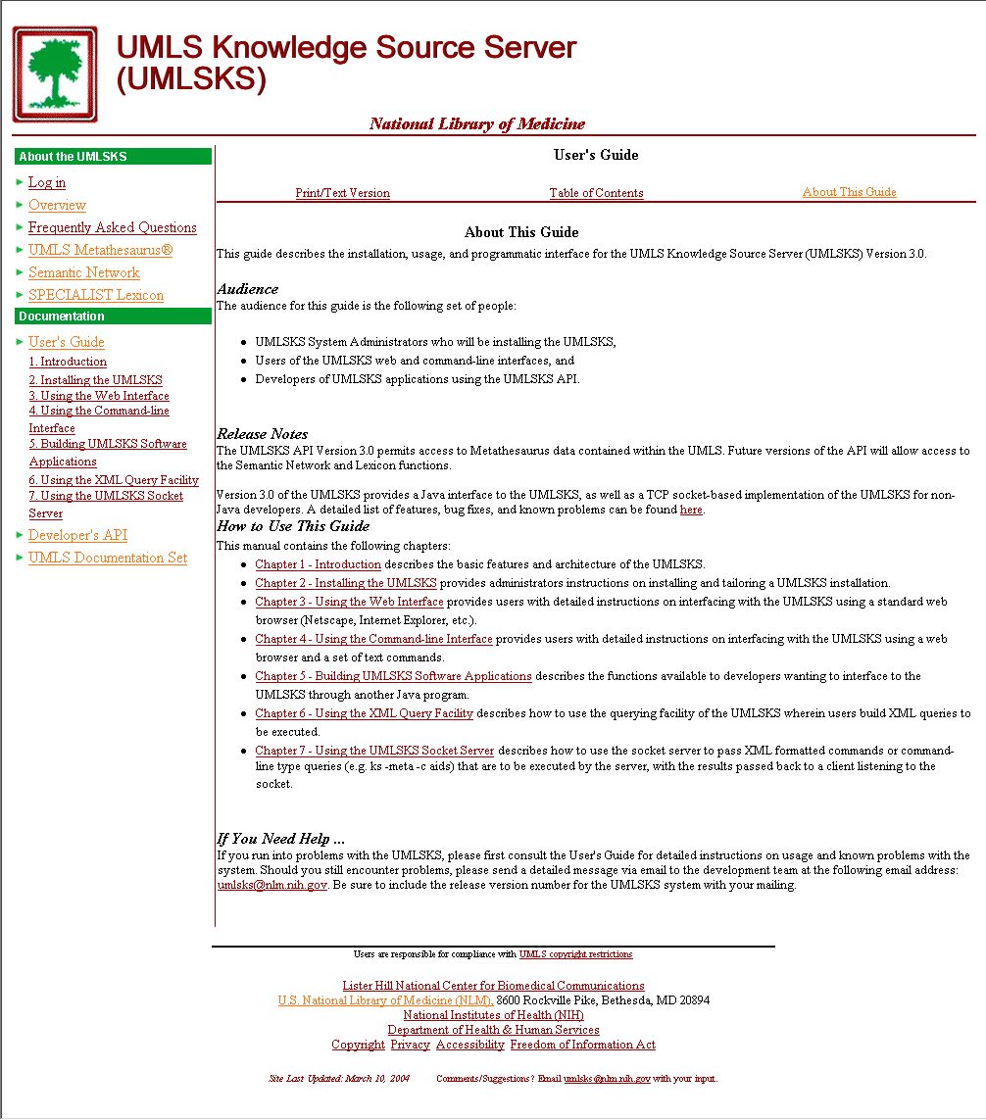

Slide 27
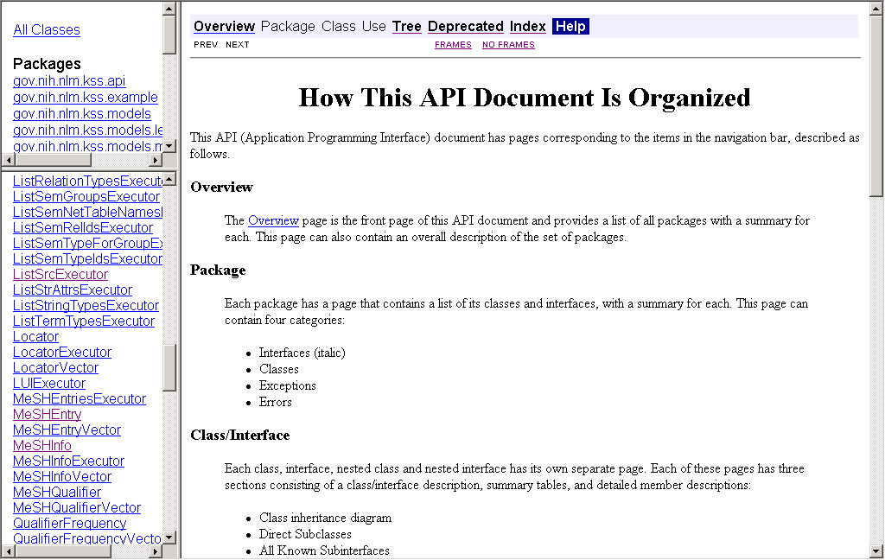

Slide 28
UMLS Distribution
Annual updates since 1990
-- quarterly updates began with Spring 2002
Available for download from the Knowledge Source Server or through use of the Applications Program Interface (API).
Available on DVD by request
Knowledge Source Server (UMLSKS):
http://umlsks.nlm.nih.gov

Slide 29
Getting Started
Explore UMLS homepage
Submit license agreement
Access UMLS knowledge sources via the NLM website (UMLSKS)

Slide 30
Notes:
Welcome to the UMLS Basics class.
This course, with hands-on computer exercises, is certified for 7.5 hours of Medical Library Association CEU’s.

