Slide 1


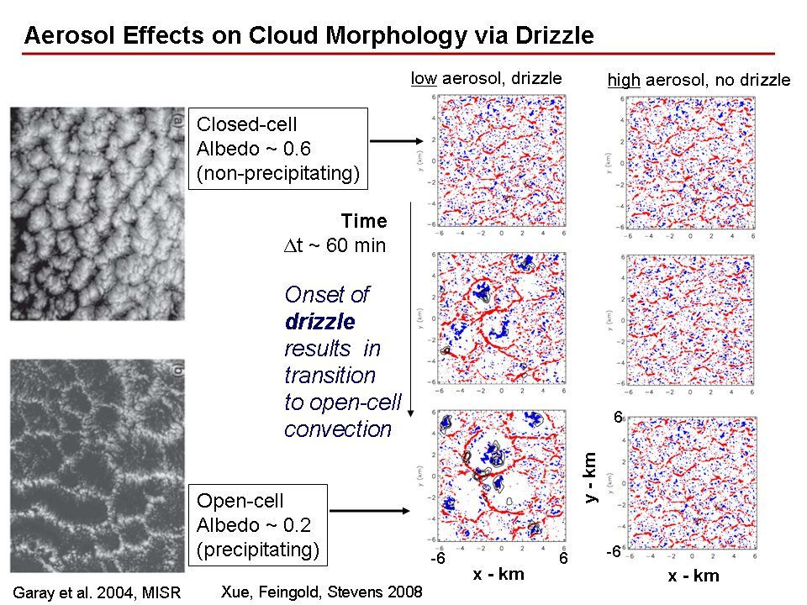
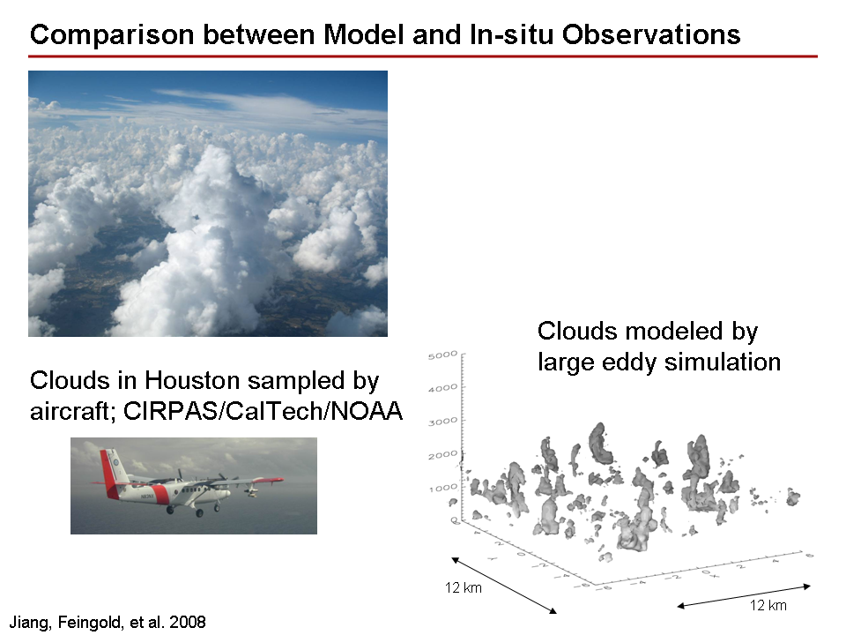
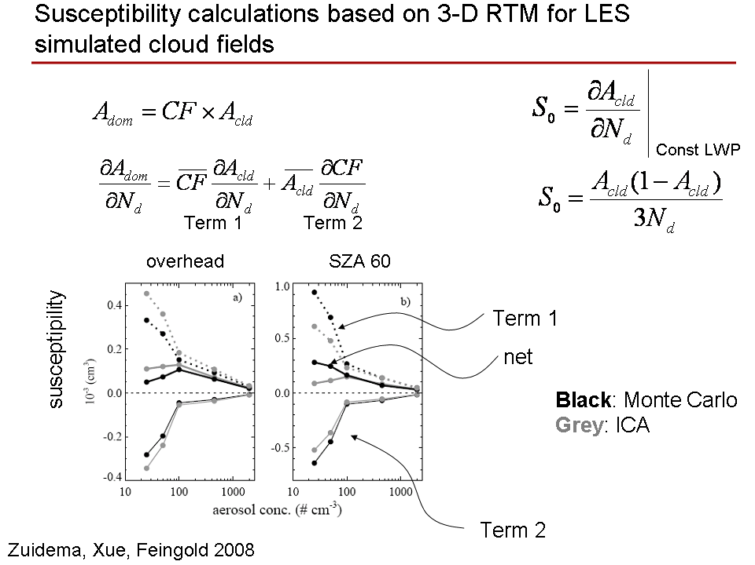
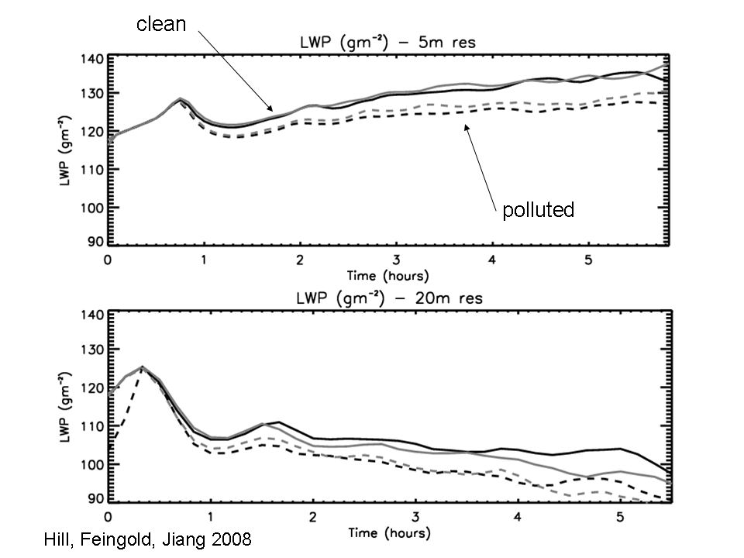
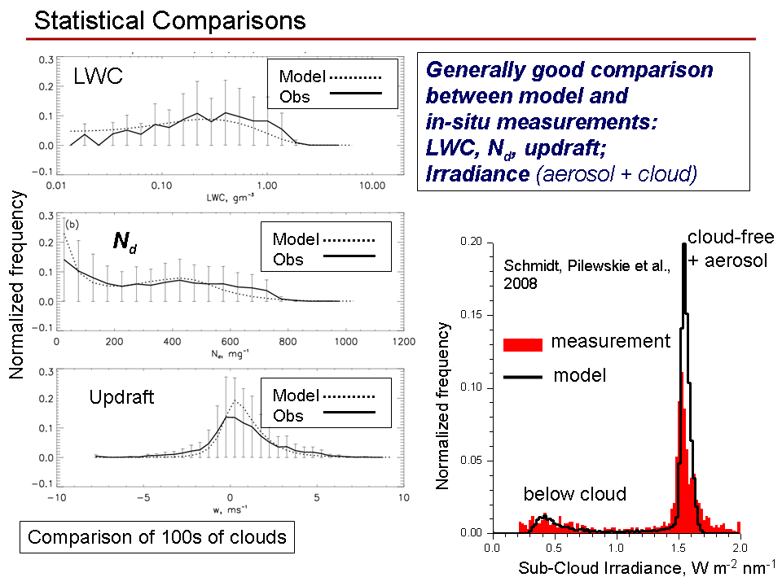
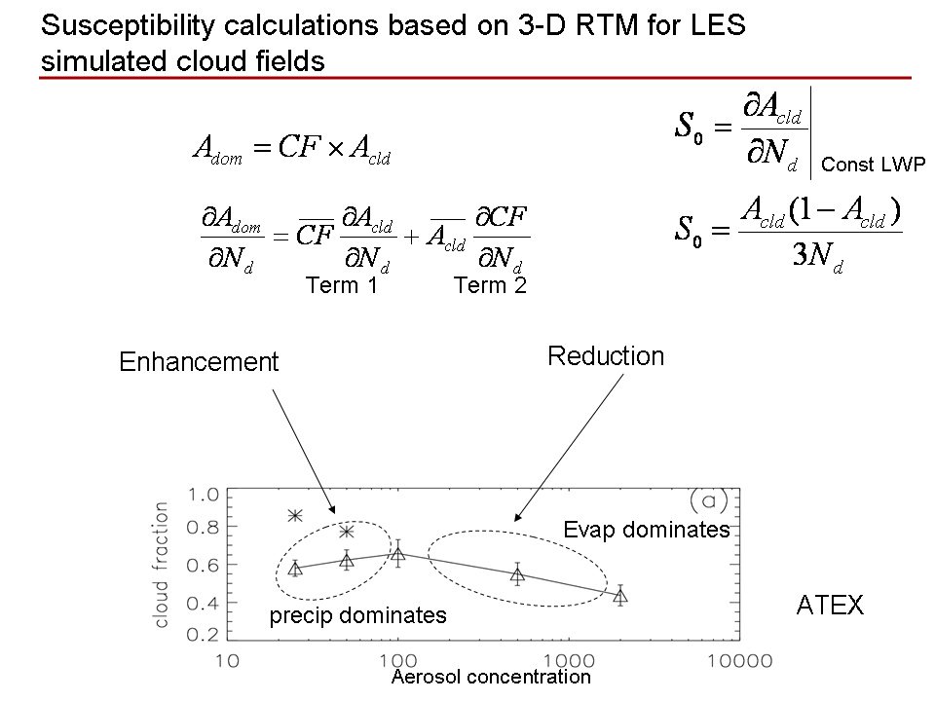
Aerosol-Cloud Interactions and Radiative Forcing: Modeling and Observations
Graham Feingold¹, K. S. Schmidt², H. Jiang³, P. Zuidema⁴, H. Xue⁵, P. Pilewskie², A. Hill¹, H. Wang¹
¹NOAA Earth Systems Research Laboratory (ESRL), Boulder, CO; ²Univ. Of Colorado, Boulder, CO; ³CIRA/NOAA/ESRL, Boulder, CO; ⁴University of Miami, Miami, FL, ⁵Beijing University, China
Introduction
The effect of aerosol on cloud microphysics ≠ aerosol indirect effect !!
The indirect effect involves radiative forcing and depends on
  cloud microphysical response,
  macroscale properties (cloud fraction, cloud depth, distances between clouds)
  aerosol between clouds
We demonstrate this via:
1. comparisons between measured irradiance fields for a field of cumulus clouds, and irradiance fields calculated based on large eddy simulations of these clouds;
2. calculations of the relative contributions of the microphysical and macrophysical responses to an aerosol perturbation for modeled cloud fields;
3. demonstrations of how sensitive the representation of aerosol-cloud interactions is to the representation of entrainment-mixing, and;
4. simulations of the transition from closed cell convection to pockets of open cells provide an example of how aerosol, through its effect on precipitation, can very effectively change radiative forcing;
Conclusions
Statistical sampling of shallow cumulus allowed comparison with LES
output. Good comparison for LWP, drop concentration, updraft
Irradiance field below cloud compares well provided aerosol between
clouds is accounted for.
In small cumulus, microphysical responses to aerosol perturbations may
counteract morphological responses (cloud fraction, LWP). This reduces
indirect effect response and albedo susceptibility may be non-monotonic.
Drizzle in stratocumulus is shown using LES to result in the formation of
open cellular structure.
LWP is shown to decrease with increasing aerosol in non-precipitating
  stratocumulus as a result of an evaporation-entrainment feedback
3.
1.
2.
Drizzle transforms closed cellular convection to open cellular convection
4. Sensitivity of Aerosol-Cloud interactions to Entrainment-Mixing: LWP
Δz = 5 m
clean
Grey lines: inhomogeneous mixing
Black lines: Homogeneous mixing
Δz = 20m
polluted (dashed)
See also Wang et al., 2003
Aerosol perturbations result in a decrease in LWP in non-precipitating warm clouds
Entrainment-mixing affects the magnitude of the response
Non-monotonic response of cloud fraction to increases in aerosol
References
Hill, A., G. Feingold, H. Jiang: The influence of mixing on the climate forcing of non-precipitating marine stratocumulus, 2008: J. Atmos. Sci., submitted.
Jiang, H., G. Feingold, et al., 2008: Comparison of statistical properties of simulated and observed cumulus clouds in the vicinity of Houston
during the Gulf of Mexico Atmospheric Composition and Climate Study (GoMACCS). J. Geophys. Res., in press.
Schmidt, K. S., P. Pilewskie, G. Feingold, and H. Jiang, 2008: Irradiance from fields of shallow cumulus clouds: Measurements vs. radiative transfer modeling based on clouds generated by a large eddy simulation. In preparation.
Wang, S., Q. Wang, and G. Feingold, 2003: Turbulence, condensation and liquid water transport in numerically simulated nonprecipitating stratocumulus clouds. J. Atmos. Sci., 60, 262-278.
Xue, H., G. Feingold, and B. Stevens, 2008: Aerosol effects on clouds, precipitation, and the organization of shallow cumulus convection. J. Atmos. Sci., 65, 392-406.
Zuidema, P., H. Xue, and G. Feingold, 2008: Shortwave radiative impacts from aerosol effects on marine shallow cumuli. J. Atmos. Sci., in press.
Acknowledgements:
Funding: DOE/ARM (DE-AI02-06ER64215), NOAA’s Climate Goal

