Slide 1

Why Study Nothing?
Voids and void galaxies in the Universe
Fiona Hoyle
Michael Vogeley
Randall Rojas – PhD Thesis Work
David Goldberg
Drexel University

Slide 2
Overview
Finding Voids
  The Voidfinder Algorithm
  Results from the 2dFGRS
  Delaunay Tessellation
Void Galaxies in the SDSS
  Photometric Properties
  Spectroscopic Properties
  Luminosity Functions
  Mass Functions
Summary

Slide 3
The Void Finder Algorithm
Based on El-Ad and Piran algorithm – some differences
Classification of galaxies as wall/void galaxies
Detection of empty cells
Growth of maximal spheres
Classification of unique voids
Enhancement of void volume
Calculation of void underdensity

Slide 4
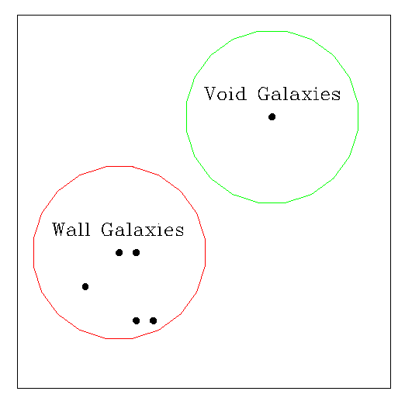
Wall/Void Galaxies
Galaxies in very underdense
regions are void galaxies
If more than three galaxies
in sphere of
l = d + 1.5 σ ∼ 7 Μpc
~ 10% of galaxies classed as
void galaxies

Slide 5
The Void Finder Algorithm
Hoyle & Vogeley 2002
Classification of galaxies as wall/void galaxies
Detection of empty cells
Growth of maximal spheres
Classification of unique voids
Enhancement of void volume
Calculation of void underdensity

Slide 6
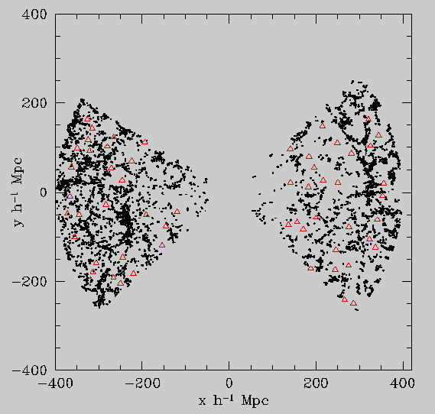
Voids in the 2dFGRS
Red – void centers
Black – wall galaxies
289 voids in total (zcrit=0.1)
Largest void radius =19.85 Mpc
Average(r > 10) =12.4 +/- 1.9 Mpc
Similar to PSCz and UZC results

Slide 7
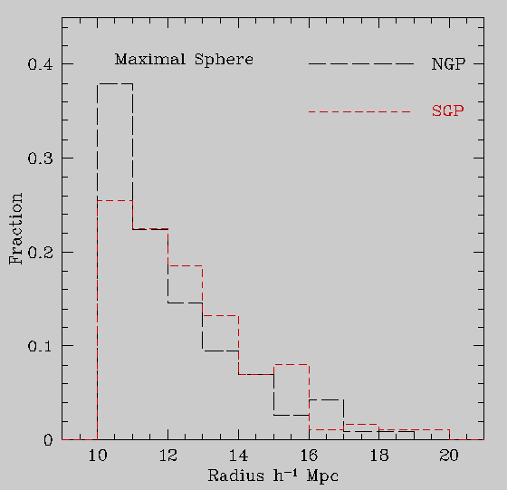
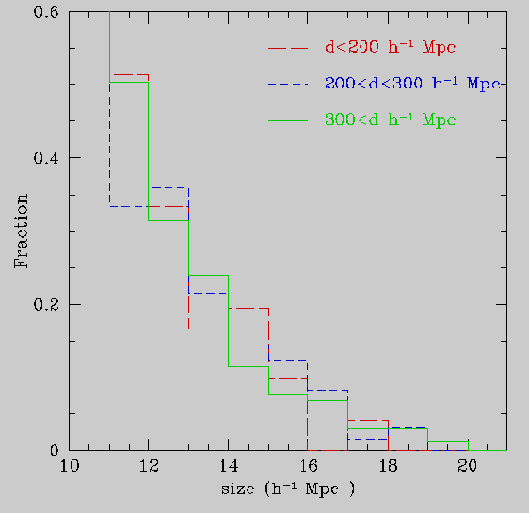
Void Distributions
Little difference in size distributions between N and S and with depth
- Possibly KAOS will detect evolution of voids and q0

Slide 8
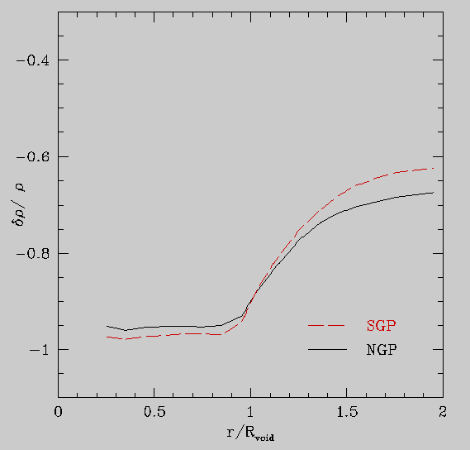
Void Profiles
Where do the void galaxies lie?
Centers of voids very empty
Steep rise at radius of void
Most of the void galaxies lie
close to the edges of the voids.

Slide 9
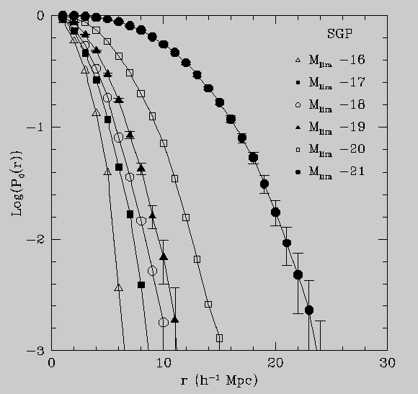
Void Probability Function
Probability that a sphere
radius r contains no galaxies
VPF can be measured from
volume-limited samples that
cover wide range of z, M
Follow a negative binomial
distribution (Croton 04)

Slide 10
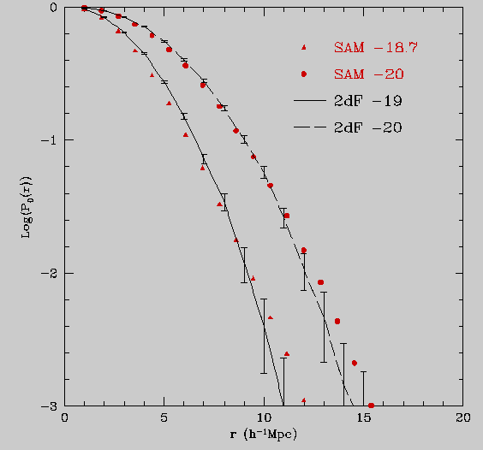
VPF and Semi-Analytic Models
Good agreement between
semi-analytic models
and the 2dFGRS VPF’s
Poor agreement with dark
matter only simulations –
as expected
Reasonable agreement with
CfA – errors greatly reduced

Slide 11
Results
Applied to 2dFGRS (and PSCz and UZC)
Voids are on average 12 Mpc in radius
  Assuming voids > 10 Mpc in radius
They fill 30-40 % of the survey volume
  Algorithms including smoothing tend to find larger volumes
The values of δρ/ρ are -0.95
Very empty at center
VPF good match with semi-analytic models

Slide 12
Future Methods: Delaunay Tessellation
Cover 3D (2D) space with tetrahedra (triangles), with galaxies at vertices
Delaunay Tessellation is the dual of Voronoi Tesselation (Delaunay vertices are centers of Voronoi cells)
Similar to SURFGEN
No free parameters – except density threshold
Applications for density estimation, computation of topological and morphological statistics (Genus, Minkowski Functionals)

Slide 13
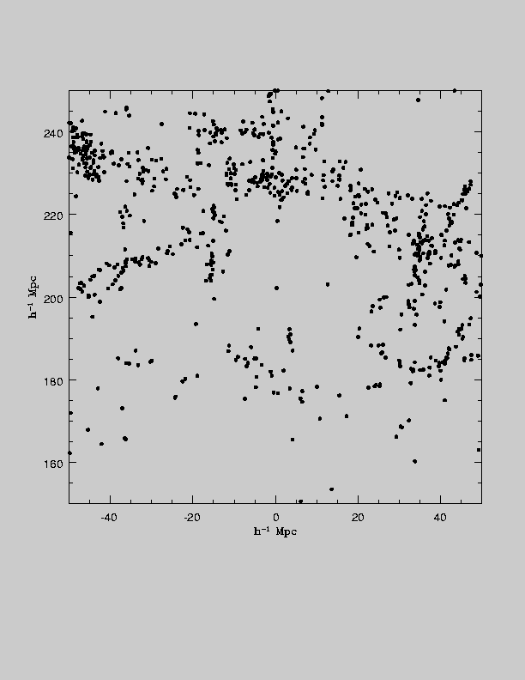
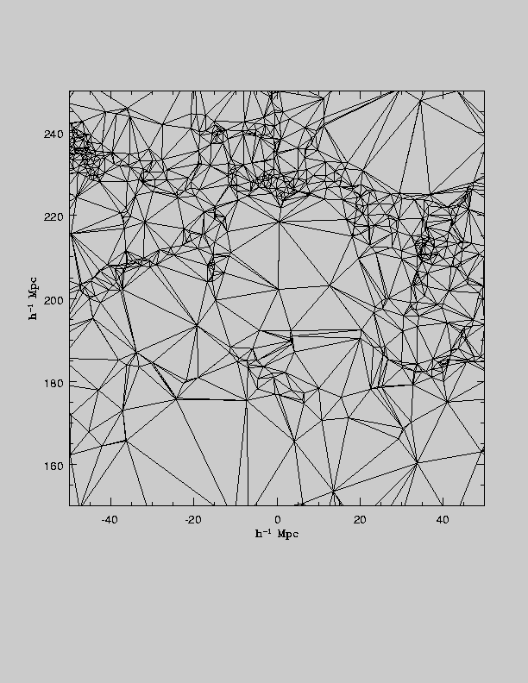
The Delaunay Tessellation
Galaxy Distribution
Delaunay Tessellation

Slide 14
Using the Delaunay Tessellation
At each galaxy point the density is
ρ(x) = (Dim + 1) / Σ V
By interpolating we find the density field at every value of x
By setting a density threshold we can draw a contour which divides a region into above and below density parts – a void
Galaxies with low density are void galaxies
Can also be used in topological analyses

Slide 15
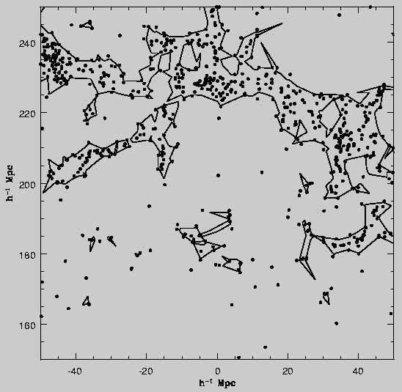
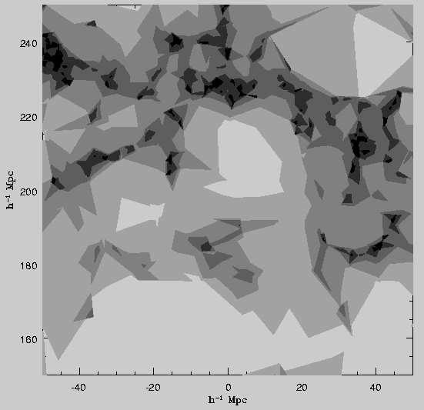
2D Density Estimation by Interpolation

Slide 16
Void Galaxies

Slide 17
Finding Void Galaxies in the SDSS
Use volume limited samples to trace the distribution of the voids
Use 3rd nearest neighbor criterion to find void galaxies
Mean density contrast around void galaxies is δρ/ρ=−0.7, consistent with VoidFinder results
Use UZC+SSRS2 nearby surveys to help find void galaxies very nearby
NB cannot yet find 3D voids in SDSS

Slide 18
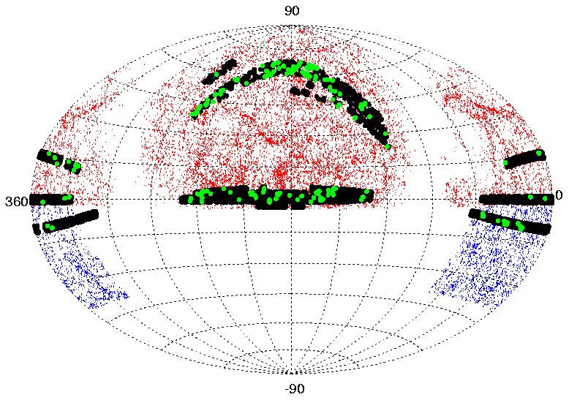
Finding Nearby Void Galaxies
Black=SDSS galaxies
Red=UZC galaxies
Blue=SSRS2 galaxies
Green=Nearby void galaxies

Slide 19
Void Galaxies
194/4000 void galaxies locally
1048/12000 void galaxies in the distant sample
First time sample >10³ void galaxies
Colours
  u-g and g-r
Morphology
  Sersic index n, exp (-r^{1/n} )
  Concentration index r50/r90
Emission Lines
  OII, Hα (star formation)

Slide 20
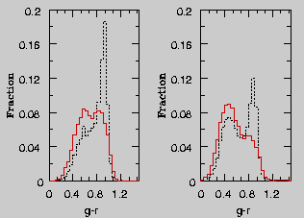
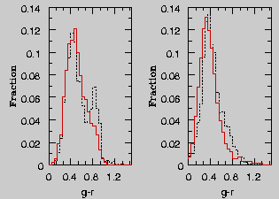
Colours of Void vs. Wall Galaxies
Distant Sample
Nearby Sample
M<-19.5 M>-19.5
M<-17.0 M>-17.0
Void galaxies (red lines) bluer than wall galaxies (dashed black lines)

Slide 21
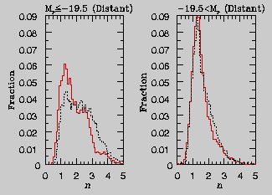
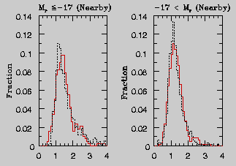
Profiles of Void vs. Wall Galaxies
Distant Sample
Nearby Sample
M<-19.5 M>-19.5
M<-17.0 M>-17.0
Bright void galaxies (red lines) more disklike than wall galaxies (dashed black lines)

Slide 22
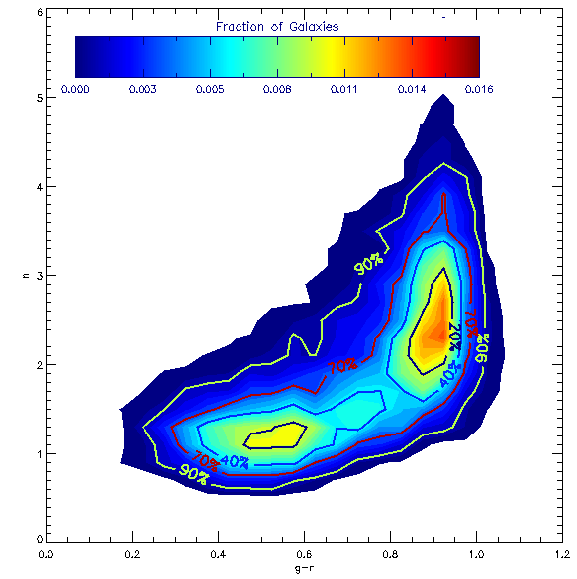
Bimodal Distribution of Galaxies
Separation into red early type (E/SO) and blue late type (Sp, Irr) galaxies at Sersic n~1.8
Are differences between void and wall galaxies simply due to the morphology density relation? (fewer E’s in voids)
Need to compare colour at fixed morphology

Slide 23
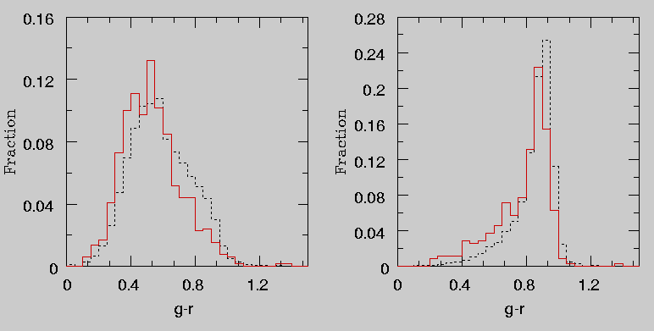
Not Explained by the Morphology-Density Relation
Early type n>1.8
Late type n<1.8
Void galaxies (red lines) bluer than wall galaxies (dashed black lines) of the same luminosity AND type

Slide 24
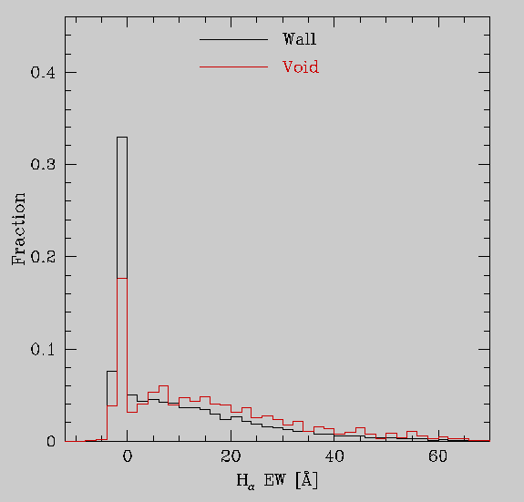
Equivalent Widths
Void galaxies have on
average larger EW(Hα)
than wall galaxies.
Same holds for OII, Hβ,
NII

Slide 25
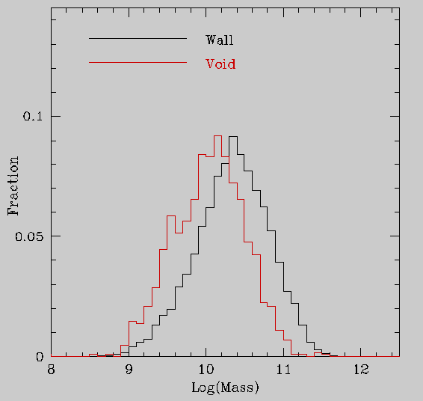
Stellar Masses
Void galaxies have on
average smaller stellar
masses than wall galaxies.
Kauffmann et al. 2003

Slide 26
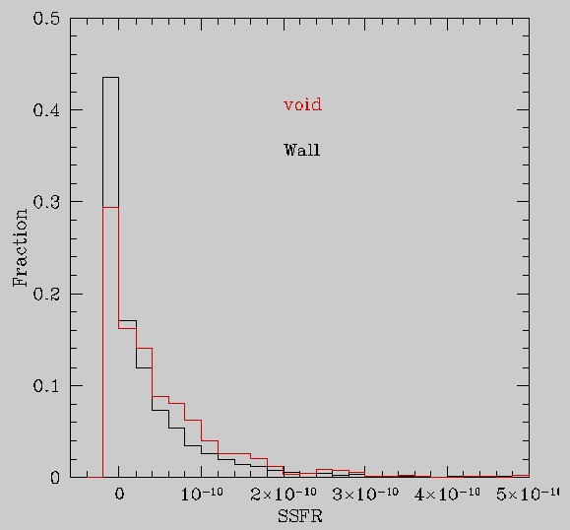
Specific Star Formation Rates
Void galaxies have on
average larger S-SFR(Hα)
than wall galaxies.

Slide 27
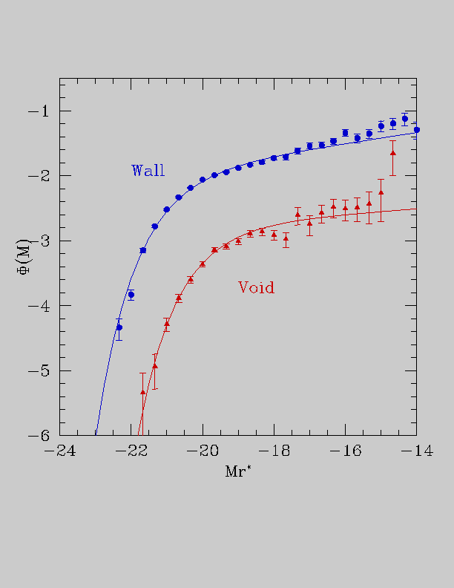
Void Galaxy Luminosity Function
Lower amplitude as
only 1/12th of galaxies
are void galaxies
From -15<Mr<-21 due
to distant and nearby
samples

Slide 28
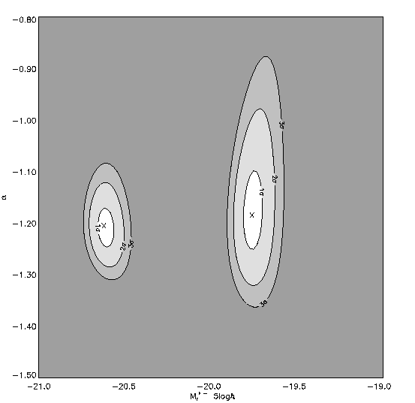
Fitting Schecter Functions
Very similar values
of α – faint end slope
1 magnitude difference
in Mr* due to lack of
big bright galaxies in
voids
α
Mr*

Slide 29
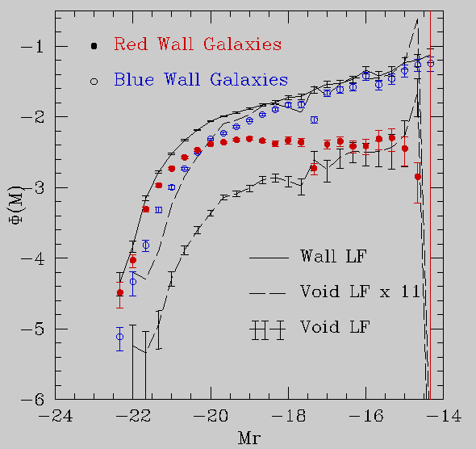
LF as a Function of Colour
Void galaxy LF more
Similar to that of
Wall galaxies that are
Blue
Low sersice indicies
High equivalent widths

Slide 30
Luminosity Function Summary
Void galaxy LF measured over wide range of magnitudes -15<Mr<-21
The void LF has fainter value of Mr* but similar value of α as the wall sample
Value of α much shallower than predicted by CDM
Similar shape the LF of blue, low sersic index, high EW(Hα) wall galaxies

Slide 31
Mass Function in Voids
Estimate the masses of the galaxies
  Ellipticals use Padmadaban et al 2003 method to estimate virial mass
  Spirals – invert the Tully Fisher relation
Compare to Press-Schuster models for the mass in voids

Slide 32
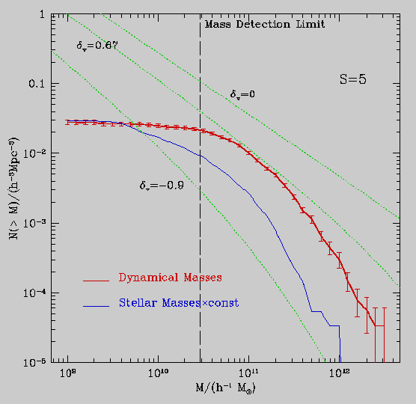
Mass Function
Find that galaxies
are approximately
unbiased estimators
of the mass in voids

Slide 33
Conclusions
Presented two methods from which voids can be
found
Voids are very underdense dρ/ρ<-0.9 and fill 40%
of the Universe
Void galaxies are fainter, bluer and more diskier than
wall galaxies
- Not explained by just the morphology-density
relation
Void galaxies also have higher rates of specific
star formation
Luminosity function similar α for void/wall galaxies

Slide 34
Advertisement
Proposal in to Aspen Center for Physics for Void Workshop next summer
Michael Vogeley, Rien van de Weygaert, Jim Peebles, Ravi Sheth and Fiona Hoyle
Aim to bring Theoreticians and Observers together to address all these issues
Watch your email!

