Slide 1
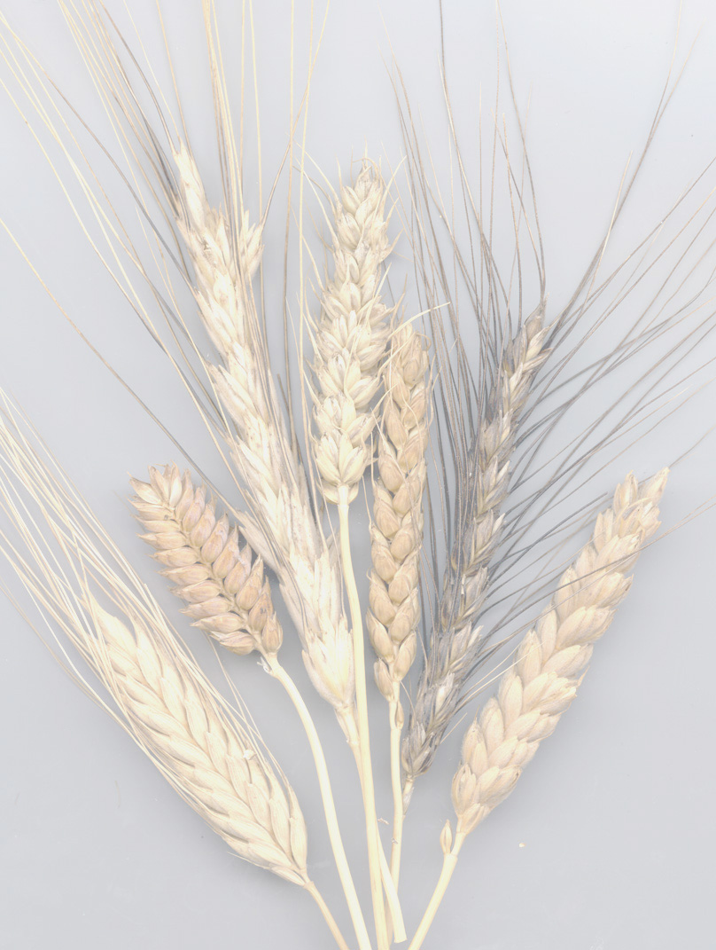

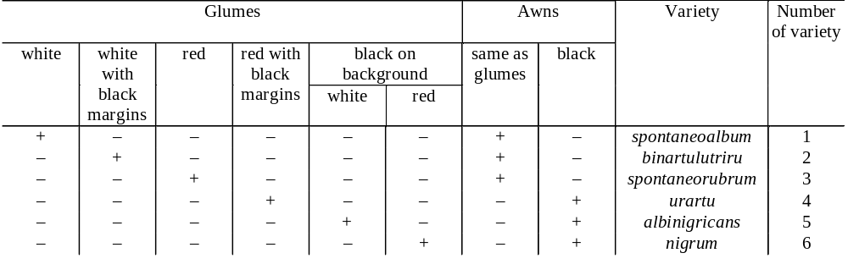
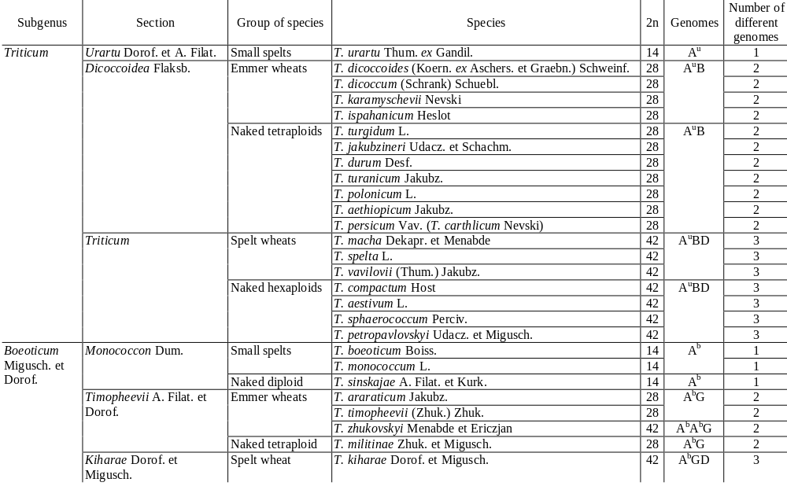
English translation of the 1979 Russian taxonomic monograph of Triticum L. by Dorofeev et al.: Project progress report
H. Knüpffer¹, L.A. Morrison², A.A. Filatenko³, K. Hammer⁴, A. Morgounov⁵, I. Faberová⁶
¹ Genebank, Institute of Plant Genetics and Crop Plant Research (IPK), D-06466 Gatersleben, Germany;
² Department of Crop and Soil Science, Oregon State University, Corvallis, OR 97331-3002, USA;
³ 13-Linija 12, kv. 7, St. Petersburg 199 034, Russia;
⁴ Universität Gesamthochschule Kassel, Steinstraße 11, D-37213 Witzenhausen, Germany;
⁵ CIMMYT, P.O. Box 374, Almaty 480000, Kazakhstan;
⁶ Genebank, Research Institute of Crop Production, Drnovská 507, CZ-161 06 Prague, Czech Republic
Introduction
The important modern taxonomic treatment of Triticum L. (Dorofeev et al. 1979) published by the N. I. Vavilov Institute of Plant Industry (VIR) is not widely known. It represents the result of a cumulative effort that began under the guidance of Vavilov. The only equivalent work in English is John Percival's (1921) monograph The Wheat Plant.
Dorofeev et al. (1979), as a traditional treatment largely based in morphology, has been eclipsed by the genetic concepts of Triticum and Aegilops. Since Bowden’s (1959) so-called phylogenetic treatment, wheat taxonomy has been in the hands of geneticists. Over the past half century, it has suffered from competing genetic concepts and an acrimonious debate over circumscription of the genera and species.
In actuality, the differences between Dorofeev et al. and the genetically based classifications are largely differences of nomenclature. Very little in the overall concept of Triticum has changed since Schulz (1913) organized the genus into the morphological groups of einkorn, emmer, and dinkel wheats, which proved later to follow the ascending polyploid series reflecting the evolutionary development of Triticum species. In Dorofeev et al., the domesticated wheats are given specific status and are fully described, while in the Bowden-type classifications, they are named as infraspecific taxa but poorly described (e.g., Mac Key, 1988) or eliminated entirely and thereby lost (e.g., Kimber and Sears, 1987). The genetic classifications have distracted attention away from infraspecific diversity. If infraspecific forms are not named and described systematically, their diversity cannot be exploited and is at risks of being lost.
One effort to bring order into the chaos of Triticum taxonomy is the GrainTax project which compiles information about taxonomic classifications and wheat synonymy (http://wheat.pw.usda.gov/ggpages/GrainTax/
description.html) (Morrison and Raup 1999, 2000). Another such effort is the "Dorofeev et al. Translation Project" (DTP), an internationally based volunteer project aimed at producing an English-language version of the 1979 Dorofeev et al. monograph (Morrison et al. 2000).
How is the Translation Project funded?
Initially CIMMYT provided a US$ 5,000 donation for the Russian to English translation. The project is seeking other donations from public and private research institutions for the costs of editing and publication (Morrison et al., 2000). The fund is maintained at the Society for the Support of Research on Cultivated Plants in Gatersleben (GFK).
Interested donors can contribute as follows (for banking instructions, contact Helmut Knüpffer, knupffer@ipk-gatersleben.de):
 Non-EEC citizens: by cheque payable to GFK- Gatersleben
 EEC citizens: by Eurocheque payable to GFK- Gatersleben
 German citizens: Eurocheque payable to GFK- Gatersleben, or via bank transfer.
Donations should be addressed to:
Dorofeev Translation Project Fund, Mr. B. Eise
Gemeinschaft zur Förderung der Kulturpflanzenforschung e.V. (GFK)
Corrensstr. 3, D-06466 Gatersleben, Germany
Extract from the English translation of Dorofeev et al. (1979)
T. URARTU Thum. EX GANDIL.
T. urartu Thum. ex Gandil. 1972, Bot. Zhurn. 57, 2: 176; Tumanian 1938, Tr. Arm. Fil. AN SSSR, Ser. Biol. 2: 211, descr. ross. – T. armeniacum Thum. ex Flaksb. 1939, Opred. Nast. Khlebov: 27, nom. nud., non T. armeniacum Nevski 1933, non T. armeniacum Jakubz. 1938 et non T. armeniacum Makusch. ex Menabde 1945. – T. monococcum subsp. urartu (Thum.) A. et D. Löve 1961, Bot. Not. (Lund) 114, 1: 49, nom. illeg. – T. boeoticum Boiss. subsp. urartu (Thum.) Vav. 1964, Mirov. Resursy Khlebn. Zlakov: 21, nom. illeg. – T. boeoticum subsp. urartu (Thum.) V. Dorof. 1968, Euphytica, 17: 453, nom. illeg. – T. monococcum subsp. michaelii An. Fed. (Theod.) et Takht. ex Zhuk. 1968, Bot. Zhurn. 53, 4: 442, nom. nud. – T. michaelii Zhuk. 1971, Kult. Rast. Sorod.: 96, nom. nud.
Type: Armenian Republic, southeastern outskirts of Erevan near Vokhchaberd and Gekhadir villages, 30. VI. 1968, P. A. Gandilyan.
General characteristics. Seedlings violet or dark green. Plant prostrate at base. Culm thin, flexible, up to 145 cm high. Stem nodes violet. Leaves velvety pubescent or glabrous, linear-lanceolate (15 cm long, 0.7–1.0 cm wide). Leaf sheaths velvety pubescent or glabrous. Auricles white, ciliate. Spikes elongate (Fig. 3, a), narrow (7–9 cm long, 0.6–0.7 cm wide), fragile, spontaneously disarticulating. Spikelets two-awned, one-grained (less often two-grained). Lateral (two-rowed) side of spike approximately twice as wide as frontal side. Pubescence of rachis internode segments the same as for T. boeoticum. Glumes scabrous-tuberculate; more delicate than for T. boeoticum,. Keel tooth long with a broad base. Tooth of main lateral glume vein considerably less distinct than keel tooth and 8–10 times shorter than in T. boeoticum. Anthers short, 2.0–2.7 mm (Gandilyan, 1972).
T. urartu has a weaker stem than T. boeoticum: stem fracture strength at first internode is 456 g versus 2,000–3,000 g for T. boeoticum (Gradchaninova, 1967).
In Armenia, found on dry slopes of foothills.
All forms of T. urartu are winter forms. Heading stage is long when sown under irrigated conditions in Tashkent. Both in Armenia and in other native habitats in the Near and Middle East, T. urartu only occurs where T. boeoticum is present.
Compared to T. boeoticum, T. urartu shows less morning flowering. It also flowers in the evening flowering (Zhukov, 1969). In Tashkent, T. urartu starts flowering before full emergence of the spike from the flag leaf (data of E. F. Migushova). In Armenia, its native land, T. urartu begins later than T. boeoticum (Araratyan and Surmenyan, 1939). T. urartu is separated from other diploid species by anther morphology as well (Dhaliwal and Johnson, 1976). Its anthers are unusually short (on the average 2.2mm, versus 3.6mm in T. boeoticum). They dehisce by a longitudinal cleft twisting into a spiral after flowering. Anthers of T. urartu are placed at the same level as the stigma; the lemma and palea open with difficulty (Araratyan and Surmenyan, 1939).
T. urartu, like other wild wheat species, stands out because of its high seed protein content (23.7- 25.0%) (Konarev et al., 1971). Lysine content is relatively high: 2.67 - 2.48% of total protein; 0.632 - 0.681mg per 100g of grain. On the average for three years, content of protein in grain of this species (reproduction in lowland Daghestan under irrigation) made up 19.1–23.7%, that of starch 53.0–58.0% (Jakubziner and Pokrovskaya, 1971).
Immunity. T. urartu is distinguished from T. boeoticum by its strong susceptibility to yellow (stripe) rust (Gulkanyan, 1938; Vavilov, 1957, 1964; Jakubziner, 1969). In the Tashkent region during 1968–1973, stripe-rust infections reached number 3 (on a 5-point scale) powdery mildew infections reached number 4 (Migushova, 1976). Sukhanberdina (1977) also found severe powdery mildew infections both in the seedling and adult plant stages.
Resistance to infection by races of brown and stem rust in the seedling stage proved to be stronger (type IV) than in T. boeoticum (Grigoryeva, 1975). Adult plants in field conditions were essentially resistant. M. M. Jakubziner (unpublished information) has noted that in his joint experiment with G. S. Turov in Southern Kazakhstan the degree of infection of adult plants by brown rust did not exceed 10%, although response to infection by the fungus was characterised as being of type IV.
Artificial infection by loose smut races, f. aestivi and f. duri, caused infection of 10.0 and 11.5% of spikes respectively (Yamaleev, 1974, Krivchenko et al., 1976). The fungal mycelium infected all the embryonic organs of the caryopsis. These researchers concluded that T. urartu was distinctly different from T. boeoticum in having no embryo race-specific resistance to loose smut in all growth stages.
In general, T. urartu is not resistant to fungal diseases.
Geographical distribution. The species distribution range in Armenia is at southeastern outskirts of Erevan and around the environs of the villages Shorbulak, Gekhadir, Vokhchaberd, and Atsavan in the Abovyan district (after Gandilyan, 1976, refined).
In recent years, forms of T. urartu were reported from Iran (Jaaska, 1974), as well as from Turkey, Iraq and Lebanon (Johnson, 1975).
Origin. A number of researchers envision the phylogenetic development of wheat as forming a branched tree, which originated from a common ancestor. According to Flaksberger (1935), the ancestor is the progenitor for the diploid and polyploid wheat species. Nevski (1933) advanced the idea that the genus Triticum originated from the ancestral tribe Protohordeae, or more particularly from plants which had a paniculate inflorescence with 2-3 spikelets grouped at each rachis node. Sinskaya (1955) believed that the tribe Protohordeae consisted of perennial biotypes (2n = 14), which evolved and turned to annual growth habit, while gaining features of xerophily. Tzvelev (1976) concluded that the coasts of the ancient Tethys ("Ancient Mediterranean") were a region where highly specialised annuals evolved from festucoid grasses. These grasses then gave rise to the first diploid wheat. In our opinion, this ancestor could have been an ancient form of T. urartu.
Taxonomy. T. urartu was found by M. G. Tumanian in 1934 who named and published the species description in Russian in 1938. Its spikes were brought into the VIR collection by N. I. Vavilov, who identified them as T. armeniacum Thum. This name was published in 1939. The T. armeniacum epithet is illegitimate, since armeniacum was assigned to another species of two-grained wheats in 1933. In 1938 and 1945, the name T. armeniacum was used as a later homonym of T. araraticum. The epithet michaelii suggested by Fedorov and Takhtajan (1968) is also a later homonym of T. urartu. Thus, a certain confusion was introduced into nomenclature.
The diagnosis of T. urartu was published by Gandilyan (1972). For many years in the botanical and genetic literature, T. urartu has been regarded as a subspecies of T. boeoticum (Vavilov, 1964) or included in T. monococcum (Löve and Löve, 1961).
Key to the determination of varieties of T. urartu Thum. ex Gandil.
What are the publication plans?
The 323 text pages have been completely translated. Scientific editing is underway. A revised reference list is in process. The DTP has obtained permission from VIR to publish the translation and to use photographs and figures from the original. Linguistic editing will start in November 2001. Final editing and revisions will be completed through the Fall of 2002. The publication is scheduled for early 2003.
The DTP plans to publish an affordable volume at no more than US$ 50. A publisher has not yet been chosen. Electronic publication of the taxonomic keys and other relevant portions of the translation on the GrainTax website is planned.
Who are the people involved in the translation project?
The DTP was initiated during the Percival Symposium "Wheat – Yesterday, Today and Tomorrow" (summer 1999) at Reading, UK. The project committee includes:
 Helmut Knüpffer – Institute of Plant Genetics and Crop Plant Research (IPK), Gatersleben, Germany
 Anna Filatenko (retired, VIR) – St. Petersburg, Russia
 Laura Morrison – Oregon State University, Corvallis, USA
 Karl Hammer – Universität Gesamthochschule Kassel, Witzenhausen, Germany
 Alexei Morgounov – CIMMYT, Almaty, Kazakhstan
 Iva Faberová – Research Institute of Crop Production, Prague, Czech Republic
Irina Sokolova (St. Petersburg, Russia) prepared the English translation. Scientific editing by A. Filatenko (one of the authors of Dorofeev et al.); linguistic editing by Charles Jeffrey (St. Petersburg); final editing by A. Filatenko, K. Hammer, L. Morrison and I. Faberová; editorial supervision by H. Knüpffer.
Why is translation of Dorofeev et al. important, and what benefits does it offer to the wheat research community?
There are several reasons for re-examining Dorofeev et al.:
It is the only modern catalogue of wild and domesticated wheat species and their infraspecific diversity.
Built on a long historical research base, it presents information that would be extremely difficult to compile in today’s research funding climate.
A detailed classification provides a guide to the tremendous diversity of the genus Triticum existing in natural and man-made habitats as well as in genebanks.
Taxonomy now promises to take on a new status as an authoritative resource for establishing the boundaries for protection of germplasm diversity and intellectual property rights. The detailed morphological classification of Dorofeev et al. will be useful in establishing the extent of diversity across the geographic range of wheat distribution, particularly for Asia, Eastern Europe, and North Africa.
Dorofeev et al. is an authoritative reference for identification of distinct forms of the wheats and for establishing public ownership of wheat genes or genetic forms in the face of proprietary ownership challenges by private companies.
Var. albinigricans Thum. ex Dorof. et A. Filat. 1979, in Dorof. et al., Kult. Fl. 1: 38. – T. urartu var. albonigricans Thum. 1938, Tr. Arm. Fil. AN SSSR, Ser. Biol. 2: 214, descr. ross. (5). A T. urartu var. spontaneoalbum glumis aristisque nigris differt.
Typus: Armenia. Reproductio stationis Daghestanskajae fulcracea, WIR, k-33871, 3. VI. 1968, leg. Soskov (WIR).
Geographical distribution. Armenia.
Var. binartulutriru Gandil. ex Dorof. et A. Filat. 1979, in Dorof. et al., Kult. Fl. 1: 38. – T. urartu var. binartulutriru Gandil. 1975, Tr. Arm. NIIZ, Ser. Pshenitsa (Echmiadzin), 3: 74, descr. ross. (2). Spica alba marginibus glumarum nigris.
Typus: Armenia, prope pagum Gegadir, 30. VI. 1968, leg. P. A. Gandiljan (WIR).
Geographical distribution. Armenia.
Var. nigrum Thum. ex Dorof. et A. Filat. 1979, in Dorof. et al., Kult. Fl. 1: 38. – T. urartu var. albonigricans Thum. 1938, l. c.: 214, descr. ross. (6). A T. urartu var. urartu glumis nigris differt.
Typus: Armenia. Reproductio stationis Daghestanskajae fulcracea, WIR, k-33870, 29. VI. 1968, leg. Soskov (WIR).
Geographical distribution. Armenia.
Var. spontaneoalbum Thum. ex Dorof. et A. Filat. 1979, in Dorof. et al., Kult. Fl. 1: 38. – T. urartu var. spontaneoalbum Thum. 1938, l. c.: 214, descr. ross. (1). Spica aristaque albae.
Typus: Armenia. 30. VI. 1968, leg. P. A. Gandiljan (WIR).
Geographical distribution. Armenia.
Var. spontaneorubrum Thum. ex Dorof. et A. Filat. 1979, in Dorof. et al., Kult. Fl. 1: 38. – T. urartu var. spontaneorubrum Thum. 1938, l. c.: 214, descr. ross. (3). Spica aristaque rubrae.
Typus: Armenia. Reproductio stationis Daghestanskajae fulcracea, WIR, k-33869, 3. VI. 1968, leg. Soskov (WIR).
Geographical distribution. Armenia.
Var. urartu. – T. urartu var. binarturutriru Gandil. 1972, Bot. Zhurn. 57, 2: 177. (4).
Geographical distribution. Armenia
Acknowledgements
The contribution of CIMMYT to the project fund is gratefully acknowledged. We also thank the "Gemeinschaft zur Förderung der Kulturpflanzenforschung", Gatersleben, for hosting the project fund. The work of A. Filatenko was carried out under the sponsorship of the Cooperative Agricultural Sciences Programme between Germany and the Russian Federation and funded by the German Ministry of Agriculture.
References
Bowden, W.M. 1959. The taxonomy and nomenclature of the wheats, barleys, and ryes and their wild relatives. Can. J. Bot. 37: 657–684.
Dorofeev, V.F., Filatenko, A.A., Migushova, E.F., Udaczin, R.A. and Jakubziner, M.M. 1979. Wheat. In: V.F. Dorofeev and O.N. Korovina, eds. Flora of Cultivated Plants, vol. 1. Leningrad (St. Petersburg), Russia. Kolos (in Russian). 346 pp.
Kimber, G. and Feldman, M. 1987. Wild wheat: an introduction. Special Report. 353. Columbia: Coll. Agric., Univ. Missouri.
Kimber, G. and Sears, E.R. 1987. Evolution in the genus Triticum and the origin of cultivated wheat. In: EG. Heyne, ed. Wheat and wheat improvement. 2nd ed. Madison: Amer. Soc. Agron., pp. 154–164.
Mac Key, J. 1988. A plant breeder’s aspect on taxonomy of cultivated plants. Biol. Zentralbl. 107: 369-379.
Morris, R. and Sears, E.R. 1967. The cytogenetics of wheat and its relatives. In: KS Quisenberry and LP Reitz, eds. Wheat and wheat improvement. Madison: Amer. Soc. Agron., pp. 19–87.
Morrison, L.A., Faberová, I., Filatenko, A.A., Hammer, K., Knüpffer, H., Morgounov, A., and Rajaram, S. 2000. Call to support an English translation of the 1979 Russian taxonomic monograph of Triticum by Dorofeev et al. Wheat Inform. Serv. 90: 52–53.
Morrison, L.A. and Raup, W.J. 1999. GrainTax synonymy table project: June 1999 progress report. Wheat Inform. Serv. 88: 52–56.
Morrison, L.A. and Raup, W.J. 2000. GrainTax synonymy tables project: June 2000 Progress Report. Wheat Inform. Serv. 90:54.
Percival, J. 1921. The Wheat Plant. Duckworth & Co, London. 463 pp.
Schulz, A. 1913. Die Geschichte der kultivierten Getreide, Halle: Verlag Louis Neberts.
What information does the monograph contain?
The monograph recognises 27 domesticated and wild Triticum species (cf. Table 1) and provides their detailed descriptions. There are 1,242 infraspecific taxa catalogued with botanical descriptions, synonymy, taxonomic keys, geographic distribution, disease traits, origin, and history. As an illustration, the treatment of Triticum urartu is shown (see right column). Over 3,000 names are listed in the monograph’s index. The translation also will include a full reference list with numerous publications not generally known outside of Russia. An English version of Dorofeev et al. will thus open a body of information to interested plant breeders, geneticists, genebank managers, botanists, archaeobotanists, and others working with wheat diversity.
By contrast, genetic classifications usually recognise only four or five species. The full range of wheat diversity cannot be described by the abbreviated species concepts of Morris and Sears (1967), Kimber and Sears (1987), and Kimber and Feldman (1987).
Table 1. System of the genus Triticum L. according to Dorofeev et al. (1979)

