Slide 1



NLM Standards Related Activities
Vivian A Auld
Senior Specialist for Health Data Standards
National Library of Medicine
National Committee on Vital and Health Statistics
Subcommittee on Standards and Security
July 26, 2005

Slide 2
Health Information Technology
April 2004 - Presidential Executive Order created ONCHIT
July 2004 – HIT Strategic Framework Goals announced
May 2005 – Secretary Leavitt announces 500-day plan
June 2005 – Report on Nationwide Health Information Exchange (results of ONCHIT RFI)
June 2005 – ONCHIT RFPs published
Upcoming:
2005 - Congress drafting several HIT bills
October 2005 – Report from Commission on Systemic Interoperability
Notes:
electronic health data standards are a key component of the national health information network, needed for efficient health care, research, public health, and emergency detection and response. Underlying NLM’s interest in health data standards is the assumption that Electronic Health Records (EHR) will make it easier to deliver relevant information at the time and place important decisions are made. “Interoperability standards” is a broad term: NLM’s interest is in the subset that deals with data content, standard vocabularies (for use in messages and records), and mapping between clinical vocabularies and administrative code sets.

Slide 3
NLM Long Range Plan
Work with other agencies and organizations to support establishment, maintenance, testing and use of health data standards.
  Active partners: Office of the Secretary - HHS, AHRQ, CDC, CMS, FDA, other NIH components, VA, DoD, NCVHS, standards development organizations, vocabulary producers, professional associations
Use the UMLS Knowledge Sources and programs to facilitate maintenance and distribution of vocabulary standards.
Notes:
View the UMLS as a vehicle for uniform distribution of administrative coding systems, detailed clinical vocabulary, and mappings between the two

Slide 4
Letter from HHS Secretary to NCVHS
Sept. 2004
“As you requested …, NLM to serve as the central coordinating body within HHS for PMRI [Patient Medical Record Information] terminologies. … several … mapping recommendations currently are being implemented by the NLM.”

Slide 5
Coordination Means:
Uniform distribution of designated standard vocabularies through the UMLS Metathesaurus
Reducing peripheral overlap and establishing explicit relationships between standard clinical vocabularies (e.g., SNOMED, LOINC, RxNorm)
Aligning standard clinical vocabularies with standard record and message formats
Mapping between standard clinical vocabularies and administrative code sets and/or other important vocabularies

Slide 6
Agenda
Changes/improvements to the UMLS
RxNorm Update
Harmonization of vocabularies supported by NLM
NLM / HL7 contract
Mapping Projects

Slide 7
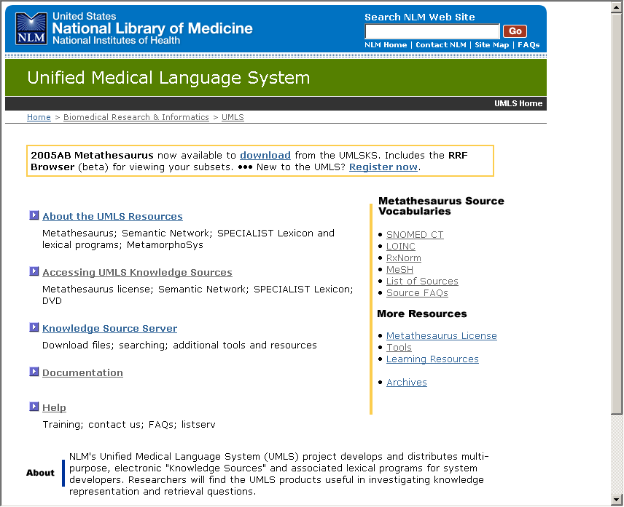
Unified Medical Language System®
umlsinfo.nlm.nih.gov
Notes:
Something you are all familiar with. Going to give you an overview of some of the key changes.
UMLS is a collection of knowledge sources or tools designed to help systems developers in the creation of health information systems including electronic health records.

Slide 8
UMLS® – Moving from a Research Project to a Production System
Includes:
  Transitioning from research branch (Lister Hill Center) to production branch (Office of Computer and Communications Systems and Library Operations)
  Migrating to new computer hardware and software
  Adding new staff to support improvements to documentation, training, QA, and customer support
Primarily affects production of the Metathesaurus release files.
Research branch will still be heavily involved in continued development

Slide 9
2005AB UMLS Metathesaurus (June 2005)
1,196,265 concepts
4,752,383 unique “strings”
  (Eye, Eyes, eye = 3)
5,578,532 source vocabulary terms
114 source vocabularies
17 different languages
Notes:
UMLS Metathesaurus® a Vocabulary Database
Preserves the meanings, hierarchical connections, and other relationships between terms present in its source vocabularies
Adds certain basic definitional information about each of its concepts
Establishes new relationships between concepts and terms from different source vocabularies
Distributes many vocabularies in a common, explicit format
Note: Those using MeSH attribute data should download the revised 2005AB files available as of 7/25/2005.

Slide 10
Improvements to the UMLS Metathesaurus
Return to quarterly updates in 2006
  Synchronization of critical source updates will factor into final release schedule
Goal is to streamline production process to provide updates of key vocabularies in a timely manner
  Experimenting with use of Rich Release Format (RRF) as a standard submission format to streamline the addition and maintenance of sources in the Metathesaurus
    Testing with HL7 code sets and RxNorm
Notes:
Added functionality introduced in 2004 is now bearing fruit.
MRMAP - Representations of simple and complex mappings between (1) concept names or (usually) their surrogates (identifiers or codes) from one source vocabulary or from the Metathesaurus and (2) concept names or (usually) their surrogates from another source vocabulary or from the Metathesaurus. This file can accommodate multiple purpose-specific mappings between the same source vocabularies and/or conditional rules for when mappings apply. Source asserted historical mappings (i.e., mappings between obsolete terms/concepts and current ones) are included here.
MetamorphoSys also generates special subsets referred to as Content Views. A content view may specify any pre-defined subset of the Metathesaurus that is useful for some specific purpose. The actual definition of a content view can take a variety of different forms: 1. An actual list of Metathesaurus UIs maintained over time. 2. A list of sources that participate in the view. 3. A complex query that identifies particular sets of data.
A Content View Flag (CVF) consists of an arbitrary bit field, with each bit representing membership in a particular content view; each content view is documented in MRDOC.RRF. The first Content View available in the 2005AA release, the MetaMap NLP View, identifies terms that are useful for Natural Language Processing. These CVF value in rows with these terms carry the value "1" in the "256" bit. MetamorphoSys users who wish this special subset should use the File Menu, Enable/Disable Views to implement this feature.

Slide 11
Improvements to the UMLS Metathesaurus
RRF as an output format enables Source transparency for key vocabularies (e.g. SNOMED CT)
Refining representation of mappings between source vocabularies
Content View Flags to identify pre-defined subsets
  2005AA release includes the MetaMap NLP View identifies terms that are useful for Natural Language Processing
  Include HIPAA, CHI, and PHIN subsets in 2006

Slide 12
MetamorphoSys
UMLS installation wizard and customization tool included in each Metathesaurus release
Goal – a user friendly tool that facilitates creation of customized Metathesaurus subsets. More enhancements on the way to help users determine what to include in their subset

Slide 13
MetamorphoSys
Three default subsets currently available:
  Level 0 vocabularies – separate/additional license agreements necessary beyond the UMLS license
  Level 0 + SNOMED CT
  RxNorm subset – contains RxNorm concepts in Level 0 sources.
Customized subsets - beginning in 2005AC users will be able to save this across versions, comparing against new sources and changes to sources.
In 2006 planning to add subsets for HIPAA, CHI, and PHIN subsets.

Slide 14
UMLSKS
UMLS Knowledge Source Server is:
  web based interactive tools including search engine
  programmer interface
  source for downloading UMLS components
New version in the works
  Back end - implementing Web Services to make it easier for people to access the system (XML based)
  Front end - portals allow users to customize their view of the Metathesaurus.
  Prototype by AMIA 2005 Annual meeting
  Implementation in 2006

Slide 15
Other UMLS Resources
Semantic Network - consistent categorization of all concepts represented in the UMLS Metathesaurus
SPECIALIST Lexicon - English language lexicon with many biomedical terms, containing syntactic, morphological, and orthographic information for each term or word
Natural language processing programs - In combination with the Metathesaurus, powerful tools for interpretation/indexing of electronic full text

Slide 16
RxNorm Update
Monthly releases currently available
  Weekly releases available by end of year
Maintaining harmony with UMLS Metathesaurus through:
  Inclusion of RxNorm updates in every Metathesaurus release
  Resynchronization of RxNorm files after every Metathesaurus release
Major improvements in process & product code
  Improving process for training staff

Slide 17
RxNorm Update
Incorporating more sources:
  First DataBank (agreement signed)
  Micromedex (agreement signed)
  Gold Standard (agreement expected any day)
  Medi-Span (agreement under review by them)
  NDC (where we can obtain them, including from the FDA website)

Slide 18
Using RxNorm
RxNorm in use to mediate Clinical Data Repository/Health Data Repository (CHDR) – joint DoD/VA project to facilitate exchange of clinical data
  DoD Clinical Data Repository (CDR) uses FirstDatabank
  VA Health Data Repository (HDR) uses NDF/RT
  RxNorm is the interlingua

Slide 19
NLM-led Support for Development and Maintenance
1999 – LOINC (lab tests/instrument observations) - contract support
2002 – RxNorm (clinical drugs) - direct development
2003 – SNOMED CT contract & license for U.S-wide use (as distributed by NLM in the UMLS)

Slide 20
Harmonization efforts NLM coordinating
SNOMED and LOINC:
  Discussions under way with CAP and Regenstrief
  CAP agreement with NHS is a factor
  Options:
    Define the scopes of SNOMED CT and LOINC such that prospective content developed for the two terminologies will be mutually exclusive
    If mutual exclusivity not possible then clarify appropriate usage of each vocabulary within the U.S. CVF will be used to indicate this information in the UMLS.

Slide 21
Harmonization efforts NLM coordinating
SNOMED and RxNorm:
  Clinical drugs in SNOMED CT are aligned with RxNorm concepts within RxNorm. Still in process
  SNOMED CT and RxNorm have different views of what constitutes a drug. Providing links to overcome
  CAP agreement with NHS is a factor
Coordinate harmonization effort with ONCHIT

Slide 22
NLM- HL7 Contract Arrangement
Sept. 2004
Align HL7 message standard with CHI standard vocabularies (NLM-initiated)
  Specify which subsets of standard vocabularies are valid for particular message segments
  Replace HL7-maintained lists of coded values with subsets of standard vocabularies, where feasible
Create implementation guide(s) for transmitting an entire Electronic Health Record between systems (on behalf of HHS)
Full project update to NCVHS February 2006
Notes:
Suzie and I talking with ONCHIT staff in next few weeks to ensure outcomes are coordinated with ONCHIT projects

Slide 23
Mapping Projects planned/underway
CHI standards → HIPAA code sets:
  SNOMED CT → ICD-9-CM, ICD-10-CM
  SNOMED CT → CPT
  LOINC → CPT
SNOMED CT → “other” vocabularies:
  Medical Dictionary for Regulatory Affairs (MedDRA)
  International Classification of Primary Care (ICPC)
  Medcin
  Medical Subject Headings (MeSH®)
  Nursing Vocabularies (NIC, NOC, NANDA)
First draft mappings available in the UMLS Metathesaurus for testing by end of 2005
Notes:
International Classification of Primary Care

Slide 24
Key NLM Assumptions about Mappings
Participants must include:
  Producers of vocabularies on both ends; prospective users and recipients of the output, e.g., health care providers, payers, as testers and validators
Mapping may/will prompt changes/corrections to content and adjustment to update schedules
Mappings must be updated every time either end is updated
Mappings will be distributed in the UMLS (not exclusively); use will be governed by terms applicable to both ends
Mapping is still an R & D problem - it will take iteration to build highly functional maps. Alignment of update schedules is critical.

Slide 25
Questions?
Vivian A. Auld
Senior Specialist for Health Data Standards
National Information Center on Health Services Research and Health Care Technology (NICHSR)
National Library of Medicine, NIH, HHS
8600 Rockville Pike, Mail Stop 20
Bldg. 38A, Room 4S410
Bethesda, MD 20894
(301) 496-7974
auld@nlm.nih.gov

