Slide 1
The colour-magnitude relation in galaxy clusters
from z~0.8 to z=0
Gabriella De Lucia
Max-Planck Institut für Astrophysik

Slide 2
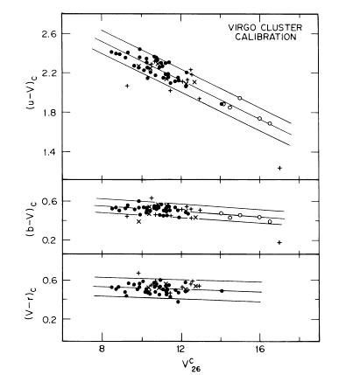
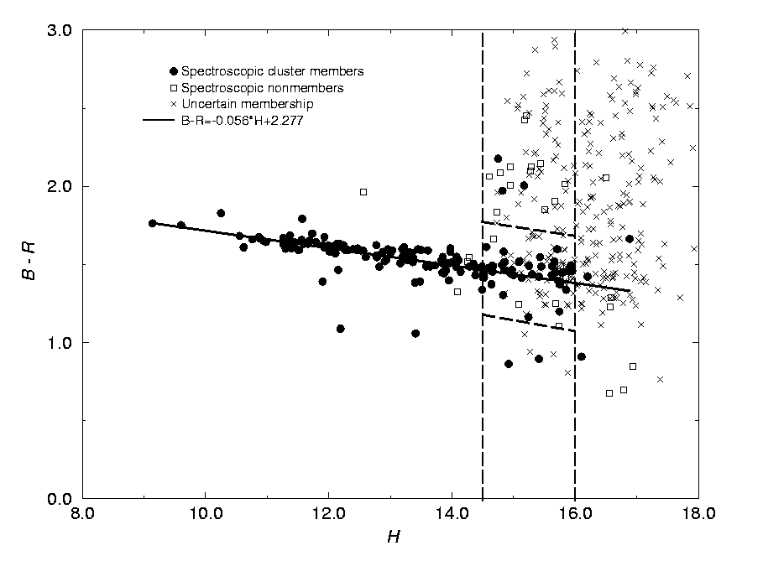
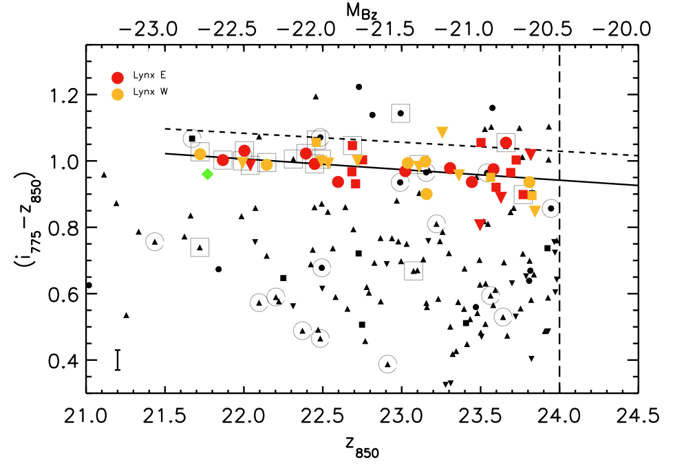
The CMR - some facts
An old result
Visvanathan & Sandage (1977)
Coma
Mei et al. 2006
5 mag!!!
De Propris et al. (1998)

Slide 3
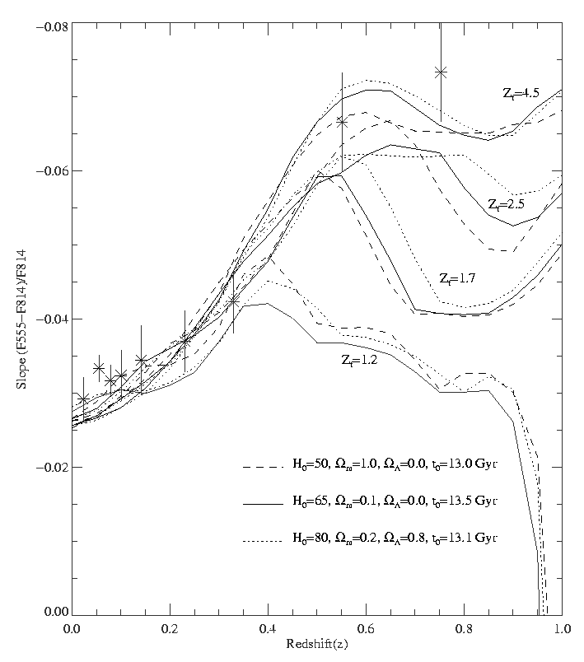
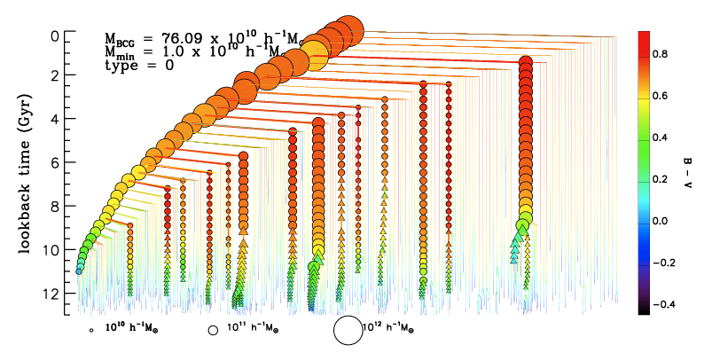
The CMR - the conjectures #1
A monolithic collapse occuring at high redshift
slope naturally arises taking into account SNe winds
(Arimoto & Yoshii 1987)
a tight CM up to high redshift consistent with a passive
evolution (Kodama et al. 1998)
obs. data
This model may be too naive
a galaxy does not have a single well defined progenitor at
each redshift (De Lucia & Blaizot 2006)
a it neglects the infall of new galaxies
Gladders et al. 1998
De Lucia & Blaizot 2006

Slide 4
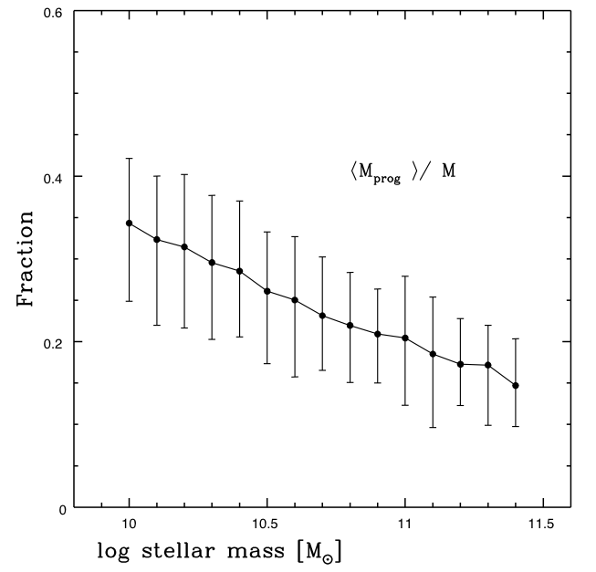
The CMR - the conjectures #2
A hierarchical merger model
slope arises because more massive Es form from the
mergers of more massive discs
(Kauffmann & Charlot 1998)
a tight CM up to high redshift - the results are robust
against halo-to-halo scatter (De Lucia, PhD thesis)
Mean progenitor mass
normalised to final mass

Slide 5
A truncation in the CMR in high redshift clusters

Slide 6
The Eso Distant Cluster Survey
A detailed follow-up of 20 clusters from LCDCS (Gonzalez et al. 2001)
10 clusters at z  0.5 and 10 clusters at z  0.8
deep optical photometry from VLT (14 nights)
Completed – White et al. 2005
near-IR photometry from NTT (20 nights)
Completed - Aragon-Salamanca et al. in preparation
multi-object spectroscopy with FORS2 on VLT (25 nights)
Completed - Halliday+ 2006; Milvang-Jensen+ in prep
80 orbits of HST to image 10 high-z clusters!!!
Completed - Desai et al. in preparation
WFI R (120m), V, I (60m)
Completed

Slide 7
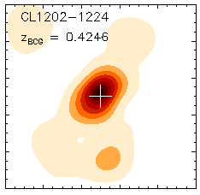
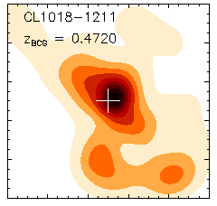
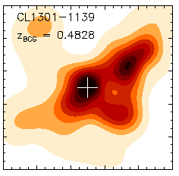
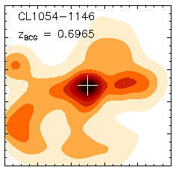
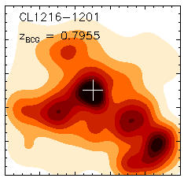
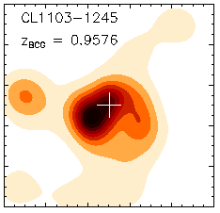
Some EDisCS clusters
White et al. 2005
A wide range of masses and structural properties

Slide 8
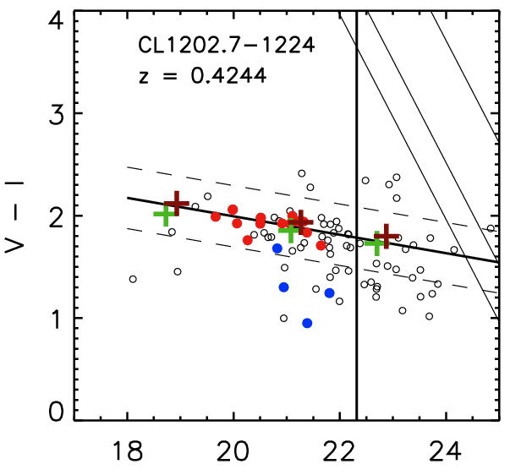
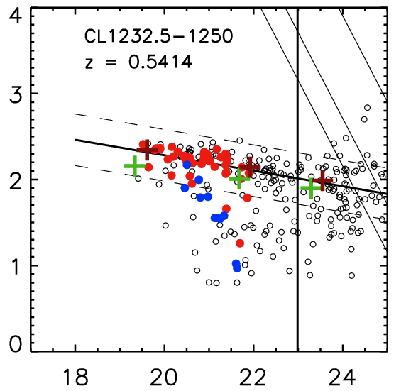
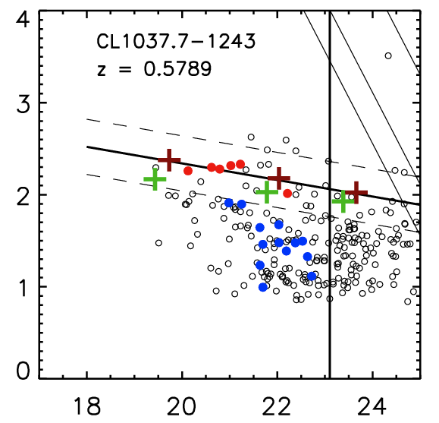
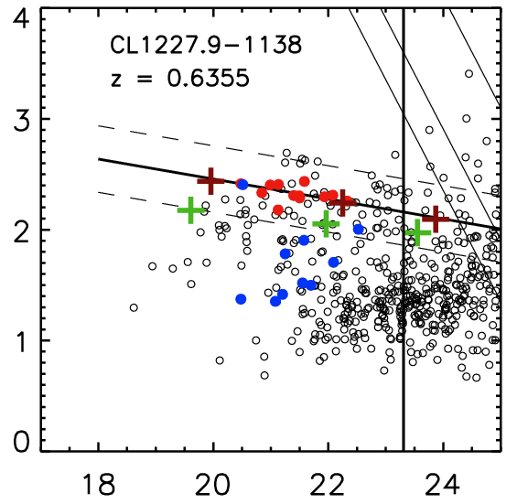
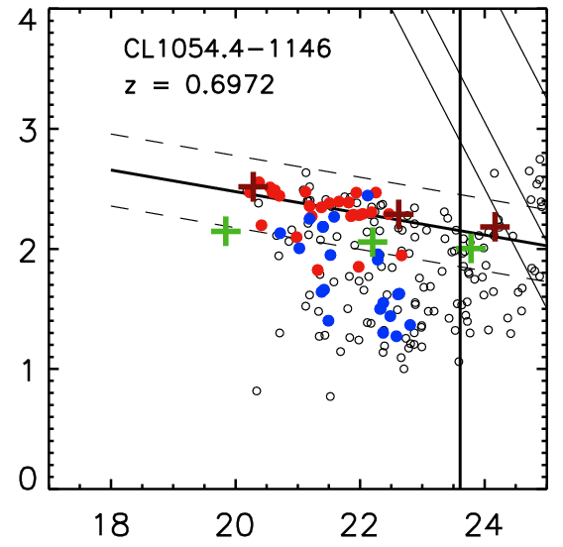
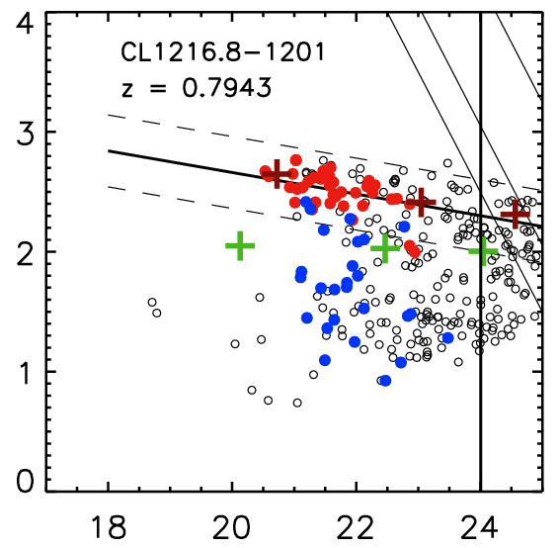
Some EDisCS CMRs
De Lucia et al. 2006, astro-ph/0610373

Slide 9
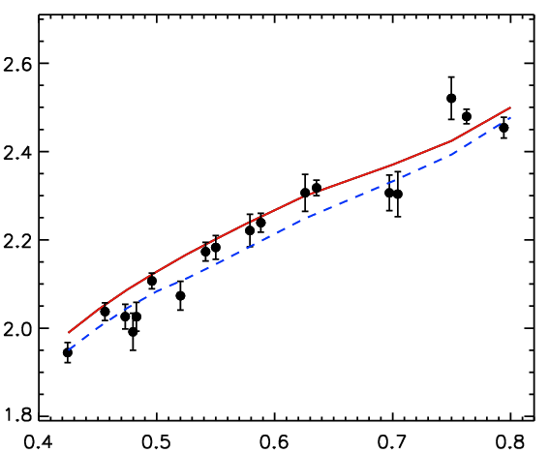
The CMR - passive evolution
The location of the CMR requires high redshifts of formation (z~3) and the slope is consistent with a correlation betweel luminosity and metal content
zero-point
redshift
De Lucia et al. 2006, astro-ph/0610373

Slide 10
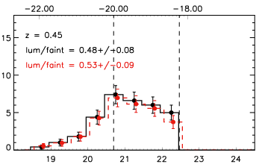
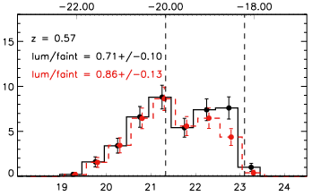
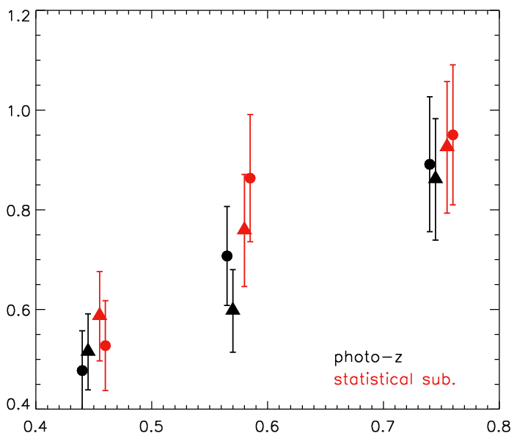
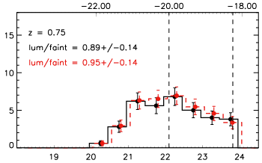
The build-up of the CMR #1
M_{V}(rest)
M_{V}(rest)
M_{V}(rest)
z = 0.45
z = 0.57
l/f = 0.48 +/- 0.08
l/f = 0.53 +/- 0.09
0.71 +/- 0.10
0.86 +/- 0.13
# of galaxies
M_{I}(obs)
0.89 +/- 0.14
0.95 +/- 0.14
z = 0.75
nlum/nfaint
# of galaxies
redshift
M_{I}(obs)
De Lucia et al. 2006, astro-ph/0610373

Slide 11
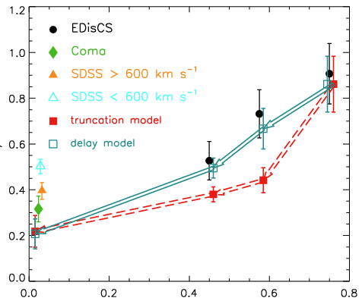
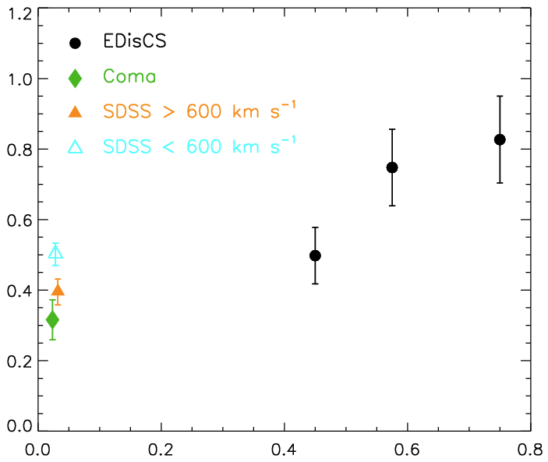
The build-up of the CMR #2
the blue galaxies observed in distant galaxy clusters provide the logical progenitors of faint red galaxies at z=0
nlum/nfaint
redshift
De Lucia et al. 2006, astro-ph/0610373

Slide 12
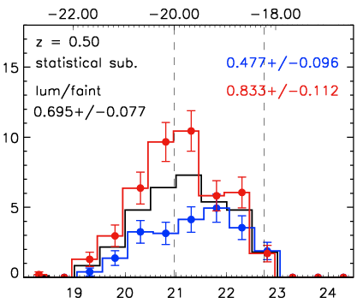
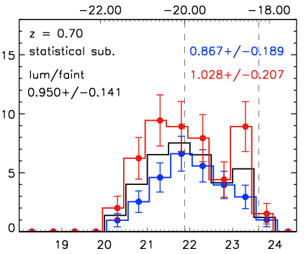
The build-up of the CMR #3
sigma < 600 km/s
M_{V}(rest)
# of galaxies
# of galaxies
M_{I}(obs)
sigma > 600 km/s
De Lucia et al. 2006, astro-ph/0610373

Slide 13
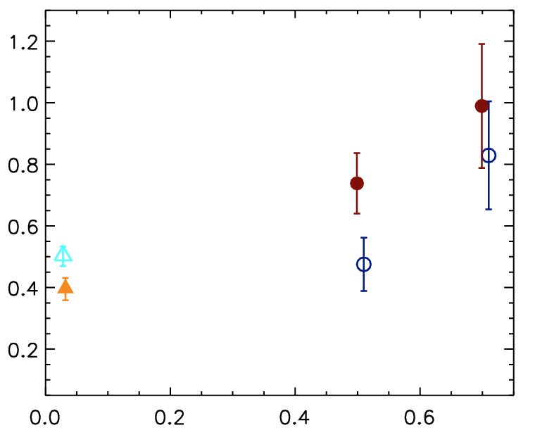
The build-up of the CMR #4
sigma > 600 km/s
nlum/nfaint
sigma < 600 km/s
redshift
De Lucia et al. 2006, astro-ph/0610373

Slide 14
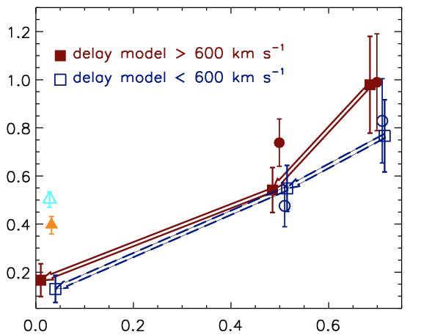
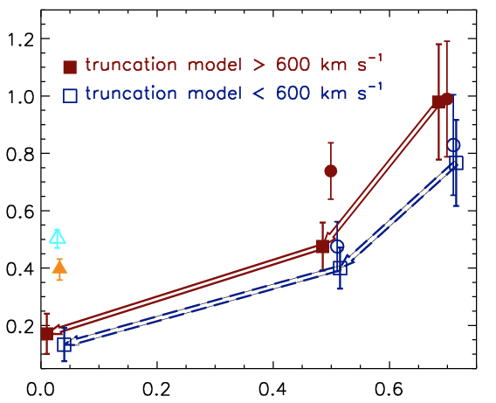
The build-up of the CMR #4
nlum/nfaint
redshift
redshift
De Lucia et al. 2006, astro-ph/0610373

Slide 15
Semi-analytic
models

Slide 16
Cooling (metallicity,structure, conductivity)
Star formation (threshold, efficiency, initial mass function)
Dust (formation, distribution, heating and cooling)
Galaxy interactions (morphological transformations, induced star formation)
galaxy formation
Winds (IGM heating, IGM enrichment)
Stellar evolution (spectro-photometric evolution, yields,feedback)
AGN
(BH growth, feedback)

Slide 17
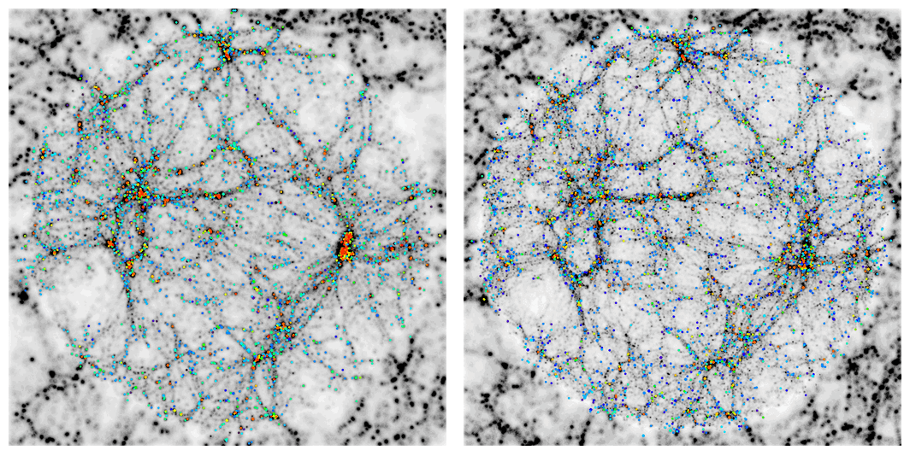
The SAM - the hybrid models
ΛCDM
τCDM
Mathis H. et al., 2002

Slide 18
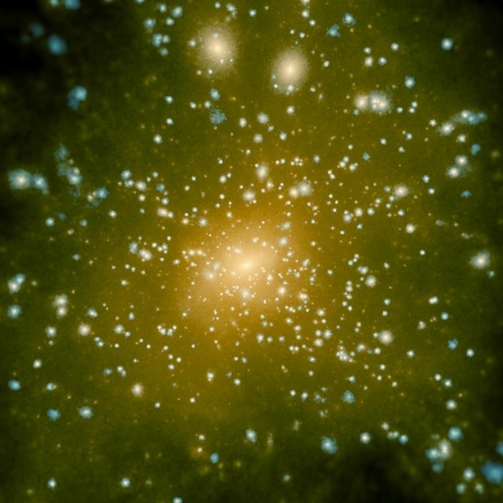
The SAM - the hybrid models
Central galaxy
Halo galaxy
Satellite galaxy
Springel et al. (2001)
De Lucia et al., 2004

Slide 19
The SAMs - the (simplified) physics
re-incorporation
Croton et al. 2006
- AGN heating
Cold Gas
Hot Gas
cooling
star formation
feedback
recycling
Ejected Gas
Stars
De Lucia, Kauffmann & White, 2004

Slide 20
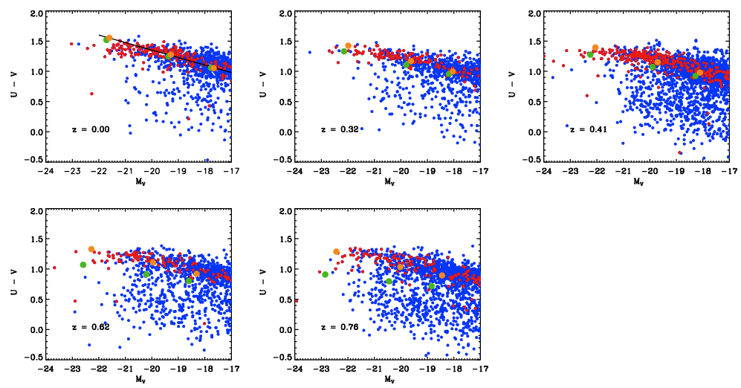
The build-up of the CMR in SAMs
De Lucia et al. in preparation
U-V
U-V
U-V
M_{V}
M_{V}
M_{V}
Coma
U-V
U-V
Single burst zf=3
Exp. tau = 1
M_{V}
M_{V}
The evolution of the CM relation in SAM models

Slide 21
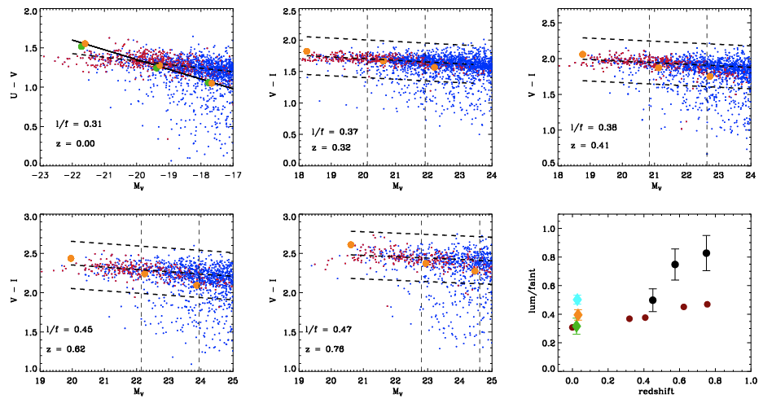
The build-up of the CMR in SAMs
De Lucia et al. in preparation
U-V
V-I
V-I
l/f = 0.31
z = 0.0
l/f = 0.37
z = 0.32
l/f = 0.38
z = 0.41
M_{V}
M_{I}
M_{I}
V-I
V-I
nlum/nfaint
l/f = 0.45
z = 0.62
l/f = 0.47
z = 0.76
M_{I}
M_{I}
redshift
Very little build-up of the red-sequence!

Slide 22
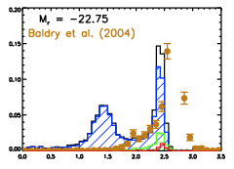
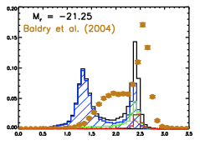
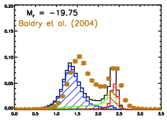
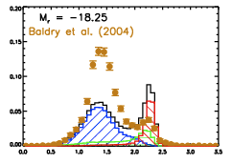
The colour-magnitude bimodality
Baldry et al. 2004
M_{r} = -22.75
M_{r} = -21.25
Tail of blue
bright objects
^{fraction}
Excess of
faint red
satellites
M_{r} = -19.75
M_{r} = -18.25
^{fraction}
Transition
region not well
populated
^{u - r}
^{u - r}
in preparation
Quantitatively the CM bimodality is not well reproduced

Slide 23
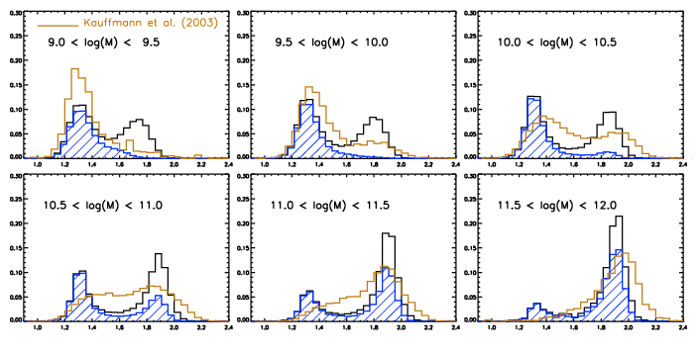
The D4000 distribution
in preparation
^{fraction}
^{fraction}
^{D4000}
^{D4000}
^{D4000}
Same problems in the D4000 distribution

Slide 24
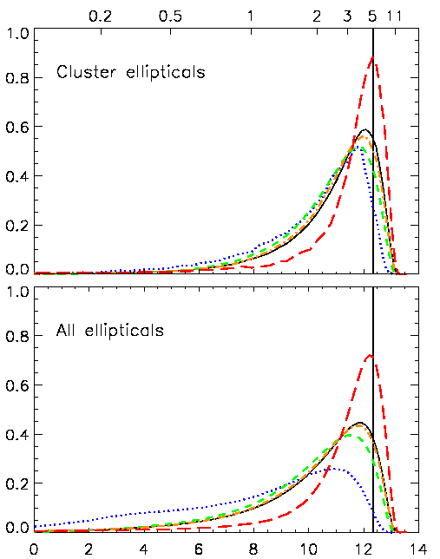
The star formation history
redshift
cluster ellipticals
M_{star} = 10¹² M_{sun}
M_{star} = 10⁹ M_{sun}
field ellipticals
Most massive elliptical galaxies also the shortest formation timescales
De Lucia et al. 2006
Lookback time (Gyr)

Slide 25
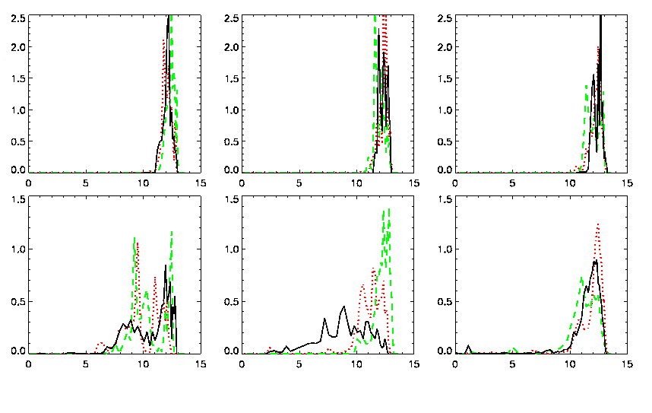
The star formation history
cluster
10¹⁰M
10¹¹M
10¹²M
field
Lookback time (Gyr)
De Lucia et al. 2006

Slide 26
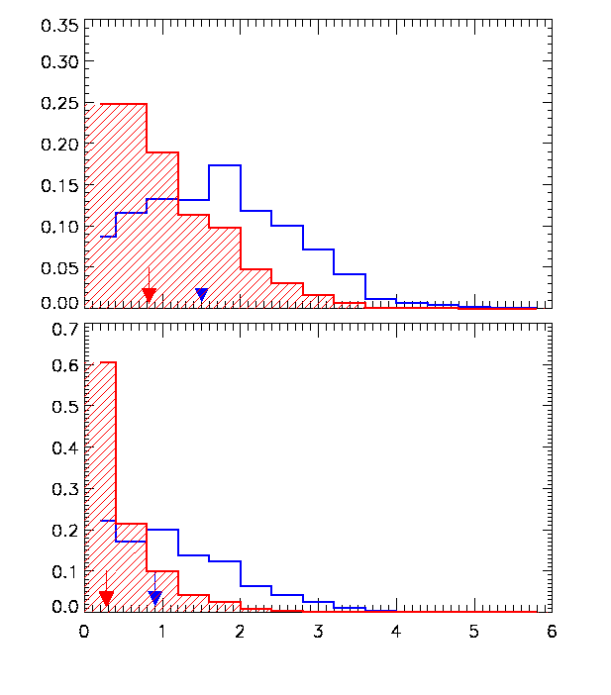
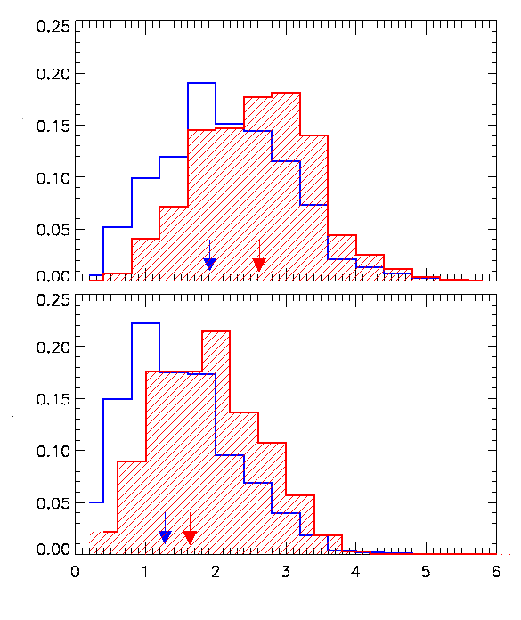
Formation and assembly
50 % stars in a single object
50 % stars formed
Fraction of galaxies
80 %
80 %
redshift
redshift
De Lucia et al. 2006

Slide 27
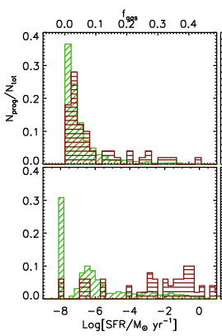
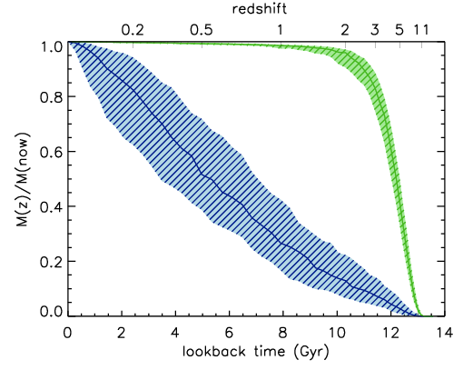
Formation and assembly of BCGs
125 BCGs selected
@z=0
”Assembly vs formation”
history
De Lucia & Blaizot, astro-ph/0606519

Slide 28
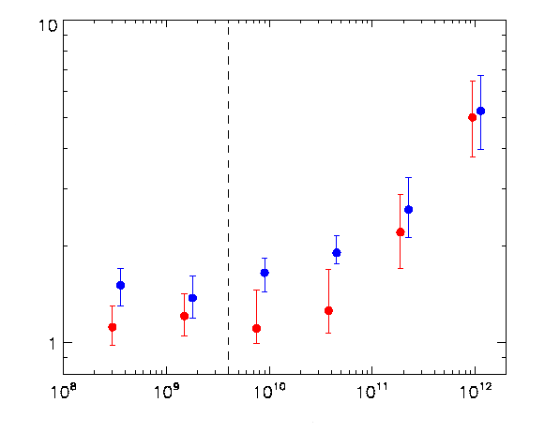
The ellipticals progenitors number
Neff = 1/2 Mfinal/<Mform>
In the monolithic
approximation: Neff=1
Effective # of progenitors
No disk instability
Mstar [M h⁻¹]
Disk instability
De Lucia et al. 2006

Slide 29
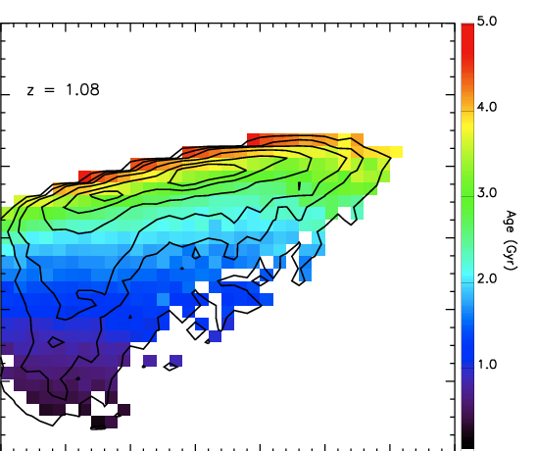
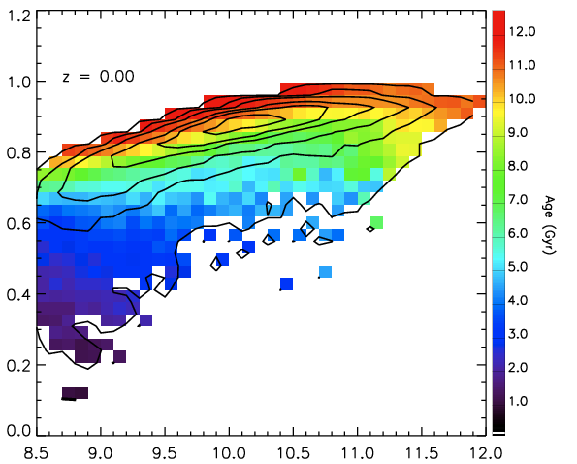
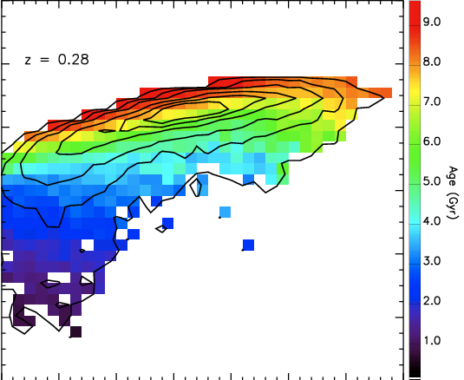
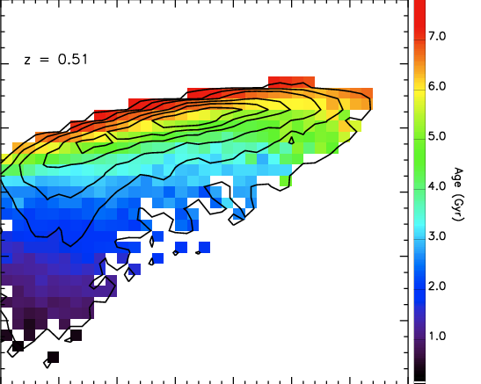







The age and metallicity dependence
De Lucia et al. in preparation
z=0.28
z=0.00
z=0.51
z=0.76
z=1.08
z=0.00
z=0.28
z=0.51
z=0.76
z=1.08
B - V
Age (Gyr)
Zstar/Z
Log[Mstar]
Log[Mstar]

Slide 30
Conclusions
Indication for a truncation of the colour-magnitude
relation at high redshift
Dependence on environment not clear
SAMs do reproduce “qualitatively” the observed
down-sizing
A clear difference between “assembly” and
“formation” time
SAMs do not reproduce “quantitatively” the colour
bimodality

