Slide 1
Mars Science Laboratory Mission
Project Science Integration Group
(PSIG)
Final Report
June 6, 2003

Slide 2
MSL Project Science Integration Group
Key Elements of Report
Page
3. PSIG Charter
Membership
6. Report Summary
8. Proposed MSL Science Objective
10. Mission Options Evaluated
12. Prioritized Mission Options
13. Prioritized Science Measurements
14. Analytical Lab Measurements
17. Remote Sensing Suite Measurements
19. Contact Suite Measurements
20. MSL Objectives Are Traceable to Guidance From Other Groups
MSL Payload
23. Interdependence of Payload Elements
25. Analytical Lab Precision Requirements
28. Contact Suite Precision Requirements
Additional Findings Related to MSL Mission Functionality
37. Appendices

Slide 3
MSL Project Science Integration Group
Charter (1)
Work with the MSL Project to define and prioritize options for scientifically exciting, implementable missions that follow Program directives and budget. (PSIG comprises scientists, MSL Project leadership, and mission engineers.)
  Options will include candidate strawman payloads and surface mission capabilities (mobility, subsurface access, sample selection, acquisition, preparation, and analysis, and landing location), and any trades among them.
  Summarize the types of astrobiology investigations that have high scientific priority for MSL, and assess the state of development of the requisite instruments against the mission schedule.
  Guidance for this effort includes the 2001 SDT report, science objectives from the MEPAG report, and the MSPSG report on long-range planning and the linkage between MSL and MSR.

Slide 4
MSL Project Science Integration Group
Charter (2)
Determine the traceability of the proposed mission concepts and their objectives to the prioritized goals, objectives, investigations, and measurements outlined in the MEPAG (July 2001) document and to the mission objectives outlined in the NRC Decadal Study.
Resolve issue of whether there exists a common solution for sample preparation and distribution (SPAD) for ice-rich or rock-only sample types.
Evaluate the “carbon provenance” issue raised at the February 2003 MEPAG meeting and whether the source of identified carbon-bearing materials, if any are detected, must be ascertained by MSL.
Determine whether the MSL mission landing zone can be restricted to 60°N to 60°S.

Slide 5
MSL Project Science Integration Group
Membership
Science Team
Dan McCleese, JPL
Jack Farmer, ASU
David DesMarais, ARC
Bruce Jakosky, U Colo.
Gary Kocurek, U Texas
Doug Ming, JSC
Paul Mahaffy, GSFC
Scott McLennan, SUNY
David Paige, UCLA
Jeff Taylor, U Hawaii
Hunter Waite, U Mich.
Blue denotes PSIG co-chairs
Project, Program, Ex-officio
Frank Palluconi (MSL Proj. Sci.)
Leslie Tamppari (MSL Dep. Proj. Sci.)
Matt Golombek (ex-MSL Proj. Sci.)
Mike Sander (MSL Proj. Mgr.)
Jeff Simmonds (MSL Payload Mgr.)
Charles Whetsel (Chief Eng.)
Gentry Lee (Chief Eng.)
Frank Jordan (Mgr. Adv. Plan.)
David Beaty (Mars Sci. Office)
Jim Garvin (NASA, Mars Lead Sci.)
Bruce Banerdt (NetLander Co-I)
Rich Zurek (PS, MRO)
Support
Marguerite Syvertson

Slide 6
MSL Project Science Integration Group
Report Summary (1)
The PSIG and Mars Science Community Have Identified Scientifically Exciting (Breakthrough) Options for the 2009 MSL Mission.
MSL ‘09 can be implemented with substantially reduced complexity and cost compared with the mission concept described by the MSL‘07 Project and Science Definition Team.
NASA should adopt Mars Habitability as the science goal for MSL.
  Two scenarios are suggested for mission
    Ancient Habitability: Highest priority mission; Enthusiastic support
    Recent Habitability: Significantly lower priority; Supported

Slide 7
MSL Project Science Integration Group
Report Summary (2)
MSL spacecraft definition is not sufficiently advanced to resolve other planning issues
  The PSIG and the MSL Project doubt that the resources, as presented to PSIG, for MSL will be sufficient to fund the payloads needed to meet the science floors of scientifically supportable missions.
The pool of in situ instruments likely to be flight-ready and that can meet the science floors of the suggested MSL missions is extremely limited.
  If MSL is to be successful scientifically an aggressive program of advanced development of in situ instruments must be given high priority by NASA.

Slide 8
MSL Project Science Integration Group
Proposed Science Objective:
Mars Science Laboratory
Explore and Quantitatively Assess a Potential Habitat on Mars
Notes:
4

Slide 9
MSL Project Science Integration Group
MSL Science Investigations
Scientific Investigations Required to Achieve Objective:
A. Assess the biological potential of at least one target environment (past or present).
  i. Determine the nature and inventory of organic carbon compounds.
  ii. Inventory the chemical building blocks of life (C, H, N, O, P, S).
  iii. Identify features that may record the actions of biologically-relevant processes.
B. Characterize the geology of the landing region at all appropriate spatial scales.
  i. Investigate the chemical, isotopic, and mineralogical composition of martian surface and near-surface geological materials.
  ii. Interpret the processes that have formed and modified rocks and regolith.
C. Investigate planetary processes that influence habitability.
  i. Assess long-timescale (i.e., 4-billion-year) atmospheric evolution processes.
  ii. Determine present state, distribution, and cycling of water and CO₂.
Note: This is not a prioritized list. PSIG judges these investigations to be the science floor for MSL.

Slide 10
MSL Project Science Integration Group
Mission Options Evaluated
MSL Mission Options for Implementing Investigations
Ancient Habitability Mission
  Biological potential
  Geology of the landing region
  Processes that influence habitability
Recent Habitability Mission
  Biological potential
  Geology of the landing region
  Processes that influence habitability
Recent Climate Mission
  Processes that influence habitability
Rover /Analytical Payload
Rover /Analytical Payload
Lander/Analytical Payload

Slide 11
MSL Project Science Integration Group
Attributes of MSL Mission Options
Ancient Habitability Mission
  Focus on past life and past habitats
    Layered sedimentary deposits
    Hydrothermal deposits
  Mid-latitude landing site
  Rover to reach and explore target terrains
Recent Habitability Mission
  Focus on recent/present life and habitats
    Polar Layered Deposits
    Polar Cap Edge
    Active hydrothermal system
    Liquid Water
  Primarily polar landing site (some mid-latitude)
  Rover to reach and explore target terrains
Recent Climate Mission
  Focus on understanding present climate
    High latitude or polar water ice cap
  Polar landing site
  Fixed lander with vertical mobility via drill

Slide 12
MSL Project Science Integration Group
Prioritized Mission Options
Ancient Habitability Mission
  Highest Priority Mission Option (Enthusiastically supported by PSIG)
    Exceptional science supportive of “Follow the Water” and MEPAG goals in astrobiology, climatology and geology.
    High probability of scientific success
Recent Habitability Mission
  Significantly Lower Priority (Supported by PSIG)
    In this decade, we seek to understand the history of habitability in order to better assess the biological potential of Mars over time.
Recent Climate Mission
  Marginally Viable (Not supported by majority of PSIG members)
    Static lander in N. polar region would address an insufficient portion of Mars Program objectives to justify this large core mission.
    PSIG conclusion: Further work on this option would not be productive.

Slide 13
MSL Project Science Integration Group
Prioritized Science Measurements
The following section describes:
- Analytical Laboratory
- Remote Sensing Suite
- MSL Remote Sensing Suite

Slide 14
MSL Project Science Integration Group
Analytical Laboratory
Essential Measurements
Approximate priority order
1. Nature, abundance, oxidation state, and isotopic properties of carbon compounds (organic and inorganic) over a range of molecular weights (depending on landing site: soils, ices, or interiors of rocks).
2. Definitive mineralogy and chemical composition (emphasize aqueous processes).
3. Molecular configuration and isotopic composition of elements other than C relevant to life (H, N, O, P, S) in rocks, soils, and the atmosphere (possibly ice).
4. Noble gas concentrations and isotope ratios.
5. Microscopy (basic geologic context, and record possible morphological biosignatures).

Slide 15
MSL Project Science Integration Group
Analytical Laboratory
Very Important Measurements
Approximate priority order
6. Abundance and oxidation state of Fe, Mn and other redox sensitive metals, as a basis for understanding the range of potential energy sources available to support biological systems and for inferring geochemical cycles.
7. Martian surface oxidation chemistry, oxidation profile with depth, and characterize surface heterogeneity

Slide 16
MSL Project Science Integration Group
Analytical Laboratory
Desirable High Risk Measurements
Approximate priority order
8. Highly specific searches and hypothesis-driven measurements of chemistry and molecular processes (e.g. search for specific biomarkers).

Slide 17
MSL Project Science Integration Group
Remote Sensing Suite
Essential Measurements
Approximate priority order
Geological context and site reconnaissance in the form of multi-color stereo images.
Distinguish rock types (e.g. mineralogy) and recognize and prioritize potential sampling sites.

Slide 18
MSL Project Science Integration Group
Remote Sensing Suite
Very Important Measurements
Approximate priority order
3. Subsurface hydrogen (to a depth of 1-2 m).
  Direct follow-up to Odyssey discoveries.
Desirable Measurements
4. Images of distant objects at resolutions from cm’s to m’s

Slide 19
MSL Project Science Integration Group
Contact Instrument Suite
Essential Measurements
Approximate priority order
1. Rapid mineralogy of undisturbed samples as input to sample selection for the Analytical Laboratory.
2. Imaging for context in color and at hand-lens resolution.
Very Important Measurements
3. Bulk chemistry of undisturbed samples for sample selection.
4. Iron mineralogy of undisturbed samples.

Slide 20
MSL Project Science Integration Group
MSL Objectives Are Traceable to Guidance From Other Groups
PSIG’s Science Objectives for MSL Are Consistent With Those Proposed by Other Science Committees
NRC “Next Decadal Survey” (2002) recommended MSL science objectives will be accomplished if NASA adopts the PSIG mission objectives for Ancient or Recent Habitability.
  A single exception is the Next Decadal Survey objective “Volatile Evolution” which is not included in the PSIG Ancient Habitability Mission. That mission’s focus on ancient Mars made volatile evolution a lesser priority.
NASA’s Mars Exploration Program Analysis Group (MEPAG) prioritized objectives for future Mars exploration. PSIG’s objectives for MSL are all high priority MEPAG objectives.

Slide 21
MSL Project Science Integration Group
MSL Payload
The following section describes:
- Payload Strategy
- Proof-of-Concept (Straw) Payload

Slide 22
MSL Project Science Integration Group
Strategic Considerations: Payload
If hardware for alternate missions is identical, mission objectives can be determined by late-breaking discoveries and thus support multiple exploration Pathways.
Ancient and Recent Habitability Mission Options Share Common Payload Architectures
  Analytical Laboratory
    This is the highest priority element of MSL science mission
    Central contribution to Mars exploration by MSL
    Detailed in situ analysis of martian samples
    Definitive mineralogy, chemistry, and high resolution textural information
    Essential to achieving proposed MSL science goals
  Remote Sensing Suite
    Reconnaissance and site geological context
    Imaging and complementary mineralogy
  Contact Instrument Suite
    Sample triage and supplemental target analysis
    Microscopic imaging, complementary mineralogy and chemistry
  Other Investigations (Addressing MEPAG priority science)

Slide 23
MSL Project Science Integration Group
Interdependence of Payload Elements
Remote Sensing Suite, Contact Suite and Analytical Laboratory
Remote Sensing Suite provides, in addition to its unique measurements, reconnaissance of potential local targets for the Contact Suite and Analytical Laboratory.
Contact Suite Precision requirements are valid only if a capable Analytical Laboratory is also included in Payload.
Contact Suite must be capable of performing complete set of analyses rapidly enough so as seamlessly interface with Analytical Lab (e.g., single communication cycle with Earth).
Contact suite must be capable of performing analyses throughout the life of the mission.

Slide 24
MSL Project Science Integration Group
Payloads for Ancient and Recent Habitability Missions
Proof-of-Concept Payload: Identical for Both Ancient and Recent Habitability Mission Options*
Analytical Laboratory
  XRD/XRF
  GCMS/EGA with TDL
  Microscope
  (Augmentation if funds available: Raman spectrometer, Oxidation instrument)
Remote Sensing Suite
  Panoramic imager
  Point IR Spectrometer
  (Augmentation if funds available: IR imaging, Neutron, and γ-ray spectrometers)
Contact Suite
  Raman
  Microscope/ Hand-lens
  (Augmentation if funds available: APXS, Mössbauer)
* MSL Science Floor (Includes Only Essential Measurements)

Slide 25
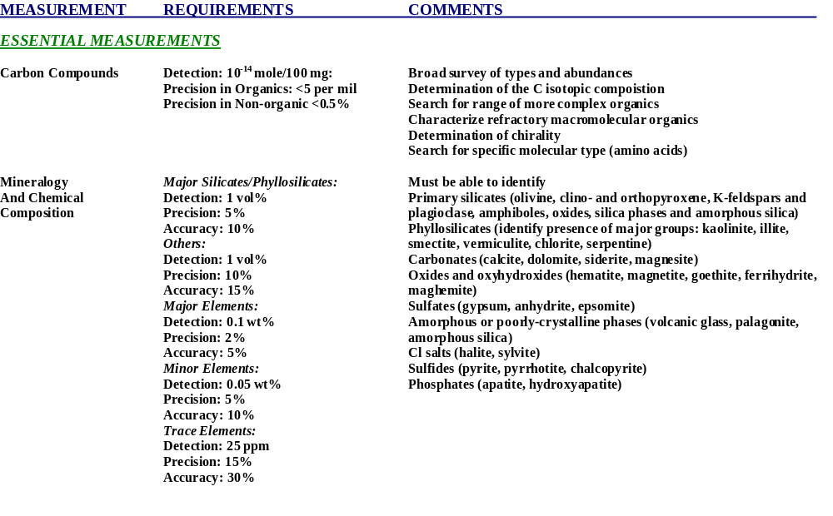
MSL Project Science Integration Group
Analytical Laboratory Precision Requirements (1)

Slide 26
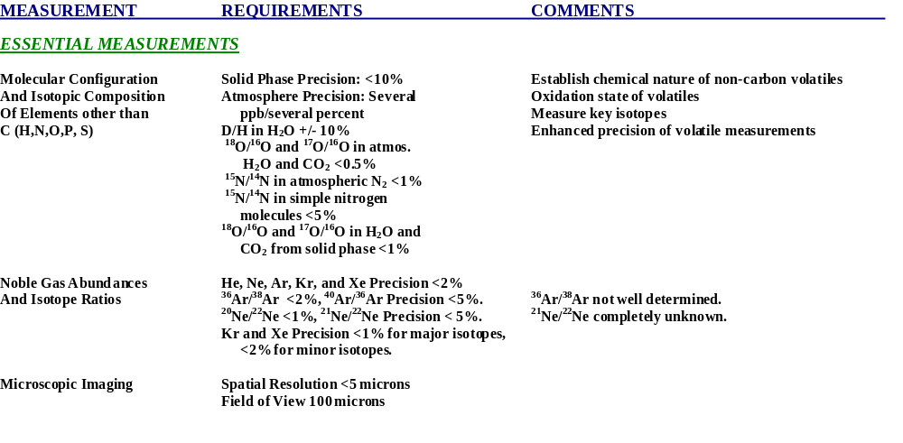
MSL Project Science Integration Group
Analytical Laboratory Precision Requirements (2)

Slide 27
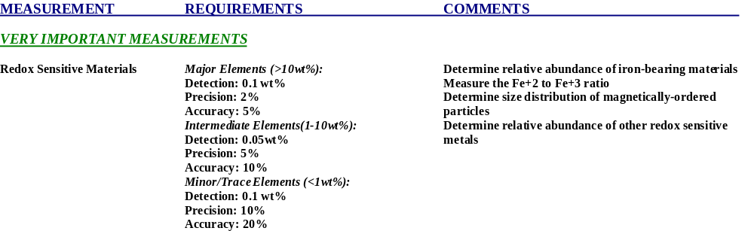
MSL Project Science Integration Group
Analytical Laboratory Precision Requirements (3)
(Requirements for Augmented Payload)

Slide 28
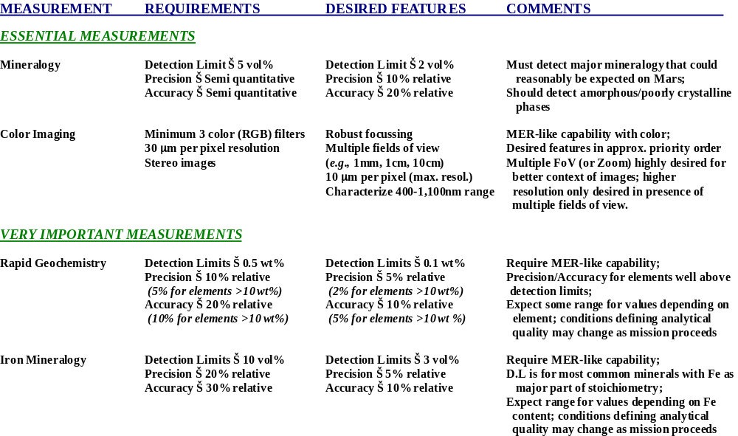
MSL Project Science Integration Group
Contact Suite Precision Requirements
(Requirements for Augmented Payload)

Slide 29
MSL Project Science Integration Group
Additional Findings Related to MSL Mission Functionality
The following section describes additional PSIG findings:
Ample Allocations for Instrument Mass and Volume May Reduce MSL Cost-Risk
Spacecraft Design Must Be Latitude-Independent
  MSL Landing Zone Must be Broad (60°N to 60°S)
  Sample Preparation for Ice and Rock
Planetary Protection Issues for MSL
Carbon Provenance
  Key to the Search for Organics on the Martian Surface is Identifying the Source of Carbon Compounds
“Go To” Mobility is Not Required for MSL
Feed Forward to Mars Sample Return is Critical to Program Goals

Slide 30
MSL Project Science Integration Group
Ample Allocations for Instrument Mass and Volume May Reduce MSL Cost-Risk
Achieving the science objectives of MSL depends upon advanced in situ instruments.
  Developing the required instruments will be challenging.
    In situ analytic instruments are typically based on laboratory equipment requiring orders of magnitude larger mass, volume and power.
    Several of the potential payload instruments have no flight heritage.
      Uncertainty of development cost could be large
  Similarly advanced subsystems comprising the MSL rover are designed with the philosophy of “large allocations and large reserves” to reduce cost-risk.
Cost-risk will be reduced if analytic instruments are given large allocations and reserves for mass, volume and power .

Slide 31
MSL Project Science Integration Group
MSL Landing Zone Must be Broad (60°N to 60°S)
Maximizing the Science Impact of MSL
MSL will be most responsive to discoveries and of greatest impact to future Mars exploration if its landing latitude is selected no earlier than when initial MRO data is interpreted (late 2006 - early 2007).
  Importance of timing arises from need to incorporate information from MRO before selecting between Ancient and Recent Habitat pathways.
MSL should maintain 60°N to 60°S as its achievable range of landing latitude until as late as is practical (~2007).
  Sites in 60°S to 60°N region appear to exist that contain accessible ice where a suitably equipped MSL could address “recent habitability” science.
Latitude landing extremes assure access to ice.
  MSL must be able to move and operate on ice and to collect and process ice samples.
  Planetary Protection issues may arise if MSL lands on icy ground.
  Discoveries from MRO may drive exploration to ice-rich recent habitats.

Slide 32
MSL Project Science Integration Group
Sample Preparation for Ice and Rock
PSIG has identified a common solution for sample preparation and distribution for ice-free and ice-bearing sample types.
• A sample preparation and distribution (SPAD) system with this increased capability will cost more than a simple rock-only system.
• Additional features needed for an ice-bearing SPAD system.
  - Separate processing paths are needed for dry and icy samples.
  - Adjustments in surface operations are needed to maintain icy samples near their original temperatures.
  - A drying station will likely be needed in the SPAD to remove liquid that could compromise mechanisms and sample transfer chutes.
  - One additional instrument in science payload to distinguish ice from rock (ice-detecting geophysics) is highly desirable.
• Incremental cost estimated to be $12M (+ cost of a drying station).

Slide 33
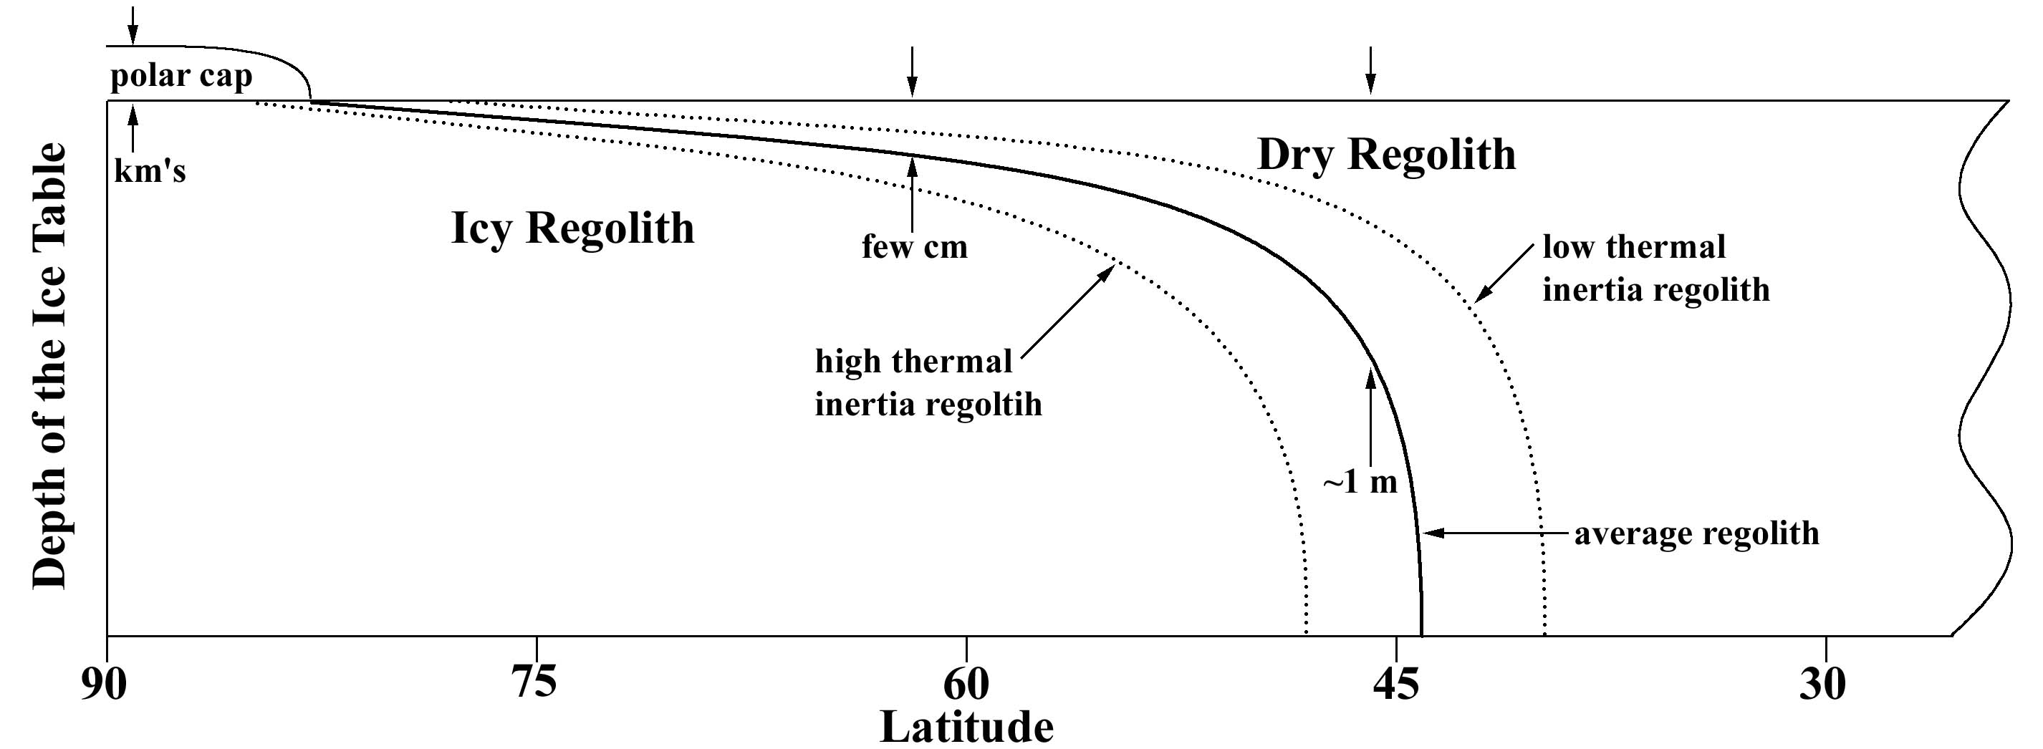
MSL Project Science Integration Group
Planetary Protection Issues for MSL
Planetary Protection (PP) issues may arise if MSL lands in a region where ice is thought to be at or close to the surface.
  Recent observations by Mars Odyssey and models of volatiles in the near subsurface suggest that this condition exists for most of Mars poleward of about 50° latitude, and in some regions as low as 40 degrees.
  The prospect of a warm MSL resting on ice raises the possibility of a high planetary protection categorization (perhaps IVc) for the mission.
A lower PP category (IVa) is probable if MSL lands in a region where ice (and water) are out of reach.
Model of Depth to Ice in Martian Subsurface
Category ?
Possible Category IVa
Possible Category IVc
Notes:
8

Slide 34
MSL Project Science Integration Group
Carbon Provenance
In the Search for Organic Carbon Compounds it is Essential that the Results Obtained be Interpretable and Explained.
To merely detect (or failure to detect) organic carbon is not sufficient for scientific purposes.
Identifying the source of carbon compounds is key (including forward contamination).
  MSL should characterize the nature, alteration processes and, potentially, sources of carbon reservoirs by measuring several classes of oxidized and reduced carbon compounds at high sensitivity.
    A diverse suite of carbon compounds might be present that reflect potentially multiple carbon sources and alteration processes (e.g., meteorites, martian abiotic processes, martian biota, contamination from Earth, oxidation and thermal alteration in the martian environment).
Potential quantitative investigation approaches exist. For example;
  MSL might characterize carbonate minerals and several classes of organic compounds (e.g., polycyclic aromatic hydrocarbons [PAH], paraffins, carboxylic acids, sulfonic acids, and at least one class of terrestrial biomarkers [e.g., lipids, amino acids, or DNA/RNA]).
    Characterize several classes of organic compounds over a range of molecular weights
    Characterize ¹³C/¹²C of carbonates and organics
  MSL could characterize organic compounds relevant to prebiotic chemistry or martian life, and on indicator of earthly contamination (e.g., RNA, biomonomers).

Slide 35
MSL Project Science Integration Group
“Go To” Mobility is Not Required
FINDING: MSL does not require “Go To” mobility to achieve its scientific objectives.
  The suggested science objectives for MSL do not require access to unique, localized features on the martian surface.
  Although features of special interest will, hopefully, be discovered, such features are expected to occur in populations, rather than singly, and can reasonably be expected to be accessed with limited mobility (1-3 km).
  Many localized features are large compared with expected landing errors
“Go To” roving capability may be unnecessary for post-MSL Mars exploration, unless
  Spatially isolated highly localized features or phenomena having priority for MEP are shown to exist on Mars.
  Precision landing is inadequate to access localized science targets.

Slide 36
MSL Project Science Integration Group
Feed-Forward to Mars Sample Return is Critical to Program Goals
Properly Planned, MSL Can Lower Risks and Costs of MSR
Program expectations for MSL include significant feed-forward to MSR in the following areas
  Systems development for MSL can be used by MSR
    Entry/Descent/Landing system for large mass lander
  Technology demonstration by MSL supports MSR needs
    A hazard detection and avoidance landing system
    Methodologies for achieving planetary protection compliance.
If MSL were to be unable to provide feed-forward to MSR in systems development and technology demonstration science support for MSL will likely decrease while MSR-costs will likely rise.

Slide 37
Appendix 1
Proof-of-Concept “Straw” Instruments for Analytical Laboratory: Functionality Requirements

Slide 38
Measurements Matrix for Analytical Laboratory Straw Instruments
 | XRD/XRF | EGA/ GCMS | TDL | LD-TOF-MS | OX | IM | MLR | AAD | SEM/ AFM | WEA
Major species | X |  |  | X
Mineral phases | X |  |  |  |  | X | X
Trace species |  |  |  | X
Isotopes |  |  |  | X
Salts & PH |  |  |  |  |  |  |  |  |  | X
Volatile Organics |  | X | X
Refractory Organics |  | X |  | X |  |  | X
Amino Acids & Biomarkers |  | X |  |  |  |  |  | X
Chirality |  | X |  |  |  |  |  | X
H2O |  | X | X
CO2 |  | X | X
Other Volatiles CH4, N2O, OCS, CO, NH3, H2S etc. |  | X | X
C |  | X | X
N |  | X
O |  | X | X
Noble Gases Isotopes |  | X
Oxidizing Effects |  |  |  |  | X
Specific Oxidants |  | X | X |  | X
Microscopic Imaging |  |  |  | X |  | X |  |  | X
Mineralogy and chemistry
Organics
Evolved Gases
Isotopes
Ox
Im

Slide 39
Analytical Laboratory Straw Instruments (1 of 3)
Measurement
Example instrument
1) The nature, abundance, oxidation state, and isotopic properties of carbon compounds (both organic and inorganic) over a range of molecular weights (learn history of reservoirs and processes in the crust and atmosphere).
a) Pyrolysis/EGA gas chromatograph mass spectrometer
Greatly advanced from Viking with a better range of species detectable and better sensitivity.
b) Laser ablation time-of-flight mass spectrometer
This gets at the more refractory organic component that does not nicely turn into discrete stable molecules on bulk thermal processing.
Can directly get isotopic information on H, C, and O isotopes in simple molecules.
c) TEGA like instrument with laser spectroscopy for H2O and CO2
d) Detector sensitive to
specific compound class(es)
Detects and identifies particular subset(s) of the organics (e.g., aromatics, N-, O- or S-containing molecules).
2) Mineralogy and elemental composition.
e) XRD/XRF
Elemental composition information is necessary to complement the volatile measurements. XRD may be used to identify mineral phases.
f) Laser Raman
Complementary to the direct IR technique. Microscopic Raman would also address science objectives #3.
g) Pyrolysis/EGA gas chromatograph mass spectrometer
Requires a variable rate temperature ramp from ambient to > 1000 C to examine the decomposition products of minerals as a function of temperature.
Notes:
9

Slide 40
Analytical Laboratory Straw Instruments (2 of 3)
3) Microscopic imager (basic geologic context, and to record possible biosignatures)
h) Microscopic IR Imager
With processing of samples to expose interiors of rocks – IR techniques may be more useful than in the survey mode where the mineralogy may be obscured by weathering products and dust.
i) Microscope
To examine microstructure down to the several micron resolution.
j) Scanning electron microscope or scanning tunneling microscope.
The sample preparation and issues of charging etc may make this experiment quite difficult. However, I am not clear on how much recent work has been carried out on this front. Some good recent work on scanning tunneling microscope development for such environments has been carried out recently – this experiment on Rosetta is presently viewed as high risk.
4) The chemical and isotopic composition of elements other than C that are relevant to life (H, N, O, P, S) present in rocks, soils, and the atmosphere.
k) Pyrolysis/EGA gas chromatograph mass spectrometer
The mass spectrometer allows the range of species to be detected – the gas chromatograph eliminates spectral interference in many cases. Highly reactive species may not make it through the plumbing to the ion source.
5) Noble gas concentrations and isotope ratios
l) Light isotope mass spectrometer
Gas separation techniques needed on the inlet to the mass spectrometer to achieve full separation of noble gases and sensitive detection.
Notes:
10

Slide 41
Analytical Laboratory Straw Instruments (3 of 3)
6) The abundance and oxidation state of Fe, Mn and other redox sensitive metals, as a basis for understanding the range of potential energy sources available to support biological systems and for inferring geochemical cycles
m) Mossbauer spectroscopy
Assess oxidation state and mineralogical environment of Fe
7) Test models of martian surface oxidation, including whether oxidation decreases in the martian subsurface, and over what scale
n) Measurements of oxidation effects
o) Direct measurement of active oxidant and/or its effects on test materials
n) Most important for missions that allow penetration into rocks or the subsurface.
o) Most relevant for materials testing for future missions
Notes:
11

Slide 42
Appendix 2
Analytical Laboratory Measurement Precision and Sensitivity Requirements

Slide 43
Analytical Laboratory Measurement Precision and Sensitivity Requirements:
Terms of Reference for PSIG Assessment
Specify top level measurements for an analytical laboratory for the MSL driven by the science objectives developed by the PSIG.
For each measurement specify baseline precision, accuracy, sensitivity, and other requirements (e.g. number of samples processed, experiment duration, and contamination).
Consider instrument sets for both MSL mission options
Determine if these example payloads apply to the full range of mission types considered by the PSIG.
State assumptions made for measurement requirements for remote sensing and contact instruments in sample triage and for requirements for sample processing and acquisition.

Slide 44
Analytical Laboratory: Measurement Precision and Sensitivity Requirements
Carbon Compounds
Objectives and Scope
  Objectives: Establish the nature, abundance, oxidation state, and isotopic properties of carbon compounds over a range of molecular weights in the atmosphere and in sampled solid phase materials such as soils, ices, and the interiors of rocks. Characterize prebiotic chemistry and search for signatures of biotic processes.
  Scope of the measurement in priority order:
    A broad survey of types and abundances of carbon containing molecules in the atmosphere and carbon contained in solid phase materials, including their oxidation state, and their provenance .
    A determination of the C isotopic composition of carbon containing compounds in these atmospheric and solid phase samples.
    A search for a range of more complex organic molecules.
    A characterization of the refractory macromolecular organic material (complex aromatic or polymeric materials) that may be present in solid phase samples.
    A determination of chirality and a search for specific molecular types relevant to terrestrial life such as amino acids.

Slide 45
Analytical Laboratory: Measurement Precision and Sensitivity Requirements
Carbon Compounds
Requirements
  Number of samples: Measurements should be made at many sites requiring a large number of samples to be processed by the acquisition and preparation system. The number of samples for a long life mobile lander (100-150 samples) would provide a considerable breadth of analysis. Instruments that require consumables should size for many samples.
  Cross Contamination: The requirement for cross contaminationcontrol within the SPAD has been specified. Investigators should insure that cross contamination within their own experiments is not significantly worse than this specification.
  Sensitivity for organic detection: Previous MEPAG committees have recommended that sensitivities of ~10⁻¹⁴ mole/100 mg sample be targeted. This is sufficient to detect organic carbon or its oxidation products delivered from meteoritic infall with gardening to a reasonable depth. The sensitivity required will depend somewhat on the species to be analyzed and the sample studied (rocks, soils, or ice) but no major class of organic species listed should be missed. The limit may be sample contamination from the lander.
  Precision in ¹³C/¹²C measurements of organics: Terrestrial analogues suggest precisions of < 5 per mil would be useful to distinguish changes that are usually associated with biological activity. Optimally, this measurement should be carried out on individual organic molecules. However, an average for the sample would also be useful.
  Precision in isotopic measurement of non-organic carbon: ¹³C/¹²C to <0.5‰ in atmospheric CO₂ and in CO₂ evolved from solid phase materials to address atmospheric loss mechanisms.
  Distribution of macromolecular material: Spatially resolved measurements on the
  scale of tens-of-microns to determine the source of the organic materials.

Slide 46
Analytical Laboratory: Measurement Precision and Sensitivity Requirements
Mineralogy and Composition
Objectives, Scope and Sampling
  Objectives: Unambiguous identification of (a) major and minor minerals and (b) measurement of the bulk chemical composition for major, minor, and selected trace elements in soils and ices, rock surfaces, and rock interiors, to reveal the extent and duration of aqueous processing of these materials. Igneous rocks: Derived from depleted or undepleted mantle, extent of fractional crystallization, role of water in magma genesis and evolution. Sedimentary rocks: Nature of source rocks, extent of fractionation during transport, deposition of authigenic minerals. Weathering products: Conditions (T, pH, water/rock ratio, etc.) under which weathering took place, role of deposition of weathering fluids, evaporation.
  Scope (in priority order):
    Abundances and identification of silicates (including amorphous and poorly-crystalline phases), phyllosilicates, carbonates, sulfates, sulfides, oxides, and phosphates.
    Concentrations to high precision of elements present in amounts greater than 0.05 wt%.
    Concentrations with lower precisions of selected elements present in amounts greater than 25 ppm.
  Number of samples: More than 50 thorough analyses for both mineralogy and chemical composition.

Slide 47
Analytical Laboratory: Measurement Precision and Sensitivity Requirements
Minerals
Requirements
Minerals: Must be able to identify, in priority order:
  Primary silicate
  Phyllosilicates (identify presence of major groups)
  Carbonates
  Oxides and oxyhydroxides
  Sulfates
  Amorphous or poorly-crystalline phases
  Sulfides
  Phosphates
  Detection limit* Precision** Accuracy**
  Major silicates 1 vol% 5% 10%
  Phyllosilicates 1 vol% 5% 10%
  Others 1 vol% 10% 15%
  *absolute abundance in volume percent
  **relative: the percentage of amount present

Slide 48
Analytical Laboratory: Measurement Precision and Sensitivity Requirements
Chemical Composition
Requirement Summary
Bulk chemical composition:
  Major elements (typically >5wt%, Si, Fe,Al, Mg, Ca):
  Detection limit Precision Accuracy
  0.1 wt% 2% 5%
  Minor elements (>0.05 wt%; Ti, Cr, Mn, K, Na, P, S, Cl) (see PT note – “minor and trace elements):
  Detection limit Precision Accuracy
  0.05 wt% 5% 10%
  Trace elements (<0.01 wt%; Zr, Sr, Sc, V, Ba, perhaps others):
  Detection limit Precision Accuracy
  Zr, Sr, Sc, V, Ba 25 ppm 15% 30%
  Priority order:
  Si, Al, Fe, Mg, Ca, Na, K, Cl, S
  Ti, Mn, Cr, P
  Trace elements

Slide 49
Analytical Laboratory: Measurement Precision and Sensitivity Requirements
Microscopic Morphology
Objectives, Scope, Requirements and Issues
Objective: Microscopic morphology to provide basic geologic and lithologic characterization, contribute to understanding environment of formation, and to search for possible biosignatures.
Scope: Resolution capable of resolving overall morphology as well as small grain sizes and shapes and search for evidence of aqueous or non-aqueous processing.
Requirements and rationale:
  Spatial resolution: <5 micrometer
    Allows observations of grain shapes and surface textures
    Allows determination of grain size distribution of fine fractions
    Allows observations of mineral intergrowths at small scales
    Allows distinction between igneous and sedimentary deposits
    Non optical techniques in an enhanced mission (SEM or ATF) could enable much higher resolution.
  100 micrometer field of view
    Provides context for microscopic imaging by overlapping magnification of mast or arm imager(s)
    Allows observations of rock textures and mineral intergrowths

Slide 50
Analytical Laboratory: Measurement Precision and Sensitivity Requirements
Other Light Elements
Objectives and Scope
  Objective: Determine the chemical and/or isotopic composition of elements other than C that are relevant to life (H, N, O, P, S) present in rocks, soils, ices, and atmosphere. These measurements are relevant to understanding prebiotic and biotic chemistry and a subset of these measurement addresses issues of atmosphere escape to space (thermal and non-thermal) or surface reservoirs. The later objective addresses ancient habitability.
  Scope:
    Establish the chemical nature of non carbon volatiles relevant to life (H, N, O, P, and S) that may be present at the sites sampled either in the atmosphere or in the solid phase soils, ices, or rocks.
    Oxidation state of these volatiles (i.e.. H₂S vs SO₂, NH₃ vs nitrogen oxides etc.).
    Measurement of key isotopes in the atmosphere and the rocks, soils, and ices. There is a long list of desired measurements but priority targets are H, N, and O isotopes in different molecular species. Success for solid phase materials depends partially on the nature of the solids encountered and their volatile fraction.
    Enhanced precision of volatile measurements, including evidence for biological fractionation and/or seasonal variations (if sufficient evidence of such variations are demonstrated by modeling and/or observations).

Slide 51
Analytical Laboratory: Measurement Precision and Sensitivity Requirements
Other Light Elements
Requirements and Issues
Atmosphere samples: At each site visited, detect H, N, O, P, and S containing volatiles in the atmosphere to mixing ratios of several ppb and several percent precision.
Solid phase samples: For each sample acquisition and processing activity determine H, N, O, P, and S containing volatiles contained in these samples to ppm of evolved gas. Released H₂O and CO₂ should be measured in all cases to <10 ‰ precision.
Isotope measurements:
  D/H in H₂O (atmosphere and solid phase materials +/- 10‰)
  ¹⁸O/¹⁶O and ¹⁷O/¹⁶O in atmospheric H₂O and CO₂ <0.5‰
  ¹⁵N/¹⁴N in atmospheric N₂ <1‰
  ¹⁵N/¹⁴N in simple nitrogen molecules evolved from solid phase materials <5‰
  ¹⁸O/¹⁶O and ¹⁷O/¹⁶O in H₂O and CO₂ from solid phase materials <1‰

Slide 52
Analytical Laboratory: Measurement Precision and Sensitivity Requirements
Noble Gas Abundance and Isotope Ratios
Objectives, Scope, Requirements and Issues
  Objectives: Noble gas chemical and isotopic composition in the atmosphere to constrain models of early accretion, atmospheric loss and planetary evolution. Many of the current estimates of these values come from SNC studies and low precision Viking measurements – this experiment can put the current atmospheric values on a firm footing and obtain several measurements that have not yet been obtained. These investigations address ancient vs current habitability.
  Scope of the measurement and precision requirements to address the above objectives:
    Atmospheric noble gas abundances of He, Ne, Ar, Kr, and Xe to <2%
    Atmospheric ³⁶Ar/³⁸Ar <2%, ⁴⁰Ar/³⁶Ar <5%. The ³⁶Ar/³⁸Ar is presently not well determined. Constrains models of atmospheric sputtering loss.
    Atmospheric ²⁰Ne/²²Ne <1%, ²¹Ne/²²Ne < 5%. The ²¹Ne/²²Ne is presently completely unknown. These measurements may constrain delivery of volatiles to the atmosphere from hydrothermal activity.
    Atmospheric Kr and Xe to <1% for major isotopes, <2% for minor isotopes. The minor Xe isotopes may enable ancient atmospheric exchange processes with planetary reservoirs to be evaluated.

Slide 53
Analytical Laboratory: Measurement Precision and Sensitivity Requirements
Redox Sensitive Metals
Objectives, Scope, Requirements and Issues
  Objectives: Determine abundance and oxidation state of Fe and other redox sensitive metals, as a basis for understanding the range of potential energy sources available to support biological systems and for inferring geochemical cycles
  Scope of measurement objectives in priority order:
  Determine the relative abundance of iron-bearing minerals(e.g. carbonates, phyllosilicates, hydroxyoxides, phosphates, oxides, silsicates, sulfides, sulfates).
  Measure the Fe+2 to Fe+3 ratio
  Determine the size distribution of magnetically-ordered particles
  Determine the relative abundance of other redox sensitive metals within minerals
  Requirements:
  Major elements (> 10wt%, Fe, Mg):
  Detection limit Precision Accuracy
  0.1 wt% 2% 5%
  Intermediate elements (1-10 wt%; Al, [Mg]):
  Detection limit Precision Accuracy
  0.05 wt% 5% 10%
  Minor (0.1-1 wt%) and trace elements (<0.1 wt%):
  Detection limit Precision Accuracy
  0.1 wt% 10% 20%

Slide 54
Contact Suite Utility and Requirements
Appendix 3

Slide 55
MSL Contact Suite Utility and Requirements
Summary
A Contact Suite building on MER-like capability, but also able to determine major mineralogy and image in color, would allow reliable sample selection for the Analytical Laboratory and provide first-rate stand alone science.
Purposes of Contact Suite are (1) Facilitate sample selection for Analytical Lab and (2) Carry-out high quality science of material not delivered to Lab.
Essential Measurements are (1) Rapid mineralogy of undisturbed samples and (2) Color imaging at hand lens resolution.
Very Important Measurements are (1) Bulk chemistry of undisturbed samples and (2) Iron mineralogy of undisturbed samples.
Contact Suite requirements were considered within the context of having a capable Analytical Laboratory.
For chemistry and iron mineralogy, improvements over MER-like capabilities are desired but not necessary
For microscopic imaging, color and stereo capability are required; further improvements over MER-like capabilities are desired but not necessary
Contact Suite needs to be capable of performing complete set of analyses rapidly enough so as not to interfere with speed at which Analytical Lab operates (e.g., single communication cycle with Earth)
Contact Suite needs to be capable of performing analyses throughout the life of the mission.

Slide 56
Purposes of Contact Suite
MSL Contact Suite Utility and Requirements
Contact Suite should be used to select samples and support sample decision-making for Analytical Laboratory
  Screen sampling locations
  Screen samples obtained (triage)
  Possibly view pre-processed and (possibly) post-processed samples
Conduct additional science investigations that are not Analytical Lab-based
  Includes studies both during time analytical lab is functional and after it is “exhausted”

Slide 57
MSL Contact Suite Utility and Requirements
Requirements for Essential
Measurements (1)
Rapid Mineralogy
  Must have sufficient capability to identify major minerals and, in conjunction with other measurements, such as color imaging, characterize lithology on unprepared and cleaned surfaces
  Should be capable of identifying and distinguishing among amorphous phases (e.g., silica, volcanic glass, palagonite).
  Require reliable identification of minerals of ≥5% by volume (2% desired).

Slide 58
MSL Contact Suite Utility and Requirements
Requirements for Essential
Measurements (2)
Color Imaging
  Assume high resolution microscopy will be performed in Analytical Lab
  Require MER-like resolution (30 μm/pixel) and ability to produce stereo images, but further improvements highly desirable (e.g., 10-20 μm/pixel maximum resolution with multiple fields of view; improved depth of field)
  Color is required - minimum 3-color RGB filters
  Desired improvements over MER-performance should also include, in priority order:
    Robust focusing ability to cover desired fields of view.
    Multiple fields of view (e.g., 1mm, 1 cm, 10 cm) or continuous zoom would greatly improve context of the images and is highly desirable
    Higher maximum resolution (to about 10 μm) is acceptable but only in context of multiple fields-of-view. Higher resolution is not a priority.
    Spectral characterization of target in over 400-1,100 nm is desirable

Slide 59
MSL Contact Suite Utility and Requirements
Requirements for Very Important Measurements (1)
Rapid Geochemistry
MER-like capability is sufficient
Improvements in detection limits and precision, beyond what is available through longer counting times, are desirable
Required detection limits of 0.5 wt % (0.1 wt % desired)
For elements at high abundance (>10%, e.g., Si, Fe) require precision of 5% and accuracy of 10 % relative; desire 2% / 5%, respectively.
For elements at lower abundance require precision of 10% and of accuracy 20% relative; desire 5% / 10%, respectively.

Slide 60
MSL Contact Suite Utility and Requirements
Requirements for Very Important Measurements (2)
Iron Mineralogy
MER-like capability is sufficient
Improvements in detection limits and precision, beyond what is available through longer counting times, is desirable
Must detect major Fe-bearing minerals where Fe is significant part of mineral stoichiometry (e.g., hematite) or as a major substitution (e.g., phyllosilicates)
Analytical requirements for common minerals where Fe is major part of stoichiometry
  Require detection limits of 10 vol% (desire 3 vol%)
  Required precision of 20% and accuracy of 30% relative; desire 5% / 10%, respectively.

Slide 61
Appendix 4
Requirements for
Sample Acquisition, Delivery and Processing

Slide 62
Sample Selection and Acquisition:
Functional Requirements
Sample Selection
Microscope, & macro camera, spectrometer and other sensors to evaluate potential sampling sites prior to sample collection.
Sample Acquisition
Regolith sample via simple scoop, sufficient articulation for trenching.
Rock abrasion tool (e.g. RAT on MER)
Rock drill/mini-corer with depth capability of 10 cm, and sampling depth resolution at least as fine as 5 cm.
For rock and regolith samples, the system should be capable of acquiring samples at least 5 gm in size.
Core/Drill process minimizes temperature rise in sample.
The capability of introducing an atmospheric sample into the instruments will be provided.

Slide 63
Sample Preparation and Distribution:
Functional Requirements
The general issues of sample comminution, splitting, surfacing, storage, transfer, contamination control, sieving, disposal, and operations have been studied by the 2002 SPAD Study Group. Their findings include:
  The capability to introduce samples into instrument ports BOTH directly and through a rock crusher should be provided, if requested by the PIs.
  A crushing specification of <1mm is appropriate for now (but may need to be revised somewhat after instrument selection)
    The crushing process will provide sufficient sample homogenization prior to delivery to the Analytical Laboratory instruments.
  The system need support processing only a single sample at one time.
  Macro/Microscope and Spectrometer observes sample after crushing (to observe broken surfaces) and prior to delivery to Analytical Laboratory instruments

Slide 64
Thermal and Contamination Requirements on Sample Acquisition and Processing
Chemical contamination:
  System cleanout and reset must limit cross contamination to < 0.5% of previous sample (with 0.2% as a goal).
  Construction of sample processing system must minimize potential contamination of samples.
  Particular attention must be paid to contamination in the form of volatiles transferred into the sample processing system from the other parts of the lander system.
Thermal alteration:
  Some instruments measure volatiles released from the samples upon thermal processing. Exposing samples to above ambient temperatures prior to processing is highly undesirable. Some Analytical Laboratory instruments will not require thermally unperturbed samples.

Slide 65
Appendix 5
Astrobiology-Focused Science Objectives

Slide 66
Astrobiology-Focused Science Objectives (1 of 2)
The primary scientific objective related to astrobiology can be broken down into four components. These four sub-objectives are judged to be necessary to achieve a substantial result in astrobiology. The measurements needed for these sub-objectives may also be sufficient to support secondary science objectives.
Characterize the geology of the landing site (at different scales) so that analytic data can be interpreted in context.
  Regional and local geology
  Primary mineralogy and texture of crustal materials, and any superimposed alteration or diagenetic effects.
Determine if liquid water persisted at the landing site, either on the surface or in the shallow subsurface:
  Perform one or more of the following depending on location
  Determine if stratified rock sequences observed on Mars formed by sedimentation in water.
  Characterize surface or subsurface ice most relevant to astrobiology and the environment in which it resides.
  Test hypotheses of recent (or even modern) near-surface water (e.g. gullies, seeps, hydrothermal systems).
Notes:
5

Slide 67
Astrobiology-Focused Science Objectives (2 of 2)
Assess the potential for habitability through studies of the chemistry of martian samples, and the chemical environment in which they formed and evolved.
  Complete some of the following (listed in approximate priority order)
  Determine the chemical state and abundance of the basic chemical building blocks of life (compounds of C, H, N, O, P, S) in rocks, regolith (certain ice?).
  Determine the biogeochemical processes that have affected interactions among these elements, including
    Physicochemical environmental parameters (pH, fO2, T, time)
    Cycling between crustal and atmospheric reservoirs.
    History of C reservoirs and processes in the crust and atmosphere
  Understand the chemical evolution of the atmosphere, and implications for past habitability.
  Determine the chemical speciation of Fe and other redox sensitive metals, to understand their potential either as biosignatures, as energy sources for life, or as indicators of past environments.
Describe features (including textural, mineralogical and chemical) that may be possible biosignatures.
Notes:
6

Slide 68
Appendix 6
Availability of In Situ Astrobiology Instruments:
Request for Information (RFI) from Experimenters

Slide 69
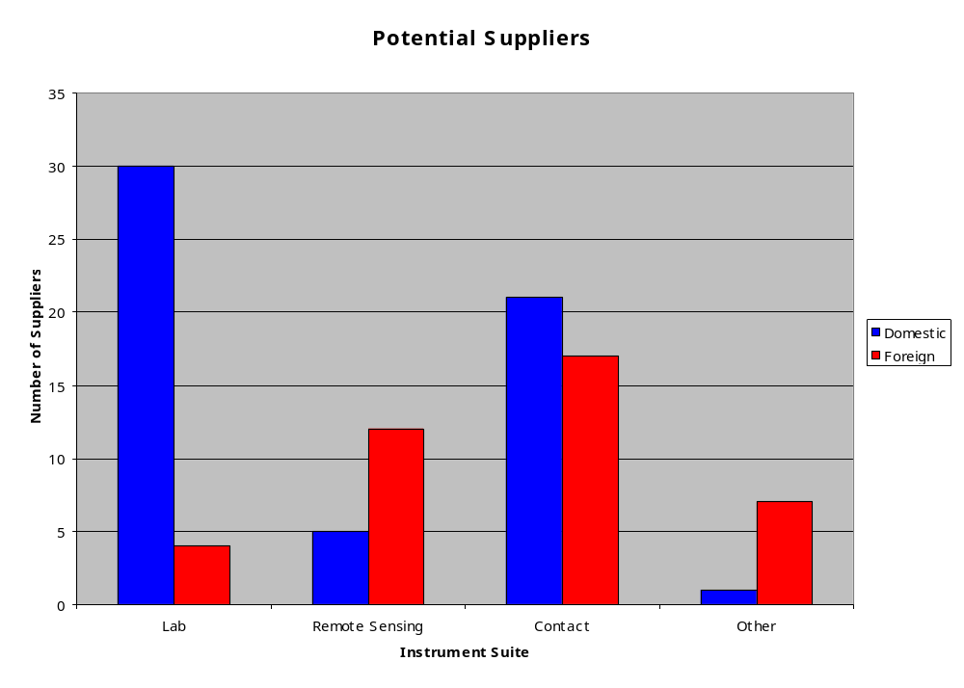
Availability of In Situ Astrobiology Instruments
Request for information on availability and development status of Astrobiology Instruments for MSL ‘09
Released RFI Dec. 18, 2002; responses due Jan. 17, 2002
97 instrument responses received
  Responses:
  57 domestic, 40 foreign
  38 contact suite
  34 analytic laboratory
  17 remote sensing suite/mast
  8 other/support equipment
  74 instruments at or above TRL 4

Slide 70
Appendix 7
Acquiring and Processing Ice-Bearing and Ice-Free Samples

Slide 71
Acquiring and Processing Ice-Bearing and Ice-Free Samples
Collecting Quality Ice-Bearing Samples
Ice is certain to have an heterogeneous subsurface-distribution at the scale of our sampling hardware.
Probability of collecting an ice-bearing sample would be significantly improved by including:
  At least one ice-sensing geophysical instrument (e.g. GRS, high-frequency radar sounder or other)
  Subsurface access capability
    Require: At least 0.3-0.5 m
    Desired: 1.5 m
    Ability to use at multiple sites.
  Access to near-surface ice is substantially improved near poles.
Notes:
8

Slide 72
Acquiring and Processing Ice-Bearing and Ice-Free Samples
Implications for NASA’s MSL AO and Responding Proposals
Announcement of Opportunity would need to specify:
  MSL will have the capability to collect both ice-free and ice-bearing samples
  Ice-free samples will go through a facility preparation process, and the ice-bearing samples will be delivered in raw state.
Proposals for Analytical Laboratory Instruments would need to specify:
  Whether an instrument would need to receive one or both sample types.
  If both, instrument will need to have two inlets, one of which is fed by the “dry” sample preparation system, and the other receives raw samples.
Notes:
8

Slide 73
Acquiring and Processing Ice-Bearing and Ice-Free Samples
Implications for Mission: Summary
PSIG Conclusion: It Is Possible to Design a Single System Capable of Preparing and Analyzing Both Ice-free and Ice-bearing Samples.
Implications of this capability:
Adding a requirement to access ice and/or to understand ice-related geological and geochemical processes, would have the following implications for MSL.
  Additional requirements on the sample collection system
    Acquire and deliver ice samples in a form that can be scientifically analyzed.
  Additional requirements on the sample preparation and analysis system.
  Probable increase in planetary protection requirements
  Possible need for one additional instrument in science payload (ice-detecting geophysics).
This is a mission enabling capability:
  The decision on landing latitude to be deferred until late in the mission development process.
Notes:
8

Slide 74
Appendix 8
Carbon Provenance:
Science and Analytical Requirements

Slide 75
Carbon Provenance
Potential Sources of Carbon Compounds at Mars
Meteoritic infall
  Aromatics, high molecular weight residues, carbonates
  Known tracer - methanesulfonic acid
  Altered by martian surficial processes? - to, e.g., hexacarboxylic benzene
Martian abiotic processes
  Carbonates, aromatics, paraffins, methane
  Altered by martian surficial processes? Oxidation, etc. reactions
Martian biotic processes?
  Amino acids, lipid and hydrocarbon biomarkers, polysaccharides, aromatics
  Altered by martian crustal processes? Oxidation, thermal, etc. reactions
Contamination
  e.g., Amino acids: Highly sensitive, highly specific, and sensitive with regard to oxidative diagenesis
  Genetic material: Extraordinary sensitivity needed

Slide 76
Carbon Provenance
Objectives and Scope of Suggested Carbon Measurements
  Objectives: To establish the nature, abundance, oxidation state, and isotopic properties of carbon compounds over a range of molecular weights in the atmosphere and in sampled solid phase materials such as soils, ices, and the interiors of rocks. To characterize any contamination from the spacecraft.
  Scope of measurements (in priority order):
    Broad survey of types and abundance of carbon containing molecules in the atmosphere and carbon contained in solid phase materials including their oxidation state.
    Determination of the C isotopic composition of carbon containing compounds in these atmospheric and solid phase samples.
    Search for a range of more complex organic molecules.
    Characterization of the refractory macromolecular organic material (complex aromatic or polymeric materials) that may be present in solid phase samples.
    Determination of chirality and a search for specific molecular types relevant to terrestrial life such as amino acids.

