Slide 1
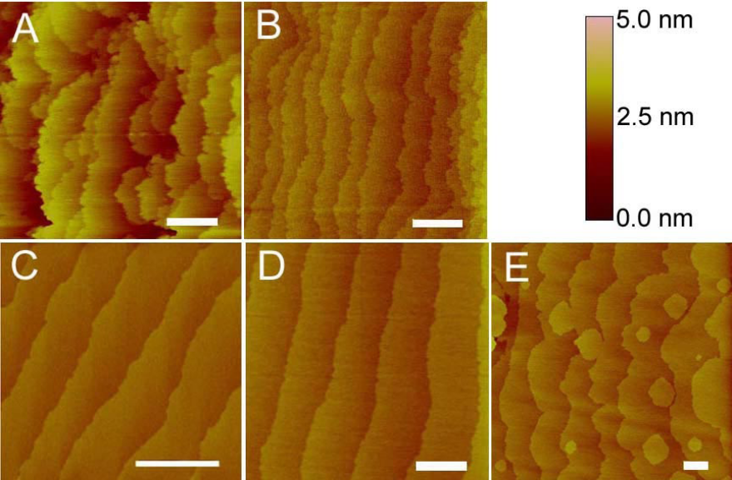
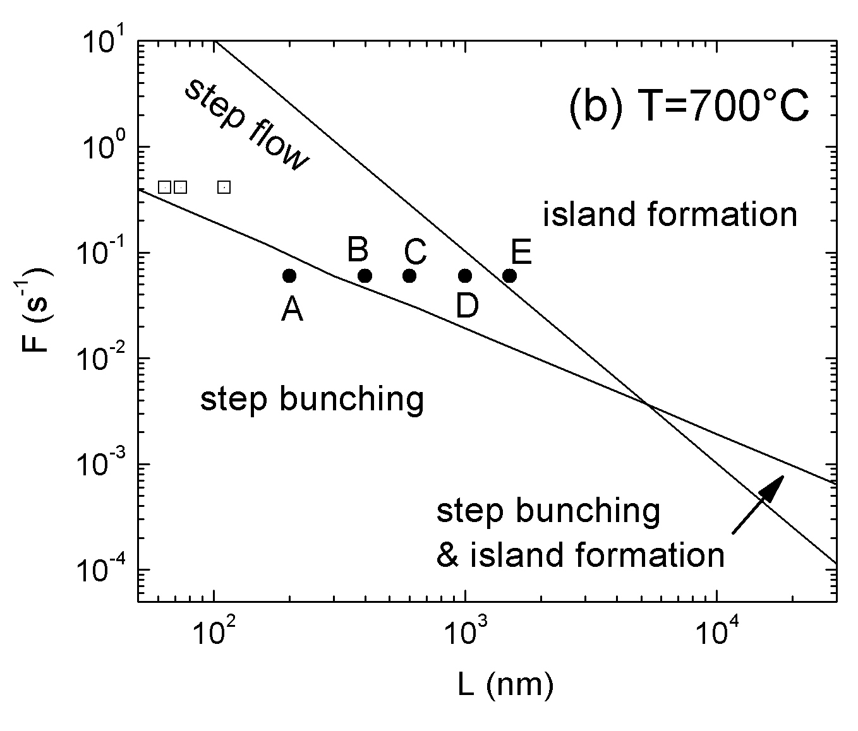
Dynamics of Strained Film Growth on Vicinal Substrates
M. Yoon^{1,2}, W. Hong³, H.N. Lee¹, H. M. Christen¹, Z. Suo³, Z. Zhang^{1,2}
¹ Oak Ridge National Laboratory, ²The University of Tennessee, ³ Harvard University
We propose a model of persistent step flow, emphasizing dominant kinetic processes and strain effects. Within this model, we construct a morphological phase diagram, delineating a regime of step flow from regimes of step bunching and island formation. In particular, we predict the existence of concurrent step bunching and island formation, a new growth mode that competes with step flow for phase space, and show that the deposition flux and temperature must be chosen within a window in order to achieve persistent step flow. The model rationalizes the diverse growth modes observed in pulsed laser deposition of SrRuO₃ on SrTiO₃.
[W. Hong, H.N. Lee, M. Yoon, H. M. Christen, D. H. Lowndes, Z. Suo, Z. Zhang, Phys. Rev. Lett. 95, 095501 (2005)]

Slide 2
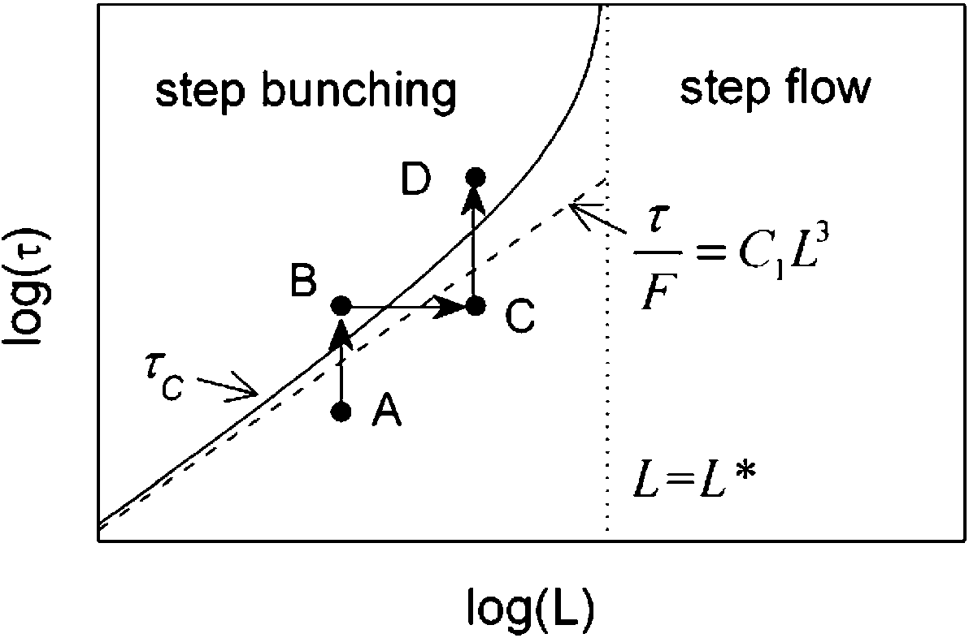
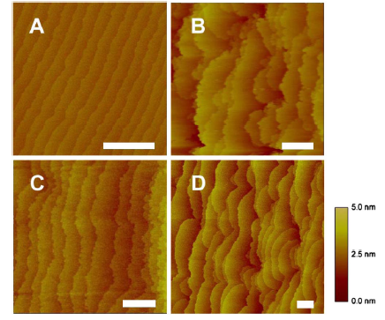
When a heteroepitaxial film is grown on a vicinal substrate, the terrace steps at the growth front may
bunch together to relieve strain, resulting in a rough surface. On the other hand, proper manipulation of the
growth kinetics may suppress the inherent bunching instability, thus preserving step-flow growth. Here we
show that the step dynamics in the early stages of growth can already determine whether the bunching
instability is truly suppressed, prior to bunching actually taking place in the unstable regime. We
determine the critical film thickness above which steps will bunch and exploit its scaling properties
and usefulness for extracting intrinsic energy parameters. Experimental studies of SrRuO₃ films grown on
vicinal SrTiO₃ substrates clearly establish the existence of the critical film thickness in step bunching.
L=200nm
τ=4nm
L=200nm
τ=10nm
A schematic view of the critical thickness τ_{c} as a
function of the average terrace width L..
Experimental confirmation of the existence of critical thickness
L=400nm
τ=10nm
L=400nm
τ=40nm
[M. Yoon, H.N. Lee, W. Hong, H. M. Christen, Z. Zhang, Z. Suo, Phys. Rev. Lett. 99, 055503 (2007)]

