Slide 1
Contamination /Aging Task Group
Materials & Fire Test Working Group
March 5 – 6, 2003
Atlantic City, NJ
Daniel Slaton
Boeing Materials Technology
Payloads Materials & Fire Technology

Slide 2
Contamination /Aging Task Group
Topics
Communication of New Task Group
Airline Survey Form Development
Request for Airline Participation
Contamination /Aging Literature Search
General Contamination Lab Results
Insulation Blanket Film Aging Studies
Future Activities

Slide 3
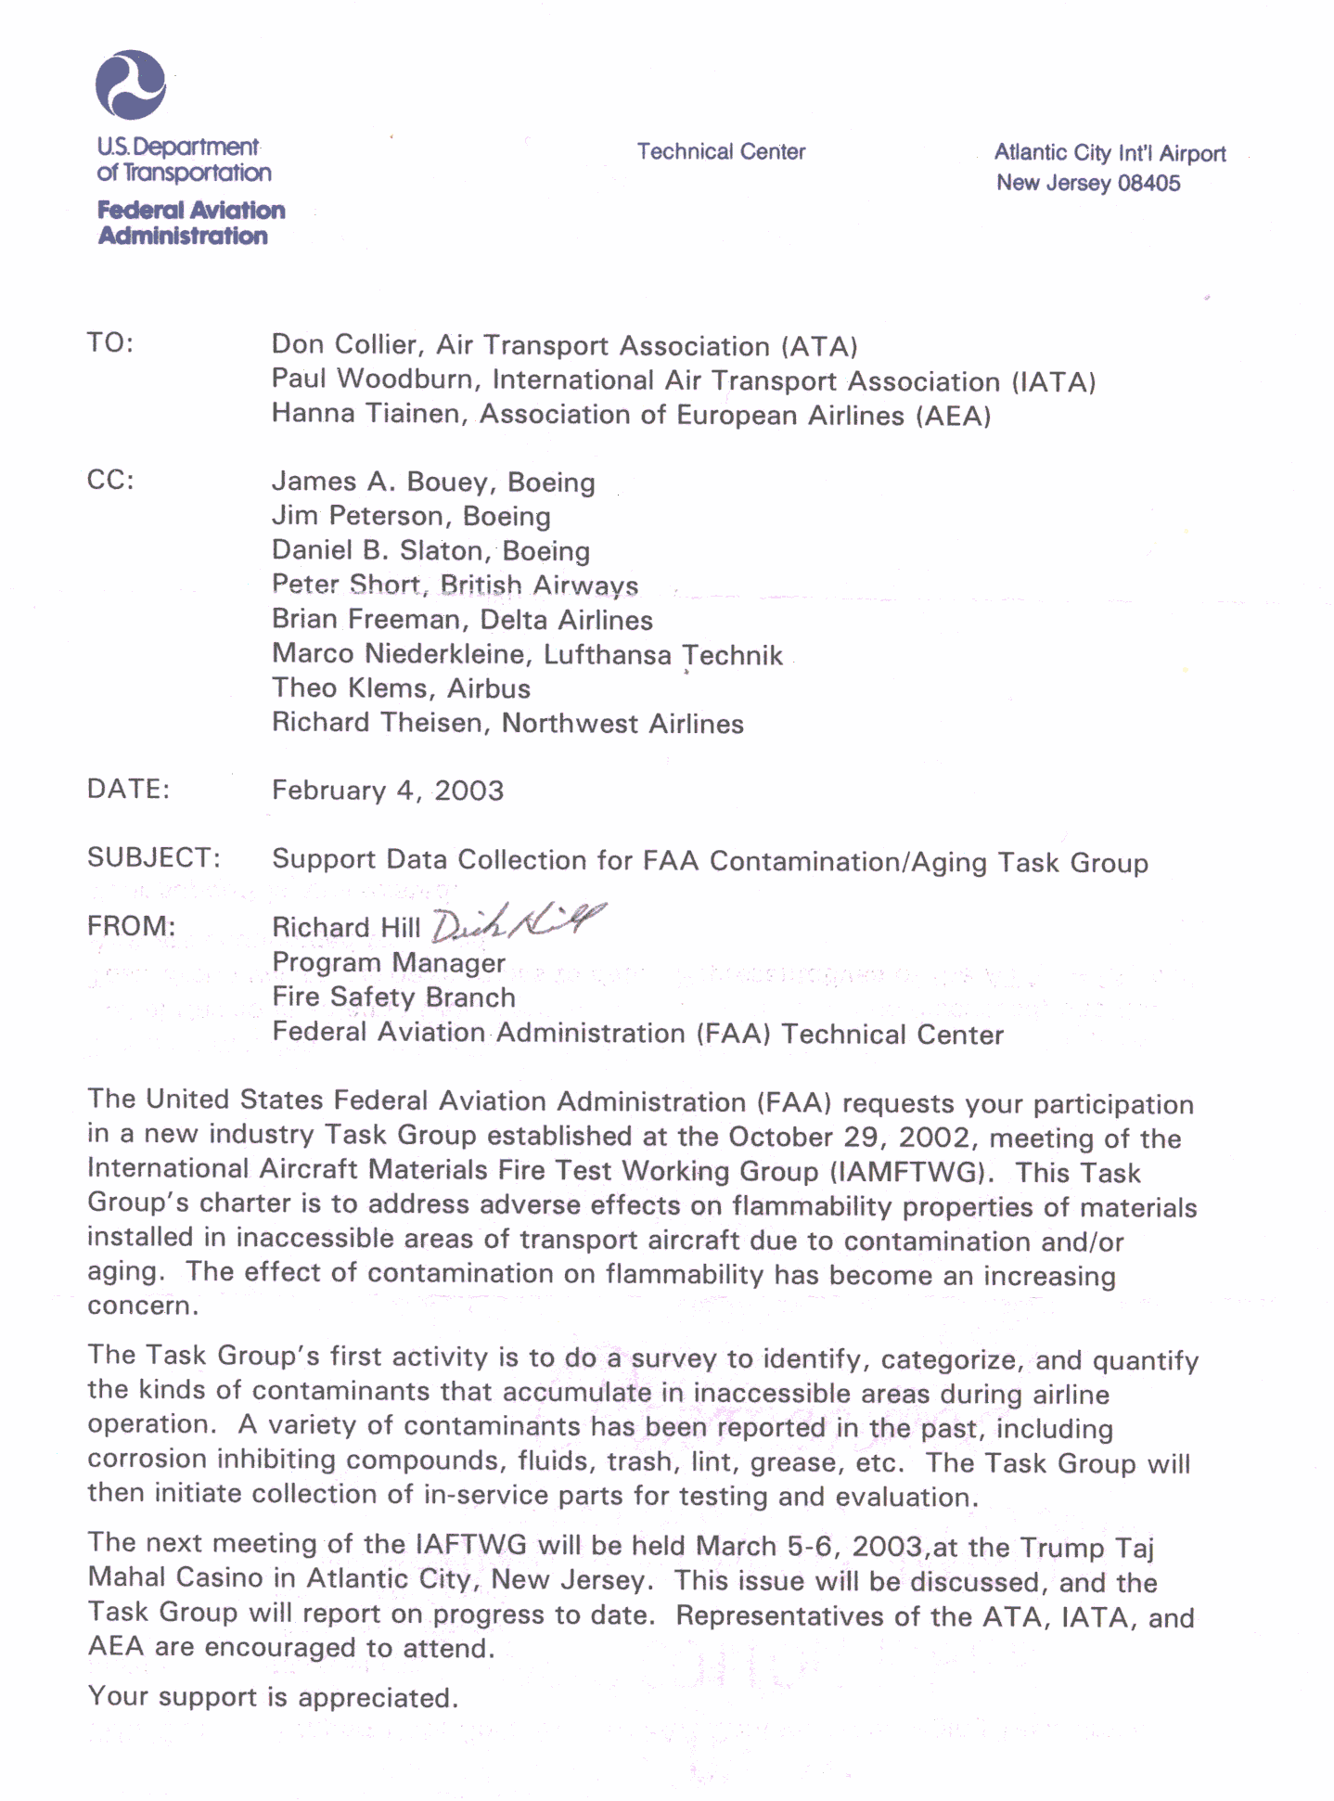
Contamination /Aging Task Group
Communication of New Task Group To Industry
February 4, 2003
Letter to ATA,
IATA, & AEA
From
Dick Hill

Slide 4
Contamination /Aging Task Group
Airline Survey Form
Development

Slide 5
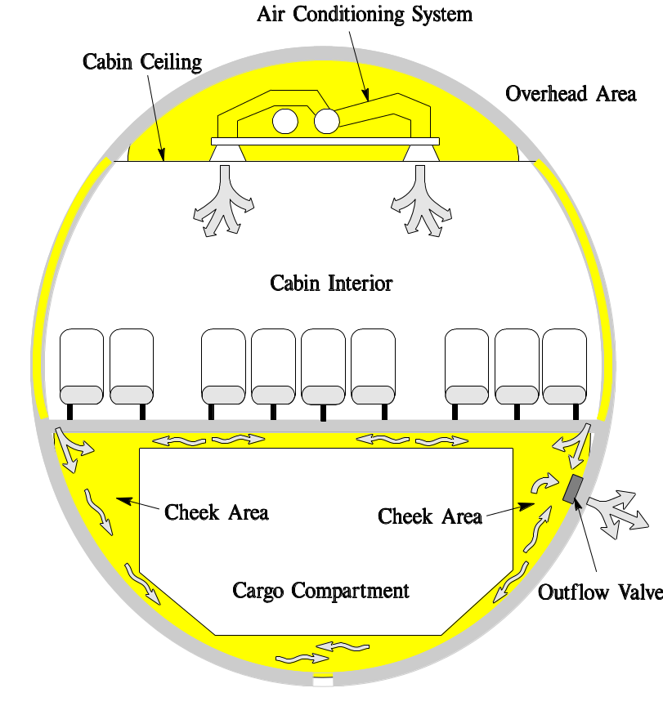
Contamination /Aging Task Group
Inaccessible / Hidden Areas

Slide 6
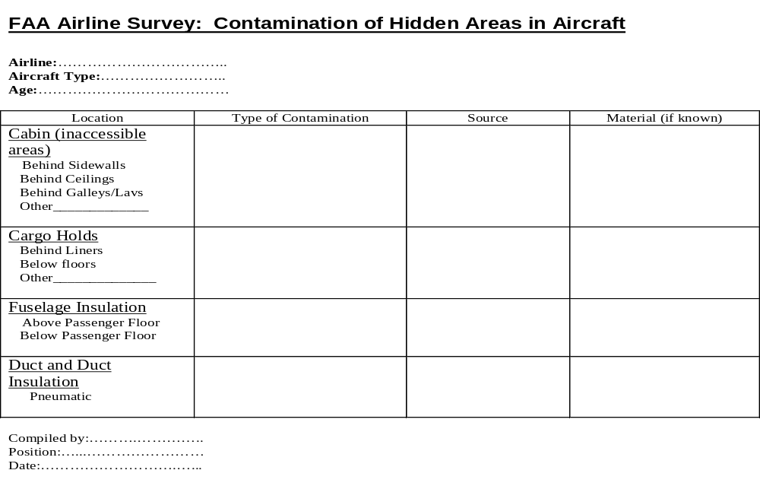
Contamination /Aging Task Group
Airline Survey Form Development
Format courtesy of Peter Short, BAB

Slide 7
Contamination /Aging Task Group
Request for Airline Participation
The following was requested of
several domestic airlines:
Onsite visit by Task Group representatives.
A schedule of upcoming heavy maintenance activity for all airplane models and locations.
An airline contact name and phone number to coordinate activities for this effort.
Samples of insulation blankets that been replaced during standard maintenance.

Slide 8
Contamination /Aging Task Group
Contamination /Aging
Literature Search

Slide 9
Contamination /Aging Task Group
Contamination /Aging Literature Search
Contamination Search Goals:
General fire testing approaches, procedures, and test data involving the effect of contamination.
Identify definitions of “contamination.”
Determine test methods used to quantify contamination (dirt, dust, lint…) and systematic ways for applying levels of contamination.

Slide 10
Contamination /Aging Task Group
Contamination /Aging Literature Search
Contamination Search Results:
Identification of industrial test reports from Combustion and Flame periodical.
Other searches still in progress.

Slide 11
Contamination /Aging Task Group
Contamination /Aging Literature Search
Aging Search Goals:
General search within the Journal of Polymer Degradation on degradation kinetics.
Summarize test methods used to evaluate changes in polymer morphology.
Summarize thermal and hydrolytic degradation methodology for use on polyethylene terephthalate (PET).

Slide 12
Contamination /Aging Task Group
Contamination /Aging Literature Search
Aging Search Results:
Summarized potential test methods used to evaluate polymer morphological changes.
Summarized physical aging test approaches on PET.

Slide 13
Contamination /Aging Task Group
Contamination /Aging Literature Search
Summary of Testing Methodology to Characterize Polymer Morphology Degradation (based on PET)
DSC - determines degradation kinetics (Tg, endotherms, percent crystallinity)
TGA - degradation temperatures, onset and average.
TMA - determine CTE (indication of shrinkage force)
ATR-IR - detect changes in the chemical “fingerprint”
Polarized Light Microscopy - thin film micrographs that differentiate morphology (crystalline and amorphous phases).
SEM – evaluate morphology and sperulite sizes after etching

Slide 14
Contamination /Aging Task Group
General Contamination
Test Results

Slide 15
Contamination /Aging Task Group
Lab Tests on Contamination
Tests used on in-service insulation blanket
Laboratory Tests Performed:
Polarized Light Microscopy performed on solids.
FTIR Analysis performed on solids removed from the surface and on solvent soluble debris.
Microprobe (elemental analysis)

Slide 16
Contamination /Aging Task Group
Lab Results on Contamination
Microscopy & Microprobe Results:
Resinous lumps, amber brown
Rubber/elastomer fragment
Metallic shaving
Inorganic particles (dirt)
Mineral grains including quartz, calcite/CaCOs, clay fines
Fiberglass fibers, some with polymer coating/binder
Cellulose fibers
Synthetic fibers (cloth type fibers, Dacron, Nylon…)
Paint flakes
Mammal hair/fur
Insect parts
Plant tissue, pollen grains, seeds

Slide 17
Contamination /Aging Task Group
Lab Results on Contamination
Results from in-service insulation blankets
FTIR Examination:
Hydrocarbon waxy materials (similar to industry CICs)
Hydrocarbon materials (hydraulic fluids similar to Skydrol)
Silicone based materials (adhesives, sealants)
Epoxy based materials (adhesives, composites)

Slide 18
Contamination /Aging Task Group
Aging Studies on
Insulation Blanket Film

Slide 19
Contamination /Aging Task Group
Aging Studies on Insulation Blanket Film
The following tests have been initiated using a PET insulation blanket film:
Isothermal Thermal Aging:
Isothermal Aging at 120F, 140F, 160F, and 200F.
Humidity Chamber Aging:
Isothermal Aging at 120F/100%RH, 140F/100%RH, and 160F/100%RH
Thermal Cycle Testing of Sealed Insulation Blanket:
Thermal cycling from –65F to 120F for 1200 cycles. Periodic injection of H₂0 into the sealed insulation blanket to maintain constant water in contact with the film.

Slide 20
Contamination /Aging Task Group
Proposed Future Activities

Slide 21
Contamination /Aging Task Group
Proposed Future Activities
Finalize Airline Contamination Survey Form, formalize notification process, and request airline survey participation.
Survey airlines and summarize common types of contamination.
Summarize CIC usage and any flammability test data on CICs.
Develop improved test methods for evaluating CIC flammability.
Identify and evaluate production application processes used by OEM’s, maintenance manual procedures, and Airline maintenance processes that may introduce fly-away “contamination”.

Slide 22
Contamination /Aging Task Group
Proposed Future Activities - continued
Identify other components/materials (besides insulation blankets), that have significant area, quantity, etc…that could be a potential fuel source in a fire.
Use a rigorous methodology (CAST approach) to prioritize those component/materials that will provide the biggest safety benefit. (e.g. FAA large scale test evaluating heat release showed little effect by small thermoplastic components/tray tables)
Request an update of the 9/2002 benefit analysis report on hidden area fires to more specifically address contamination. [DOT/FAA/AR-02/50, A Benefit Analysis for Enhanced Protection from Fires in Hidden Areas on Transport Aircraft, by RGW Cherry]

