Slide 1
HL-RDHM, STAT_Q, XDMS
Overview and General Features
Lecture 3

Slide 2
Lecture/Workshop Approach
Lectures 3, 4, and 5 are intended to provide scientific, and technical background and introduce the workshops
Details not covered in lecture are covered in the HL-RDHM 2.0 User’s Manual and other documents
Workshops are scripted to make sure the full range of software capabilities are described given the short time we have; once a script is completed, we encourage individual experimentation with any remaining time
THIS IS THE FIRST TIME WE’VE GIVEN THIS COURSE! WE DON’T KNOW HOW LONG THINGS WILL TAKE. WE WILL TRY TO ADJUST TIMES AS NEEDED
Notes:
DHM Overview and details will be in lecture 5

Slide 3
Outline
What are HL-RDHM, DHM, XDMS, and STAT_Q?
HL-RDHM Overview
Using ICP Plot-TS, STAT_QME with HL-RDHM time series files
STAT_Q Overview
XDMS Overview (James Paul)
DHM Overview will be given by Lee Cajina
Notes:
DHM Overview and details will be in lecture 5

Slide 4
Acronyms and Features Evolution
Core Distributed Model
Research
Track
HL-RMS
(Koren, 2004)
HL-RDHM
(Research model shared as AWIPS local application)
DMS 1.0
(ABRFC, WGRFC prototype)
DHM
(AWIPS operational software)
Operational
Track
Complementary Programs
XDMS: GUI for grid and time series display developed at ABRFC
Stat_Q: Stand-alone statistical analysis program developed at OHD for analyzing time series data in NWSRFS Calibration System DATACARD Format.
Notes:
HL-RMS: Hydrology Laboratory - Research Modeling System
HL-RDHM: Hydrology Laboratory Research Distributed Hydrologic Model
DHM: Distributed Modeling System
XDMS: X – Distributed Modeling System
You will see that because of separate development paths for HL-RDHM, DHM, and XDMS, there are some details that are not smoothly integrated but there has been substantial collaboration and data can be shared by these programs. Various workers have gone outside of their normal duties to make coordination on these applications happen.

Slide 5
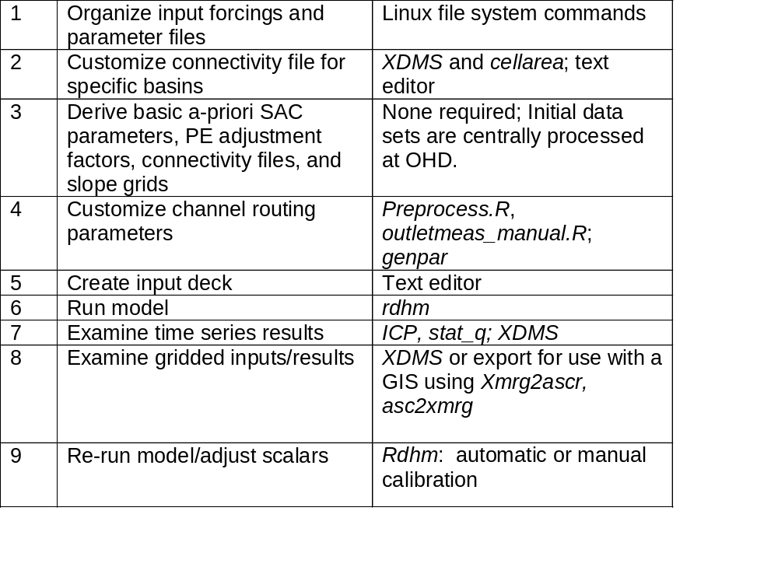
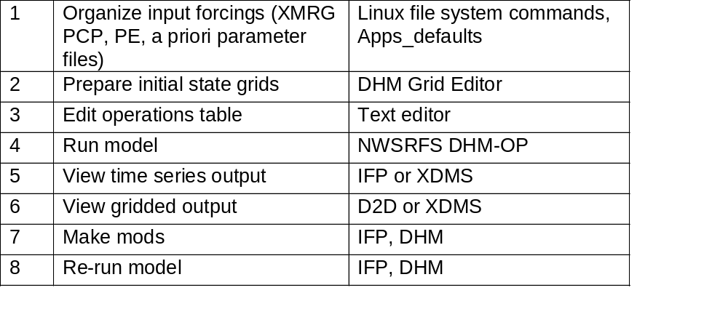
Typical RFC Forecast Basin Modeling Procedure
Step
Available Tool
HL-RDHM
Simulation/Calibration Mode
Calibrated scalars,
Initial states
DHM
Forecast Mode
Notes:
We will run through all of these steps in the workshops for this course.

Slide 6
HL-RDHM 2.0 Features
Designed for river forecast, flash flood, and water resources research and development
Supports gridded connected or unconnected domain runs
Flexible I/O in standard NWS formats
Common programming framework for researchers
  Facilitates rapid model testing
  Promotes good (modular) programming
Multiple modeling resolutions
Contains models for all hydrologic cycle components: snow, rainfall/runoff, frozen ground, overland and channel routing
Simulation/calibration mode exists. Forecast mode planned for HL-RDHM 2.1.
Notes:
DHM Overview and details will be in lecture 5

Slide 7
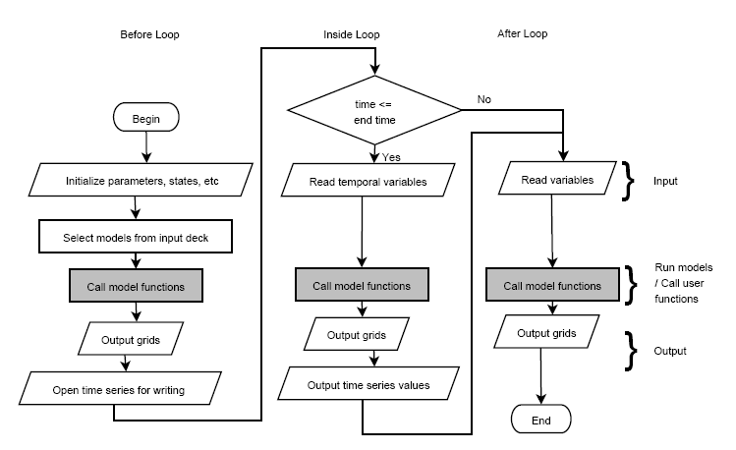
HL-RDHM Generic Computational Flow Chart
Researcher defines functions for 1-3 of the gray rectangles. System handles many tedious I/O tasks.
HL-RDHM Developer’s Manual available for download on the LAD
Notes:
We do not have time to provide training for the model development features of HL-RDHM at this workshop; however, we do welcome collaborative R&D using HL-RDHM for those who wish to take their own initiative. The HL-RDHM Developer’s Manual and source code is available on the LAD.

Slide 8
HL-RDHM 2.0 Available Operations
Snow-17 (snow17)
SAC-SMA-HT (sac, calsac*)
Continuous API (api)
Frozen ground (frz)
Overland and channel routing (rutpix7,rutpix9,calrutpix7,calrutpix9)
Automatic optimization (funcOpt)
* Operations preceded by the ‘cal’ prefix are coded to improve performance over the non-’cal’ version. These operations are particularly useful for automatic and manual calibration runs. The non-‘cal’ versions have their own advantages (e.g. more output options and developer flexibility). Cal and non-cal operations cannot be mixed.
Notes:
With the calsac and calrutpix options you can only output grids of model parameters, precipitation, and discharge.

Slide 9
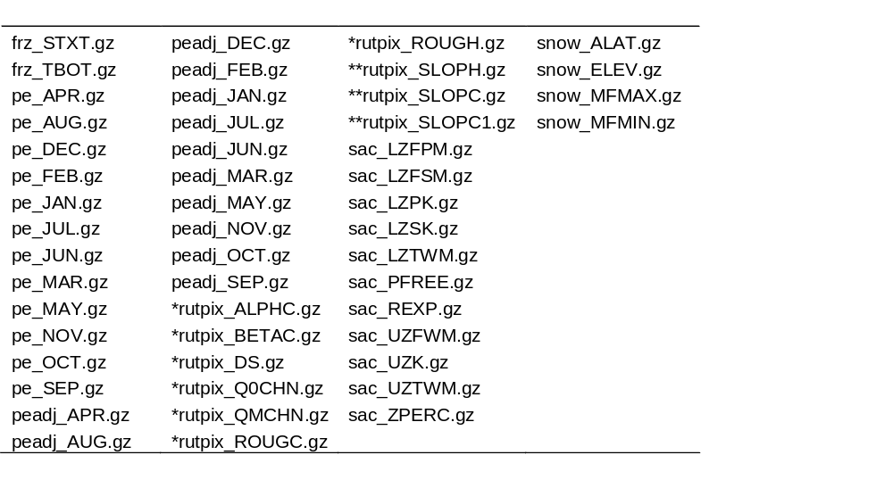
Default Parameter Files Provided with HL-RDHM 2.0
XMRG file format
hrapfa10.xmrg**: flow accumulation grid for display in XDMS (not used by HL-RDHM)
hrapfd10.xmrg**: flow direction grid for display in XDMS (not used by HL-RDHM)
xxrfc4k.con: ASCII connectivity files (one for each CONUS RFC)
* Grid is a template and requires local customization.
** All grids cover CONUS with the exception of rutpix_SLOPH, rutpix_SLOPC, rutpix_SLOPC1, hrapfa10.xmrg, and hrapfd10.xmrg which are provided separately to each CONUS RFC
Notes:
Say how this data can be obtained from the NOAA1 Server

Slide 10
Key Words
Key words are used to define a model run in the Input Deck (ASCII file)
User Manual Chapter 8 describes all key words and syntax specifics
Selected Key Words
time-period
time-step
connectivity (used for a connected domain)
window-in-hrap (used for an unconnected domain)
subwindows
output-path
input-path
ignore-1d-xmrg
operations
window-input
input-data (specify parameters or scale factors for specific basins)
mask (a grid defining an irregular domain boundary for unconnected calculations can be provided)

Slide 11
Outputs
Output Key Words
output-grid-before-timeloop
output-grid-inside-timeloop
output-grid-after-timeloop
output-grid-step
output-grid-last-step
output-timeseries-basin-average
output-timeseries-basin-outlet
Can output grids or time series for any model states in selected operations (102 different states for all operations)
Can output grids for any parameters in selected operations (136 different parameters for all operations)
Output Formats
Grids are output as XMRG-like binary files
Time series are output in NWSRFS Calibration System DATACARD format
XDMS displays these grids and time series
ICP displays these time series
Notes:
Note: Most of these options are not available with the calsac and calrutpix operations.

Slide 12
Example HL-RDHM Input Deck
#simulation time period
time-period = 19951001T00 20060930T23
#
ignore-1d-xmrg = false
#simulation time step in the format of HH:MM:SS.XXXX
time-step = 1
#the connectivity file
connectivity = /fs/hsmb5/hydro/rms/sequence/abrfc_var_adj2.con
#output path
output-path = /fs/hsmb5/hydro/dmip2/talo2/ws1a
#input paths
input-path = /fs/hsmb5/hydro/rms/parameterslx
input-path = /fs/hsmb5/hydro/Hydro_Data/ABRFC/PRECIPITATION
#selected operations
operations = calsac calrutpix9
#data to be output before, inside and after timeloop in grid format
#In number of timestep, example, 2 means output every 2 timestep
#output-grid-step = 1
#output-grid-before-timeloop = sac_LZFPM
#data to be output at the last time step
#output-grid-last-step = uztwc uzfwc lztwc lzfsc lzfpc adimpc
#output-grid-last-step = real_uztwc real_uzfwc real_lztwc real_lzfsc
#output-grid-inside-timeloop = discharge surfaceFlow
#Time series to be averaged over every basin
#output-timeseries-basin-average = xmrg
#output-timeseries-basin-average = surfaceFlow
#Time series at the outlet
output-timeseries-basin-outlet = discharge
#basin id and factors for input data
# basin id followed by "name=value" pairs
#------------------
#----- TALO2 ------
#------------------
input-data = TALO2
#SAC parameters
input-data = sac_PCTIM=0.005
input-data = sac_ADIMP=0.1
input-data = sac_RIVA=0.03
input-data = sac_EFC=0.5
input-data = sac_SIDE=0.0
input-data = sac_RSERV=0.3
input-data = sac_UZTWM=-0.5
input-data = sac_UZFWM=-0.80
input-data = sac_UZK=-0.7
input-data = sac_ZPERC=-3.49
input-data = sac_REXP=-0.74
input-data = sac_LZTWM=-0.82
input-data = sac_LZFSM=-1.24
input-data = sac_LZFPM=-2.1
input-data = sac_LZSK=-0.51
input-data = sac_LZPK=-0.45
input-data = sac_PFREE=-0.30
input-data = pe_JAN=0.9 pe_FEB=1.0 pe_MAR=1.70
input-data = pe_APR=2.7 pe_MAY=3.7 pe_JUN=5.2
input-data = pe_JUL=5.6 pe_AUG=5.3 pe_SEP=4.1
input-data = pe_OCT=2.4 pe_NOV=1.3 pe_DEC=1.0
input-data = peadj_JAN=1.0 peadj_FEB=1.0 peadj_MAR=1.0
input-data = peadj_APR=1.0 peadj_MAY=1.0 peadj_JUN=1.0
input-data = peadj_JUL=1.0 peadj_AUG=1.0 peadj_SEP=1.0
input-data = peadj_OCT=1.0 peadj_NOV=1.0 peadj_DEC=1.0
#SAC states
input-data = uztwc=0.66 uzfwc=0.0 lztwc=0.69
input-data = lzfsc=0.0 lzfpc=0.57 adimpc=0.69
#rutpix parameters
input-data = rutpix_Q0CHN=-1.8 rutpix_QMCHN=-0.92
#rutpix states
input-data = areac=5.0 depth=0.0

Slide 13
Example ICP Input Deck to Display HL-RDHM time series
TALO2 , analize results
10 1996 9 2006
DEF-TS
TALO2 QIN 1 INPUT
ws1a/talo2.mod2
TALO1 SQIN 1 INPUT
ws1a/TALO2ap_discharge.outlet_ts
TALO2 SQIN 1 INPUT
ws1a/TALO2_discharge.outlet_ts
TALO2 MAPX 1 INPUT
ws1a/TALO2_xmrg.ave_ts
TALO2 QME 24 INTERNAL
TALO1 SQME 24 INTERNAL
TALO2 SQME 24 INTERNAL
END
MEAN-Q TALO1
TALO1 SQIN 1 TALO1 SQME 24
MEAN-Q TALO2
TALO2 SQIN 1 TALO2 SQME 24
MEAN-Q TALO2-OBS
TALO2 QIN 1 TALO2 QME 24
PLOT-TS TALO2
SCE vs. RFC 3 2 4 0
ARIT 30 0.0 50.0 1
TALO2 MAPX 1 pcp P
ARIT 30 0.0 1000.0 3
TALO2 QIN 1 USGS o
TALO1 SQIN 1 u u
TALO2 SQIN 1 c c
STAT-QME TALO1
Illinois - uncali 2483. TALO1 SQME 24 TALO2 QME 24 1
QUAR
STAT-QME TALO2
Illinois - calib 2483. TALO2 SQME 24 TALO2 QME 24 1
QUAR
STOP

Slide 14
Stat_q
Statistical analysis of any two time series in single column NWSRFS Calibration Data Card format
Similar to STAT_QME but with many more options
Flexible analysis time step (hourly – 24 hourly)
Yearly, monthly statistical summaries
Flow interval statistics
Event statistics for user defined events

Slide 15
GIS Import/Export Tools
Utilities will be made available to export grids or import grids in ESRI gridascii format. Format can also be easily imported to GRASS software.
xmrg2asc
asc2xmrg
Notes:
If you want to know more about GIS related tools, talk to someone from your office who is participating in the GIS workshop being held this year in Wilmington, Ohio.

Slide 16
Workshops Overview
Workshop 1: Become familiar with HL-RDHM, XDMS, ICP, and STAT-Q. Step through some examples to demonstrate basic HL-RDHM simulation mode features, use of XDMS to examine spatial output, and use ICP and STAT-Q to examine time series outputs.
Workshop 2: Step through procedures for local routing parameter customization (HL-RDHM User’s Manual Chapter 9)
Workshop 3: Run through a simple automatic calibration exercise. Examine hydrograph results in ICP before and after calibration. Manually examine the impacts of parameter scalar changes for both rainfall-runoff and routing.
Workshop 4: Setup and run DHM through IFP.
Workshop 5: Demonstrate an uncalibrated run over a large area. Revisit any questions from earlier workshops. Continue Workshop 4 if necessary.
Workshops assume some basic knowledge of existing RFC software applications such as IFP and ICP. Therefore let’s try to put at least one experienced RFC person in each group.

Slide 17
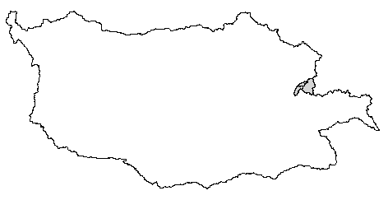
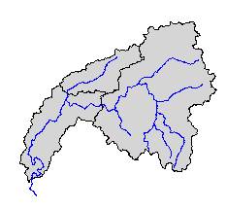
Workshops Overview
ABRFC
KNSO2
WTTO2
TALO2
Workshop exercises will focus on the ABRFC domain with most specific examples coming from the Illinois River above Tahlequah (TALO2) and two subbasins (The Illinois R. at Kansas (KNSO2) and the Illinois R. at Watts (WTTO2))

