Slide 1
The Business Case for XML Web Services
Presentation to Web-Services.gov
February 18, 2003
By Scott Christiansen
Adjunct Professor of Computer Science
Seattle Pacific University
Notes:
Frequently, presenters must deliver material of a technical nature to an audience unfamiliar with the topic or vocabulary. The material may be complex or heavy with detail. To present technical material effectively, use the following guidelines from Dale Carnegie Training®.
Consider the amount of time available and prepare to organize your material. Narrow your topic. Divide your presentation into clear segments. Follow a logical progression. Maintain your focus throughout. Close the presentation with a summary, repetition of the key steps, or a logical conclusion.
Keep your audience in mind at all times. For example, be sure data is clear and information is relevant. Keep the level of detail and vocabulary appropriate for the audience. Use visuals to support key points or steps. Keep alert to the needs of your listeners, and you will have a more receptive audience.

Slide 2
Introduction
The Basics of XML Web Services
What others are doing
XML Web Services potential
Return on investment
How to get there – Transition Architecture
Summary
Notes:
In your opening, establish the relevancy of the topic to the audience. Give a brief preview of the presentation and establish value for the listeners. Take into account your audience’s interest and expertise in the topic when choosing your vocabulary, examples, and illustrations. Focus on the importance of the topic to your audience, and you will have more attentive listeners.

Slide 3
XML Web Services
The Basics of XML Web Services
Allow companies and individuals to use the Internet to unlock vast stores of data and relate unconnected applications, services, devices.
Notes:
If you have several points, steps, or key ideas use multiple slides. Determine if your audience is to understand a new idea, learn a process, or receive greater depth to a familiar concept. Back up each point with adequate explanation. As appropriate, supplement your presentation with technical support data in hard copy or on disc, e-mail, or the Internet. Develop each point adequately to communicate with your audience.

Slide 4
Expedia.com - before XML Web Services
The Basics of XML Web Services
Establish direct links to each individual application or database, with unique communications protocols, running on different platforms, translating, processing and re- purposing unique data
United
Delta
SouthWest
Airlines
Expedia
Hilton
Ramada
Loews
Avis
Hotels
Hertz
Dollar
Rental Cars
Notes:
If you have several points, steps, or key ideas use multiple slides. Determine if your audience is to understand a new idea, learn a process, or receive greater depth to a familiar concept. Back up each point with adequate explanation. As appropriate, supplement your presentation with technical support data in hard copy or on disc, e-mail, or the Internet. Develop each point adequately to communicate with your audience.

Slide 5
Expedia.com - using XML Web Services
The Basics of XML Web Services
Registry
1. Apps expose functionality as W/S
2. W/S functionality provided to registry
3. XML Web Service app discovers service & finds where to get data/details
4. Connection established, request send to data provider, data returned to W/S app
5. Data processed
Location:
Delta.com
Services Exposed:
Schedules
Costs
Routes
Details: on connection & data returned
3.
Expedia
NEW
2.
5.
United
All data is:
passed as XML
uses XML/SOAP
uses XML/WSDL
may use UDDI
4.
Delta
SouthWest
Airlines
1.
Notes:
If you have several points, steps, or key ideas use multiple slides. Determine if your audience is to understand a new idea, learn a process, or receive greater depth to a familiar concept. Back up each point with adequate explanation. As appropriate, supplement your presentation with technical support data in hard copy or on disc, e-mail, or the Internet. Develop each point adequately to communicate with your audience.

Slide 6
Enabling Technologies
The Basics of XML Web Services
SOAP – Simple Object Access Protocol
WSDL – Web Services Description Language
UDDI – Universal Discovery, Description and Integration
Notes:
If you have several points, steps, or key ideas use multiple slides. Determine if your audience is to understand a new idea, learn a process, or receive greater depth to a familiar concept. Back up each point with adequate explanation. As appropriate, supplement your presentation with technical support data in hard copy or on disc, e-mail, or the Internet. Develop each point adequately to communicate with your audience.

Slide 7
SOAP
The Basics of XML Web Services
XML based
Defines an XML envelope for delivering XML content
Specifies set of rules for servers to handle SOAP message
Defines what to do when message received
Identifies what to provide in response
Allows app to invoke object methods residing on remote servers (using non-proprietary protocol)
Notes:
If you have several points, steps, or key ideas use multiple slides. Determine if your audience is to understand a new idea, learn a process, or receive greater depth to a familiar concept. Back up each point with adequate explanation. As appropriate, supplement your presentation with technical support data in hard copy or on disc, e-mail, or the Internet. Develop each point adequately to communicate with your audience.

Slide 8
WSDL
The Basics of XML Web Services
XML format
Describes how two applications connect
Defines how the consumer of a Web Service can access it
Identifies what is needed as inputs
Describes outputs returned
Notes:
If you have several points, steps, or key ideas use multiple slides. Determine if your audience is to understand a new idea, learn a process, or receive greater depth to a familiar concept. Back up each point with adequate explanation. As appropriate, supplement your presentation with technical support data in hard copy or on disc, e-mail, or the Internet. Develop each point adequately to communicate with your audience.

Slide 9
UDDI
The Basics of XML Web Services
XML based
Defines infrastructure for software to automatically discover available Web Services
Notes:
If you have several points, steps, or key ideas use multiple slides. Determine if your audience is to understand a new idea, learn a process, or receive greater depth to a familiar concept. Back up each point with adequate explanation. As appropriate, supplement your presentation with technical support data in hard copy or on disc, e-mail, or the Internet. Develop each point adequately to communicate with your audience.

Slide 10
Implementation
The Basics of XML Web Services
Behind the firewall
Beyond the firewall
Notes:
If you have several points, steps, or key ideas use multiple slides. Determine if your audience is to understand a new idea, learn a process, or receive greater depth to a familiar concept. Back up each point with adequate explanation. As appropriate, supplement your presentation with technical support data in hard copy or on disc, e-mail, or the Internet. Develop each point adequately to communicate with your audience.

Slide 11
Typical Application Architecture
The Basics of XML Web Services
Behind the Firewall
Finance App 1
Finance App 2
Finance App 3
Engr App 1
Engr App 2
Engr App 3
Ops App 1
Ops App 2
Ops App 3
Today – applications exist and are being developed to satisfy specific business process (sub-optimize)
Notes:
If you have several points, steps, or key ideas use multiple slides. Determine if your audience is to understand a new idea, learn a process, or receive greater depth to a familiar concept. Back up each point with adequate explanation. As appropriate, supplement your presentation with technical support data in hard copy or on disc, e-mail, or the Internet. Develop each point adequately to communicate with your audience.

Slide 12
Web Services Enabled Architecture
The Basics of XML Web Services
Behind the Firewall
Registry
Finance App 1
New opportunities:
Integration - platform independence
Functionality -allow collaboration of data (e.g. from Fin, Engr and Ops)
Business models -revenue generation
Location:
Ops.com
Services Exposed:
BOM
Costs
Parts
Details: on connection & data returned
App 2
App 3
Finance
NEW Web Service App
Engr App 1
App 2
App 3
Ops App 1
Engineering
App 2
App 3
Operations
Notes:
If you have several points, steps, or key ideas use multiple slides. Determine if your audience is to understand a new idea, learn a process, or receive greater depth to a familiar concept. Back up each point with adequate explanation. As appropriate, supplement your presentation with technical support data in hard copy or on disc, e-mail, or the Internet. Develop each point adequately to communicate with your audience.

Slide 13
Advantages
The Basics of XML Web Services
Behind the Firewall
New, integrated functionality using existing applications
Lowest cost integration solution
Integration based on standards (vs. proprietary API’s or method invocation – DCOM, CORBA, RMI)
Investment in existing apps extended
Query backend systems (e.g.build intelligent employee portal)
Future-proof application development
Notes:
If you have several points, steps, or key ideas use multiple slides. Determine if your audience is to understand a new idea, learn a process, or receive greater depth to a familiar concept. Back up each point with adequate explanation. As appropriate, supplement your presentation with technical support data in hard copy or on disc, e-mail, or the Internet. Develop each point adequately to communicate with your audience.

Slide 14
Registry
The Basics of XML Web Services
Behind the Firewall
Not required, but provides many advantages
UDDI.org, xMethods.org, etc.
Can build for internal use
Allows for fault-tolerance/fail-over
May reveal duplicate data and business logic (could lead to application and data elimination)
Notes:
If you have several points, steps, or key ideas use multiple slides. Determine if your audience is to understand a new idea, learn a process, or receive greater depth to a familiar concept. Back up each point with adequate explanation. As appropriate, supplement your presentation with technical support data in hard copy or on disc, e-mail, or the Internet. Develop each point adequately to communicate with your audience.

Slide 15
Web Services Enabled Architecture
The Basics of XML Web Services
Beyond the Firewall
Registry
Finance App 1
FIREWALL
Location:
Ops.com
Services Exposed:
BOM
Costs
Parts
Details: on connection & data returned
Registry
App 2
UDDI.org
xMethods.org
…other
App 3
Finance
NEW Web Service App
Engr App 1
United
App 2
Delta
App 3
Ops App 1
SouthWest
Engineering
Airlines
App 2
App 3
Operations
Notes:
If you have several points, steps, or key ideas use multiple slides. Determine if your audience is to understand a new idea, learn a process, or receive greater depth to a familiar concept. Back up each point with adequate explanation. As appropriate, supplement your presentation with technical support data in hard copy or on disc, e-mail, or the Internet. Develop each point adequately to communicate with your audience.

Slide 16
Advantages
The Basics of XML Web Services
Beyond the Firewall
Complete supply chain integration
Collaborative data available to current and new customers
Enable new business models – leads to new revenue or lower costs
Provide customer real-time status alerts
Distribute prices lists to customers and suppliers
Integrate data for all end users
Notes:
If you have several points, steps, or key ideas use multiple slides. Determine if your audience is to understand a new idea, learn a process, or receive greater depth to a familiar concept. Back up each point with adequate explanation. As appropriate, supplement your presentation with technical support data in hard copy or on disc, e-mail, or the Internet. Develop each point adequately to communicate with your audience.

Slide 17
What Others are Doing
Key drivers
  Reduce costs
  Increase revenue
Spending
  Most CIO’s/CTO’s plan increase spending in 2003
Case studies
  Microsoft.com/resources/casestudies/
Notes:
If you have several points, steps, or key ideas use multiple slides. Determine if your audience is to understand a new idea, learn a process, or receive greater depth to a familiar concept. Back up each point with adequate explanation. As appropriate, supplement your presentation with technical support data in hard copy or on disc, e-mail, or the Internet. Develop each point adequately to communicate with your audience.

Slide 18
Examples
What others are doing
A pension mgt company built XML Web Services interfaces to it’s mainframe systems – enabled 1000’s of participating companies to automatically update info (salary, address, etc) from their HR app vs. faxing or FTP
A health care provider, with a mix of back-end systems is using XML Web Services to integrate existing Java & Microsoft apps – using open standards
Notes:
If you have several points, steps, or key ideas use multiple slides. Determine if your audience is to understand a new idea, learn a process, or receive greater depth to a familiar concept. Back up each point with adequate explanation. As appropriate, supplement your presentation with technical support data in hard copy or on disc, e-mail, or the Internet. Develop each point adequately to communicate with your audience.

Slide 19
Examples – cont.
What others are doing
A major financial institution is using XML Web Services to combine data from credit service company, delivering real-time rate calculations
A nationwide student information data provider is using XML Web Services to eliminate expensive EDI costs
Notes:
If you have several points, steps, or key ideas use multiple slides. Determine if your audience is to understand a new idea, learn a process, or receive greater depth to a familiar concept. Back up each point with adequate explanation. As appropriate, supplement your presentation with technical support data in hard copy or on disc, e-mail, or the Internet. Develop each point adequately to communicate with your audience.

Slide 20
Examples – cont.
What others are doing
An insurance company is using XML Web Services to pull HR data from many unique systems to create new, value-added collaboration data for employees
A Chicago manufacturing company using XML Web Services to integrate the entire supply chain
Notes:
If you have several points, steps, or key ideas use multiple slides. Determine if your audience is to understand a new idea, learn a process, or receive greater depth to a familiar concept. Back up each point with adequate explanation. As appropriate, supplement your presentation with technical support data in hard copy or on disc, e-mail, or the Internet. Develop each point adequately to communicate with your audience.

Slide 21
XML Web Services Potential
Strong growth predicted
Software industry determined that more money can be made by allowing companies and customers to share data than by locking it
Identifying the potential – the XML Web Services Challenge (exercise for SPU students)
Notes:
If you have several points, steps, or key ideas use multiple slides. Determine if your audience is to understand a new idea, learn a process, or receive greater depth to a familiar concept. Back up each point with adequate explanation. As appropriate, supplement your presentation with technical support data in hard copy or on disc, e-mail, or the Internet. Develop each point adequately to communicate with your audience.

Slide 22
XML Web Services Challenge
XML Web Services Potential
1. Select Applications/Sites
2. Affinitize Around Business Process
3. Brainstorm Possibilities
4. Select Opportunity
5. Analyze Data
6. Identify Missing Data
7. Conduct Business Reality Check
8. Build Architecture
Repeat
9. Build XML Web Service application
10. Test Market Opportunity
11. Deliver Completed Application
12. Monitor Progress
Notes:
If you have several points, steps, or key ideas use multiple slides. Determine if your audience is to understand a new idea, learn a process, or receive greater depth to a familiar concept. Back up each point with adequate explanation. As appropriate, supplement your presentation with technical support data in hard copy or on disc, e-mail, or the Internet. Develop each point adequately to communicate with your audience.

Slide 23
1. Select Applications/sites
XML Web Services Potential
XML Web Services Challenge
Choose from the following:
  Five favorite web sites
  Five sites from competitors, suppliers, business partners
  Three internal corporate applications that are not integrated
  Combination
Notes:
If you have several points, steps, or key ideas use multiple slides. Determine if your audience is to understand a new idea, learn a process, or receive greater depth to a familiar concept. Back up each point with adequate explanation. As appropriate, supplement your presentation with technical support data in hard copy or on disc, e-mail, or the Internet. Develop each point adequately to communicate with your audience.

Slide 24
Ideas from xMethods.org
XML Web Services Potential
XML Web Services Challenge
1. Select Application/sites
Airline Related | Basic information on over 53000 aircraft | Provides the 3-letter International Airport designator | Provides 2-letter codes for all known commercial airline carriers | Runway Length in Feet, Runway Elevation in
Weather Related | Forecasts for a valid US Zip code | Get 5 days Hong Kong Weather Forecast | Report California Weather | FastWeather will determine the visitor's weather by IP address, zip code or city/state combination
Sports related | Store golf rounds and calculate your handicap | Play Chess with a WebService | Returns directory listings for registered ski resorts | Get the NFL Headline News
Business Related | Company Market data | Get conversion rate from one currency to another currency | Credit Card Validation and Card Type Web Service | SendFax - Freely send fax anywhere in the world
Stock Related | Retrieve stock quote around the world | Provides NASDAQ and LJSE stock values based on multiple criteria. | Retrieve Stock's Historical Quotes | Stock price, stock volume, and other financial intelligence
Must Haves! | Access Amazon.com using SOAP | Incorporate yellow page listings into your application | Comprehensive mapping and geographical information service | Track packages shipped with either UPS, USPS or FedEx
Notes:
If you have several points, steps, or key ideas use multiple slides. Determine if your audience is to understand a new idea, learn a process, or receive greater depth to a familiar concept. Back up each point with adequate explanation. As appropriate, supplement your presentation with technical support data in hard copy or on disc, e-mail, or the Internet. Develop each point adequately to communicate with your audience.

Slide 25
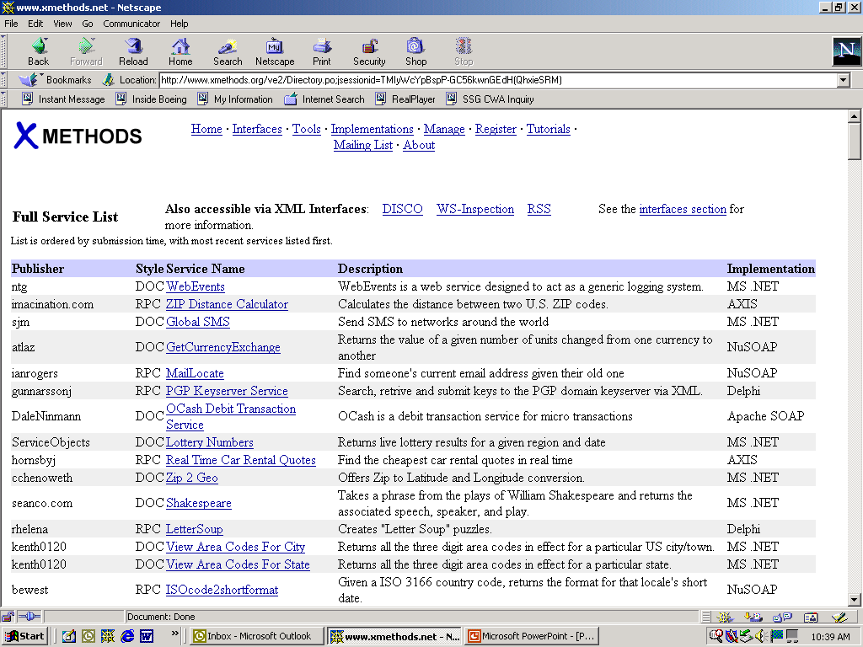
Ideas from xMethods.org
XML Web Services Potential
XML Web Services Challenge
1. Select Application/sites
Notes:
If you have several points, steps, or key ideas use multiple slides. Determine if your audience is to understand a new idea, learn a process, or receive greater depth to a familiar concept. Back up each point with adequate explanation. As appropriate, supplement your presentation with technical support data in hard copy or on disc, e-mail, or the Internet. Develop each point adequately to communicate with your audience.

Slide 26
2. Affinitize by Business Process
XML Web Services Potential
XML Web Services Challenge
Group like functions based on:
  Business function – sales, manufacturing, engineering, finance, HR, etc
  Vertical markets
  Horizontal markets
  Other – supply chain, customer engagement, etc
Notes:
If you have several points, steps, or key ideas use multiple slides. Determine if your audience is to understand a new idea, learn a process, or receive greater depth to a familiar concept. Back up each point with adequate explanation. As appropriate, supplement your presentation with technical support data in hard copy or on disc, e-mail, or the Internet. Develop each point adequately to communicate with your audience.

Slide 27
3. Brainstorm Possibilities
XML Web Services Potential
XML Web Services Challenge
Analyze the business process from the sites and applications
Build a table of key applications
Brainstorm integration possibilities based on:
  New business model(s)
  New cost savings opportunities
Develop plan for each potential opportunity (see Potential Opportunity Matrix)
Notes:
If you have several points, steps, or key ideas use multiple slides. Determine if your audience is to understand a new idea, learn a process, or receive greater depth to a familiar concept. Back up each point with adequate explanation. As appropriate, supplement your presentation with technical support data in hard copy or on disc, e-mail, or the Internet. Develop each point adequately to communicate with your audience.

Slide 28
Potential Opportunity Matrix
XML Web Services Potential
XML Web Services Challenge
3. Brainstorm Possibilities
Business Unit | Application | Business Process | Inside Firewall Opportunity | Outside Firewall Opportunity
Finance | Finance App1 Finance App2 Finance App3 | Payroll Accts Pay Receivables | Integrate Engineering drawings and the Operations work instructions to create an application that allows a direct link from the work instructions to the associated drawing. | Integrate Engineering drawings and the Operations work instructions to create an application that allows a direct link from the work instructions to the associated drawing to parts inventory availability at Acme.
Engineering | Engr App1 Engr App2 Engr App3 | Drawings Changes Standards
Operations | Ops App1 Ops App2 Ops App3 | Parts Instructions Schedules
FIREWALL
Suppliers | Acme Ace Bolts Inc | Inventory Price Availability
Notes:
If you have several points, steps, or key ideas use multiple slides. Determine if your audience is to understand a new idea, learn a process, or receive greater depth to a familiar concept. Back up each point with adequate explanation. As appropriate, supplement your presentation with technical support data in hard copy or on disc, e-mail, or the Internet. Develop each point adequately to communicate with your audience.

Slide 29
4. Select Opportunity
XML Web Services Potential
XML Web Services Challenge
Choose top opportunity based on:
  Feasibility – technical, skills (available and required)
  Core competencies
  Company branding
  Position in marketplace
  Timing
  Impact-Changeability (see chart)
Notes:
If you have several points, steps, or key ideas use multiple slides. Determine if your audience is to understand a new idea, learn a process, or receive greater depth to a familiar concept. Back up each point with adequate explanation. As appropriate, supplement your presentation with technical support data in hard copy or on disc, e-mail, or the Internet. Develop each point adequately to communicate with your audience.

Slide 30
Impact-Changeability
XML Web Services Potential
XML Web Services Challenge
4. Select Opportunity
Focus on these first
IMPACT
CHANGEABILITY
Notes:
If you have several points, steps, or key ideas use multiple slides. Determine if your audience is to understand a new idea, learn a process, or receive greater depth to a familiar concept. Back up each point with adequate explanation. As appropriate, supplement your presentation with technical support data in hard copy or on disc, e-mail, or the Internet. Develop each point adequately to communicate with your audience.

Slide 31
5. Analyze Data
XML Web Services Potential
XML Web Services Challenge
For the selected opportunity:
  Build a table of high-level data and functionality available from the sites/apps
  Identify data and functionality needed
If critical data is missing:
  Consider alternatives
  Select next prioritized opportunity
  Identify alternative method to secure data
Notes:
If you have several points, steps, or key ideas use multiple slides. Determine if your audience is to understand a new idea, learn a process, or receive greater depth to a familiar concept. Back up each point with adequate explanation. As appropriate, supplement your presentation with technical support data in hard copy or on disc, e-mail, or the Internet. Develop each point adequately to communicate with your audience.

Slide 32
6. Identify Missing Data
XML Web Services Potential
XML Web Services Challenge
Determine data or functionality required to build XML Web Service app
If critical data missing:
  Consider alternatives
  Select next prioritized opportunity
  Identify alternative method to secure data
Notes:
If you have several points, steps, or key ideas use multiple slides. Determine if your audience is to understand a new idea, learn a process, or receive greater depth to a familiar concept. Back up each point with adequate explanation. As appropriate, supplement your presentation with technical support data in hard copy or on disc, e-mail, or the Internet. Develop each point adequately to communicate with your audience.

Slide 33
7. Conduct Business Reality Check
XML Web Services Potential
XML Web Services Challenge
Conduct research and analysis on the viability of the delivered product
Determine competitive issues
Identify legal ramifications
Build business case based on ROI/IRR for each proposed product or service
Notes:
If you have several points, steps, or key ideas use multiple slides. Determine if your audience is to understand a new idea, learn a process, or receive greater depth to a familiar concept. Back up each point with adequate explanation. As appropriate, supplement your presentation with technical support data in hard copy or on disc, e-mail, or the Internet. Develop each point adequately to communicate with your audience.

Slide 34
8. Build Architecture
XML Web Services Potential
XML Web Services Challenge
Identify high-level data flow, data stores, interfaces and application logic required (see Data Flow Template)
Build one chart for each opportunity
Revisit Impact-Changeability
Notes:
If you have several points, steps, or key ideas use multiple slides. Determine if your audience is to understand a new idea, learn a process, or receive greater depth to a familiar concept. Back up each point with adequate explanation. As appropriate, supplement your presentation with technical support data in hard copy or on disc, e-mail, or the Internet. Develop each point adequately to communicate with your audience.

Slide 35
Data Flow Template
XML Web Services Potential
XML Web Services Challenge
8. Build Architecture
Registry
TBD App 1
FIREWALL
Location:
TBD
Services Exposed:
TBD
TBD
TBD
Details: on connection & data returned
Registry
TBD 2
UDDI.org
xMethods.org
…other
TBD 3
NEW Web Service App
TBD App 1
TBD
TBD 2
TBD
TBD 3
TBD App 1
TBD
TBD 2
TBD 3
Notes:
If you have several points, steps, or key ideas use multiple slides. Determine if your audience is to understand a new idea, learn a process, or receive greater depth to a familiar concept. Back up each point with adequate explanation. As appropriate, supplement your presentation with technical support data in hard copy or on disc, e-mail, or the Internet. Develop each point adequately to communicate with your audience.

Slide 36
9. Build XML Web Service App
XML Web Services Potential
XML Web Services Challenge
Identify skills
Secure resources
Procure tools
Build prototype
Notes:
If you have several points, steps, or key ideas use multiple slides. Determine if your audience is to understand a new idea, learn a process, or receive greater depth to a familiar concept. Back up each point with adequate explanation. As appropriate, supplement your presentation with technical support data in hard copy or on disc, e-mail, or the Internet. Develop each point adequately to communicate with your audience.

Slide 37
10. Test Market Opportunity
XML Web Services Potential
XML Web Services Challenge
Use different testing venues depending on:
  Internal integration vs. external customer set
  New business model vs. cost reduction
Notes:
If you have several points, steps, or key ideas use multiple slides. Determine if your audience is to understand a new idea, learn a process, or receive greater depth to a familiar concept. Back up each point with adequate explanation. As appropriate, supplement your presentation with technical support data in hard copy or on disc, e-mail, or the Internet. Develop each point adequately to communicate with your audience.

Slide 38
11. Deliver Completed Application
XML Web Services Potential
XML Web Services Challenge
Test application (unit test, user acceptance)
Market system
Deliver
Notes:
If you have several points, steps, or key ideas use multiple slides. Determine if your audience is to understand a new idea, learn a process, or receive greater depth to a familiar concept. Back up each point with adequate explanation. As appropriate, supplement your presentation with technical support data in hard copy or on disc, e-mail, or the Internet. Develop each point adequately to communicate with your audience.

Slide 39
12. Monitor Progress
XML Web Services Potential
XML Web Services Challenge
Assess progress of the delivered application against the pre-defined Business Reality Check created in step 7
Make changes and adjustments as needed
Notes:
If you have several points, steps, or key ideas use multiple slides. Determine if your audience is to understand a new idea, learn a process, or receive greater depth to a familiar concept. Back up each point with adequate explanation. As appropriate, supplement your presentation with technical support data in hard copy or on disc, e-mail, or the Internet. Develop each point adequately to communicate with your audience.

Slide 40
Repeat
XML Web Services Potential
XML Web Services Challenge
Return to step 4
Select the next opportunity
Continue
Notes:
If you have several points, steps, or key ideas use multiple slides. Determine if your audience is to understand a new idea, learn a process, or receive greater depth to a familiar concept. Back up each point with adequate explanation. As appropriate, supplement your presentation with technical support data in hard copy or on disc, e-mail, or the Internet. Develop each point adequately to communicate with your audience.

Slide 41
XML Web Services Challenge – Q&A
XML Web Services Potential
XML Web Services Challenge
Q. Why expose data?
A. If you don’t, your competition will
A. If you make it happen, you drive the market
Observation: Consider the financial impacts if Hilton Hotels or Delta Airlines decided not to expose data to Expedia.com, Travelocity.com or Orbitz.com
Notes:
If you have several points, steps, or key ideas use multiple slides. Determine if your audience is to understand a new idea, learn a process, or receive greater depth to a familiar concept. Back up each point with adequate explanation. As appropriate, supplement your presentation with technical support data in hard copy or on disc, e-mail, or the Internet. Develop each point adequately to communicate with your audience.

Slide 42
Return on Investment
XML Web Services – relatively simple technology with high value proposition
Costs to develop XML Web Services low – most tools less than $5,000 or free
Cost and tool comparison – Microsoft vs. Java
Notes:
If you have several points, steps, or key ideas use multiple slides. Determine if your audience is to understand a new idea, learn a process, or receive greater depth to a familiar concept. Back up each point with adequate explanation. As appropriate, supplement your presentation with technical support data in hard copy or on disc, e-mail, or the Internet. Develop each point adequately to communicate with your audience.

Slide 43
Costs to Implement - Microsoft
Return On Investment
Cost Comparison – Microsoft vs. Java
Requires VB, Microsoft Web Server (e.g IIS) and Microsoft SOAP toolkit (downloaded free) which enables:
  Client-side component which allows app to invoke XML Web Services operations described by a WSDL
  Server-side component that maps calls described in WDSL to COM object calls
  Marshalling/unmarshalling of components
  Tool to generate WDSL files
Notes:
If you have several points, steps, or key ideas use multiple slides. Determine if your audience is to understand a new idea, learn a process, or receive greater depth to a familiar concept. Back up each point with adequate explanation. As appropriate, supplement your presentation with technical support data in hard copy or on disc, e-mail, or the Internet. Develop each point adequately to communicate with your audience.

Slide 44
Costs to Implement - Microsoft
Return On Investment
Cost Comparison – Microsoft vs. Java
Implementation of .NET and using Microsoft’s tools (VisualStudio.NET = VB.NET & ASP.NET) costs, but makes development easier as most of the behind the scenes technologies are handled
Notes:
If you have several points, steps, or key ideas use multiple slides. Determine if your audience is to understand a new idea, learn a process, or receive greater depth to a familiar concept. Back up each point with adequate explanation. As appropriate, supplement your presentation with technical support data in hard copy or on disc, e-mail, or the Internet. Develop each point adequately to communicate with your audience.

Slide 45
Costs to Implement - Java
Return On Investment
Cost Comparison – Java and Microsoft
All tools free
Software required:
  Java
  Apache Jakarta Tomcat web server
  Apache Xerces XML parser
  Apache Axis SOAP implementation
  JavaMail and JavaBeans Activation Framework
Once installed, download Apache SOAP tool, start Tomcat, build XML Web Services in Java
Notes:
If you have several points, steps, or key ideas use multiple slides. Determine if your audience is to understand a new idea, learn a process, or receive greater depth to a familiar concept. Back up each point with adequate explanation. As appropriate, supplement your presentation with technical support data in hard copy or on disc, e-mail, or the Internet. Develop each point adequately to communicate with your audience.

Slide 46
IDE’s - Integrated Development Environments
Return On Investment
Several moderately priced IDE’s available make implementation easier including:
  Microsoft - VisualStudio
  Macromedia – MX products
  IBM – WebSphere Studio
Notes:
If you have several points, steps, or key ideas use multiple slides. Determine if your audience is to understand a new idea, learn a process, or receive greater depth to a familiar concept. Back up each point with adequate explanation. As appropriate, supplement your presentation with technical support data in hard copy or on disc, e-mail, or the Internet. Develop each point adequately to communicate with your audience.

Slide 47
Costs to Integrate into Existing Environment
Return On Investment
Costs to develop new XML Web Services are small, but the greatest leverage is integrating into existing environments which have disparate:
  Platforms
  Databases
  Applications
  Communications protocols
The greater costs will be integration into existing application architecture
Notes:
If you have several points, steps, or key ideas use multiple slides. Determine if your audience is to understand a new idea, learn a process, or receive greater depth to a familiar concept. Back up each point with adequate explanation. As appropriate, supplement your presentation with technical support data in hard copy or on disc, e-mail, or the Internet. Develop each point adequately to communicate with your audience.

Slide 48
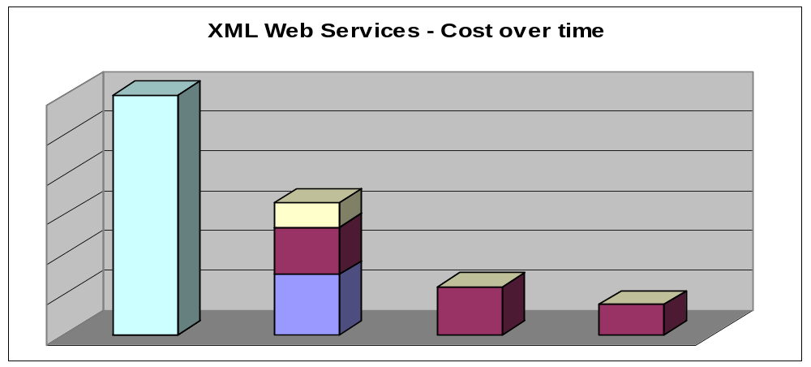
Development Costs Over Time
Return on Investment
Cost to Integrate into Existing Environment
Original Application Development Costs
Costs to Create Registry
XML Web Service Application Development Cost
Total Cost to Expose Web Services on Original Applications
XML Web Service Application Development Cost
XML Web Service Application Development Cost
1st XML Web Service Application
2st XML Web Service Application
3st XML Web Service Application
Notes:
If you have several points, steps, or key ideas use multiple slides. Determine if your audience is to understand a new idea, learn a process, or receive greater depth to a familiar concept. Back up each point with adequate explanation. As appropriate, supplement your presentation with technical support data in hard copy or on disc, e-mail, or the Internet. Develop each point adequately to communicate with your audience.

Slide 49
Integration Costs - Summary
Return on Investment
Cost to Integrate into Existing Environment
Majority of the costs are re-writing original apps to expose services
Future XML Web Services apps may not incur these costs
Follow-on app development significantly lower:
  New app could be reused, so the average costs of development decreases rapidly (see Development Costs over Time chart)
  Learning curve
Notes:
If you have several points, steps, or key ideas use multiple slides. Determine if your audience is to understand a new idea, learn a process, or receive greater depth to a familiar concept. Back up each point with adequate explanation. As appropriate, supplement your presentation with technical support data in hard copy or on disc, e-mail, or the Internet. Develop each point adequately to communicate with your audience.

Slide 50
How to Get There -
Transition Architecture
Define a road map to XML Web Service Oriented architecture
Build and enact Transition Architecture plan
Notes:
If you have several points, steps, or key ideas use multiple slides. Determine if your audience is to understand a new idea, learn a process, or receive greater depth to a familiar concept. Back up each point with adequate explanation. As appropriate, supplement your presentation with technical support data in hard copy or on disc, e-mail, or the Internet. Develop each point adequately to communicate with your audience.

Slide 51
Transition Architecture Plan Steps
How to get there – Transition Architecture
Document the “as-is”
Create the “to-be” XML Web Service vision
Identify Transition Architecture steps
Identify key issues and work-arounds
Build applications that support vision
Implement in phases
Monitor success
Alter implementation plans to optimize success
Notes:
If you have several points, steps, or key ideas use multiple slides. Determine if your audience is to understand a new idea, learn a process, or receive greater depth to a familiar concept. Back up each point with adequate explanation. As appropriate, supplement your presentation with technical support data in hard copy or on disc, e-mail, or the Internet. Develop each point adequately to communicate with your audience.

Slide 52
Transition Architecture Summary
How to get there – Transition Architecture
Transition Architecture enables the creation of a vision and plan to incorporate XML Web Services
Migrate applications over time based on ROI
For all future application development, build with the XML Web Services vision as the guide!
Notes:
If you have several points, steps, or key ideas use multiple slides. Determine if your audience is to understand a new idea, learn a process, or receive greater depth to a familiar concept. Back up each point with adequate explanation. As appropriate, supplement your presentation with technical support data in hard copy or on disc, e-mail, or the Internet. Develop each point adequately to communicate with your audience.

Slide 53
XML Web Services: IS NOT and IS
XML Web Services IS NOT:
  A highly complex technology
  A high-cost proposition
  A skills issue (your developers are probably already experimenting with the tools)
XML Web Services IS:
  A potential political issue – it will not be easy to get all operating groups to cooperate or share the vision
  A cultural change
  A high-value proposition leading to increased revenue and decreased costs
Notes:
If you have several points, steps, or key ideas use multiple slides. Determine if your audience is to understand a new idea, learn a process, or receive greater depth to a familiar concept. Back up each point with adequate explanation. As appropriate, supplement your presentation with technical support data in hard copy or on disc, e-mail, or the Internet. Develop each point adequately to communicate with your audience.

Slide 54
Summary
Your greatest challenge will be to create and communicate the XML Web Service vision
Using the teaming approach to build the Transition Architecture plan will go a long way in moving all toward the common goal
Notes:
If you have several points, steps, or key ideas use multiple slides. Determine if your audience is to understand a new idea, learn a process, or receive greater depth to a familiar concept. Back up each point with adequate explanation. As appropriate, supplement your presentation with technical support data in hard copy or on disc, e-mail, or the Internet. Develop each point adequately to communicate with your audience.

Slide 55
Acknowledgments
Reviewers from:
  Boeing
  Microsoft
  AT&T Wireless
  MS ISM 6910 Seattle Pacific University class
Notes:
If you have several points, steps, or key ideas use multiple slides. Determine if your audience is to understand a new idea, learn a process, or receive greater depth to a familiar concept. Back up each point with adequate explanation. As appropriate, supplement your presentation with technical support data in hard copy or on disc, e-mail, or the Internet. Develop each point adequately to communicate with your audience.

Slide 56
More Information
Website
  scottachristiansen.com
Email
  info@scottachristiansen.com
  chriss@spu.edu
Phone
  425 772-3571
  425 337-2997
Notes:
Determine the best close for your audience and your presentation. Close with a summary; offer options; recommend a strategy; suggest a plan; set a goal. Keep your focus throughout your presentation, and you will more likely achieve your purpose.

Slide 57
THANK YOU
Questions

