Slide 1

DEAR 201
Improving Investment Management
An advanced course on the DOI Enterprise Architecture Repository (DEAR)

Slide 2
Course Topics
What DEAR is
What DEAR is for
DEAR is central to EA
The DEAR metamodel
Parts of the metamodel
Who benefits from DEAR
Using DEAR
Data modeling: IDEF0 and IDEF3
Conclusion

Slide 3
What DEAR Is
Course Topic 1
Review (from the DEAR 101 course) of the DOI Enterprise Architecture Repository.

Slide 4
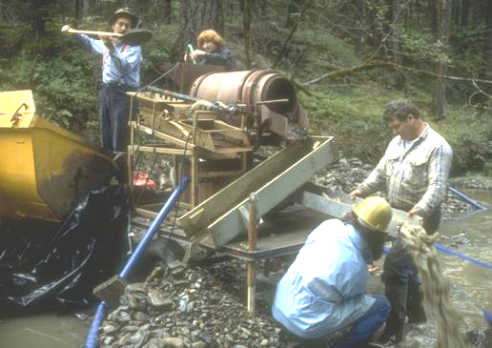
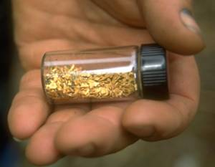
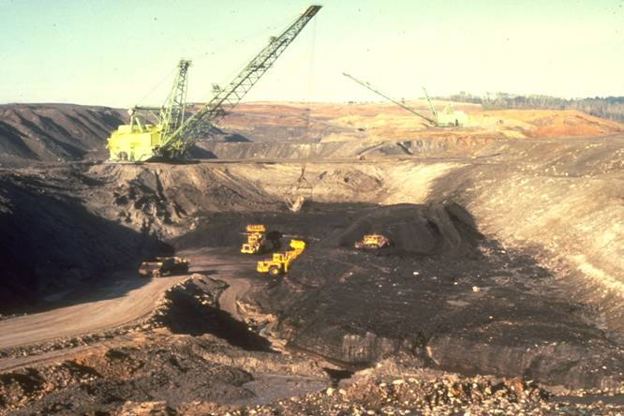
What DEAR Is
DOI Enterprise Architecture Repository
A tool to help you manage IT investments for the best value.
Without DEAR: You don’t know where the business value is; you have to dig up everything.
With DEAR: Less work, less disturbance, more result. You dig only where there’s value.

Slide 5
What DEAR Is
Improves IT decisions by linking data on Interior’s
  Business objectives
  IT systems
  Technology standards
Like a combination of graphics software and database software
  Lets you use text and diagrams together
Used for storing data
  For bureaus: bureau-level data
  For Interior:
    Integrates the data tracked at the bureau level
    Includes significant bureau investments and critical systems
    Relates bureau-level data to Interior objectives and goals
  For enterprise architecture (EA): all architecture-related models, data, and artifacts
Reporting tool: gives decision-makers critical information for analyzing architecture
Source-of-record for architecture information on the systems tracked by Interior or bureaus

Slide 6
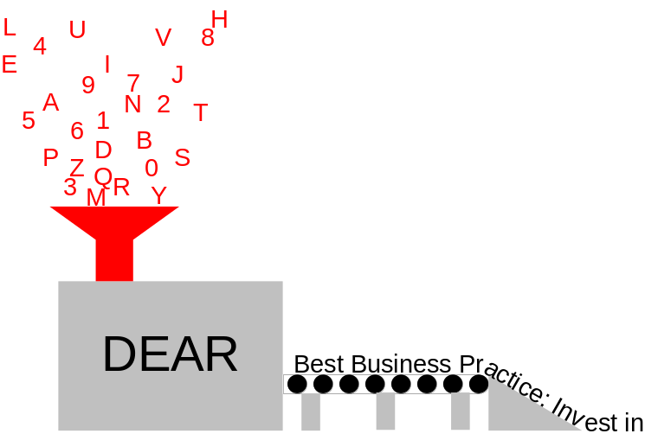
What DEAR Is
Inputs:
  Old stores of data for Interior and bureaus
    All the related information that used to be isolated in unconnected databases
  New data, that’s being collected right now
  Models
    Data models
    Process models
    Enterprise system information
    Federal architecture guidance
    Technical Reference Model (TRM)
    Business Reference Model (BRM)
    Performance measure
  Data on Interior’s
    Strategic goals, objectives, planned outcomes and measures
    Systems and IT investments
    Endorsed products and standards

Slide 7
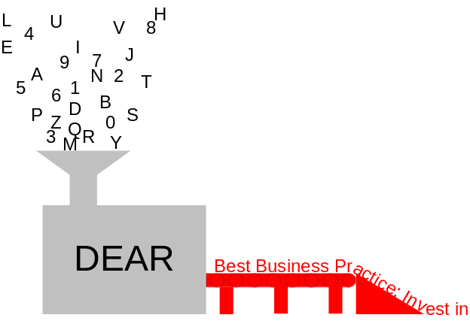
What DEAR Is
Outputs:
  Reports on what processes, equipment, software, data, etc. Interior owns, and where it all is
  Models showing how well Interior fits the federal architecture framework
  Models showing how well Interior meets its own standards
  Reports suggesting where to find cost savings
  Reports showing gaps where we may need new IT systems
  Reports showing overlaps where we need to streamline the IT portfolios
  Reports showing where systems need to talk and don’t
  In general, DEAR maps relationships between the data so it can be analyzed. The analysis drives Interior’s IT investments.
Users:
  People who collect and input architecture data
  People who analyze architecture data
  People who use this information for IT decisions

Slide 8
What DEAR Is
DEAR Is Central to EA
DEAR standardizes data so that it is available for a variety of uses
  EA will not work without this commonality
DEAR also holds the standards to evaluate architecture
EA target models are built in DEAR
DEAR is itself an EA data warehouse
  Combines information from many databases (such as ITIPS) into one store of Interior working data
  Interior EA source-of-record
DEAR reports
  show gaps and redundancies
  track progress toward target

Slide 9
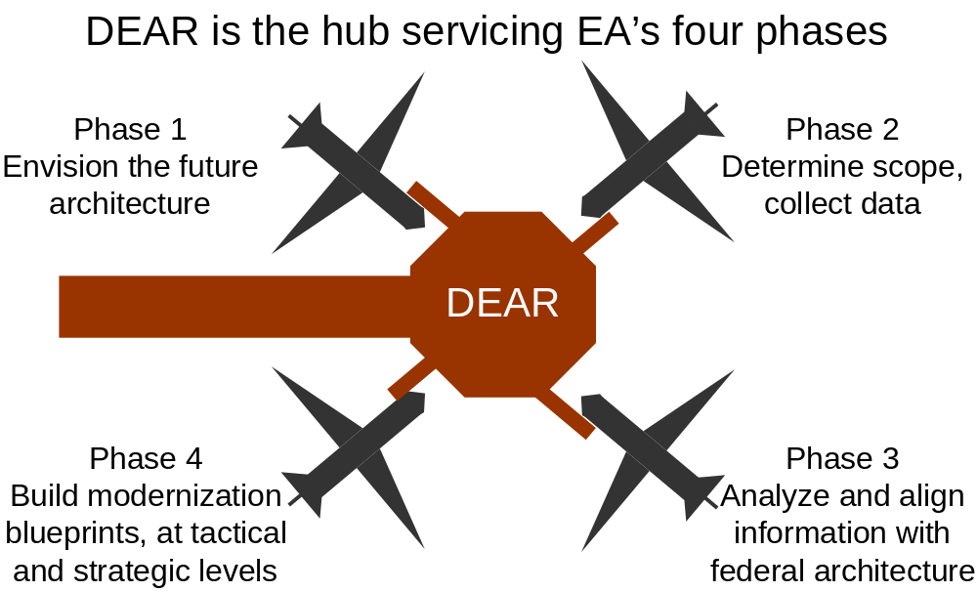
What DEAR Is
DEAR Is Central to EA

Slide 10
What DEAR Is For
Course Topic 2
How DEAR is valuable to the Interior.

Slide 11
What DEAR Is For
EA Phase | EA task | How DEAR is used
1 | Envision the future architecture | Build the architecture model in DEAR, showing how inputs relate to outputs
2 | Determine scope, collect data | DEAR models show the scope; DEAR holds the data
3 | Align Interior architecture with federal architecture | Query DEAR’s models and analyses to compare with federal models
4 | Build modernization blueprints, at tactical and strategic levels | Use DEAR’s information to generate modernization blueprints

Slide 12
What DEAR Is For
The work from phases 1 through 3 all leads up to phase 4: Modernization Blueprints
There are two modernization blueprints, produced and managed in parallel, using DEAR
  Tactical = short-term; what we can get a return on right now
  Strategic = long-term; a broader view on saving and improving
Tactical modernization blueprint assists these decisions:
  O&M
  Project management
Strategic modernization blueprint assists these decisions:
  Investment proposals
  Business cases

Slide 13
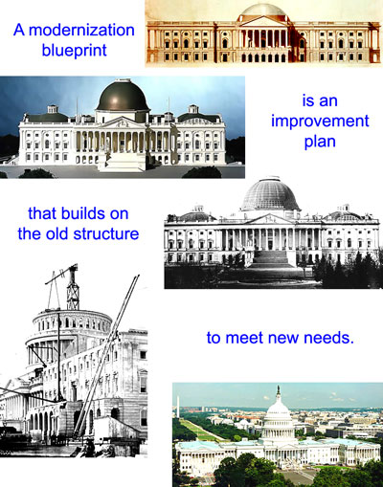
What DEAR Is For

Slide 14

What DEAR Is For
How to use a Tactical Modernization Blueprint
The blueprint shows managers
  Best candidates for tactical improvements
  Estimated time/money involved for each
  Models of architecture: as it now is, and as it should be
  Dependencies
Managers can then
  Define and manage a baseline
  Set improvement targets
  Identify, select, and propose improvements
Analysts use DEAR’s information to create a Tactical Modernization Blueprint Sequencing Plan
  Shows start and finish dates of events
  Shows which events depend on others

Slide 15

What DEAR Is For
How to use a Strategic Modernization Blueprint
Supports
  Mission goals
  Tactical plans
  What phase of investment each system is in
  Systems that overlap (candidates for cost savings)
  Relationships between systems and initiatives (such as e-government)
  Federal guidance on architecture and e-government
DEAR is used to derive a Strategic Modernization Blueprint Sequencing Plan
  Road map to a more cost-effective architecture
  Plan for retiring and re-engineering systems
  Shows which investment proposals are most urgently needed for the future architecture

Slide 16
What DEAR Is For
Value of modernization blueprints from DEAR
Tactical recommendations give managers something to use now, with today’s dollars
  Top-down effect: High-level managers can watch how results affect overall mission
  Bottom-up effect: Practical tool for middle managers’ wise spending
Strategic recommendations give managers an overall business direction for their technology and line of business
  Top-down effect: Practical tool for high-level managers to use in major decisions
  Bottom-up effect: Big-picture view for middle managers to show where business is headed

Slide 17
The DEAR Metamodel
Course Topic 3
How DEAR is designed.

Slide 18

The DEAR Metamodel
Database schema for all DEAR data elements
  Also holds data element attributes
Map of where to put things in DEAR
Describes how the organization is described
Metamodel is to DEAR as an outline is to a white paper
  Tool to organize information
  First step in planning
  Reviewed and improved with each draft, or release, of DEAR
Built through customization code called “userprops” (short for “user properties”)

Slide 19
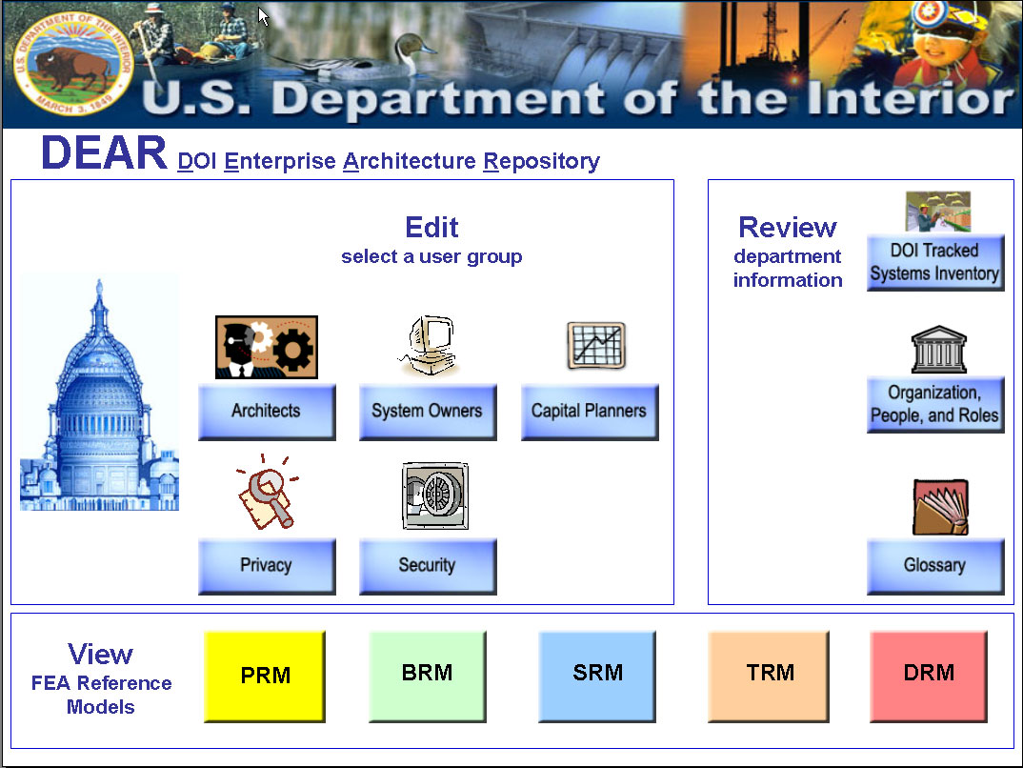
The DEAR Metamodel
User interface
DEAR has a custom user interface
  Administrators can set which data different user types can get to
  Buttons on entry screen show possible selections
  Depends on
    Security needs
    Usability needs
    Editing rules

Slide 20
Parts of the Metamodel
Course Topic 4
Description of the different domains in DEAR, and what each is used for.

Slide 21
Parts of the Metamodel
The entry screen is the interface between the user and the domains in DEAR, protecting the user from the full complexity of DEAR.
Clicking on one of the buttons filters what the user sees.

Slide 22
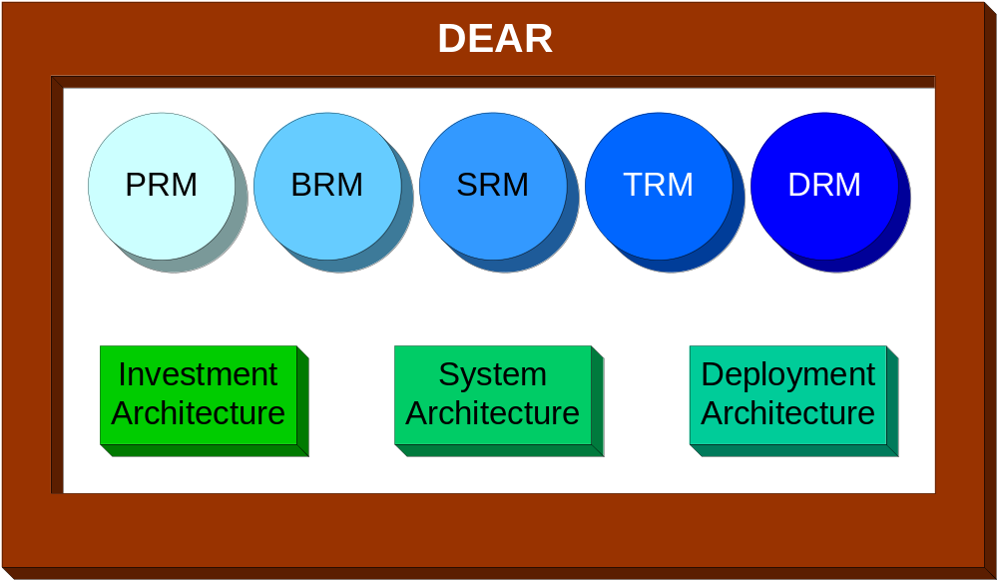
Parts of the Metamodel
DEAR has 8 domains
5 FEA models +
3 sub-architectures
PRM = Performance Reference Model
BRM = Business Reference Model
SRM = Service Component Reference Model
TRM = Technical Reference Model
DRM = Data Reference Model

Slide 23

Parts of the Metamodel
5 domains are FEA models:
PRM—strategy/goals/objectives that drive the architecture
BRM—business functions/activities/processes
SRM—service components, or capabilities
TRM—technology that performs the services, and standards
DRM—data standards and models used by the services

Slide 24
Parts of the Metamodel
3 domains are sub-architectures—other ways to look at the architecture
  Investment Architecture—investment information (pending)
  System Architecture—systems and their building blocks
  Deployment Architecture—where things are
Note: ABC work activities are separate but associated with the PRM.

Slide 25
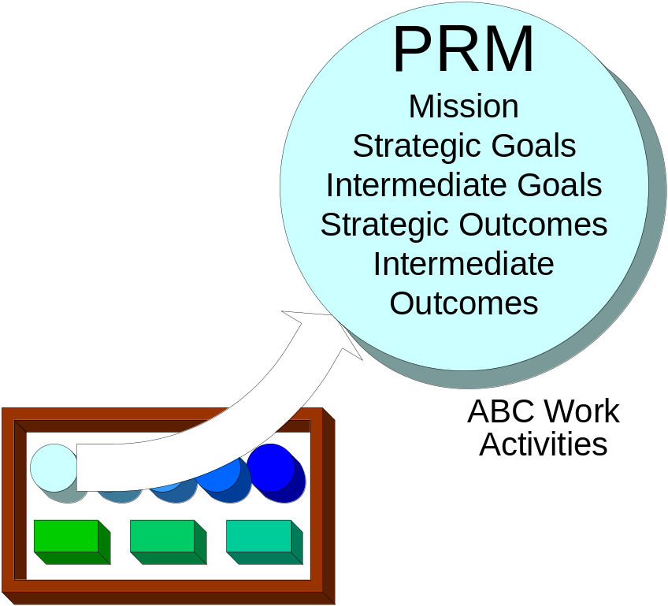
Parts of the Metamodel
PRM: Strategy/goals/objectives that drive the architecture
Contains pieces of Interior’s Strategic Plan
  Goals, objectives, outcome measures
Linked to the ABC work activities (which define work performed) by intermediate outcomes (which define strategic objectives supported)
  Work activities must be linked to goals. DEAR is the only system of its kind to show that link
Linked to the Investment Architecture—investments must support PRM goals from the Strategic Plan

Slide 26
Parts of the Metamodel
PRM: Strategy/goals/objectives that drive the architecture
Linked to the BRM through the ABC work activities.
Example: If the number of oil permits is listed in the PRM, the PRM section of the metamodel may record
  Investments supporting oil permitting
  Systems supporting oil permits
  Oil permit lines of business
  How oil permitting is classified in the Interior-level PRM

Slide 27

Parts of the Metamodel
Potential PRM reports (examples)
List of Interior Strategic Plan pieces that are both classified in the FEA PRM and linked to ABC work activities
ABC work activity report
All the investments and systems, listed by the goal they support
All the ABC work activities, listed by their intermediate outcome goals (by Strategic Plan goals supported)
All intermediate outcome goals that don’t support ABC work activities (may be the ones to eliminate)

Slide 28
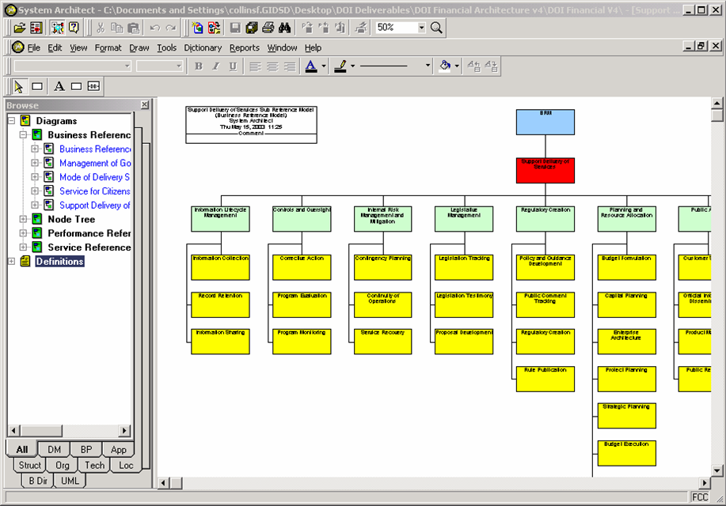
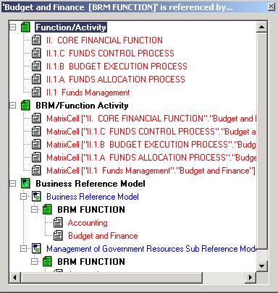
Parts of the Metamodel
BRM: Business functions/activities/processes
Maps Interior business to the FEA BRM
Because the Interior BRM is done in DEAR, when the FEA BRM changes, this can also easily be changed.
Also being in DEAR makes it easy to see where there are many financial systems doing the same function (you can see where it’s redundant)
BRM is linked to the PRM so you can see what business is meeting which goals

Slide 29
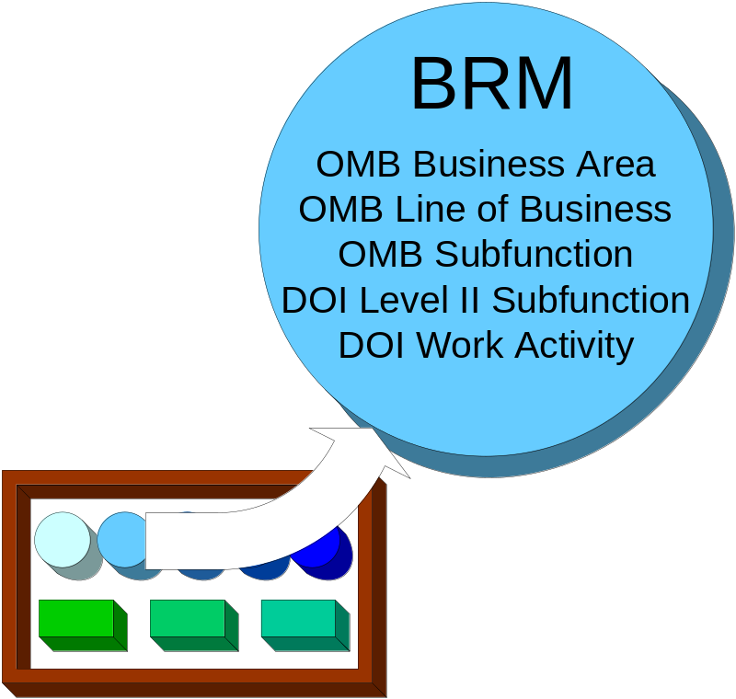
Parts of the Metamodel
BRM: Business functions/activities/processes
Interior’s BRM is built on the pattern of the FEA BRM
The BRM goes down to the level of ABC work activities
Defining these low-level work activities and processes gives everyone in Interior common terms to describe Interior business
Another benefit: these low-level pieces of functions help show the best way to move your IT investments forward
Data in the BRM section of the metamodel might include
  What investments support a work activity
  What sytems support a subfunction

Slide 30
Parts of the Metamodel
Potential BRM reports (examples)
Printout of the BRM with a list showing which subfunctions and work activities support which investments and systems
Investments and systems listed by line of business (such as recreation, law, fire)
Investments and systems listed by FEA business area
All systems with overlapping subfunctions (may be the ones to consolidate)

Slide 31
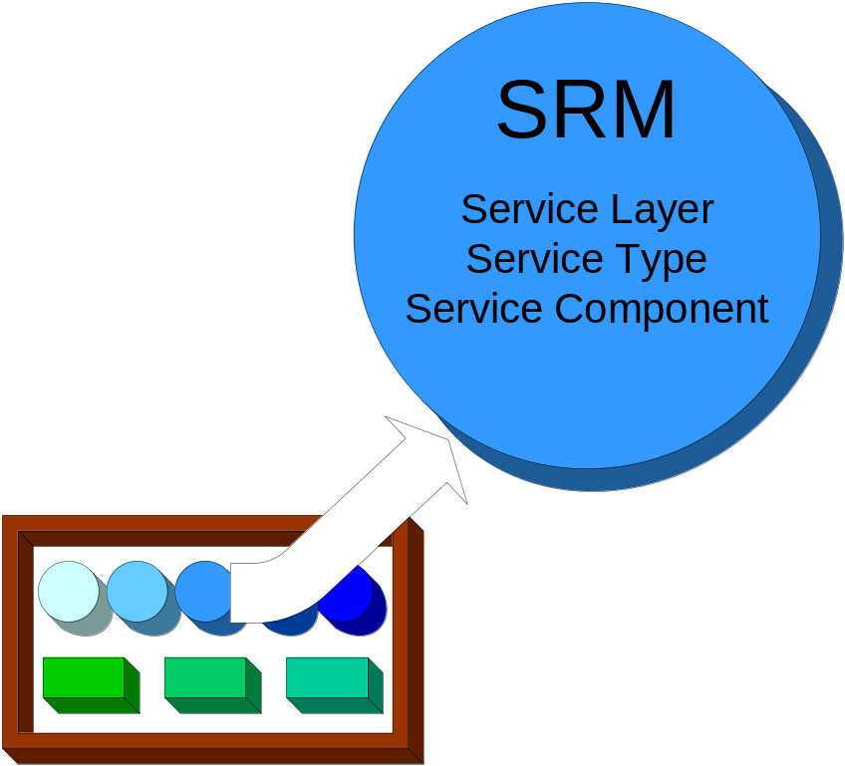
Parts of the Metamodel
SRM: Service components, or capabilities
Interior’s SRM is built on the pattern of the FEA SRM, but adds IT principles and best practices for Interior
The SRM links to the BRM to show which BRM subfunction each SRM service supports.
The SRM also has links to the TRM to show which technologies perform each service.

Slide 32
Parts of the Metamodel
Potential SRM reports (examples)
List of service components
Service components listed by system
Systems listed by service component
Printout of SRM, with links to principles and best practices
How many different technologies or products satisfy a SRM capability

Slide 33
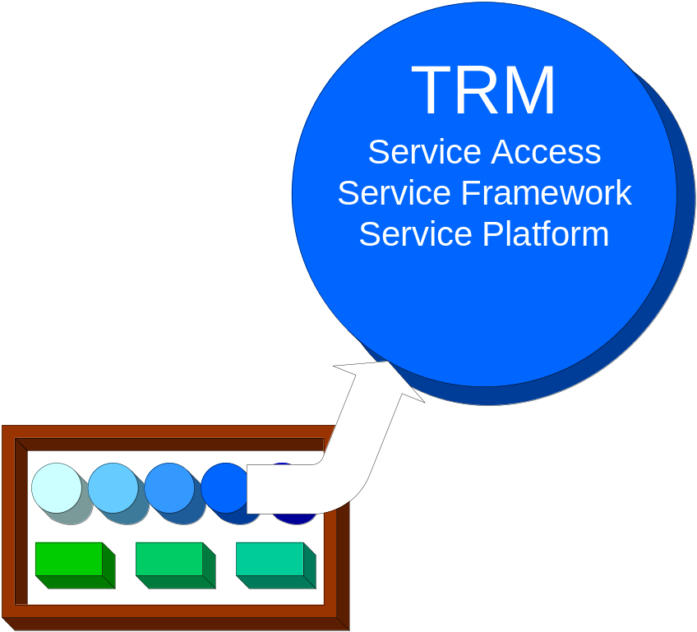
Parts of the Metamodel
TRM: Technology that performs the services, and standards
Interior’s TRM is built on the pattern of the FEA TRM down to the third level (Technology Standards)
Below the third level, the TRM adds details such as Technology Service Specifications for products, specifications, standards and technologies used by Interior and the bureaus

Slide 34
Parts of the Metamodel
Potential TRM reports (examples)
Catalog of TRM products and their classifications
TRM best practices and principles
Report showing which technologies are being replaced
Matrix showing how technologies depend on each other
List of technology products
List of which technology products support which SRM capabilities (service components)

Slide 35
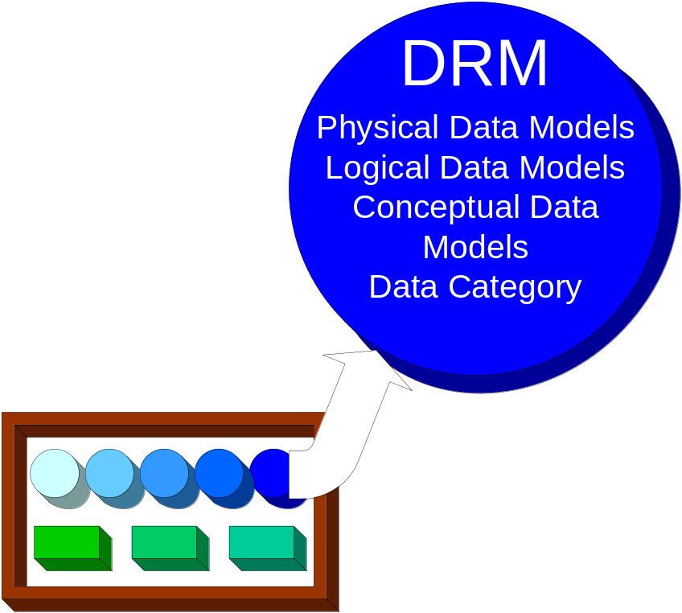
Parts of the Metamodel
DRM: Data standards and models used by the services
FEA DRM is not formally released: Interior’s DRM is built on the best FEA DRM information available
The DRM includes
  Logical data models
  Conceptual data models
  Data categories (groups of data entities, also known as data subject areas)

Slide 36
Parts of the Metamodel
Potential DRM reports (examples)
Physical ERDs / IDEF1x (graphic representations of data, their relationships to each other, and their properties)
Logical ERDs / IDEF1x
Conceptual ERDs / IDEF1x
List of data subject areas
Matrixes showing create-read-update-delete (CRUD) connections
List of which data products support which systems

Slide 37
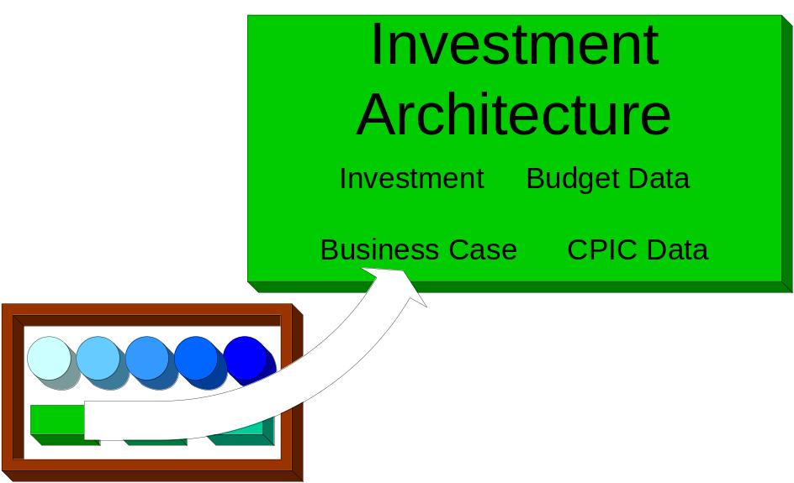
Parts of the Metamodel (Future)
Investment Architecture: Investment information
Project or investment information about the system
Allows investments and systems to be compared:
  Where are they in the investment cycle
  How are they funded
Not the system of record for investment data
DEAR lets you analyze the data

Slide 38
Parts of the Metamodel
Potential investment reports (examples)
Template printout (Word document with all the PRM, BRM, SRM, TRM, and DRM information filled in.) Useful in starting an investment after going through business process re-engineering (BPR) Lab
List of all the investments modeled in DEAR, together with information previously stored in separate databases
Investment requests listed by line of business

Slide 39
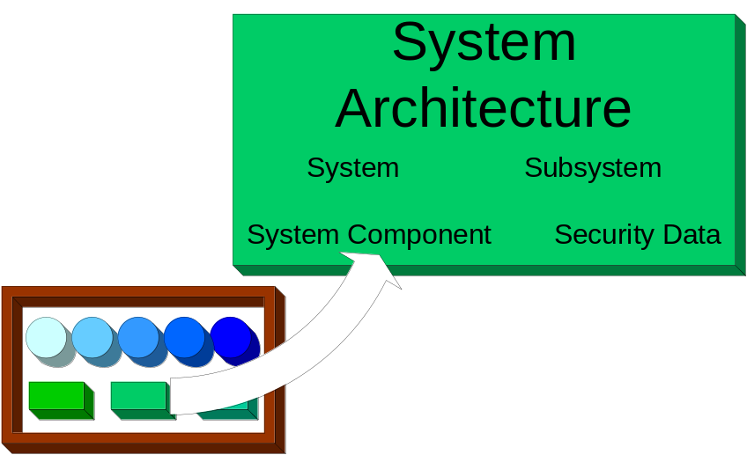
Parts of the Metamodel
System Architecture: Systems and their building blocks
Closely related to investment architecture
Shows how these fit together:
  Systems
  Subsystems
  System components
Describes these things about system components:
  Services they perform (how they fit the SRM)
  Technology they use (TRM)
  Data they use (DRM)
  What business they support (BRM)
  What goals they support (PRM)
Has C&A information to classify systems by whether they are certified and accredited (C&A status)

Slide 40
Parts of the Metamodel
Potential system reports (examples)
Information about the system and its links to other architecture domains (PRM, BRM, SRM, TRM, DRM, investment, and deployment)
Information on how major systems exchange their information
List of technology products each system uses
List of each system’s capabilities (service components)
Report listing systems by
  (Future) Phase in the investment cycle
  C&A (certification and accreditation) classification
  Line of business

Slide 41
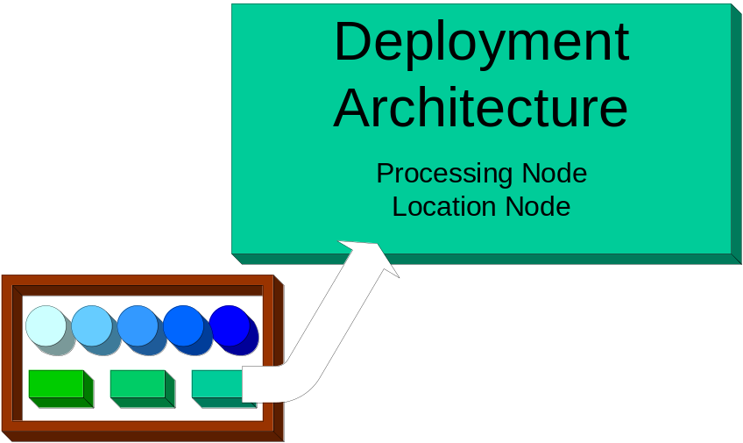
Parts of the Metamodel
Deployment Architecture: Where things are
Shows systems’ physical location and where their processing happens (not necessarily the same place)
Tool for deciding whether systems could be concentrated or moved

Slide 42
Parts of the Metamodel
Potential deployment reports (examples)
List of systems and system components by location
Affinity reports that highlight location of similar systems (shows which systems could be consolidated for the most savings)

Slide 43
Who Benefits From DEAR
Course Topic 5
Who gets what from DEAR.

Slide 44
Who Benefits From DEAR
This type of stakeholder… | Is in this position… | And DEAR helps them with…
Executive | OMB, ITMC, MIT, Agency Head, IRB, OCIO | Vision, guidance, direction
Functional | Agency Sponsor, Project Sponsor, Functional Managers, Program Managers, IBAT | Requirements, portfolio funding requests, acceptance
Execution-Level | Project Managers, System Managers, DEAR IPT | Life-cycle information
Enterprise/Cross-Cutting | Strategic Planners, Investment Planners, IAWG, Security Managers, A-130 Managers | Strategies, plans, integrated views, standards, oversight

Slide 45
Using DEAR
Course Topic 6
Important concepts about DEAR which you will need to understand to use it.

Slide 46
Using DEAR
Subtopics
Encyclopedia
Data input (collecting data)
Data analysis
Data output (creating reports)
Features

Slide 47

Using DEAR
Encyclopedia
The data repository underlying DEAR
  Every bureau has a copy of the encyclopedia, used and edited within that bureau
  “The” encyclopedia is the departmental Production encyclopedia which receives updates from the bureaus
Stable database for information storage
Holds all the components that capture the model’s meaning
  Diagrams, symbols, definitions
  Each encyclopedia component has information in properties or fields about the thing being modeled

Slide 48
Using DEAR
Encyclopedia
Structure is laid out by the DEAR metamodel
  Only privileged users can change the metamodel
One master encyclopedia—the department-level Production encyclopedia
  Not directly editable
  Updated from bureau-level encyclopedias
  Holds a stable copy of all current information
  Used for publishing Interior reports

Slide 49
Using DEAR
Encyclopedia
Why there is a master encyclopedia
Problem:
  DEAR can be useful to bureaus
  Bureaus need control over their own systems
  Interior needs to be able to track systems that cut across bureaus and support the investment process
Possibilities:
  One encyclopedia, many users—department and all bureaus use the same encyclopedia
    Too much information shared
  Many encyclopedias, one user for each—department and bureaus disconnected
    Too little information shared

Slide 50
Using DEAR
Encyclopedia
Why there is a master encyclopedia
Solution: Interior has main encyclopedia, each bureau has a copy
  Bureaus can change any part of their own content
  Bureau copies periodically get merged with the Interior encyclopedia
  Only information specific to the bureau gets merged; no bureau can merge up a change to another bureau
  Interior will not change bureau-specific information
  Metamodel may be extended, but not changed, so the encyclopedias stay compatible for merges
  All department-level reports come from the department-level encyclopedia
Result: Culture of bureaus is respected while still meeting needs of the department. Bureaus have flexibility, but Interior can still track information on cross-bureau systems

Slide 51
Using DEAR
Encyclopedia
Caution: Issues with managing Interior and bureau encyclopedias
Out-of-date interface descriptions
Same name used for different things
Different names used for same thing
Harder to notice conflicts within an encyclopedia
More encyclopedias means more administrator time
Updates in one bureau may occasionally affect other bureaus at the next merge

Slide 52

Using DEAR
Data Input
Normal method: use the menu and browsers to create or update symbols and definitions
Other methods:
  Import definitions
  Reverse-engineer data *
  Reverse-generate code *
  Define a macro to import data
  Use XML Metadata Interchange (XMI)
* Reverse-engineered models are made by taking code and making a model out of it, instead of writing code from a model.
A relational database can be reverse-engineered into a physical data model that shows the tables and their relationships in a diagram.
Class definitions in C++ and Java can be reverse-engineered into a UML Class Diagram.

Slide 53
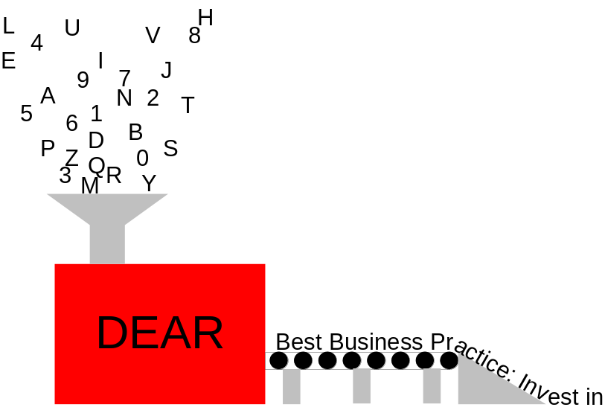
Using DEAR
Data Analysis
DEAR shows relationships between model data definition types, using matrixes
  If there is no relationship, the box where two types intersect will be blank
  If there is a relationship, the box may just have an X or may have a paragraph describing the relationship.

Slide 54

Using DEAR
Data Output
DEAR is not just for storage; all the intellectual resources stored in the models need to be distributed to the people who make decisions, through reports
Reports can be produced in many forms for a wide audience:
  Simple query reports
  DEAR-generated documents
  HTML pages
  Database schemas
  DEAR-generated code
  Data exported to simulation tools

Slide 55

Using DEAR
Data Output
Query language is used to get report information from the encyclopedia
Many report templates (Standard Report files) to use or modify
Send report directly to printer, or format it with Word for more clarity
Diagrams can be published in HTML
  Symbols and definitions can be linked to explanatory pages for readers’ convenience

Slide 56






Using DEAR
Features
Supports many users at the same time
  Inactive users get kicked off after a set period so someone else can use the license
Check-out feature
  Changeable to the one who checked it out
  “Read-only” to everyone else
Freeze feature
  Unchangeable until unfrozen
  “Read-only” to everyone
  Only administrator can freeze or unfreeze
Supports many
  Modeling techniques
  Types of databases
  Programming languages

Slide 57
Using DEAR
DEAR Features
For this kind of work | DEAR gives you these tools
Business Process Re-engineering (BPR) | IDEF0 function modeling, IDEF3 process flows, IDEF1X data models, *BPMN (support for v0.9 of BPMN, generation of BPML and BPEL4WS)
Structured systems analysis and design | Gane and Sarson, Ward/Mellor, SSADM, Yourdon/DeMarco.
Data modeling | Entity relation models, physical data models.
Object Oriented Analysis & Design | UML, OMT (Coad/Yourdon, Booch 94, Shlaer/Mellor)
Extensible Markup Language (XML) | XML diagram – generation of BizTalk and DTD
Data modeling database support | Reverse data engineering into, and schema generation out of, physical data models, using AS400, Oracle, SQL Server, dBASE, OS/2, SYBASE10, DB2, Paradox, Teradata, INFORMIX, Progress, WATCOM, Ingres, RDB, XDB, InterBase, SQLBase, Microsoft Access, SQL Anywhere
Object-Oriented (OO) language support | Support for generating languages from OO diagrams (includes reverse code engineering options for C++ and Java). Languages include C++, Java, CORBA, Visual Basic
Documentation | Supports web publishing with HTML, also links to Microsoft Word 97 and 2000

Slide 58
Data Modeling: IDEF0 and IDEF3
Course Topic 7
A brief description of the two main types of data modeling.

Slide 59
Data Modeling: IDEF0 and IDEF3
Brief introduction to the data modeling diagrams used in DEAR
DEAR uses IDEF diagrams, especially IDEF0 and IDEF3 diagrams
Boxes and arrows make a model as words make a story
Easy to expand into deeper detail
Widely used in government, industry, and commerce
Way to communicate about processes, to build consensus
Shows up no-value processes
Shows up processes with lots of improvement potential
Used for activity modeling; complements data modeling
IDEF0
Shows main inputs and outputs
Shows what you need to do the activity
Shows forces controlling the activity
Simple picture of an activity, showing just inputs, outputs, controls, and mechanisms (ICOMs)
Answers question “What do we do?” (or at least “What should we be doing?”)

Slide 60
Data Modeling: IDEF0 and IDEF3
IDEF3
Describes a process
Includes time information
Shows the order in which things happen
Shows what causes what
Shows how decisions are made and how the decisions affect shared data
Helps analyze trade-offs of system design changes
Good way to record data on how systems work after interviewing system experts
For more on IDEF modeling, see http://www.idef.com

Slide 61
Conclusion
Course Topic 8
Summary and references.

Slide 62

Conclusion
Now: We’re using DEAR to collect data to model the architecture we have now.
Next: We will analyze the data in DEAR and find the best direction to move forward
Finally: We will use DEAR to create the modernization blueprint that will get Interior’s key business areas to the architecture we want to have

Slide 63

Conclusion
Remember
DEAR is a method of communication; a way for many contributors to come to a shared understanding
DEAR has the potential to give decision-makers vital information at the time they need it
DEAR makes life easier for EA modelers
But…
The ultimate purpose of DEAR is not to build successful models, but a successful Interior!

Slide 64
For More Information: Contacts and References
Colleen Coggins—Interior Chief Architect, (202)208-5911, Colleen_Coggins@ios.doi.gov
  Jim Johnson—Interior Business Architecture (IBA) Contract Team Lead, (202) 452-7733, James_Johnson@blm.gov
  Jim Barrett—IBA Contract Technical Lead, (303) 236-5353, James_Barrett@blm.gov
Draft DEAR metamodel: http://www.doi.gov/ocio/architecture/dear/
Popkin website: http://www.popkin.com

Slide 65
Document Abstract
Key Words: | Architecture, curriculum, DEAR 201 | FEAF Area: Subject Function Code: | M 1230 | Contract #: NBD020221 Task Number: 8
Part of the Architecture Curriculum for the Communications task
Revision History
Doc Status | Rev. Date | Author/Editor | Description of edit | Filename/lineage
WIP | 11/07/03 | Karen Tallentire | Made Colleen’s changes from draft | S:\Dear\IBA\WIP\Communications\Architecture Curriculum finals (sent to Colleen)\DEAR 201

