Slide 1

AHIC
Business Model for the Successor Organization to AHIC
Sharon Benjamin
Lisa Kimball
Curt Lindberg
703-836-1303
sharon@sharonbenjamin.com
June 2007

Slide 2
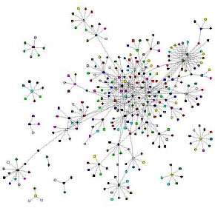
It’s About the Network
Notes:
The environment within which the successor to AHIC will operate will be a complex network of stakeholders and activities. We recommend that the AHIC successor focus on playing a significant role in brokering connections, catalyzing innovation, and facilitating communication. The successor to AHIC can help foster smarter, more effective networks of networks by understanding that its role is not to control but to enable and facilitate.
Our team brings to this task deep understanding about and experience with networks, change, scaling, and diffusion of innovation. We have significant experience working on cutting edge projects applying these concepts in the field of health care. Our recommendations will focus on some key dynamics that we believe are essential to the scale and complexity of this challenge as well as some specific ideas about ways to kick start the process. We expect others to be better positioned to contribute ideas about the policy and administrative dimensions of the task but we have included thoughts about ways to think about these that we believe will enable the needed system design.
Network graphic courtesy of Valdis Krebs http://networkweaving.com
Additional notes are included in the Slide Notes: Supplementary Material

Slide 3
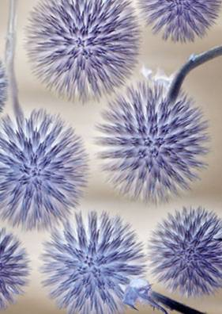
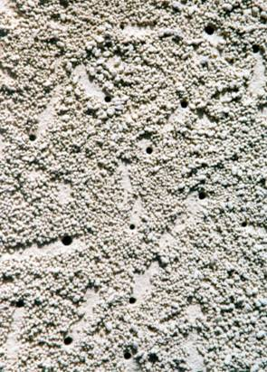
Managing the Unknowable:
Accepting An Unforeseeable Future
Notes:
One of the biggest challenges for the AHIC successor is to provide leadership and set policy for a health care system that is, and will continue to be, changing continuously in ways that cannot be predicted. Leaders of complex systems sometimes joke that it is like trying to change a tire on a car while it is going 50 miles-per-hour. In such systems, complexity science offers some useful principles about system dynamics.
Complexity science is a discipline that is providing important new insights into how living systems self-organize, evolve and adapt as a result of emergent and nonlinear interactive processes. It has been called the science of the 21st century by Stephen Hawking and was recently embraced by the Institute of Medicine “as a guide in formulating its agenda for change” for the U.S. healthcare system (Crossing the Quality Chasm: A New Health System for the 21st Century). This emerging science represents an intellectual revolution that is transforming our understanding of life – its structures and functions, its care and well-being.
Additional notes are included in the Slide Notes: Supplementary Material

Slide 4

Form follows Function
What business model will enable the new organization to facilitate the key processes needed to steer the community toward the mission?
What mechanisms will enable it to effectively…
  Convene the diverse community around conversations and decisions that matter
  Catalyze innovations
  Engage peer-to-peer learning
Notes:
Wide-spread diffusion and adoption in a field with fast-changing technology requires multiple, different mechanisms each of which needs a different form in which to thrive.
A mechanism to draw ideas IN from the periphery to the network core: surface ideas, process ideas, synthesize ideas, choose ideas, publish ideas, promote ideas through high quality engagement with and among diverse stakeholders
A mechanism to ignite creativity and catalyze research, experimentation, entrepreneurship, skunk works, and lots of independent action by big and small players working independently and in collaboration
A mechanism to circulate insights, foster collaborative learning and support local, differentiated problem-solving around specific applications and challenges
Putting everything into a homogenized, single structure will reduce the ability to support any of these mechanisms effectively.

Slide 5
Different Models for Different Tasks
We recommend three distinct models:
  The Health Information Roundtable
  Innovation Fund
  Diffusion Network
Additionally, we recommend that HHS’ ONC and other HHS functions should continue their important roles as representatives of the public at large.
Notes:
When the challenge is about dynamics of diffusion of innovation and scaling, a network approach is required. Based on our understanding of the pattern dynamics associated with high functioning networks, we believe that a single business model cannot provide a container adequate to the tasks HHS and AHIC now face. There are at least three major ways in which the successor can and should “steer” the network and each requires a different set of relationships, incentives, and strategies for facilitation.
Therefore, rather than designing ONE entity to serve as the AHIC successor, we recommend creating a set of multiple, synergistic initiatives that
Health Information Roundtable*
Innovation Fund
Diffusion Network
We heard from multiple sources that the most successful activities of the current AHIC have been those that have been highly focused on core issues and that AHIC has suffered from “scope creep” Several sources expressed concern that trying to tackle too many different things at once has watered down AHIC’s ability to make significant progress on the core initiative of establishing a national system of interoperable electronic health records.
*This new entity might be called “AHIC” or Health Information Consortium, or Network. But, since some of those names are very similar to current organizations, we’re using “Health Information Roundtable” to make the distinction for the purposes of this presentation.

Slide 6
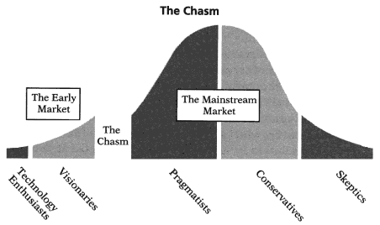
The HIT Adoption Challenge:
Crossing the Chasm
Notes:
This alternative version of Everett Rogers’ technology adoption is an adaptation of the original that includes a gap in the bell curve, between early adopters and the early majority. This essentially splits the innovation adoption process into three distinct phases, an early market and a mainstream market, separated by a period of time called the valley of death where uptake slows or even stops. This curve is appropriate for discontinuous innovations where the new technology forces the user to change behavior. The “chasm” represents the gulf between two distinct marketplaces for technology products – the first, an early market dominated by early adopters and insiders who are quick to appreciate the nature and benefits of new development, and the second a mainstream market representing “the rest of us,” people who want the benefits of new technology but who don’t want to experience it in all its gory details. The transition between these two markets is anything but smooth.
This deep and abiding chasm between early adopters and the early majority has significant strategy implications for the effort to achieve widespread adoption and use of HIT because approaches that work to engage the early adopters in the community will be unsuccessful in attracting the mainstream. Our recommendations for an AHIC successor are based on the need to not only create the means for developing required technology but also the compelling need to create the structures and processes essential to the ultimate adoption of the technology (and associated processes) by the mainstream health care community.
Current usage of EHRs is extremely low in the health care sector – gaining greater adoption across the sector will not be a linear process. In fact, great adoption will require crossing the chasm.
Diagram Source: Crossing the Chasm by Geoffrey A. Moore, Harper Business, 1991
Additional notes are included in the Slide Notes: Supplementary Material

Slide 7
In the Short Term
Create roadmaps owned by the communities involved that identify and define shared objectives
Kick start technical development to open standards by a target date
Take advantage of on-going pilots and launch multiple new experiments and pilots
Nurture the key relationships among stakeholders
Establish a vigorous, aggressive and responsive technical assistance network
Notes:
Clearly, there are many experiments and pilot projects currently underway. AHIC would provide a concrete service to the healthcare community by issuing a (series) of assessments of the lessons learned both from the most promising and failed initiatives in the form of white papers and bulletins. Additionally, we find an enormous, relatively unrecognized need for additional support for the existing but informal EHR technical assistance network that currently exists.
During our research we were repeatedly referred to the story of a small, community-based hospital in Midland, TX which, through a combination of financial need and technical moxie downloaded the code for the VA’s EHR system to design and build their own system. Apocryphally, the story is that the initial bid from an EHR vendor was for a $25 million dollar system. We’ve heard the story confirmed from multiple sources and key facts about this case include: the poor payer mix of the community, the fact that the physicians in the system were community-based and therefore the hospital could only persuade, not compel, them to use the new system and that the project was completed including hardware acquisition and staff training for under $7 million. Additionally, many outside observers note that the VA system wasn’t a perfect fit for the hospital because it lacked several key software modules including one for Emergency Room Treatment and OB-GYN services.
What is apparently less widely known, are several additional factors that we believe may have allowed this small hospital in Texas to succeed. First, the hospital is a member of VHA and had strong relationships with a wide network of similar hospitals facing the same difficulties. Second, and of even more interest, is the fact that this small hospital did not have to create the missing modules on its own. The Maternity Module was adapted from a sharing initiative with a large public hospital system in Mexico which had built and was using this module.
This case is a good example of how these short term goals can jumpstart EHRs in even the most unlikely systems.

Slide 8
Health Information Roundtable*
Set bold direction and catalyze the conversation about the role and power of Health IT in the community of stakeholders
Create and manage “roadmaps”
Establish “min specs” for technology development and certification
Identify and use leverage points: government policy, industry incentives, sector engagement
Delegate key authorities (for example to CCHIT for certification)
Coordinate with local, regional, and federal government bodies with related oversight responsibilities for privacy and security issues.
Notes:
*Note: it may make sense to call the new organization AHIC or Health Information Network or one of the other names already in use. However, for purposes of clarity in this presentation we will use Health Information Roundtable (HIR). We recommend a term like “roundtable” rather than “association” because its connotations suggest more flexibility in structure and governance.
We envision an AHIC successor entity that could convene conversations about small changes that could amplify into large impact and structural and network solutions between and across healthcare systems.
The two keys to success in this role are the full participation of the stakeholder community and collaborative nature of the bottom-up policy development process.

Slide 9

HIR: Distributed Control
Distributed Control:
In a Complex Adaptive System control is shared by many elements, rather than centralized in a single command center
Coexistence of
Order and Disorder:
In a healthy adaptive system, order and disorder coexist

Slide 10
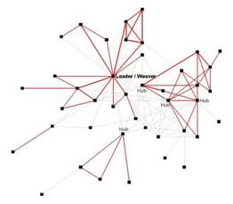
HIR Ecosystem
Members
Advisory Councils
Board
Work Groups
Collaboration Forums
Notes:
Note: Adopting the “memo of intent” strategy to catalyze the formation of HIR means that neither HHS (nor AHIC) will have direct control over dictating the details of how HIR will be structured and governed. However, the following are recommendations that could be shared with potential HIR incorporators and some might be included as criteria in the memo of intent.
HIR would be organized as a permanent network of stakeholders and would provide service to industry (the developers and vendors), healthcare providers (the buyers), policy makers and patients. Membership in HIR would be open to all with an interest in the mission organized into an ecosystem of related elements including: some kind of Board (or steering committee), Members, Advisory councils, Collaboration forums, Work groups
Straw man HIR structure
The HIR Board and staff should reflect the diversity of stakeholders invested in the mission of the organization. The Board is elected by the membership (see membership slide) in a manner to ensure diverse stakeholder representation on the Board. A Nominating Committee would seek to ensure that the HIR Board is composed of members who in the aggregate display diversity in geography, culture, skills, experience, and perspective.
Additional notes are included in the Slide Notes: Supplementary Material

Slide 11
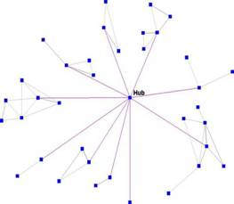
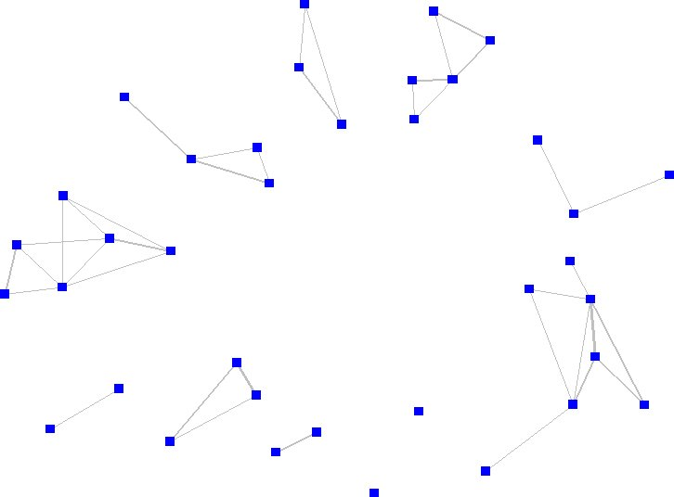
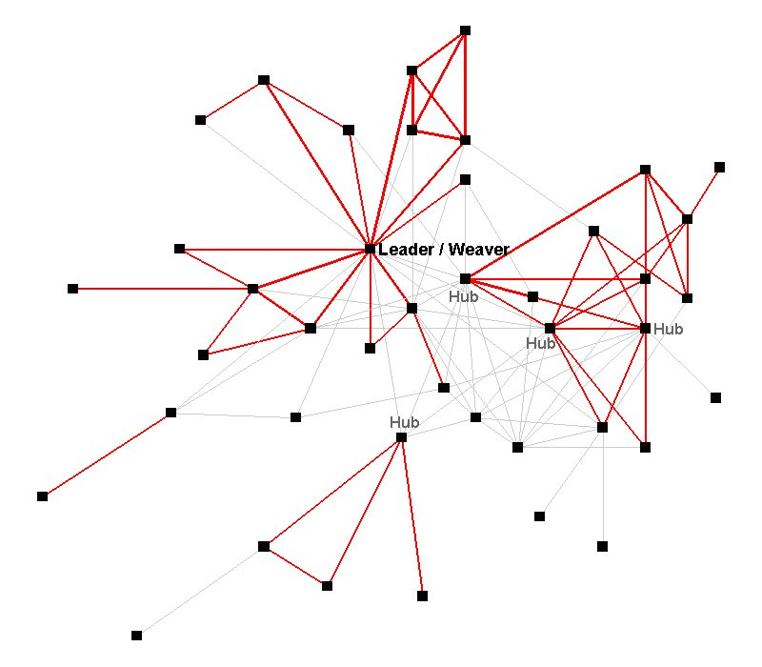
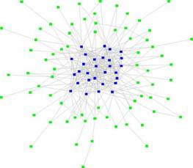
Stages of Network Development
Stage 1: Scatted Clusters & Unconnected Individuals
Stage 2: Hub & Spoke
Stage 3: Multi-hub Small World
Stage 4: Core -Periphery Network or Smart Network
Notes:
A vibrant community network is generally built in four phases, each with it’s own distinct topology. Each phase builds a more adaptive and resilient network structure than the prior phase. The current environment in which AHIC appears to be operating is somewhere between Stage 1 and 2 in terms of development. We are recommending that the AHIC successor be capable of evolving from being a single hub to facilitating the evolution to a multi-hub small world network and ultimately to a complex smart network. We have identified four stages of “smart networks” as follows:
Stage 1: Scatted Clusters and Unconnected Individuals: Without active leaders who take responsibility for building a network, spontaneous connections between groups emerge very slowly, or not at all
Stage 2: Hub and Spoke Network: Network weavers begin with a hub and spoke network, with the weaver as the hub. The weaver has the vision, the energy, and the social skills to connect to diverse individuals and groups and start information flowing to and from them.
Stage 3: Multi-Hub Small World Network: In healthy networks, the spokes of the hub do not remain separated for long. When other hubs [network weavers] are emerging in the network, the various weavers begin to connect to each other, creating a multi-hub community. Not only is this network topology less fragile, it is also the best design to minimize the average path length throughout the network – remember, the shorter the hops the better for work flow, information exchange and knowledge Sharing.
Stage 4: Core-Periphery Network or Smart Networks: The end-goal for vibrant, sustainable community networks is the core/periphery model. This topology emerges after many years of network weaving by multiple hubs. It is a stable structure that can link to other well-developed networks in other regions.

Slide 12
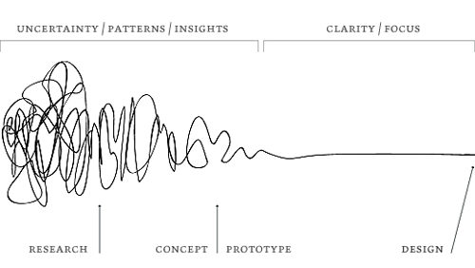
Innovation Fund
In addition to creating a Health Information Roundtable, we recommend establishing an Innovation Fund as a strategic investment mechanism to support collaborative research, development and innovation projects that are of importance to the mission of ONC, the new Health Information Roundtable and to meet anticipated unexpected needs.
Notes:
The overall goal of innovation funds is to mobilize interesting partnerships (university, research lab, private/public) that:
stimulate local innovation and learning-centered action
give rise to more replicable and sustainable practice
lead to long-term improvements in practices and resource management
impact favorably on underserved in terms of processes, outcomes and spread.
Although an option would be to place an Innovation Funding strategy within the HIR, we believe that it might produce more creativity to use a funding strategy to create a network that could include a diverse set of players including academic institutions, skunk works within existing research institutions, independent developers & entrepreneurs, as well as government and non-government organizations.
Graphic: The Design Process from a great height from Central Office of Design http://www.leadershipnow.com/leadingblog/2006/06/problem_solving_with_a_design.html
Additional notes are included in the Slide Notes: Supplementary Material

Slide 13
Diffusion Network
Biggest problem is USE v. development
Need for regional outreach mechanism “technical assistance” meaning assistance with application (not just technology)
Competitive markets take care of technical development, but aren’t good at social development
We recommend creating a network of regional and local entities that can support adoption and adaptation
Notes:
AHIC has begun the process of identifying, nurturing and creating diffusion networks and this momentum is key to the future. AHIC work groups and other AHIC networks, such as the state networks, are important relationships to tend and grow. Beyond existing networks the successor organization to AHIC has an important role to play as a network weaver.
For example, the European Institute for Health Records established a network of national non-profit organizations (the "ProRec centres).
The scope of the ProRec centres may, for instance, include: analyses of the field situation regarding EHRs from different perspectives, conceptual work to inspire proposals of a political nature. These ProRec centres may also make suggestions to public authorities on technical analysis work to study generic specifications (e.g. European or international standards) which might require specific adaptation. Thus, the ProRec centres may also make suggestions on the development of standards-setting organizations and authorities.

Slide 14
Diffusion Network:
Theory of Action
Knowledge does not change behavior
It is easier to act your way into a new way of thinking than it is to think your way into a new way of acting.
~ Jerry Sternin
Notes:
This quote from Jerry Sternin, Director of the Positive Deviance Initiative at Tufts University is an important lesson for AHIC and its planned successor which can be learned from another intractable problem in healthcare.
Organizations spend millions on change strategies focused on identifying “best practices” and disseminating them through training and knowledge management initiatives. When they don’t get the change they hoped for they tend to blame the training design or look for ways to attract more people to the solutions database or make it more “user friendly.” They think, “If only we could explain to people what they should do more clearly, more often, or more creatively they surely would start doing what we want them to do!”
One significant example of this approach in healthcare has been the attempt to reduce and eliminate the transmission of hospital acquired infections. Although some aspects of this problem can be solved with new technology or breakthroughs in medical practice, many problems turn out to be simple in the sense that changes in how caregivers do basic things – like hand washing – turn out to make the difference. Methicillin Resistant staphylococcus aureus (MRSA) is an antibiotic resistant bacteria that is especially deadly for the very young, the very old, and those with compromised immune systems. Because MRSA bacteria survive on people’s hands and on other surfaces such as clothing, furniture, and medical instruments the primary means of MRSA transmission is via health care workers themselves. Everyone “knows” which practices keep that from happening but few hospitals have figured out how to get everyone to comply with these practices. It turns out that the challenge is not about disseminating the handful of best practices but rather discovering and supporting the thousands of individual and local adaptations necessary to make adopting the best practices possible by different people in different environments.
Additional notes are included in the Slide Notes: Supplementary Material

Slide 15
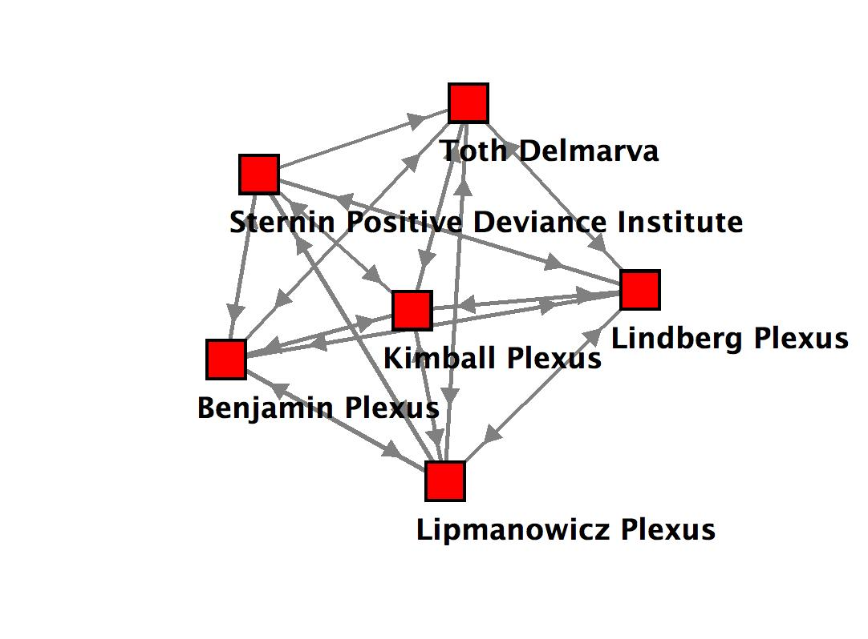
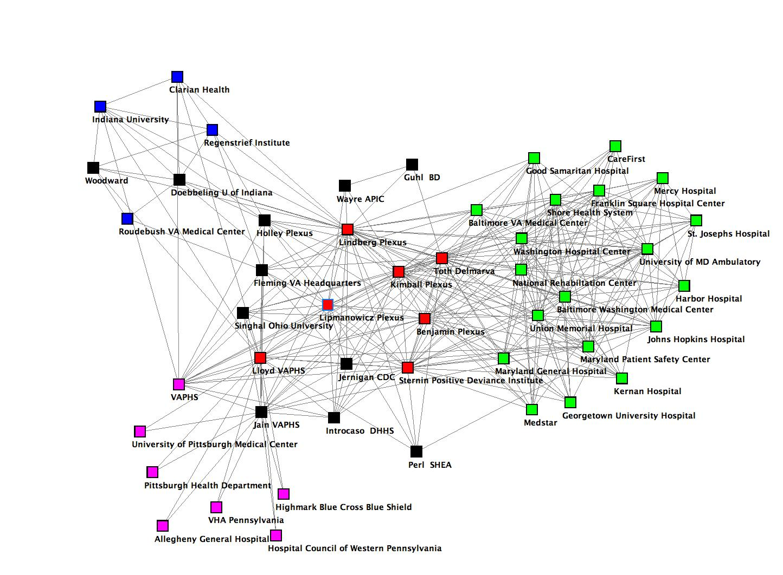
Diffusion Network: Outcomes
Innovation Learning Network example
MD MRSA network example
Early Stage Network
Developing Network
Notes:
Social Network mapping can illustrate outcomes from this kind of network strategy. The illustration above shows the same network at an early/beginning stage and again at a later/developing stage. The first map below shows the Plexus Institute related MRSA network in 2005, the second map shows portions of the network at the end of 2006. A quick scan of the 2006 network shows the emergence of regional networks (shows by different colors) and the beginnings of inter-regional connections.
The Innovation Learning Network is an international learning consortium of healthcare organizations engaged in cutting-edge innovation work. ILN is advancing technology and workflow with an eye toward disseminating innovations internally and externally. The ultimate goal is nothing less than the widespread transformation of health care. A learning network with regularly scheduled conference calls, a knowledge management wiki, and three in-person meetings have been successfully launched. Project themes include: personal electronic health records; virtual simulation technologies; medication reconciliation; social network analysis to help spread innovations; personal mastery in sponsoring, championing, and measuring innovation; and, an innovation “toolkit.” ILN was started with generous funding from the VHA Foundation www.vhahealthfoundation.org/vhahf/ which continues to be a partner and helps guide ILN’s approach to collaborative learning and "socially inventive" innovation practices. As noted in the VHA Case Study building relationships is at the core of VHA’s work and the organization provides multiple opportunities for members to connect and work collaboratively. This happens in VHA’s 17 regional offices, at the national level and through a wide variety of activities where members come together at both regional and national levels to work collaboratively on issues they deem important.
Additional notes are included in the Slide Notes: Supplementary Material

Slide 16

Power the transition
with multiple,
simultaneous actions

Slide 17
Nature is not economical of structures—only of principles.
~ Abdus Salam
Winner Nobel Prize
for Physics, 1979

Slide 18


Principals
Sharon Benjamin
sharon@sharonbenjamin.com
Lisa Kimball
lisa@groupjazz.com
Curt Lindberg
curt@plexusinstitute.org

