Slide 1
Electricity Requirements for a Digital Society
Walter S. Baer
RAND
baer@rand.org
NREL Energy Analysis Seminar
June 12, 2003

Slide 2
Project Objective and Approach
Objective: Assess the nation’s electricity needs as the U.S. evolves toward a digital economy and society
Approach:
  Identify key ICT drivers and likely impacts
    ICT= Information & Communication Technology
  Develop 20-year scenarios with alternative paths of ICT development and use
  Evaluate scenario implications for electricity consumption and supply

Slide 3
What Characterizes a Digital Society?
  Universal access to ICT equipment and services
  Pervasive use
  24-7 availability
    “always on”
    “anytime, anyplace”
    “death of distance”
  ICT becomes embedded and invisible
  Public trust in ICT networks for mission critical functions

Slide 4
Outline
  Information and communications technology (ICT) scenarios
  Implications of scenarios for U.S. electricity use
  Implications of scenarios for U.S. electricity supply
  Study conclusions and recommendations

Slide 5
Why Focus on Hard-to-Predict
Long Term Developments?
  This is not a 20-year forecasting exercise
  Scenarios depict ICT drivers of electricity use and the uncertainties surrounding them
  Scenarios can reveal mismatches between ICT-driven needs and energy technology availability
  Scenarios can inform R&D decisions and suggest hedging strategies

Slide 6
Scenarios Contrast Likely ICT Trends from Uncertain Trends
Examples of probable ICT trends:
  Moore’s Law holds for at least 10 more years
  Wireless networks become ubiquitous
  Networked sensors and devices proliferate rapidly
Examples of plausible but uncertain trends:
  Cities build ICT-rich Intelligent Transportation Systems
  Telework leads to significant population dispersal
  E-commerce cuts demand for commercial retail space

Slide 7
Recurring Themes in ICT Development
  Contradictory trends proceed simultaneously
  Hard and soft infrastructures reinforce each other
  Technologies become invisible as they proliferate
  Technology bottlenecks move from hardware to software to human factors
  Adoption/diffusion time, not technology, is the primary rate limiter
  Unplanned and mostly unintended consequences dominate long-term outcomes

Slide 8
Scenario Development Aided By
Focusing on Two Driving Dimensions
We selected these dimensions:
1. Level of ICT use and trust
  Use more important than technology
  Use correlated with trust and confidence
2. Centralized or distributed control
  Important both for ICT and energy systems
  Choices lead to different evolutionary paths

Slide 9
ICT Common Scenario, 2001-2006
Locus of Control
Centralized Distributed
Low High
Level of Use & Trust
2006
2001

Slide 10
Four ICT Scenarios Through 2021

Slide 11
2021 Reference Scenario
2001-2006 trends extended and/or modified:
  Moore’s Law slows after 2015 for computing and storage, but not for optical bandwidth
  Smart embedded devices, voice control, complex software agents, biometric ID, MEMS in general use
  Relatively high use of and confidence in the Net
  Balance between centralized and distributed control, although more distributed than in 2006
  ICT problems and issues persist, but U.S. society has achieved generally workable solutions

Slide 12
“ Zaibatsu” 2021
Higher ICT use, more centralized control
  Large corporate conglomerates own ICT infrastructure, dominate e-commerce and other ICT applications
  Emphasis on wired over wireless infrastructure
  Most population, GDP growth in cities and suburbs
  Investment in intelligent transportation systems eases commuting, results in less telework than Reference
  Tight security, harsh laws keep cybercrime controlled
  Very little privacy, but accepted by most people
  More emphasis on grid, somewhat less on DER

Slide 13
“Cybertopia” 2021
Higher ICT use, distributed control
  ICT infrastructure and Net services operated by mix of large and small enterprises
  Emphasis on wireless over wired infrastructure
  More growth in small towns and rural areas
  More telework, distance learning, telemedicine
  More substitution of e-commerce for store visits
  Very large deployments of tiny wireless sensors
  Technology keeps Net secure, lowers cybercrime
  More emphasis on DER, somewhat less on grid

Slide 14
“Net Insecurity” 2021
Loss of public trust in Net leads to lower usage
  Public Net peaks around 2012 and then declines due to persistent, unresolved security problems
    massive identity theft and loss of user data
    penetration of home networks and firewalls
    destruction, spoofing of information on public Net
    viruses, malicious code hard to counter
  Less telework, B2C e-commerce, medical monitoring
  Consumers invest heavily in standalone ICTs, one-way media, home network “islands” unconnected to Net

Slide 15
Comparing the 2021 Scenarios
Reference Cyber- Net
Item Scenario Zaibatsu topia Insecurity
Digital TV hh (%) 95 98 98 99
Adult Net users (%) 92 98 95 80
Households on Net (%) 92 98 95 50
Full/part-time teleworkers (mil) 40 30 60 20
Devices on Net (billion) 4-6 5-10 >15 < 1
Big firms using e-commerce (%) 98 99 98 90
Consumers using e-commerce(%) 88 95 95 25
Hholds with home networks (%) 90 95 95 80
Medical monitoring on Net yes more more little

Slide 16
Outline
  Information and communications technology (ICT) scenarios
  Implications of scenarios for U.S. electricity use
  Implications of scenarios for U.S. electricity supply
  Study conclusions and recommendations

Slide 17
ICT Affects Electricity Consumption in Three Different Ways
1. Electricity use by ICT devices in all sectors
2. ICT contributions to energy efficiency and energy management in all sectors
3. Changes in electricity use due to ICT-related individual and societal changes
    e.g., telework, e-commerce, videoconferencing
    changes differ in different sectors
    these are the most important changes in the long run and the most difficult to assess analytically

Slide 18
Powering Digital Devices Will Have
Modest Impact on Total Electricity Use
  Our 2001 baseline of 118 TWh for computer, office and network equipment is well below some prior estimates
  Growing numbers of ICT devices in scenarios offset by
    more energy-efficient components
    low-power embedded devices
    wireless equipment and networks
  Projected power use by computer, office and network equipment grows from 3.4% of U.S. total in 2001 to 4.8% in 2021 Reference scenario
    other three scenarios range from 4.5% to 5.5%
    10% of total by 2021 judged to be implausible

Slide 19
Other ICT-Driven Changes
Reduce Electricity Use by 2021
  Energy Management Systems (EMS) in buildings
  Digital process controls
  Telework
  E-Commerce

Slide 20
ICT Net Effects on Projected Electricity
Consumption in 2021 Vary By Sector
  Residential use above AEO 2002 estimate, largely due to more home offices, home networks and digital TV
    home networks increase kwh used, but home EMS can reduce peak loads and save other fuels
  Commercial and industrial use below AEO estimates, primarily due to EMS, telework and e-commerce
    telework cuts kwh in commercial and industrial sectors while raising use at home
  Total electricity use 3-11% lower than AEO estimates
    ICT-driven savings differ widely among scenarios

Slide 21
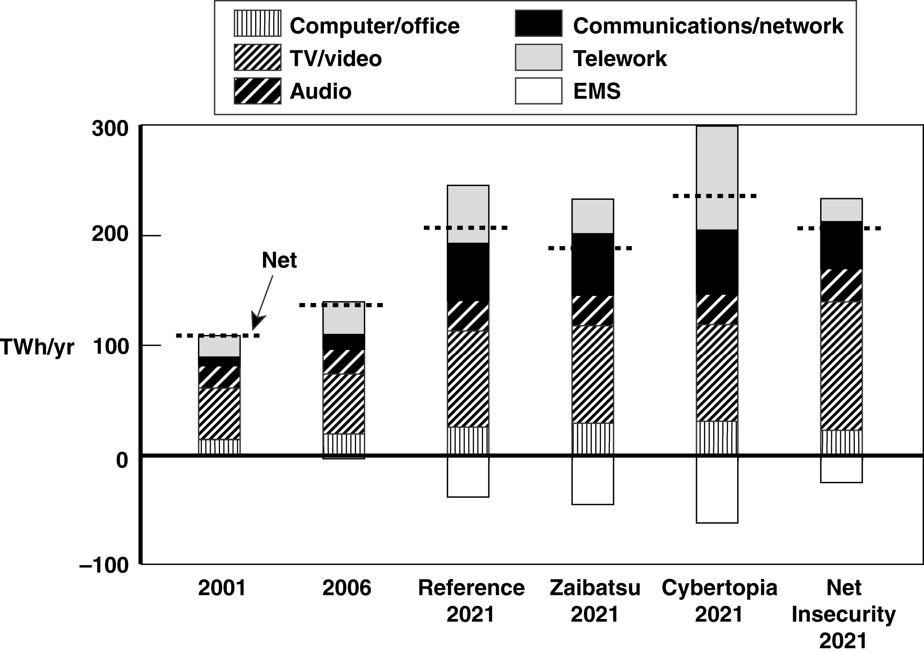
ICT-Driven Residential Electricity Use,
2001-2021

Slide 22
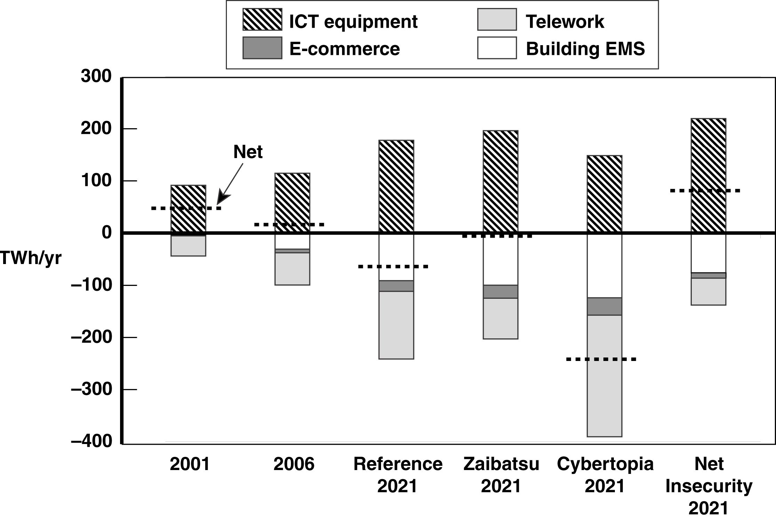
ICT-Driven Commercial Electricity Use,
2001-2021

Slide 23
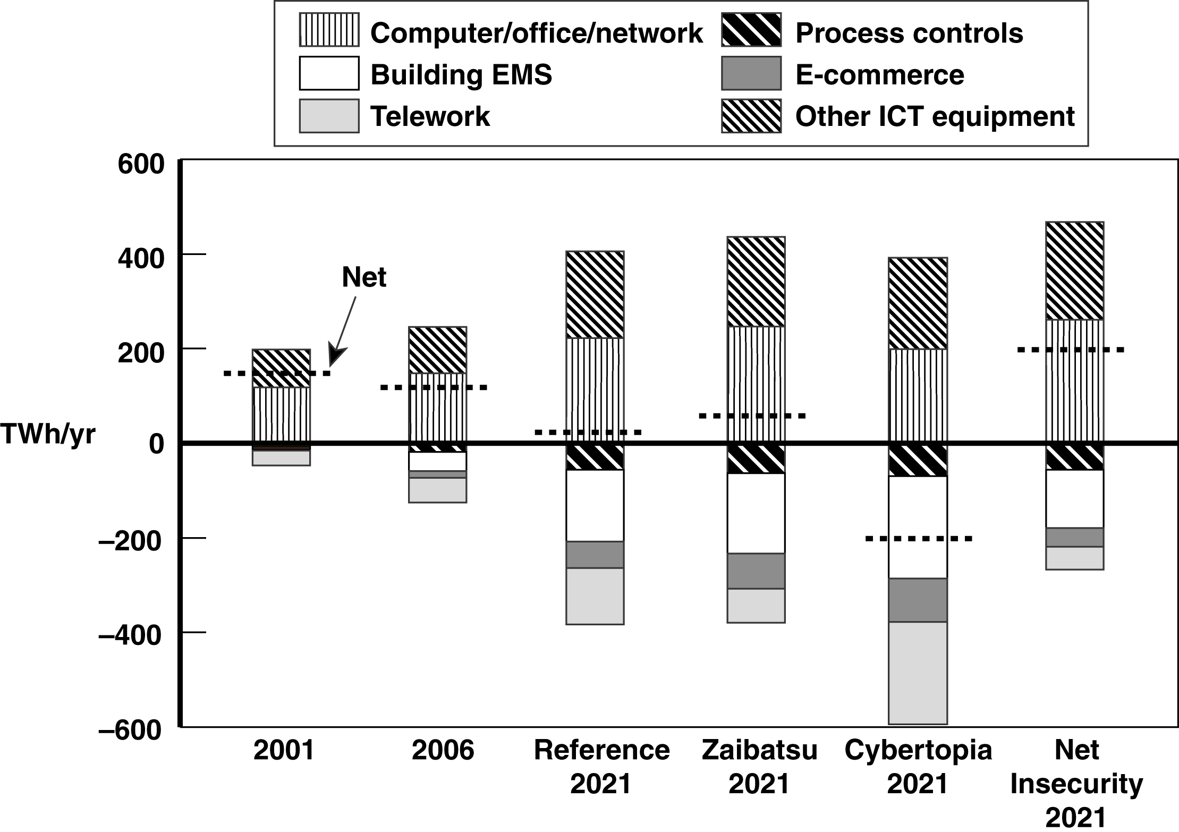
ICT-Driven Electricity Use in Residential,
Commercial & Industrial Sectors to 2021

Slide 24
2021 Projected Electricity Use Below
AEO 2002 Estimate in All Scenarios
Reference Cyber- Net
2021 Electricity Use AEO 2002 Scenario Zaibatsu topia Insecurity
TWh 4,980 4,630 4,670 4,410 4,810
% difference from AEO 2002 - - 7 - 6 - 11 - 3
  Systematic difference primarily reflects lower 2001 baseline
  400 TWh difference between highest and lowest use scenarios
    largest savings in Cybertopia from EMS, telework, e-commerce
    least in Net Insecurity due to much less trust in ICT networks
    9% difference shows extent of ICT influence on U.S. power use

Slide 25
Outline
  Information and communications technology (ICT) scenarios
  Implications of scenarios for U.S. electricity use
  Implications of scenarios for U.S. electricity supply
  Study conclusions and recommendations

Slide 26
Electricity Supply Issues
Raised By ICT Scenarios
  Assuring power quality for very large numbers of digital devices
  Using ICT to improve grid reliability and operations
  Using ICT to support distributed generation and storage
  Addressing vulnerabilities of ICT and electricity infrastructures

Slide 27
Assuring Power Quality for Ubiquitous Digital Devices
Findings and observations:
  Digital loads need different levels of power quality
    “high” for digital audio, video, appliances
    “very high” for most home and office computers
    “ultra high” for mission-critical functions
  Storage/conditioning feasible at several levels: chip, device, plug, building, substation, “power park”
  Industry restructuring blurs responsibility for quality
  Manufacturers may underinvest to keep costs down
  Industry R&D may not meet growing needs for quality

Slide 28
Using ICT to Improve
Grid Reliability and Operations
Findings and observations:
  T&D reliability likely to decline in short term
  Even decentralized scenarios need a robust grid
  ICT developments essential to improve T&D monitoring and control
  Unclear whether industry R&D and investment will provide grid capacity and reliability needed in Reference and Zaibatsu cases

Slide 29
Using ICT to Support
Distributed Energy Resources
Findings and observations:
  DG growth largest in Cybertopia, lowest in Zaibatsu
  Distributed storage increasingly integrated with DG
  Technical standards essential for DG interconnection at large scale; other technical obstacles seem solvable
  Principal factors limiting DER growth are non-technical
  ICT will support DER integration and control under all scenarios

Slide 30
Addressing Vulnerabilities of
Power and ICT Infrastructures
Findings and observations:
  While ICT supports both centralized and decentralized scenarios, decentralization adds flexibility, resilience
  “Self-healing” systems represent an important goal whose feasibility, cost and timing remain unclear
  More generally, tradeoffs between system robustness, cost and efficiency remain largely unexplored
  Unclear whether Internet will be secure enough for essential communication and control links

Slide 31
Outline
  Information and communications technology (ICT) scenarios
  Implications of scenarios for U.S. electricity use
  Implications of scenarios for U.S. electricity supply
  Study conclusions and recommendations

Slide 32
Principal Conclusions of the Study
  Enormous growth of ICT devices and use will have only modest impact on U.S. kwh consumption
  Increased demand for higher PQR more important to a digital society
  ICT developments crucial for meeting PQR goals
  ICT advances needed to support growth of DER
  ICT has great potential to flatten load curves, thus avoiding some new generation and T&D investment
  Scenarios point out need to bring R&D results into commercial practice to support digital load demand

Slide 33
Recommendations: Improving ICT Scenarios for Energy Planning
  Use scenarios rather than single-point projections for rapidly changing influences such as ICTs
  Refine scenarios or develop new ones to include
    ICT effects on energy industry restructuring
    greater range of cultural or lifestyle changes
    “wild cards” challenging standard assumptions; e.g.
      fuel cell vehicles common as DG sources in 2021
      adverse health effects of wireless ICTs
      nanotechnology “personal fabricators” at home

Slide 34
Recommendations: Improving
Electricity Projections Involving ICTs
  Develop baseline estimates and projections for “digital load” components based on PQR needs
  Assess ICT-driven usage other than for ICT equipment
    savings from ICT-enabled EMS in buildings
    effects of telework on electricity and vehicle fuels
    e-commerce effects on floorspace, inventories and vehicle miles traveled
    savings from digital controls in manufacturing
    power consumption in ICT manufacturing
    behavioral response to dynamic electricity pricing

Slide 35
For Additional Information...
Electricity Requirements for a Digital Society
  Report can be downloaded, or printed copies ordered, from RAND’s website: www.rand.org/publications/MR/MR1617
  Additional comments or questions welcomed: baer@rand.org

