Slide 1
SCADA and WSN Security
Dr. Ben Arazi
ben.arazi@louisville.edu

Slide 2
SCADA Security-
Three proposed research activities
Applying IPS in SCADA encrypted communication
Peer-to-Peer aspects
Distributed (multisensor) correlation

Slide 3
What is SCADA
SCADA is acronym for Supervisory Control And Data Acquisition. It is a computer system for gathering and analyzing real time data.
SCADA systems are used to monitor and control a plant or equipment in industries such as electric power distribution, water and waste control, oil and gas refining and transportation.
A SCADA system gathers information, such as where a leak on a pipeline has occurred, transfers the information back to a central site, alerting the home station that the leak has occurred, carrying out necessary analysis and control, such as determining if the leak is critical, and displaying the information in a logical and organized fashion.

Slide 4
Associating SCADA with Homeland Security
www.ea.doe.gov/pdfs/21stepsbooklet.pdf
The Department of Energy plays a key role in protecting the critical energy infrastructure of the nation as specified in the National Strategy for Homeland Security.
In fulfilling this responsibility, the Secretary of Energy’s Office of Independent Oversight and Performance Assurance has conducted a number of assessments of organizations with SCADA networks to develop an in-depth understanding of SCADA networks and steps necessary to secure these networks.

Slide 5
The first DHS SBIR solicitation
November 14, 2003
The U.S. Department of Homeland Security's Science and Technology division announced today the release of a Small Business Innovation Research (SBIR) Program Solicitation by the Homeland Security Advanced Research Projects Agency (HSARPA).
HSARPA is seeking proposals for the following topics:
New system/technologies to detect low vapor pressure chemicals
Chem-bio sensors employing novel receptor scaffold
Advanced low cost aerosol collectors for surveillance sensors
Modeling tool for vulnerability assessment of U.S. infrastructure
Marine asset tag tracking system
AIS tracking and collision avoidance equipment for small boats
Ship compartment inspection device
Advanced secure supervisory control and data acquisition (SCADA)

Slide 6

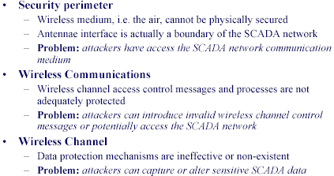
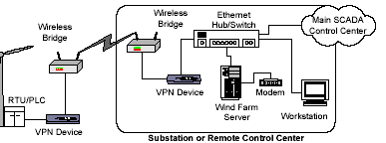
While cryptography is
Recommended ….
Cryptographic Protection of SCADA Communications
Draft 4
AGA Report No. 12
November 1, 2004
SANDIA

Slide 7

Intrusion Detection is still very valid . . . .
IEEE POWER ENGINEERING SOCIETY / SUBSTATIONS COMMITTEE
http://grouper.ieee.org/groups/sub/wgc3/c37sections/clause5/clause5_3_security/Substations%20communications%20system%20security%20D1r2.pdf
IEEE Std C37.1-Standard Definition, Specification, and Analysis of Systems Used for Supervisory Control, Data Acquisition, and Automatic Control
IEEE C37.1 recommends that high value substations integrate an intrusion detection system (IDS).

Slide 8
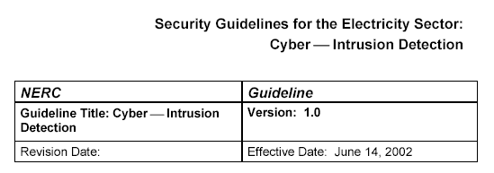
Intrusion Detection in SCADA-
NERC
ftp://www.nerc.com/pub/sys/all_updl/cip/Guides/V1-Cyber-IDS.pdf

Slide 9
Intrusion Detection in SCADA-
Recent examples
Intrusion Detection and Cyber Security Monitoring of SCADA and DCS Networks
http://www.digitalbond.com/SCADA_security/ISA%20Automation%20West.pdf
Presented at ISA Automation West, 2004
http://www.lurhq.com/press_scada.html Nov. 1, 2004
LURHQ, the leader in Managed Security Services for security professionals, today announced it will leverage Digital Bond's extensive SCADA Intrusion Detection and Data Dictionary research to deliver more advanced detection of cyber-threats targeting these critical systems.

Slide 10
IPS – Intrusion Prevention System
Advantage 1: Parsing encrypted data
http://www.intranetjournal.com/articles/200206/pse_06_13_02a.html
Signature based intrusion detection systems can only work on unencrypted links.
[This will] create less demand for network based intrusion detection systems, and more demand for host based intrusion prevention systems.
http://techrepublic.com.com/5102-6264-1051215.html
IDSs are installed on network segments.
IPSs are installed on servers and desktops.
IDSs can't parse encrypted traffic.
IPSs can better protect applications.

Slide 11
IPS – Intrusion Prevention System
Advantage 2: Prevention vs. detection
There are network-based intrusion-prevention systems that work so accurately and so reliably that network managers who decline to even consider using them out of worry IPS generates false positives or in-line equipment crashing must now re-think that position. http://www.nwfusion.com/news/2004/0126ipstest.html
The NSS Group - noted experts in this field - has nailed its colors to the mast and come out in favor of IPS following extensive tests of the main products of the market. http://www.techworld.com/news/index.cfm?fuseaction=displaynews&newsid=896

Slide 12
Research issue #1: Applying IPS in SCADA encrypted communication
Investigate the suitability to the SCADA environment of IPS products analyzed by the NSS. No intention to duplicate available solutions. (A Development project rather than basic research.)
Intrusions relevant to SCADA: False data to act upon; eavesdropping. A practically positive observation: SCADA is application specific
Analyze the performance of these systems in the frame of encrypted SCADA data laid in leading specifications (i.e., the AGA document)
Introduce the findings to the DNP3 Working Group

Slide 13
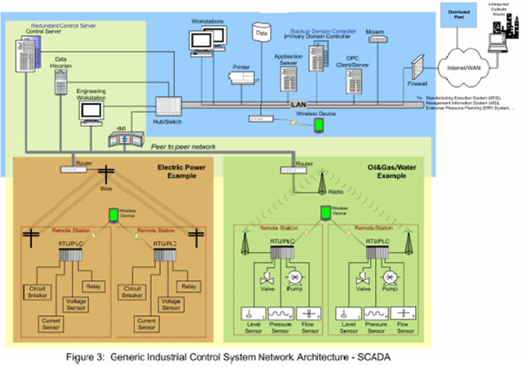
SCADA and P2P communication-
From a NIST document
http://www.isd.mel.nist.gov/documents/falco/ITSecurityProcess.pdf
Peer to peer network

Slide 14
SCADA and P2P communication-
IEEE specifications
http://grouper.ieee.org/groups/c37/115/H5Documents/H5DOC.pdf
IEEE PSRC Working Group H5 Report to the Communications Subcommittee
APPLICATION OF PEER-TO-PEER
COMMUNICATIONS FOR PROTECTIVE RELAYING
http://www.electricity-today.com/et/issue0403/microproc_based_relays.pdf
In addition, the possibility of exchanging protection/control signals in real time over a high-speed LAN in a peer-to-peer relationship means that a great deal of inter-device control wiring can be eliminated by performing inter-device control signaling over the LAN.

Slide 15


SCADA and P2P - more
http://www.sandc.com/webzine/092903_1.asp
It uses distributed intelligence to dynamically track system conditions and quickly initiate restoration switching through peer-to-peer communications—without the delays inherent in dispatcher-operated, centrally controlled SCADA systems.
Nashville Tennessee Water and Sewerage Department
The SCADA master station…. monitors and controls remote facilities located throughout the greater Nashville area.
The communication system forms a peer-to-peer Wide Area Network (WAN).

Slide 16

Positive security aspects of P2P
http://www.technologyreview.com/articles/wo_garfinkel100303.asp
October 3, 2003
A client-server architecture is vulnerable. When a single server goes down, all the clients that rely on it essentially go down with it. You can minimize this problem by having multiple servers, but then you have to make sure that they all stay synchronized. In fact, the server doesn’t even have to go down—all you need is a break in the network.
At the end of the day, peer-to-peer technology is about increasing the reliability of Internet-based systems. Peer-to-peer can also be used to create networks that earthquakes, wars, and terrorists can’t shut down.
http://www.cnn.com/2001/TECH/internet/08/03/p2p.potential.idg/
Peer-to-peer technologies can also be used to improve security in e-business environments by providing fine-grained access controls. "We need a more lateral approach to security. It opens up the network, but in a very constrained way. You are controlling things at the software layer rather than at the network layer."

Slide 17
Research issue #2: SCADA P2P issues
A general observation: Wide geographic distribution, legacy communication systems, unsecured open standards, and field power limitations conspire to distinguish the SCADA security problem from traditional peer-to-peer network security.
Threats aspects: If the RTUs/PLCs are interconnected by a Peer-to-Peer network this means that once an intruder penetrates an RTU/PLC, he can transmit faulty information, within the decentralized network, to other RTUs/PLCs.
Proactive aspects: Tailoring p2p security tools to the specific collaborative environment of SCADA. Here, p2p is not intended for file swapping among unknown individuals, but for expediting the communication and enhancing reliability. The unique security features of p2p can be optimally utilized in such a collaborative environment.
http://www.sandia.gov/ECI/ci/scada.htm

Slide 18
Distributed and multisensor correlation in SCADA IPS
The SCADA networks typically consist of large numbers of sensors and controllers connected to a central server. These devices are often spread geographically across a wide area.
Working assumption:
We treat the very reasonable case where an attacker, interested in compromising the security of a particular SCADA network, mount attacks against each exposed device in the network until a vulnerable one is found and the network is penetrated, allowing the subversion of the device compromised.

Slide 19
Distributed and multisensor correlation in SCADA IPS
Using ordinary firewall technology, the beginning stages of such an attack would most likely be missed. Conclusions are rather being drawn based on the commonalities between the attacks on different network devices.
Two aspects:
Filtration and refinements of false positives
Detecting attacks that otherwise would have been below a detection threshold

Slide 20
Research issue #3: distributed correlation in SCADA IPS refinement
Investigating the applicability of IDS correlation tools in SCADA IPS environment.
Collecting evidences from available IPS solutions to refine and enhance the isolated individual findings, for filtration and refinements of false positives.
and detecting attacks that otherwise would have been below a detection threshold.
Determining whether unconnected attacks were being mounted against randomly chosen individual targets or whether a coordinated effort was being made to probe and defeat the SCADA defenses.
Forensics issues: To which extent does the ‘security threshold’ meet the ‘legal threshold’.

Slide 21
MORE DNP3 SCADA security activities at
The University of Louisville
Dr. James Graham
jhgrah01@gwise.louisville.edu
Correctness proofs for SCADA communication protocols
Contribution to the DNP3 Working Group
Based on formal analysis of security enhancement for the DNP3 communication protocols.

Slide 22
MORE DNP3 SCADA security activities at
The University of Louisville
Authentication via digital signatures
Using digital signatures along with secure hash
Authentication via challenge response
Formal analysis and formal proofs of the protocol security

Slide 23
Time-power-communication tradeoffs in key-establishment among WSN nodes

Slide 24
The material presented next is the subject of two research proposals submitted to the NSF with partners from UT Knoxville

Slide 25


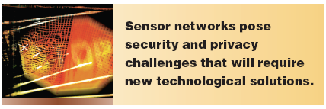
Needs: Confidentiality, authentication, access control

Slide 26
Inherent constraints of WSN
Limited processing capabilities
Limited memory
Limited power resources
Low cost

Slide 27
The need
Nodes have to share a secret key in order to establish a secure channel
Need for dynamic management in ad-hoc networks
Numerous publications

Slide 28
Question
How did Nodei and Nodej manage to share a secret value?
Answer 1: Rely on an on-line central agent
Answer 2: DH key-establishment
(There are other PKI solutions)

Slide 29
DH Key Establishment
Alice
Bob
Generates a random x
Calculates T = xG
Generates a random y
Calculates V = yG
V
T
Calculates K = xV
Calculates K = yT
Both keys equal xyG

Slide 30
State of the art
The operation C = sG is implemented as modular exponentiation or as ECC multiplication
ECC multiplication is significantly more efficient
Still, resources needed for DH implementation in WSN are currently unavailable

Slide 31
How to proceed
Approach 1: Ignore PKI altogether
Q Huang et. al., Fast authenticated key establishment protocols for self-organizing sensor networks, 2nd ACM international conference on Wireless sensor networks and applications, Pages 141 – 150, 2003
A. Perrig et. al., SPINS: Security Protocols for Sensor Networks, Mobile Computing and Networking, Pages 189-199, 2001

Slide 32
How to proceed
Approach 2:
Due to the undisputable necessity of PKI:
develop applications to the best of your ability,
wait for Moore’s law to catch up,
in the meantime devise algorithms
D. J. Malan, Crypto for Tiny Objects, Harvard Technical Report, TR-04-04, 2004

Slide 33
A need
Efficient authentication mechanism in DH key-establishment
How does Alice know she communicates with the right Bob, and vice versa
Many publications assume that authentication is given

Slide 34
A standard procedure: Certification – Fixed key
All operations are ECC. Certificate verification needs two exponentiations.
Alice
Bob
T
Certificate
+
2
Verifies the certificate
#
# of exponentiations
1
Calculates K = yT

Slide 35
Certification – Ephemeral key
Certificate and signature verification each needs two ECC exponentiations.
Alice
Bob
Calculates T = xG
1
Signs T
2
T
Signature
Certificate
regarding
signature
reference
1
Verifies the certificate
Verifies Alice signature
on T
+
+
2
1
Calculates K = yT

Slide 36
A possible minimalist approach
(For comparison purposes. Not a part of the proposal.)
Use RSA for certificate and signature verification.
(Such an operation needs two modular multiplications of 1024-bit values.)
Fixed key generation: One RSA certificate verification. One ECC exponentiation for generating the key K.
Ephemeral key generation: One RSA certificate verification. One RSA signature verification. Two ECC exponentiations, one for generating the ephemeral value T and one for generating the key K. One full RSA exponentiation (modular exponentiation for a 1024-bit exponent) for signing T.

Slide 37
Proposed method: All verifications are embedded in one single key confirmation
Number of ECC exponentiations
Standard
procedure
Proposed
method
DH fixed key generation
with certification
3
1
DH ephemeral key
generation with
certification
7
3
Compare to the minimalist approach. (Note: the proposed approach is based only on ECC operations.)

Slide 38
Group-key generation
A major application: Generating a key common to all sensors in an ad-hoc group
A central issue: Managing keys of joining and departing sensors
Certification is essential in authoritatively specifying sensor’s attributes, based upon which group joining validity is established
A feature of the proposed methodology: self-certification at a group level. Instead of performing a pairwise key-confirmation, a cyclic key confirmation for the entire group validates the authenticity of the implied certificates of all members

Slide 39
Certification delegation
Enabling field agents to issue user keys, where the sensor validates the agent’s authority while minimizing the overall computational complexity and communication overhead
Further enhancements are suggested, based on the observation that such a process in done in a short distance, while communicating with a powerful source (the agent)
The same mathematical principle can be used in validating the route from source to destination, if sensors act as relays

Slide 40
Another aspect of the proposed method:
Offloading an exponentiation to an assisting node
The computational complexity of an exponentiation operation is O(n³), where n is about 160
Even if communication power consumption in is orders of magnitude higher than processing consumption, it is still desired to offload non-secure exponentiations to neighboring nodes, if the communication load is O(n).

Slide 41
The exponentiation cT, which is one of the two performed by Bob when generating a session key K with Alice, is non secure.
It can be downloaded to a neighboring node Charlie.
Alice
Alice
or
T
T
c ;
T
c
Bob
Char
Bob
Cha
cT
cT

Slide 42
More research issues
Synthesized Hash for lightweight challenge/response purposes
Nanotechnology aspects
RF MEMS
MEMS memory tamper resistance
A new look at obfuscation

