Slide 1
Summary of DØ Alpha hardware status*
Appx. 10 trustworthy Alphas from two production runs (24+12).
MBus PIO difficulties currently prevent us from running multiple Alphas in a crate. Arbitration problems seem to have been solved by moving to TTL from PECL. A firmware patch is being developed by R. Kwarciany to fix remaining PIO issues. But it’s not yet clear if our FPGA will deliver (have talked about dropping parity, or building a daughter card…)
DØ baseline for Run2a requires 24 Alphas, bare minimum configuration ‘fallback’ requires 15 boards. Our plans also called for having additional boards to add power through parallelism as the run progressed.
Best case: 40% Run2a performance w/ available Alphas
*Numbers in this talk are approximate, typical sigma plus/minus ~1 board

Slide 2
Enter the βetas:
Alpha replacement
Originally proposed at end of 2000 to cover DØ in case of major shortfall in Alpha production + provide clear upgrade path & reduce dependence on component lifetimes (rapid obsolescence).
Beta designed w/ several goals in mind:
Turn around time (~ 18mo from settling design to full production)
Low Risk
Plug-in hardware compatibility w/ Alphas
Minimal impact on software infrastructure
Minimal drain on Run2a commissioning efforts
Easy upgrades

Slide 3
Timescale for Project:
May 2001 - finalize design, start schematics
Feb 2002 - first prototype
Jun 2002 - order pre-production samples
Now - pre-production board checks
Sep/Oct 2002 - Start production
Dec/Jan - Install in trigger
Firmware effort started ~Dec01 expected to finish ~Oct/Nov02
  part time efforts of ~1.5 Engineers (est. 30% on project)
Web link for details on L2βeta (TDR, etc):
http://galileo.phys.virginia.edu/~rjh2j/l2beta/

Slide 4
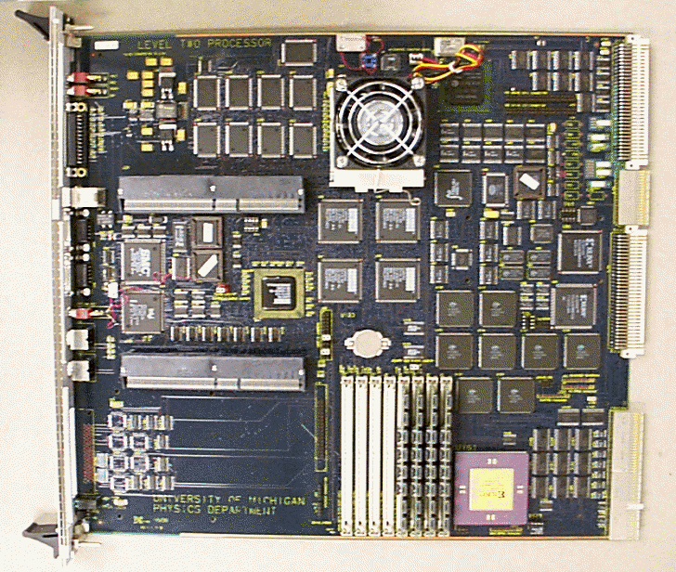
‘L2ßeta’ CPU
Same Basic Concept as L2Alpha, but with simplified implementation
Keep UII
Modern FPGA/
PCI interface replaces:
DMA
PIO
TSI device
Just add drivers…
Keep ECL drivers
Buy this and get a warranty!

Slide 5

Basic Idea
PIII Compact PCI card
9U card with “custom” devices (3 BGA’s)
Universe Chip VME interface
commercial 64-bit PCI interface chip
MBus and other logic in FPGA
9U board
6U board
J5
64 bit
<2MHz
Compact PCI
VME
Drivers
J4
UII
J3
32 bits
64 bits
J2
66
MHz (max)
33 MHz
PLX
Local bus
PCI
9656
J1
Clk
(s)/
FPGA
Drivers
roms
ECL Drivers
128 bits
~20 MHz
MBus

Slide 6
What is the PLX and we did we use it?
The PLX is a hardware PCI interface that provides a simplified local bus data protocol. Supports 64/66MHz on PCI, 32/66MHz on LBus.
Local and PCI buses are asynchronous.
Simplified DMA model. Setup the PLX w/ source & target addresses, it masters both buses and controls the transaction.
No need to deal w/ PCI core implementation, reduce firmware risk.

Slide 7
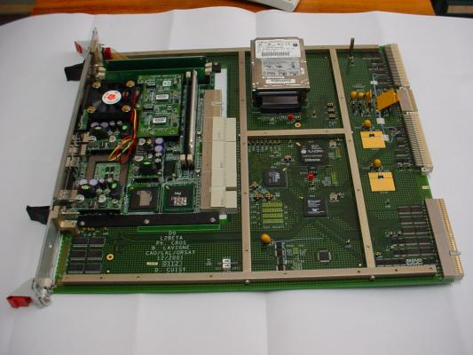
Level 2 βeta: 1st assembled prototype
Feb ‘02

Slide 8
New/Improved features:
3x CPU performance +
>2x on chip cache
I/O Performance
Alpha | ~100 MB/s
MBT | ~160 MB/s
L2βeta | ~250 MB/s
SBC | ~500 MB/s
Cheap upgrade = add 2nd CPU*
CPU/MHz | Specint95 | Specfp95
Alpha/500 | ~15 | ~21
PIII/850 | ~41 | ~35
PIII/1000 | ~48 | ~41
*but SW not trivial

Slide 9
Estimated DMA Performance (typical usage)
MBWords | Rate (MB/s)
1 | 67 (84)
2 | 106 (126)
4 | 150 (168)
8 | 187 (201)
16 | 215 (224)
32 | 232 (237)
Estimated DMA rates adding 3 PCI + 3 Local clocks for arbitration,
Numbers in () do include the Local clocks
Further speedup options:
Place UII behind a bridge allowing 66MHz bus on 9U card
Replace PLX w/ PCI core

Slide 10
FPGA: Xilinx XCV405E (Virtex extended memory)
FPGA resources used (approximate):
I/O pins 359/404
Block Ram 69K/70K
Other resources <25%
Most functions implemented, still need DMA engine
and some mapper code.

Slide 11
DØ compatibility:
HW: plug-in Alpha replacement .
SW: rewrite device level code, high level framework/algorithms essentially unaffected by the switch over, just recompile on PIII hardware.*
System: Linux 2.4.x kernel
add Ext3 file system
add memory management module
will test ‘real time’ scheduler patch, improved profiling, etc available for PIII
*Software compatibility is a huge benefit of going with βetas for DØ.
This project would not have been feasible on the Run2a timescale if software impacts we large.

Slide 12
Issues for CDF Adaptation
Hardware:
We have moved to a full TTL MBUS (removed 4 PECL drivers)
A smaller subset of J2 user I/O pins connected ~ 24 CDF specific signals unconnected on Beta. 1-2(?) signals may have reversed direction…
Front panel output is ECL, not LVDS (it’s output only, but I/O can be set for each pin in firmware
Layout design on Cadence (LAL Group in Orsay)
Software:
???
(As far as a DØ character can guess!)

Slide 13
Issues for CDF Adaptation (continued)
Firmware:
MBUS PIO should be equivalent, TSI functions are essentially the same save the unconnected pins (CDF specific regs, not implemented)
All FW written in Verilog - no PCI code & 1 design tool!
DMA/Broadcast Firmware is quite different. Data FIFO same, but:
  9 bits of DMA address supported (vs 10 on Alpha)
  Address FIFO replaced by addr. change and counter fifos
  (assumes >= 4MB words/per each MB broadcast
  DMA engine waits for a source to complete and tells the
  PLX to initiate a burst of a known size.
  Fifo input rate – fast enough? (Dstrobe + ~30ns now, shooting for 25…)
  (Alpha FIFO scheme could be implemented in our FPGA if broadcast addresses limited to 8 bits, else $500 more buys a bigger chip w/ same footprint. Higher speed grades also available.)

Slide 14
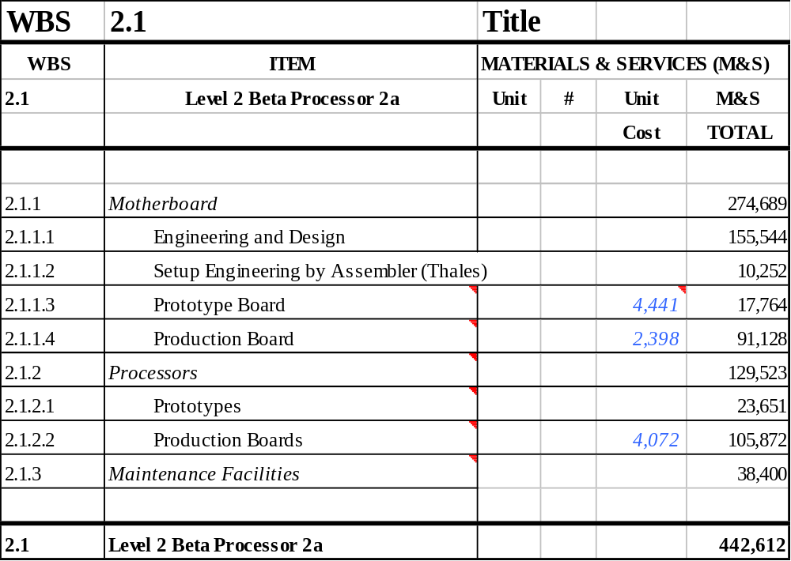
Cost Estimate: 1Q02
In-kind
contribution
from LAL for
Engineeering
Assembled by
Thales in France
-Mech. design
-PCB test
-Jtag test
SBCs have been coming down in price, but price range is large…
we expect to shave $1K+ off SBC+disk combo…Just over $5K/board – production price

Slide 15
21st Century approach…
What if we were starting from a completely clean slate?
Might consider Vertex Pro series – CPU + FPGA on chip
No need to mess / PCI, communicate w/ CPU through shared memory
Very simple board design

