Slide 1

3-particle correlations: methods and results
Marco van Leeuwen, LBL

Slide 2
Introduction
2-particle azimuthal correlations in p+p, Au+Au
Introduced to measure di-jets in Au+Au
  Disappearance at high-p_{T}
  Enhancement, broadening at low, intermediate p_{T}
Other sources of correlations
  Flow
  Resonance decays
associated
Δϕ
trigger
3-particle correlations
Relatively new activity
Can remove two-body decays
Flow still important
Present activity focuses on intermediate p_{T}
(mach cone vs deflected jets)
Prospects for other measurements exist
Focus of this talk: Introduce/discuss methods
but will confront with data

Slide 3
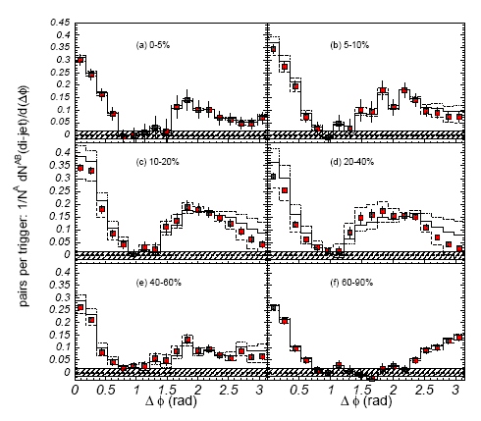
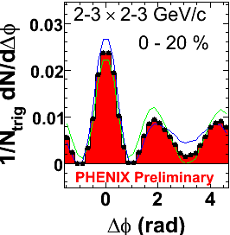
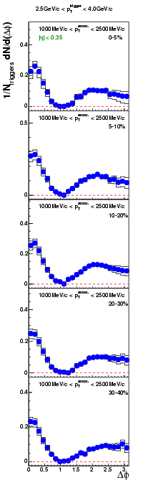
2-particle correlations at intermediate p_{T}
Status at QM05:
N.Grau, J.Jia, J. Ulery, M. Horner et al
2.5 < p_{T,trigger} < 4.0 GeV
1.0 < p_{T,assoc} < 2.5 GeV
PHENIX
STAR Preliminary
Strong away-side broadening seen at low p_{T,assoc}
Is there a ’dip’ at the away-side?
Conical emission: Mach cone? Cherenkov? Other mechanisms?
So far only shown for intermediate p_{T,trigger} and low p_{T,assoc}
Need to establish jet-related origin…
Also note: systematic uncertainties should not be disregarded

Slide 4
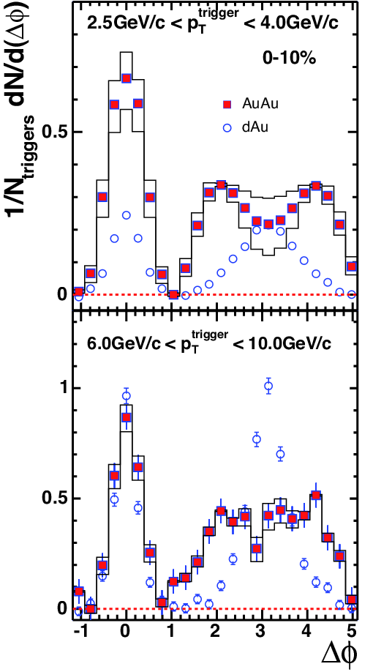
New 2-particle results
2.5 < p_{T,trigger}< 4 GeV
6 < p_{T,trigger}< 10 GeV
STAR preliminary
1 < p_{T,assoc} < 2.5 GeV
STAR preliminary
Poster, M. Horner
Systematic study of intermediate p_{T,assoc} under way
Broadening persists to higher p_{T,trigger}, but not ‘dip’
What happens to the away-side at intermediate p_{T}?

Slide 5
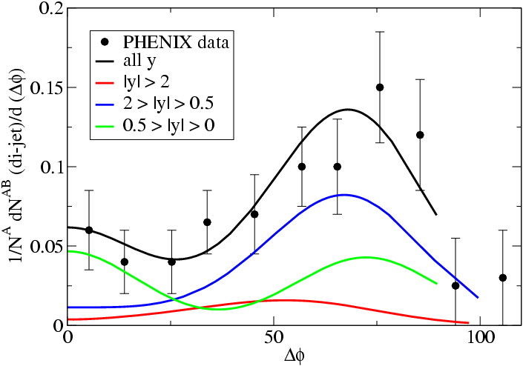
What is happening at intermediate p_{T}?
Mach cone calculations materialising
T. Renk and J. Ruppert, hep-ph/0509036, hep-ph/0605330
What is it?
Conical emission (mach cone, cherenkov)
k_{T}-like effect/push from radial flow
Problem with background/flow normalisation?
… but also: coalescence/recombination?
2-particle correlations
Possible systematics
  p_{T,trigger}, p_{T,assoc} and centrality dependence
  Particle type dependence
And detailed, honest theory evaluations/predictions
Or give up…
3-particle correlations
New avenue
Sensitive to event-by-event structure
Challenge: signals small, backgrounds large

Slide 6
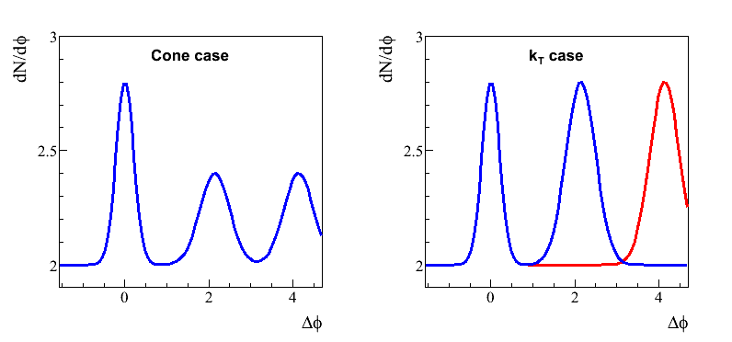
Toy model I
Simple ansatz to illustrate 2- and 3-particle structures
1D generation in φ
‘Cone’ case
‘k_{T}’ case (deflected jets)
All events same distribution:
Two classes of events:
Background
level
Normalisation chosen to have the same 2-particle structure
Note:
All events have one trigger
All events are the same, no impact parameter fluctuations
No flow

Slide 7
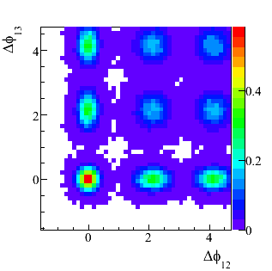
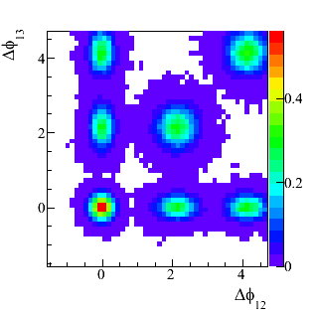
Raw signal I no background
2
Cone case
k_{T} case
Δφ₁₂
Δφ₁₂ ≈Δφ₁₃
3
(π,π)
(π,π)
2π−Δφ₁₃
1
z-scale
1
d²N
N_{trig}
dΔφ₁₂ dΔφ₁₃
Δφ, Δφ correlations can identify conical vs deflected jet emission
In the absence of backgrounds…
i.e. high p_{T,trigger} and p_{T,assoc} in Au+Au

Slide 8
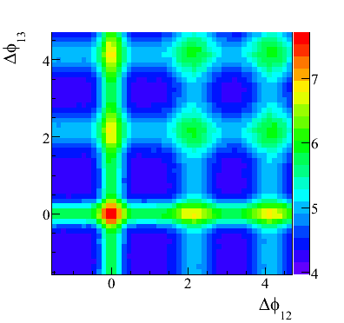
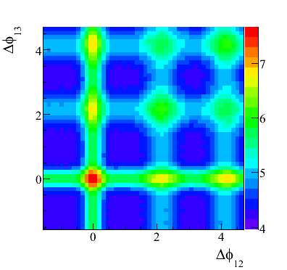
Toy model I, raw data
Cone case
k_{T} case
Background level
Dominant structure:
Combinations of jet-pairs with random third particle

Slide 9
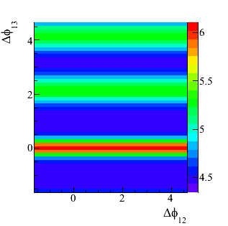
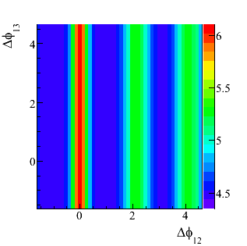
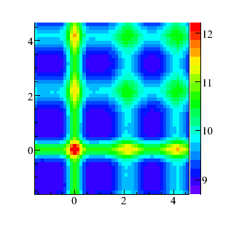
Background terms
First assoc particle
not correlated
ρ₁(φ₂) ρ₂(φ₁,φ₃)
Second assoc particle
not correlated
ρ₁(φ₃) ρ₂(φ₁,φ₂)
+
=
Dominant structure in raw plots is the
2-particle structure folded with random third particles, ρ₁ρ₂
Need to subtract 2x1 combinatorics
There is one more term, see later

Slide 10
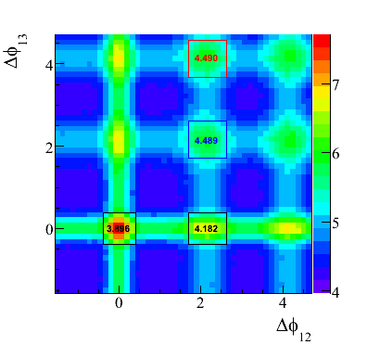
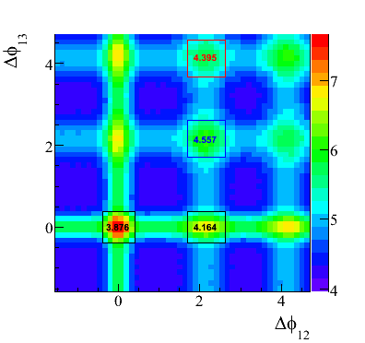
Toy model I, raw data
Cone case
k_{T} case
So there is a difference:
Cone case: on-diagonal and off-diagonal are the same
k_{T} case: difference between on- and off-diagonal
Difference is small:
Need well-controlled background subtraction

Slide 11
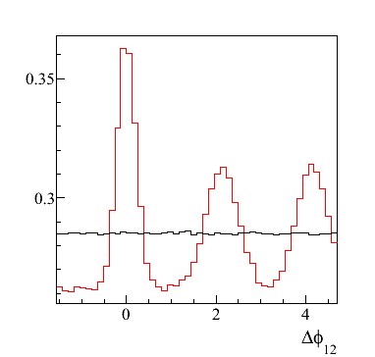
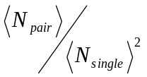

Background normalisation
Signal ρ₂
Background ρ₁ ρ₁
(or mixed events)
Different normalisation schemes possible:
Absolute normalisation (average at )
⇒ Cumulant
Phenomenological normalisation (e.g: scale background to have dips at 0)
ρ₃(1,2,3) – ρ₁(1)ρ₂(2,3) – ρ₁(2)ρ₂(1,3) – ρ₁(3)ρ₂(1,2) + 2ρ₁ ρ₁ ρ₁

Slide 12
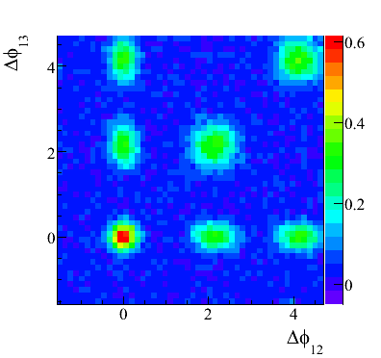
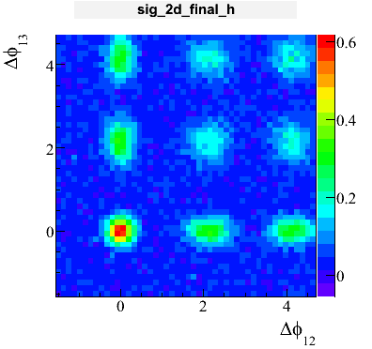
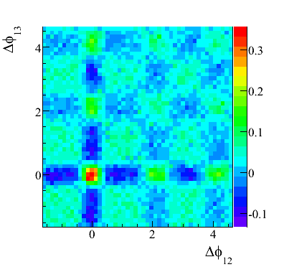
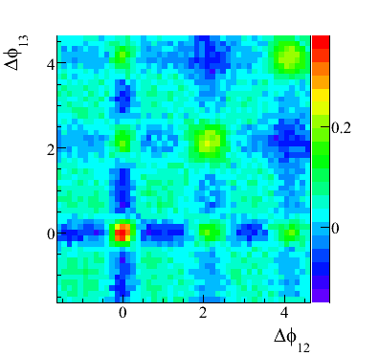
Background subtracted results
Cone case
k_{T} case
ZYAM/Purdue normalisation
4-peak structure for conical
emission
2-peak for k_{T}-smearing
Cumulant normalisation
Valleys and peaks due
to different normalisation
4-peak/2-peak difference
also visible
Valley-peak strength similar:
0.2 in both cases
Signal seen in both schemes.
Both schemes distinguish between conical emission and k_{T} effect
Caveat: soft-soft term ignored (see next slides)

Slide 13
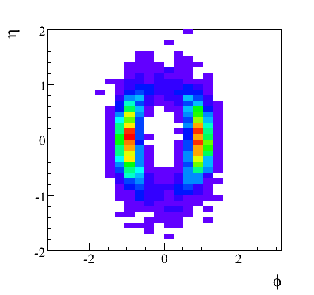
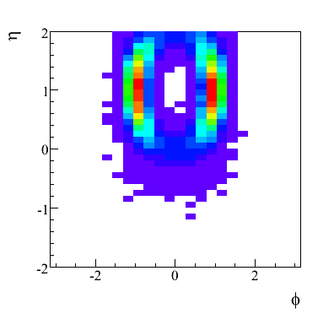
Toy Model II
Example cone at (ϕ,η)=(0,0)
Idea: include more dynamics
So far, only ‘cone version’ implemented
Generate full set of η, φ, p_{T} from:
Toy jet
  Simple jet spectrum
  Fragmentation from FF
Toy cone
  Similar p_{T} - distribution, but angle spread out to 1±0.15 radian
Background
  Thermal spectrum, T=300 MeV
Example cone at (ϕ,η)=(0,1)
Jet and cone distributed flat in η
Generation in η, φ allows to study other variables
Note: apparent depletion at φ=0
due to fixed p_{T}-cut

Slide 14
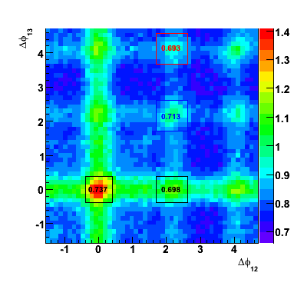
Raw 3-particle correlation
Qualitatively similar to
Toy model I
New feature:
diagonal stripes from soft-soft
1
d²N
z-scale
N_{trig}
dΔϕ₁₂ dΔϕ₁₃

Slide 15
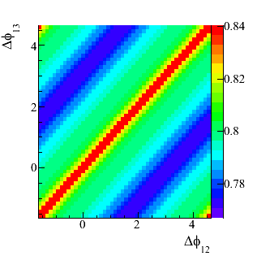
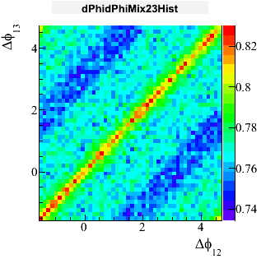
Soft-soft correlations
Cumulant ρ₁ ρ₂(φ₂,φ₃)
Soft-soft contributions:
correlations of assoc particles,
no relation to the trigger
Jet-structure with uncorrelated trigger
thermal component in model
Resonance decays
Flow
Not present in model
Possible sources scale differently with ratio
fake triggers/real triggers
Mixed events
No clear-cut way to subtract only unwanted terms (a la ZYAM):
⇒ Use (approximate) cumulant normalisation
for both method: ρ₁(φ₁) ρ₂(φ₂,φ₃)
Note: cumulant scaled with N_{event}/N_{trigger} for per-trigger normalisation

Slide 16
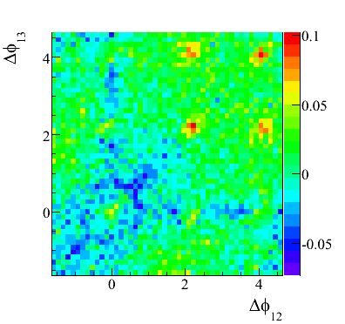
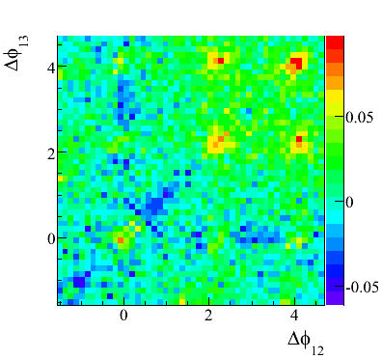
Result from Toy Model II
Cumulant method
ZYAM/Purdue method
Results with different background normalisations very similar
Extract signal robustly

Slide 17

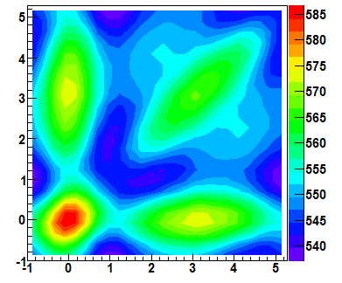
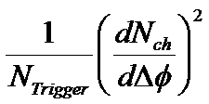
Flow in three-particle correlations
Flow is dominant term in raw correlation
J. Ulery, RHIC/AGS meeting
Dominant terms are again 2x1
and drop out to high precision
Exercise for the reader
Leading remaining term: v₂ v₂ v₄
Δφ₁
Can be explicitly subtracted

Slide 18
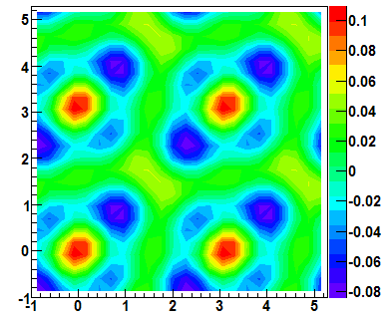
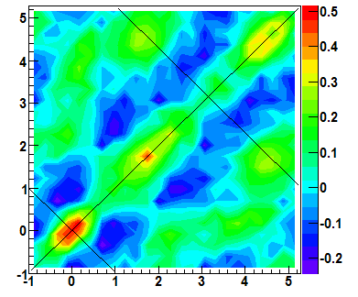
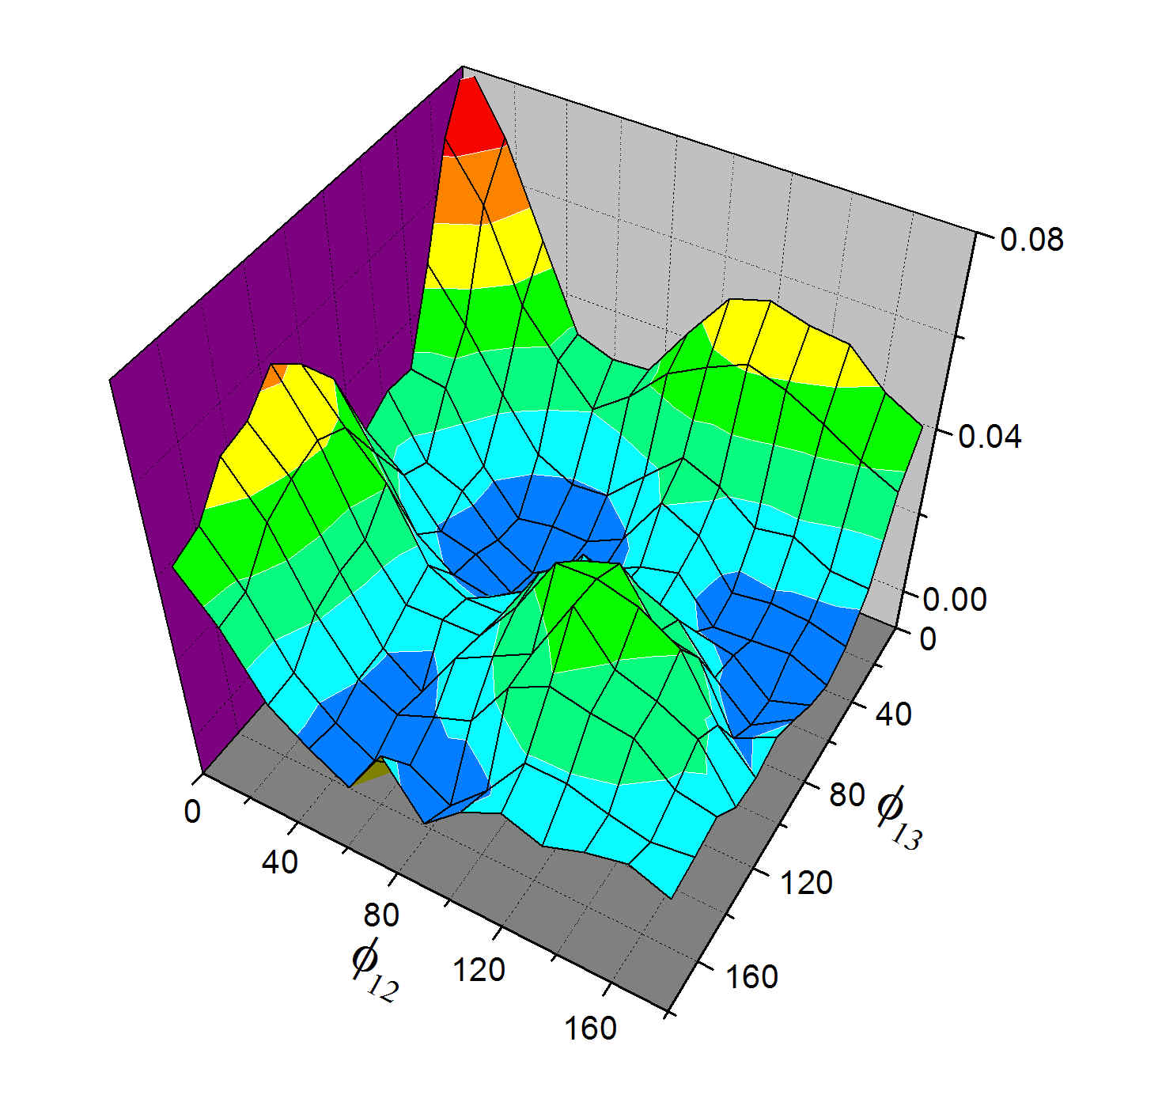
Experimental results: STAR
Data corrected for flow
and 2x1 correlations
Central Au+Au
0-12% triggered
ZYAM/Purdue normalisation
J. Ulery, parallel II Monday
3 < p_{T,trigger} < 4 GeV
1 < p_{T,assoc} < 2 GeV
10-20% central Au+Au
Only v₂ subtracted
N. Ajitanand, QM talk
Off-diagonal peaks
indicate conical emission
PHENIX Preliminary
v₂ v₂ v₄ term subtracted
Additional structure
along diagonal
(no off-diagonal equivalent!)
Also note:
On-diagonal and off-diagonal
peaks not same height
Δφ₂
PHENIX:
“ridges indicative
of conical flow”
First evidence of conical emission?
Possibly
Need careful systematic checks (see Jason’s talk)
Folded to [0,π):
no distinction on/off-diagonal
If there is conical emission, it is not the only thing
Jet remnants along diagonal?
No subtraction of 2x1
Like to see cumulant analysis as systematic check

Slide 19
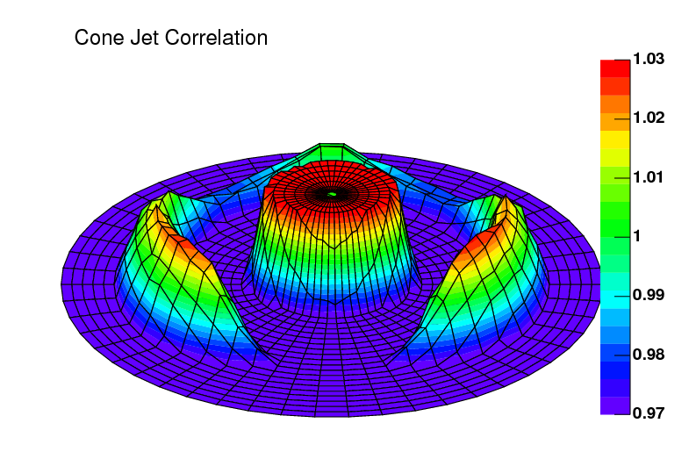




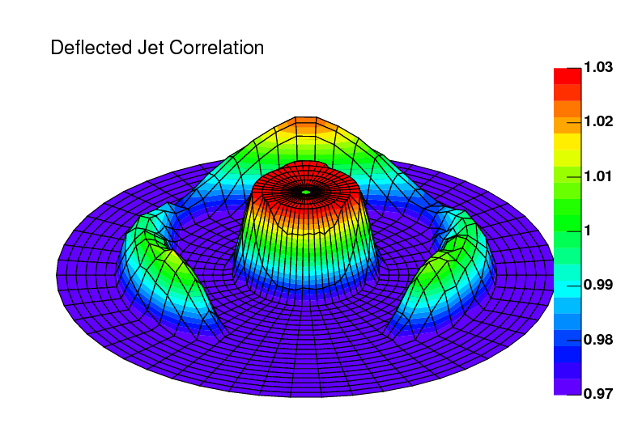
Polar co-ordinates
Method being developed in PHENIX
Trigger
Cone simulation
Combinatorial
background
Associated
More strength
at Δφ =0 for deflected
Δφ=180° swamped?
Motivation:
cone ‘lives’ at
constant θ
Deflected Jet simulation
θ
Caveat: cone not necessarily
back-to-back with trigger in 3-space
Talk N. Ajitanand, parallel II Monday

Slide 20
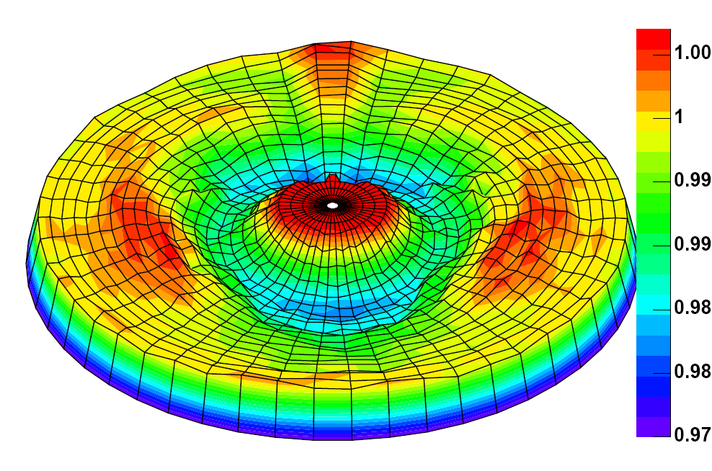
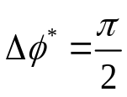
Experimental results: PHENIX
PHENIX Acceptance
PHENIX Preliminary
Δφ = 0
Cent: 0-5%
3 < p_{T,trigger} < 4 GeV
1 < p_{T,assoc} < 2 GeV
Uncorrected,
no v₂ subtraction
θ = 120
Cone simulation
Need careful comparison
to expectations
Deflected Jet simulation
And/or 2x1, flow subtraction
See N.N. Ajitanand’s talk

Slide 21
Summary/conclusion
Methods promising
Two-particle contributions overwhelming: need to subtract
Background normalisation:
  Cumulant is unambiguous
  But may want to tune for specific observables
Soft-soft normalisation most difficult
First results show signs of conical emission
… but also something else
Cross-checks/alternative approaches welcome:
Cumulant method
Other co-ordinates (polar angle, possibly Δη)

Slide 22
Outlook
Possible future applications of three-particle correlations
Total 6 co-ordinates (φ,η)₁, (φ,η)₂ and (φ,η)₃
Make useful combinations. Need to cut on others
Δφ₁₂-Δη₂₃ correlations
(cut on Δφ₂₃?)
Δη₁₂-Δη₁₃ correlations
(with cuts on Δϕ₁₂, Δφ₁₃)
Explore Δη structure
of away-side jet
Explore near-side ridge
event-by-event
Different systematics, possibly
also useful for conical emission
versus
η
So far only speculation. Needs study
3-particle correlations provide new angle on variety of questions
Thanks to: F. Wang, J. Ulery, S. Voloshin, C.Pruneau, N. Ajitanand

Slide 23
Extra slides

Slide 24
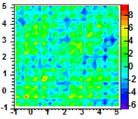
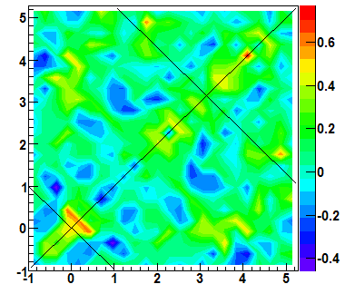
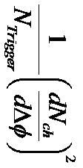
Change from QM
Slide taken from J. Ulery, RHIC/AGS User’s Meeting
Au+Au 10%
Au+Au 0-10%
Δφ₂
Δφ₂=φ₂-φ_{trig}
dN²/dΔφ₁dΔφ₂/N_{trig}
Δφ₁=φ₁-φ_{trig}
Δφ₁
Mesh pattern removed.
Increased statistics by about a factor of 1.5.
Analysis improvements.
Qualitatively similar structure.
Not much signal at 1 radian from π, but interesting structure maybe present beyond 1 along the off diagonal in both.

Slide 25
Quantitatively…
Slide taken from J. Ulery, RHIC/AGS User’s Meeting
Au+Au 10%
Au+Au 0-10%
Δφ₂
Δφ₂=φ₂-φ_{trig}
dN²/dΔφ₁dΔφ₂/N_{trig}
Δφ₁=φ₁-φ_{trig}
Δφ₁
center – deflected =
0.3 ± 0.3 (stat) ± 0.4 (syst)
center – cone =
2.6 ± 0.3 (stat) ± 0.8 (syst)
center – deflected =
-0.04 ± 0.06 (stat) ± 0.09 (syst)
center – cone =
0.13± 0.06 (stat) ± 0.05 (syst)
Large systematic fluctuation due to mesh.
Mesh effect did not completely cancel out in differences between different areas; this was not taken in the systematics.

