Slide 1
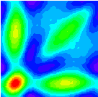


Three-Particle Azimuthal Correlations from STAR
Jason Glyndwr Ulery
Purdue University
for the STAR Collaboration
2nd International Conference on Hard and Electromagnetic Probes of High-Energy Nuclear Collisions
12 June 2006

Slide 2
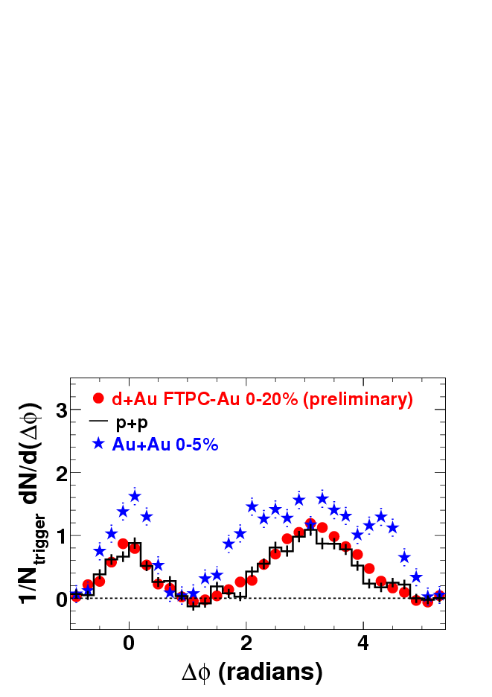
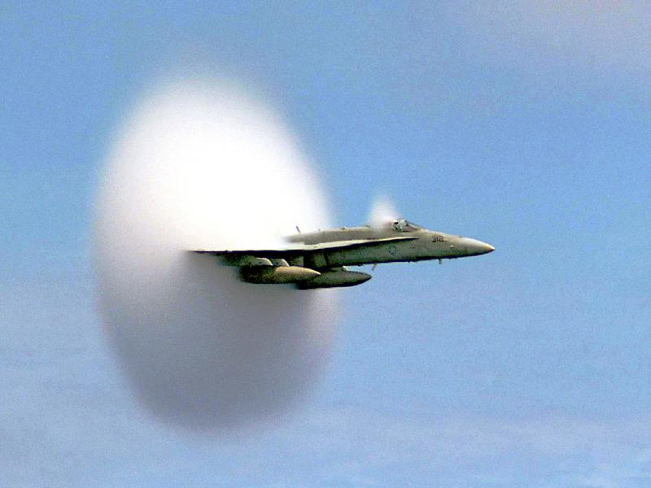
Motivation
4.0<P_{T}Trig<6.0 GeV/c
0.15<P_{T}Assoc<4.0 GeV/c
Jets are expected to be modified by the medium we create.
We can therefore use jets to probe the medium.
3-particle correlations can give additional information.
Can be used to look for mach cone.

Slide 3
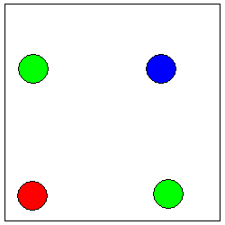
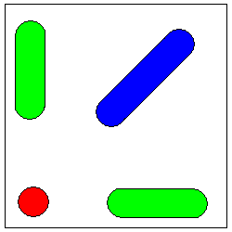
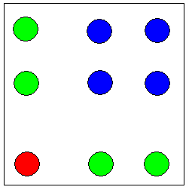
Conical Flow vs Deflected Jets
near
near
π
Medium
Medium
away
0
deflected jets
0
π
away
near
di-jets
Medium
away
mach cone

Slide 4

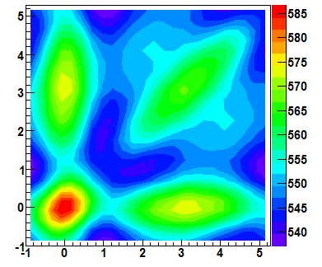
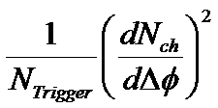
Analysis Procedure
Trigger
Δφ₂
Δφ₁
Trigger particle selected with transverse momentum 3<p_{T}<4 GeV/c.
Look at Δφ=φ_{Assoc}-φ_{Trigger} for all pairs of associated particles with 1<p_{T}<2 GeV/c.
Plot Δφ₁ vs Δφ₂ for each pair of associated particles.
Δφ₂
Δφ₁

Slide 5
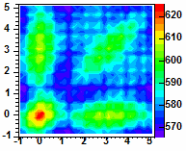
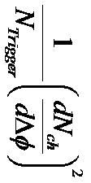
Change in the Raw Signal From QM
QM 2005
STAR Preliminary
Mesh present in the QM signal.
This has been corrected using a single particle φ acceptance correction.
Increased statistics.
1/N_{Trigger} (dN/d(Δφ))²

Slide 6
Analysis Procedure
What we get contains (Jet+Bkgd) x (Jet+Bkgd).
To get Jet x Jet we must subtract Bkgd x Bkgd and Jet x Bkgd (and Bkgd x Jet.)
Δφ₂
Δφ₁

Slide 7
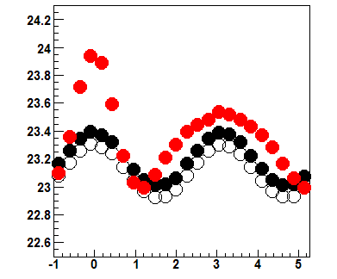

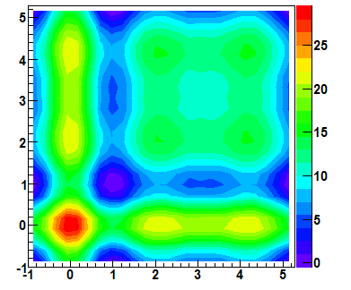
Jet x Background (Hard-Soft)
Top plot is 2-particle correlation.
Red is Jet + Background
Black is Background and open black is scaled background (such that Red - Open Black is zero around ±1.)
Jet x Background term is created by folding 2-particle jet signal with 2-particle background.
(Red – Open Black) x Open Black + Open Black x (Red – Open Black)
Δφ
Δφ₂
Δφ₁

Slide 8
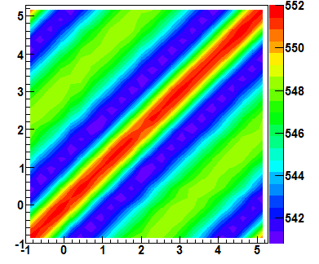
Background x Background (Soft-Soft)
Term is constructed using a random trigger particle angle and looking at the pairs of associated particles in background events.
Contains correlations between associated particles that are not associated with a trigger particle.
Δφ₂
Δφ₁

Slide 9
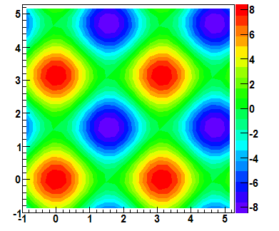
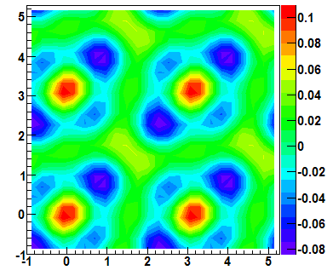
Flow
Δφ₂
Previous term contains flow terms between the two associated particles but there are additional flow contributions that include trigger particle flow times associated particle flow.
Top plot contains terms of v₂^{Trigger}*v₂^{Associated}.
Bottom plot contains terms of v₂*v₂*v₄ with v₄ = 1.15*v₂².
v₂ is taken as average of reaction plane and 4-particle measurements.
Δφ₁
Δφ₂
Δφ₁

Slide 10
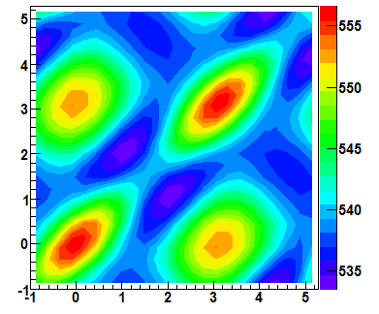
Soft-Soft Including Flow
+
+
=
These three background x background terms are summed and then scaled such that the projection of the final signal to either Δφ axis will be zero in the range of |Δφ±1|<0.2

Slide 11
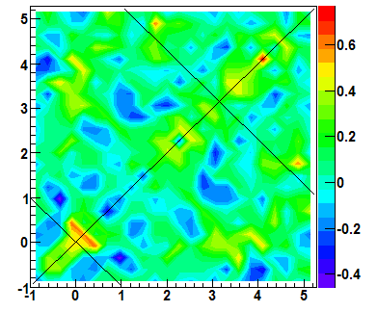
Final Signal
_
_
=
Raw – Jet x Bkgd – Bkgd x Bkgd
(Hard-Soft)
(Soft-Soft)
Final signal is constructed by subtracting the background from the raw signal.

Slide 12
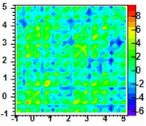
Change from QM
Au+Au 10%
Au+Au 0-10%
Δφ₂
Δφ₂=φ₂-φ_{trig}
dN²/dΔφ₁dΔφ₂/N_{trig}
Δφ₁=φ₁-φ_{trig}
Δφ₁
Mesh pattern removed.
Increased statistics by about a factor of 1.5.
Analysis improvements.
Qualitatively similar structure.
Not much signal at 1 radian from π, but interesting structure maybe present beyond 1 along the off diagonal in both.

Slide 13
Quantitatively…
Au+Au 10%
Au+Au 0-10%
Δφ₂
Δφ₂=φ₂-φ_{trig}
dN²/dΔφ₁dΔφ₂/N_{trig}
Δφ₁=φ₁-φ_{trig}
Δφ₁
away – deflected =
0.3 ± 0.3 (stat) ± 0.4 (syst)
away – cone =
2.6 ± 0.3 (stat) ± 0.8 (syst)
away – deflected =
-0.04 ± 0.06 (stat) ± 0.09 (syst)
away – cone =
0.13± 0.06 (stat) ± 0.05 (syst)
Large systematic fluctuation due to mesh.
Mesh effect did not completely cancel out in differences between different areas; this was not taken into account in the systematics.

Slide 14
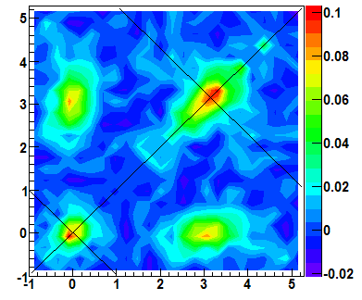
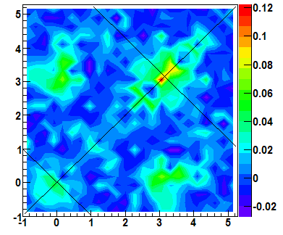
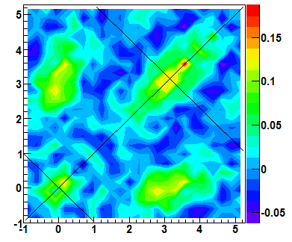
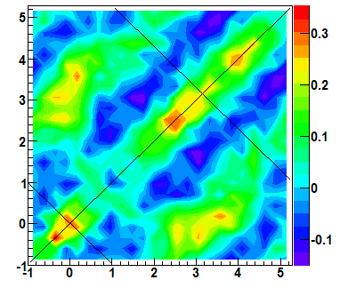
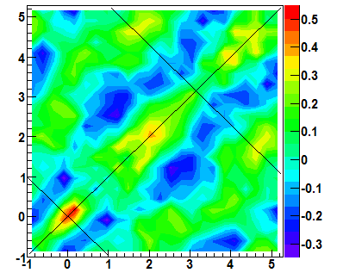
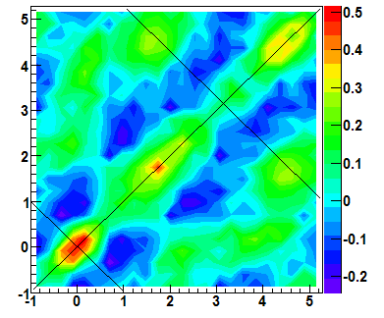
Signal
Comparison
pp
d+Au
Au+Au
50-80%
Au+Au
30-50%
Au+Au Central 0-12% Triggered
Au+Au
10-30%
Au+Au
0-10%

Slide 15
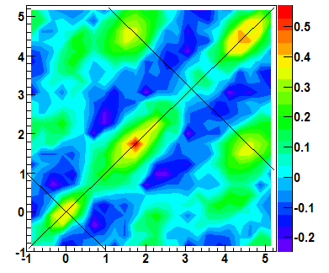
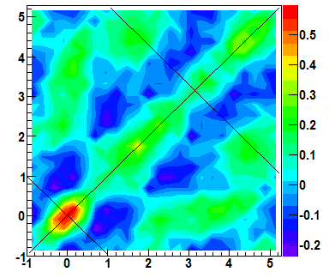
Flow Systematic
Reaction Plane v₂
Flow is varied between the reaction plane result and the 4 particle cumulant result.
Result is robust with the variation in v₂.
_
_
4 Particle Cumulant v₂

Slide 16

Background Normalization Systematic
Default
Normalization around Δφ=±1 assuming zero yield at minimum.
Default uses a normalization range of 0.35.
Normalization range of 0.70 used to check systematic.
Result is robust with respect to normalization range.
Wide

Slide 17
Signal Strengths
Au+Au Central 0-12% Triggered
d+Au
Δφ₂
Δφ₂
Δφ₁
Δφ₁
  Evaluate signals by calculating average signals in the boxes.
  Near Side, Away Side, Cone, and Deflected.

Slide 18
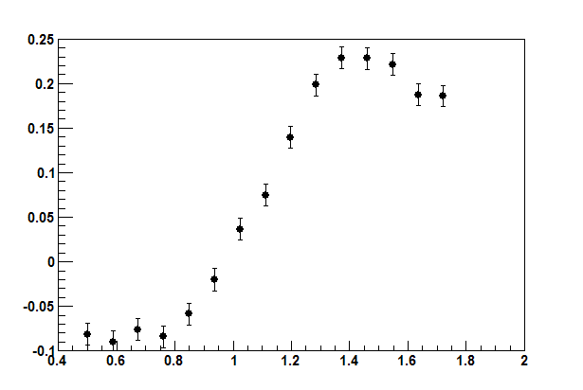
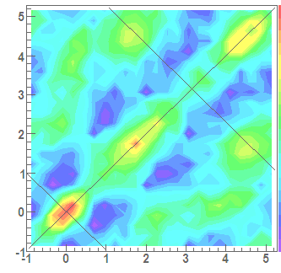
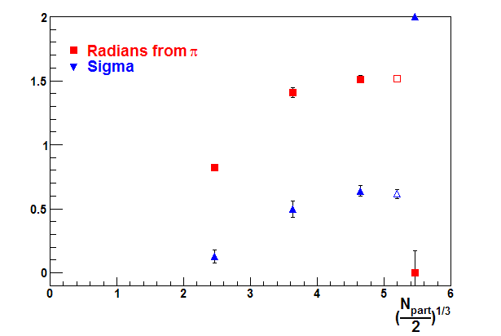
Cone Position
Average Cone Signal
Optimum placement of boxes can be determined from varying the placement and from fits.
Fit fails for
0-10% Au+Au.
1.3 radians from π was chosen.
Average Signal in 0.7x0.7 Squares
Stat. error only
Au+Au Central 0-12% Triggered
Radians from π
2D Gaussian Fit

Slide 19
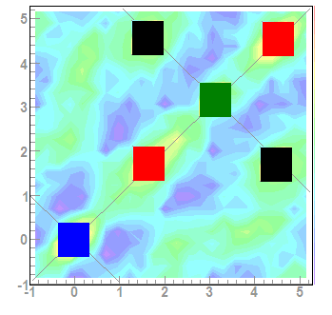
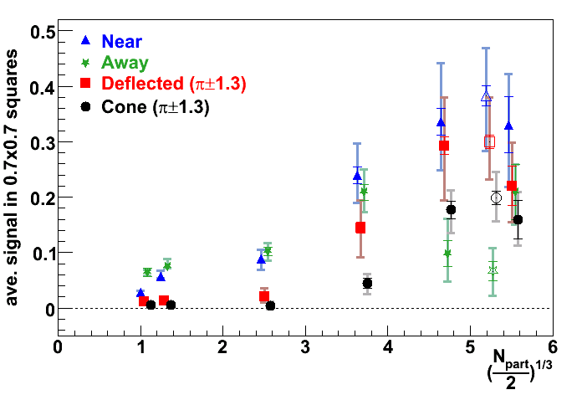
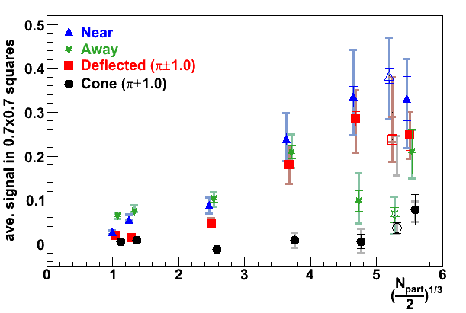
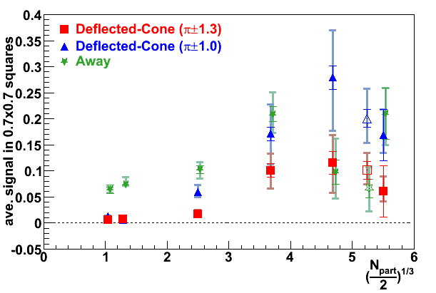
Signals
Signals taken from average in 0.7x0.7 squares.
Open symbols are ZDC triggered and are shifted to the left.
Large source of systematic errors comes from uncertainty in flow.
Another significant source is the width of the fitting region for background normalization.
Signal consistent with mach cone at about π±1.3 in more central Au+Au collisions.

Slide 20
Summary and Conclusions
Analysis improvements in 3-particle correlations.
Improved statistics.
Elongation along the diagonal seen in pp, d+Au and peripheral Au+Au.
Signal along the off-diagonal at about π±1.3 consistent with mach cone and/or Cherenkov radiation.

Slide 22
Backups

Slide 23
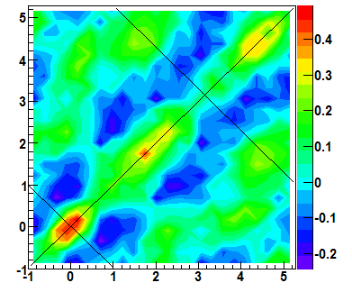

V₄ Systematic
v₄*1.2
V₄ is taken as 1.15*v₂²
This is varied by ±20%.
Has no significant effect on the result.
v4*0.8

Slide 24
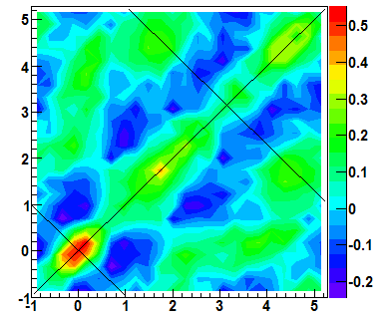
Trigger Flow
Default
Trigger particle flow effect may be different for 3 particle correlations than for 2 particle correlations because of the additional associated particle, ie v₂(trig+assoc)≠v₂(trig)
Take difference between v₂(3.5 GeV/c) and v₂(5.0 GeV/c) of 20% as an estimate.
No significant effect on the result.
Trigger Particle Flow*1.2

Slide 25
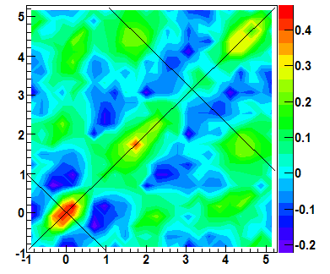
Soft-Soft Systematics
Soft-soft term is constructed from minbias data.
The underlying soft-soft bkgd in triggered events may be different due to trigger bias.
This systematic was checked using triggered event multiplicity distribution.
No significant effect.
Default
Result from this check

Slide 26
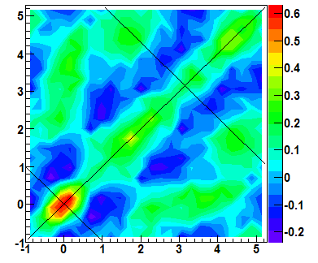
V₂ of Central Trigger Data
Default
Currently do not have flow measurements for central trigger data.
Default has same v₂ as minbias data with the same centrality (from TPC multiplicity cut).
This effect is checked using 5% most central v₂ for the central data corresponding to the minbias top 5% and v₂ values from 10-5% for the rest of the data.
No significant change.
This check

