Slide 1
Weak Lensing of the CMB
by Large-Scale Structures
Alexandre Amblard
University of California, Berkeley
Santa Fe 2004

Slide 2
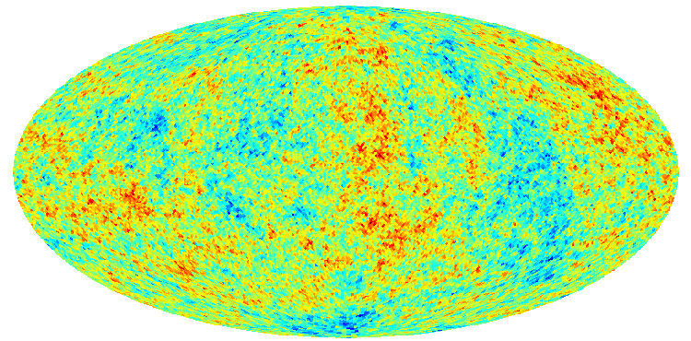
How does it work
z≈ 1100
α
z=0
M
D_{LS}
D_{L}
LSS
Effect depends on the mass of the lens
M, and the distance D_{L}(lens), D_{S} (source),
D_{LS} (lens-source)
The light from the Last Scattering Surface is deflected by matter along the line of sight

Slide 3
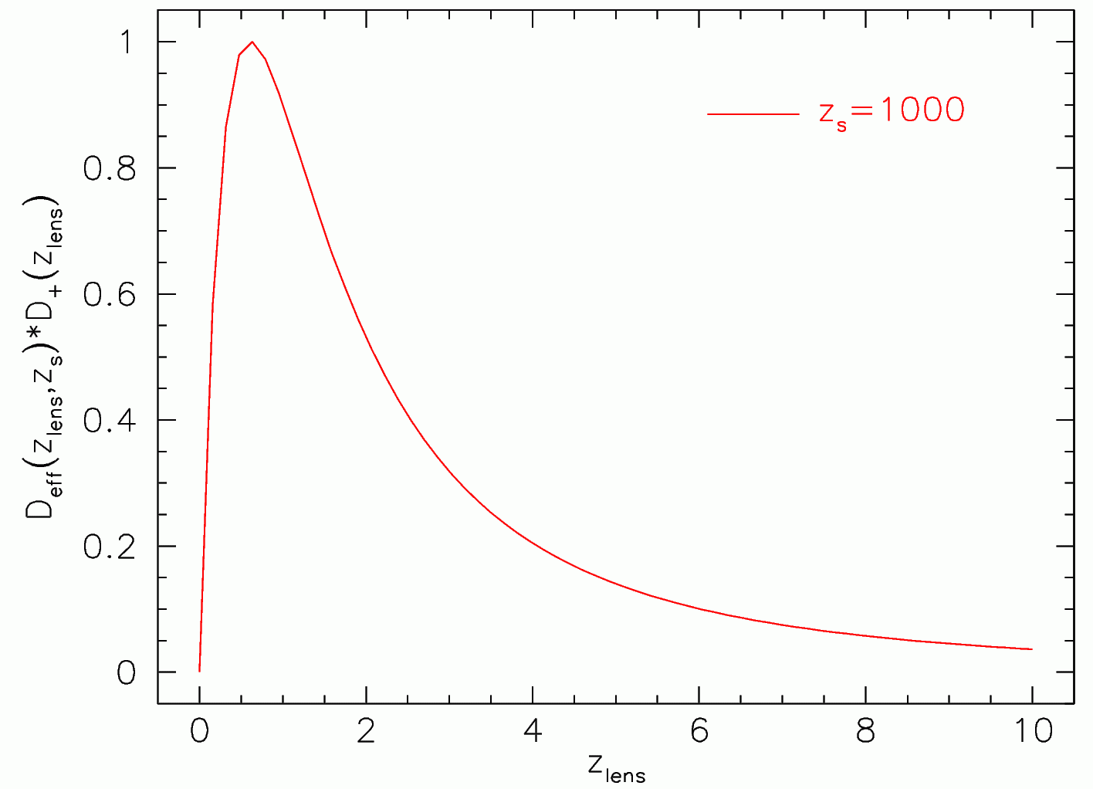
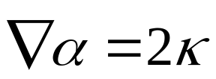
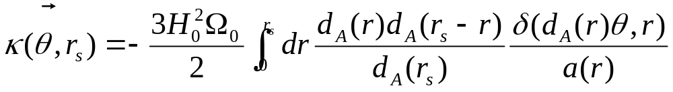
Contribution to the
lensing effect of the CMB
versus redshift :
Efficiency * Growth factor
From Bartelmann
If the deflection is small, one can relate the deflection angle
α with the convergence κ :
With the convergence κ representing the projected mass distribution :

Slide 4
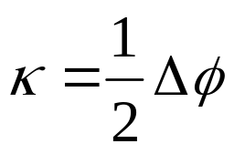
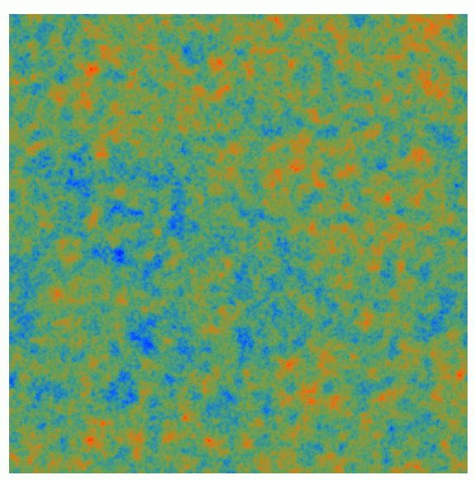
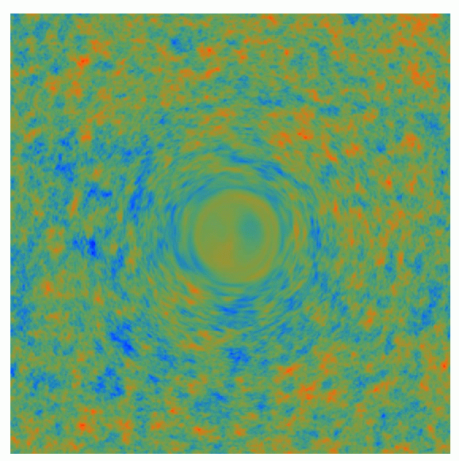
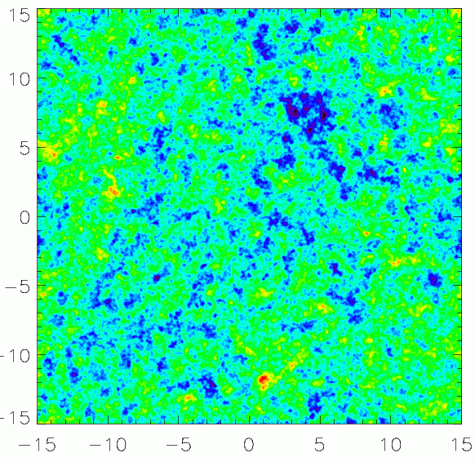
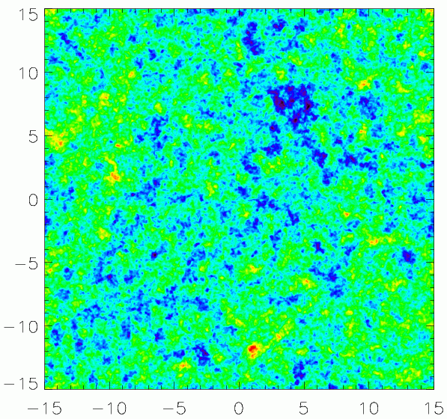
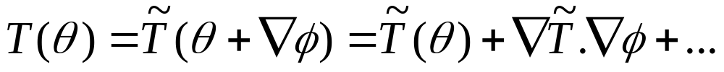
Convergence :
with
CMB
Lensed CMB
CMB
Lensed CMB
For very big mass (unrealistic)
(From Hu)
Lensed
Unlensed
Effect to detect

Slide 5
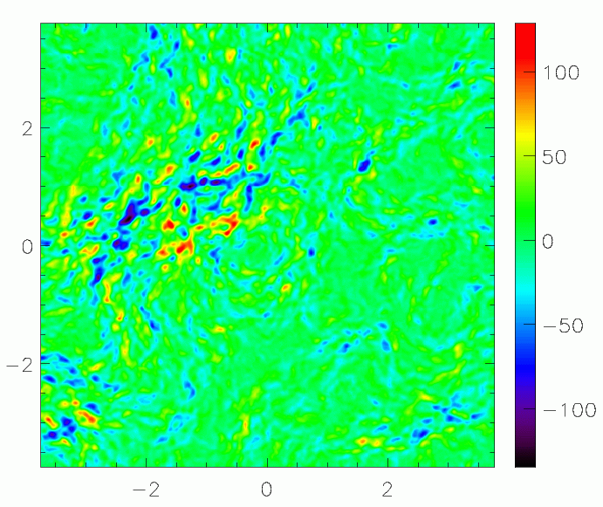
Order of Magnitude
Size of the deflection : ~ 1’
Temperature difference : ~ 20μK
( 1 μK for E, B)

Slide 6
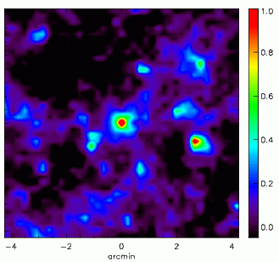
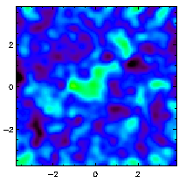
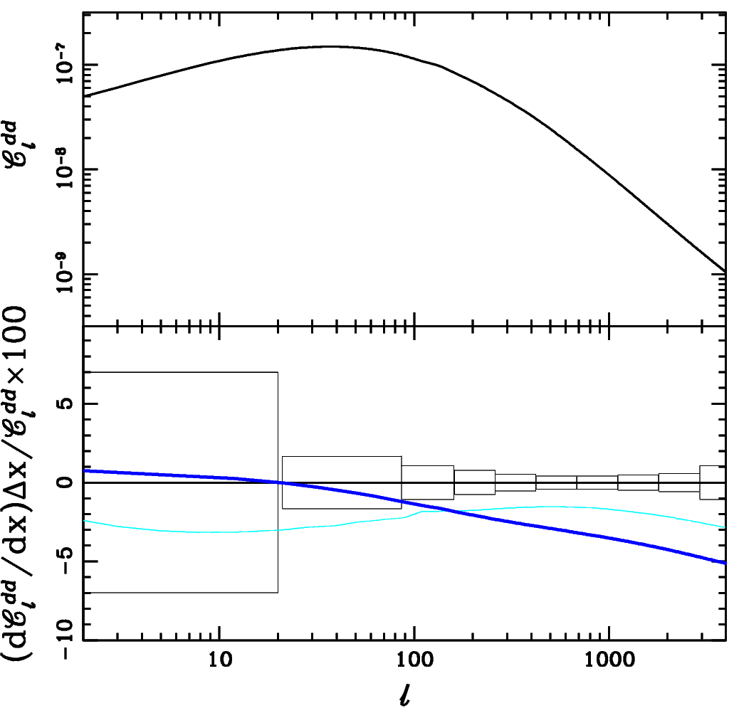
What can we do with the CMB lensing ?
On small scales to reconstruct
the cluster density profile and mass
Zaldarriaga & Seljak (2000)
Holder & Kosowsky (2004)
Vale et al. (2004)
Dodelson (2004)
8’
7.5º
4% for 0.1 eV
On larger scales, measure the convergence power spectrum [Hirata et al. (2003), Okamoto et al. Kesden et al. (2003), Amblard et al. (2004)]
Kaplinghat et al. (2003)

Slide 7
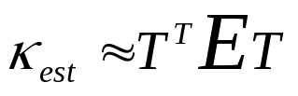
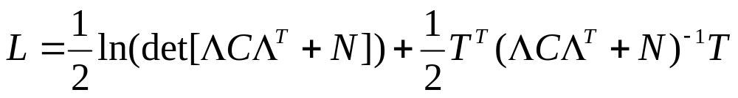
How to estimate of κ ?
Basically 2 ways :
Quadratic Estimator :
lensed noisy map
Okamoto & Hu (PRD 67 - 2003)
Kesden et al. (PRD 67 – 2003)
Maximum Likelihood :
noise correlation matrix
lensing operator
CMB correlation matrix
Hirata & Seljak (astro-ph/0306354)
use simplify likelihood and iterate to solve it

Slide 8
Assumptions
Valid if the CMB anisotropies distribution is Gaussian
Valid if the deflection angle is small (especially quadratic one)
Valid if the noise is uncorrelated
Valid if the convergence field is Gaussian
Valid in the absence of foreground
But large scale structures
are not Gaussian on small
scales
But at least the kinetic SZ is
spectrally undistinguishable from
the CMB.
Test with simulations to quantify the effect
(work done with C. Vale & M. White)

Slide 9
The simulations
The simulations used in the following contained :
a lensed CMB map by :
an uniform Gaussian noise of 2 μK/arcmin
an estimated kinetic SZ with the same N-body simulation
a combination of a Gaussian field for z>2 and a simulated
convergence field from a N-body simulation for z<2
Our test survey has the following characteristics :
0.8’ of angular resolution
2 μK/arcminute noise level
30x30 degrees sky coverage

Slide 10




How to assess the results ?
The reconstructed map, which tell us where the denser
regions lies,
Similarities in the map
The cross spectrum of the estimated map with the input one,
which tell us how good statistically is the estimate :
Bias in the estimated map κ_{est}
Ratio :
The auto spectrum of the estimated map, which contains
some cosmological information, and that should match our input one :
obtained
expected
Bias in the convergence
power spectrum estimate

Slide 11
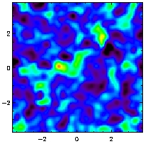
Map reconstruction (no kSZ)
20’ smoothed maps :
input
Recovered
(quadratic estimator)
The two maps are very similar at 20 arcminutes, but the noise level is
still quite high

Slide 12
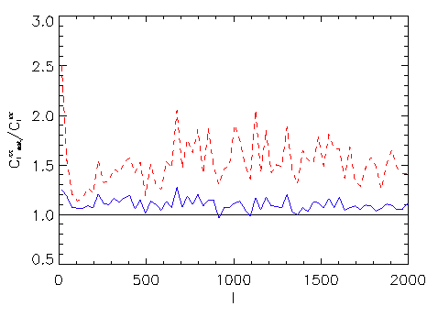
Power Spectrum
The power-spectrum
is now bias by 50%
The map is now bias
by 10%
The non-Gaussianity of the convergence field bias the quadratic
estimator even more.

Slide 13
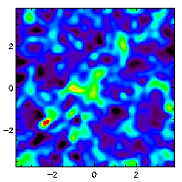
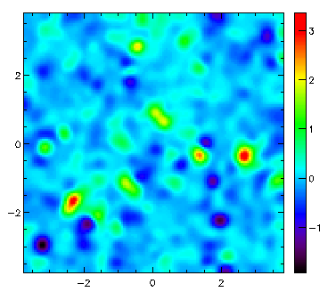
Adding a foreground
Smoothed (20’)
kSZ map
input
recovered
Obvious contamination
from the kSZ
The estimated convergence map still look quite
alike the input one but spurious fluctuations due
to the kSZ appear.

Slide 14
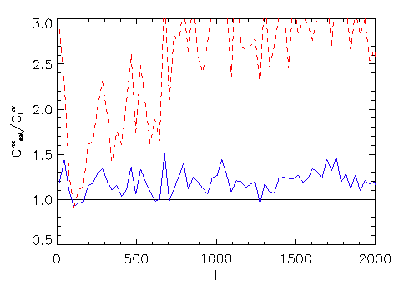
200% bias on the
estimated spectrum
, kSZ contributes to
150% level
20% of bias in the map, showing the correlation between the kSZ and the lensing
Correlated and uncorrelated kSZ structures bias our measurement
of the convergence power spectrum.

Slide 15
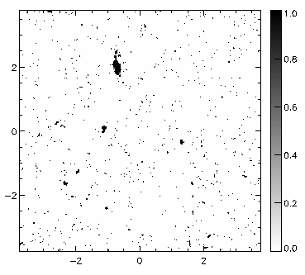
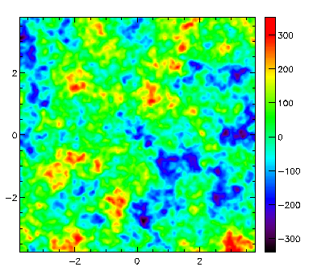
On the way to separate the kSZ
Could we get rid of the kinetic SZ ?
Let’s assume we have a map at another frequency which allows to
detect clusters via thermal SZ (S > 50 μK), 1.4% of the pixels are masked.
Mask used
Interpolated Map
(using Renka & Cline algorithm)

Slide 16
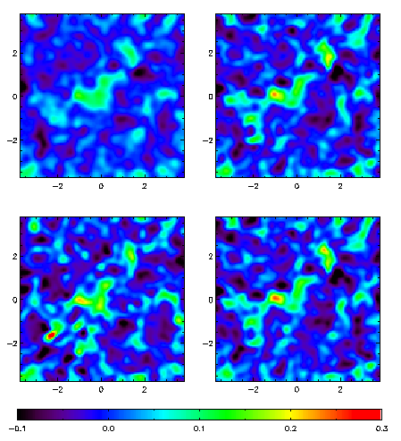
Results
the main kSZ spots have
disappeared with the masking
technique
the recovered map using the
masking technique looks very
similar to the ones which does
not contain any kSZ
input
output without kSZ
output with kSZ
output with masked kSZ

Slide 17
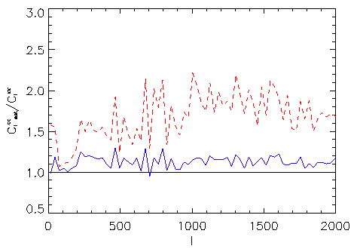
Back to 70% extra power
20 % residuals
10% bias on the map
Most of the correlated
structures are gone
The mask suppresses most of the correlated kSZ structures, does
not affect much the convergence spectrum (less than 5%), and
suppresses almost 90% of the bias linked to the kSZ.

Slide 18
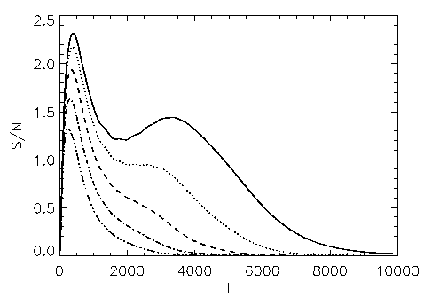
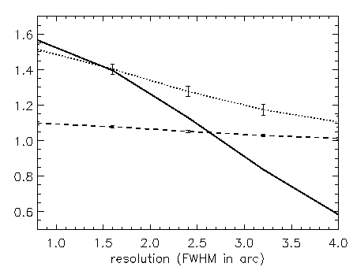
Bias and angular resolution : a solution ?
Non-Gaussianity comes
from small structures
Small structures may
create the bias
Estimated power
spectrum bias
From 4 to 0.8 arcminutes (FWHM)
bias on the estimated map
A low angular resolution limits the coverage in l space but
decreases the bias level.
A mission with large coverage, good sensitivity, but moderate
resolution may be the suitable one.

Slide 19
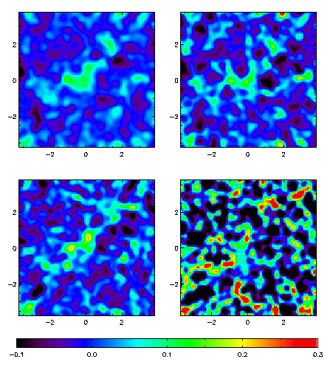
What could we expect from forthcoming experiments
The 20’ features are quite
recognizeable with APEX, ACT
and SPT, but not with Planck
as its noise will be at least 6
times larger.
APEX : 0.8’ resolution, 8 μK/arcmin, 15x15 degrees
(2004)
SPT : 1.1’ resolution, 10 μK/arcmin, 60x60 degrees
(2006)
PLANCK (1/10) : 5’ resolution, 65 μK/arcmin, 60x60 degrees – one tenth of Planck (2007)
input
APEX/ACT recovered
SPT recovered
Planck recovered

Slide 20
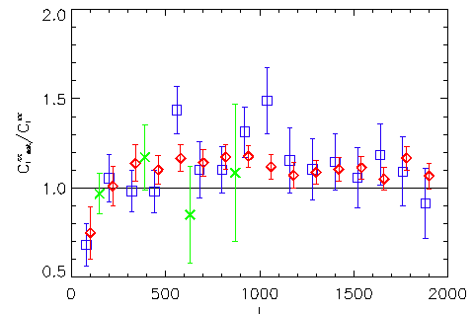
Bias on the power spectrum for
Planck, SPT and APEX
with masking the kSZ
Thet bias is around 10% for APEX
and SPT, Planck estimated power
spectrum does not present
a significant bias.

Slide 21
Conclusions
CMB lensing is promising but it requires “great” data and robust detection algorithm.
The kinetic SZ and the non-Gaussianity create a bias on the estimated convergence power spectrum, but could be both reduce (masking in real and Fourier space)
Other foreground effect need to be addressed, polarization
(B-mode especially) measurement is maybe the way to go
Forthcoming experiments should be able to detect the lensing
of the CMB

