Slide 1

MNM Fatal 2006-03
Machinery
February 13, 2006 (Pennsylvania)
Crushed Stone Operation
Superintendent
25 years old
5 years mining experience

Slide 2
Overview
The victim was fatally injured when he was
struck by a pitman assembly that was being
removed from the crusher at the secondary
plant. A crane, operated by a contractor
employee, was being used to remove the
pitman assembly. The victim was standing
on the work platform with two other employees.

Slide 3
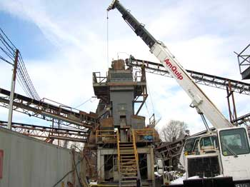

Slide 4
Root Causes
A risk assessment to determine all possible hazards and to establish safe work procedures was not conducted prior to performing the task. No procedures were in place to ensure that persons were clear of suspended loads. The location of the pitman assembly in relation to the upper level screening section catwalk on the crusher prevented a straight, perpendicular, and unrestricted crane pick causing the lifting line to scrape against the upper catwalk.
Standards and controls were inadequate and failed to ensure that training regarding hand signals was provided to the miners by the contractor’s crane operator before performing the task.

Slide 5
Best Practices
Train miners in safe work procedures, including hand signals, before beginning repairs that involve cranes. Ensure they are familiar with the manufacturer's recommendations.
Stop, Look, Analyze, and Manage (SLAM) each task to identify all potential hazards before performing work.

Slide 6
Best Practices
Prior to hoisting loads, crane operators should ensure that all persons are positioned in areas where they will not be exposed to hazards of suspended loads.
Arrange the rigging to prevent shifting of the load being lifted. Balance the load by placing the crane or hook block directly above the load's center of gravity and ensure the pick line isn't contacting or deflected by any structure.

