Slide 1
FEA of structures with insulation damage in fire
A.M.Khaskia (Mallett)
Dat Duthinh (NIST)
FEMCI Workshop 2006 October 25-26
FINITE ELEMENT MODELING
CONTINUOUS IMPROVEMENT
NASA Goddard Space Flight Center
Greenbelt, Maryland, USA

Slide 2
FEA of structures with insulation damage in fire
Topics
  Motivation
  Physics
  Procedures
  Test Case
  Future Work

Slide 3
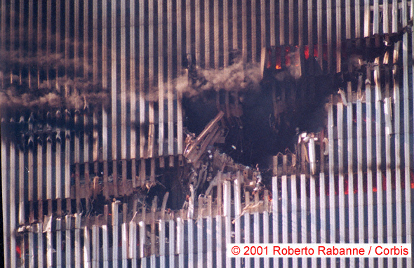
FEA of structures with insulation damage in fire
Motivation – WTC Disaster

Slide 4
FEA of structures with insulation damage in fire
Motivation
  WTC destruction
    Need to treat fire as a structural load
    Analyze complex structures under fire all the way to collapse
    National Construction Safety Team recommended enhancing capabilities of available computational software to study the effect of fire on buildings and the design of fire protection systems
  Interface limited to compatible elements
  Intense fire of long duration requires modeling damage and collapse

Slide 5
FEA of structures with insulation damage in fire
Physics: Fire-Structure Interaction
Fire
Combustion
Heated Gases
Heat Transfer
Heated Gases
Deflection and Failure
Heated Structure
Structural Deflections
Thermal Body and Other Loads

Slide 6
FEA of structures with insulation damage in fire
Procedure
Fire Dynamics Simulator
Combustion
Heated Gases
Thermal Analysis
Heated Gases
Thermal FEM
Deflection and Failure
Heated Structure
Temp2body_ld
Geom_up
Structural Analysis
Thermal Body and Other Loads
Structural FEM

Slide 7
FEA of structures with insulation damage in fire
Temp2Body_ld
  Same Global CSYS
  Transfer Nodes
  Temperature Mapping
  Gradient Calculation and Body Load Definition
  Use Area-Weighted Averages
Geom_up
  Maps Deflections and Strains from Structural onto Thermal Model Domain
  For Deflections use the Kinematics Relationship
    U = u + r x d
  Interpolates Strains from Selected Cross Section Cell Nodes of Structural onto Thermal Model Domain

Slide 8
Temp2Body_ld Transfer Nodes
Temperature transfer nodes
2R_{o}
W₂
W₂ /2
t₂
2R_{i}
3
2
1
2
6
5
4
3
1
7
z
6
y
4
W₃
W₄
8
9
7
t₃
9
12
11
10
8
z
15
14
y
13
t₁
W₁

Slide 9
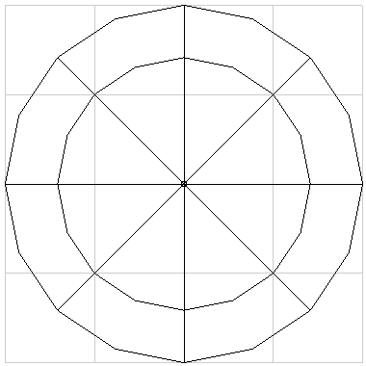
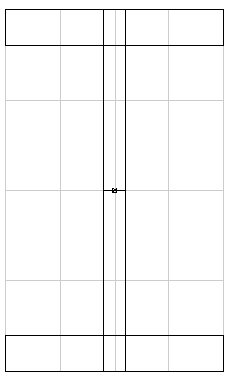
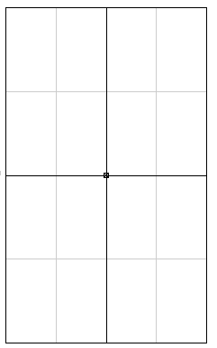
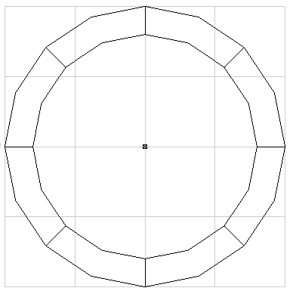
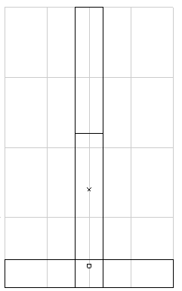
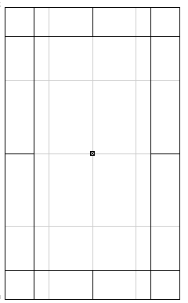
Common cross sections
Cells and strain transfer nodes

Slide 10
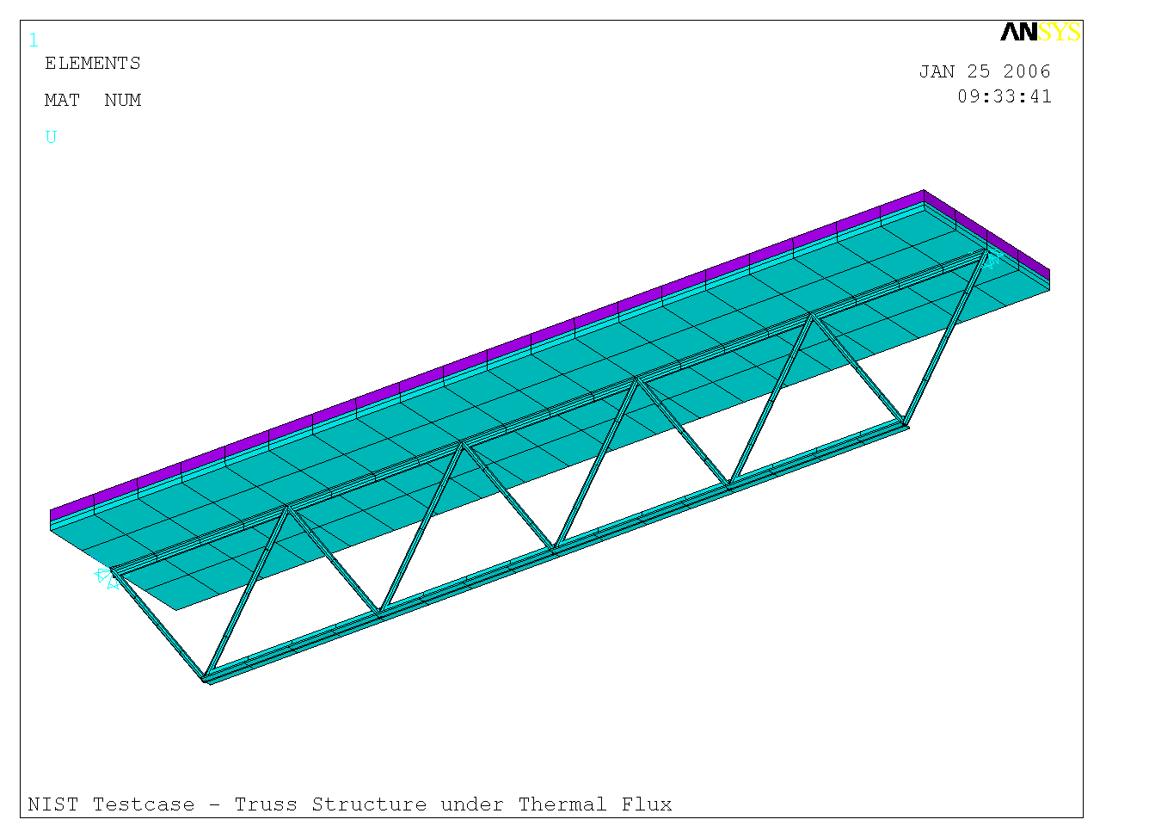
Test Case - Floor Slab Supported by an Open Web
Structural FEM – Beam and Shell Elements

Slide 11
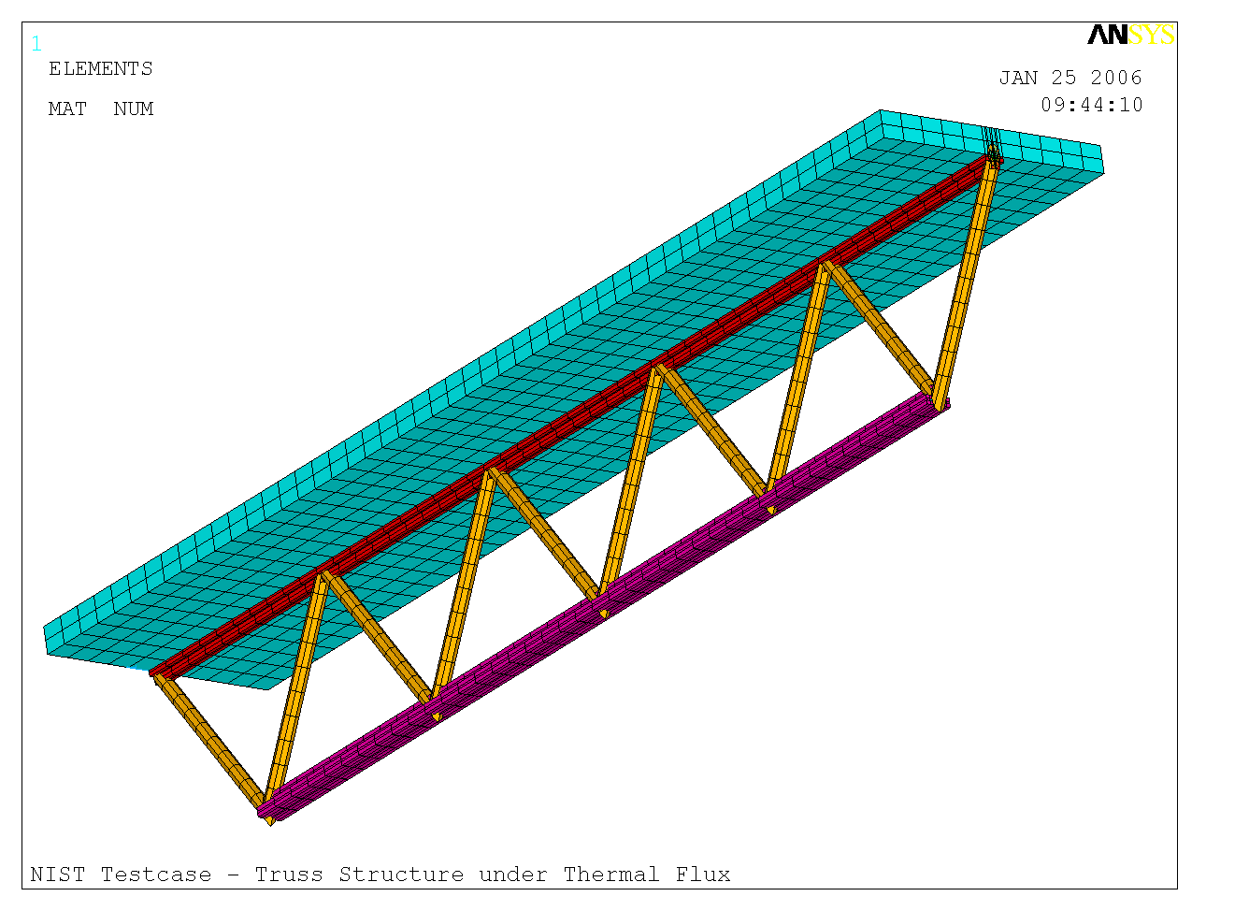
Test Case - Floor Slab Supported by an Open Web
Thermal FEM – Solid Elements

Slide 12
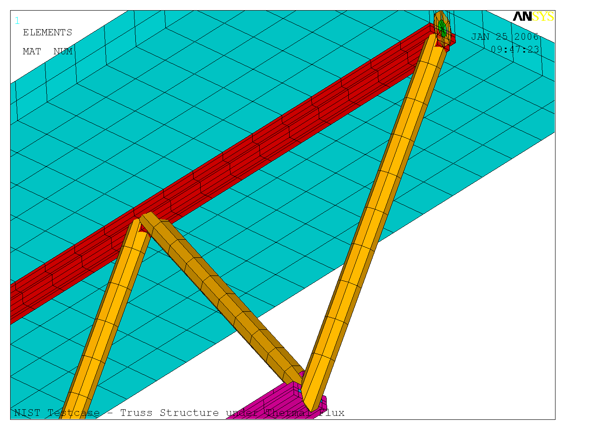
Test Case - Floor Slab Supported by an Open Web
Thermal FEM – Insulation Details

Slide 13
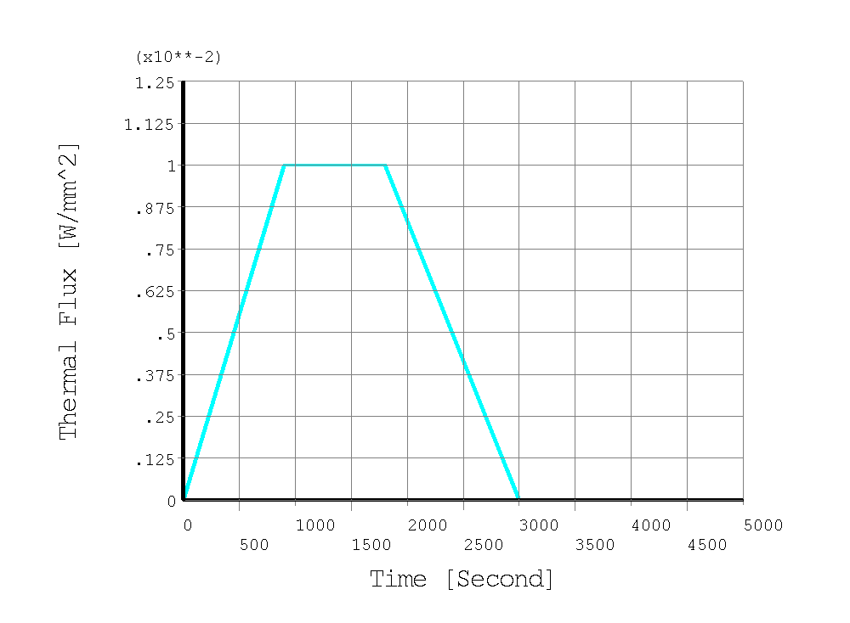
Thermal Finite Element Model – Thermal Flux

Slide 14
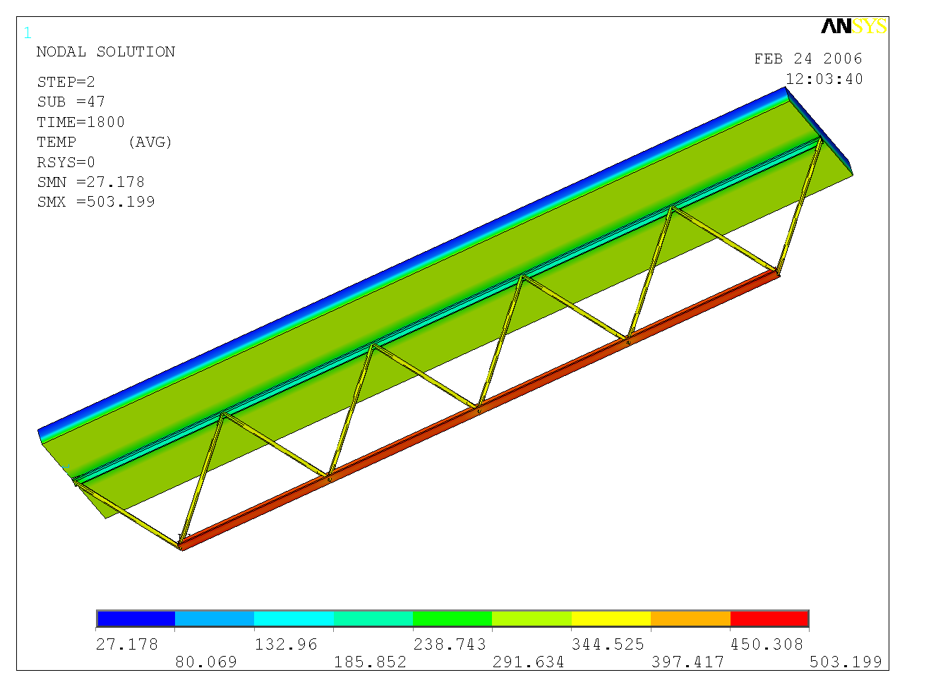
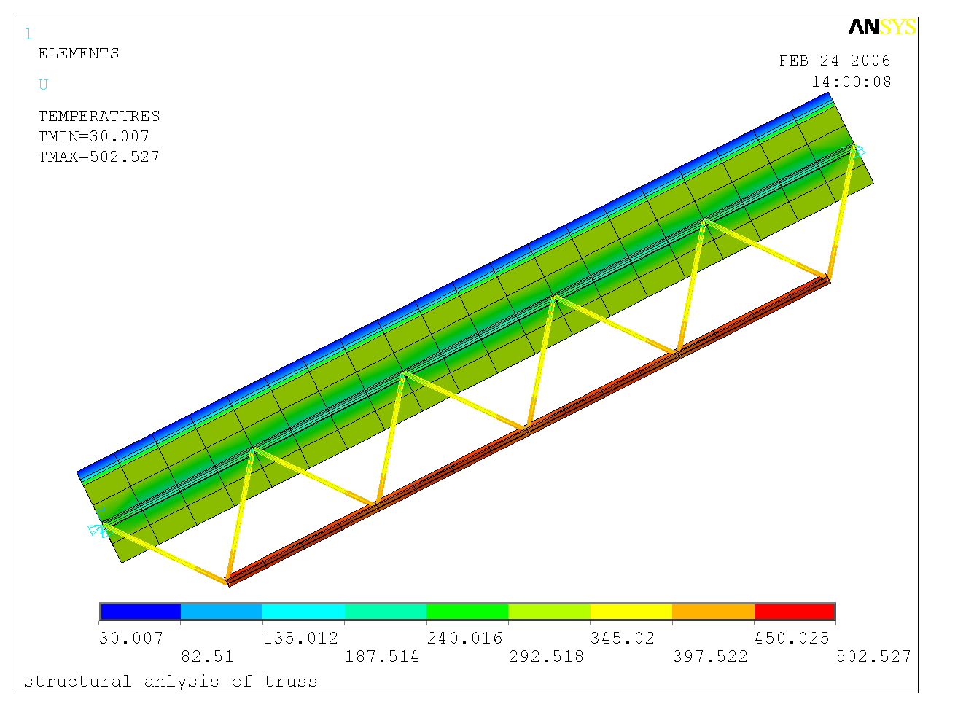
Test Case - Floor Slab Supported by an Open Web
Thermal and Structural FEM
Temperature Solution and Thermal Body Load

Slide 15
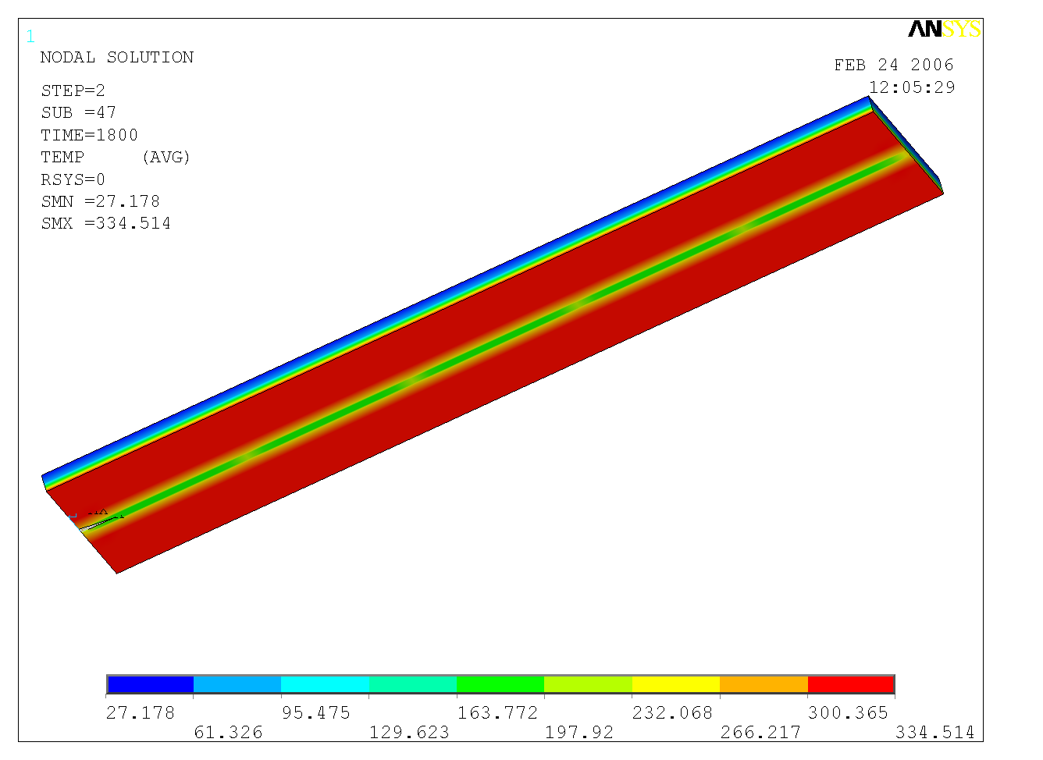
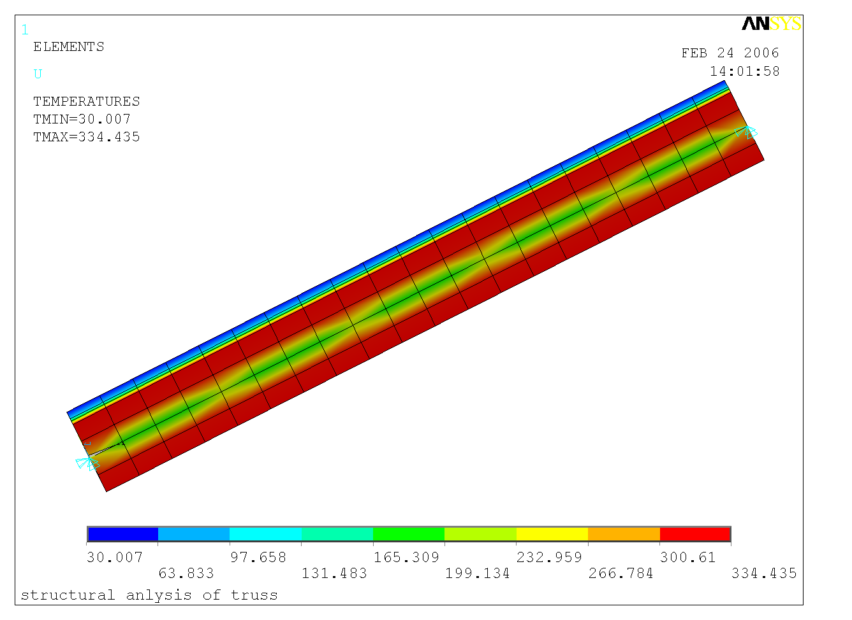
Test Case - Floor Slab Supported by an Open Web
Thermal and Structural FEM
Temperature Solution and Thermal Body Loads - Slab

Slide 16
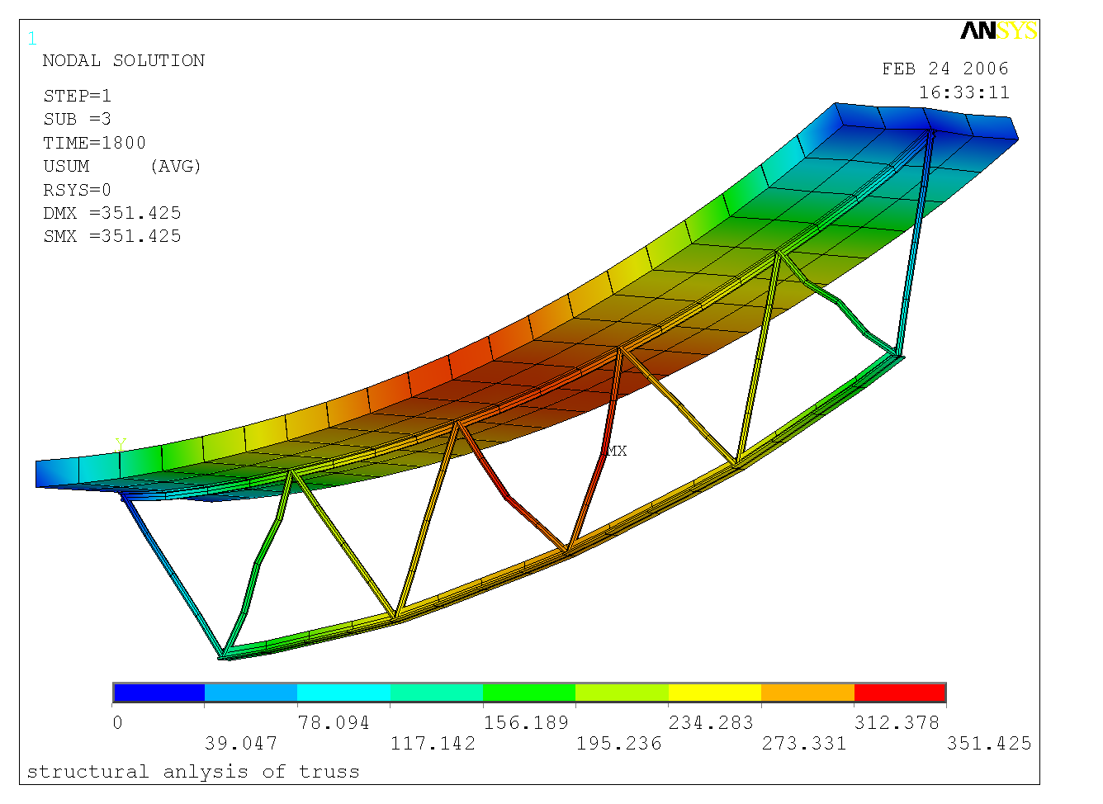
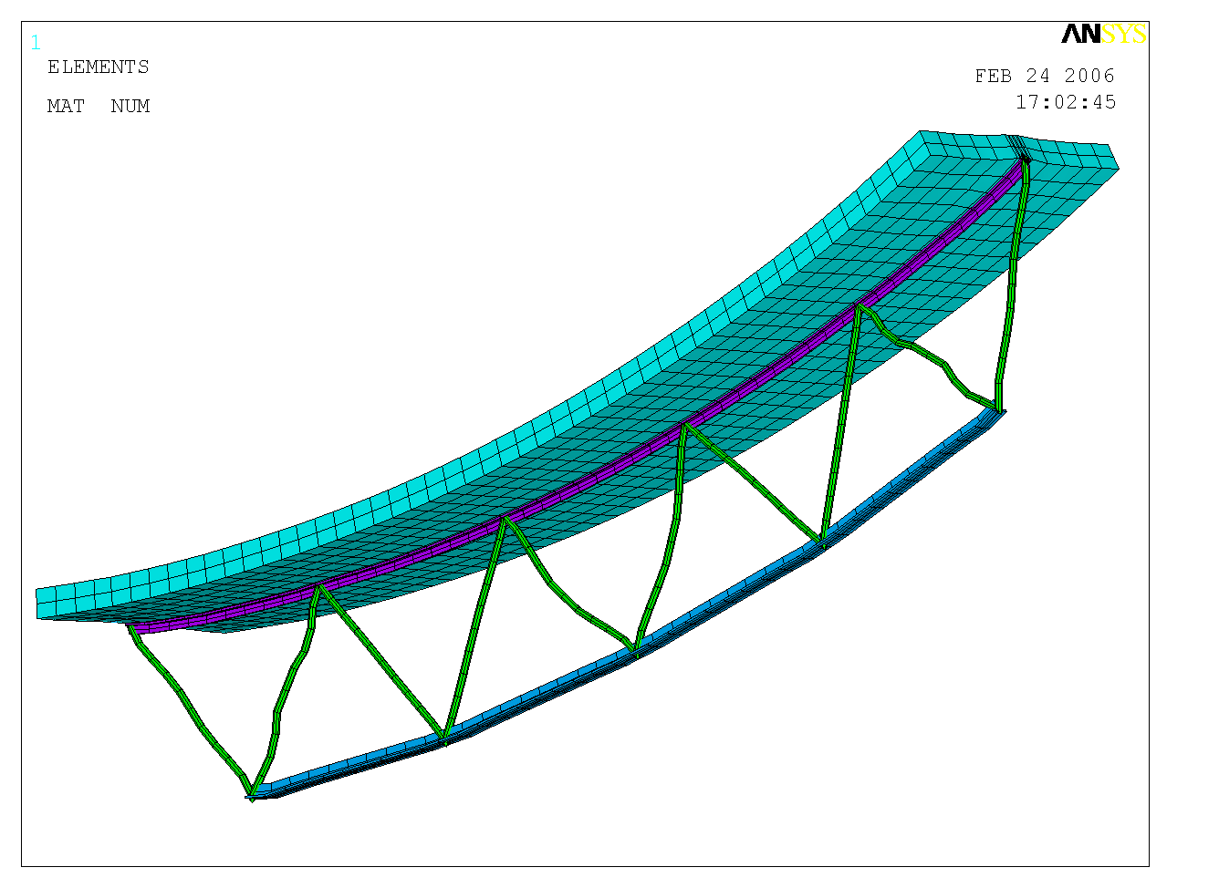
Test Case - Floor Slab Supported by an Open Web
Structural and Thermal FEM
Deflected and Updated Shapes

Slide 17
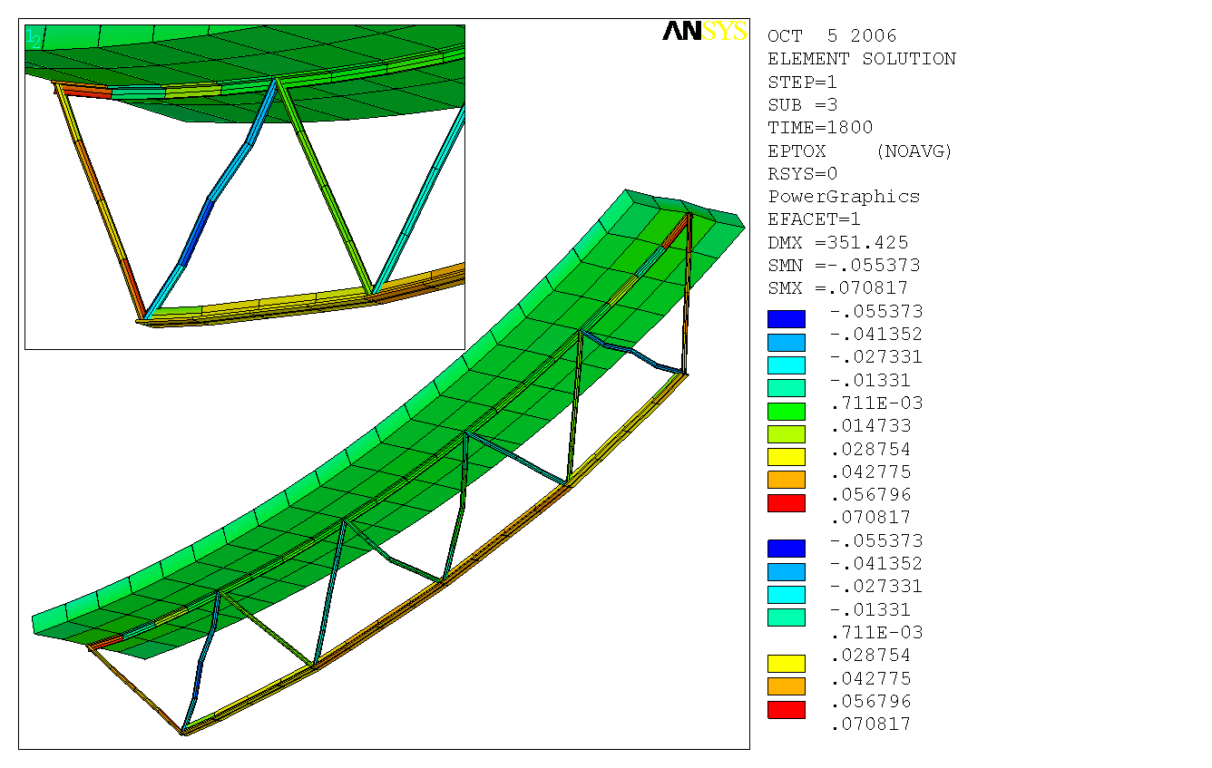
Structural strains ε_{xx} at 1800 s

Slide 18
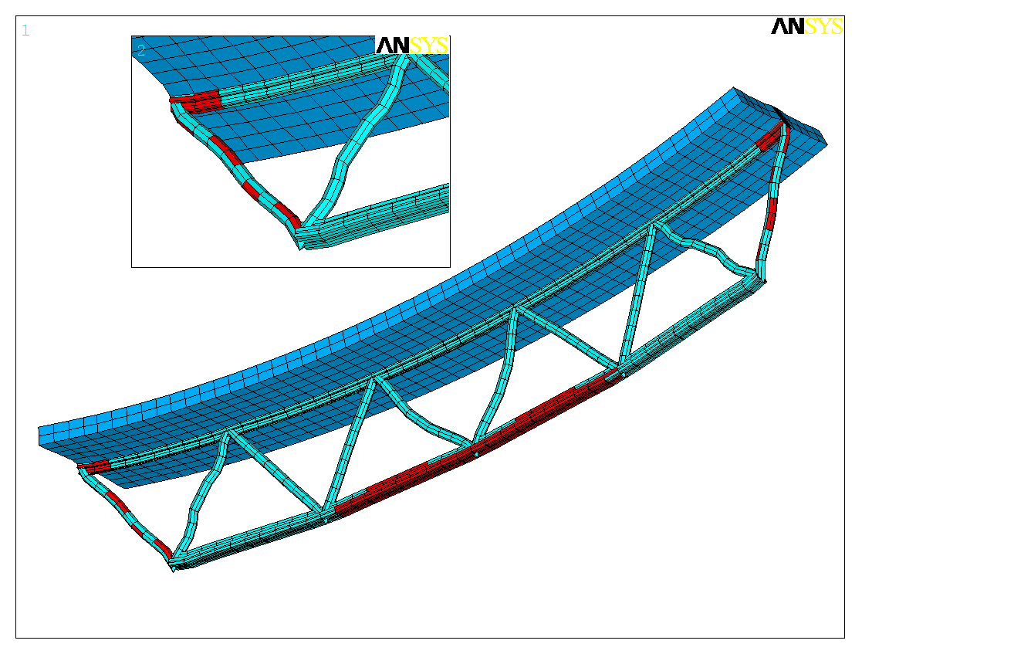
Failed Insulation of Thermal Model (Red)

Slide 19
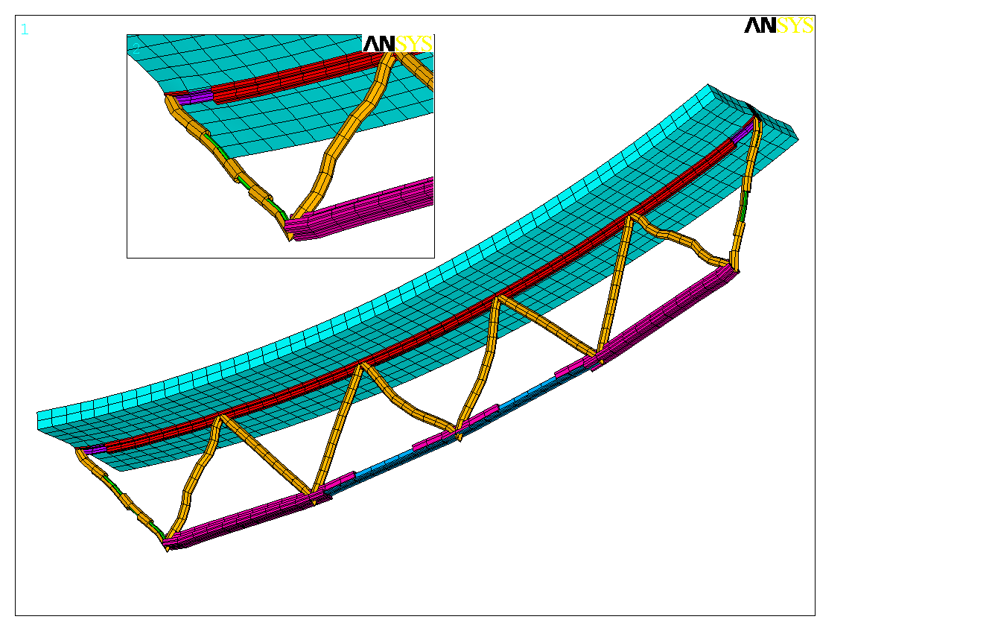
Failed Insulation of Thermal Model (Removed)

Slide 20
FEA of structures with insulation damage in fire
Future Work
  Better failure criteria for insulation (experiments)
  Predicting structural failure: computational criteria

