Slide 1
Mach cone shock waves at RHIC
Jörg Ruppert
Nuclear Theory, Department of Physics,
McGill University, Montreal, Quebec, Canada
In collaboration with:
Thorsten Renk (Univ. of Helsinki and Jyväskylä),
Berndt Müller (Duke University)

Slide 2
Outline
Jet-Medium coupling
Mach cone structures from colored and colorless sound
Mach cone shockwaves in a dynamical model simulation
Shockwaves go with the flow
Ridge
Conclusions

Slide 3
Jet-Medium Coupling
What happens to the jets’ lost energy? What part is “heating” the
plasma, what part is redistributed into excitations of the medium?
Colorful Modes:
longitudinal modes => Mach cones
J. Ruppert & B. Müller (Phys.Lett.B618:123-130,2005)
transverse modes => Cherenkov (like) radiation
I. Dremin, (e.g Nucl.Phys.A767:233-247,2006),
A. Majumder et al. (e.g. Phys.Rev.Lett.96:172302,2006)
2) Colorless (hydrodynamical) mode => Mach cones
H. Stöcker et al. (e.g. Nucl.Phys.A750:121-147,2005),
J. Casalderra-Solana et. al. (e.g. Nucl.Phys.A774:577-580,2006),
T. Renk & J. Ruppert (e.g. Phys.Rev.C73:011901,(2006))
I. Dremin’s talk

Slide 4
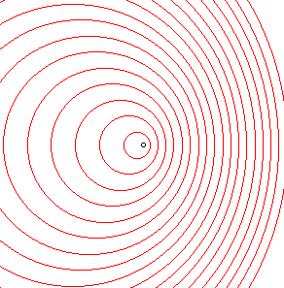
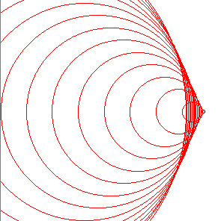
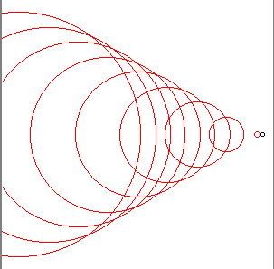



Mach cones from colored sound?
What is the wake structure induced by a high-p_{T} color charge traversing the QCD medium?
Can Mach waves in the QGP be created?
Information on part of plasma’s properties is contained in longitudinal and transverse components of the dielectric tensor
Two scenarios of interest:
High temperature pQCD plasma
Plasma as a quantum liquid
J. Ruppert & B. Müller, Phys. Lett. B618 (2005) 123

Slide 5
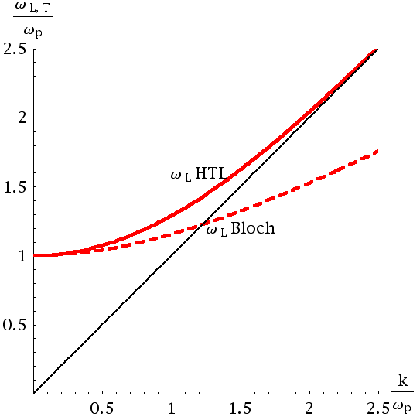
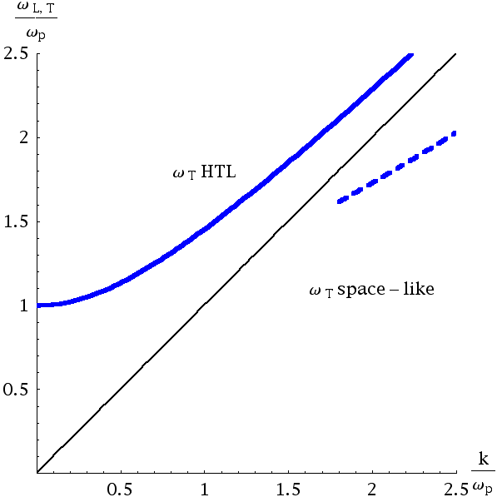
Plasmon branches
Longitudinal modes
Transverse modes
Colored sound
Generic result: if a space-like longitudinal plasmon branch exist Mach cone structures could be induced.
J. Ruppert & B. Müller, Phys. Lett. B618 (2005) 123
Generic result: if a space-like transverse plasmon branch exist Cherenkov-like gluon radiation could be induced. Koch, Majumder, Wang, Phys. Rev. Lett 96:172302, 2007

Slide 6


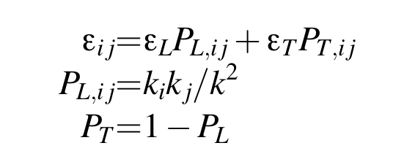

Making colorful wakes
Hard scattered parton (=jet-precursor) acts as a point-like probe current:
Energy loss of the
incident color charges:
Thoma, Gyulassy, Nucl.Phys.
B351:491 (1990), Weldon,
Phys. Rev. D26, 1394 (1983)
Induced charge- and current densities:
Ruppert & B. Müller,
Phys. Lett. B618 (2005) 123

Slide 7
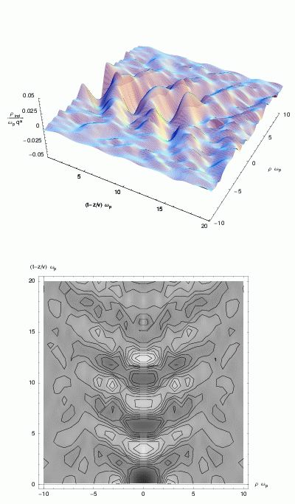
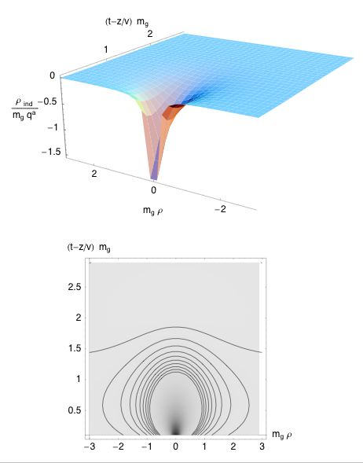
Colored wakes in the QCD Medium
2. Plasma as a quantum liquid:
  Subsonic jet: analogous results
  to pQCD plasma case
  Supersonic jet: excitation of
  longitudinal plasma modes
  (colored sound) with Mach cone
  emission angle:
1. High temperature pQCD plasma:
  Color charge density wake
  is a co-moving screening cloud:
J. Ruppert & B. Müller,
Phys. Lett. B618 (2005) 123

Slide 8
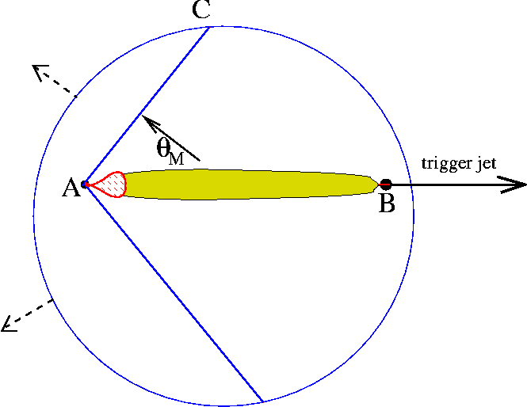
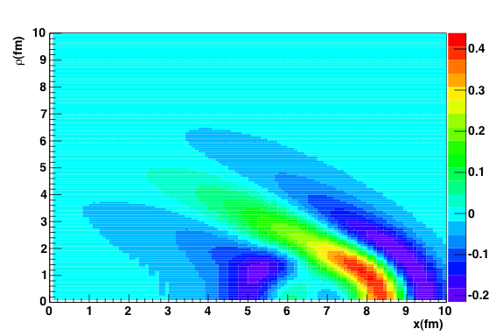
Mach cones in a hydrodynamical framework
Colorless sound
Radiative energy could be deposited in collective hydrodynamical modes.
H. Stöcker et al. (e.g. Nucl.Phys.A750:121-147,2005),
J. Casalderray, E. Shuryak, D. Teaney,
Nucl.Phys.A774:577-580,2006
Idea similar to studies of waves in the nuclear medium which can be excited if supersonically travelling source occurs:
See e.g. A. E. Glassgold,
W. Heckroth, and KM Watson, Ann. Phys. (Paris) 6, 1 (1959), Scheid et al. Phys.Rev. Lett. 32 (1974), 741
J. Casalderray, E. Shuryak, D. Teaney,
Nucl.Phys.A774:577-580,2006

Slide 9
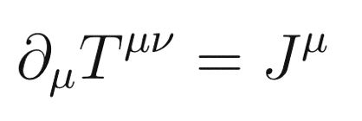

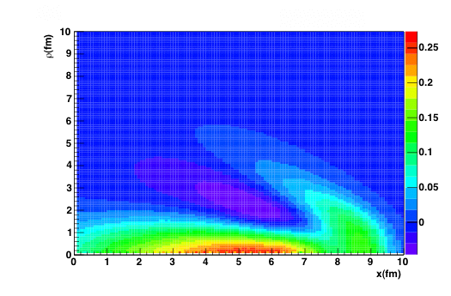
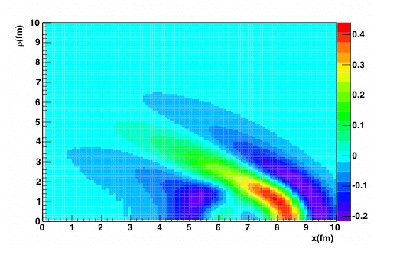
Strong shock excitation only created with specific source term!
Source term not yet derived
fundamentally. Has to
express non-equilibrium
coupling of jet’s secondaries
Non isentropic excitations: the main excitation mechanism is entropy production and the flow field introduces vorticity.
Isentropic excitations: No significant entropy production. Medium excitation by sound wave emission.
Weak correlation signal with point-like
source: Chaudhuri & Heinz, Phys.Rev.Lett.97:062301,2006
QM 2006, Casalderray-Solana

Slide 10
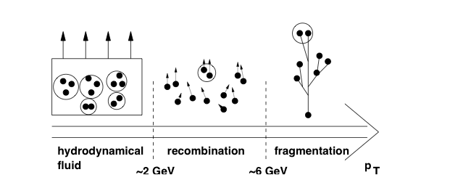
Hadron production in different p_{T} regions
Jets created in hard collisions --> Fragmentation regime >6 GeV
Lost energy - redistributed in the medium --> hydro window <2 GeV
Intermediate window --> recombination region
Momentum cuts allow to concentrate on energy redistribution
in the medium of hard partons to the soft bulk medium

Slide 11
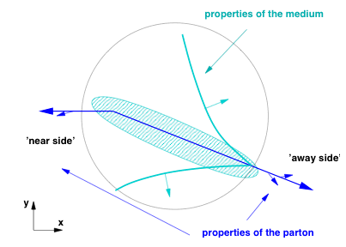


Correlation Measurements:
Theoretical modeling in a dynamical medium I
φ
Assume: energy lost from hard partons
excites collective mode with fraction f
φ=0
φ=π
Follow flow of energy/momentum in
dynamical medium =>
dispersion relation
(Fig. Casalderray-Solana)
Renk & Ruppert, Phys.Rev.C73:011901,2006,
Phys. Lett. B646:19-23,2007, and
Phys. Rev. C 76, 014908 (2007)
(Fig. Renk)

Slide 12
Theoretical modeling in a dynamical medium II
Fireball evolution model describing hadronic m_{t} spectra, HBT, photon emission and R_{AA} (cf. Renk, Phys. Rev. C. 70 (2004) 021903)
Space-time position dependent jet energy deposition into the medium
(in BDMPS according to ASW quenching weights, anologously as in e. g. Renk, Ruppert, Nonaka, Bass, Phys.Rev.C75:031902,2007 )
Fraction f_{mach} of energy deposition into collective mode (sound)
Local speed of sound u (and fireball thermodynamics) from lattice EOS
Propagation of sound waves through evolving medium (incl. longitudinal and transverse expansion)
Freeze-out using Cooper-Frye formula
Monte-Carlo sampling using trigger conditions and acceptance cuts
Renk & Ruppert, Phys.Rev.C73:011901,2006

Slide 13
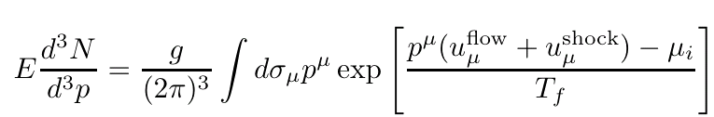
Monte Carlo
Near side:
Hard parton energy (and type)
LO pQCD parton spectrum
Vertex sampling from nuclear overlap
Pobabilisitc energy loss in BDMPS
Near and away side fragmentation
Fragment and check against near side trigger threshold
Away side:
Intrinsic k_{T}
Chosen such that d-Au width of far side peak is reproduced
Away side probabilistic energy loss from in-medium path
Propagate excited mode
Freeze-out according to Cooper-Frye
Count hadrons above associate threshold
Contains all information on trigger bias, pathlength distribution and
nuclear density. . .

Slide 14
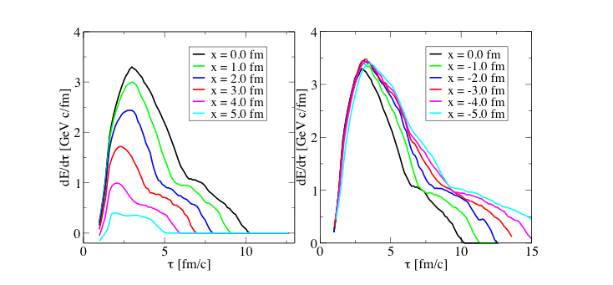
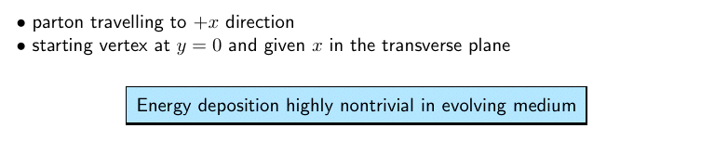
Energy deposition
Renk, Ruppert, Phys.Rev.C73:011901,2006

Slide 15
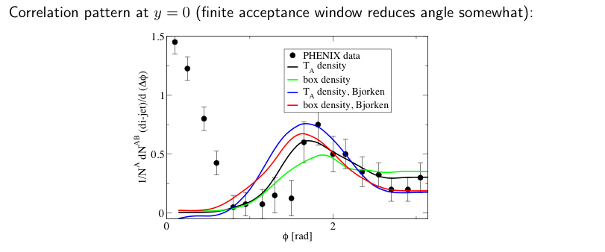
2-particle correlation and medium properties
Renk, Ruppert
Faster evolution <=> larger angle
More flow exposure <=> structures are washed out
Tool to probe speed of sound and longitudinal and
transverse flow.

Slide 16
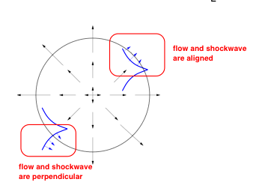
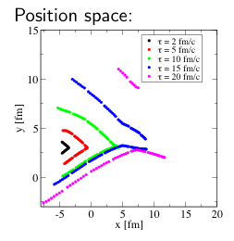
Transverse flow I
Shockwave: additional boost for hadrons at freeze-out
“Position space” vs. ”Momentum space”
(Fig. T. Renk)
Renk, Ruppert, Phys.Rev.C73:011901,2006
At 1 GeV, a Mach signal only appears if aligned with flow
Renk, Ruppert, Phys.Rev.C73:011901,2006; Satarov, Stocker, Mishustin, Phys.Lett.B627:64-70,2005.

Slide 17
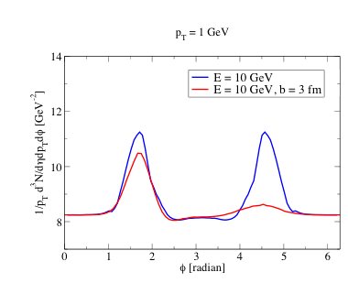
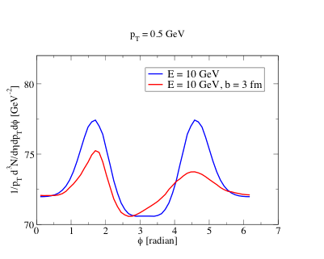
Transverse flow II
Renk, Eur. Phys. J. C49 : 13-17,2007
Wing of the cone “vanishes” for some geometries due
to non - alignment flow - mach shock
Due to momentum conservation: reappearance of strength at lower p_{T}
Misidentification as ‘deflected jet’ possible

Slide 18
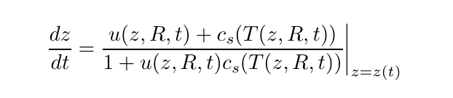
Shockwaves go with the flow
Propagate with c_{s} relative to local medium
(Elongation in rapidity space)
Longitudinal flow field at final z_{final} determines
boost in momentum space
Elongation only for excitation propagating relative to
the medium! Poses severe challenges to non-hydro scenarios.
Renk, Ruppert, Phys.Lett.B646:19-23,2007

Slide 19
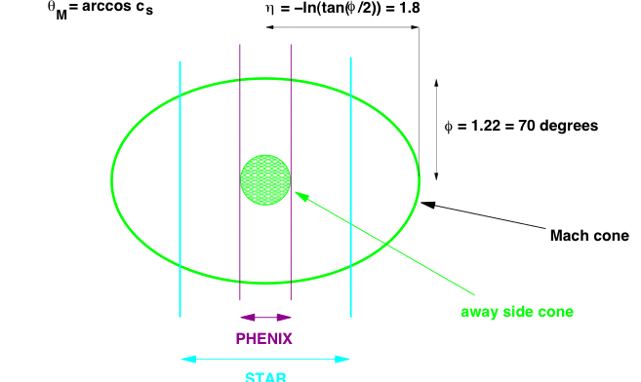
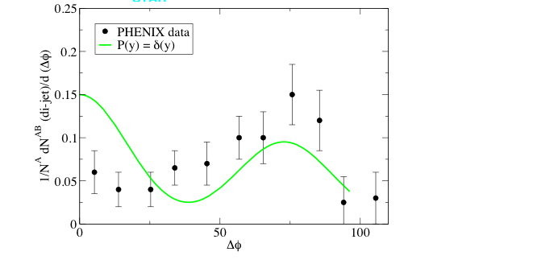
Away side parton at midrapidity
(Fig. T. Renk)
Renk, Ruppert,
Phys.Lett.B646:19-23,2007

Slide 20
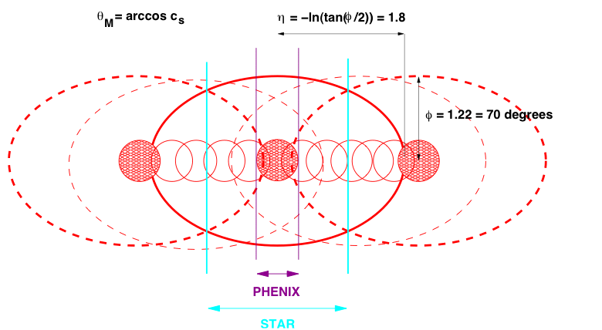
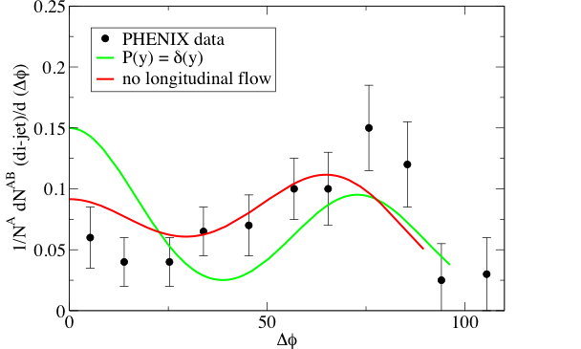
Rapidity-averaged away-side parton
(Fig. T. Renk)
Renk, Ruppert,
Phys.Lett.B646:19-23,2007

Slide 21
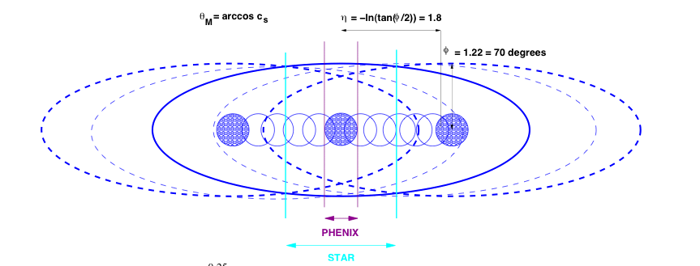
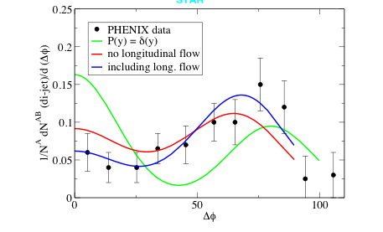
Including longitudinal flow
(Fig. T. Renk)
Renk, Ruppert,
Phys.Lett.B646:19-23,2007
Longitudinal flow: if near-side at mid-
rapidity and cut for away-side at (small)
forward-rapidity => away-side correlation signal
still (almost) unchanged [rapidity cuts only show
longitudinally elongated cone]

Slide 22
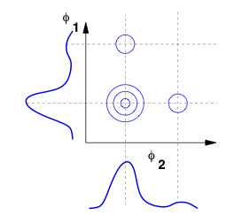
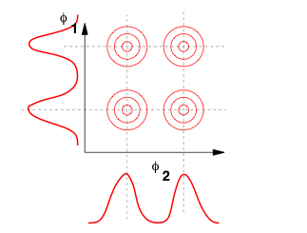
Three particle correlations
Assumption: calculated as factorized 2-particle correlations
(Fig. T. Renk)
Calculated backround subtracted
Each particle from shockwave is correlated with away side parton
Neglect additional correclations among particles in shockwave
(motivation: momentum conservation in cone
shared among O(20+) particles)

Slide 23
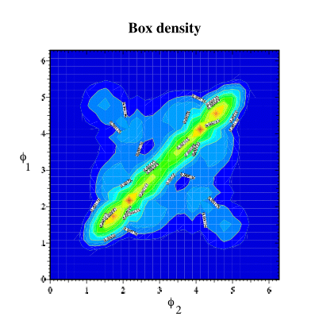
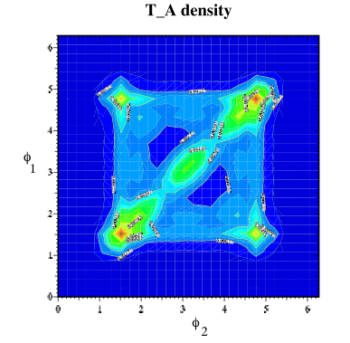
3-particle correlations and medium properties
Correlation at y=0
Renk, Ruppert, Phys. Rev. C 76, 014908 (2007)
Strong flow distortion <=> diagonal contribution dominant
Off-diagonal strength does not appear
automatically for Mach cones

Slide 24
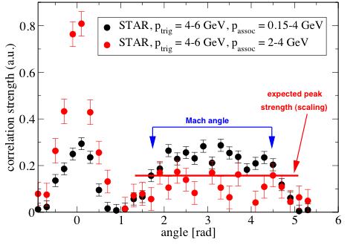
P_{t} cut variations
(Fig. T. Renk)
No apparent change in angle as function of p_{associate}
No apparent change in angle as function of p_{trig}
Scaling law describes relative peak strength as a function of p_{trig}
Disappearance of dip (punchthrough?)
J. Adams et. al. [STAR Collaboration] Phys. Rev. Lett. 95 (2005) 152301
Complication due to recombination region -- not yet included
in dynamical model. Therefore arguments more qualitative here.

Slide 25
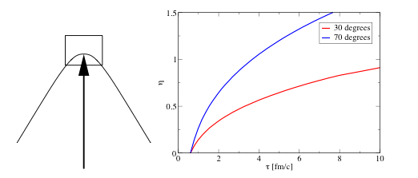
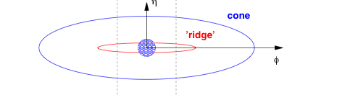
Is the ridge a similar hydro phenomenon?
Ridge vs. large angle correlation might be a resemblance of
bow shock vs. Mach shock!
(Figs. T. Renk)
Large spread in rapidity would be a genuine hydro
phenomenon also for smaller-angle soundwave
Conclusive measurement would be determining
the transition region of 4-particle correlation with di-hadron trigger
Renk, Ruppert, hep-ph/0701154

Slide 26
Conclusions
Redistributed energy in collective (colorless) modes
leading to Mach shocks explains:
Measured correlation gives averaged speed of sound of
the nuclear medium <c_{S}> (angular measurement)
Sensitive in details to evolution (especially 3 particle correlation)
Relative independence of away-side correlation width with
ptrig and passociate
Presence of a dip on the away-side
(weak) off-diagonal structures in 3 particle correlations
Ridge might be a similar hydro phenomenon: bow shock
Special thanks to T. Renk

Slide 27
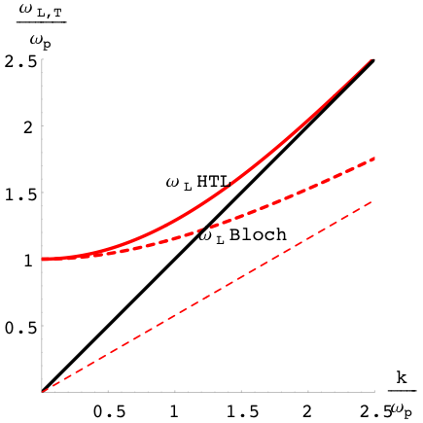
Color Octet vs. color singlet
Colored sound

