Slide 1
Volume Reflection Simulations
using Yazynin’s Channeling Code
and Application to Possible e- Experiment
Bob Noble
SLAC
October 29, 2008
Special thanks to Igor Yazynin (IHEP) for kindly responding to questions and
generously sharing his code. Thanks to Walter Scandale (CERN) for information
on volume reflection and capture.
1

Slide 2
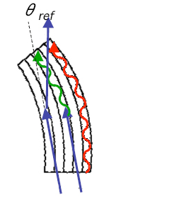
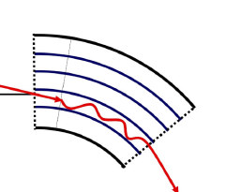
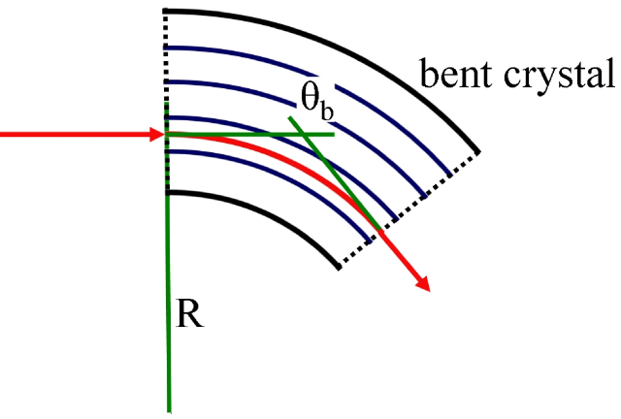
This is a “decision-tree” code, not full Monte Carlo.
Yazynin Code includes processes:
multiple scattering
channeling
volume capture
de-channeling
volume reflection
Basic approx: Code replaces details of particle orbits with Monte Carlo fits based on distribution fcns and analytic formulas for trajectories over long distances (not on scale of betatron motion in bent crystal). It applies probabilities to dechanneling, volume capture, volume reflection, amorphous transport, Coulomb and nucl scattering angles, energy loss, etc. Both proton and electron versions of code exist.
w
dech
ch
2

Slide 3
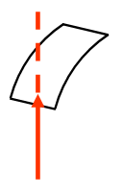
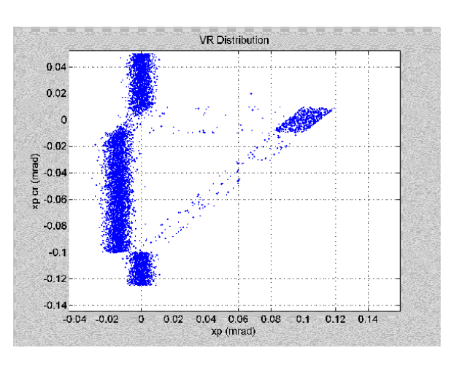
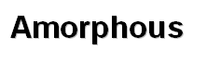
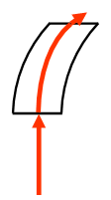
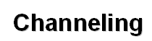
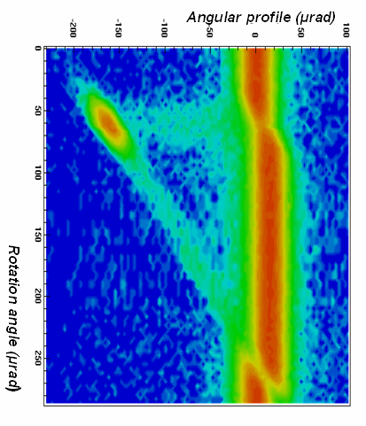
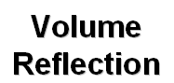
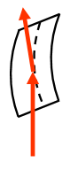
Example: 400 GeV protons, Si(110),
crystal R = 10 m, length=1mm
Rotation angle
“Rotation
Angle”-
crystal
orientation
rel. to beam
input
direction
Usual expt plot
(other than sign)
0 degr
a
ch
dech
“Angular Profile”
change in particle angle
relative to input angle
which is induced by crystal
VC
VR
Max rot angle= xtal thickness/R=0.1 mrad
a
3

Slide 4
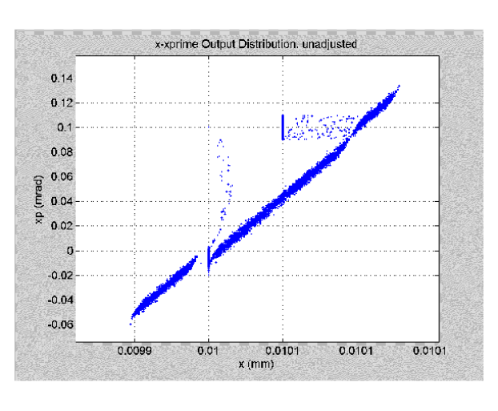
Example: Code runs 7000 protons (400 GeV), as pencil beam at R (horiz coord, not a radius) =0.01 mm, Z (vert) =1 mm with Z’=0, and R’ uniformly spread over [-0.05, +0.125] mrad. Transports each proton through 1 mm long, curved (10m) Si crystal.
VR Angular Profile Plot
Output phase space R’-R
R’
a1
dech
ch
input
ch
vc
a2
dech
VR
vc
VR
a2
a1
R
4

Slide 5
We exercised the p and e- codes over a large range of energies, curvature
radii, crystal thickness (primarily Si) to understand limitations and compare to
other work and data where available. Code was originally written for use with
multi-hundred GeV - TeV protons, so some approximations are not expected to be
valid in all regimes.
What we found and modified in our test version of the code:
1. VC particles channeled orders of magnitude deeper than physically reasonable.
Changed the VC dechanneling formula to same as for normally channeled particles.
2. Added a bremsstrahlung energy loss term ~ E to the electron code.
3. Modified the multiple scattering formula to include log(z/Z_{rad}) term so MS is
correctly reduced for thin crystals (still need to add plural scatt. for ultra-thin).
4. At low energy and large x=R_{crys}/R_{crit}, code’s VC probability > 1 (intended for
proton E>100 GeV, x<30). Modified VC probability following Taratin and Scandale’s
potential well capture probability (~E^{-1.5}), and used an exponential form to keep P<1.
5. Prior to VC at a plane deep in the crystal, code applied no MS, resulting in too
narrow of angle spread for these particles. We added MS, and when angle increase
is too large, we set capture probability to zero.
5

Slide 6
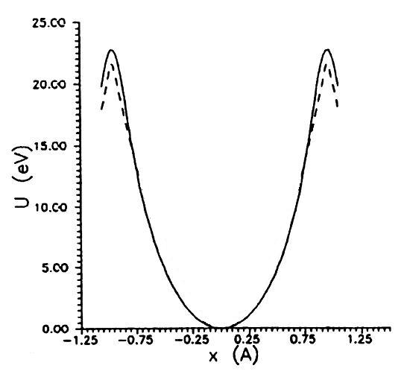
Taratin and Scandale’s potential-well capture probability, NIM B262 (2007) 340 (modified from an argument of Biryukov & Chesnokov)
Volume capture (VC) results from MS-induced energy transitions of order U₀ – E_{xc} from above barrier to top-levels of potential.
U_{o}
Si
Fast VC
orbits
KE= ½ (E₀ /c²) v² = ½ E₀ θ²
d (KE)/ dz = ½ E₀ dθ_{Nms}²/dz
Capture length L_{N} ≈ (U₀ – E_{xc}) / d (KE)/ dz
E_{xc}
Long-life
channeling
orbits
+
+
VC probability in curved crystal ≈
Distance that particle angle is within θ_{c 0} of plane / Capture length
P ≈ Rθ_{c 0} / L_{N} (P<<1)
To insure P<1 for all regimes in code, we replace this by the usual decay rate form
P = 1- exp(- Rθ_{c0} / L_{N} )
* For thin crystal where s < Rθ_{c 0 ,} include correction s / (s+ Rθ_{c 0} )
6

Slide 7
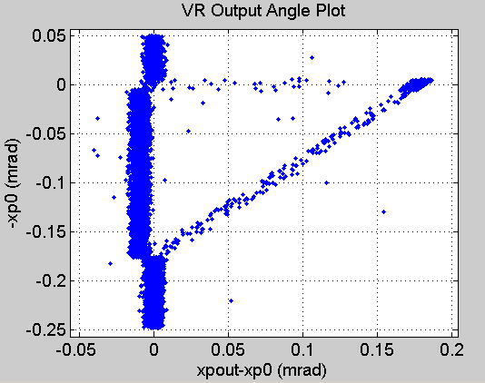
980 GeV protons
5mm Si, R=28.5m
a1
rms=2.78E-3 mrad
chan
dech
rms=2.9E-3 mrad
(MS+VR)
0.175 mrad
VR
vc
a2
rms=2.84E-3 mrad (θ_{ms} ~ E⁻¹)
-9.2E-3 mrad
Code VR: θ_{refl} = -1.5 θ_{c 0} (1- 1.67 (R_{crit} / R)) ~ E^{-1/2}
θ_{c 0} ~ E^{-1/2} R_{crit} ~ E L_{dech} ~ E
VR rms = 1.7 θ_{c 0} R_{crit} / R ~ E^{1/2} (MS ~ 1/E)
(6.4E-3 mrad) (2 m) (0.49m)
7

Slide 8
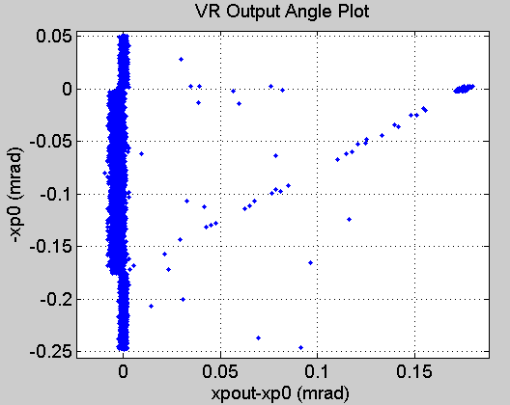
3500 GeV protons
5mm Si, R=28.5m
a1
rms=7.8E-4 mrad
chan
dech
0.175 mrad
VR
rms=1.7E-3 mrad
vc
a2
rms=8.0E-4 mrad
-3.1E-3 mrad
θ_{c 0} ~ E^{-1/2} R_{crit} ~ E L_{dech} ~ E
Code VR: θ_{refl} = -1.5 θ_{c 0} (1- 1.67 (R_{crit} / R))
VR rms = 1.7 θ_{c 0} R_{crit} / R
(3.4E-3 mrad) (7.3 m) (1.75m)
8

Slide 9
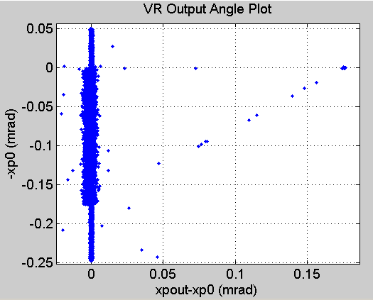
7000 GeV protons
5mm Si, R=28.5m
a1
rms=3.9E-4 mrad
chan
dech
0.175 mrad
VR
rms=1.8E-3 mrad
(VR rms dom)
vc
a2
rms=3.9E-4 mrad
-9.3E-4 mrad
θ_{c 0} ~ E^{-1/2} R_{crit} ~ E L_{dech} ~ E
Code VR: θ_{refl} = -1.5 θ_{c 0} (0.1972 R/R_{crit} -0.1472)
VR rms = 0.714 θ_{c 0} sin(0.4713 R/R_{crit}+0.85)
(2.4E-3 mrad) (14.6 m) (3.5 m)
9

Slide 10
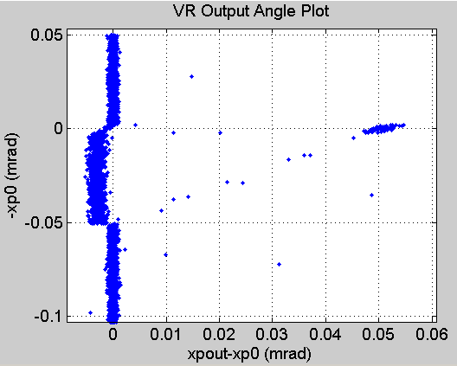
7000 GeV protons
5mm Si, R=98.5m
a1
rms=3.9E-4 mrad
chan
dech
VR
rms=7.2E-4 mrad
0.051 mrad
vc
a2
rms=3.9E-4 mrad
-2.9E-3 mrad
θ_{c 0} ~ E^{-1/2} R_{crit} ~ E L_{dech} ~ E
Code VR: θ_{refl} = -1.5 θ_{c 0} (1- 1.67 (R_{crit} / R))
VR rms = 1.7 θ_{c 0} R_{crit} / R
(2.4E-3 mrad) (14.6 m) (3.5 m)
10

Slide 11
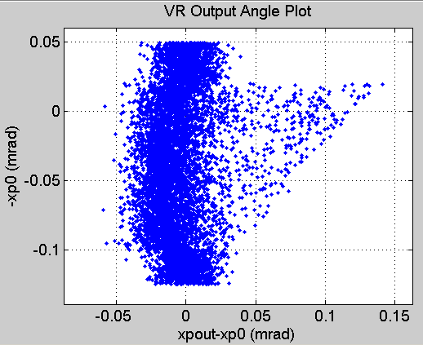
100 GeV electrons
1mm Si, R=10 m
a1
rms=1.2E-2 mrad
chan
2 θ_{c 0}
VR
0.1 mrad
rms=1.2E-2 mrad
(MS dominates)
vc
a2
rms=1.2E-2 mrad
-1.4E-2 mrad
θ_{c 0} ~ E^{-1/2} R_{crit} ~ E L_{dech} ~ E
Code VR: θ_{refl} = -0.8 θ_{c 0} (1- 2.55 (R_{crit} / R))
VR rms = 1.8 θ_{c 0} R_{crit} / R (negligible)
(0.02 mrad) (0.21 m) (3 mm)
11

Slide 12
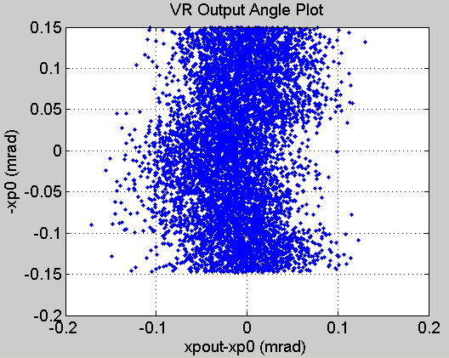
30 GeV electrons
1mm Si, R=10 m
a1
rms=3.9E-2 mrad
dechan
2 θ_{c 0}
VR
vc
rms=3.8E-2 mrad
a2
rms=3.8E-2 mrad
-2.5E-2 mrad
θ_{c 0} ~ E^{-1/2} R_{crit} ~ E L_{dech} ~ E
Code VR: θ_{refl} = -0.8 θ_{c 0} (1- 2.55 (R_{crit} / R))
VR rms = 1.8 θ_{c 0} R_{crit} / R (negligible)
(0.037 mrad) (0.063 m) (0.9 mm)
12

Slide 13
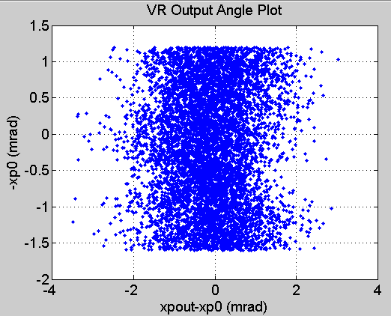
SLAC
NLCTA
360 MeV electrons
0.1mm Si, R=10 cm
ε_{n} ~ 10 μm
10 μm spot,
1 mrad
a1
rms=0.87 mrad
dechan
2 θ_{c 0}
VR & VC
dech
rms=0.77 mrad
a2
rms=0.85 mrad
-0.19 mrad
θ_{c 0} ~ E^{-1/2} R_{crit} ~ E L_{dech} ~ E
Code VR: θ_{refl} = -0.8 θ_{c 0} (1- 2.55 (R_{crit} / R))
VR rms = 1.8 θ_{c 0} R_{crit} / R (negligible)
(0.34 mrad) (0.76 mm) (0.01 mm)
13

Slide 14
Summary
1. We made several improvements to Yazynin’s code for VR/VC probabilities,
dechanneling of VC particles, multiple scattering, and e- energy loss, which
extend applicable range of R, E, crystal thickness for both p and e.
2. The coded formulas for VR angle and rms values still need to be confirmed
and generalized (current version from Monte Carlo fits over restricted energy range).
Basically the code gives VR ~ θ_{c 0} (with R_{crit} / R correction) , VR rms ~ θ_{c 0} R_{crit} / R ,
θ_{MS}~1/E.
3. At LHC energies (θ_{c 0} ~2 μrad), crystal curvature radius needs to be many tens
of meters to reduce VR rms spread < μrad and obtain good VR angular separation
(~ 2-3 μrad). This reduces VR angular acceptance (~thickness/R), but it is
still tens of micro-radians.
4. For an e- experiment at 360 MeV, MS ( ~ 1/E) dominates the rms spreads,
and the VR deflection tends to get lost in this spread, even for 100 micron
thick Si. De-channeled particles tend to escape in same direction as VR
deflection, adding to the apparent population of “deflected” particles. VR deflection
~ 0.2 mrad which is slightly less than θ_{c 0} , and rms spread is nearly 4 times this.
14

Slide 15
Extra slides

Slide 16
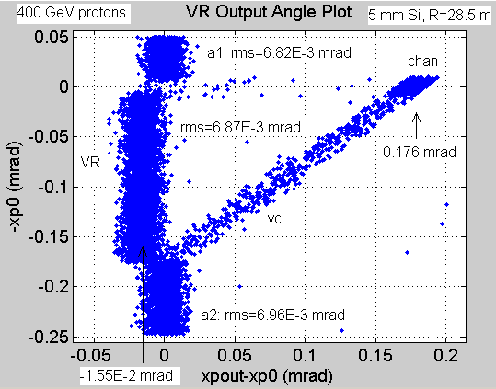
Code VR: θ_{refl} = 1.5 θ_{c0} (1- 1.67 (R_{crit}/R))
θ_{c0} ~ E^{-1/2} R_{crit} ~ E L_{dech} ~ E
(0.01 mrad) (0.835m) (0.2m)

Slide 17
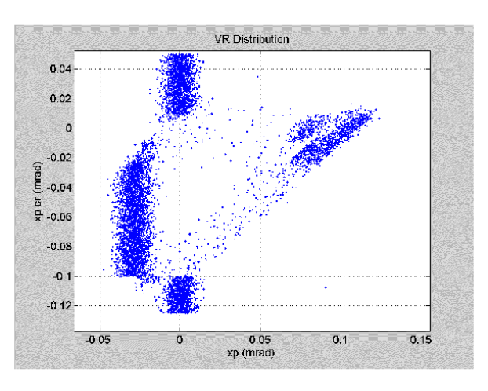
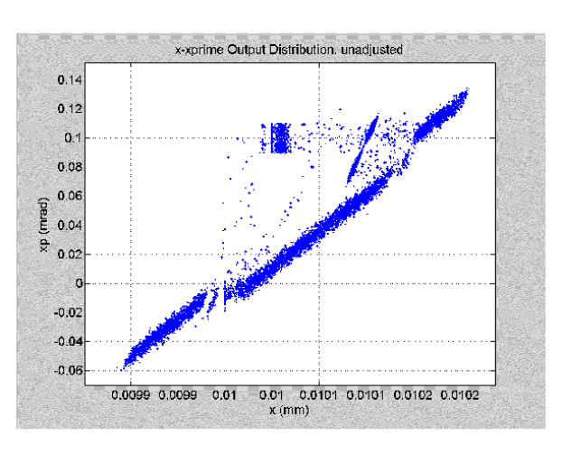
Profile plots
Phase space plots
in
N_cry=1
N_cry=1
in
N_cry=2
N_cry=2

