Slide 1
Interaction of Beta and Charged Particles with Matter
betas, protons, alphas and other heavy charged particles as ¹⁶O, gamma and x-rays, and neutrons
to understand the physical basis for radiation dosimetry/radiation shielding, one must be able to comprehend the mechanisms by which radiations interact with matter including biological material

Slide 2
Interaction of Beta and Charged
Particles with Matter
in any type of matter, radiation may interact with the nuclei or the electrons, in excitation or ionization of the absorber atoms
finally, the energy transferred either to tissue or to irradiation shield is dissipated as heat
Consider: What is the difference between excitation and ionization?

Slide 3
Heavy Charged Particles (HCP)
Energy Loss Mechanisms
protons, alphas, ¹²C, ¹⁶O, ¹⁴N; not electrons or positrons (β⁻, β⁺)
HCP traversing matter loses energy primarily through the ionization and excitation of atoms
except at low velocities, a HCP loses a negligible amount of energy in nuclear collisions

Slide 4
Heavy Charged Particles (HCP)
HCP exerts electromagnetic forces on atomic electrons and imparts energy to them
energy transferred can be sufficient to knock an electron out of an atom and ionize it
or it may leave the atom in an excited non-ionized state
since a HCP loses only a small fraction of its energy in a simple collision and almost in a straight path, it loses energy continuously in small amounts through multiple collisions leaving ionized and excited atoms

Slide 5
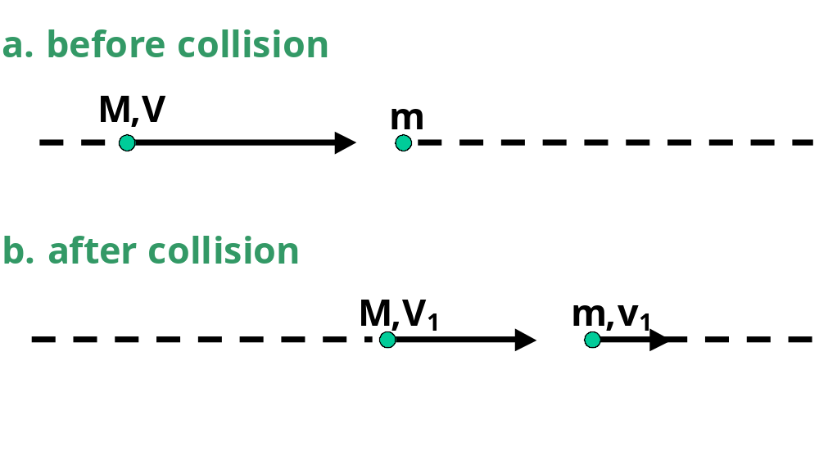
Heavy Charged Particles (HCP)
Maximum Energy Transfer in a Simple Collision

Slide 6
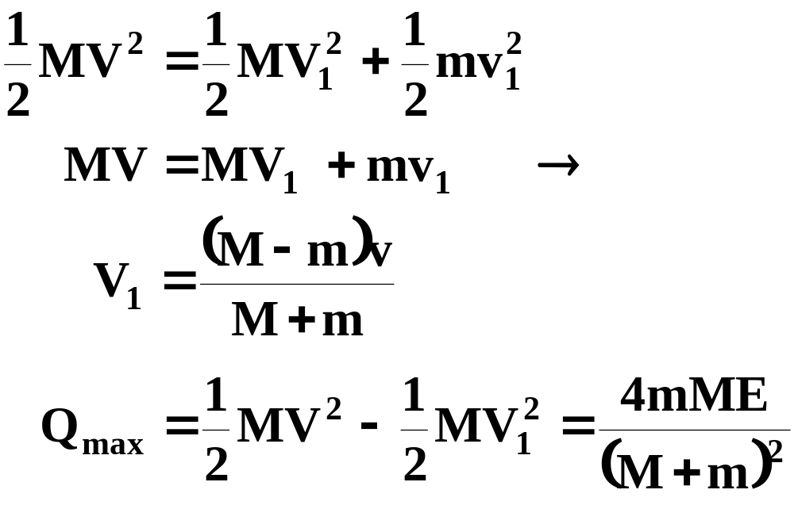
Heavy Charged Particles (HCP)
since momentum and energy are conserved:
where E = MV²/2 is the initial kinetic energy of the heavy particle

Slide 7

Heavy Charged Particles (HCP)
when M = m, Q_{max} = E; so the incident particle can transfer all of its energy in a billiard ball type collision
calculate the maximum energy of a 10 MeV proton can lose on a single collision can be treated non-relativistically
since the mass of electron is « mass of the proton 

Slide 8
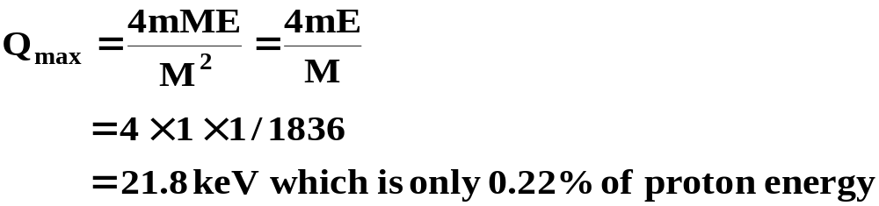
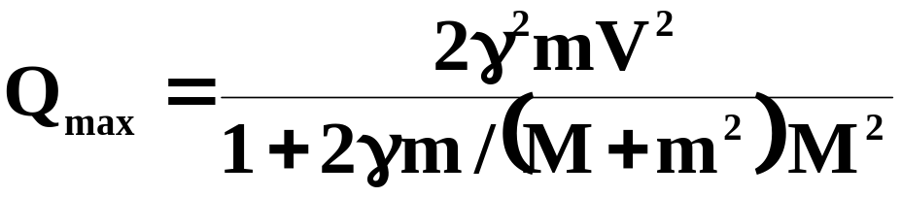
Heavy Charged Particles (HCP)
the ratio of mass of the proton to electron is 1/1836
for a relativistic expression:

Slide 9
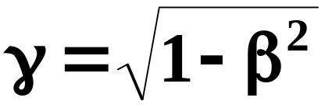
Heavy Charged Particles (HCP)
where:
and
β = v/c
c is the speed of light
Q_{max} = 21.9 keV

Slide 10
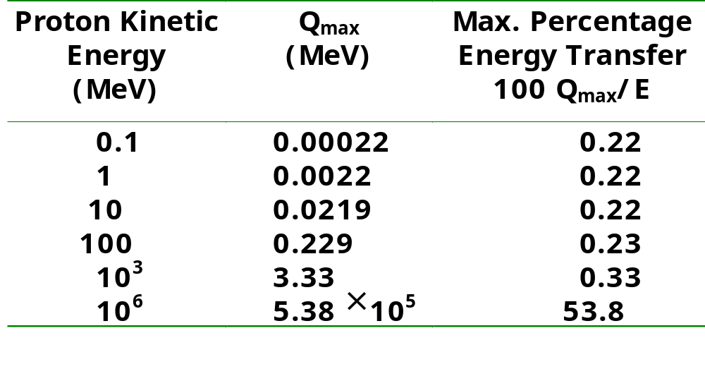
Maximum Possible Energy Transfer Q_{max} in Proton Collision with Electron

Slide 11
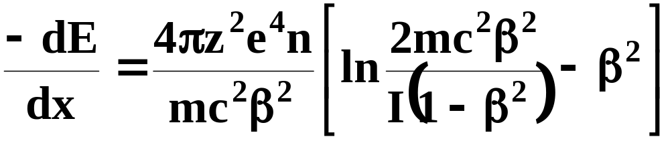
Heavy Charged Particles (HCP)
3. Stopping Power
linear rate of energy loss to atomic electrons along the path of a HCP in a medium (MeV/cm) is the basic physical quantity that determines the dose that particle delivers in the medium
quantity -dE/dx is the stopping power of the medium for the particle

Slide 12
Heavy Charged Particles (HCP)
where:
  z = atomic no. of HCP
  e = magnitude of electron charge
  m = no. of electrons/unit volume in medium
  c = speed of light
  β = v/c = speed of particle relative to c
  i = mean excitation energy of medium
stopping power depends only on charge ze and velocity β of the particle
mass of stopping power =
  -dE/ρdx (stopping power/density)

Slide 13
Heavy Charged Particles (HCP)
expresses the rate of energy loss of the charged particle per g/cm²
mass stopping power does not differ greatly for materials with similar atomic composition
eg
for 10 MeV protons:
  -dE/ρdx for H₂O is 45.9 MeV cm²/g
and for anthracine (C₁₄H₁₀) it is
44.2 MeV cm²/g

Slide 14
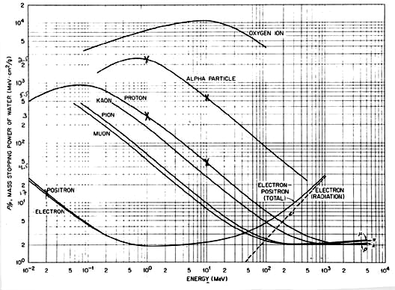

Slide 15
Heavy Charged Particles (HCP)
for 10 MeV protons and Pb (z = 82)
  -dE/ρdx = 17.5 MeV cm²/g
in general heavy atoms are less efficient on a cm²/g basis for slowing down HCP
the reason being that many of their electrons are too tightly bound to the inner shells to absorb energy

Slide 16
Heavy Charged Particles (HCP)
4. Mean Excitation Energies
the following empirical formula can be used
19.0 eV, z = 1
I = 11.2 + 11.7z eV, 2 ≤ z ≤ 13
      52.8 + 8.71z eV, z ≥ 13
for a compound or a mixture the stopping power is calculated by the separate contribution of the individual constituent elements

Slide 17

Heavy Charged Particles (HCP)
if there are n_{I} atoms/cm² of an element with atomic number z_{I} and mean excitation energy i_{I}
n is the total number of electrons/cm² in the material
calculate mean excitation energy of H₂o
I_{n} = 19.0 eV
I₀ = 11.2 + 11.7 × 8 = 105 eV
electron densities n_{i}z_{i} can be computed, however only rations n_{i}z_{i}/n are needed

Slide 18
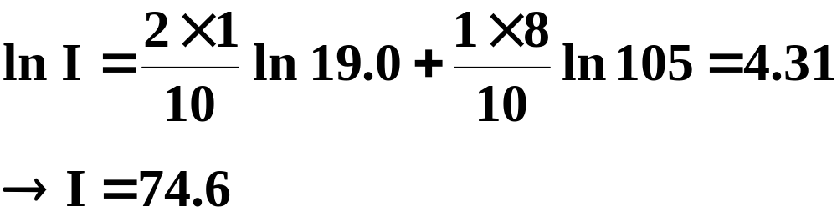
Heavy Charged Particles (HCP)
H₂O has 10 electrons, 2 to H and 8 to O 

Slide 19
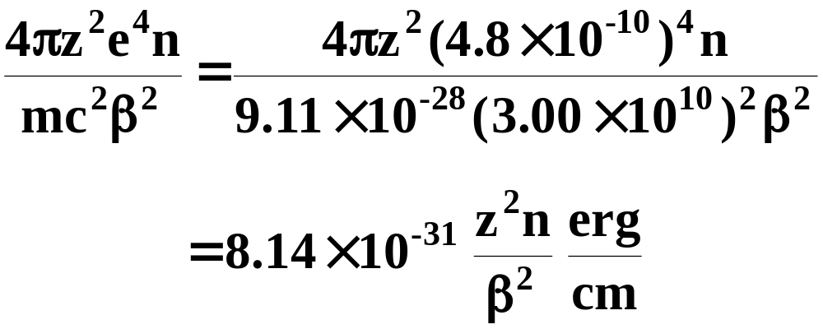
Heavy Charged Particles (HCP)
5. Table for Computation of Stopping Powers
to develop a numerical table to facilitate the computation of stopping power of HCP in any material

Slide 20
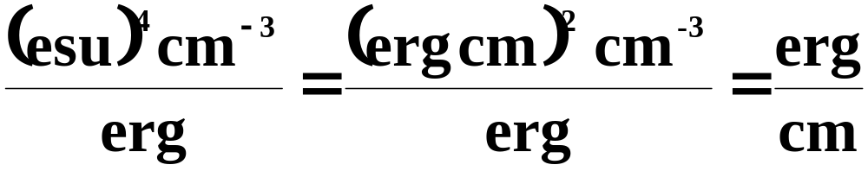
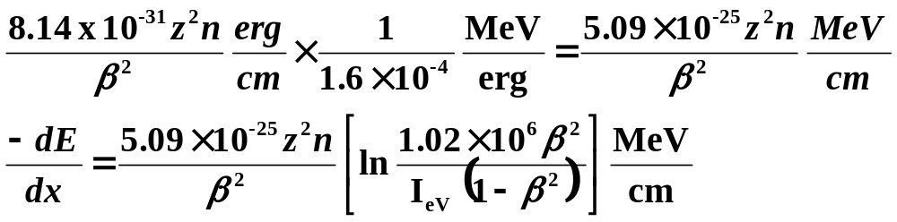
Heavy Charged Particles (HCP)
units of those e⁴n/mc
replaced erg/cm to replace esu²
converting to MeV we get:

Slide 21
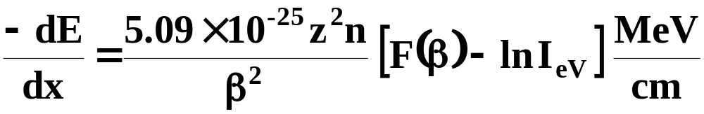
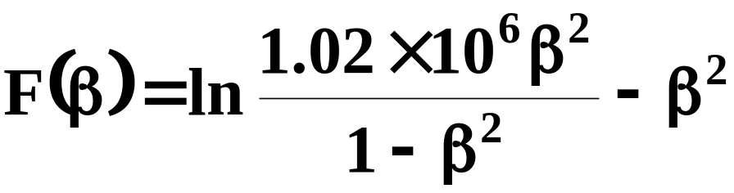
Heavy Charged Particles (HCP)
general formula of any HCP in any medium is:
        where

Slide 22
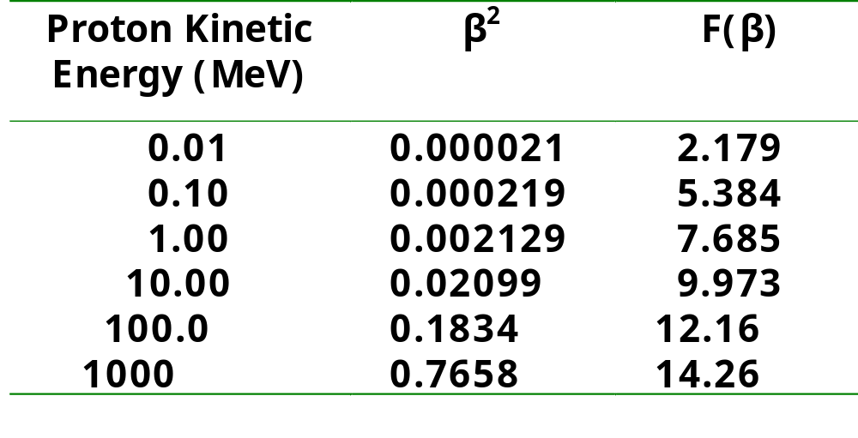
Data for Computation of Stopping Power for Heavy Charged Particles

Slide 23
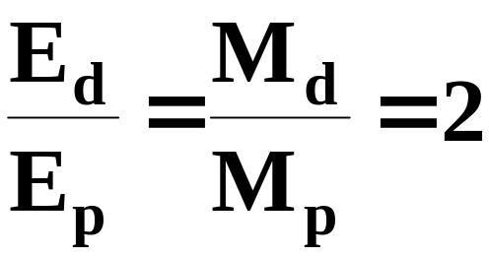
Data for Computation of Stopping
Power for Heavy Charged Particles
since for any given value any β, the KE of a particle is proportional to its rest mass, the table can also be used for other HCP
ratio of KE of a deuteron and proton traveling at the same γ speed is:
F(β) for 10 MeV is the same for a 20 MeV deuteron

Slide 24
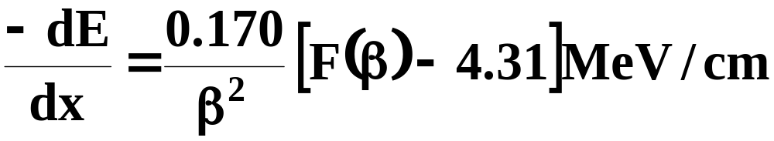
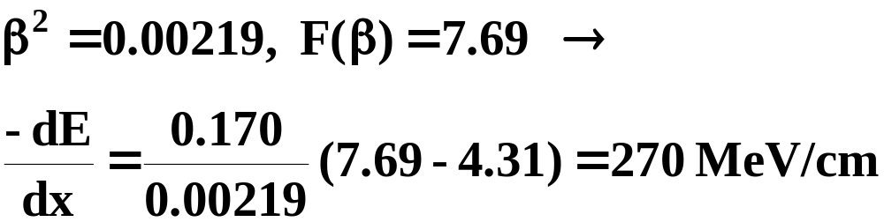
Data for Computation of Stopping
Power for Heavy Charged Particles
6. Stopping Power of H₂O for Protons
protons z = 1 and for water
n = (10/18) × 6.02 × 10²³ = 3.34 × 10²³ cm⁻³
lnI_{eV} = 4.312 
        at 1 MeV:

Slide 25
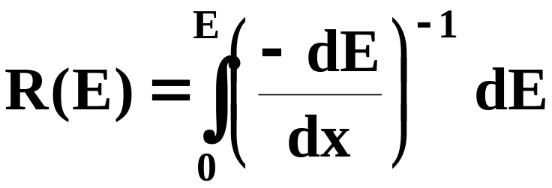
Heavy Charged Particles (HCP)
7. Range
range of charged particle is distance it travels before coming to rest
reciprocal of the stopping power give the distance traveled per unit energy loss:

Slide 26
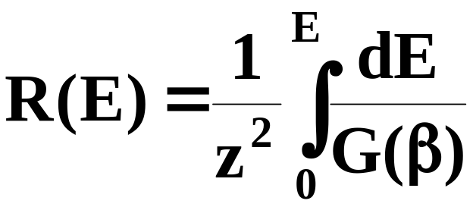
Heavy Charged Particles (HCP)
where R(E) = range of the particle kinetic energy E
range is expressed in g/cm²
above equation can not be evaluated but range can be expressed as:

Slide 27
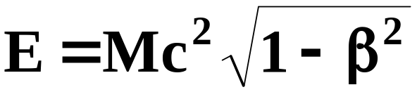
Heavy Charged Particles (HCP)
where:
z - is the particle's charge
g(β) - depends on the particle’s velocity
recall:
and M is the particle's rest mass 
dE = Mg(β)dβ and g is another function of velocity

Slide 28
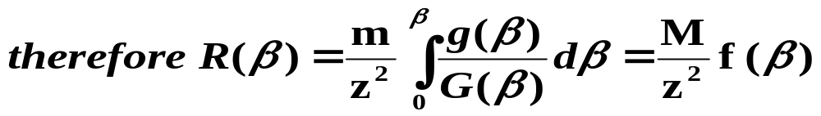
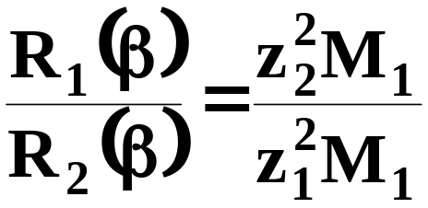
Heavy Charged Particles (HCP)
where ƒ(β) depends only on velocity of HCP
since ƒ(β) is the same for two hcp with the same speed β, the ratio of their ranges is simply:

Slide 29
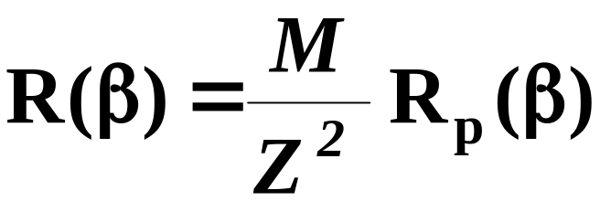
Heavy Charged Particles (HCP)
where:
m₁ and m₂ are the rest masses
  z₁ and z₂ are the charges
if particle number 2 is a proton then m₁=z₂=1, then the range r of the other particle (mass m₁ = m proton mass and charge z₁ = z₂) is:
where:
R_{p}(β) is the proton range

Slide 30
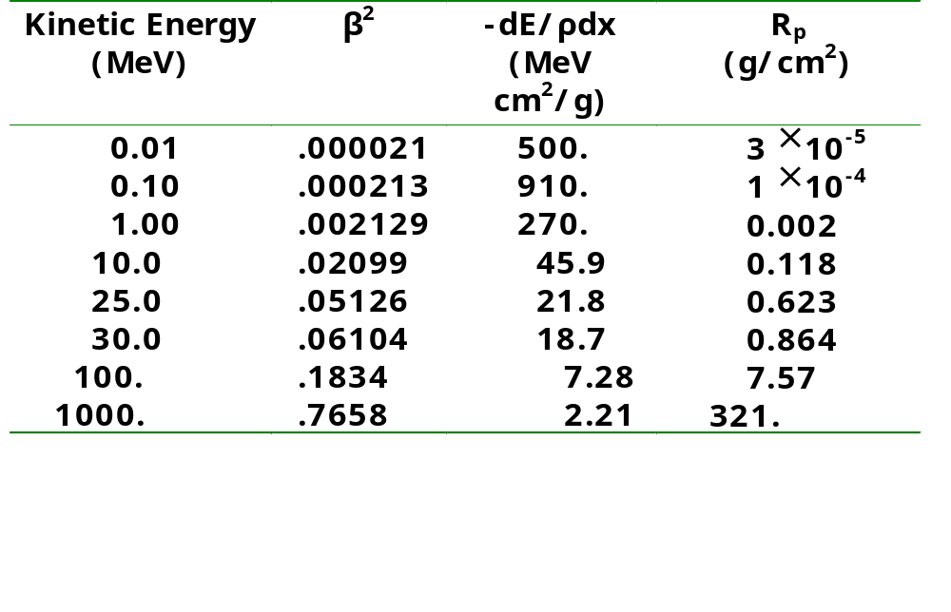
Mass Stopping Power dE/ρdx and
Range Rp for Protons in Water

Slide 31
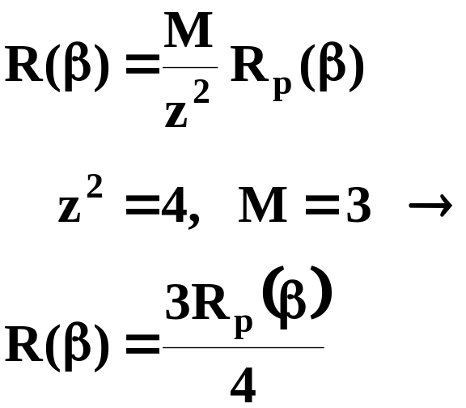
Heavy Charged Particles (HCP)
problem: find the range of 80 MeV ³He²⁺ ion in soft tissue
range is 3/4 that of a proton with the speed and 80 MeV ³He²⁺ ion
speed e = mc²(γ-1) at - 80 MeV 
mc² = 3 AMU= 3 × 931.48 =2794 MeV

Slide 32
Heavy Charged Particles (HCP)
where:
γ = 1.029
β² = 0.0550
value is between R_{p} = 0.623 and 0.864 g/cm²
by interpolation  β² r_{p} = 0.715 g/cm²
the range for 80 MeV ³He²⁺ is:
3(0.715)/4 g/cm² in soft tissue (assume unit density)
for a given proton energy the range in g/cm² is > in Pb than H₂o; which is consistent with the smaller mass stopping power

Slide 33
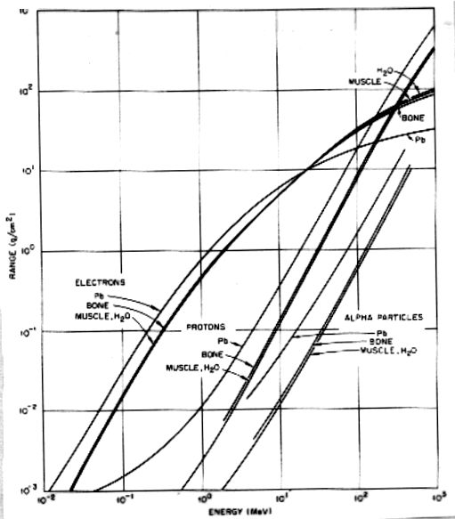

Slide 34
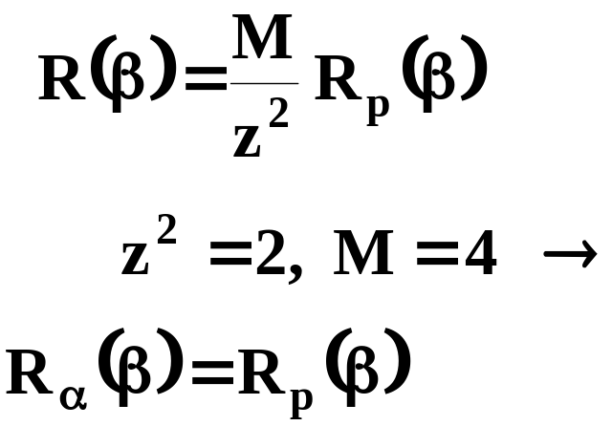
Heavy Charged Particles (HCP)
the range in cm for alpha particles in air is given by the approximate empirical relation
R = 0.56E E<4
R = 1.24E -2.62 4<E<8 where E is in MeV
radon daughter ²¹⁴Po emits 7.69 MeV alpha particle. What is the range of this particle in soft tissue?
recall:

Slide 35
Heavy Charged Particles (HCP)
ranges of both of these are the same for the same velocity
ratio of KE energies is:
E_{α}/E_{p} = m_{α}/m_{p} = 4 
E_{p} = E_{α}/4 = 7.69/4 = 1.92 MeV
the alpha particle range is equal to the range of 1.92 Mev proton
interpolation from mass stopping power table 
R_{p} = R_{α}= 6.6 × 10⁻³ cm

Slide 36
Heavy Charged Particles (HCP)
hence the ²¹⁴Po alpha particle cannot penetrate the 7 × 10⁻³ cm minimum epidermal thickness from outside the body to reach the lung cells
however once inhaled the range of alpha particles is sufficient to reach cells in the bronchial epithelium
increase in lung cancer incidence among uranium miners has been linked to alpha particle doses from inhaled radon daughters

Slide 37
Heavy Charged Particles (HCP)
another way of estimating the range of alpha particles in any medium is:
R_{m} mg/cm² = 0.56 A^{1/3} R
where:
A = atomic number of the medium
R = range of the alpha particle in air

Slide 38
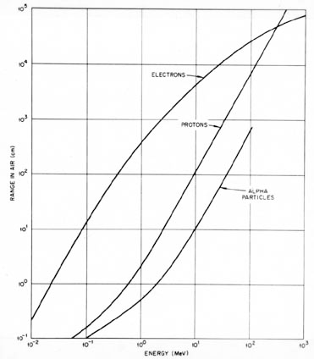

Slide 39
Heavy Charged Particles (HCP)
what thickness of Al foil, density 2.7 g/cm³ is required to stop an alpha particle of 5.3 MeV ²¹⁰Po
R = 1.24 × 5.3 - 2.62 = 3.95 cm
R_{m} = 0.56 × 27^{1/3} × 3.95 = 6.64 mg/cm²
for ²⁷Al, A = 27
let us introduce the concept of t_{d} (density thickness) where:
t_{d} [g/cm²] = ρ [g/cm³] × t_{l} [cm]
ρ = density
t_{l} = linear thickness

Slide 40
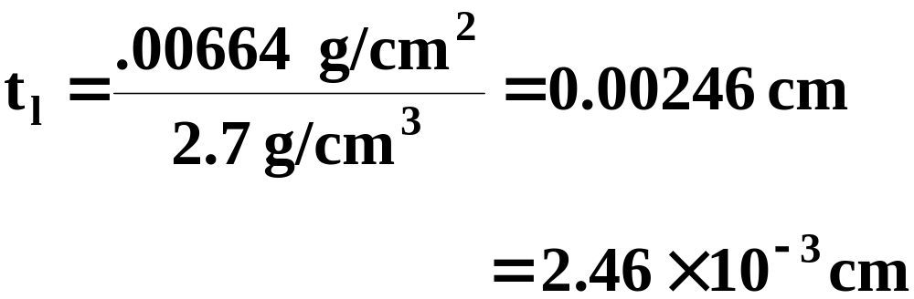
Heavy Charged Particles (HCP)
therefore 6.64 mg/cm² is the density thickness, 2.7 g/cm³ is the density of aluminum 
because effective atomic composition of tissue is not very much different from that of air we can have:
R_{a} × ρ_{a} = R_{t} × ρ_{t}

Slide 41
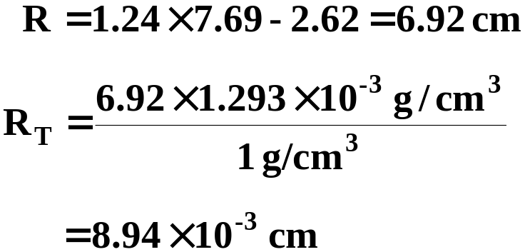
Heavy Charged Particles (HCP)
where:
R_{a} and R_{t} = ranges in air and tissue
ρ_{a} and ρ_{t} = density of air and tissue (1g/cm³)
what is the range of the ²¹⁴Po 7.69 MeV alpha particle previously done?
as compared to 6.6 × 10⁻³ cm (35% higher)

Slide 42
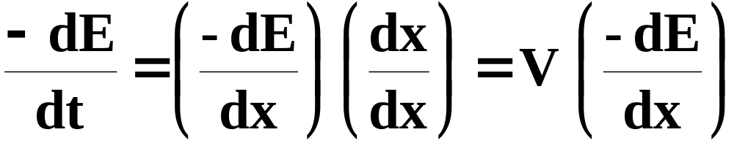
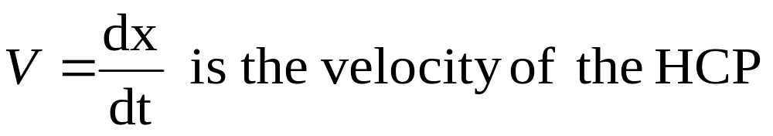
Heavy Charged Particles (HCP)
8. Slowing-down rate
one can calculate the rate at which a HCP slows down
rate of energy loss -dE/dt is expressed as (by the chain rule of differentiation):
where:

Slide 43
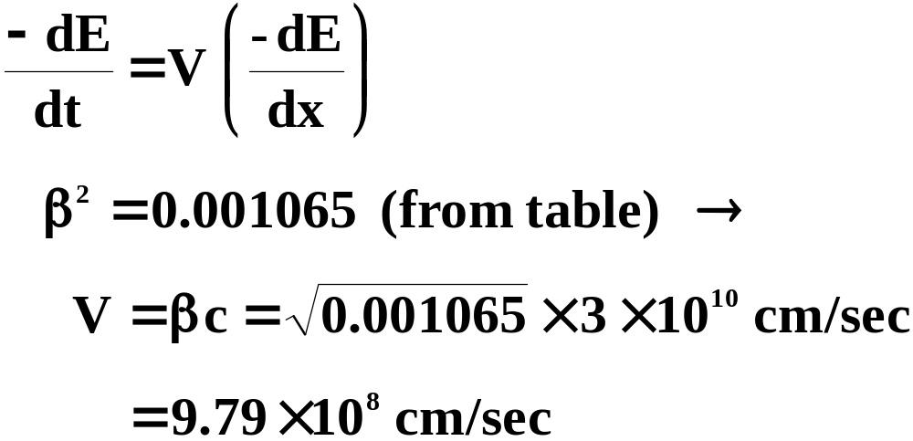
Heavy Charged Particles (HCP)
calculate the slowing down rate and estimate stopping time τ, for 0.5 MeV protons in water

Slide 44
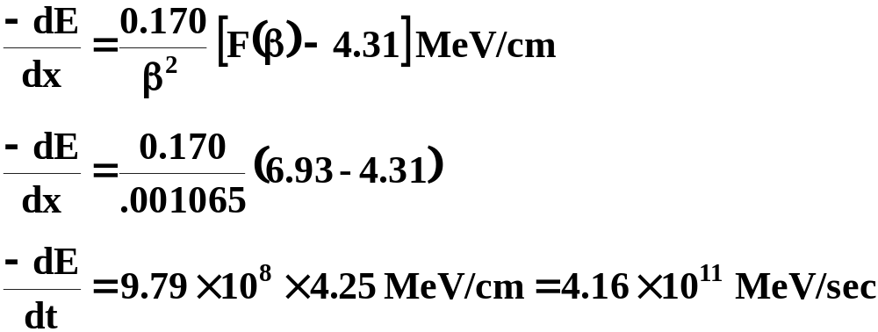
Heavy Charged Particles (HCP)
stopping power ρ for protons in water
recall:

Slide 45
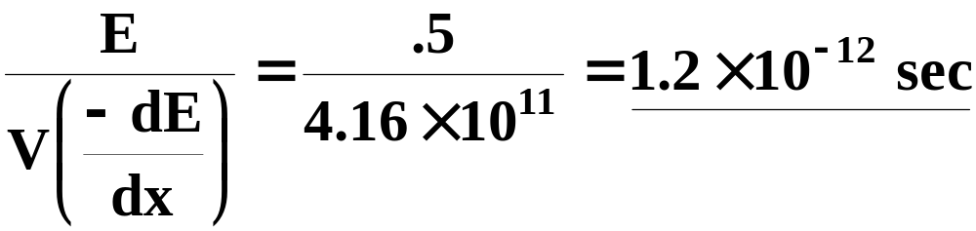
Heavy Charged Particles (HCP)
to estimate the time it takes a proton of kinetic energy e to stop we take the ratio:

Slide 46
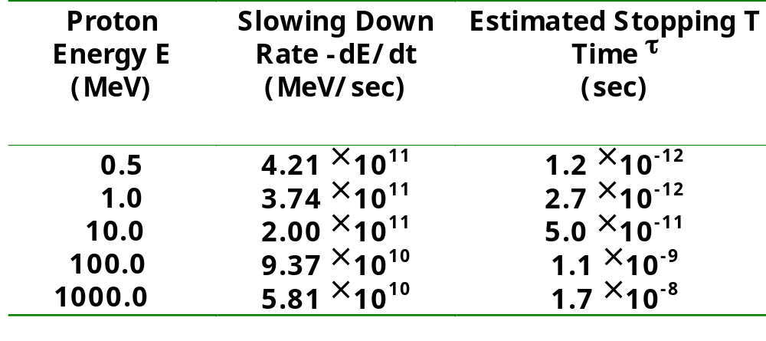
Calculated Slowing Down Rates -dE/dt and Estimated Stopping Time τ for Protons in Water

Slide 47
BETA PARTICLES (β⁺, β⁻)
1. Energy-loss Mechanisms
excitation and ionization- beta particles can also radiate energy by bremsstrahlung
2. Collision Stopping Power
different than for heavy charged particles because the beta particle can lose a large fraction of its energy in the first collision
also since β⁻ is identical to the atomic electrons and β⁺ is the anti-particle certain symmetry conditions are required

Slide 48
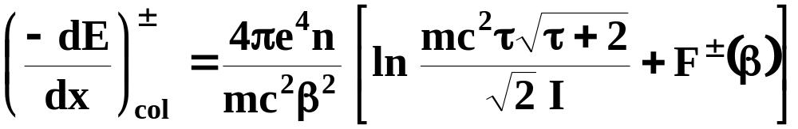
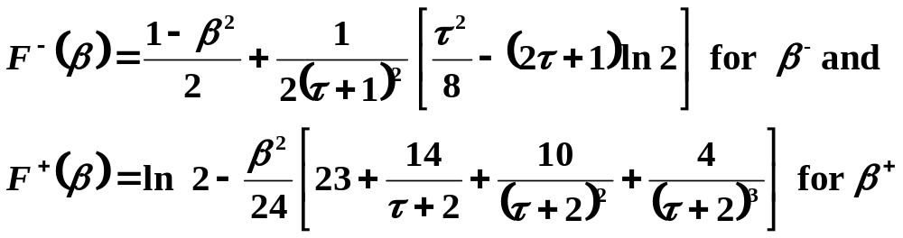
BETA PARTICLES (β⁺, β⁻)
the collisional stopping power for β⁻ and β⁺ is written:
where:
τ =E/mc² - is the KE of β⁺ or β⁻
mc² = electron rest energy

Slide 49
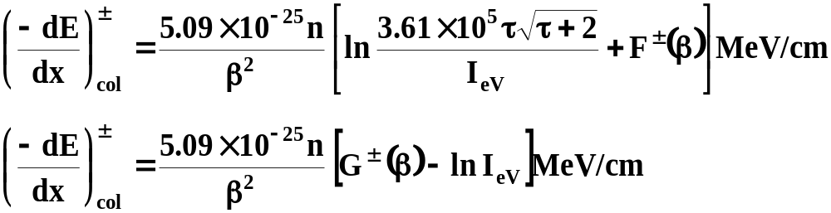
BETA PARTICLES (β⁺, β⁻)
as with HCP the symbols e, n, β² are the same
where:

Slide 50
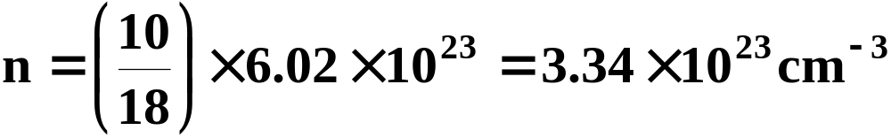
BETA PARTICLES (β⁺, β⁻)
calculate the collisional stopping power of water for 1 MeV electrons
need to compute β²,τ, F⁻(β) and g⁻(β)
for water

Slide 51
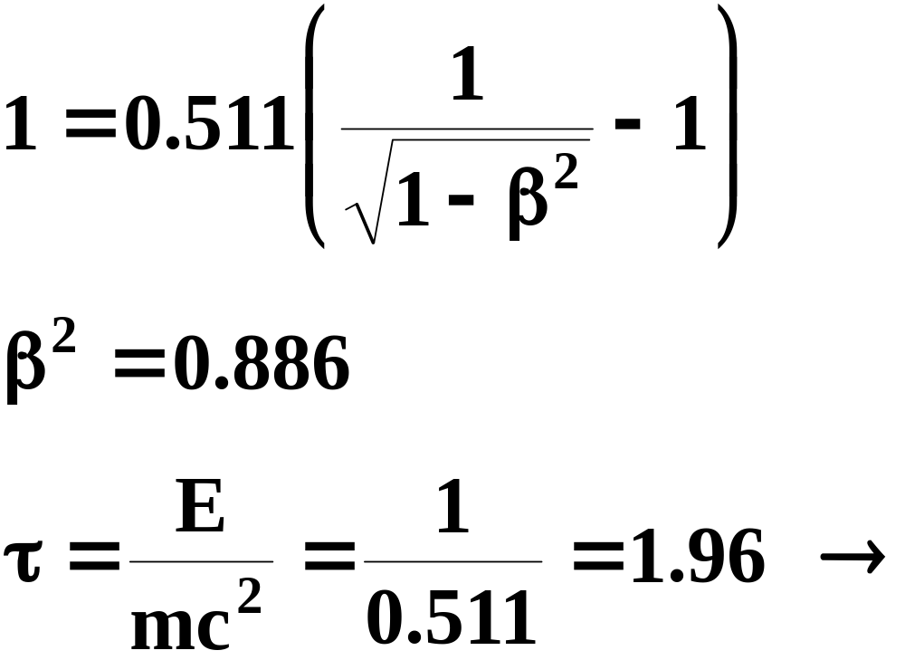
BETA PARTICLES (β⁺, β⁻)
in I_{ev} = 4.31
using relativistic formula for e=1 MeV and mc² = 0.511 MeV:

Slide 52
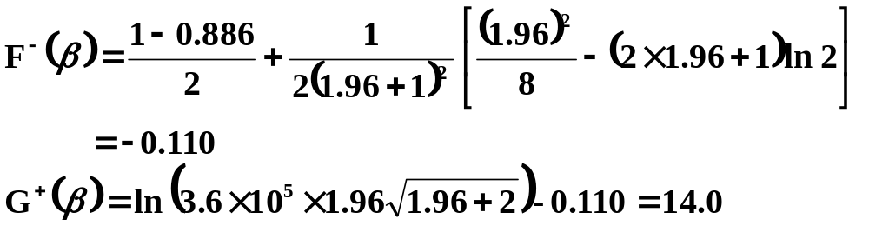
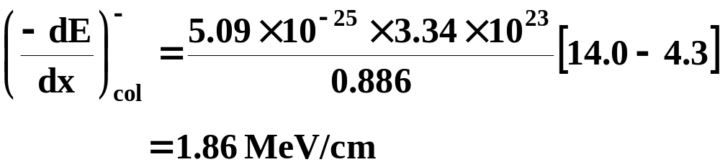
BETA PARTICLES (β⁺, β⁻)
finally

Slide 53
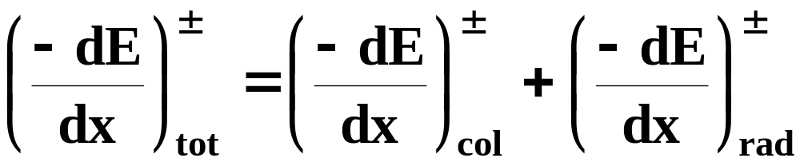
BETA PARTICLES (β⁺, β⁻)
total stopping power for β⁺ and β⁻ is the sum of the collisional and radiative contributions
table in Turner exhibits these characteristics for 10 eV to 1000 MeV kinetic energy of beta particle

Slide 54
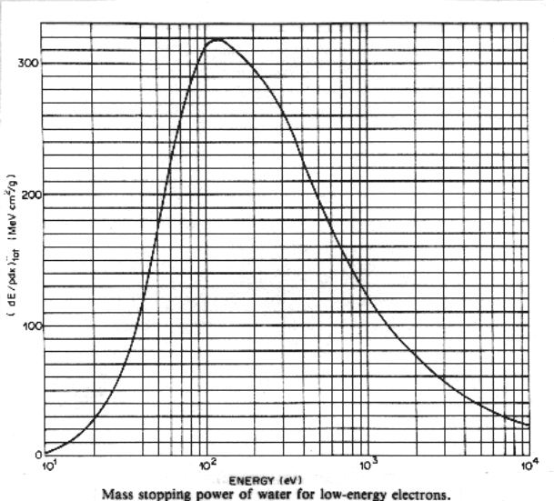
BETA PARTICLES (β⁺, β⁻)

Slide 55
BETA PARTICLES (β⁺, β⁻)
3. Radiative Stopping Power
beta particles, because of their small mass can be accelerated by electromagnetic forces within an atom and hence emit radiation called Bremsstrahlung
Bremsstrahlung occurs where a beta particle is deflected in the electric field of a nucleus and to a lesser extent in the field of an atomic electron
at high beta particle energies, the radiation is emitted mostly in the forward direction

Slide 56
BETA PARTICLES (β⁺, β⁻)
efficiency of Bremsstrahlung in elements of different atomic number Z varies nearly as Z²
for beta particles of a given energy bremsstrahlung losses are considerably greater in high-Z materials such as Pb than in low-Z materials such as water
collision loss rate is proportional to n and hence Z
radiative loss rate increases nearly linearly with beta particle energy where as collisional rate increases only logarithmically

Slide 57
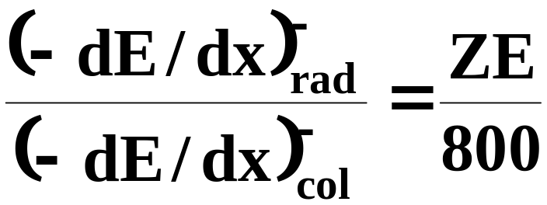
BETA PARTICLES (β⁺, β⁻)
at high energies Bremsstrahlung becomes the predominant mechanism of energy loss
the ratio of radiative and collisional stopping powers for an electron of total energy E (MeV) in an element number Z is:

Slide 58
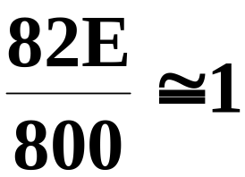
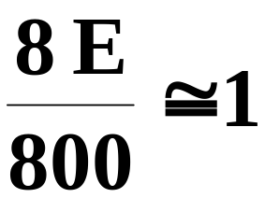
BETA PARTICLES (β⁺, β⁻)
for Pb (Z=82) we have:
when the total electron energy ≅ 9.8 MeV (for KE = E-mc² ≅ 9.3 MeV)
for oxygen (Z = 8)

Slide 59
BETA PARTICLES (β⁺, β⁻)
when the total electron energy ≅ 100 MeV ≅ KE have an order of magnitude difference to have the radiative and collisional stopping powers to be equal
at very high energies the dominance of the radiative over collisional energy results in electron-photon cascades which in turn produces Compton electrons and electron-positron pairs and more Bremsstrahlung

Slide 60
BETA PARTICLES (β⁺, β⁻)
4. Radiation Yield
an estimate of the radiation yield is very important in trying to deduce the potential Bremsstrahlung hazard of strong beta sources where:
    Y = radiation yield
Z = atomic number of absorber
    E = critical KE energy of the beta
    particle

Slide 61
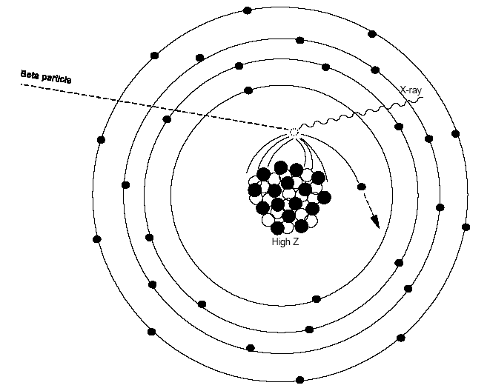
Bremsstrahlung
BETA PARTICLES (β⁺, β⁻)

Slide 62

BETA PARTICLES (β⁺, β⁻)
problem: estimate the fraction of a 2 MeV
beta particle that is converted into Bremsstrahlung when it is absorbed by aluminum and lead
for aluminum:
ZE = 13 × 2 
this represents 1.6% of the KE of the beta particle

Slide 63

BETA PARTICLES (β⁺, β⁻)
for Pb ZE = 82 × 2 
this represents 9% of the KE of the beta particle
hence it is prudent in shielding a source to stop the beta particles with a low z material and then attenuate the Bremsstrahlung photons with a high z material

Slide 64

BETA PARTICLES (β⁺, β⁻)

Slide 65

BETA PARTICLES (β⁺, β⁻)
problem: 10 mCi ⁹⁰Y source enclosed in a lead shield thick enough to stop all the beta particles where the maximum beta energy is 2.27 MeV and average beta energy is 0.76 MeV
estimate the rate at which energy is radiated as bremsstrahlung and estimate photon flux rate at 1 meter from the source

Slide 66
BETA PARTICLES (β⁺, β⁻)
total beta particle energy released for a 10 mCi source is:
(3.7 × 10⁸/sec)(0.76 MeV) = 2.81 × 10⁸ MeV/sec
fluence rate at 1 meter is calculated as when:
φ = flux
E_{β} = average beta energy 

Slide 67

BETA PARTICLES (β⁺, β⁻)

Slide 68
BETA PARTICLES (β⁺, β⁻)
we divide by 2.27 MeV since it is assumed that all the beta particle energy is converted to 2.27 MeV photon
this is a conservative approach in assessing radiation hazards
another formula for estimating the yield is:
Y = 3.5 × 10⁻⁴ ZE

Slide 69
BETA PARTICLES (β+, β-)
5. Range
the collisional mass stopping power for beta particles is smaller in high Z materials, such as Pb, than in water
the following empirical equation for electrons in low Z material relates the range R in g/cm² to the kinetic energy E in MeV

Slide 70
BETA PARTICLES (β⁺, β⁻)
for 0.01 ≤ E ≤ 2.5 MeV
R = 0.412 E^{1.27-0.095 lnE} or
lnE = 6.63 - 3.24 (3.29- lnR)^{1/2}
for E > 2.5 MeV
R = 0.530E -0.106 or
E = 1.89R + 0.200

Slide 71

Heavy Charged Particles (HCP)

Slide 72

Heavy Charged Particles (HCP)

Slide 73
BETA PARTICLES (β⁺, β⁻)
problem: how much energy does a 2.2 MeV electron lose in passing through 5mm of lucite?
(ρ = 1.19 g/cm²)
compare using both the equations and graph
R = 0.412(2.2)^{1.27-0.00954} ln2.2
= 1.06 g/cm²
recall:

Slide 74

BETA PARTICLES (β⁺, β⁻)
this is the distance that the electron travels
since the lucite is only 0.5 cm thick, the electron emerges with enough energy E′ to travel another (0.891 - 0.5) cm =.391 cm or 0.465 g/cm²

Slide 75
BETA PARTICLES (β⁺, β⁻)
we then can use:
ln E′ = 6.63 - 3.24 (3.29 - ln 0.465)^{1/2}
= 0.105
✦ E′ - 1.11 MeV
which all agrees with the graph
therefore the energy lost by the electron is:
E - E′ = (2.20 - 1.1) MeV = 1.09 MeV

Slide 76
BETA PARTICLES (β⁺, β⁻)
unlike alpha particles, beta particles have numerous radionuclides with ranges > the thickness of the epidermis
even a 70 keV electron can penetrate the
7 mg/cm² of the epidermal layer
beta particles can be potentially damaging to both the skin and eyes

Slide 77

BETA PARTICLES (β⁺, β⁻)
problem: what must be the minimum thickness of a shield made of plexiglass and Al such that no beta particles from a ⁹⁰Sr source pass through?
⁹⁰Sr has a beta particle of 0.54 MeV but its daughter ⁹⁰Y emits a beta particle whose max energy is 2.27 MeV
from the range graph 2.27 MeV beta particle
is found to be 1.1 g/cm² 

Slide 78
BETA PARTICLES (β⁺, β⁻)
since plexiglass may suffer radiation damage and crack if exposed to very intense radiation for a long time, aluminum is a better choice
using the same calculation for Al the thickness is found to be 0.41 cm
6. Slow Down Time
read Turner - the calculations are similar to those done for heavy charged particle

Slide 79
BETA PARTICLES (β⁺, β⁻)
7. Single Collision Spectra in Water
interaction of low energy electrons with matter is fundamental to understanding the physical and biological effects of ionizing radiation
low energy electrons are responsible for producing initial alterations that lead to chemical changes in tissue and tissue-like materials such as water
interaction of an electron with kinetic energy e can be characterized by probability N(E,E′)dE that it loses an amount of energy between E′ and E′ + dE

Slide 80

BETA PARTICLES (β⁺, β⁻)
distribution N(E,E′) is called a single collision spectrum of an electron energy of E
as a probability function it is normalized and has the dimensions of inverse energy
calculated single collision spectra for electrons: 30, 50, 150 eV and 10 keV are shown in the following figure

Slide 81

BETA PARTICLES (β⁺, β⁻)

Slide 82
BETA PARTICLES (β⁺, β⁻)
for 10 keV, the average value of the single collision spectrum for energy losses between 45 - 50 eV is 0.1 eV⁻¹
since the interval is 5 eV 
  0.01 eV⁻¹ × eV = 0.05
this implies that a 10 keV electron in water has about a 5% probability of having an energy loss between 45 and 50 eV in its next collision

Slide 83
BETA PARTICLES (β⁺, β⁻)
note that all the curves begin a 7.4 keV which is the minimum of energy needed for electronic excitation
at E = 30 eV, excitation is as probable as ionization with increasing energy ionization as more probable

Slide 84

BETA PARTICLES (β⁺, β⁻)

Slide 85

BETA PARTICLES (β⁺, β⁻)
the collisional stopping power is related to the single collision spectrum n(E, E′)
the average energy lost ′(E) by an electron of energy E in a single collision is the weighted average over the energy-loss spectrum

Slide 86

BETA PARTICLES (β⁺, β⁻)
the stopping power at energy E is the product of ′(E) and the probability μ(E) per unit distance then an elastic collision occurs

Slide 87
BETA PARTICLES (β⁺, β⁻)
8. Electron Tracks in Water
Monte Carlo computer codes are used to simulate electron transport in water
each primary electron starts with 5 keV and each dot
represents the location at 10⁻¹¹ sec of a chemical active species

Slide 88

Examples of Electron Tracks in Water

Slide 89
BETA PARTICLES (β⁺, β⁻)
the Monte Carlo code randomly selects events from specified distributions of flight, distance energy loss and angle of scatter in order to calculate the fate of individual electrons

Slide 90
Phenomena Associated with
Charged Particle Tracks
1. Delta Rays
HCP or electrons passing through matter sometimes produce a secondary electron with enough energy to leave and create its own path
such an electron is called delta ray

Slide 91

Phenomena Associated with
Charged Particle Tracks
2. Restricted Stopping Power
stopping power gives the energy lost by a charged particle in a medium
this is not always equal to the energy absorbed in a target
this is particularly important for small targets such as DNA double helix whose diameter is 20
restricted stopping power is given as:

Slide 92

Phenomena Associated with
Charged Particle Tracks
it is defined as the linear rate of energy loss due only to the collisions in which the energy transfer does not exceed a specified value Δ
one integrates the weighted energy loss spectrum only up to Δ

Slide 93
Phenomena Associated with
Charged Particle Tracks
tables in Turner show the restricted mass stopping power for protons and restricted collisional mass stopping mass power for electrons

Slide 94

Phenomena Associated with
Charged Particle Tracks
3. Linear Energy Transfer (LET)
concept of LET introduced in the early 1950's to characterize the rate of energy transfer per unit distance along a charged particle track
distinction made between the energy transferred from a charged particle in a target and the energy actually absorbed
LET has units of keV/micron

Slide 95

Phenomena Associated with
Charged Particle Tracks
4. Specific Ionization
specific ionization is defined as the number of ion pairs that a particle produces per unit distance traveled
quantity expresses the density of ionization along a track

Slide 96

Phenomena Associated with
Charged Particle Tracks
what is SI of 5 MeV alpha particle in air?
stopping power = 1.23 MeV/cm
an average of 36 eV needed to produce an ion pair 

Slide 97

in soft tissue:
Phenomena Associated with
Charged Particle Tracks
with w = 25 eV to produce an ion pair

Slide 98
Phenomena Associated with
Charged Particle Tracks
6. Energy Straggling
read Turner
7. Range Straggling
read Turner
8. Multiple Coulomb Scattering
read Turner

