Slide 1
Jet-Medium Interactions from RHIC/STAR to LHC/ALICE
Fuqiang Wang
Purdue University
What have been learnt at RHIC?
What can be done at LHC?

Slide 2
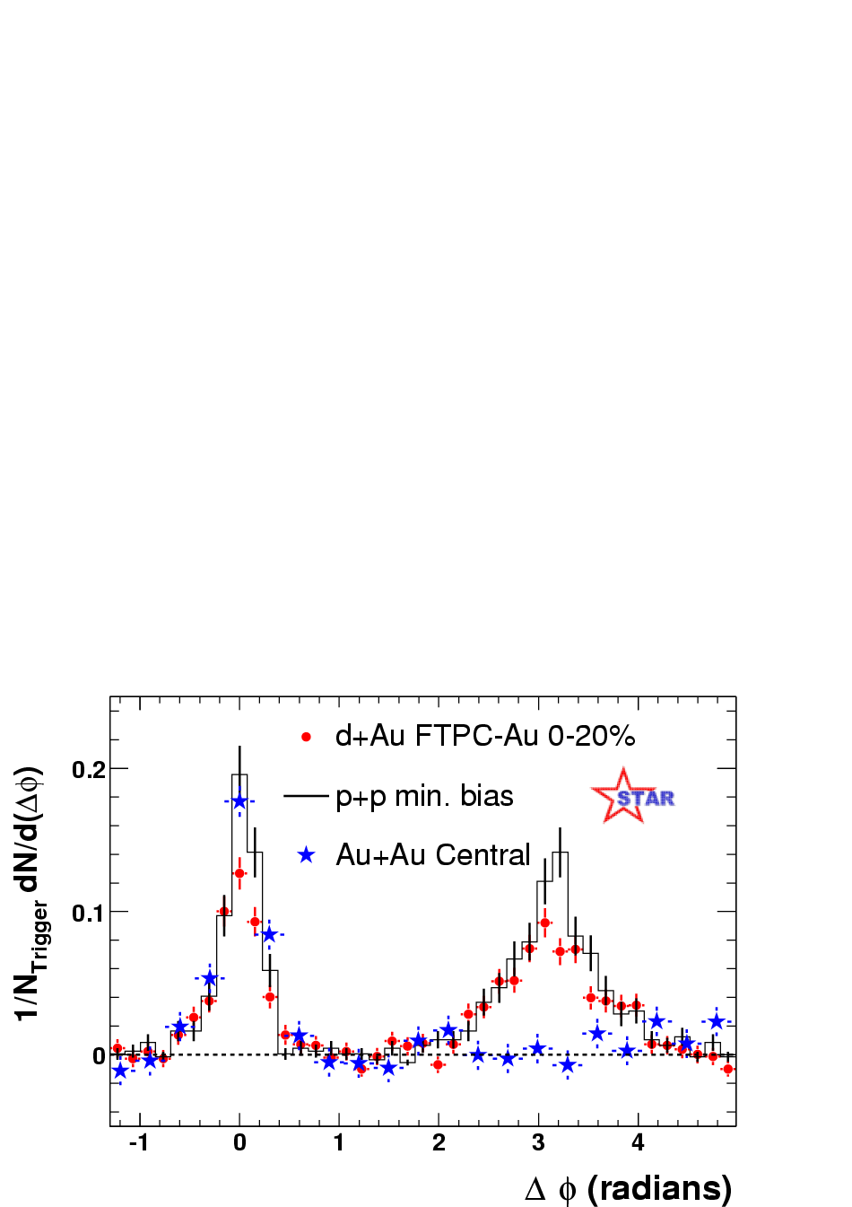
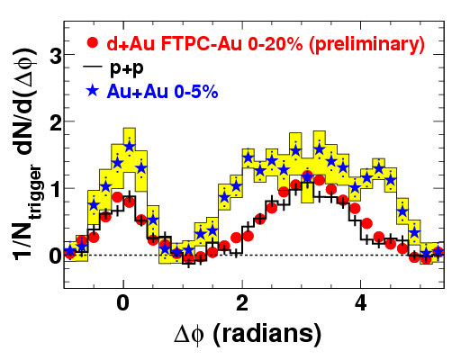
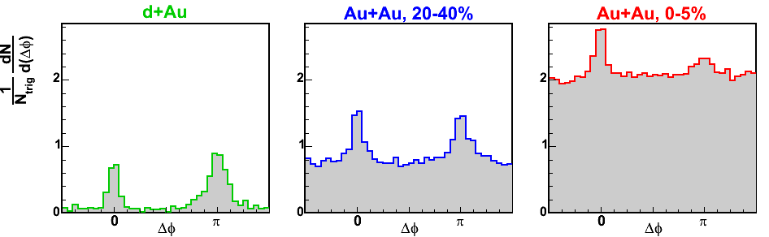
Jet-like angular correlations have provided valuable information at RHIC.
4 < p_{T}^{trig} < 6 GeV/c
p_{T}^{assoc} > 2 GeV/c
4 < p_{T}^{trig} < 6 GeV/c
0.15 < p_{T}^{assoc} < 4 GeV/c
8 < p_{T}^{trig} < 15 GeV/c
p_{T}^{assoc} > 2 GeV/c
At high pt
away-side is
suppressed.
At low pt
away-side is enhanced
and broadened.
At higher trigger pt
away-side is
reappearing.

Slide 3
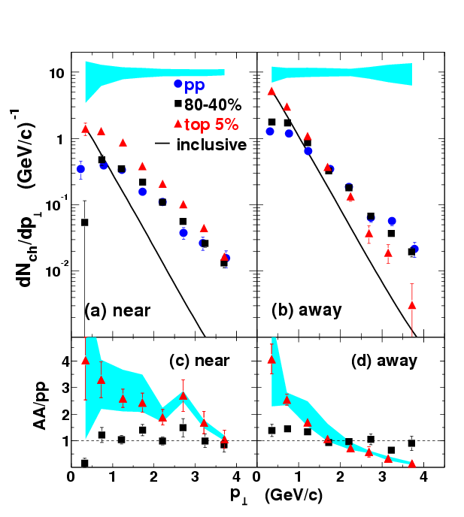
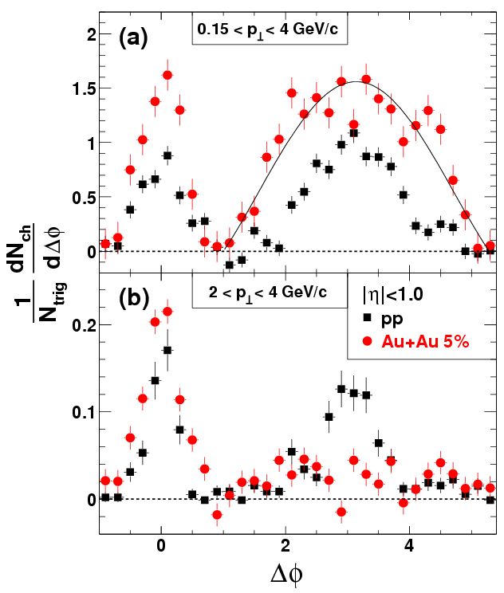
Associated p_{T} spectra: experimental way to study thermalization processes.
4 < p_{T}^{trig} < 6 GeV/c
PRL 95, 152301 (2005).
syst. error
hard-soft parton interactions drive jet products and medium to equilibrate.

Slide 4
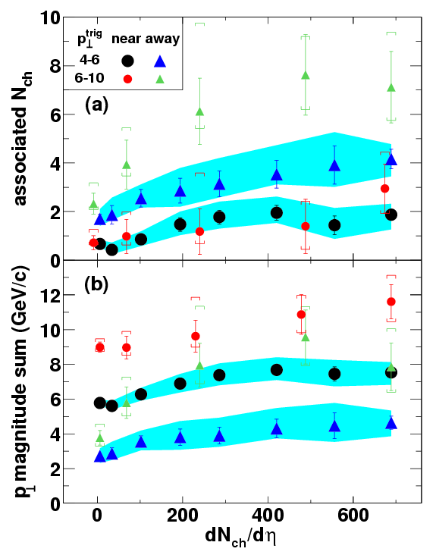
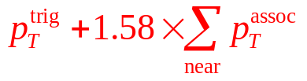
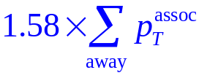
Full reconstruction of “jet” energy
One may construct fragmentation functions for different centralities.
pp

Slide 5
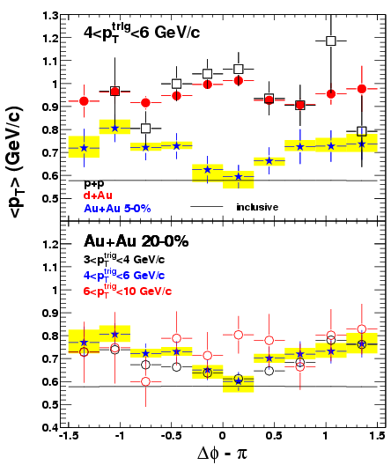
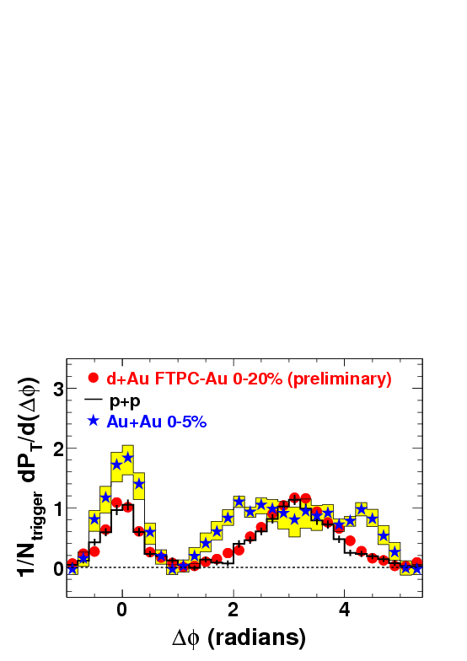

<pt> can be studied in greater detail.
p_{T}^{trig}=4-6 GeV/c
p_{T}^{assoc}=0.15-4 GeV/c
number
correlation
Away side <p_{T}> (GeV/c)
p_{T}-weighted
correlation
path-length effect? conical flow? deflected jets?

Slide 6
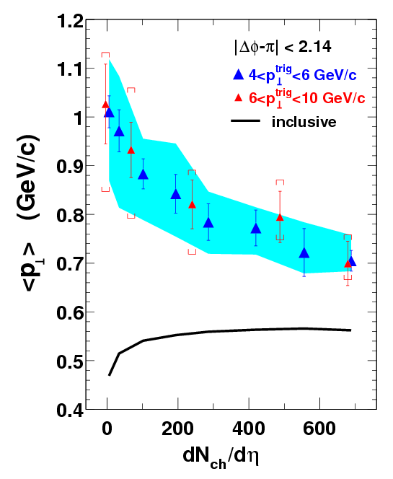
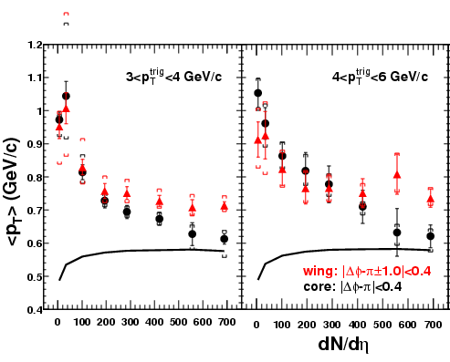
centrality dependence of <p_{T}>
near
Leading
hadrons
away
<p_{T}> from away jets
Medium
Away side <p_{T}> (GeV/c)
<p_{T}> from medium decay

Slide 7
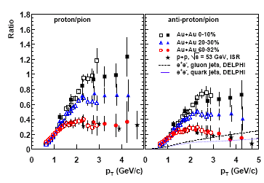
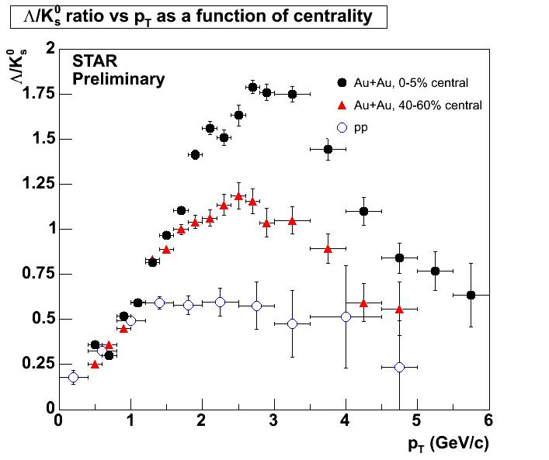
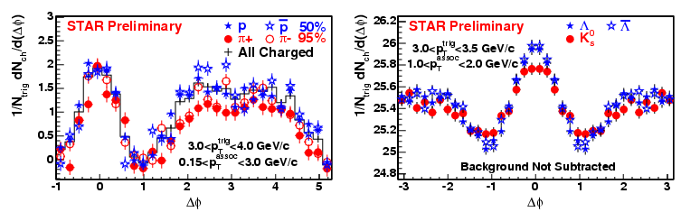
baryon/meson anomaly
Coalescence/recombination models are very attractive.
But baryon and meson trigger correlations are not much different.

Slide 8
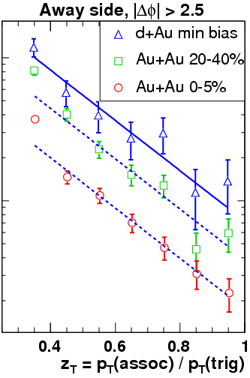
With the emerged away-side jet, we can do tri- or quad-hadron correlations!
Away-side fragmentation patterns appear unchanged with centrality.
Are they the fraction of partons that escaped without interactions?
Reconstruct the away-side jets including low p_{T}.
Dan Magestro

Slide 9
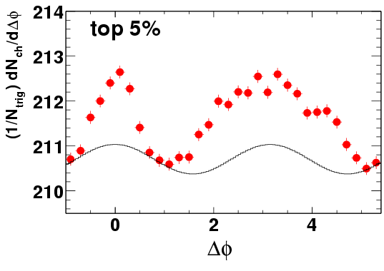
All these studies can be carried out at LHC/ALICE, and better.
ALICE best suited for “semi-hard” region: probably where most of the jet-quenching actions take place.
Large p_{T} coverage: full reconstruction of jets. Jet-fragmentation studies.
background increase (x2) from RHIC to LHC.
But huge increase in high-p_{T} statistics.
unique PID capabilities.
larger statistics: multi-dimensional studies.

Slide 10
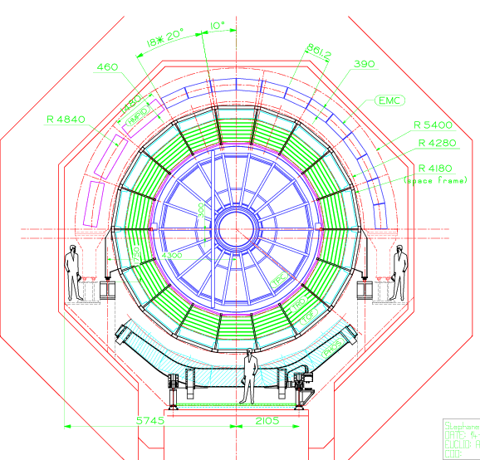
And even better… with triggering!
γ (PHOS/EMC) + jet (TPC)
γ (EMC) + π⁰ (PHOS)
γ (PHOS) + jet (EMC)
  both surface and volume emission.
  full reconstruction of
  away-side jets.
  energy balance?
  medium-energy pick-up?
  modified jet-fragmentation functions.
γ (PHOS/EMC) + e± (TPC)
γ (PHOS) + e± (EMC)
  heavy-flavor energy loss

Slide 11
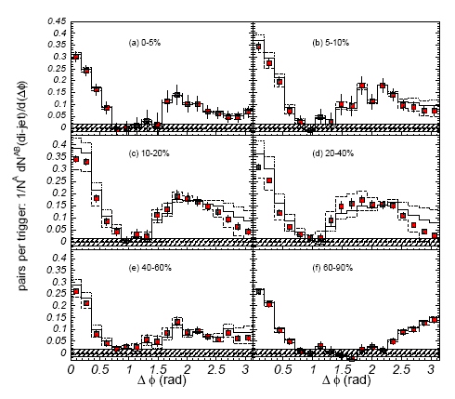
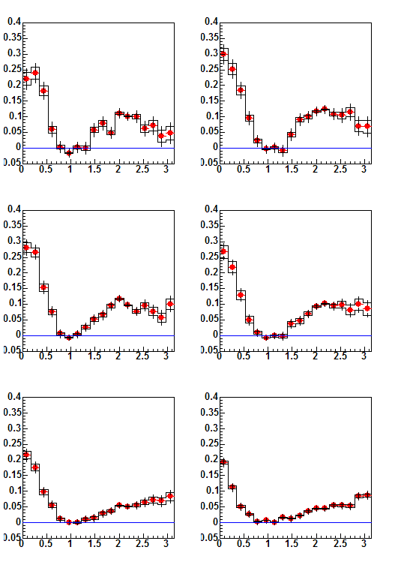
Conical flow?
trigger pt =2.5-4.0 GeV/c, associated pt =1.0-2.5 GeV/c
PHENIX: |η|<0.35
STAR: |η|<0.35
Jason Ulery
Mark Horner
0-5%
5-10%
10-20%
20-40%
40-60%
60-80%
STAR Preliminary

Slide 12
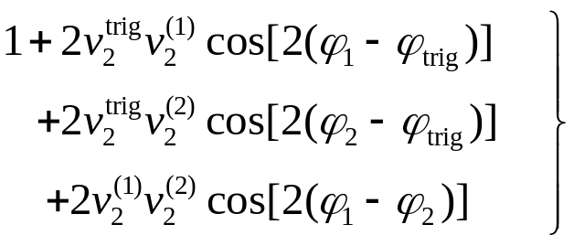
Three-particle correlations?
near
Δφ₂
J
B
Medium
away
mach cone
Δφ₁
near
T(J+B)₁(J+B)₂ = (TJ₁J₂) + (TJ₁)B₂ + (TJ₂)B₁ + T(B₁B₂)
Δφ₂
T(B₁B₂) = B₁B₂ =
flow
modulated
background
Medium
away
deflected jets
+ SS (soft-soft correlation in Background)
Δφ₁

Slide 13
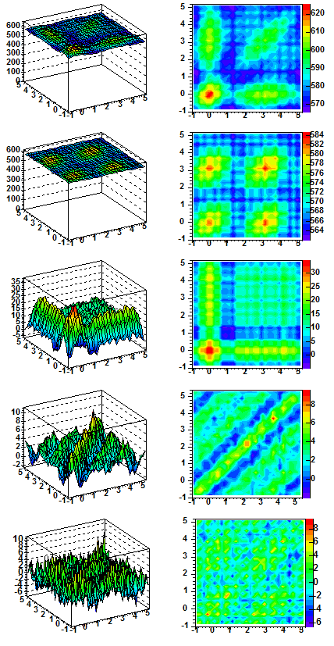
3-particle correlation analysis
3 < p_{T}^{trig} < 4 GeV/c, 1 < p_{T}^{assoc} < 2 GeV/c, Au+Au 0-10%
Raw signal: T(J+B)₁(J+B)₂
flow modulated background
STAR Preliminary
soft-soft correlation
Hard-Soft-bkgd: (TJ₁)B₂ + (TJ₂)B₁
bkgd-bkgd: B₁B₂

Slide 14
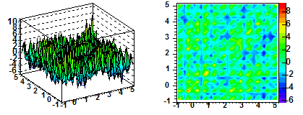
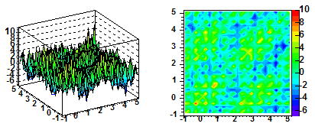
effect of v₂ on 3-particle correlation
3 < p_{T}^{trig} < 4 GeV/c, 1 < p_{T}^{assoc} < 2 GeV/c, Au+Au 0-10%
1/N_{trig} d²N/d(Δφ₁)d(Δφ₂)
average of 4 particle cumulant v₂ and reaction plane v2
STAR Preliminary
4 particle cumulant v₂
reaction plane v₂
correlation result is robust with v₂.

Slide 15
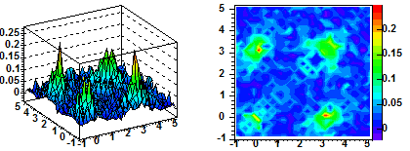
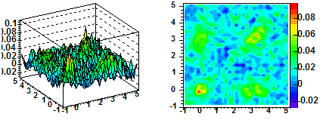
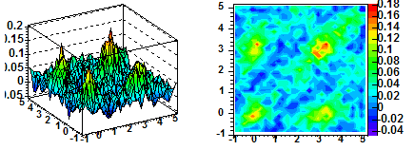
pp and d+Au results
2 < p_{T}^{trig} < 4 GeV/c, 1 < p_{T}^{assoc} < 2 GeV/c
1/N_{trig} d²N/d(Δφ₁)d(Δφ₂)
Δφ
d+Au
pp
STAR Preliminary
3 < p_{T}^{trig} < 4 GeV/c, 1 < p_{T}^{assoc} < 2 GeV/c
Δφ
Appears elongated along the diagonal axis in d+Au, possibly due to k_{T} broadening
away σ_{Σ/2} = 0.89 ± 0.11
σ_{Δ} = 0.69 ± 0.05
near σ_{Δ} = 0.66 ± 0.07
d+Au
Δφ

Slide 16
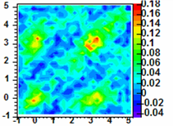
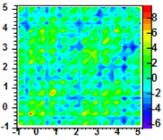
conical flow? 3-particle correlation
p_{T}^{trig}=3-4, p_{T}^{assoc}=1-2 GeV/c
2-particle corr, bg, v2 subtracted
d+Au min-bias
d+Au and Au+Au elongated along diagonal:
kT effect, and deflected jets?
Δφ₂=φ₂-φ_{trig}
Three regions on away side:
center = (π, π) ±0.4
corner = (π+1,π+1) ±0.4 x2
cone = (π+1,π-1) ±0.4 x2
difference in Au+Au
average signal per radian²:
center – corner = 0.3 ± 0.3 (stat) ± 0.4 (syst)
center – cone = 2.6 ± 0.3 (stat) ± 0.8 (syst)
Au+Au 10%
Δφ₂=φ₂-φ_{trig}
dN²/dΔφ₁dΔφ₂/N_{trig}
Distinctive features of conical flow
are not seen in present data with
these p_{T} windows.
Δφ₁=φ₁-φ_{trig}

Slide 17
Three-particle correlations can be done at LHC, also much better. may have to be limited at low-modest p_{T} (need 2 associated particles).

