Slide 1
Particle ID with Si dE/dx

Slide 2
Intro
Our goal is to write a program that takes two track measurements, a particle’s momentum and the charge deposition it produces in our silicon detector, and outputs the certainty that the track was made by a proton,pion, muon, kaon, or electron.

Slide 3
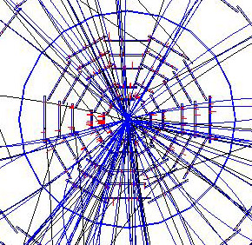
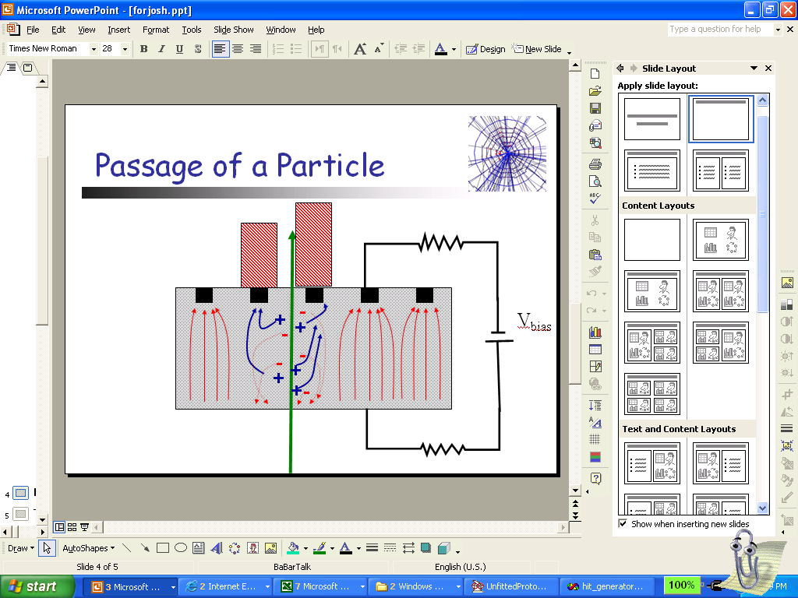
Description of Si
Basic design of silicon detector: silicon wafers (300 microns thick) arranged dodecagonally around the beam pipe.
6 layers.
Particle comes in, ionizes silicon atoms along its path.
Amount of ionization/deposition depends on particle speed.
Charge collected on strips.
Up to six hits per track. Each gives:
  Charge Deposition
  Number of Strips (1-5).

Slide 4
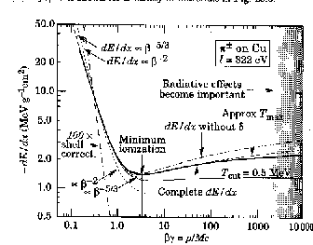
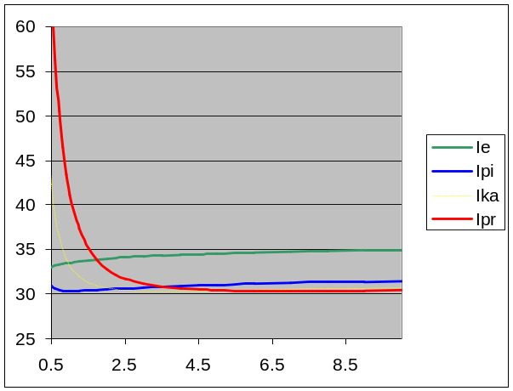
Using dE/dx for Particle ID
Ionization as a function of particle velocity: Given by Bethe-Bloch Equation.(see graph on upper right)
This can also be drawn in momentum space; get one curve per particle.
Particle identity determined by the curve our momentum/ ionization measurements land on.

Slide 5

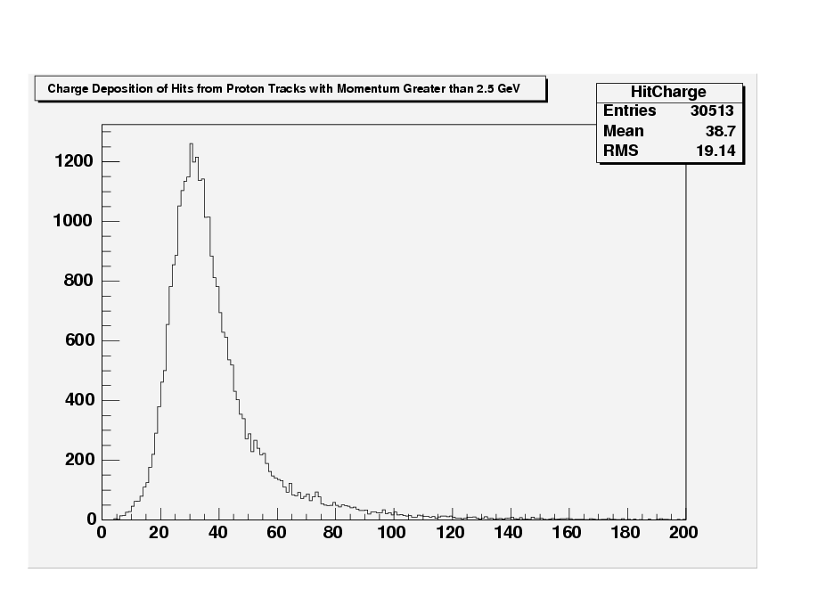
The Landau Distribution
6 hits along single track fall into the Landau Distribution
High tail resulting from secondary ionization, which occurs when the electrons deflected by a passing particle cause additional, “secondary”, electrons to be knocked free.
Cannot be expressed in closed form
No mean
!

Slide 6
Hit Clustering; Multiple Strips
Can use spatial information about the charge deposition (number of strips) to detect and compensate for presence of secondary ionization.
More strips mean more secondary ionization, so we can ignore hits with too many strips.

Slide 7
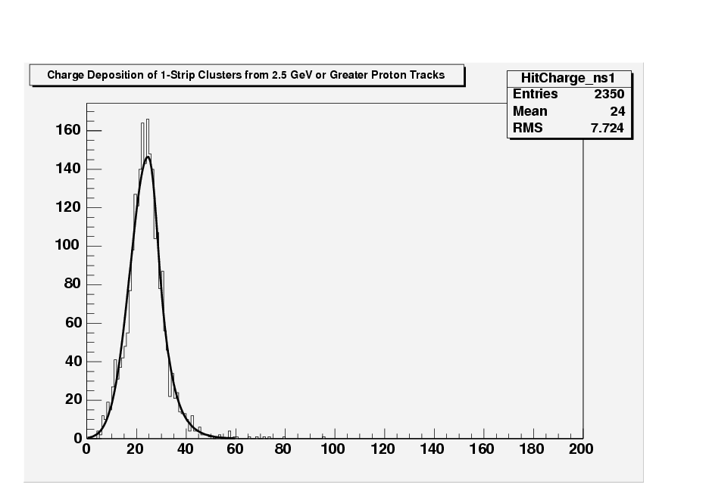
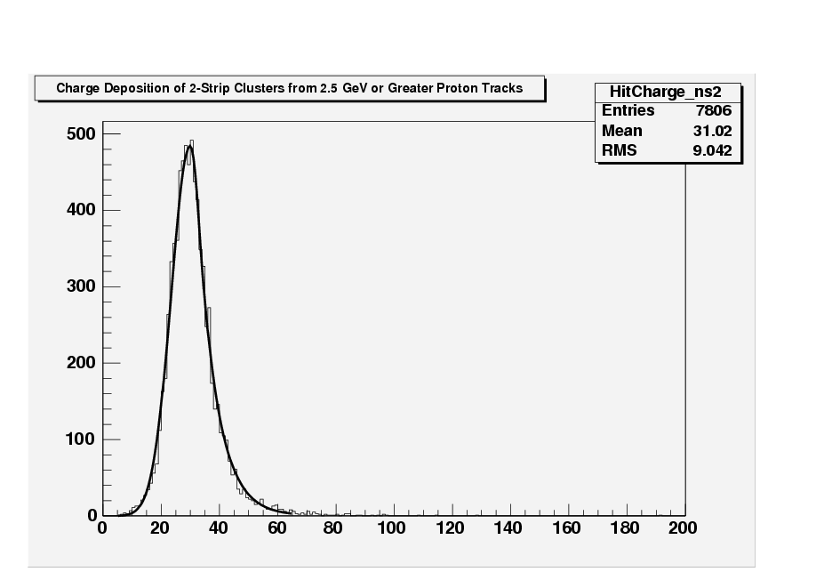
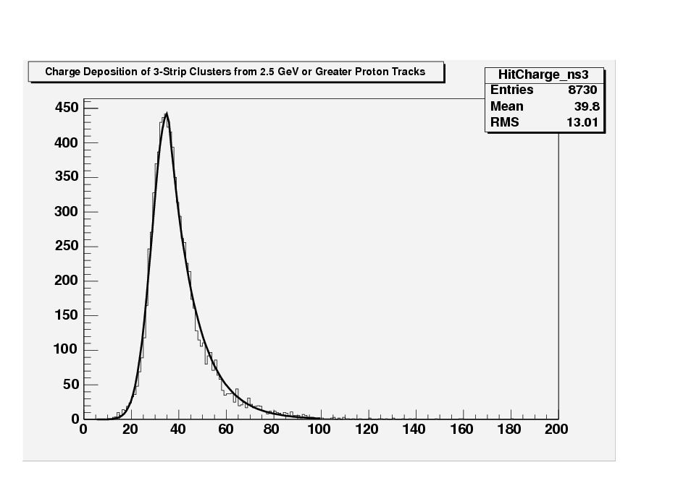
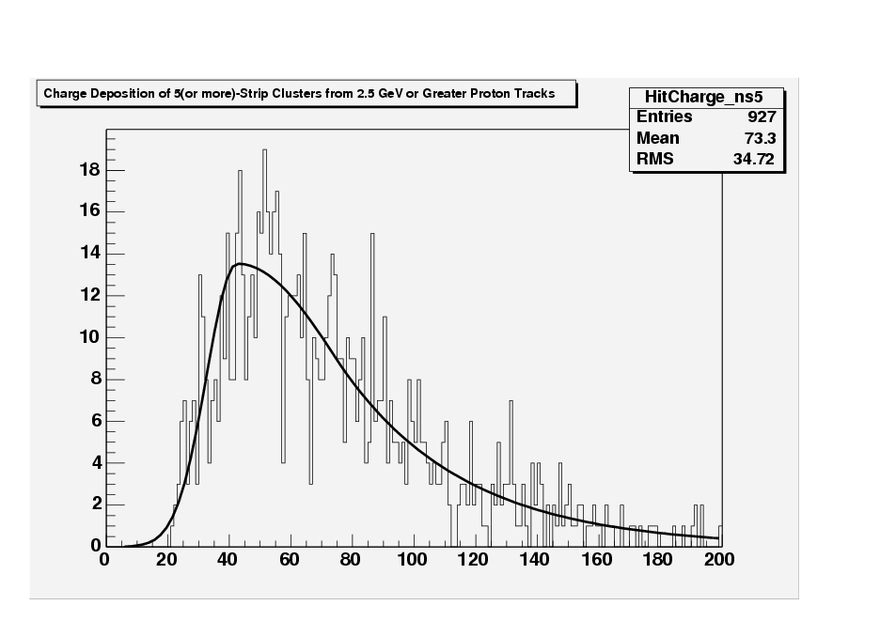
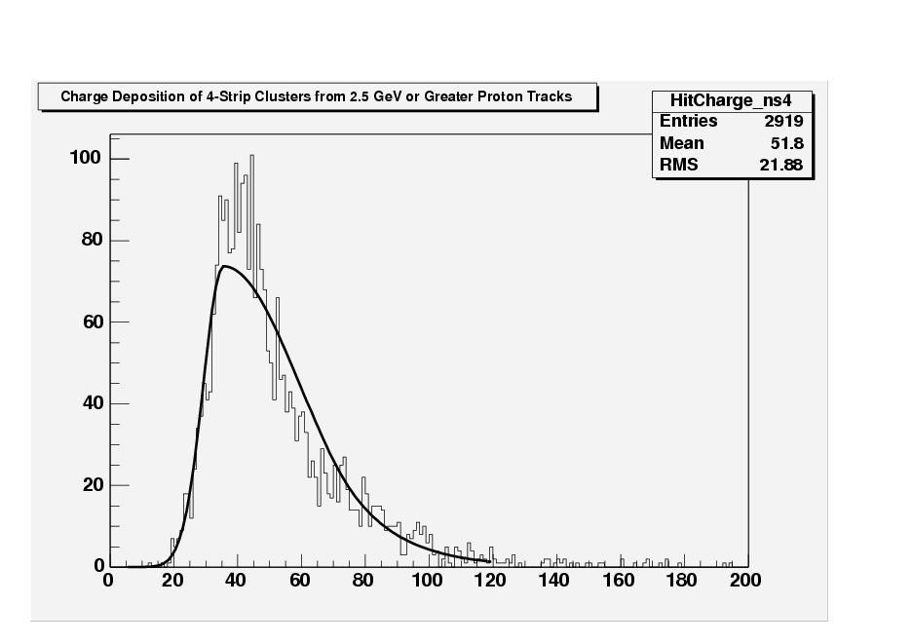
Fitted Single Hit Distributions for ns(number of strips)=1,2,3,4,5

Slide 8
Combining the Track’s Hits
We would like to associate with each track a single value for the ionization-i.e. we need a way of combining the six hits in a way that accurately represents the track as a whole.
The most obvious way of doing this is to average the six hits.
As it turns out, this is an extremely poor measure of the track ionization, since the Landau itself has no mean.

Slide 9
Combining the Track’s Hits (Alternatives to the Average)
Truncated Mean (averages a subset of the track’s hits)
  Trunc: discards hit with largest deposition
  Usens: discards hits with more than 3 strips
  Trunc3: like usens, but also discards 3-strip cluster w/ largest charge
Slowing power: =1/<1/I_{i}>
Maximum Likelihood
  Best option; haven’t fully implemented it yet, but from what we seen, holds most promise as far as distinguishing particles. Will be explained in detail later.

Slide 10
Single Hit and Track Distributions
If we send many of the same particle into our detector at fixed momentum, we expect their ionization to be the value predicted by the Bethe-Bloch equation for that curve.
Measurements actually fall into a distribution around expected value.
Two types of distributions which will be discussed:
  Single Hit: (e.g. The Landau) over hit readings taken directly from the detector, no combination of 6 hits.
  Track Distributions: over combined ionization for individual tracks. Particular method (trunc, trunc3, etc.) used here must be taken into account.
We will be interested in the quantity
(I_measured(particle) – I_expected(particle))/ 
which tells us, for a specific particle, the number of standard deviations separating the measured track Ionization (using some combination of the six hits) from the expected track ionization given by the Bethe-Bloch Equation.
We can see from the track distributions on the next page (given for protons at low momenta) that the mean ionization follows the shape of the Bethe-Bloch curve, decreasing with increasing momentum.
Notice also that the width of the distribution decreases.

Slide 11
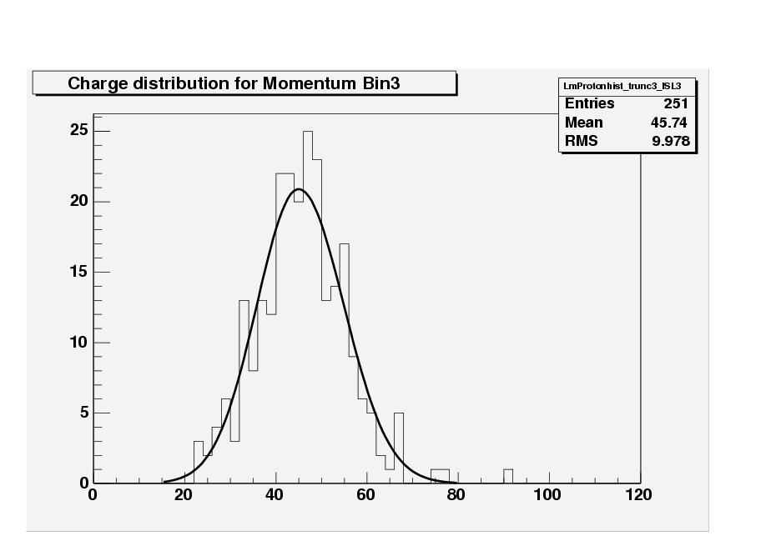
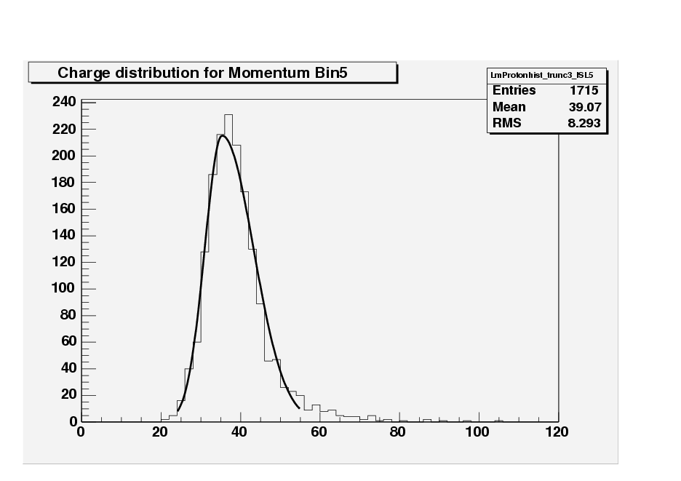
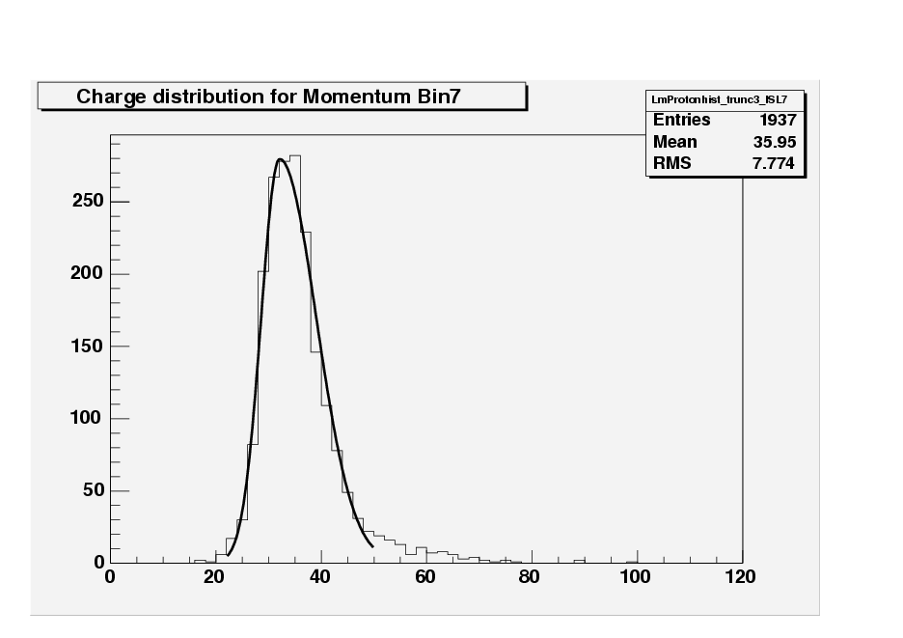
Examples of Track Distributions

Slide 12
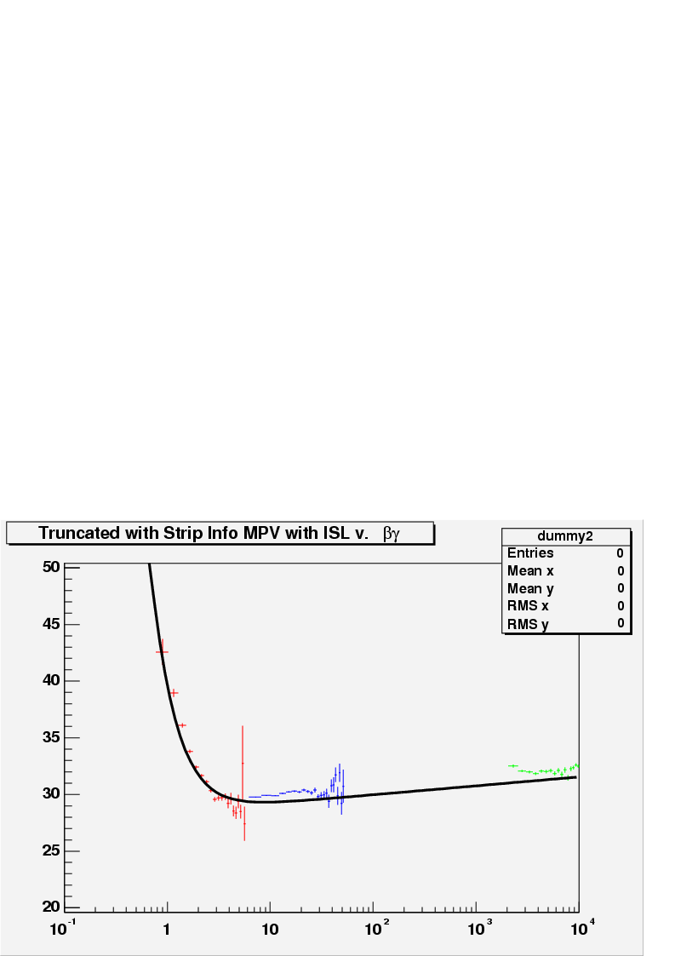
The Bethe-Bloch Equation and the Universal Curve
Using B-B eqn, devised our own parametrization to UC.
Fit to data from detector (usens shown here: red=protons, blue=pions,green=electrons).
Use param values from fit in our program.
This is our basis for determining I_expected for a particular particle with a known momentum.

Slide 13
Uncertainties
Reminder: we would like to know the quantity
(I_measured – I_expected)/ 
  for a given particle track.
In order to determine this, we need to know , the track uncertainty.
Need to know upper and lower uncertainties as functions of mean ionization.
Collected track distributions for fixed momenta (for trunc, trunc3, trunc3_ISL).
Fit a bifurcated Gaussian to distribution for each momentum. Found mean (), upper and lower widths (₂ , ₁, respectively).
Plotted upper, lower widths with respect to mean, to find variation of uncertainties with mean ionization.
We then used the parametrizations:
  1 = (5.2+(k1²²))
  2 = (5.2+(k2²²))
  to fit the plot.

Slide 14
Uncertainty Plots (revisited)

Slide 15
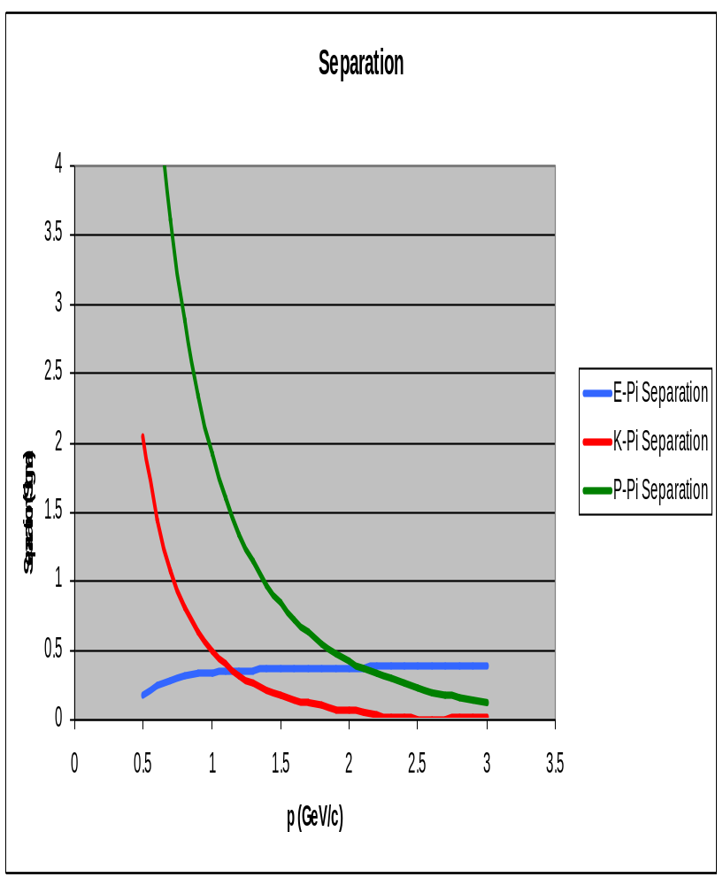
Separations
When the Bethe-Bloch curves for two particles get too close (relative to the width of the track distribution), it is impossible to tell one type of particle from the other.
The appropriate measure of distance between two curves is given by the separation, which is defined as the difference in ADC counts divided by the width of the track distribution.
Since the distances between the curves is fixed by Bethe-Bloch, we require small uncertainties to be able to classify a measurement as belonging on one particle’s curve or another’s.

Slide 16
Maximum Likelihood Technique
Is a way of finding the underlying probability distribution for a set of data drawn randomly from the distribution.
Requires:
  data points x₁,…,x_{n} taken from an unknown probability distribution.
  an initial guess P(x) at the distribution’s general functional form, with at least one free parameter u.
We define the likelihood function L() as the product of the probability densities at each xi:
L() = P(x₁)…P(x_{n})
In order to find the u that makes the set x₁,…, x_{n} most probable, we need to find the value of u at which L has its absolute maximum.
Instead of maximizing L, however, it is completely equivalent, and often much easier, to minimize -ln(L), which is given by:
  -ln(L) = -ln(P(x₁))- …-ln(P(x_{n})).

Slide 17
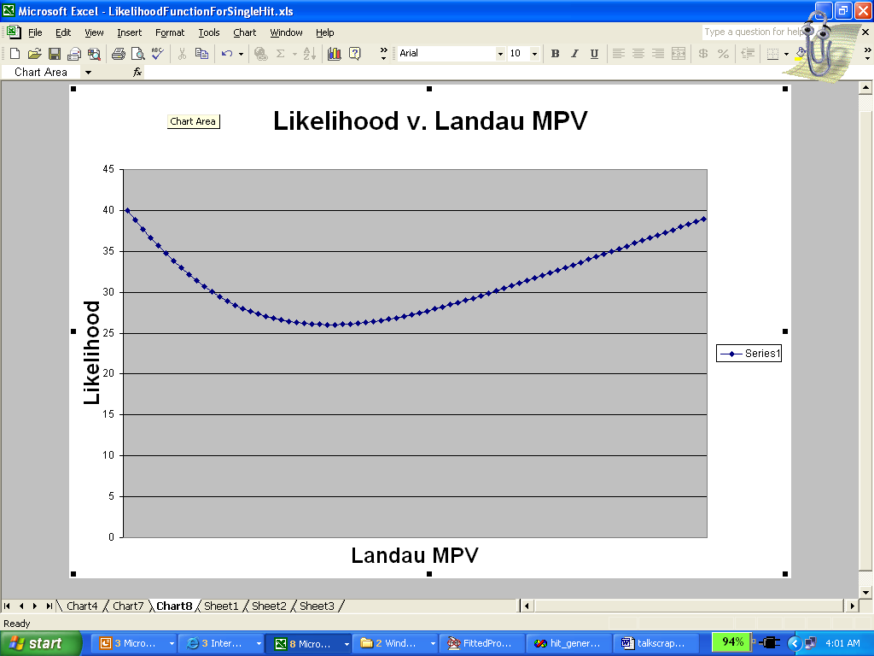
Maximum Likelihood as an Alternative to Trunc, Usens, etc.
Both common sense and experience suggest that the Maximum Likelihood Technique is the best way to combine the six hits along a particular track. Its only drawback is that it is much more difficult to apply.
As an approximation to the Landau, and as a parametrization for Maximum Likelihood fitting, we use a piecewise defined function that is a bifurcated Gaussian with an exponential tail.
This function has 5 parameters, and ultimately we would like to express them all in terms of the MPV, so that we can perform a Likelihood fit on each track; i,.e. find the value of the MPV that maximizes the Likelihood function for a given set of hits

Slide 18
Finding u1(u1ag), u2(u1ag), s1(u1ag), and s2(u1ag)
Use fits to Single Hit Distributions shown above (for aggregate and 5 ns distributions) to express all parameters as linear functions of u1ag.
Now able to perform Likelihood fit.
STDEV/AVG ->
 | Av(s1/mu1ag) | Av(s2/mu1ag) | Av(mu1/mu1ag) | Av(mu2/mu1ag)
ag | 0.247916 | 0.328999 | 1 | 1.346366
ns=1 | 0.230004 | 0.178224 | 0.829174 | 1.047041
ns=2 | 0.188371 | 0.232363 | 0.962608 | 1.220573
ns=3 | 0.190532 | 0.285314 | 1.143752 | 1.390308
ns=4 | 0.213832 | 0.631839 | 1.298738 | 1.935205
ns=5 | 0.355758 | 1.558563 | 1.726436 | 3.282429
ag | 0.04483 | 0.122604 | 0 | 0.071549
ns=1 | 0.027966 | 0.205839 | 0.040664 | 0.12298
ns=2 | 0.016562 | 0.020457 | 0.017109 | 0.015171
ns=3 | 0.067405 | 0.201227 | 0.012474 | 0.082183
ns=4 | 0.101398 | 0.224923 | 0.048367 | 0.150548
ns=5 | 0.269718 | 0.385868 | 0.256614 | 0.342063

Slide 19
Simulation
Used random number generator in computer to simulate tracks in the detector.
Generated 1000 hits, found width of distribution to be substantially better than anything we’ve tried before.
Will fit bifurcated Gaussians to track distributions, as before. Expecting smaller uncertainty with Likelihood.

Slide 20
Conclusion
State of Project: Actual code already written. Attempting to refine uncertainty measurements with Likelihood.
For Trunc and Trunc3, we’ve found resolutions of 14.8 and 15.6 percent, respectively.
Compare to 11% for COT and 12% for Likelihood.

