Slide 1
POSSIBILITY OF USING CRYSTALLINE TARGETS FOR COLLIMATION SYSTEM IN TEVATRON
__________________
I.A Yazynin
(A. Apyan)
IHEP, FNAL, CERN

Slide 2
Outline
__________________
Layout of collimation system and principles of estimation the efficiency.
One and two stage collimation
Channeling effect (thickness, position, alignment)
Volume reflection effect
Multichanneling effect
Comparison efficiency of systems
Conclusion

Slide 3
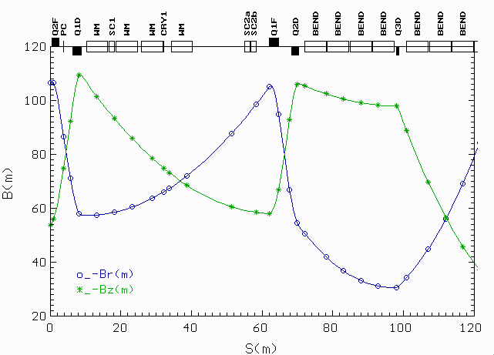
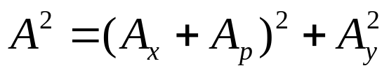

Layout of system and principles of estimation efficiency
__________________
Inefficiency – part of protons lost in the ring after interaction with the system.
Simulation for estimation of efficiency --- Structure of system, limitation for transfer amplitudes, 6D matrix of last ring.
Limitation for amplitude defined by beam parameters and size of chambers.
For beam pipe can be used the full amplitude:
Main sources of losses: target and secondary collimators:

Slide 4
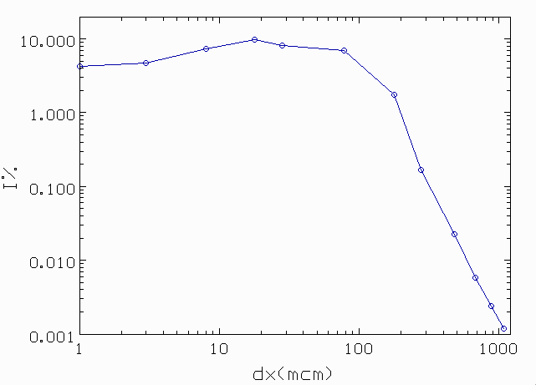
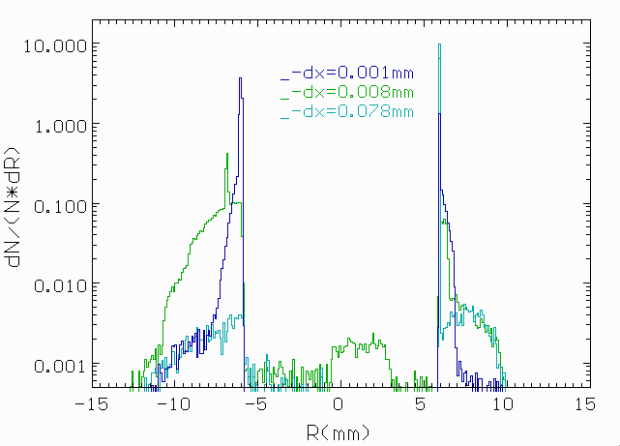
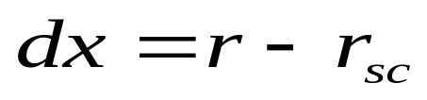
Inefficiency from secondary collimators
__________________
For impact parameter, dx>1mm, beam losses are negligible and for design systems with crystals the main part of deflected beam must have the impact parameter bigger than 1mm.
At the equilibrium density D=1p/mm losses will be Ieq=0.0083
Were considered all 4 edges of secondary collimators: right, left, up, down
Here is presented impact protons at right edge.
Notes:
Fig.1: Inefficiency versus impact parameter.
Fig.2: Distribution protons at SC with some impact parameters.

Slide 5
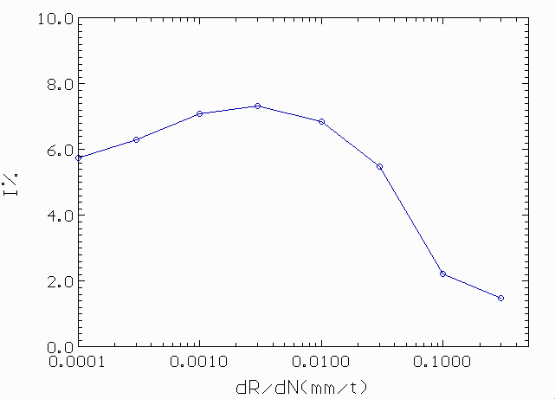
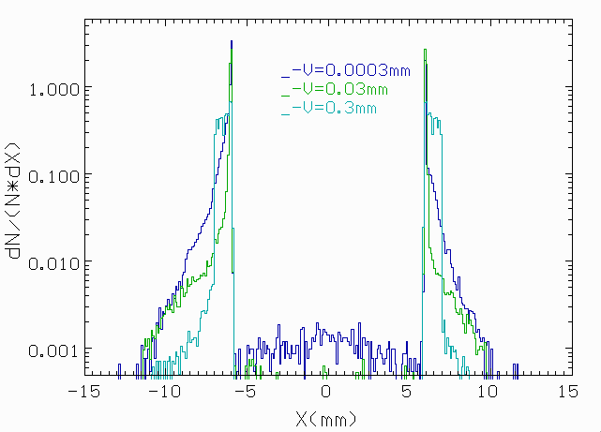
One stage collimation
__________________
At the small value of beam diffusion the inefficiency of one stage system (only secondary collimators) will be Iacc=6-7%.
That value agree with previous consideration of inefficiency at small impact parameters
Notes:
Fig.1: Inefficiency versus the diffusion velocity of the beam halo.
Fig.2: Distribution protons at SC at some diffusion velocities of beam.
In that and another simulations used size of circling beam Rbeam=8.3σ

Slide 6
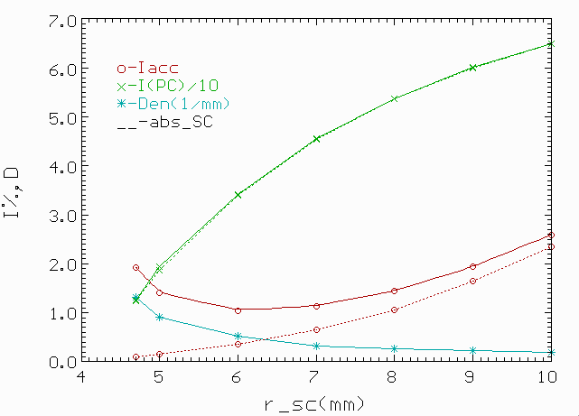

Two stage collimation
__________________
Efficiency versus gap of the secondary collimator (E03).
Minimum beam losses will be when (half) gap in the range , r_sc=5-7mm
For circulating beam all losses are defined by two sources:
primary collimator (PC) (or target) and secondary collimators (SC).
Estimation formula for losses
Coefficients may defined by simulation of localization process with use the absolute secondary collimators.
Notes:
Absolute collimator catches all particles.

Slide 7
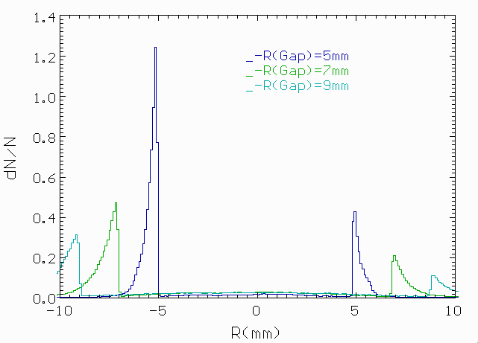
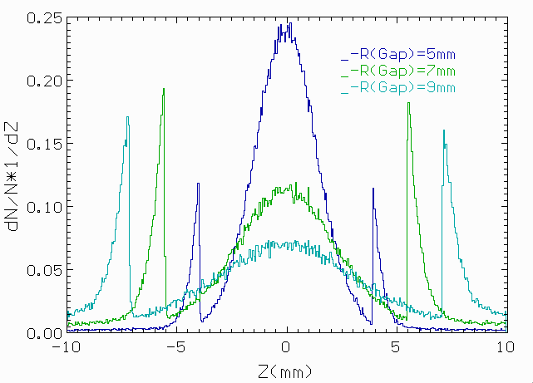
Distribution of protons at SC
__________________
High density of protons at right and left edges of secondary collimator with small gap.
Asymmetry in radial plain is explained by existence the none zero dispersion at SC. Protons after interaction with PC has momentum P< P₀ .
At big gap there are more p inelastically interacted with PC and range angle for outgoing p will wider that will increase the losses (that can see at previous slide).

Slide 8
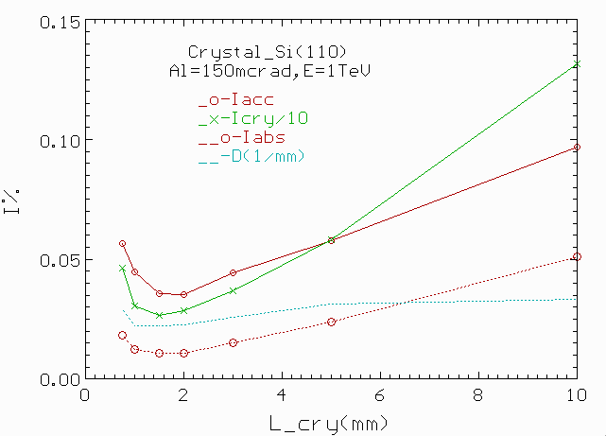
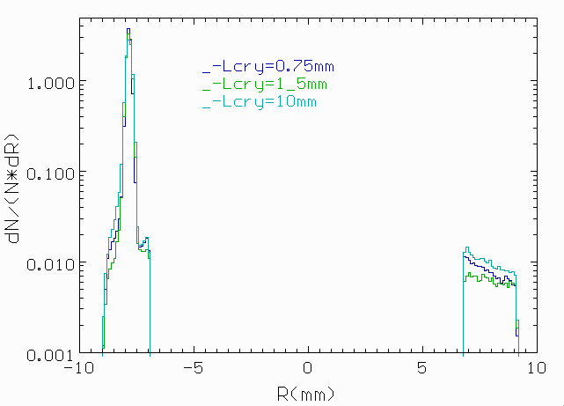
The choice of crystal thickness
__________________
Optimum thickness of crystal lc=1.5-2mm and inefficiency is ~ 0.035%.
At lc=5mm losses increase in 1.5 time.
Main change of losses defined by part of protons inelastically interacted (diffraction part) with the crystal (Icry, green curve)
The density (D, blue) at edge of SC is negligibly changed ~ 0.03%.
Notes:
Fig.1: Inefficiency versus the thickness of crystal.
Fig.2: Distribution protons at SC.
In that and another simulations used size of Gap the SC R=+-6mm=11.2σ
This consider old place of crystal installation and minimum inefficiency will be ~0.035%

Slide 9
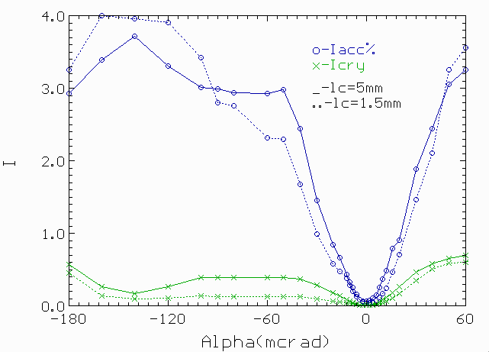
Inefficiency versus alignment
__________________
For thin crystal the angular acceptance is wider with good efficiency due to the smaller losses at in crystal (dashed green curve).
Volume reflection occur at the left side from zero point where the beam losses are smaller.
Maximum influence occur on the short crystal (lc=1.5mm). The level of losses less than 5% in angular range (-160 - 0)
At the large angle of alignment > 40 and < -180 µrad the crystal works as an amorphous target and losses increase up to 60%.
Notes:
Old variant installation

Slide 10
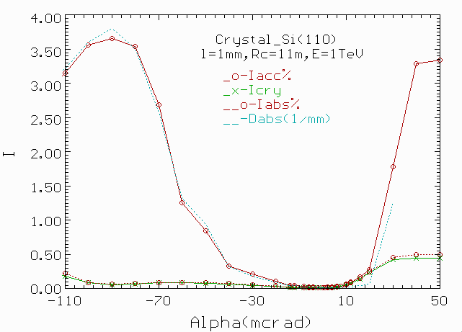
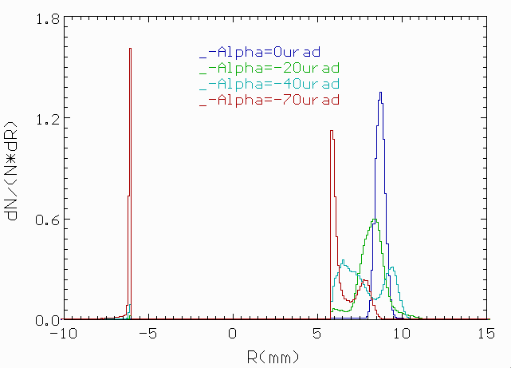
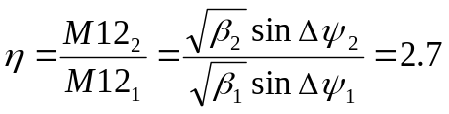
New variant installation of crystal
__________________
Crystal install at place of PC, that allows to reduce the deviation angle of beam by the crystal from 150 up to 90 µrad.
Reduction of a component of losses due to the inelastic interactions of protons with the crystal. Density of losses on edge of SC depends on the matrix element M12 as D~1/M12.
The reduction of density:
As a results the losses decrease in 3 time, up to 0.01%, that in 100 time smaller then for usual collimation.
Notes:
Where volume reflection occur (-100 - -5mcrad) the main losses defined by 2 part – density p at SC (blue dashed curve).

Slide 11
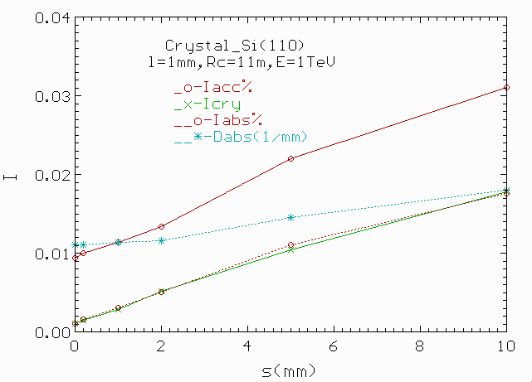
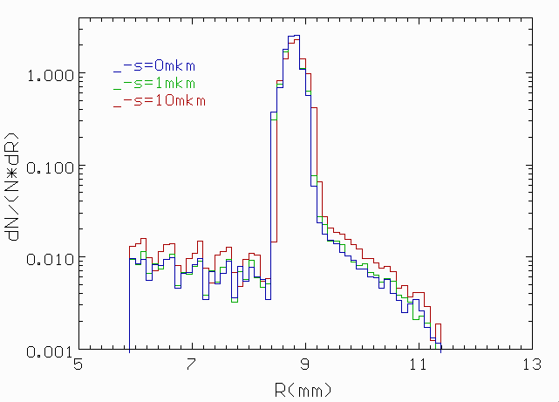
Influence of amorphous layer
__________________
Density of protons at the edge of SC (Dabs) is increasing slowly with the thickness of amorphous layer.
Increasing losses in the main defined by growing inelastically interaction of protons with crystal (Icry).
Part of this losses shown by red pointed line (Iabs).
Difference between red lines Iacc – Iabs is losses from SC.
All losses may be defined as: Iacc=Icry x c1 + Dabs x c2, c1~0.01, c2~0.8.

Slide 12
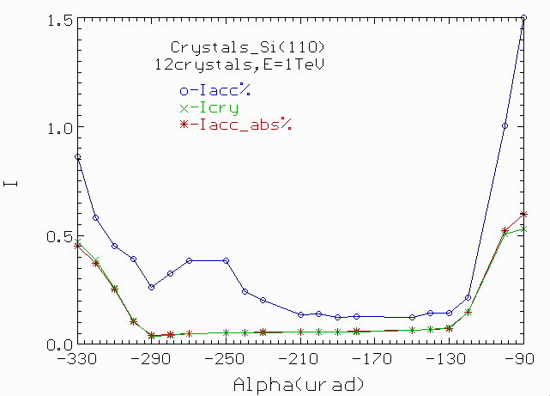
Volume Reflection Effect
__________________
Angular acceptance for VR is rather big ~ 100 µrad (-220—120) (see blue line).
Inefficiency ~ 0.13% that at 8 time smaller than for usual collimation.
12 crystals, Si(110) with Rc=10m and full L=20mm, were used for simulation .
Crystalline target was installed in place PC, Rbeam=8σ, and R(SC)=11.3σ

Slide 13
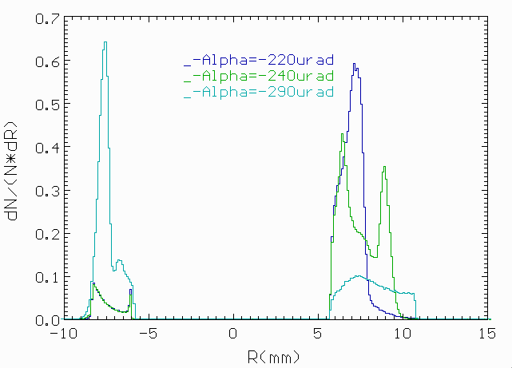
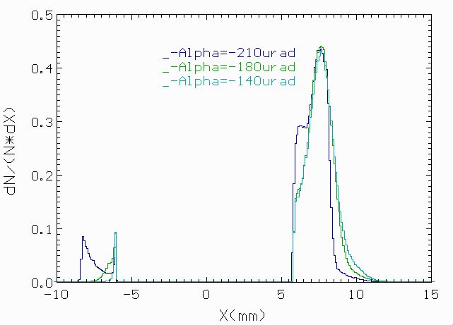
Protons Distribution at SC
__________________
At angular alignment α = -290 µrad multichanneling effect.
At range of angles from -230 to -130 µrad we see pure volume reflection effect.
At the angles >-120 the target work how amorphous.

Slide 14
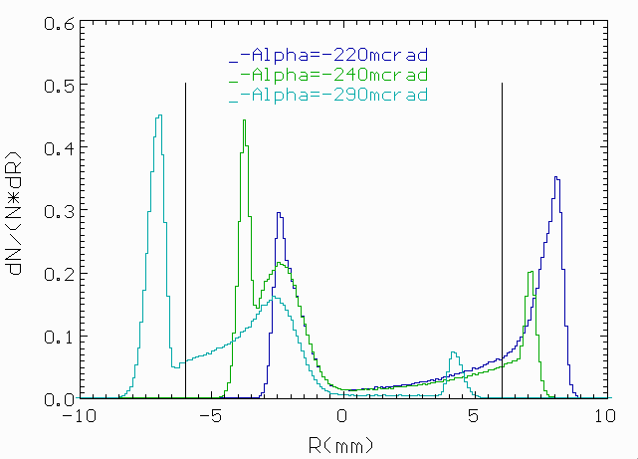
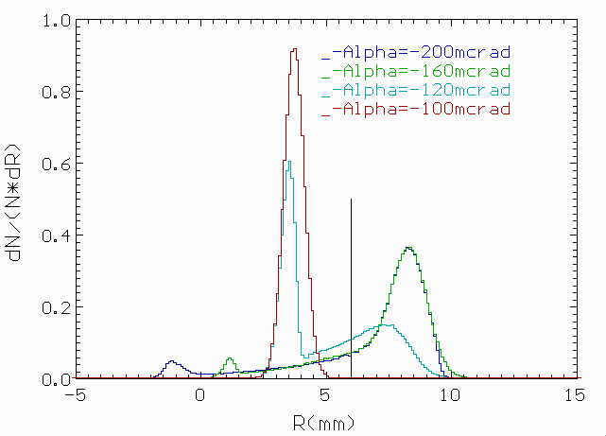
Simulation for one turn
__________________
Simulation of one turn process of interaction protons with target and considering distribution of protons at place of SC.
Left figure represent VR plus multichanneling effects (1,2) and pure multichanneling (3)
Right figure represent pure VR effect (1,2). Target works as an amorphous (-100 µrad, the angle of beam envelope = -210 µrad) at large angles.

Slide 15
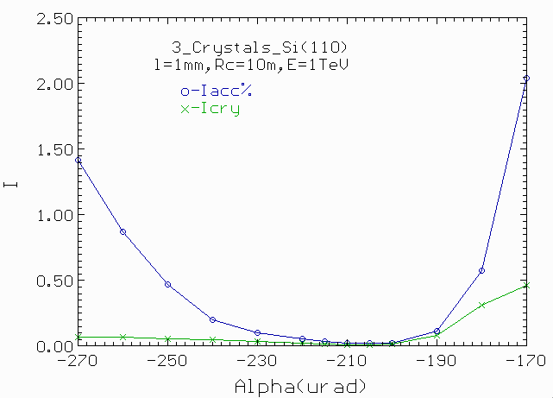
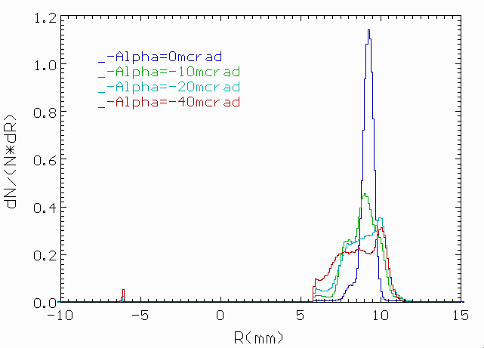
Using of multichanneling effect
__________________
Three crystals Si(110), Rc=10m were used for simulation
Angular acceptance is bigger than for 1 crystal in 1.5 time
Beam losses are 2 times larger.
Multichanneling is effective for one interaction of beam.

Slide 16
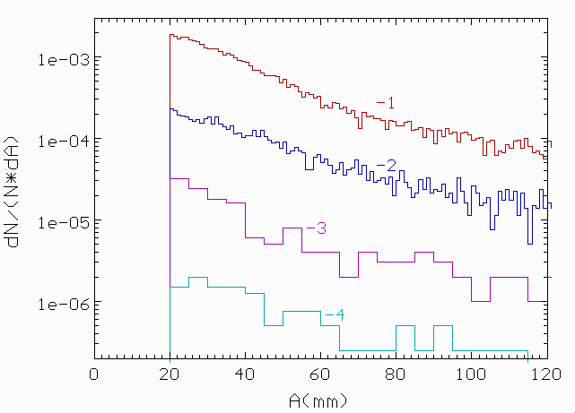
Amplitude distribution of losses
__________________
1 – One stage collimation
2 – Two stage collimation
3 – Volume reflection
4 – Channeling
Protons with A>35mm will be lost during the some periods.

Slide 17
CONCLUSIONS
__________________
Volume reflection effect decreases losses in ten time.
Very large range of angle alignment with good efficiency ~100 µrad.
Channeling effect decreases the losses in accelerator more than hundred times.
The range of angle alignment with good efficiency will be ~15 µrad

