Slide 1
A Tale of Two Glauber Calculations:
Monte Carlo vs. Optical Limit Approaches
Mark Baker, Peter Steinberg
Brookhaven National Laboratory
Patrick Decowski
Massachusetts Institute of Technology

Slide 2
Theory vs. Experiment
Theoretical calculations
  Fundamental Input: b is chosen at random
  N_{part}, N_{coll} are derived
  Particles are generated
Experimental measurements
  Fundamental Input: Particles are measured
  derive N_{part} , N_{coll} , b
Not a completely theoretical derivation
  Based on some robust assumptions
  Can estimate systematics

Slide 3
Assumptions
Monotonicity
  monotonic relationship (on average) between X and the measured quantity (N)
    d⟨X⟩/d ⟨N⟩ > 0 (or < 0) for all ⟨N⟩
  A given fraction of events selected from N corresponds to ⟨X⟩ for the same fraction
Total Cross Section
  Fraction of what? (i.e. model has correct σ_{TOT})
  RHIC experiments have not used the directly measured cross section (see A. Drees talk)
  Instead trigger efficiency is estimated using models (e.g. HIJING)
  Systematic error based on this is included in the final results

Slide 4
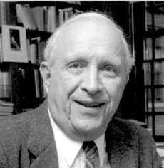
Glauber calculations
Nucleons are distributed according to a density function (e.g. Woods-Saxon)
Nucleons travel in straight lines and are not deflected as they pass through the other nucleus
Nucleons interact according to the inelastic cross section measured in pp collisions, even after interacting
  Participants – counts nucleons which interact
  Binary collisions – counts collisions
Two methodologies satisfy basic criteria
  Probability integrals
  Monte Carlo approach
Do they give the same answer?
Roy Glauber

Slide 5
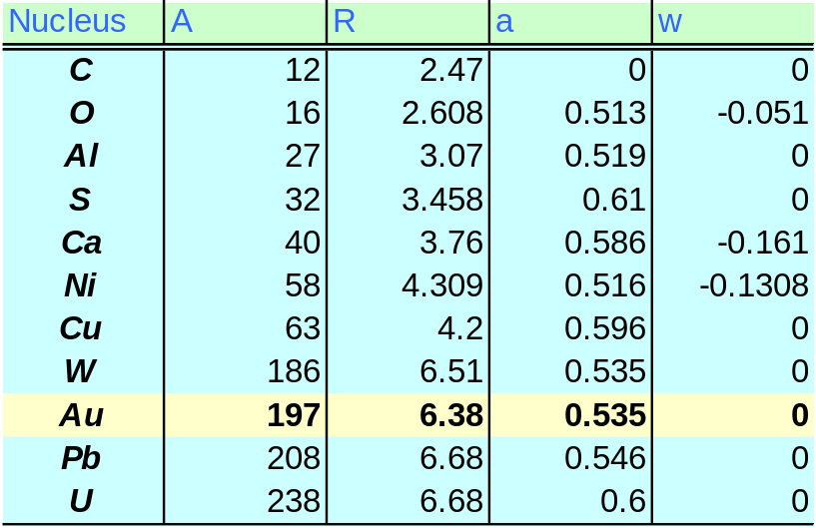
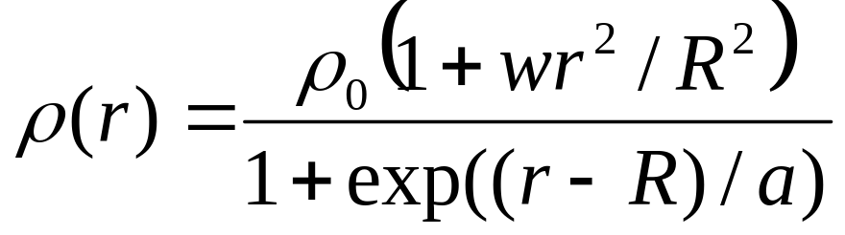
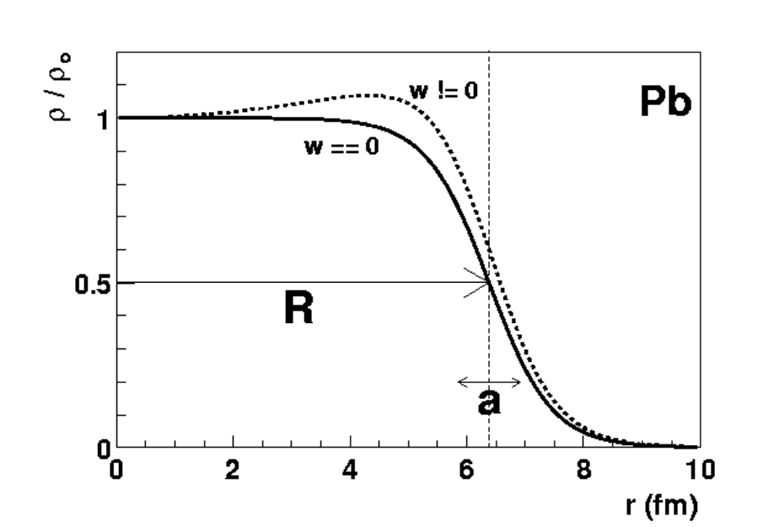
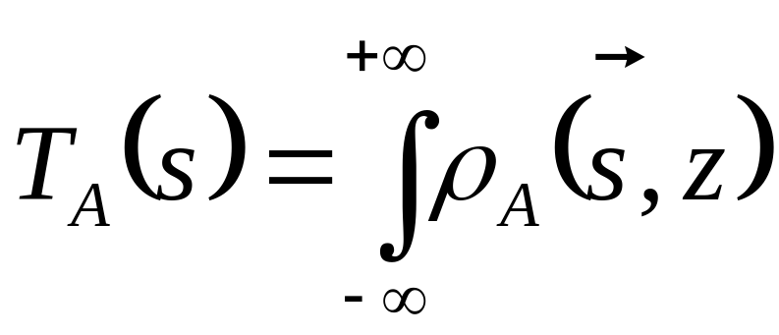
Nuclear Profile & Thickness
H. DeVries, C.W. De Jager, C. DeVries, 1987

Slide 6
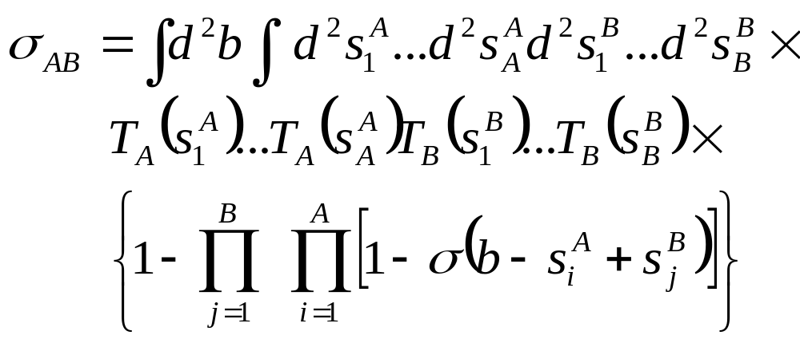
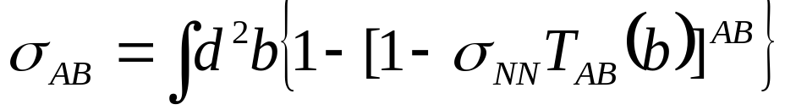
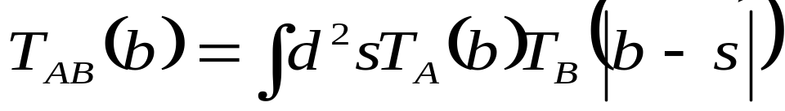
Total AB Cross Section
Configuration Space
Nuclear Thickness
Interaction Terms
Intractable. Instead, most people use “optical limit”:
where
Supposedly valid for large A and/or when σ_{NN} is small

Slide 7
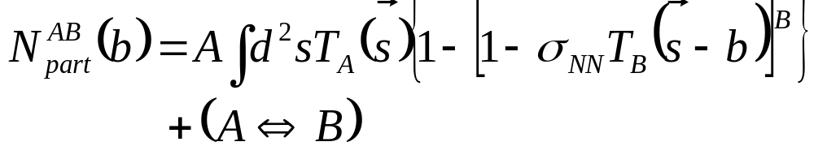
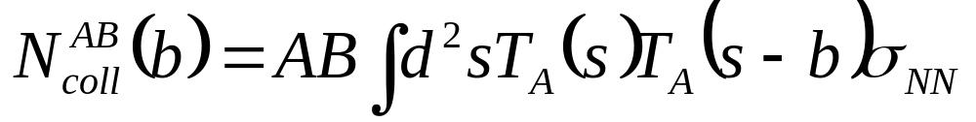
Calculating N_{part} and N_{coll}
Number of participants
Number of collisions

Slide 8
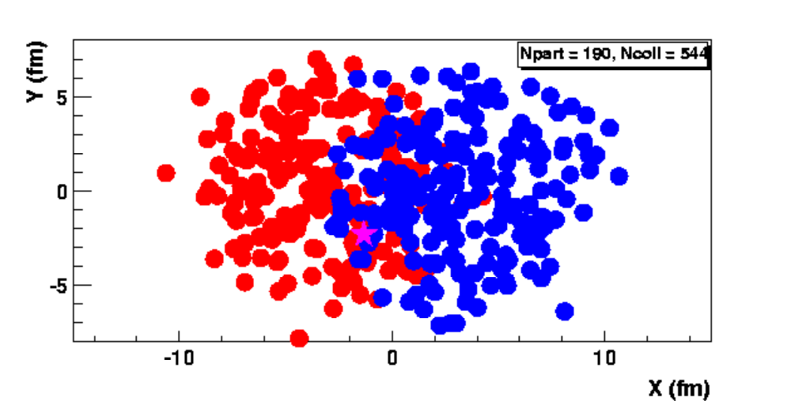
Glauber Monte Carlo
Random impact parameter, nucleon positions
Interactions occur for D < sqrt (σ_{NN}/π)
Can directly count N_{part}, N_{coll} for each event

Slide 9
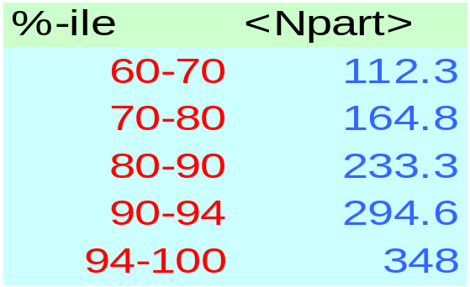
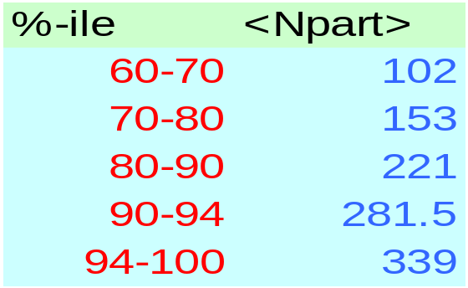
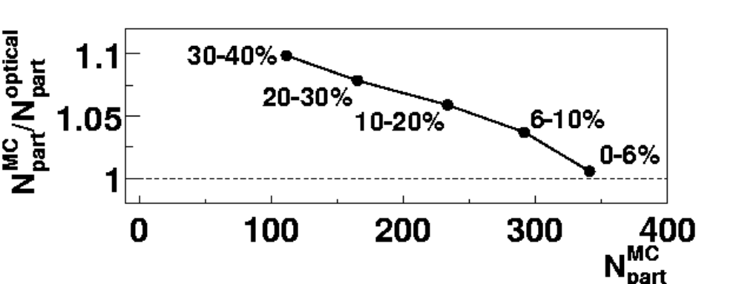
Two Different Answers?
HIJING 130 GeV
  Monte Carlo approach
  Gaussian nucleon profile
Kharzeev/Nardi
  Optical-limit approach
  Point nuclei
nucl-ex/0105011

Slide 10
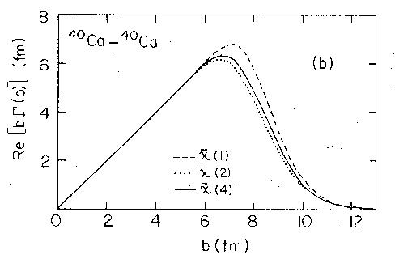
Beyond the Optical Limit
Franco & Varna, 1977
Include higher order terms in optical limit
  Next higher order decreases cross section
  Addition of next term increases it again
Not clear if series is convergent
Shows difficulty of problem

Slide 11
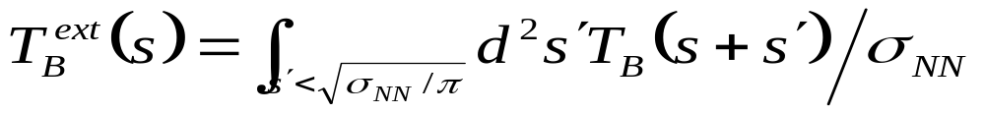
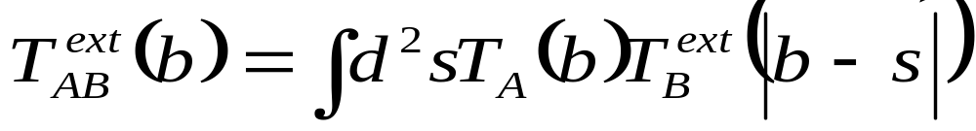
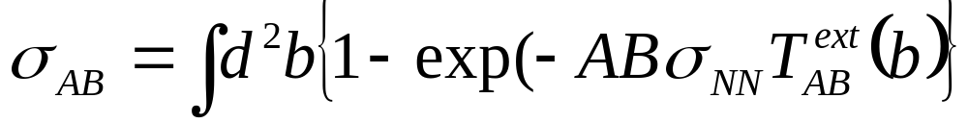
“Ball” Glauber
Keep optical limit formalism but give nucleons finite size
Modifies nuclear thickness function
Overlap function
Total cross section
Number of participants

Slide 12
Study of systematics
We have implemented our own
  Monte Carlo (MC) Glauber calculation
  Numerical Integration
    Point-like nucleons
    Ball-like nucleons
Allows us to directly compare quantities
  Total cross section
  N_{part} as a function of percentile of cross section
  What are the sensitivities to R, a, σ_{NN}

Slide 13
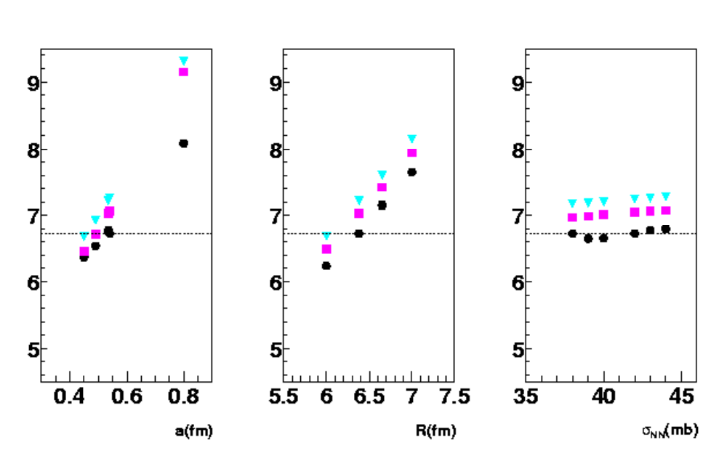
Total Cross Section
Standard Parameters:
Ball optical
Point optical
Monte Carlo
σ_{TOT} = 6.7 b

Slide 14
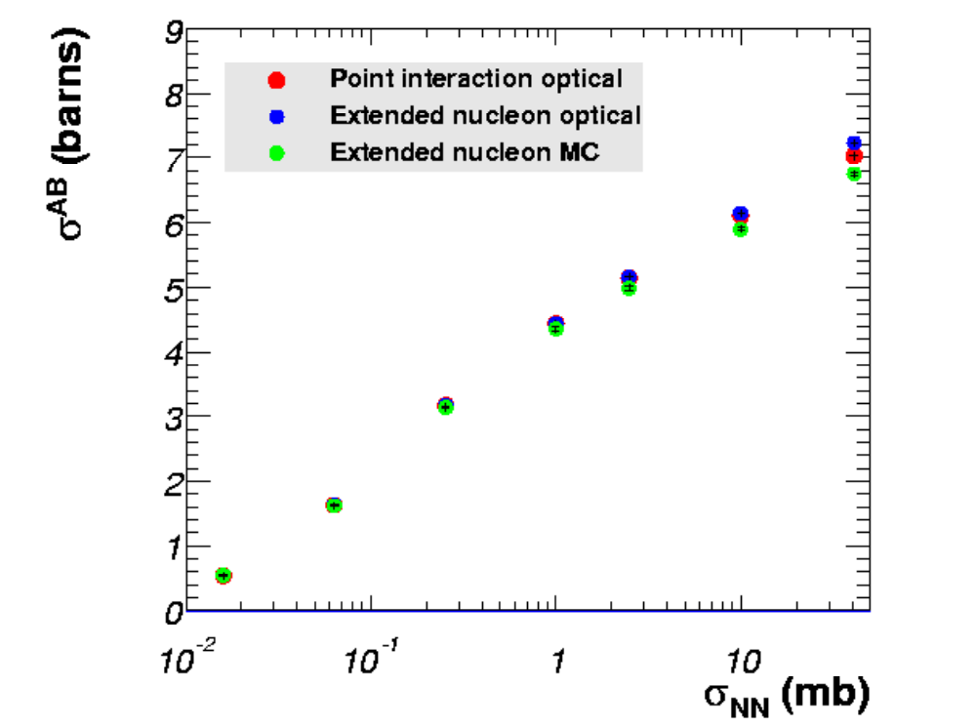
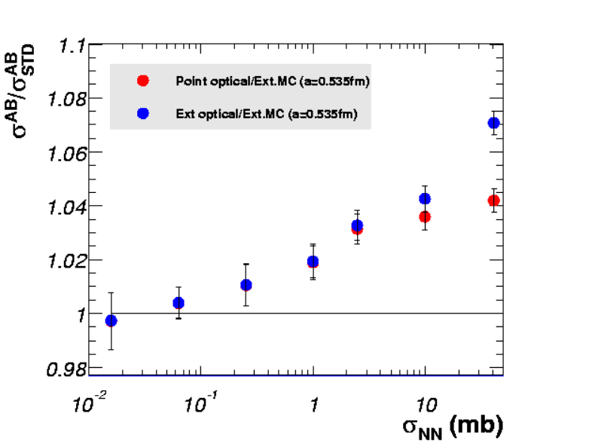
Dilute Limit: Convergence
As we lower the NN cross section, two methods converge!
Reduces effects of multi-particle collisions

Slide 15
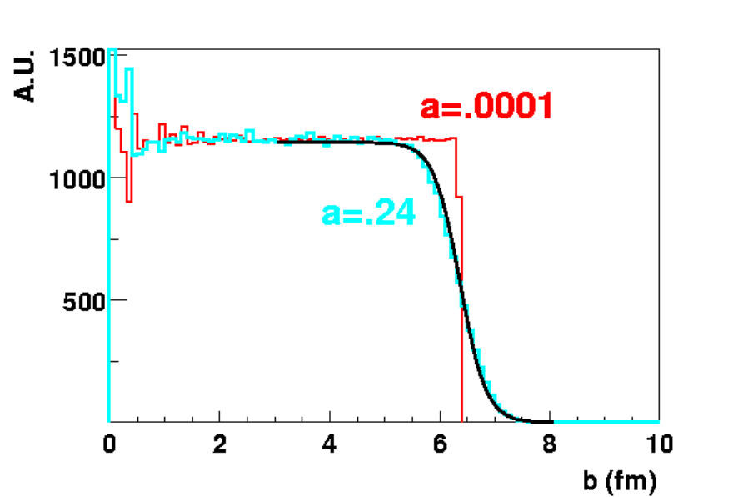
Proton Charge Distribution
Electron experiments measure charge distribution
Density ρ(s) tracks nucleons
Can do calculation
  Nucleons distributed by 2-parameter Woods-Saxon
  Nucleon charge distributed in gaussian sphere (R_{p}~.8fm)
  Recalculate a’ for original a
(input)
(output)
a~0 induces a ~ .24 fm
  Adds in quadrature
  a(input) = .48 gives a~.535
  Gives σ_{TOT} = 6.5 b
R_{p}
R

Slide 16
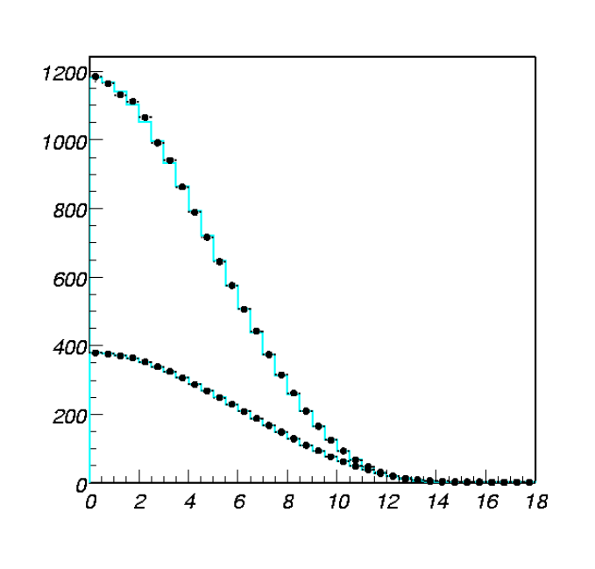
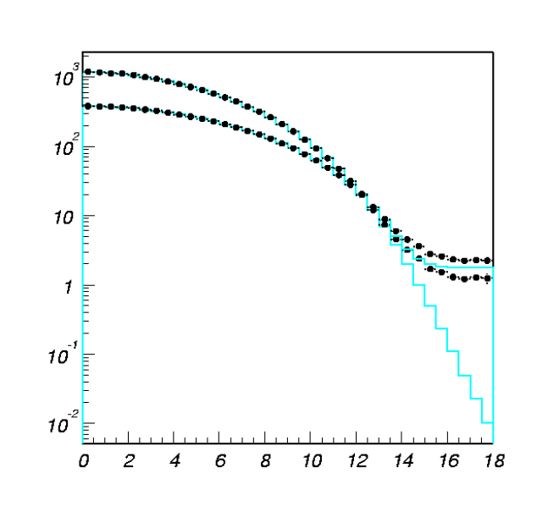
Impact parameter dependence
N_{coll}
N_{coll}
N_{part}
N_{part} = 2
N_{part}
N_{coll} = 1
Impact Parameter
Impact Parameter
Using standard parameters
Both approaches yield same N_{part}(b), N_{coll}(b)
We have fixed N_{part} to prevent N_{part}<2, not N_{coll}
  N_{part}(b) x (1-P₀(b)) where P₀(b) = exp(-ABσ_{NN}T_{AB})

Slide 17
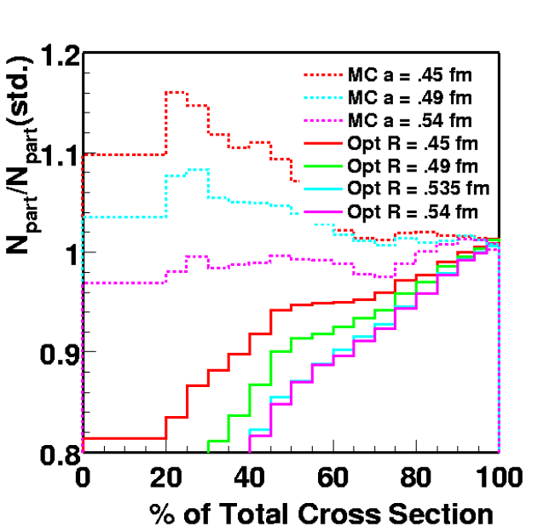
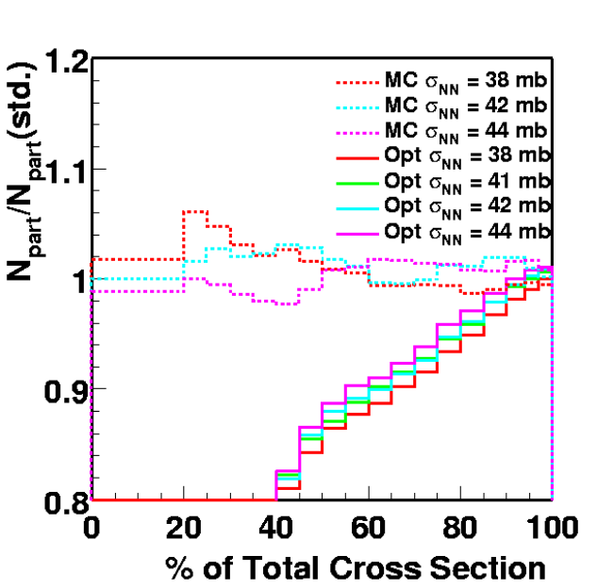
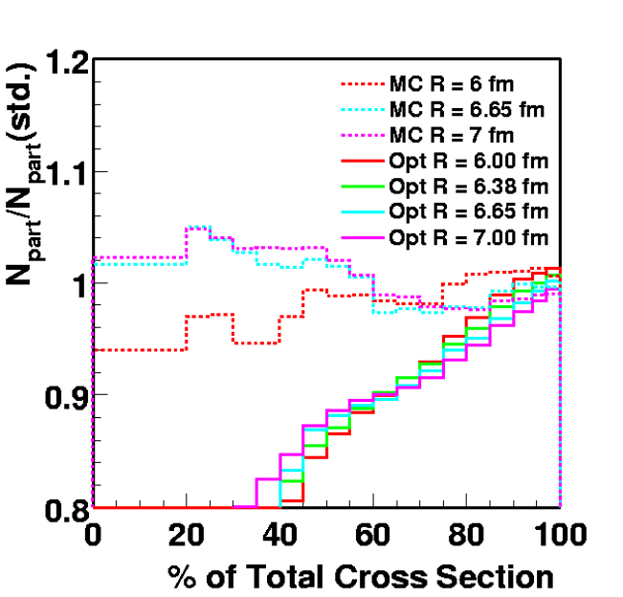
Npart in %-ile bins
Although N_{part}(b) and N_{coll}(b) agree, bins in %-ile bins disagree systematically
  Clear separation in reasonable ranges in R,σ
  Need to lower a substantially to even approach agreement
Total cross section is clearly not the only controlling parameter for N_{part} in bins

Slide 18
Conclusions
Two kinds of Glauber calcuations are done
  Optical Limit & Monte Carlo
Agree on certain features
  N_{part}(b), N_{coll}(b)
Disagree on others
  Total cross section – 6.5 b vs. 7-7.2 b
  Extraction of N_{part} vs. fraction
  Connection between these is not completely clear
Two approaches converge in dilute limit (σ_{NN}→0)
Side-point about skin thickness
  a ~ .48 fm might be better than the standard
  Not critical, but could use some clarification

