Slide 1
A Possible Source of the Tune Drift on the Front Porch in the Tevatron.

Slide 2
The data come from a the following reference:
Studies of the Chromaticity, Tune, and Coupling Drift in the Tevatron
Mike Martens, Jerry Annala, Pierre Bauer, Vladimir Shiltsev, Gueorgui Velev
2005 Particle Accelerator Conference
Knoxville, Tennessee
May 16, 2005

Slide 3
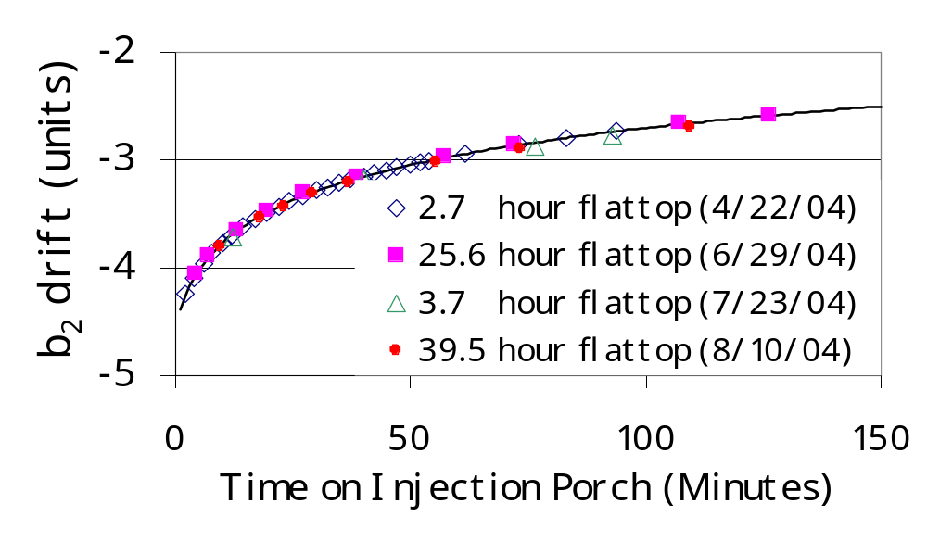
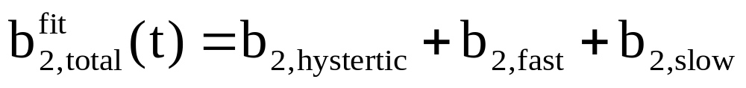
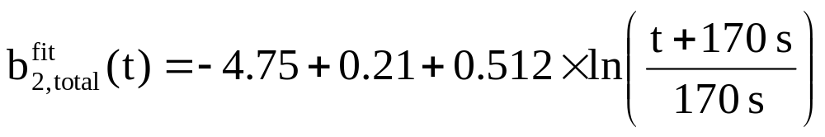
Measured b₂ Drift in Tevatron

Slide 4
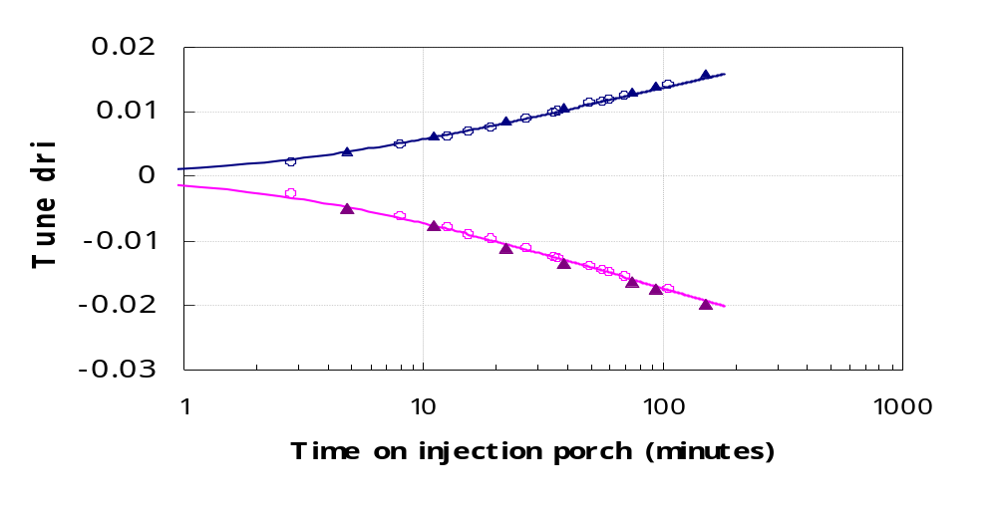
Tune Drifts in the Tevatron
Horizontal Tune
Vertical Tune

Slide 5
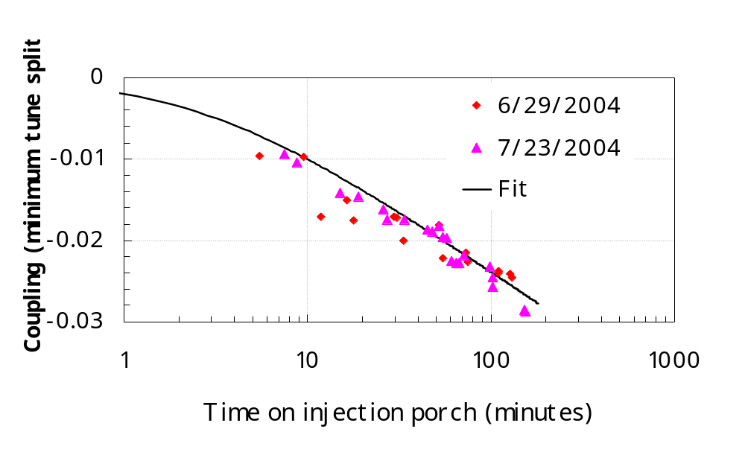
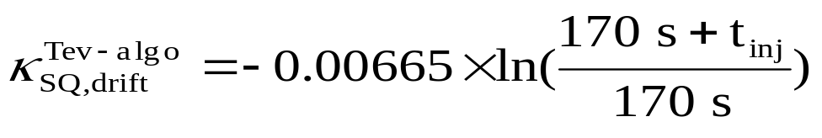
Coupling Drifts in the Tevatron
Horizontal Tune
Vertical Tune

Slide 6
All the observed drifts have the same time dependence. It is therefore natural to ascribe then to the same cause.
Since the b₂ is known to vary it is natural to say that the tune drift and the behavior of the tune minimum is due to the change in the b₂.

Slide 7
A drift in b₂ will cause the tune to drift if the beam does not go through the center of the magnets.
However:
Modeling of the Tevatron fails to give a tune drift similar to that observed.

Slide 8
Model
Nominal Tevatron lattice at injection.
Separators off.
High order multipoles as measured at MTF.
Survey data.
The measured closed orbit locations at the BPM.

Slide 9
These data were used to calculate the closed orbit. The closed orbit at the dipoles shows only small offsets in the dipoles.
The calculated tune shifts are smaller than the measured tune shifts by a factor of ~10.

Slide 10
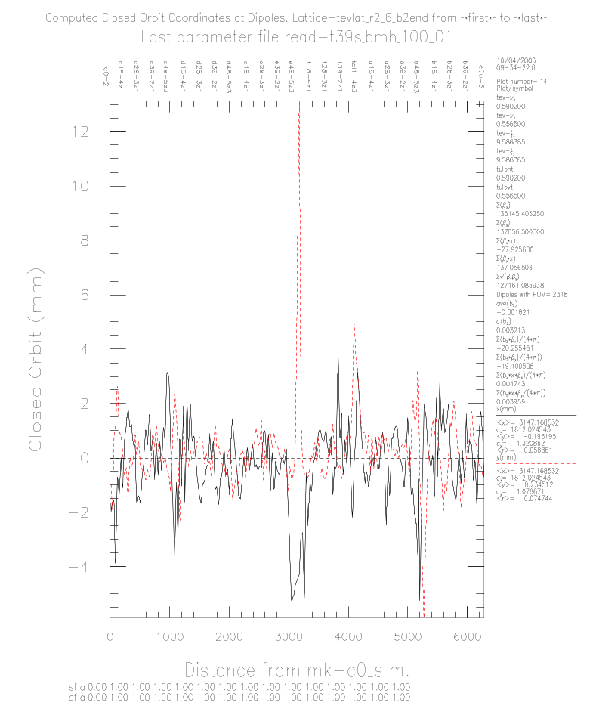
Calculated Offsets in the Dipoles

Slide 11
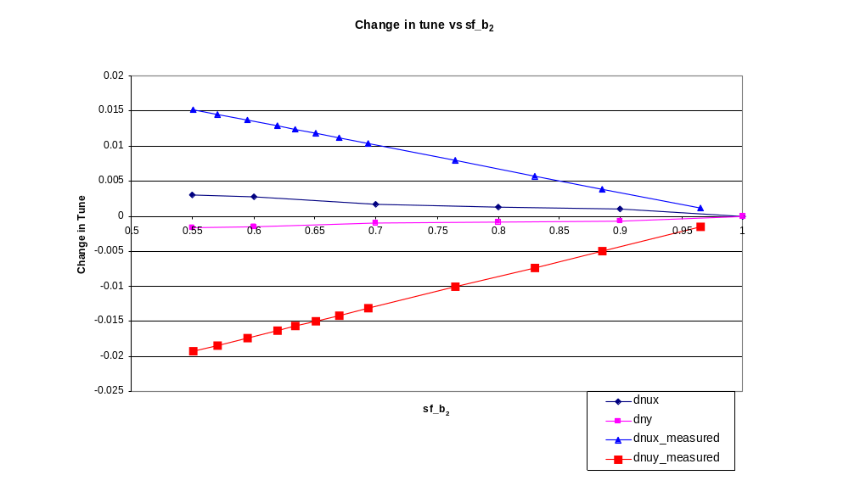
Comparison of Measured and Calculated Tune Shifts.

Slide 12
The calculated tune shifts are much smaller than those observed.
Why?
A possible explanation.

Slide 13
Tevatron Model
When the Tevatron was first turned on a large tune split (ν_{x} <> ν_{y}) was observed which was not due to coupling.
This was incorporated into the models by adding a zero length “quadrupole” on to the end of each dipole. (bendq in the MAD models. The strength of bendq is kbendq=+2.26e-05/m).

Slide 14
The origin of this focusing element has been thought to be in the sextupole moment, the b₂, of the dipoles.
If the beam does not go through the center of the dipole then there will be a feed down of the b₂ into an effective quadrupole.
If the b₂ varies than kbendq (the strength of bendq in the mad model) should also vary.

Slide 15
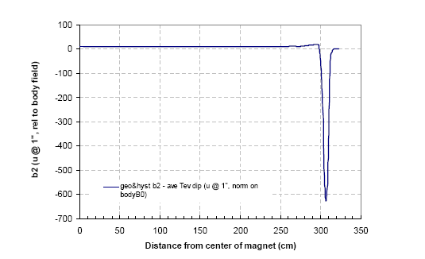
Distribution of b₂ in a Tevatron Dipole

Slide 16
Unfortunately the change in b₂ and the change in kbendq are not the same.
kbendq depends on the distribution of the sextupole moment in the dipole and the physical shape of the dipole.
If the dipole is bent so that the on axis beam is on the center line of the magnet there would not be any kbendq.

Slide 17
What do we know about the shape of the dipoles?
“The curve that results in the magnet's sagitta is not a true radius or parabola. The curve is what is expected from a beam supported at it's
ends and deflected by an evenly distributed load. This was done to evenly load the magnet suspension system.”
“The design sagitta for the 235" long magnet core is .230". We tried to keep the sagitta within a 20 mil envelope, in practice we were happy with twice that.”
The sagitta of the bend is 0.2445”.

Slide 18
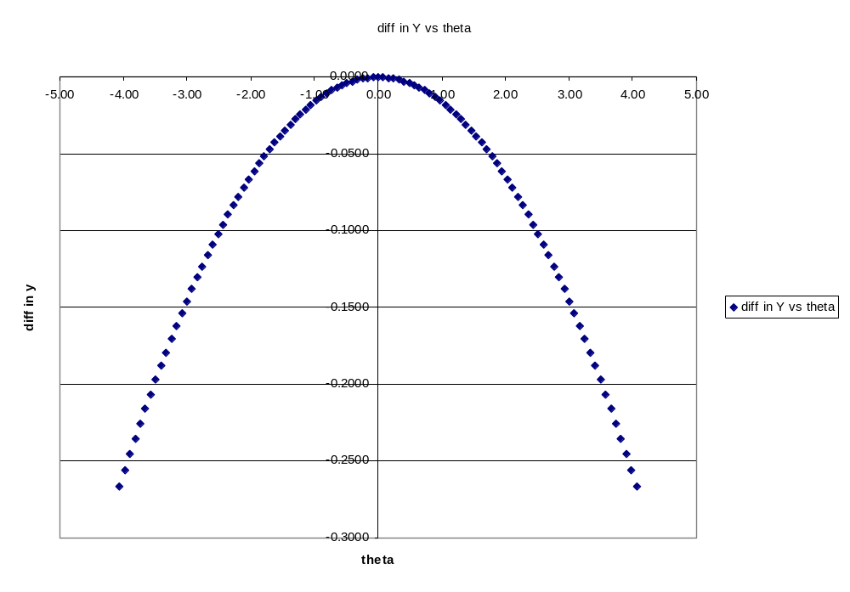
The difference between the center line of the dipole and beam path.

Slide 19
Using a very simple model we can calculate the strength of the end and body fields and the length of the end.
The results are:
b₂( end)= -682 units
b₂(body)= +11.4 units
L(end) = 13.8cm
Sagitta = 234mil
These agree well with the MTF measurements.

Slide 20
What remains?
To calculate the values of kbendq that will give the observed tune shifts.
Problem is the strong correlation between the parameters used in the fitting the tunes and chromaticity of the Tevatron, viz. the skew quads tsq and tsqa0 and the sextupole correctors, tsf and tsd.
Correlate these values of kbendq with the strengths of the sextupole fields in the dipoles.

