Slide 1

GUIDANCE ON
CAPABILITY REFINEMENT PROCESS
John M. Weber
ICF Consulting

Slide 2
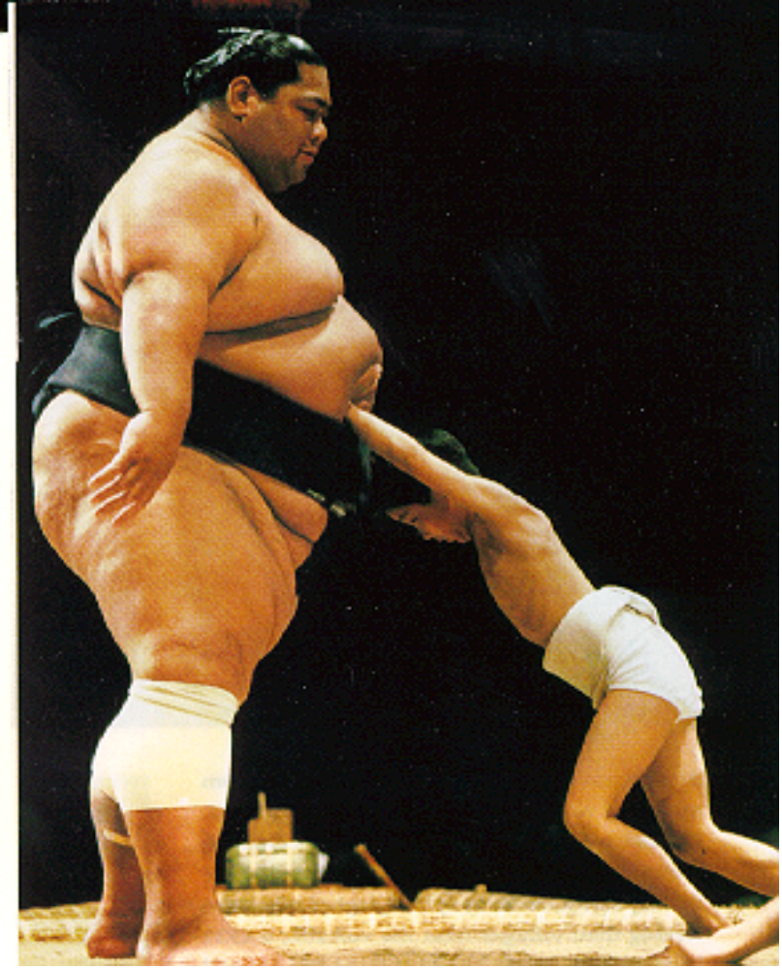
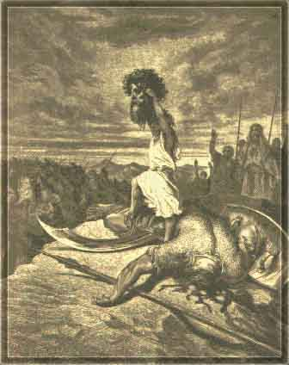
It’s About Attitude…
THE WAY WE DO IT NOW
FINAL SCORE
DAVID: 1
GOLIATH: 0
TARGET CAPABILITY
Notes:
1

Slide 3

Target Capability
“Serving up the Process for Success”
Objectives for the “Soup”:
National Target Levels
Strategies for Large Event
Assign Responsibility

Slide 4

Overview
Refining Target Capabilities
12 Step “Cooking” Process
“Cooking” Timeline
“Cooking” Instructions
36 capabilities = “36 varieties”
“Recipe” for Refining
Target Capabilities

Slide 5
Target Capability:
“Steps in the Process”
Unconstrained
National
Capability
F
E
D
E
R
A
L
12: Assign capabilities to specific levels
11: Consider feasibility & adjust requirements
10: Compare different scenarios
S
TA
T
E
9 : Determine national capability levels
8 : Determine capability requirements
for a single incident
7 : Identify capability elements
& capacity
L
O
C
A
L
6: Define performance measures
5: Review & Refine Critical Tasks
4: Describe desired outcome (s)
PRIVATE
3: Determine demand for capability
NGO
2: Select scenarios to be addressed
1: Describe capability

Slide 6
Unconstrained National Capability
Capability Targets
Unconstrained
National Capability
Target
Federal Gov’t
Target
State Gov’t
Target
Local and Tribal Gov’t
Target
Private Sector and NGOs
Capability

Slide 7


Target Capability
“Process and Timeline”
2005
June
July
August
September
2-3 June Workshop
4-26 Aug National Review “adjusting the recipe”
6 Jun- 20 Jul
Work groups “gather ingredients (data)”
29 Aug -30 Sep DHS
“PUBLISH THE RECIPE”
20 Jul
Work groups “send ingredients (data)”
21-29 Jul
DHS “cook ingredients (analysis)”
1-3 Aug Workshop “tasting the soup”

Slide 8
Setting Capability Targets
Worksheet walk-through – 12 Step “Cooking Process”
Example:
“How many urban search and rescue teams and of what level do we need nationwide?”
  Capability = Search and Rescue
  Sample contains fictional data – used for illustration only.
Turn to page 7: “Guidance on Capability Refinement Process”.

Slide 9
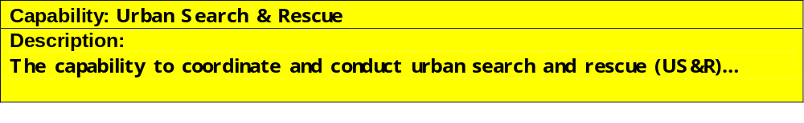
Objective 1: Determine National Target Level for Capability
Step 1: Describe Capability
Capability description needs to be comprehensive and accurate
Review TCL definition of the capability—note any needed changes
List & describe the services (i.e., key activities) that would be performed by this capability
Services Performed by Capability
Source of Information
Team Management – Provides overall mgt & coordination of task force operations
US&R System Operations Manual
Search – utilizes canines and technical/electronic search to locate trapped victims

Slide 10
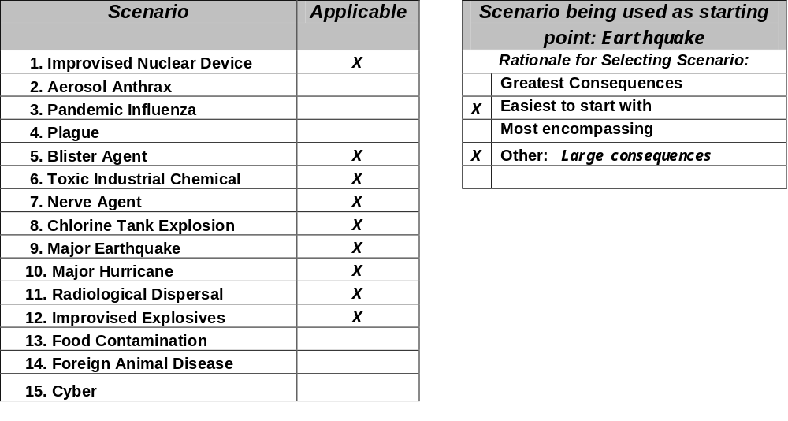

Objective 1: Determine National Target Level for Capability
Step 2: Select scenarios to be addressed
Identify which scenarios are likely to be applicable
Review Scenario Consequences Tables to determine which scenario may be most appropriate as a starting point
Select Earthquake scenario to begin…

Slide 11

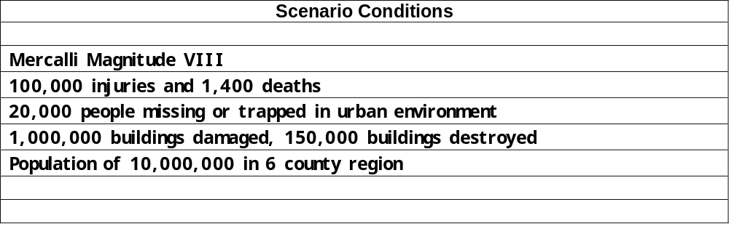
Objective 1: Determine National Target Level for Capability
Step 3: Determine Demand for Capability (A)
List the scenario conditions/elements that are key “drivers” of your capability
Specifically what elements affect when, how much, and what resources you would need to address this scenario

Slide 12
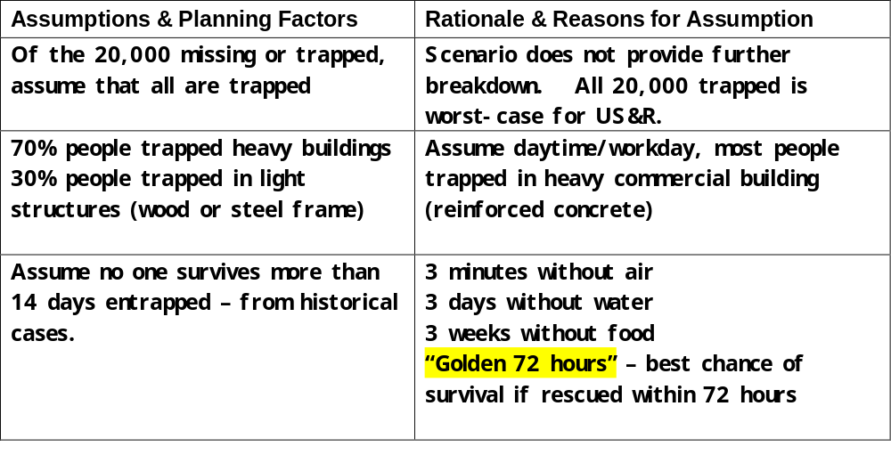
Objective 1: Determine National Target Level for Capability
Step 3: Determine Demand for Capability (B)
It may be necessary to develop assumptions and planning factors to give you enough data to conduct a capability analysis
Where you appear to be missing key data that is relevant to your capability, you can make reasonable assumptions.
List the assumptions made and provide an rationale for each.

Slide 13
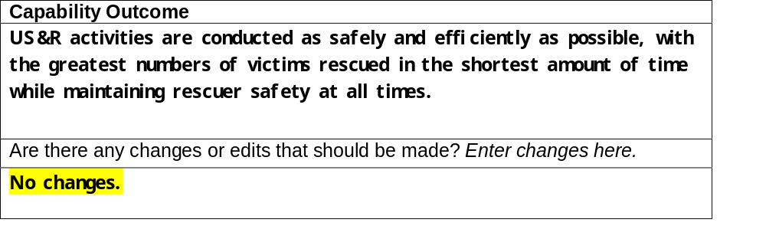
Objective 1: Determine National Target Level for Capability
Step 4: Describe Desired Outcome
Review existing outcome description in the Target Capabilities List.
Indicate any revisions and provide an explanations for the changes made.

Slide 14
Objective 1: Determine National Target Level for Capability
Step 5: Review and Refine Critical Tasks
Review the list of critical tasks from the Target Capabilities List
Add any new tasks that are not found in the TCL that are critical and refine any current tasks that seem too general
You must include the UTL number for each task.
Changes to current TCL Critical Tasks
Critical Tasks | Rationale for adding, deletions, or revising task
Res.B.4.3 Coordinate urban search & rescue response
Res. B.4.4 Conduct urban search and rescue operations
Res. B.4.4.2.2. Deploy urban search & rescue task forces or teams
Res. B4.4.2 Assess situation and needs | From UTL
Existing critical task list was focused at strategic level and did not provide enough detail to set performance measures. Expanded the list encompass the full cycle of tactical US&R activity. Tasks derived from FEMA US&R Operations Manual and UTL.
Critical Task that NEEDS to be added

Slide 15
Objective 1: Determine National Target Level for Capability
Step 6: Define Performance Measures & Objectives
Review list of performance measures provided in the TCL.
Determine whether there are any existing performance objectives within your discipline or industry.
These objectives should quantify the performance measure at a level that will ensure that the capability can achieve the outcome (defined in Step 4).
Most significant performance driver
Performance Measure | Define Performance Objective (i.e. ‘X’ minutes to arrive to the scene of a disaster)
Number of victims rescued/injured/killed safely extricated in the incident | 100% of Victims must be safely extricated within 14 days Source: SME Knowledge
Number of US&R personnel injured/killed during rescue efforts | No US&R personnel injured or killed.
Time to get water supply to trapped victims | Must have water to trapped victims within 72 hours.
Changes to existing TCL
Quantifiable Performance Measure
Performance Measure to be added

Slide 16
Objective 1: Determine National Target Level for Capability
Step 7: Identify Capability Elements and Capacity (A)
Identify the resources needed to accomplish the critical tasks.
These should be presented in the smallest resource organization(s)
Use NIMS typing description if available
Resource Organization | Description | Reference
US&R Task Force | US&R Task Force consists of two 31-person teams, 4 canines, a comprehensive equipment cache. | NIMS
Structure Collapse Team | A non-standardized team usually comprised from local fire departments. Has the capability to extricate people from light structures such as houses and apartment buildings. Team is non-deployable and can work in own or adjacent jurisdiction. | SME Knowledge See Worksheet A for list of resources

Slide 17
Objective 1: Determine National Target Level for Capability
Step 7: Identify Capability Elements and Capacity (B)
Estimate the capability of the previous resource organization to perform the critical tasks.
Use established standards where they exist.
If there are no established standards, estimate the capacity based on reasonable assumptions and critical limiting factors.
Resource Organization | Estimated Capacity (e.g. throughput) | Rationale (How did you arrive at this estimate?)
Type I US&R Team (Heavy Structure) | Extricate 150 victims over 10 days in a single site | Equipped to medically treat 50 victims for 72 hours. Teams are self sustaining for 72 hours; can work 10 days if re-supplied every 72 hours. Teams are depleted after 10 days. Therefore each team can extricate approximately 150 victims in 10 days (within 14 day target). Victims can survive without water for 72 hours, assume we can provide water to trapped victims no later than 72 hours
Structure Collapse Team | Extricate 1 household of 4 victims per day or 40 people in 10 days. | Team works 12 hour day (8 hour rescue, 2 hours transit each way). Can work own or adjacent jurisdiction w/o resupply. Assume teams work 10 days and can be re-supplied through US&R re-supply system, therefore each team can extricate 40 victims in 10 days.
No capacity standard exists for victim extraction. Capacity estimated from medical supplies and deployment cycle.

Slide 18
Objective 1: Determine National Target Level for Capability
Step 8: Determine Capability Requirement for a Single Incident
Consider the “drivers” and most limiting factor in determining your overall capacity to determine the quantity of resources needed.
Calculate quantity needed
Resource Organization | Estimated Capacity | Scenario Requirement Values | Quantity of Resources Needed (Note: to completely mitigate scenario volume)
Type I US&R Team (Heavy) | 150 victims over 10 days in a single site | Total victims trapped 20,000. 14,000 trapped in heavy structures | 93 teams (14,000 victims/150 victims per team = 93 teams)
Structure Collapse Teams (light structures) | Extricate 1 household of 4 victims per day | Total victims trapped 20,000. 6,000 trapped in light structures | 150 teams (6,000/40=150) Within 2 hours driving time of major metro area

Slide 19
Objective 1: Determine National Target Level for Capability
Step 9: Determine National Capability Requirements (A)
Determine your approach for deciding where resources will need to be accessible and outline them.
It is important to remember:
  Where are your resources most needed for the base “worst-case scenario”?
  Take into consideration time-distance requirements
Approach Considerations
Account for time-distance requirements
Type I US&R Teams –
- Can be airlifted or trucked to the site
- Centralized assets geographically dispersed in UASI cities such that they can be delivered to the earthquake site within 24 hours by road or air
- US&R teams will handle the heavy building collapse, subways and tunnels first...

Slide 20
Objective 1: Determine National Target Level for Capability
Step 9: Determine National Capability Requirements (B)
Using your approach, determine the following for each resource:
  Who takes ownership
  Geographic location
  Quantity of the Resource
Resource | Geographic Distribution | Quantity | Rationale
US&R Team | in or near the 93 largest metropolitan areas | 93 | Teams equipped and trained to handle heavy structures found mainly in metropolitan areas. They can be transported between areas. They need to be located where there is a large enough resource base to keep them staffed, trained, and practiced.
Structure Collapse Team | Distributed in regional areas surrounding major metropolitan areas in earthquake zones; 1.5 teams per 100K population. | 1153 | Must be located close to the damaged areas and capable of providing mutual aid to each other. 64 MSA’s > 100K population in 16 states in earthquake zones Calculated 1.5 teams per 100K population to arrive at 1153 teams
Who
How Much
Where

Slide 21
Objective 1: Determine National Target Level for Capability
Step 10: Compare Different Scenarios
Repeat Steps 2 – 9 for the remaining scenarios.
Update the original worksheet or complete new worksheets as necessary.
Determine the following:
  New tasks or conditions require different resources.
  Scenario conditions affect the total quantity or resources required.
  Scenario conditions affect the distribution of resources required.
Scenario | Resource Organization | Changes
Toxic Industrial Chemical | Type I US&R Team (Heavy) | Added equipment for respirators; no change to quantity or distribution of teams as this is a lesser magnitude scenario.
Improvised Explosive Device | Structure collapse team | Increased requirement to at least one team per county nationwide, since event could happen anywhere. 1.5/100k Ratio continues for earthquake risk areas. There are 3,142 counties in the U.S. This increases the total number of teams to approximately 4,231 i.e, [3,142 county teams + (1153 earthquake teams – 64 MSAs which are also counties)].

Slide 22
Objective 2: Develop Strategies
Step 11: Consider Feasibility & Adjust National Requirements
Review your results thus far.
Determine if you can use innovative strategies to accomplish the same goals more efficiently:
  Volunteers, technology, just-in-time training...
Determine if you need to modify performance objectives...
  Changing performance measures/objectives/standards
  Establishing different thresholds with different strategies for response
Innovation: Use of industry teams
Scenario | Resource Organization | Changes | Rationale (revised strategy)
Earthquake | Type I US&R Team (Heavy) | Decrease requirements by 3 US&R teams to 90 teams total. | Will augment US&R teams with 30 mine rescue teams from industry.
Earthquake | Industry mine rescue team | Added 30 6-person mine rescue teams | See above.

Slide 23
Objective 3: Assign Responsibilities
Step 12: Assign Capabilities to Specific Levels
Make a final determination as to who owns it, where it’s located, and how many of each resource you need.
Consider any defining characteristics that may indicate differences in distribution among local jurisdictions.
Resource | Assigned level | Geographic Distribution | Quantity | Rationale (distinguishing characteristic)
US&R Team | Federal | in or near the 90 largest metropolitan areas | 90 | They need to be located where there is a large enough resource base to keep them staffed, trained, and practiced – metro areas.
Structure Collapse Team | Local | Minimum of 1 team per county; teams increased in in major metropolitan regional areas surrounding major earthquake zones to 1.5 teams per 100K population. | 4231 | They are non-deployable, so they must be located close to the damaged areas and capable of providing mutual aid to each other. See calculation in Step 10.
Final Inputs based on identified demand and adjusted feasibility and your strategy

Slide 24
Target Capabilities
Key points to remember:
Process acts as a “funnel”
Work iteratively – go back and forth among steps as needed
“Adjust the recipe”
This is a first estimate

Slide 25
Project Completion
Submit Results
Please submit your completed worksheets as follows—
When: July 20, 2005
Where: UTL@DHS.GOV
How: E-mail or fax to 202-786-9930
If you have any questions:
Contact your Group Liaison, or
Marcus Pollock, ODP Tel: 202-786-9523
  Email: marcus.pollock@dhs.gov
For Electronic Secure Portal-- Help Desk 804-744-8800

Slide 26
Unconstrained National Capability
Capability Targets
Unconstrained
National Capability
Target
Federal
Gov’t
Target
State Gov’t
Target
Local Gov’t
Gaps
Target
Non-Gov’t Organizations
Target
Private Sector
Capability

