Slide 1

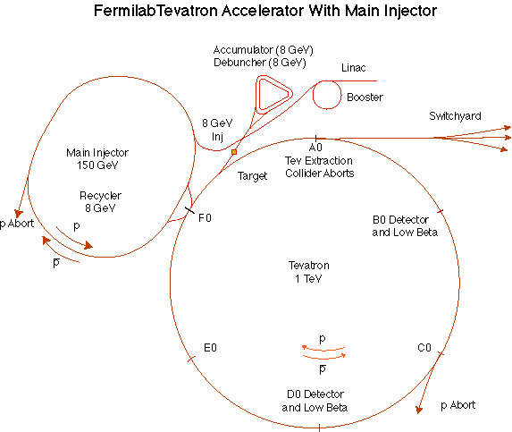
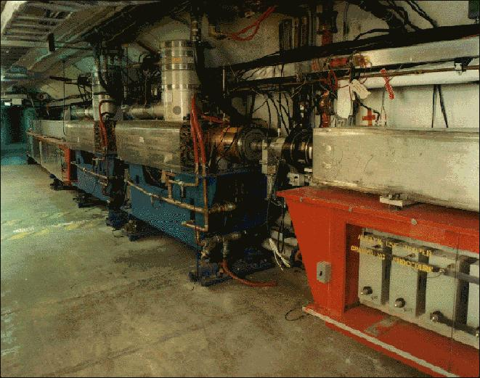
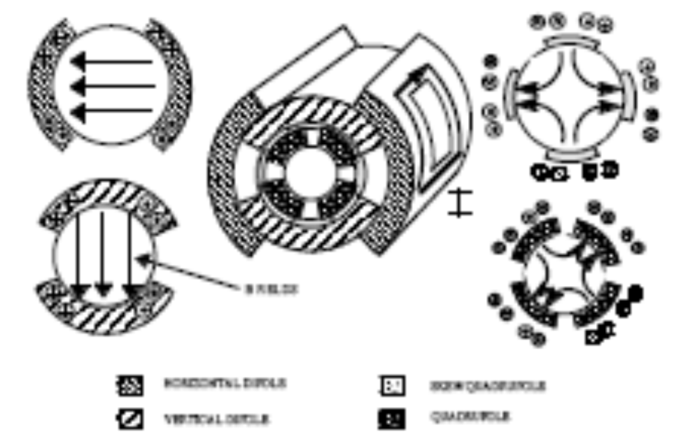
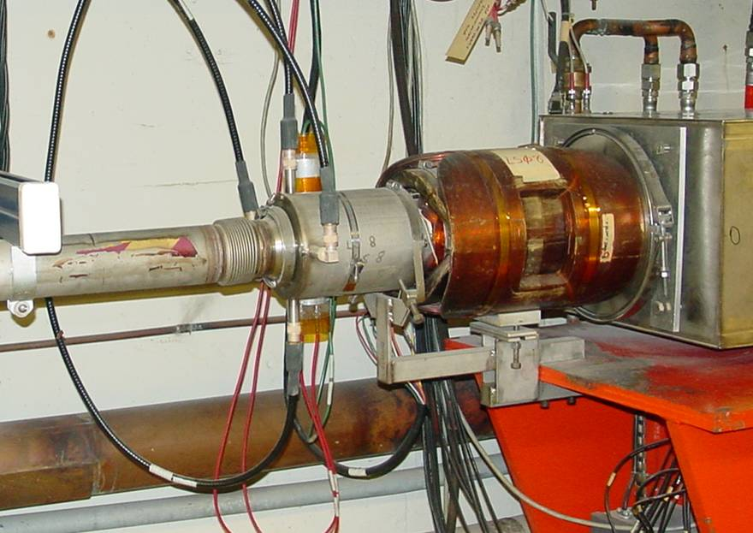
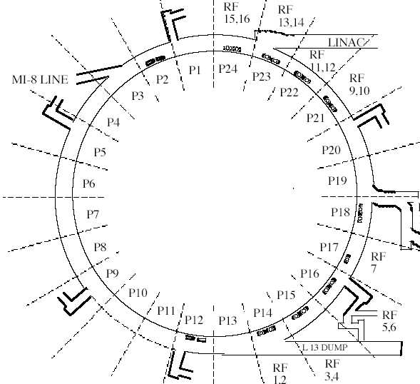
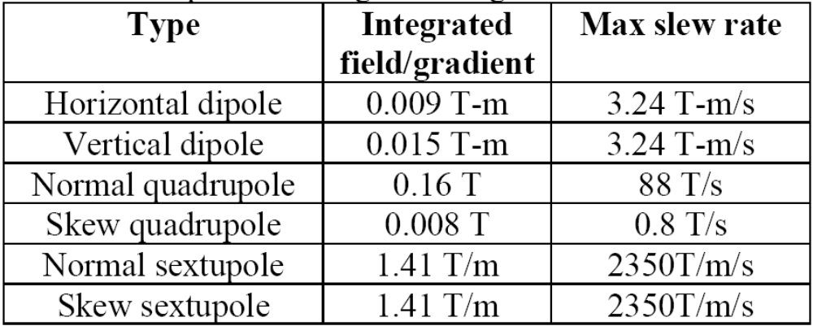
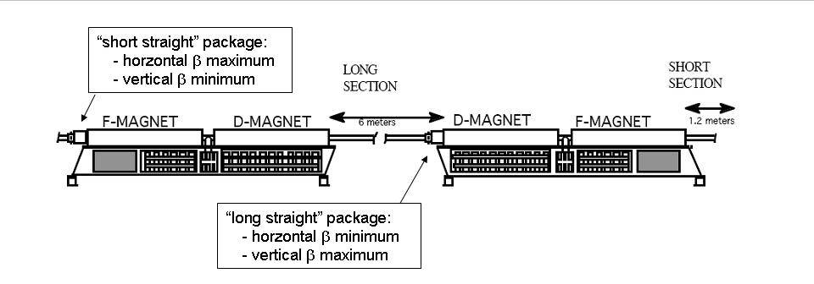
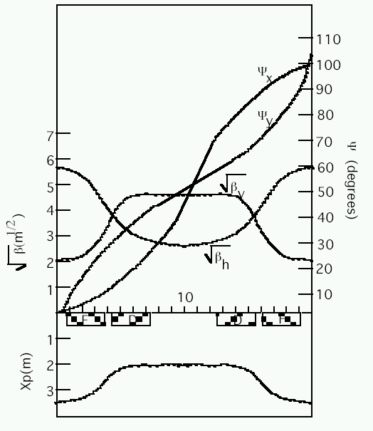
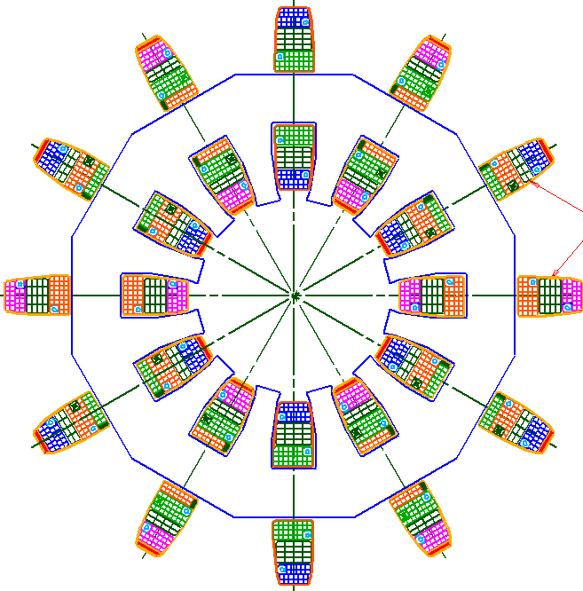
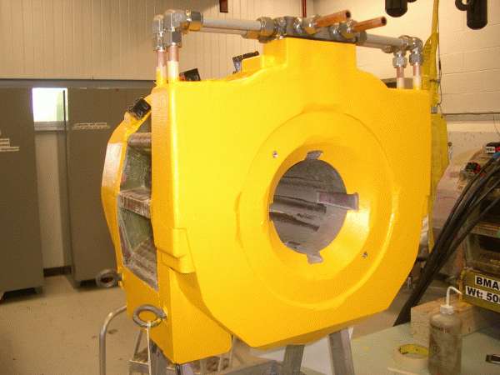
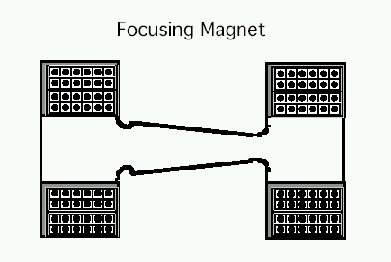
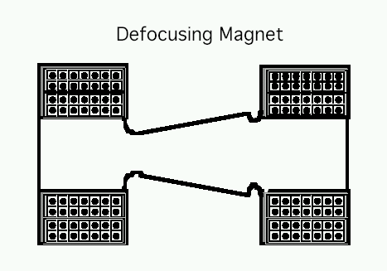
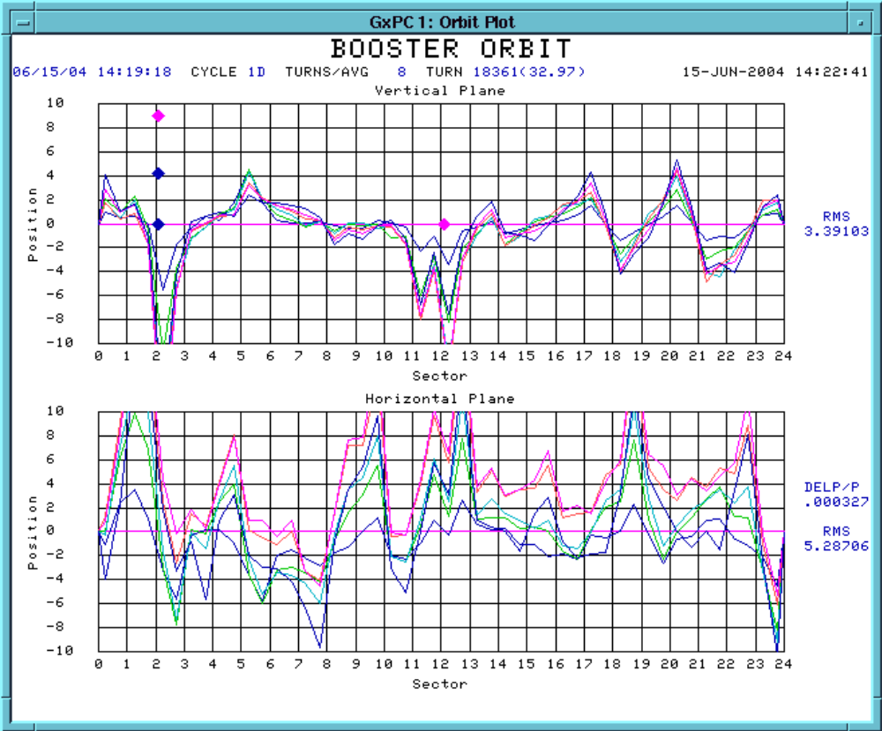
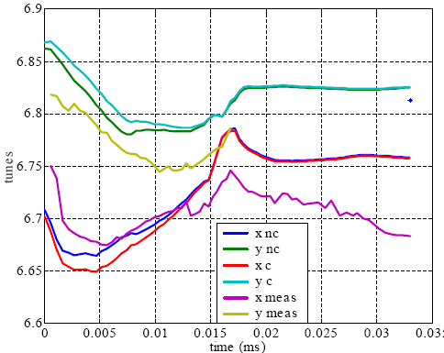
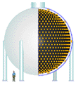
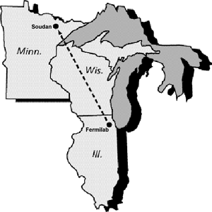
New Corrector System for the Fermilab Booster
E.J. Prebys, C.C. Drennan, D.J. Harding, V. Kashikhin, J.R. Lackey, A. Makarov, W.A. Pellico
Fermilab, Batavia, IL 60510
ABSTRACT
We present an ambitious ongoing project to build and install a new corrector system in the Fermilab 8 GeV Booster. The system consists of 48 corrector packages, each containing horizontal and vertical dipoles, normal and skew quadrupoles, and normal and skew sextupoles. Space limitations in the machine have motivated a unique design, which utilizes custom wound coils around a 12 pole laminated core. Each of the 288 discrete multipole elements in the system will have a dedicated power supply, the output current of which is controlled by an individual programmable ramp. This poster describes the physics considerations which drove the design, as well as issues in the control of the system.
The Fermilab Booster
Existing Corrector System
New Corrector System
Corrector Packages (x48):
Motivations:
  Dipoles
    Must produce ± 1cm of beam motion at all momenta
    Sufficient slew rate to correct for observed beam motion
  Quadrupoles
    Maintain tunes arbitrarily close to upper integer resonance throughout cycle to mitigate space charge tune shift
    Capable of slewing anywhere from half integer to integer resonance in 1 ms at transition
  Sextupoles
    Same integrated strength as existing system.
    Capable of slewing between extrema in 1 ms at transition
The Booster takes the 400 MeV Linac beam and accelerates it to 8 GeV.
Runs at an instantaneous 15 Hz repetition rate
From the Booster, beam can be directed to the Fermilab Main Injector or directly to an 8 GeV beam line currently servicing the MiniBooNE Experiment
Corrector Package
400 Mev Beam from Linac
Dipoles
  Ramped in high-beta periods
  DC control in low-beta periods
BPM
8GeV Beam to Main Injector and MiniBooNE
Quadrupoles:
  Ramped in groups: long normal, long skew, short normal, short skew
  Individual DC correction for harmonic control
Magnetic specifications
472m in circumference
24-fold periodic lattice
Each period contains
4 combined function magnets.
Magnets cycle in a 15 Hz offset resonant circuit.
Sextupole System
  Horizontal chromaticity controlled by sextupoles at all odd short straights
  Vertical chromaticity controlled by sextupoles at long straights in 4, 10, and 18
  Third order corrections controlled by skew and normal sextupoles at long straights in periods 4,5,6,7
LATTICE
Horizontal chromaticity
Vertical chromaticity
3rd order resonance correction
Increasing Proton Demand
Shortcomings of Existing System
Unique design
- laminated core
- 12 poles
- wound for 6 discrete multipoles
Fabrications details
- water cooled
- all coils potted in place
- alignment keyways for BPM
ANTIPROTON PRODUCTION
8E12 protons sent to the Main Injector every 2.2 seconds, to be accelerated to 120 GeV and delivered to the antiproton production trarget
~1E16 protons per hour
Small compared to…
Orbit motion:
Tune variation:
NEUTRINO PROGRAM
Features of New System:
  Increased strength of dipole and quadrupole elements
  Normal and skew sextupoles at all 48 sub-periods
  Individual, ramped current control of all 6x48=228 elements
  Emulation of existing hardware
  Dramatically improved alignment
MiniBooNE-neutrinos from 8 GeV Booster proton beam (L/E~1):
absolutely confirm or refute the LSND result: Running since fall 2002. To date has taken >8E20 protons: more protons than all other experiments in the 35 year history of the lab combined!
NuMI/Minos – neutrinos from 120 GeV Main Injector proton beam (L/E~100):
precision measurement of ν_{μ} ↔ ν_{τ} oscillations as seen in atmospheric neutrinos. Began running in March, 2005. Will ultimately use numbers of protons similar to MiniBooNE
Fabrication and installation:
  First 24 magnets being fabricated now
  These will be installed in the long straight (vertical high-beta) regions in August and September, 2007
  Remaining correctors will be fabricated and installed in 2008
Nova – Same beam line as Minos, but detector built off axis. Would like 2-4 times the protons of Minos.
Orbits shown relative to injection at 5 ms intervals
Predicted and measured tunes
Total proton output limited by beam loss (radiation in Booster) -> Must improve efficiency!

Slide 2
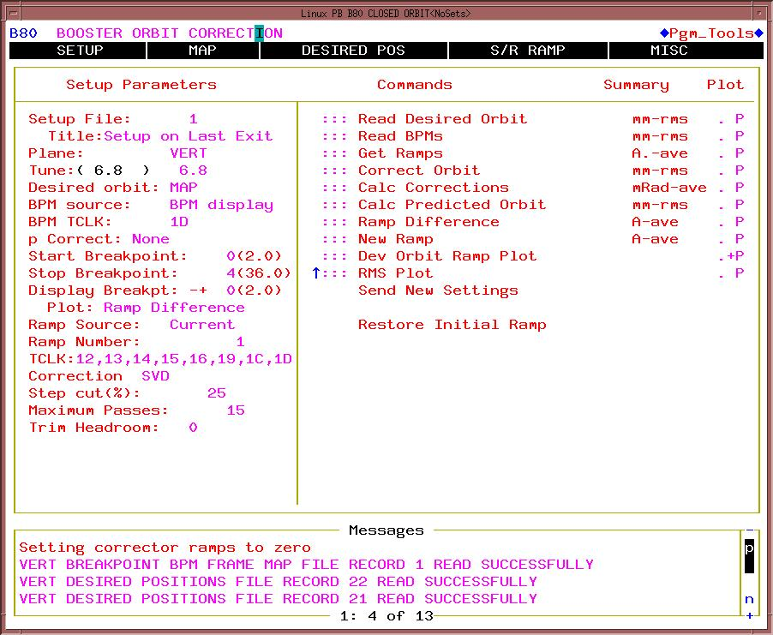
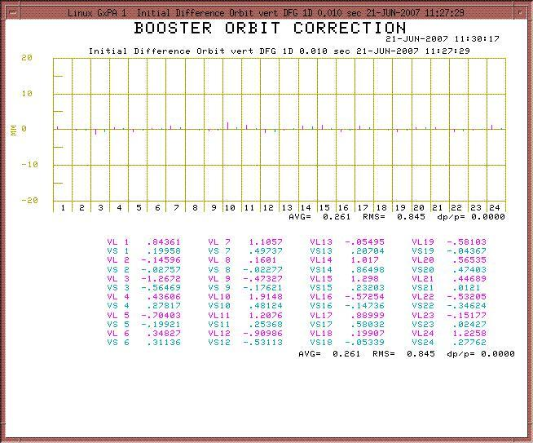
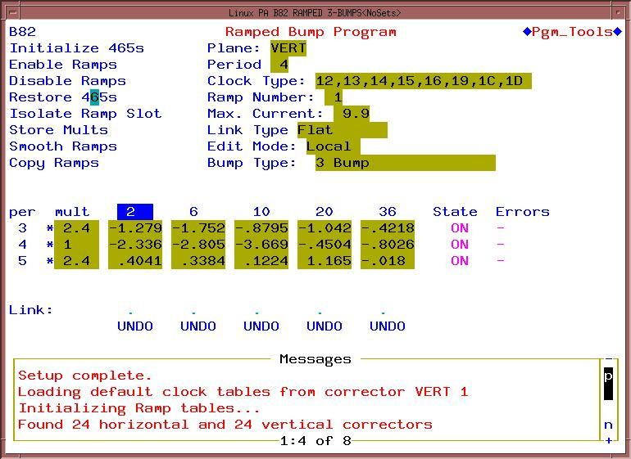
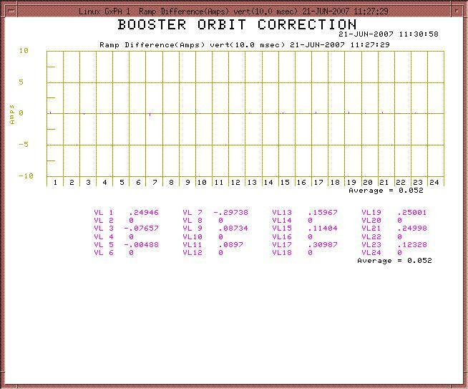
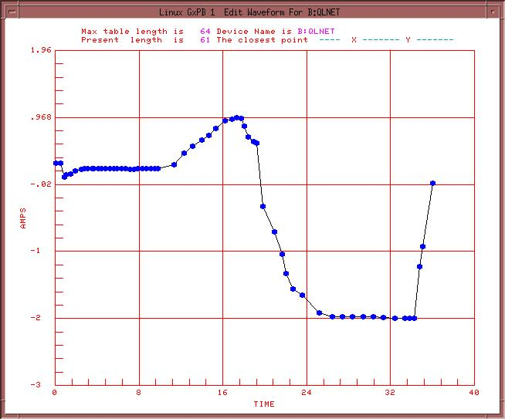
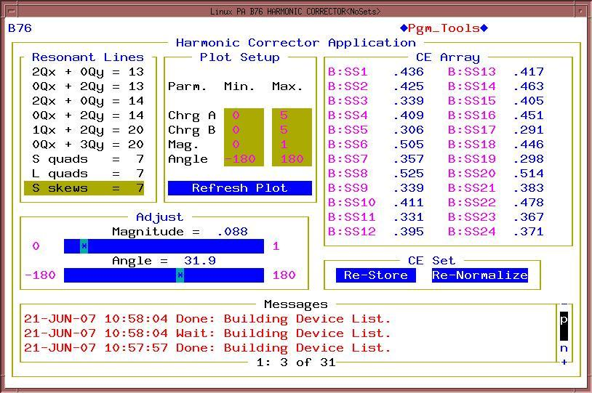
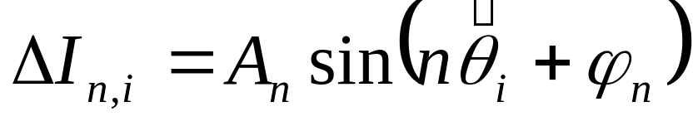
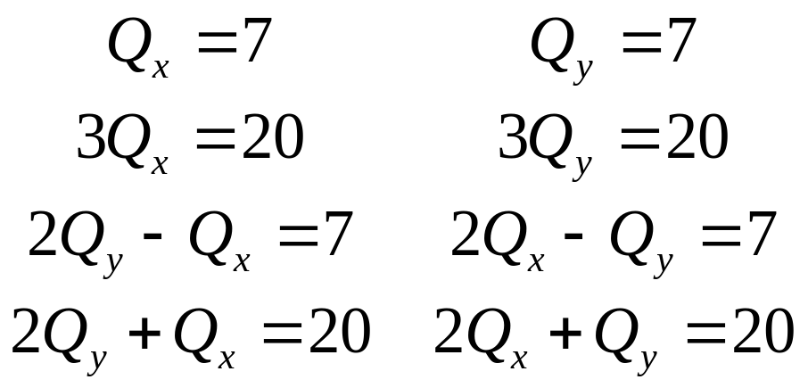
Control of Corrector System
Time Dependent Dipole Control
Closed Orbit Correction
Orbit deviations:
Initial System (identical to present)
Magnet current ratios
Orbit correction sequence
Corrections to magnet currents:
Time Breaks
Closed orbit control:
  Finds optimum magnet currents to reproduce desired orbit
    Can select from a variety of algorithms
  Commissioning with existing corrector system
    Insufficient strength to control position throughout cycle
  Being modified to accommodate new correctors
Time dependent dipole control:
  Used for existing system
    Dipoles only have time-dependent current ramps at high beta regions
      Verticals at long straights, horizontals at short straights
  Straightforward to modify for new correctors
    Will now have control of all dipoles
Plans
Tune Control
Harmonic Correction
  Initial operation will focus on establishing acceptable performance for the ongoing laboratory physics program as quickly as possible
    Will run new system in a mode which will emulate existing system, even if this means limiting some of the capability of the new system.
  The new corrector system will allow a great deal more versatility in the control of the accelerator
    Individual ramped control of every channel
    Among other things, this will allow for time dependent harmonic corrections.
  Fully exploiting the capabilities of the new system will represent challenges to both accelerator physics and application development for some time.
Dominant Resonances
These will improve with new sextupole system
Arbitrary harmonic corrections
Related Posters
  “Design and Fabrication of a Multi-element Corrector Magnet for the Fermilab Booster”
    D. Harding, et al
    MOPAS006, Monday June 25, 2-4PM, Southwest Hall
    Describes details of the magnet design and fabrication
  “Using a Slowly Rotating Coil System for AC Field Measurements of Fermilab Booster Correctors”
    G. Velev, et al
    MOPAS021, Monday June 25, 2-4PM, Southwest Hall
    Describes the system used to qualify the magnet design and test the production units.
  “System Overview for the Multi-Element Corrector Magnets and Controls for the Fermilab Booster”
    C.C. Drennan, et al
    MOPAS005, Monday June 25, 2-4PM, Southwest Hall
    Details of the hardware implementation of the corrector system
Corrections calculated according to the algorithm:
  Correctors grouped by type
    Long normal, long skew, short normal, short skew
  Ramps superimposed on harmonic (DC) terms
  New system will be strong enough to allow tune control feedback
    In development
New sextupole system can correct for all potential third order resonances
Correct with normal sextuples
Correct with skew sextuples
Corrected with existing system
Work supported under DOE contract DE-AC02-76CH03000

