Slide 1
Upcoming Dates Accumulator Ring:
DOE Review October 2003
Extraction magnets being assembled
Injection DC Magnets and Kickers Complete
Design complete July 2003
More ½ cells delivered.
First doublet cell assembled
RF Cavities delivered
First quarter cell assembled
HEBT and RTBT Collimators Delivered
Ring 1 and 2 Collimator Chambers Coated

Slide 2
Hot Topics
South Crane capacity is 15 tons – half-cells are 16 to 18.5 tons (w/lifting fixture).
Corrector magnet naming convention – fix jumper.
Crane Chain Box interference – drawing to ORNL.
Lifting fixture for ring ½ cell assembly – single point and double point lifting.
Production magnetic measurement of 41CDM30.
First Article Measurement of 26S26 and then 30Q44.
Return #4 Chicane Magnet – Yes.
Price for ring primary collimator and RTBT top plate.
Installation drawings.
ORNL remote clamp design.

Slide 3
Collimators
Friday 11:00 Weekly Meeting in the EAG Conference Room
Procurement STATUS – Visit with SDMS
HEBT Collimator Beam Line Stand and Shield – Redesigned for required clearance.
HEBT collimator to ship June 20, 2003.
RTBT #1 to ship August 29, 2003.
HEBT Strippers.
HEBT Momentum Collimator Checking – complete?
Ring Primary Collimator Detailed Drawings.
Ring Moveable Scraper – Shielding Layout Complete
Remaining Work:
Ring Primary Collimator Order, Momentum Collimator and shielding order, Primary/Moveable Collimator Stand and Shielding, Assemble and drive moveable scrapers, Assemble and drive HEBT Strippers, Ring 1 and 2 shielding,
RTBT #2 Lifting Frame, RTBT 1 and 2 shielding

Slide 4
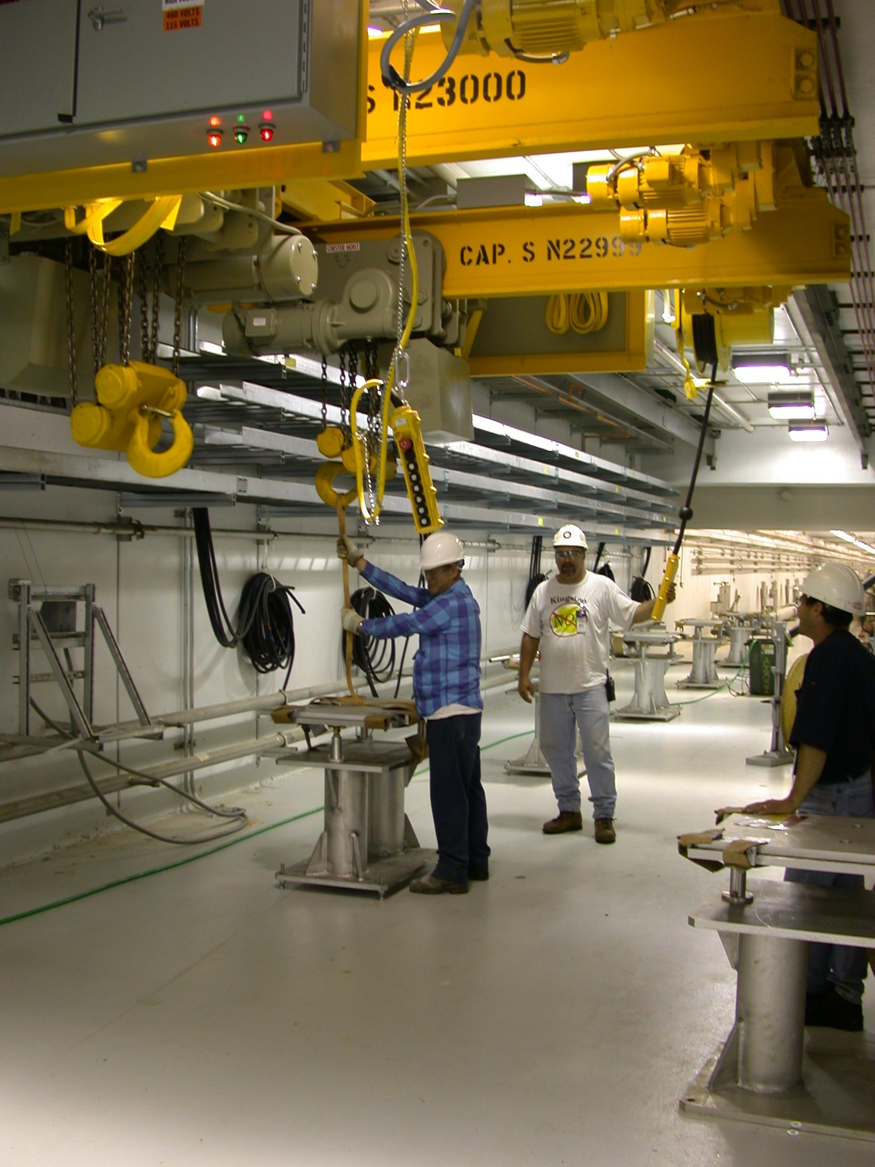
HEBT Magnets
HEBT Dipole, 12Q45 Quadrupole, & 16CD20 Corrector – Check naming.
HEBT/RTBT 27CD30 Corrector
NETC – First Article Approved.
Parameter Sheet updated? Check naming.
HEBT/RTBT 21Q40 Quadrupole
Phase II Magnets received.
Second shipment dispatched end of June?
Third shipment dispatched end of July?
Final shipment dispatched end of August?
Stands to ORNL?

Slide 5
Ring Magnets
902 ½ Cell Assembly Area
# 9 Shipped!
Production schedule for 10, 11, 12
Lifting fixture for ORNL ring crane.
17D120 - complete
21Q40 Quadrupole – 29/29 in house (shim measurement priority 3)
Shimming Status.
26Q Quadrupole Requisition (production measurement priority 2)
Delivery complete 6/1/03!!

Slide 6
Ring Magnets
30Q Quadrupole Requisition (1st article measurement Priority 2)
Shipment #1 in house 5/30/03.
Shipment #2 on the truck (5/15/03)
Shipment #3 (ship 6/5/03)
21S26 High Field Sextupole
In production
26S26 High Field Sextupole (1st article measurement Priority 1)
1st article 5/15/03 – Measurement Status?
27CDM30 Corrector All Magnets in house
Production Measurement complete
Fix jumpers are ORNL magnets.

Slide 7
Ring Magnets
21CO26 Corrector – 8 at ORNL
21CS26 Corrector – ALL 9 in house
Production Measurement complete.
41CDM26 Corrector (production measurements priority 1)
Measure production magnets.
36CDM26 Corrector
Released for production
Update Parameter Sheet – Check naming.

Slide 8
Special Injection Magnets
Injection Vacuum Chambers
In the shops – delivery date?
Injection Septum Magnet - magnet measurements in 902. (1st article measurement priority 4)
SDMS vacuum chamber by July 30, 2003?
Injection Dump Septum Magnet and Chicane Magnets #2, #3 (1st article measurement priority 2, 3)
Injection Magnet #1 Alpha Magnetics Order
Thin Foil Mechanism – D. Gasner motor control design.
Spare Unit Parts shops RFQ underway
Thick (Injection Dump) foil status
Injection Magnet #4 – Z Bumps III results OK?
Return to NETC
Magnet Stands – In fabrication
Injection Kicker Magnets
Production Assembly #2 long pair complete, #1 short magnet pair complete.
Shipping container magnet.
Ceramic Chamber Coating Underway/Order Status

Slide 9
Magnet Measurement Schedule
First Articles
26S26
30Q44
30Q58 check final configuration
Chicane #2 and #3 separate
Injection septum
Chicane #4 ??
Production Measurements
41CDM30
26Q40
21Q40 – shimmed? For Hunter? STL meeting
21S26
30Q58
30Q44

Slide 10
Special Extraction And RTBT Magnets
Extraction Kicker Magnets
Design Status – #1 drawing revisions, #2 Drawings in checking.
Ferrite Order
Shops RFQ
Lambertson Magnet
Design Status – design meeting on Monday
ORNL Design Review Comments
Rad resistance coil estimate and issues e-mail.
36Q85
Fourth production coil winding complete - #5 underway
The rest of the coil material being received.

