Slide 1
IR optics compensation
US LHC Accelerator Research Program
brookhaven - fermilab - berkeley
Fulvia Pilat
LARP Collaboration Meeting
Danfords, September 16-18, 2003

Slide 2
outline
IR optics compensation (introduction, motivation)
Optics measurements
Local IR correction
RHIC and LHC IR correction systems
Linear compensation (data RHIC Run 2000 and 2001)
Non-linear correction methods
IR bumps method →results RHIC run 2001
IR bumps application → results RHIC run 2003
Beta* knobs
Non-linear chromaticity
Dynamic aperture
LARP areas of activity: commissioning, IR upgrade

Slide 3
IR Correction systems
Motivation:
local correction of linear errors (coupling, gradient)
Local correction of nonlinear errors ( IR magnets field errors)
Beta squeeze, crossing angle
Beam control, luminosity
Design:
Multi-layer corrector packages installed next to IR triplet
quadrupoles
Typically, dipole → dodecapole
Independently powered
RHIC → LHC → (VLHC)

Slide 4
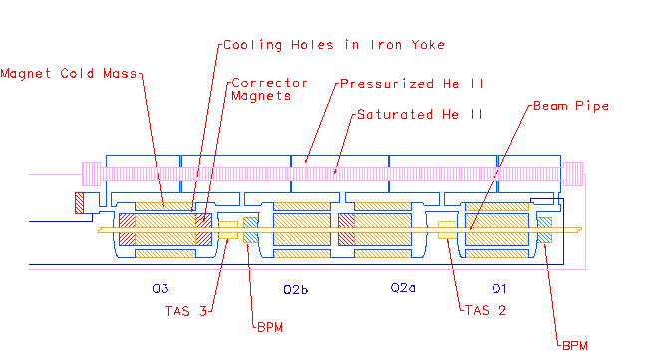
LHC inner triplet - correctors
MCBX: b1 a1
MCBX: b1 a1
MQSXA: a2 a3 a4 b4
→ a2 + a3 a4 b4
MCBXA: a1 b1 b3 b6
Optimization process:
Magnet design – correction system
To
IP
→
a3
a4
b4
M
a2
M
M
C
B
C
C
B
B
MQXA
P
MQXB
B
MQXB
B
MQXA
P
X
M
X
X
M
A
LMQXB
LMQXC
LMQXA
LQXB
LQXC
LQXA
“Q3”
“Q2”
“Q1”

Slide 5
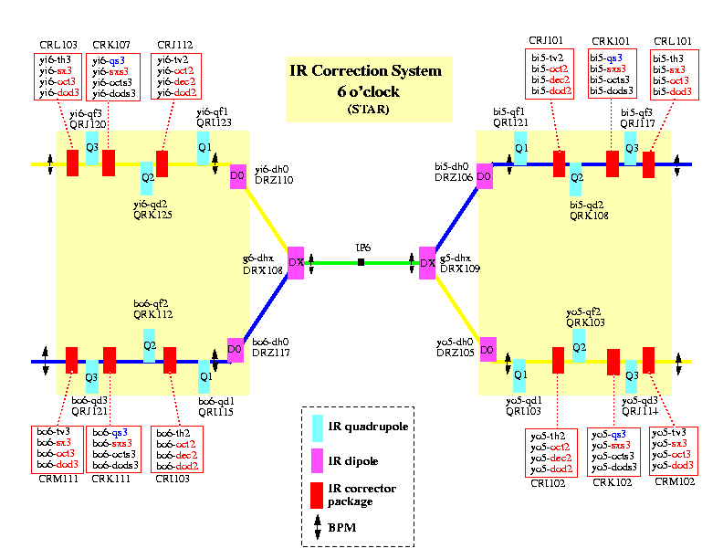
RHIC IR’s - layout
6 o’clock IR
8 o’clock IR:
Dipole correctors
Skew quadrupoles
Nonlinear
Other IR’s:
dipole correctors
Skew quadrupoles
(nonlinear layers
exist but no PS
yet)

Slide 6
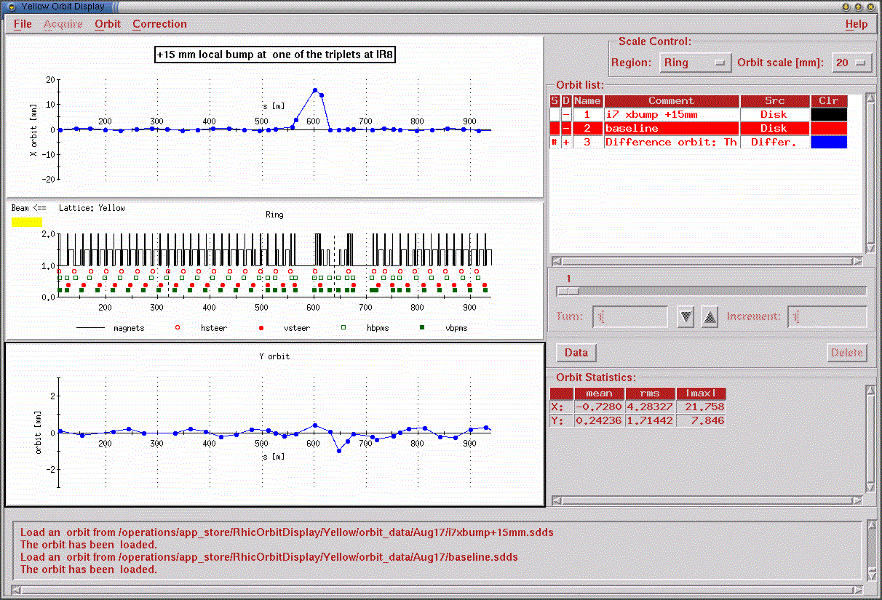
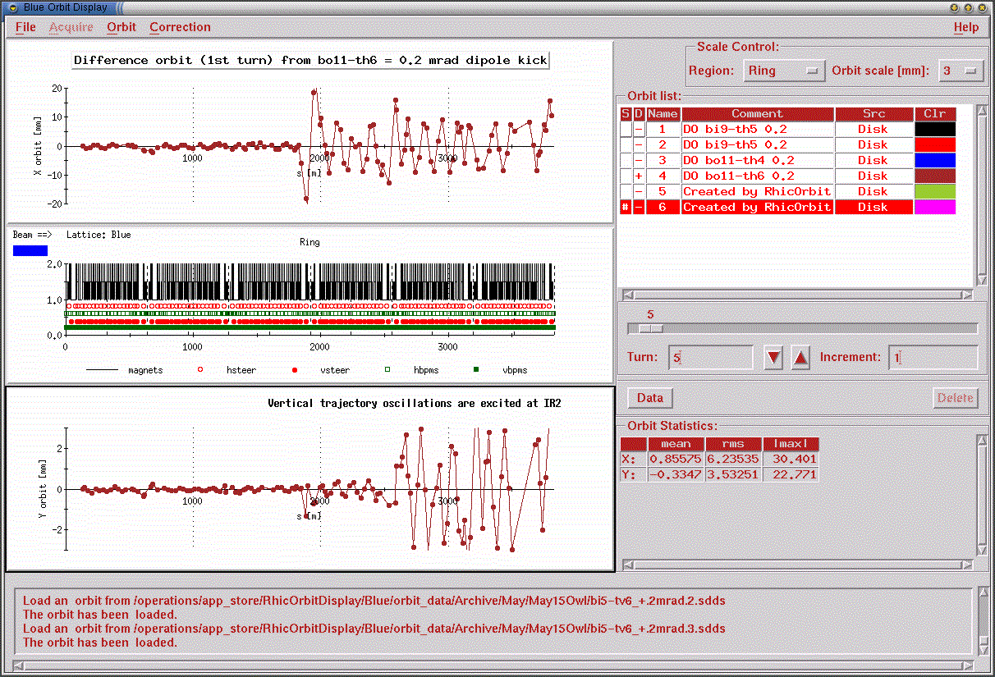
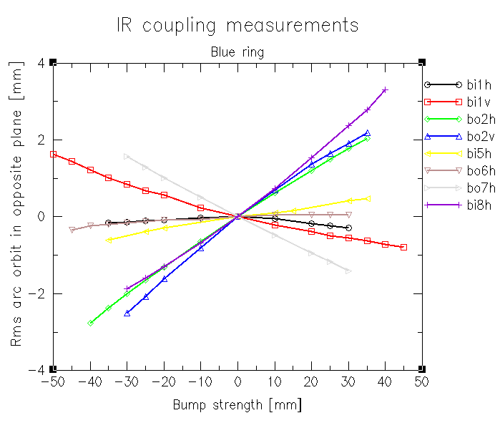
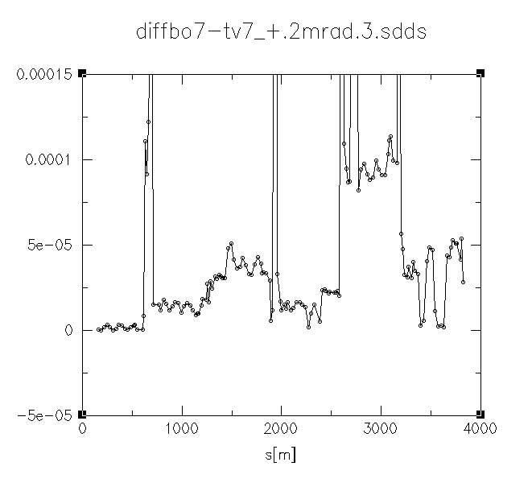
Run 2000 – IR correction linear
Determine local IR skew quadrupole correction strenghts (Cardona, Ptitsyn, Pilat)
IR bump method
Action-jump method

Slide 7
IR Correction - linear
From Run 2000 IR bump data and action jump data, we had predictions
for the 12 IR skew quad correctors in each ring
The results from the 2 methods agree (5-10%)
The predicted values from the 2000 data analysis agree with the
corrector settings found operationally in 2001
The residual coupling in the machine (not arising from the IR triplets)
is corrected with skew quadrupole families by correcting the coupling
resonance (minimum tune separation)
Configuration 2001 (blue ring) | ΔQ(min)
Uncorrected | 0.009
Local correction IR8, IR10,IR2 | 0.019
Local correction in all IR’s | 0.008
Local correction + global correction | 0.0005 (tune meter resolution)

Slide 8
IR nonlinear correction methods
Dead reckoning: action-kick minimization (Wei)
order-by-order prescription, assumes field errors known
(off-line code – “IR filter”- to set corrector strengths)
driving terms compensation (Farthouk)
needs 2 knobs for each multipole to cancel selected DT for both beams:
a2 (1,1) a2(1,-1) b3 (1,2) a3(0,3) b4(4,0) b4(0,4) a4(1,3) a4(3,1) b6(6,0) b6(0,6)
operational: beam based + off-line analysis
IR bumps: measure and fit observables vs. bump amplitude:
(Koutchouk) rms orbit (BPM’s, linear, sextupole)
(Ptitsyn, Pilat) tunes (Tune Meter, up to dodecapole)
(tune spread) (Schottky, octupole, dodecapole?)
frequency analysis: “better FFT” detect and correct nonlinear
(Schmidt, Tomas) resonance driving terms
SUSSIX

Slide 9
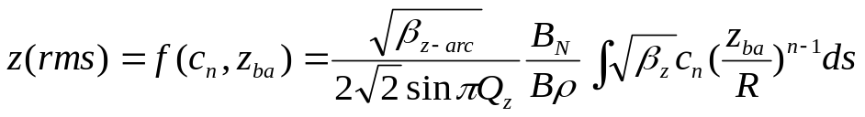
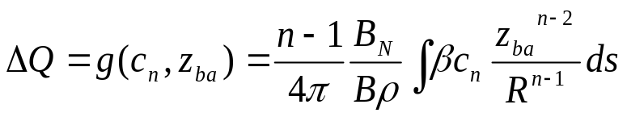
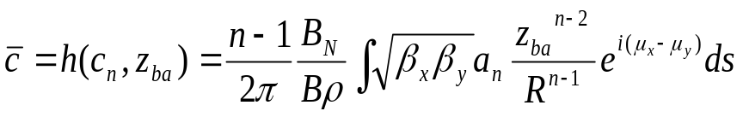
IR bumps method - principle
Closed local orbit bump (triplet)
Observable as function of bump amplitude:
rms orbit outside the bump
z=(x,y) c_{n}=(a_{n},b_{n}) z_{ba}=bump amplitude
The orbit perturbation depends on the plane of the bump (H,V)
And the parity of the multipole order
tune shift
Arises from normal gradients (ΔQ) or repelling effect of linear coupling (measured by c)
Selection of one or the other effect depends on the plane of the bump, whether the multipole
is skew or normal and on the parity of the multipole order

Slide 10
IR bumps: simulation, performance
Use MAD to compute orbit and tune response to H and V orbit bumps in the
LHC IP5, assuming:
0.1% gradient error (Δβ/β~20%), 1 mrad roll (c~0.04)
Multipoles set to 10 units in Q2B.
Orbit response:
(assuming 20 data points)
Tune response:
Assuming 20 measurements and tune resolution of 2 10⁻⁴
→ resolve multipoles up to b6 (dodecapole)
DC offset of BPM can be eliminated by subtracting 2 orbits
Accuracy can be improved by increasing the number of measurements
Perturbation | BPM resolution
roll 0.1 mrad | 15 μm rms
b3 = 7.6 10⁻⁴ | 8 μm rms
b4 = 7.2 10⁻⁴ | 3.5 μm rms

Slide 11
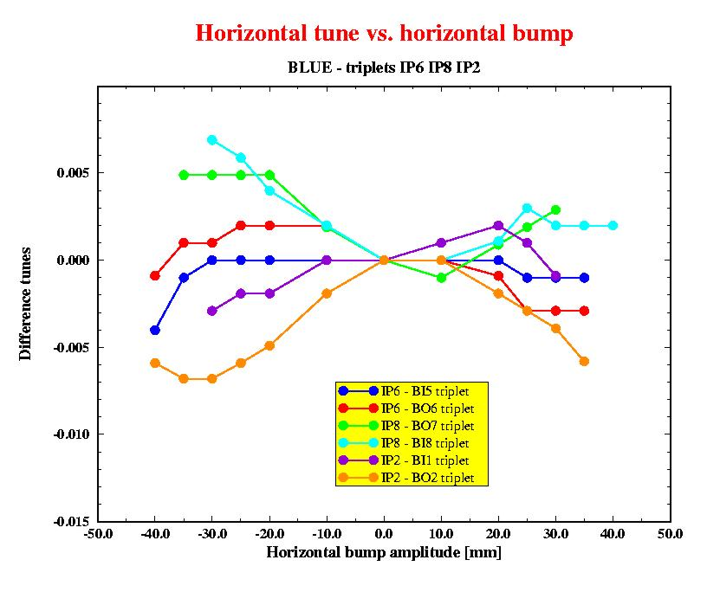
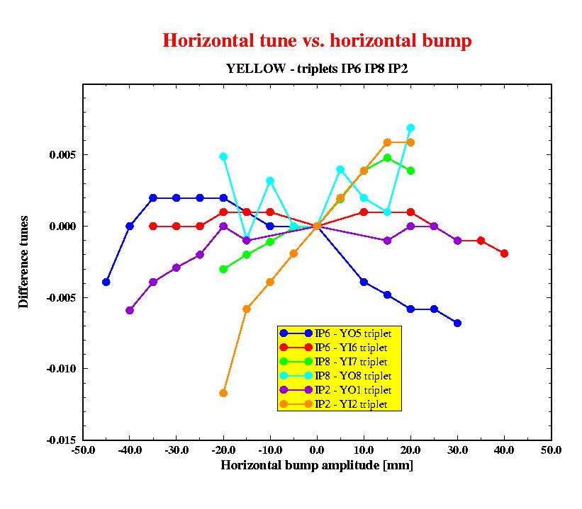
Run 2000–IR correction nonlinear
RHIC IR bumps – beam experiment
Bump data at IR2, IR6, IR8, blue & yellow
Mostly H bumps, some V bumps
Tune resolution run 2000: 0.001
Bump amplitude typically to 6s
Orbit→ linear, sextupole
Tune→ 5th order polynomial
triplet | b3 | a3 | b4 | b5 | a5 | b6
YO5 | 0.94 | -0.55 | 0.03 | -0.08 | 0.11 | -0.01
YI6 | -0.95 | 0.14 | 0.36 | 0.03 | -0.06 | -0.03
YI7 | 1.01 | -0.22 | 0.81 | 0.36 | -0.17 | -0.15
YO8 | 3.81 |  | -0.47 | -1.85 |  | 0.06
YO1 | 0.32 | -0.14 | 0 |  |  | 0
YO2 | 1.51 |  | 0.76 | -0.75 |  | -0.21
Tune resolution 2001 (0.0002)→ decapole
dodecapole?

Slide 12
IR corrections: run 2003
Q3
Q2
Q1
Q1
Q2
Q3
IP
DX
D0
DX
dcor
sex3
oct3
dod3
sq
ssex
soct
sdod
dcor
oct2
dec2
dod2
dcor
oct2
dec2
dod2
sq
ssex
soct
sdod
dcor
sex3
oct3
dod3
bump across IR
sextupole correction
bump across triplet
octupole correction
Orbit bumps at triplets and across IR
→rms orbit and tunes vs. bump amplitude
PLL ~10⁻⁵ resolution
Motivation:
Dynamic aperture
Operations (closure of steering bumps)

Slide 13
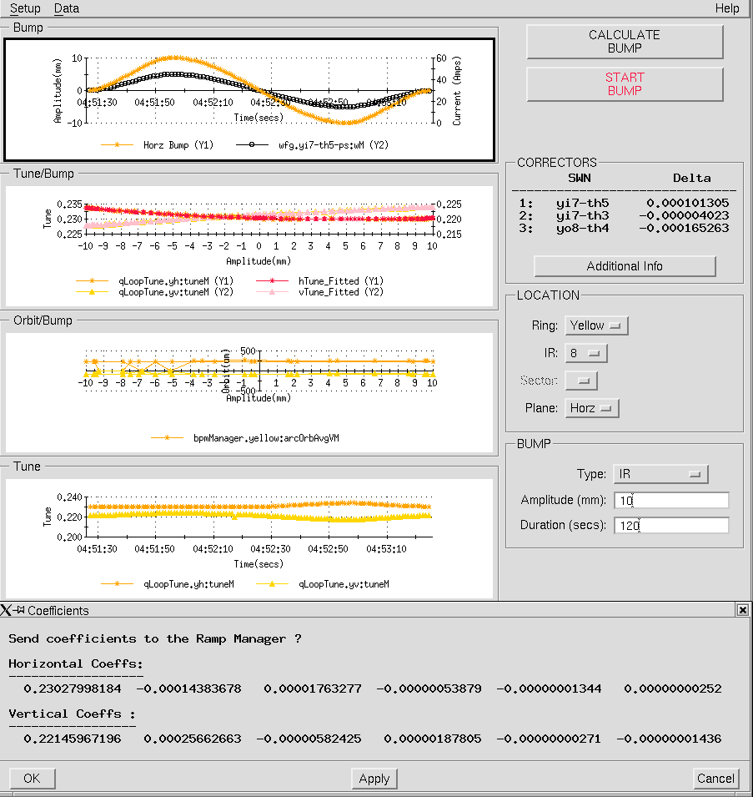
IR bumps application
IR bump application:
set-up and ramp-up of IR and triplet bumps in specified time (1-2 minutes)
Tune and power supply monitoring
Plot orbit rms and tunes as a function of bump amplitude
Polynomial fitting up to 5th order of tunes versus amplitude → coefficients→nonlinear corrector settings

Slide 14
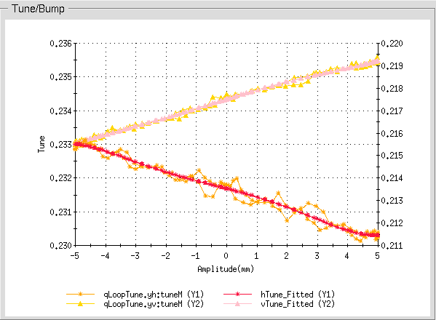
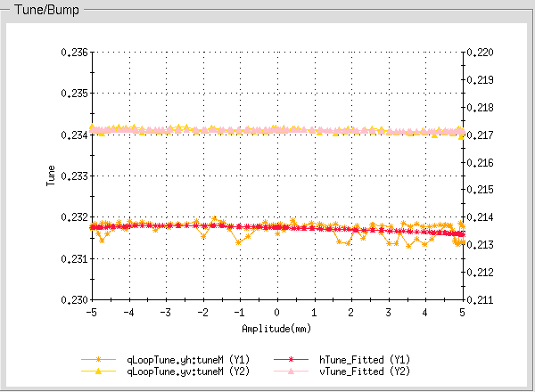
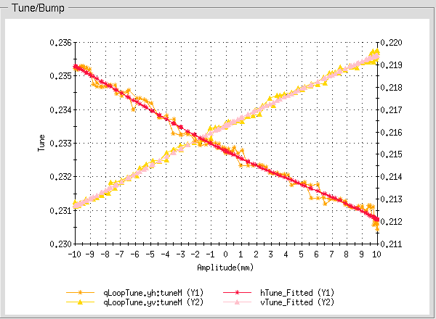
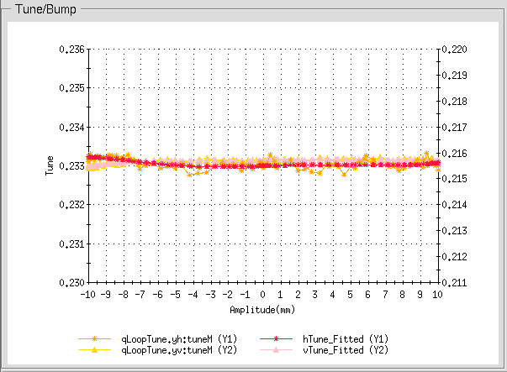
Run 2003: sextupole correction yellow ring
Yellow – IR6
after
correction
Yellow IR8

Slide 15
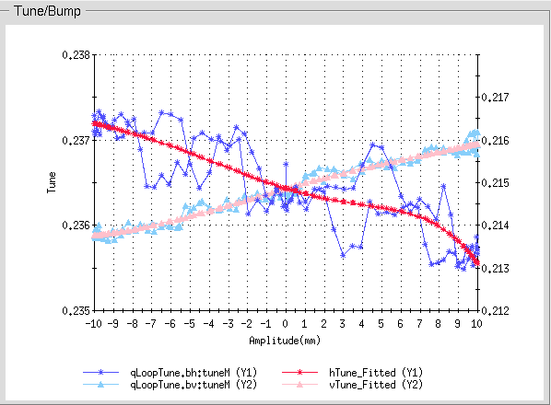
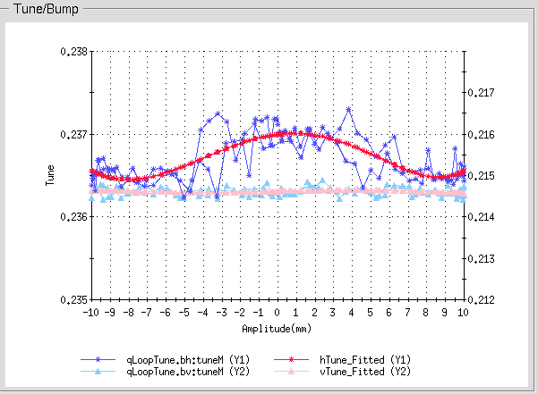
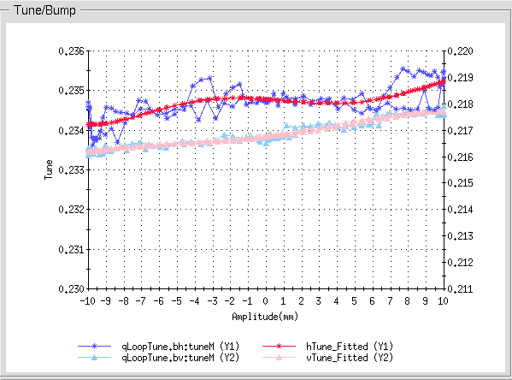
Run 2003: octupole correction blue ring
Blue – IR6
small effect
left uncorrected
Blue IR8

Slide 16
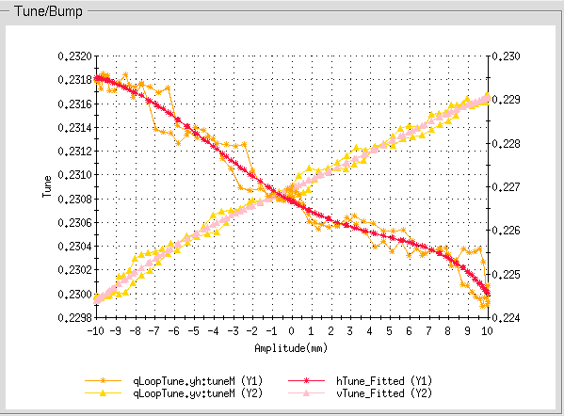
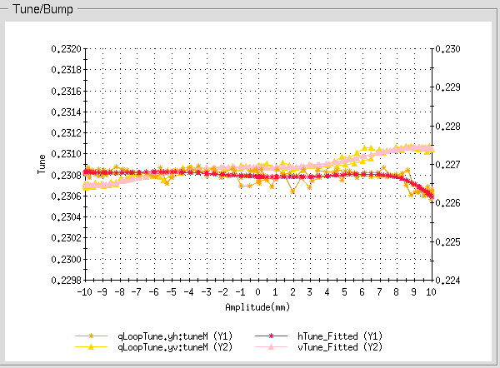
Run 2003: β*=2m vs. 1m
β*=2m
Yellow
IR8
β*=1m
before
sextupole
correction
after
sextupole
correction
Sextupole correction at IR6 and IR8 – blue and yellow rings beta*=1m and 2m
test of octupole correction at YIR8 (2 octupoles allow individual triplet correction)
feed-down octupole→sextupole, to be repeated: octupole first, then sextupole
Current dependence of field harmonics (left 5000A, right ~2000A)

Slide 17
IR correctors - results
Fit coefficients (x10⁻³) before and after correction – beta*=2m
IR | plane | Sextupole BC | Sextupole AC | Octupole BC | Octupole AC
Y IR8 | H | 0.22209 | 0.01347 | 0.00535 | 0.00093
 | V | -0.33559 | 0.00595 | -0.00388 | 0.00119
Y IR6 | H | -0.23338 | -0.02673 | -0.00968 | -0.00051
 | V | 0.41028 | -0.00042 | -0.00745 | -0.00251
B IR8 | H | -0.03204 | -0.03204 | -0.00557 | -0.00557
 | V | 0.07865 | 0.07865 | 0.00646 | 0.00646
B IR6 | H | -0.06853 | 0.02713 | 0.00536 | -0.01491
 | V | 0.12877 | 0.01121 | -0.00176 | 0.00002
Similar tables for beta*=1m
Full set of measurements taken in IR10 and IR2
(to evaluate β* options at Phobos and Brahms )

Slide 18
IR corrector strengths 2m vs 1m
Sextupole corrector | Strength β*=2m ~5000 A | Strength β*=1m ~2000 A
yo5-sx3 | -0.014 | -0.003
yi6-sx3 | 0.004 | 0
yi7-sx3 | 0.003 | 0.007
yo8-sx3 | -0.01 | -0.038
bi5-sx3 | 0.012 | 0.001
bo6-sx3 | -0.004 | -0.003
bo7-sx3 | 0.0 | -0.003
bi8-sx3 | 0.0 | -0.0005
Difference in strength due mainly to the current dependence of the
triplet field errors (if the effect is local).
The β*=2m strengths can be used as a starting point for correction
next year Au-Au run + readjustment when needed (β*=1m at ~5000A)

Slide 19
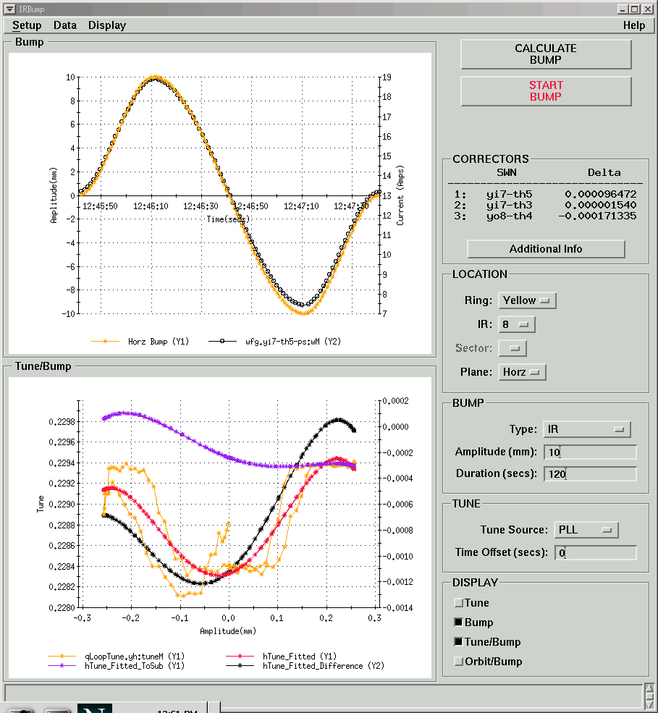
IR bumps – tune shift vs.crossing angle
Test of using the IR bump application to speed up the measurement of tune shift vs. crossing angle at the IP. (compare cogged vs. un-cogged beams)
Promising – to be repeated with beams better centered in the triplets

Slide 20
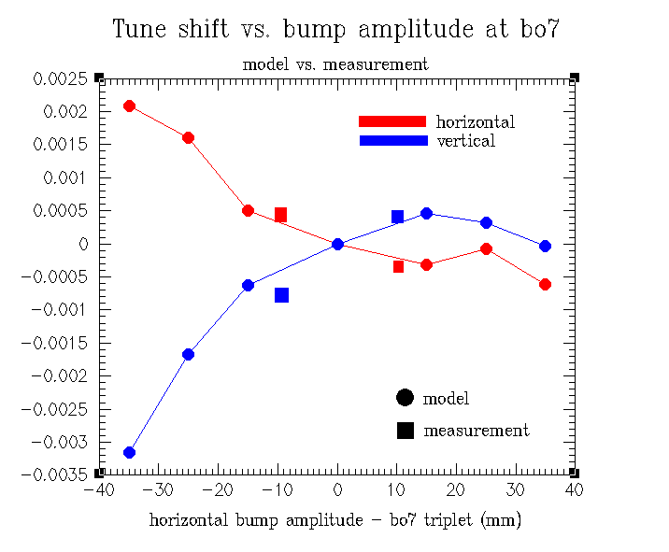
Model predictions
Started comparison of experimental data with RHIC model (including measured individual field errors in triplet cold masses and alignment errors)
R.Tomas working on RHIC modeling with beam-beam and IR errors (→working point)

Slide 21
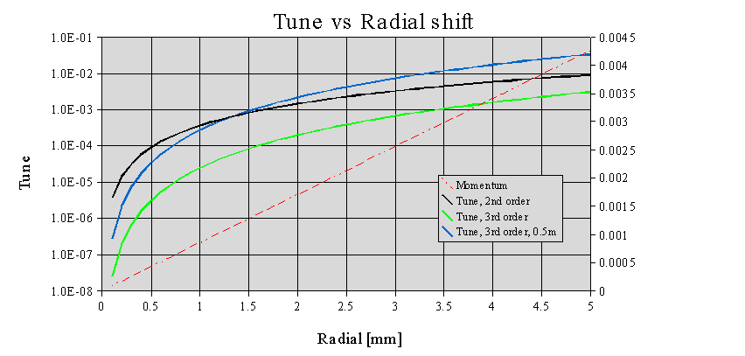
Nonlinear chromaticity
Correct linear chromaticity to 0
Separate tunes (reduce coupling effects)
Compare radial steering shift to bpm
Tried various radial steering ramps
  Radial steps (chrom app)
  5 and 10 steps
  Radial modulation (PLL)
  0.4mm amplitude at 1Hz
  1mm amplitude at 0.4Hz
  2mm amplitude at 0.2Hz
Prediction from model:

Slide 22
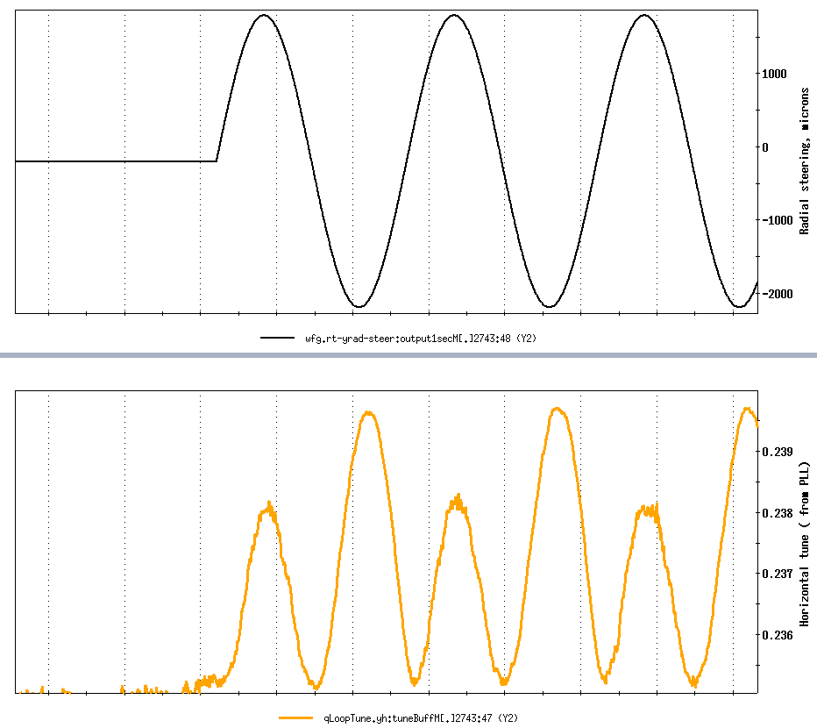
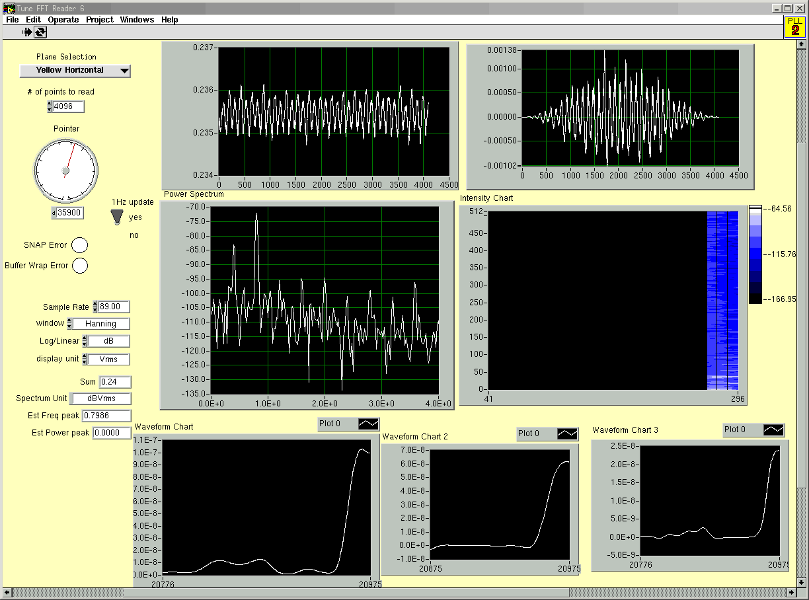
Nonlinear chromaticity - 2
Radial
modulation
PLL FFT
Signal
←
Residual linear
chromaticity

Slide 23
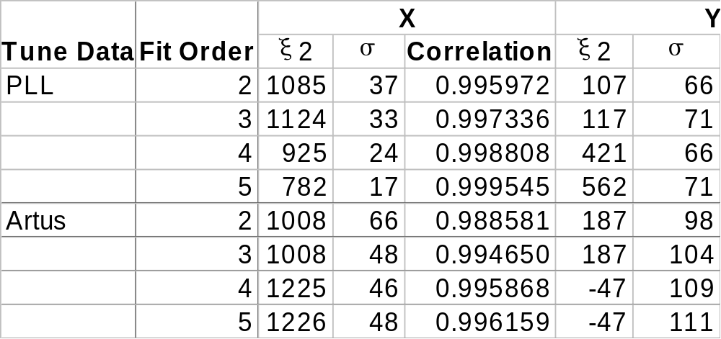
Nonlinear chromaticity - results
Ring | β* | run | date | ξ2x | ξ2v
blue | 2m | d-Au | Feb 5 2003 | 999 +/- 158 | 212 +/- 202
yellow | 2m | d-Au | Feb 26 2003 | 271 +/- 179 | 81 +/- 463
blue | 1m | p-p | May 23 2003 | 884 +/- 179 | 988 +/- 79
yellow | 1m | p-p | May 23 2003 | -720 +/- 218 | 743 +/- 281
analysis of
PLL and Artus data

Slide 24
(Dynamic) aperture measurements
Goal: collect data to compare with (up-to-date) model
Method used:
ramp 6 bunches (avoid possible emittance blow-up), nominal tunes
use scrapers to confirm halo beam size (PIN diodes) and core beam size (DCCT and WCM, beam intensity)
increase H emittance of bunches selectively via tune meter kicks (1 Hz)
measure continuously emittance with IPM and Schottky
emittance ‘saturation’ defines aperture
use scrapers to confirm beam size
check loss pattern and use orbit to discriminate physical from dynamic aperture (physical typically at the abort, and triplets)
repeat procedure for vertical emittance
repeat procedure for horizontal tune close to the 0.25 resonance

Slide 25
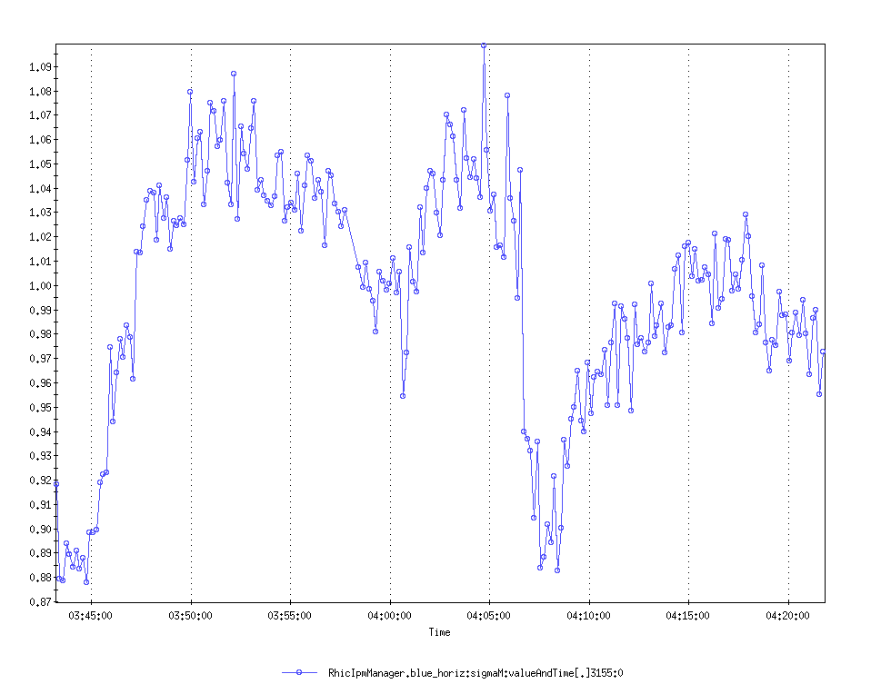
Dynamic aperture, blue, β*=2m
Blue ring - β*=2m in IP6 and IP8
Qx=.235
(nominal)
Qx=.247
(resonance)
Dynamic aperture
(nominal tune) ~4.5 sigma
By rescaling the emittance
To the initial one
kicking
Dynamic aperture
(resonant tune) ~3.6 sigma
kicking
data to compare
with simulation
“fresh bunch”

Slide 26
β* tuning “knobs”
For β*< 2m we β* tuning “knobs” are desireable
Tuning knobs = (quasi) orthogonal quadrupole vectors able to produce
matched changes in b* in a range of about +/-20%
Necessary:
Find the appropriate orthogonal knobs
Verify orthogonality and matching (offline)
Online model with beta, dispersion, coupling in order
Implementation in RE (online matching capability – cfr. JVZ talk)
Optics measurements with 5-10% resolution
Existing work for LHC (“Correcting the LHC β* at collision – Wittmer
Verdier, Zimmermann, PAC2003)
Calculation & matching
Tested orthogonality
Tested performance in simulation (with errors)
They have the RHIC lattice with 2m and 1m beta star and agreed to
repeat the study for RHIC, possible test in run 2003 if study is
successful.

Slide 27
LARP-related IR activities
IR optics compensation is necessary for the IR upgrade and
to enhance the baseline machine performance
Development of operational IR correction techniques capabilities
for the LHC (application, analysis) – correction system testing at RHIC
1. IR bumps 2. Resonance driving terms
Test of LHC simulation IR filter (compensation of selected driving terms)
at RHIC: apply filter in simulation and measure driving terms with
before and after correction (RHIC beam experiment)
Test of LHC β* tuning knobs at RHIC
Precise beta function measurements with AC dipole
Measurement techniques for non-linear and skew chromaticity
Dynamic aperture measurements
Test of β* squeeze 1m -> 0.5m optics at RHIC
(LHC IR upgrade also factor~2 in β*) – possible with p at 100 GeV without
change in power supplies

