Slide 1
Section 13
Atmospheric Corrector
. . . Dennis Reuter
EO-1 LEISA Atmospheric Corrector

Slide 2
Summary of Changes Since Red Team Review
No modifications to instrument
AC remained on spacecraft
  Several disconnects and reconnects (optics module cable, WARP cable)
Some modifications to spacecraft software (RTS mods)
Additional 14 hours failure-free operation
  302 hours of operation
  101 failure-free hours since mounting on spacecraft
Two PRs generated in T/V II

Slide 3
PRs Generated in T/V II
EO1-WOA-1099
  Event# 20, PR# 12
    Apparent loss of telemetry packets
    Previously know difference in packet counter between AC and spacecraft C&DH system
    No action required -- operational workaround
  Event# 20, PR# 18
    Actual loss of telemetry packet
    Caused by S-Band telemetry noise
    NO AC action required -- determined to be an S-Band problem

Slide 4
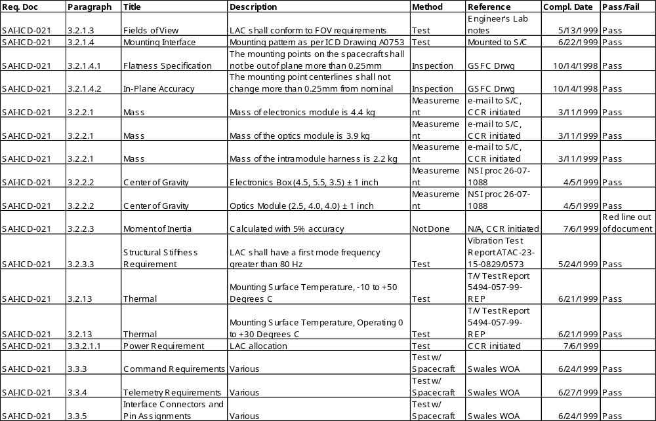
Verification Matrix

Slide 5
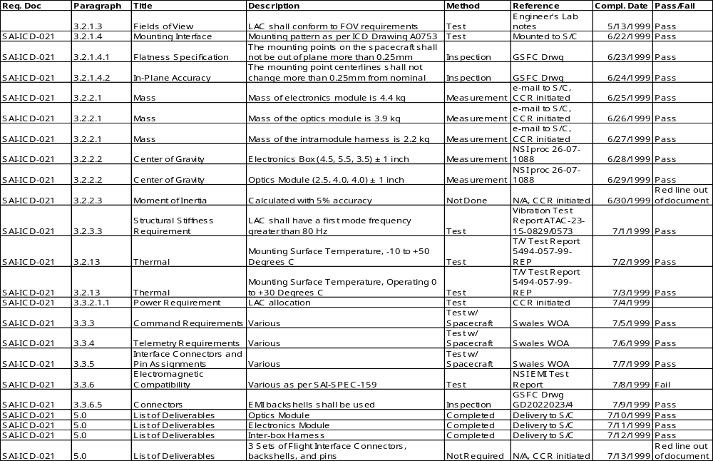
Verification Matrix

Slide 6
Final Status
No open issues
No Redbook candidates
Instrument is fully ready to fly and return valuable scientific data

