Slide 1
SPEAR Upgrade – EPICS Status
SPEAR Controls:
Clemens Wermelskirchen,
Till Straumann,
Harvey Rarback,
Stephanie Allison
http://www.slac.stanford.edu/~spear/epics/

Slide 2
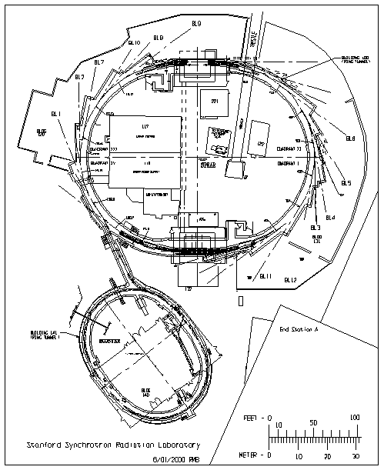
SPEAR Accelerator Facility

Slide 3
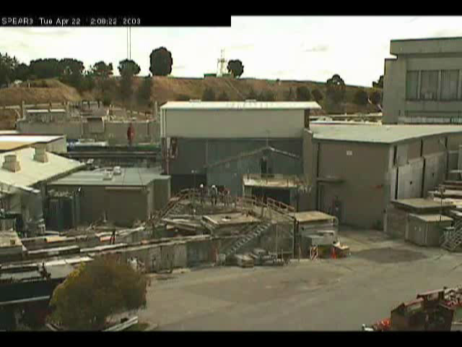
SPEAR Construction

Slide 4
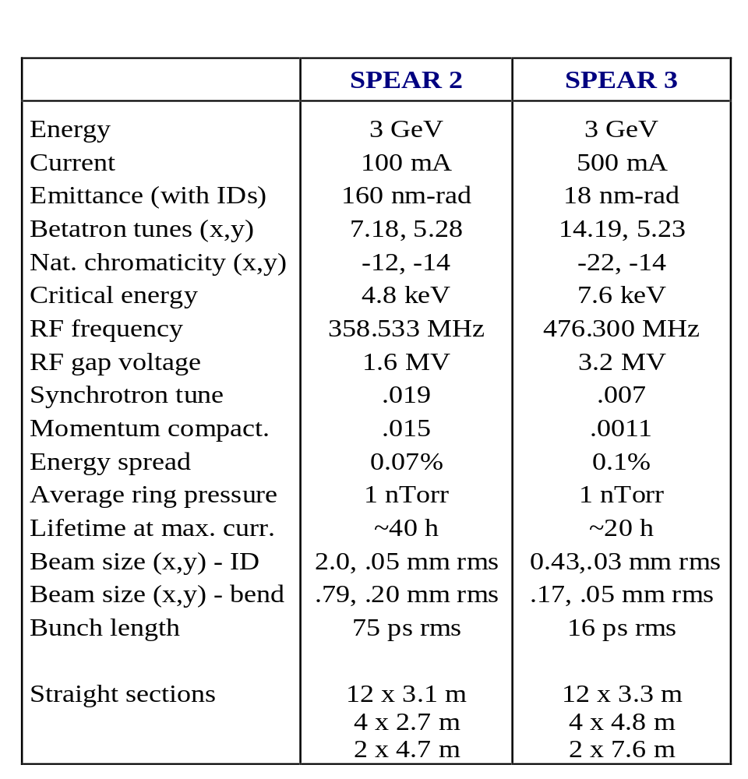
SPEAR Machine Parameters

Slide 5
EPICS at SPEAR
Acc Physics
PCs
Engineer
Unix Machines
Operator and RDB
VMS Machines
T/Cs,
BSOICs,
Vacuum,
IDs
M
V
A
X
C A
M
V
A
X
SPEAR CA
Server
Injector CA
Server
Injector
Signals
100 Mbit Dedicated Ethernet
Bergoz
MCOR
18 Corrector
IOCs
Fast Fbck
IOC
2 BPM
IOCs
Timing
Orbit Interlock
Fault
CANBus
BitBus
PS
IOC
MultiUse
IOC
RF
IOC
VXI RF Signals
DIO
AB RF MPS
AB MPS
EtherIP
LAN/GPIB
GPIB

Slide 6
EPICS/OS Versions
New IOCs:
RF IOC:
SPEAR/Inj CA Servers:
Oper Tools, RDB Sys:
RF Engineer Tools:
Developer Tools:
3.14.1/RTEMS 4.6.0pre2
3.13.6/Tornado 2.0.2
3.13.1/OpenVMS 7.3-1
3.13.1/OpenVMS 7.3-1
3.13.6/Solaris 8
3.13.6 and 3.14.1/ Linux and Solaris
3.13.4/Windows
Acc Phys MatLab Apps:

Slide 7
IOC Hardware
PPCs (~25): Synergy VME VGM, Kinetics VXI V152
Crates: Wiener VME 64X, Elma VXI, SLAC/PEPII MCOR
Perle Terminal Servers
Crate I/O:
  Echotek ECDR-814 Digital Receivers for parallel first/single/multi-turn BPMs
  Fast ADCs (General Standards 16AI64SS PMC or Hytec 8401 IP) for MUXed multi-turn BPMs
  INCAA VEBB BitBus Controllers for PEPII DC Power Supplies
  SLAC MCOR Interface Modules for PEPII Corrector Power Supplies
  Acromag 9670 IP Carriers with TIP/Acromag IPAC Modules
  SLAC/PEPII RF VXI Modules
  AB VME Scanner
Ethernet I/O:
  Agilent GPIB LAN Boxes
  AB EtherIP Modules
  Keithley 2701 DMM?

Slide 8
Host Hardware
OpenVMS AlphaServer (2)
Tru64 Unix AlphaServer (NFS, TFTP Server)
Solaris 8 Sun-Blade-100
SLAC Solaris/Linux Servers on other Subnets
Various PCs (Windows and Linux)
UPS

Slide 9
IOC Applications
Corrector PS (108) Control
Quad/Main PS (70) Control
Parallel-Button BPM (36) Processing
MUXed BPM (54) and Beamline Photon Monitor (24) Digitization (instead of X and Y)
RF System, RF Frequency Control
MPS Monitoring
Orbit Interlock Monitoring
Beam Current/Lifetime
Kicker Timing
Booster Injection Timing
Relay Switching
Wiener Crate Monitoring

Slide 10
IOC Applications (Later)
Fast Orbit Feedback (4kHz)
Control System Timing
Synchrotron Light Monitor
Tune Monitor and Driver Interface
More GPIB Apps

Slide 11
Host Applications
EDM Operator Displays
StripTool
Data Archiver (to RDB)
Data Browser (from RDB, X-Windows)
Event Monitor and Messaging (RDB)
Configuration Save/Restore (RDB)
Knobbing (X-Windows)
Insertion Device Control (IDL)
SciLab Apps
RF Apps (MatLab, DM, CMLOG, ALH, CW)
Acc Physics Lattice Control and Orbit Monitor and Control Apps (MatLab)

Slide 12
RDB System
VMS
Apache
Web Server
“Static” Info
via JDBC
IOC/PCAS
CA Server
CA
CA Monitoring
VMS
PC
MS Access
Data
Data via ODBC
RDB Tables
SQL Server
DB
MatLab/JDBC
IOCInit
TCP
PV Server
VMS
Data
Record List
History
Browser
Reboot Restore Values
Config Restore
Setpoints

Slide 13
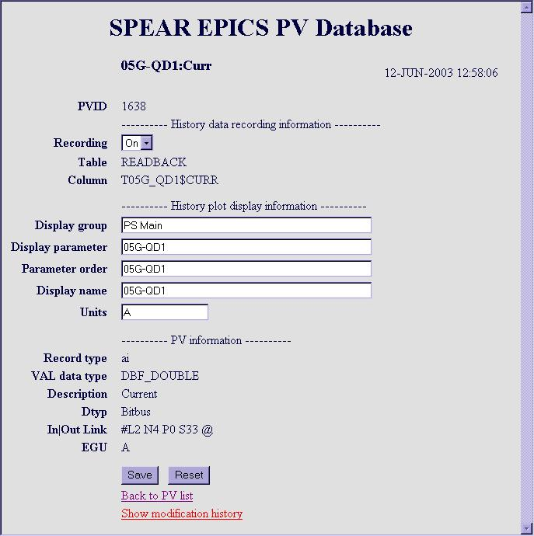

Slide 14
Software Schedule
Priority 1 Software:
Commission w/o Beam:
Commission with Beam:
Photon Beam to Exp:
Priority 2 Software:
Oct 1, 2003
Nov 1, 2003
Dec 8, 2003
Early 2004
Mid 2004

Slide 15
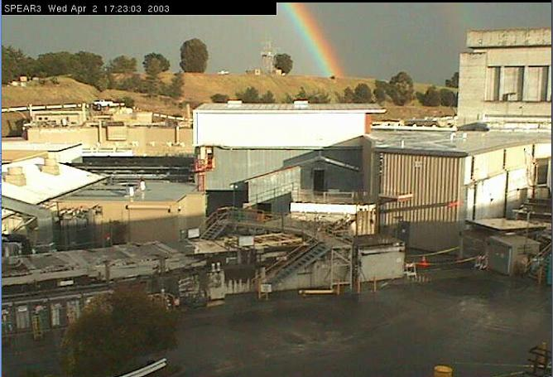
Just another day at SPEAR…

