Slide 1
LINAC BEAM QUALITY DEMANDS
Workshop on Linac Space Charge
Jie Wei
SNS/ORNL Accelerator Physics
June 25 - 26, 2001
Notes:
Good morning, everyone. I’m Jie Wei. I’m going to report to you on AP interface and integration activities.

Slide 2
Key parameters
assuming 4% injection loss; 4% target window loss; linac max. -20º phase
 | Baseline | Back-up
Kinetic energy, E_{k} [MeV] | 1000 | 975
Uncertainty, ΔE_{k} (95% probability) [MeV] | +/- 15 | +/- 15
SRF cryo-module number | 11+12 | 11+15
SRF cavity number | 33+48 | 33+60
Peak gradient, E_{p} (β=0.61 cavity) [MV/m] | 27.5 (+/- 2.5) | 27.5 (+/- 2.5)
Peak gradient, E_{p} (β=0.81 cavity) [MV/m] | 35 (+2.5/-7.5) | 27.5 (+/- 2.5)
Beam power on target, P_{max} [MW] | 1.4 | 1.7
Pulse length on target [ns] | 695 | 699
Chopper beam-on duty factor [%] | 68 | 68
Linac beam macro pulse duty factor [%] | 6.0 | 6.0
Average macropulse H- current, [mA] | 26 | 32
Linac average beam current [mA] | 1.6 | 1.9
Ring rf frequency [MHz] | 1.058 | 1.054
Ring injection time [ms] / turns | 1.0 / 1060 | 1.0 / 1054
Ring bunch intensity [10¹⁴] | 1.6 | 1.9
Ring space-charge tune spread, ΔQ_{sc} | 0.15 | 0.20

Slide 3
Linac Beam Quality Demands
Output energy within +/- 5% window
Key challenge: control transverse emittance and jitter
  Effective beam size growth & ring injection activation (< a factor of 2)
  Compared with other facilities (e.g. 5 –8 times growth at LANSCE), identified transverse jitter as main issue; easier for 402.5 MHz DTL
  New halo findings based on non-water-bag measured distributions
Control momentum spread and jitter
  Facilitate longitudinal painting with a narrow paint brush
  Need to control total energy deviation within +/- 0.3% (3 MeV)
  Phase error an added complication
Reduce uncontrolled beam loss across linac
  About 1 W/m and lower
Notes:
As a brief review of past activity:
We’ve chosen accumulator design for loss minimization, and it was endorsed by this committee in May 1999.
We’ve chosen SCL for its maintainability, technology and savings and it was endorsed by this committee in March 2000.
We’ve finally decided on 1 klystron per cavity, independent Rf control and it was endorsed by the mini-ASAC this July.

Slide 4
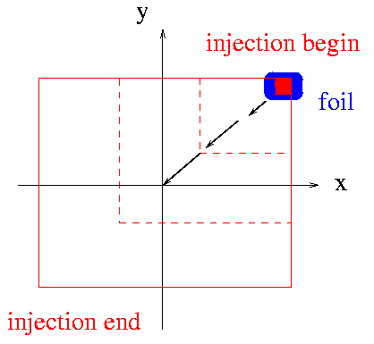
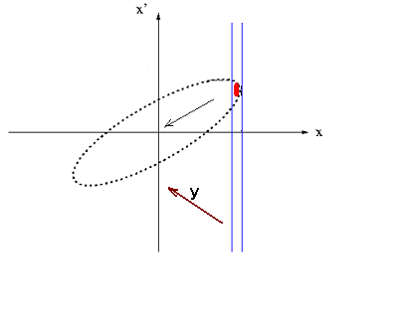
Transverse Requirements
To facilitate transverse painting
  Ring injection foil miss, foil heating, foil traversal, radio-activation

Slide 5
Emittance evolution
Device | Emittance (ε_{Ν}) rms [μm] | Jitter [mm] | Comments
IS/LEBT | 0.09 / 0.2 |  | Aberrations
RFQ | 0.21
MEBT | 0.27 |  | Transverse space-charge growth due to chopper gap & longitudinal rebunching
Linac | 0.41 | +/- 0.2 | Transverse space-charge mismatch due to lattice & acc. gradient change
HEBT | 0.45 | +/- 0.2 | Energy spread (chromatic)
Ring | (44+44) |  | Painting; space-charge/magnet error halo (Full ε_{UN} = 120+120 μm)
RTBT | (44+44) |  | Full ε_{UN} = 120+120 μm
Target | 50 – 150 times |  | Window scattering
Notes:
Second table is on emittance evolution. This is the nominal case, and we’ll study the consequence when the actual deviates from it. The emittance grows at various stages due to lattice change, space charge, etc. The key to preserve linac emittance is for ring injection foil/dump design. Then painting is used to reduce space charge.

Slide 6
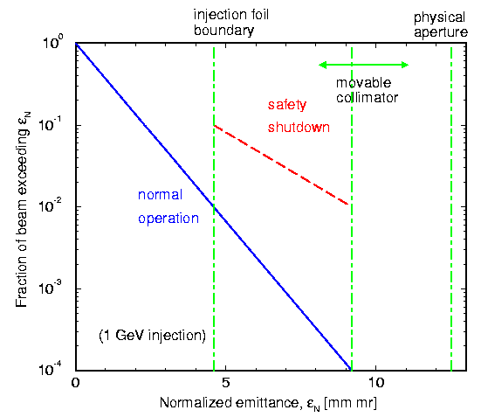
Linac/Ring interface (transverse)
Nominal norm. rms emittance ~ 0.4 mm mr
Nominal jitter ~ 0.2 mm
Larger emittance compromises power & loss/activation
Injection dump accepts 10% power
Movable transverse collimator for protection; takes 1% power
Chamber aperture: HEBT rf cavity …
(equivalent; including jitter)
Notes:
This shows linac/ring interface. Blue is the nominal. Beyond that, the first consequence is the at injection foil: increased foil miss, reduced power, or increased foil hits. The dump takes 10%. The foil hit is nominally 6.5. Further beyond is protected by a movable HEBT collimators, which can stand 1% heat. It is designed to protect the HEBT and ring injection.

Slide 7
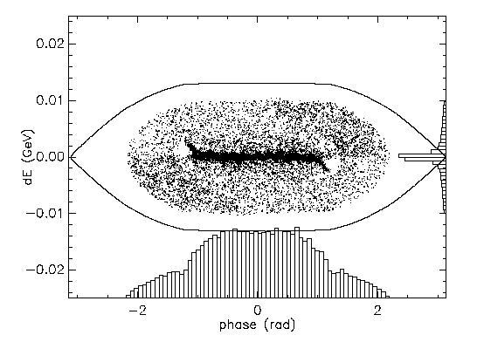
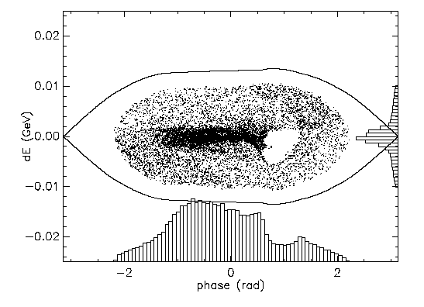
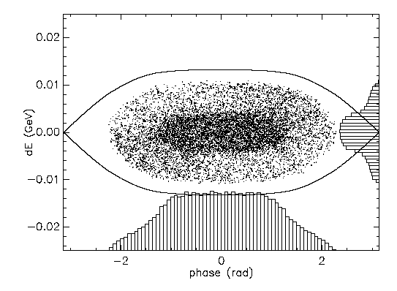
Longitudinal Requirements
Facilitate longitudinal painting (instability, beam-in-gap cleaning, loss)
  No spreader, on energy
  No spreader, off energy
  With corrector & spreader

Slide 8
Energy spread evolution
Device | Spread [MeV] | Centroid Jitter [MeV] | Comments
Linac | 0.33 (rms) | +/- 1.5 | 0.5% amplitude, 0.5 deg. phase error (space charge, magnet errors, beam loading/transient, Lorentz detuning, microphonics, non-equipartition)
HEBT collimator | 0.72 (rms) | +/- 1.5 | space charge growth due to lack of RF
Energy corrector | 1.3 -> 0.85 (rms) | +/- 1.5 -> +/- 0.2 | space charge growth due to lack of RF; cavity corrects the energy error (jitter & spread)
Energy spreader | +/- 4 (full) |  | cavity broadens the energy core, without enhancing tail
Ring | +/- 10 (full) |  | gap cleanness versus beam stability
Notes:
Similarly, evolution of beam energy spread.
Stovall will show that the present RF control is at 0.5% 0.5 degree level, corresponding to an energy jitter of 1.5 MeV, and a spread of 0.33 MeV. This is corrected by the HEBT corrector, and then intentionally broadened without enhancing tail with the spreader. In the ring, it is a balance between gap cleanness and stability.

Slide 9
HEBT energy corrector & spreader
Function: longitudinal painting with a narrow paint brush
  Control space charge tune spread (20 - 30 %)
  Enhance Landau damping (a factor of 2 - 3 in Δp/p FWHM)
  Avoid local non-uniformity (holes & spikes); reduce tail loss
Possible instabilities in the absence of the cavities
  Electron-proton instability (PSR like): scales with (Δp/p)²
  Transverse instability (kickers): estimate 3.6 -> 0.9 x 10¹⁴
Study conclusions:
  Estimate < 0.5 MW in the absence of cavities
  Functions not easily replaceable by the last linac cavity with fast feedback
    Cavity response ~ 10 kHz (<< 100 kHz); very challenging
    Ideal: correction before bend; spreading after bend; collimate
Notes:
As a brief review of past activity:
We’ve chosen accumulator design for loss minimization, and it was endorsed by this committee in May 1999.
We’ve chosen SCL for its maintainability, technology and savings and it was endorsed by this committee in March 2000.
We’ve finally decided on 1 klystron per cavity, independent Rf control and it was endorsed by the mini-ASAC this July.

Slide 10
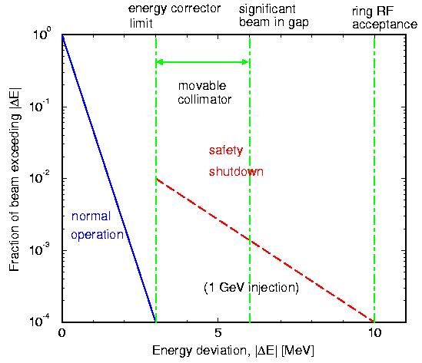
Linac/Ring interface (longitudinal)
Nominal energy jitter limit: +/- 2.2 MeV
Nominal rms energy spread: 0.3 MeV
Impact of beam loading, Lorentz detuning, and microphonics (under study) 1-on-1 controlled
Movable energy collimator; corrector limit & ring acceptance
Two locations of energy corrector reserved (present & future)

Slide 11
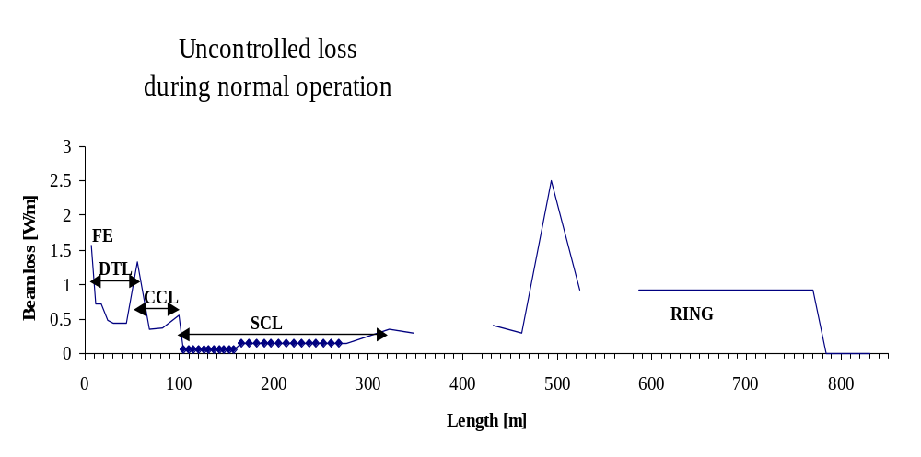
Beam loss distribution
High rad
areas
HEBT
RTBT

Slide 12
Controlled Losses
Mechanism | Location | Fraction | Energy | Power
FRONT END
Unbunched beam | LEBT chopper | 27.7 e-2 | 0.065 MeV | 36 W
Unbunched beam | MEBT chopper | 3.4 e-2 | 2.5 MeV | 215 W
HEBT
H⁰ ionization in the Linac | Linac dump | 1.0 e-5 | < 1 GeV | 20 W
Linac transverse tails | x-y collimator | 3.0 e-5 | 1 GeV | 600 W
Energy jitter/spread | z collimator | 1.0 e-3 | 1 GeV | 2 kW
RING
Beam in gap | Collimators | 1.0 e-4 | 1 GeV | 200 W
Excited H0 at foil | Collimator | 1.3 e-5 | 1 GeV | 26 W
Partial ionization/foil miss | Injection dump | 1.0 e-2 | 1 GeV | 20 kW
Space-charge halo | Collimator | 1.9 e-3 | 1 GeV | 3.8 kW
Energy straggling at foil | Collimator | 3.0 e-6 | 1 GeV | 6 W
RTBT
Kicker miss-fire | Collimator | 1.0 e-5 | 1 GeV | 20 W
Nuclear scattering at target window | Target window | 4 e-2 | 1 GeV | 80 kW

Slide 13
Uncontrolled Losses (I)
Mechanism | Location | Fraction | Energy [MeV] | Length [m] | Power [W/m]
Front End
RFQ transmission | Uniform | 2.0 e-1 | 0.75 | 3.7 | 80.7
H- stripping | MEBT | 1.1 e-3 | 2.5 | 3.6 | 1.6
Drift Tube Linac (DTL)
Emittance growth | End of Tank 1 | 6.6 e-5 | 2.5 – 7.5 | 4.2 | 0.24
Emittance growth | End of Tank 2 | 2.4 e-5 | 7.5 - 22 | 6.1 | 0.18
H- stripping | continuous | 5.8 e-4 | 2.5 - 87 | 37 | 0.3 – 0.6
Couple Cavity Linac (CCL)
Double H- stripping | CCL module 1 | 1.9 e-5 | 86.5 - 107 | 12 | 0.35
Emittance growth | CCL module 1 | 4.7 e-5 | 86.5 - 107 | 12 | 0.86
H- stripping | continuous | 4.6 e-5 | 87 - 186 | 55 | 0.22
Super Conducting Linac (SCL)
Emittance growth | Warm sections | 3.7 e-6 | < 1000 | 37 | <0.2
Emittance growth | Supl. 9 modules | 1.2 e-5 | < 1000 | 71 | 0.35
H- stripping | Medium beta warm | <5 e-8 | 186 - 379 | 18 out of 63 | <0.002
H- stripping | High beta warm | <3 e-8 | 379 - 1000 | 19 out of 94 | <0.002
H- stripping | Supl. 9 modules | <5.3 e-6 | 1000 | 71 | <0.15

Slide 14
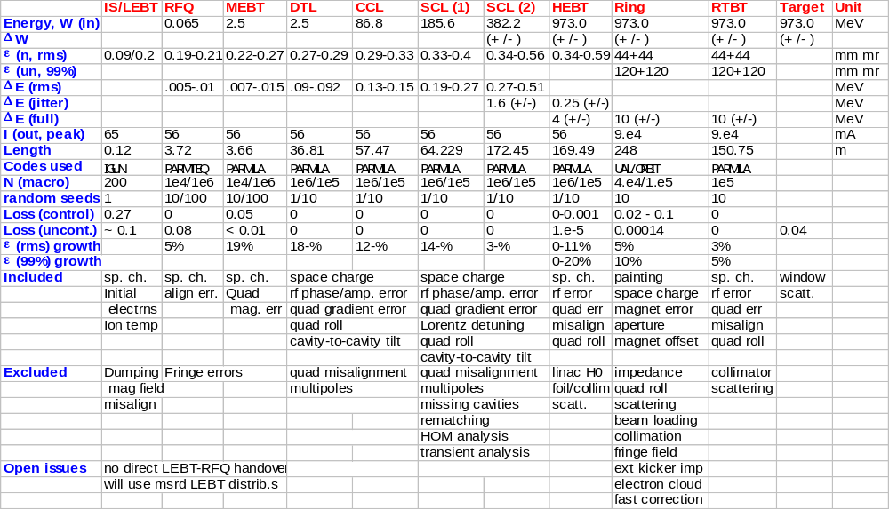
End-to-end evolution & simulation (2000)
Notes:
This is a busy table. There will be 3 zoomed-in tables following this.
This is mainly to show you that
1) There is a consistent design and parameter set from FE to Target
2) It is section-by-section connected but not completely continuous
a) LEBT to RFQ and b) HEBT to Ring
3) Some are included, more not included but separately studied.
4) There are open issues identified.

