Slide 1
Week in Review: 03/03/03-03/09/03
Ron Moore – FNAL
Tev Shutdown Summary
Booster Studies & A New Record!
Schedule for Week

Slide 2
Tev Shutdown Summary
Ground fault in A1 isolated to A14 spool piece
Dipole A15-3 replaced due to bad voltage tap
  Could not be repaired in situ
  Possible ground fault waiting to happen
Unrolled many magnets; replaced some stands
  2 quads, 14 dipoles?
  Reduce current in corrector dipoles
Tunnel work proceeded quickly, turn-on more slowly
  Quenched A15 at ≈930 GeV on first ramp attempt (training?)
  Cooldown problems, replaced Kautky valve at A15
  Ramps to 900, 920, 930, 950, 980 GeV OK

Slide 3
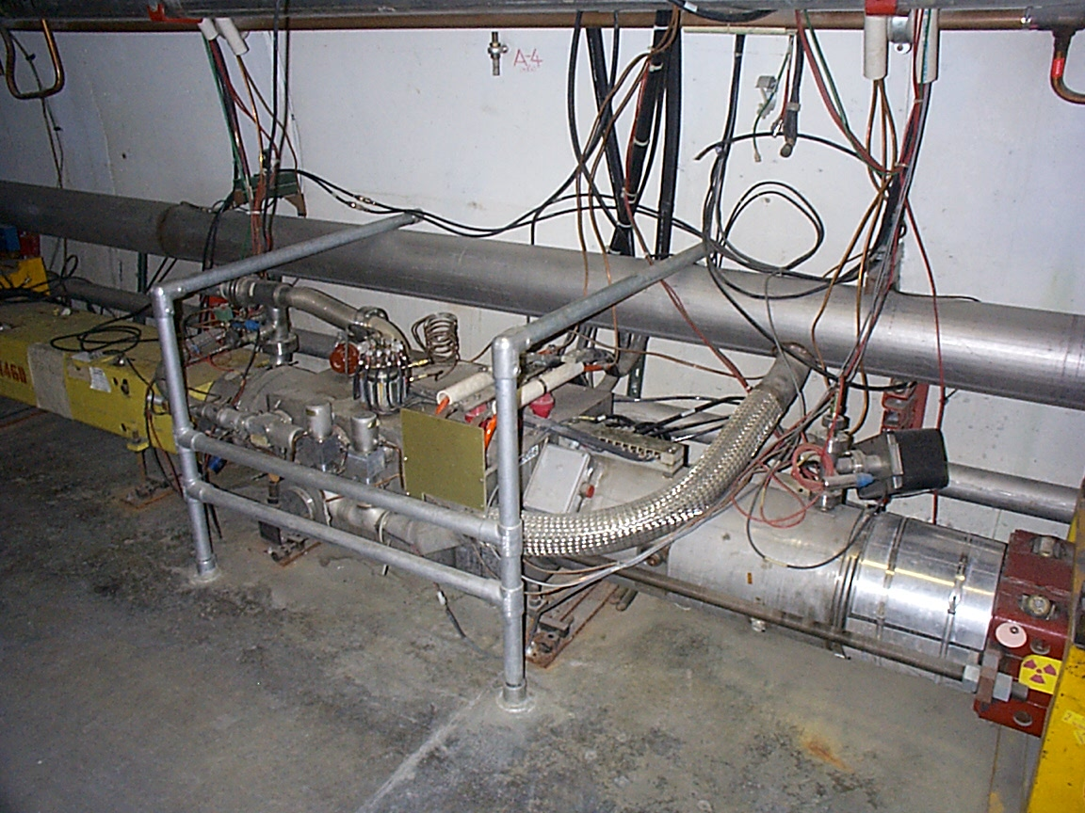
A14 spool – ground fault
quad
Safety leads
Fault in one of them.
The spool contains corrector magnets and quench bypass cables.
dipole

Slide 4
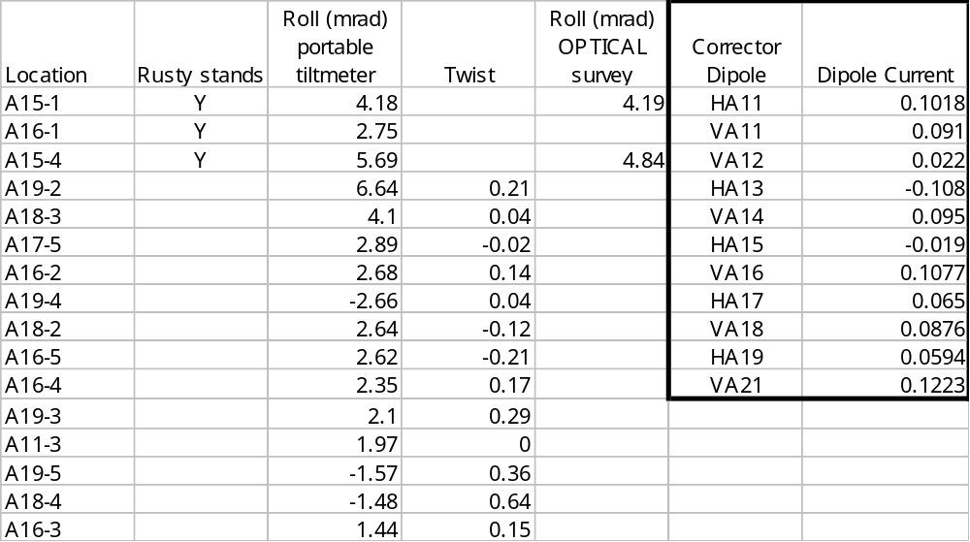
Magnet Rolls in A1

Slide 5
Recycler Status
77% stashing efficiency on 3/3 pbar shots
Schottky amp failures caused by radiation damage
  MI beampipe near these amps was sagging, causing beam spray to hit amps…sag was fixed
Two vertical correctors running too hard
  Corresponds to ~8 mm correction
  Awaiting results from survey conducted on 3/8
Flying wire cans removed, replaced with spools
  Vacuum recovering OK

Slide 6
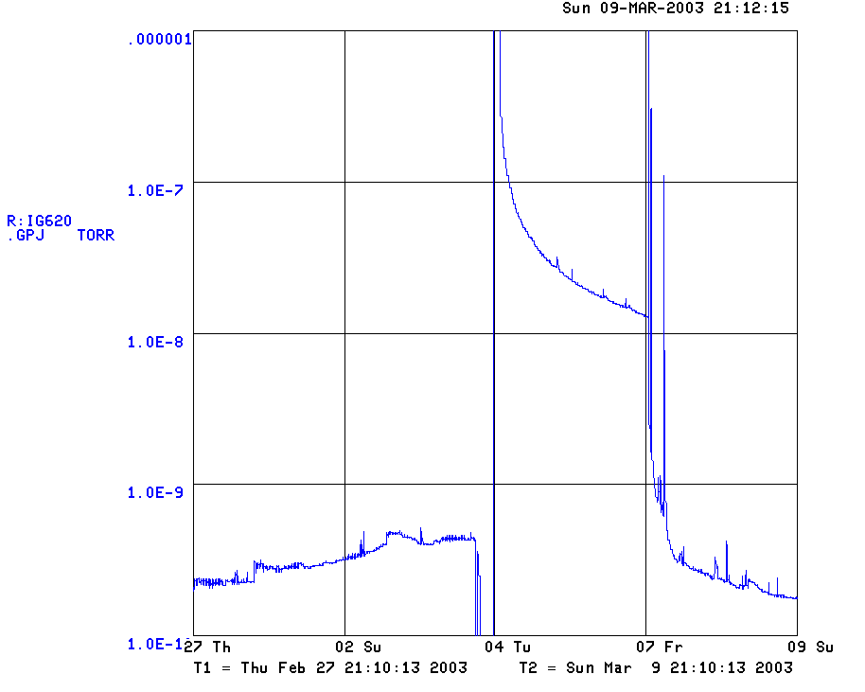
Recycler Vacuum Near Flying Wires
Before removal
After removal

Slide 7
Booster Studies
Dogleg magnets thought to have bad effect on injection lattice
MP01 septum raised 1 inch to allow 1 dogleg to be turned down/off
  Ran in this configuration for 7 shifts of studies
  No “short-batching” for other machines’ studies
Observed tune and dispersion differences with doglegs off
Saw 10% more beam coming out @ 7 turns (reduced losses!)
  Allowed Booster intensity records to be set
Booster has been restored to normal operating configuration
  Digest the data, develop scheme to run with reduced dogleg current

Slide 8
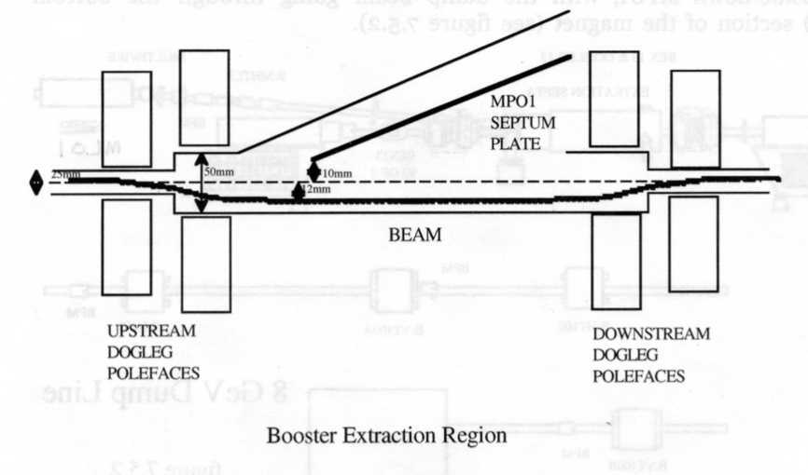
MP01 in Booster
For study, raised MP01 1” to allow lower dogleg current

Slide 9
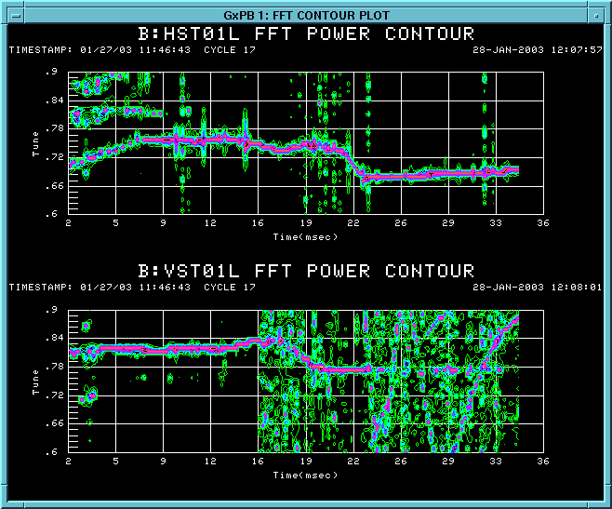
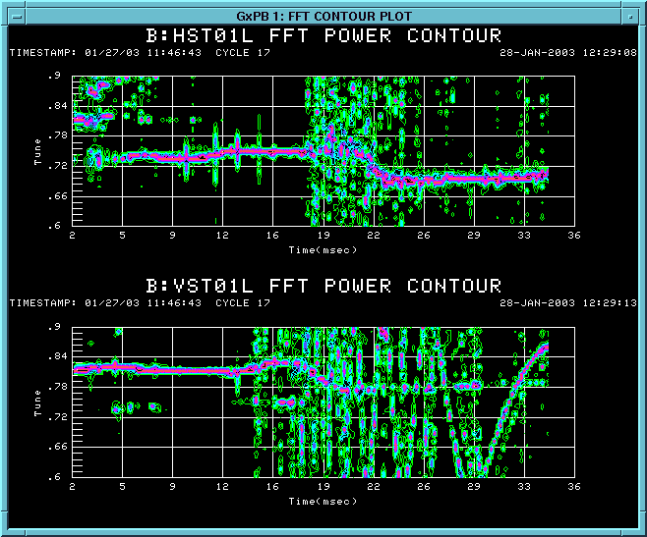
Tune Shift from Dog Leg Change
Dog Legs Nominal
Dog Legs down 40%

Slide 10
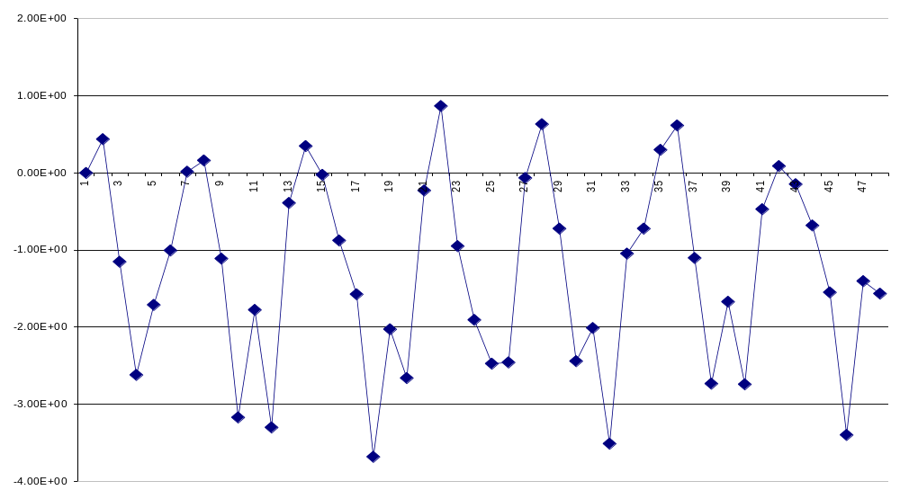
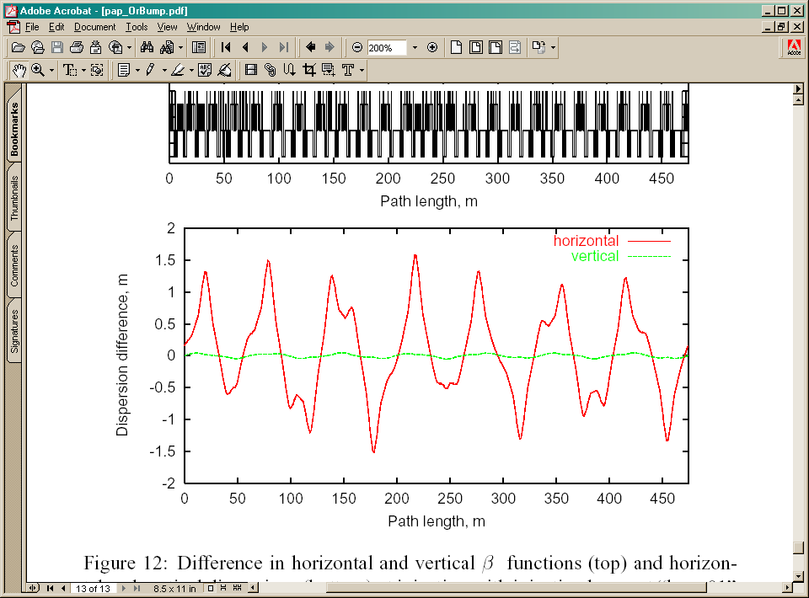
Edge Effects from Dog Legs
H Dispersion Difference: Dog Legs at 100% and 60%
Data

Slide 11
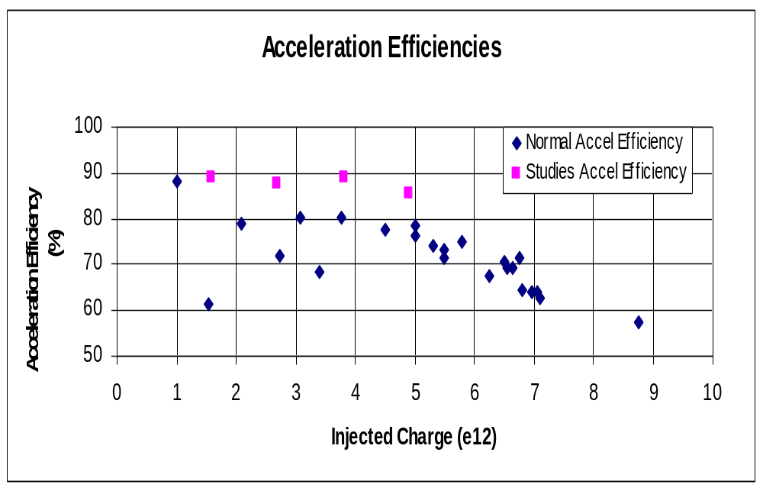
Booster Studies

Slide 12
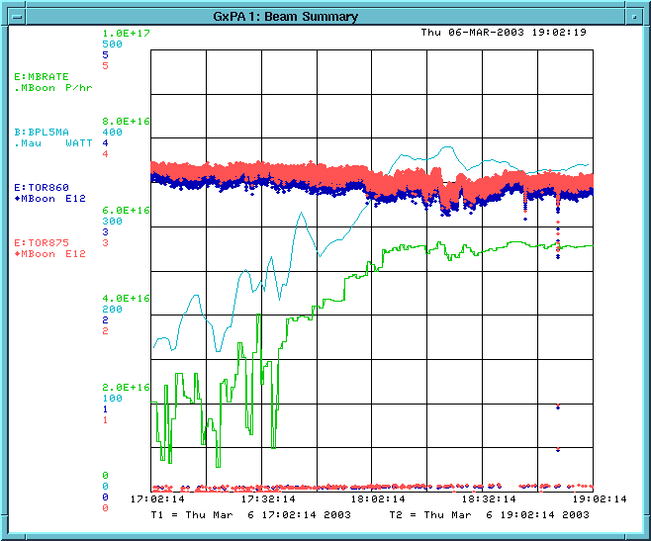
Record Booster/MiniBoone Operation
MiniBoone rate
Protons/hr
Boo power loss
(5 min avg) W
Proton Intensity
@ 860 E12
Proton Intensity
@ 875 E12
5 E16
1 hour

Slide 13
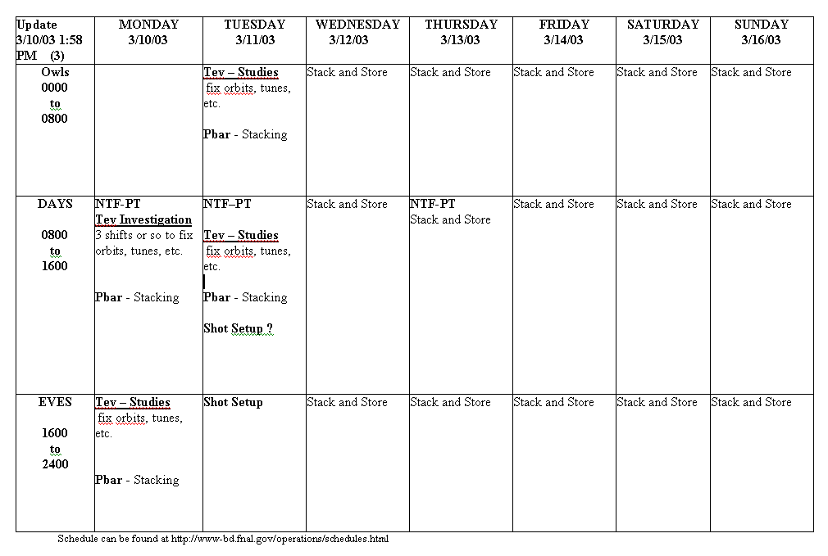
Weekly Schedule

Slide 14
Summary
Tev ground fault in A1 isolated to A14 spool piece
  Spool replaced, A15-3 dipole replaced, magnets unrolled
Special Booster configuration for studies allowed new records to be set – 5.5 E16 protons in 1 hour to MiniBoone
  Gained valuable knowledge on effect of dogleg magnets
Recycler flying wire cans removed – vacuum improved
Once Tev has been recommissioned, “Stack & Store” for 10-14 days to integrate luminosity

