Slide 1
Prediction of Consensus TC Track Forecast Error and
Correctors to Improve Consensus TC Track Forecasts
Joint Hurricane Testbed Project
James S. Goerss
NRL Monterey
March 5, 2008

Slide 2

Predicting TC Track Forecast Error
  Predictors of consensus forecast error must be quantities that are available prior to the time when official forecasts must be issued.
  Consensus model spread is defined to be the average distance of the member forecasts from the consensus forecast.
  The possible predictors are consensus model spread; initial and forecast TC intensity; initial TC location and forecast displacement of TC location (latitude and longitude); TC speed of motion; and number of members available (for CONU).

Slide 3
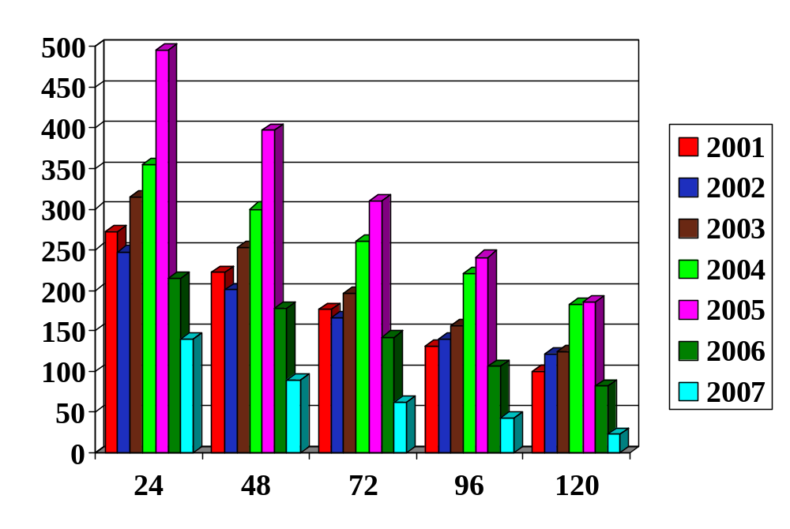
Number of Verifying Official Forecasts
for the Atlantic Basin

Slide 4
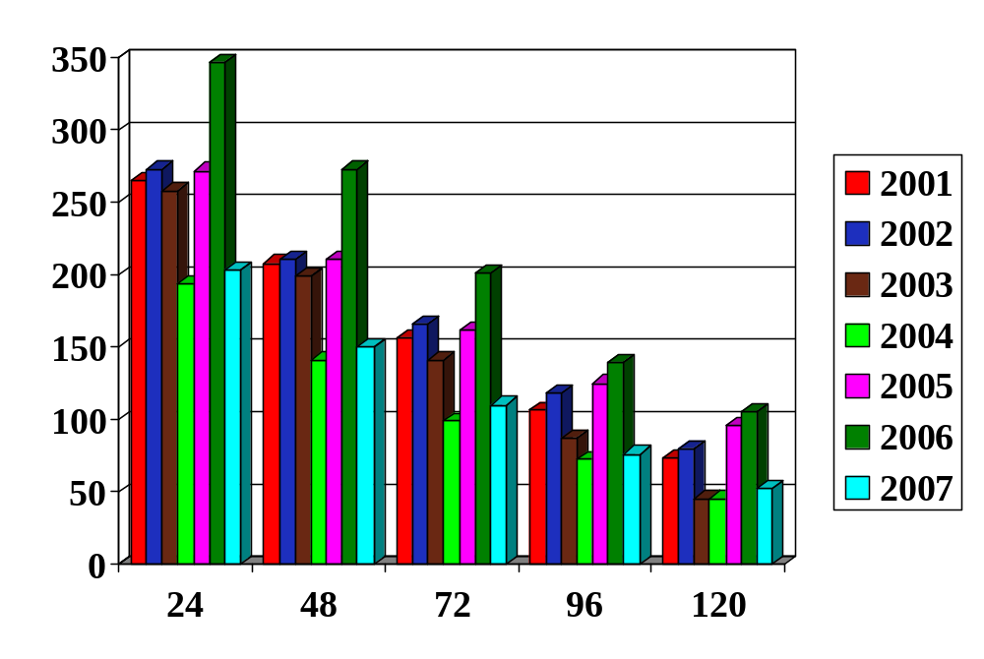
Number of Verifying Official Forecasts
for the Eastern North Pacific Basin

Slide 5
Predicting TC Track Forecast Error
  Using stepwise linear regression and the aforementioned pool of predictors for the 2002-2006 seasons, regression models were found to predict consensus TC track forecast error for each combination of forecast length, consensus model, and basin.
  The regression models were then used to determine the radii of circular areas drawn around the consensus model forecast positions within which the verifying TC position was expected to be contained approximately 75% of the time.
  These circular areas were graphically displayed on the ATCF for use by the forecasters at NHC and JTWC. This graphical predicted consensus error product is referred to as GPCE (“gypsy”).

Slide 6
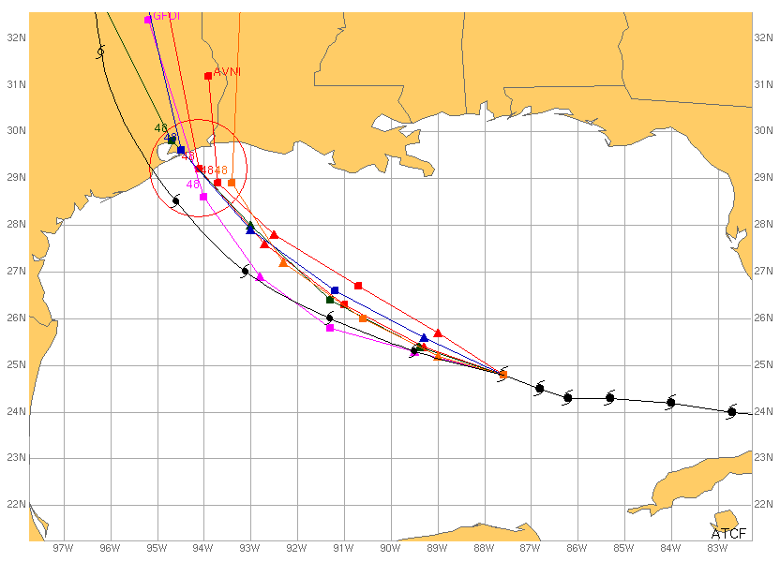
48-h Predicted Consensus Error
Hurricane Rita - 06Z 22 September 2005

Slide 7
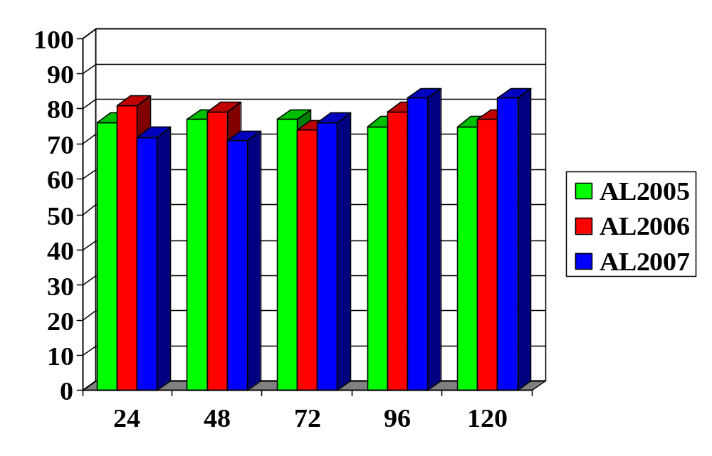
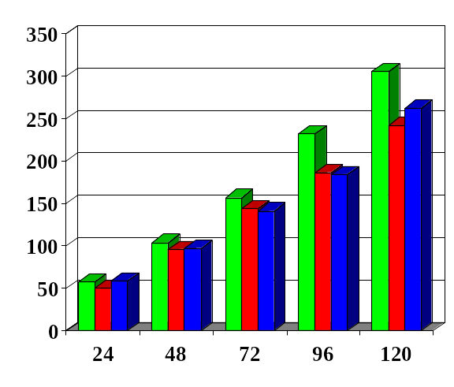
GPCE Validation
2005-2007 Atlantic
GPCE Validation
(Percent)
CONU Forecast Error
(nm)

Slide 8
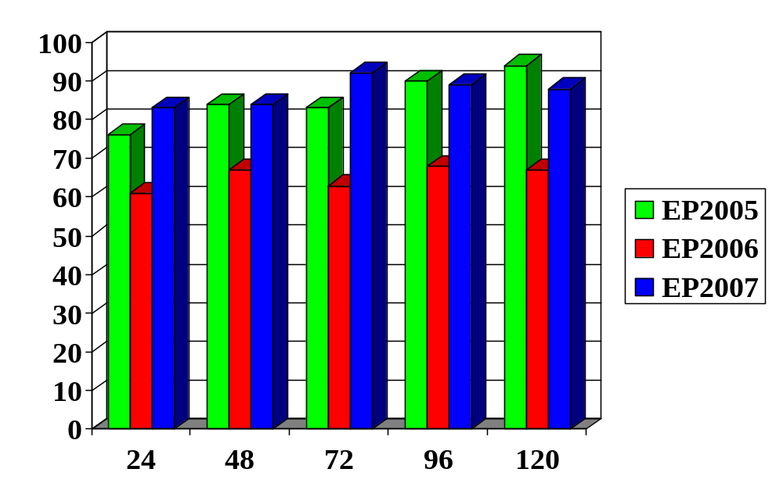
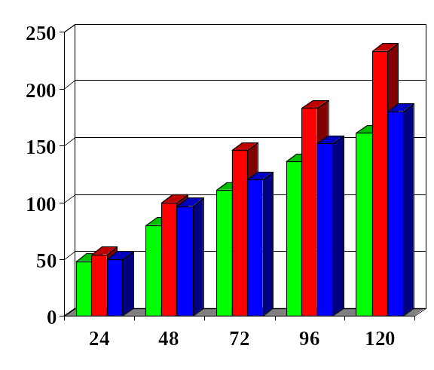
GPCE Validation
2005-2007 Eastern North Pacific
GPCE Validation
(Percent)
CONU Forecast Error
(nm)

Slide 9
Predicting Consensus Model Correctors
Atlantic
  The techniques used to predict consensus error were applied to predict the east-west and north-south forecast error of the consensus models.
  Regression models to predict CONU and GUNA east- west and north-south forecast error for all forecast lengths in the Atlantic were derived using the aforementioned pool of predictors for 2001-2006 seasons.
  The means of the CONU and GUNA east-west and north-south forecast errors for all forecast lengths in the Atlantic were also found for the 2001-2006 seasons to be used as bias correctors.

Slide 10
Predicting Consensus Model Correctors
Atlantic
  For both CONU and GUNA, the bias correctors were found to be more effective than the statistical correctors derived using the regression models for forecast lengths less than or equal to 72 h.
  For CONU, the application of only the statistical corrector for the north-south error was most effective at 96 h and 120 h. For GUNA, the application of the north- south statistical corrector and the east-west bias corrector was most effective at 96 h and 120 h.
  Using these strategies, corrected consensus forecast guidance (CCON and CGUN) was produced for the 2007 season and installed on the ATCF as experimental guidance.

Slide 11
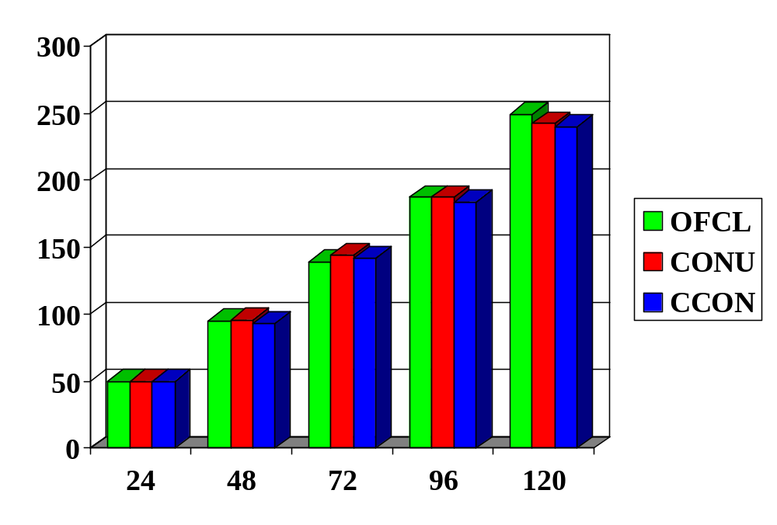
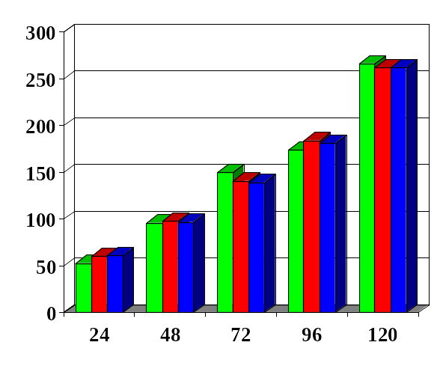
Atlantic TC Forecast Error (nm)
Corrected Consensus - Homogeneous Comparison
2006
2007
207
169
131
97
75
129
87
62
42
23
Number of Forecasts

Slide 12
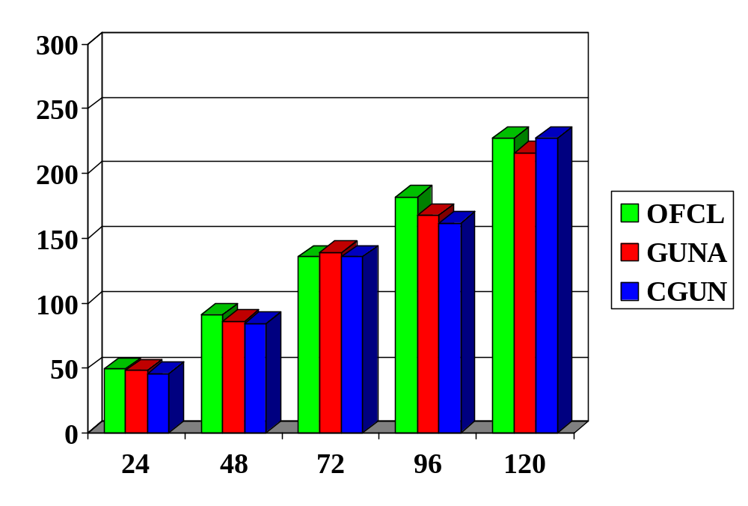
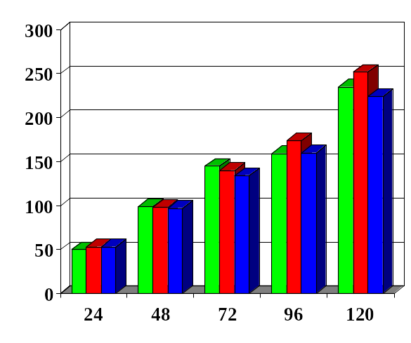
Atlantic TC Forecast Error (nm)
Corrected Consensus - Homogeneous Comparison
2006
2007
173
136
98
68
50
94
65
44
27
16
Number of Forecasts

Slide 13
Predicting Consensus Model Correctors
Eastern North Pacific
  Regression models to predict CONU east-west and north-south forecast error for all forecast lengths in the eastern North Pacific were derived using the aforementioned pool of predictors for the 2002-2006 seasons.
  The means of the CONU east-west and north-south forecast errors for all forecast lengths in the eastern North Pacific were also found for the 2002-2006 seasons to be used as bias correctors.
  The statistical correctors derived using the regression models were found to be more effective than the bias correctors for all forecast lengths and were used to produce corrected consensus guidance (CCON) for the 2007 season.

Slide 14
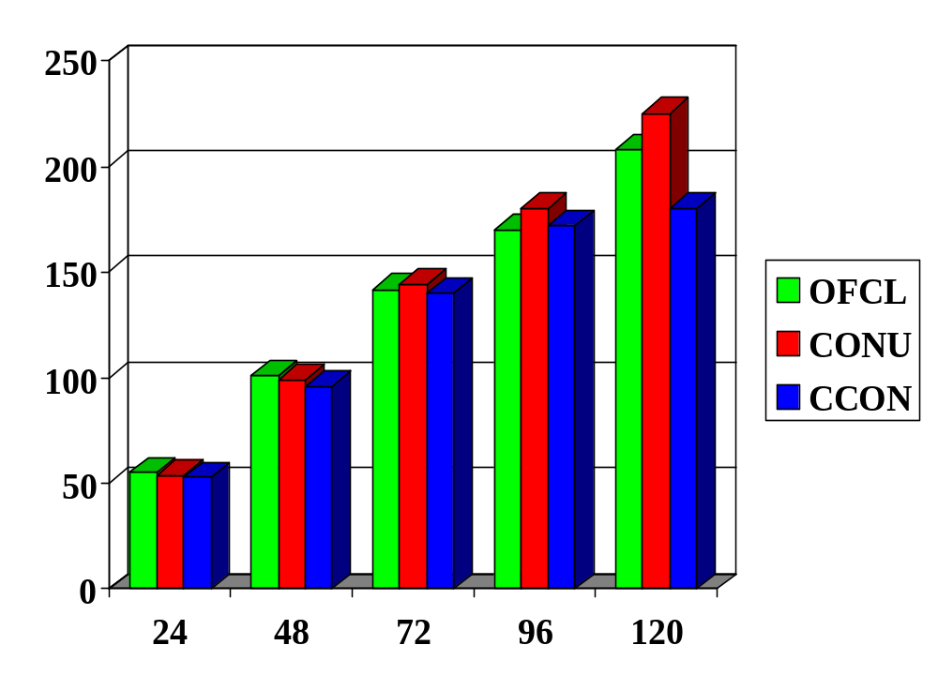
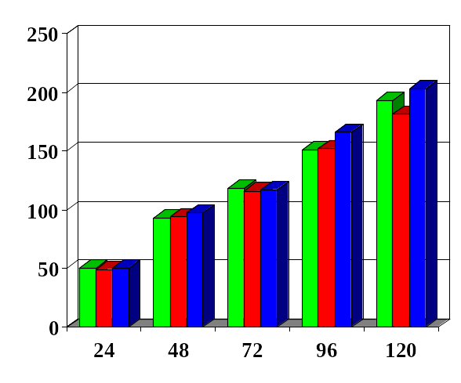
Eastern North Pacific TC Forecast Error (nm)
Corrected Consensus - Homogeneous Comparison
2006
2007
297
223
156
98
61
198
146
103
68
47
Number of Forecasts

Slide 15
Summary
  For the 2007 Atlantic season, the circular areas displayed by GPCE contained the verifying TC position 72%, 71%, 76%, 83%, and 83% of the time at 24 h, 48 h, 72 h, 96 h, and 120 h, respectively.
  For the 2007 Atlantic season, the predicted radii for CONU varied from 30-205 nm at 24 h, 65-210 nm at 48 h, 130-315 nm at 72 h, 170-435 nm at 96 h, and 270-570 nm at 120 h. (NHC Potential Day 1-5 Track Area graphic uses 70, 128, 188, 231, and 303 nm, respectively)
  For the 2007 eastern North Pacific season, the circular areas displayed by GPCE contained the verifying TC position 83%, 84%, 92%, 89%, and 88% of the time at 24 h, 48 h, 72 h, 96 h, and 120 h, respectively.

Slide 16
Summary
  For the 2007 eastern North Pacific season, the predicted radii for CONU varied from 45-115 nm at 24 h, 90-235 nm at 48 h, 145-250 nm at 72 h, 215-325 nm at 96 h, and 275-425 nm at 120 h. (NHC Potential Day 1-5 Track Area graphic uses 66, 117, 167, 192, and 231 nm, respectively).
  Corrected consensus forecast guidance (CCON and CGUN) was produced for the Atlantic and installed on the ATCF as experimental guidance for the 2007 season. For most forecast lengths the CCON and CGUN forecast errors were slightly less than those for CONU and GUNA.
  Corrected consensus forecast guidance (CCON) was produced for the eastern North Pacific and was installed on the ATCF for use as experimental guidance for the 2007 season. Unlike what we saw for 2006, the CCON forecast errors for 2007 were larger than those for CONU.

Slide 17
Questions?

