Slide 1


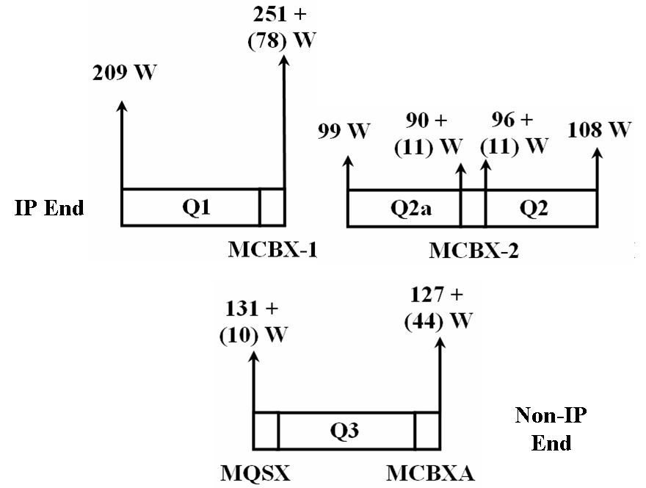
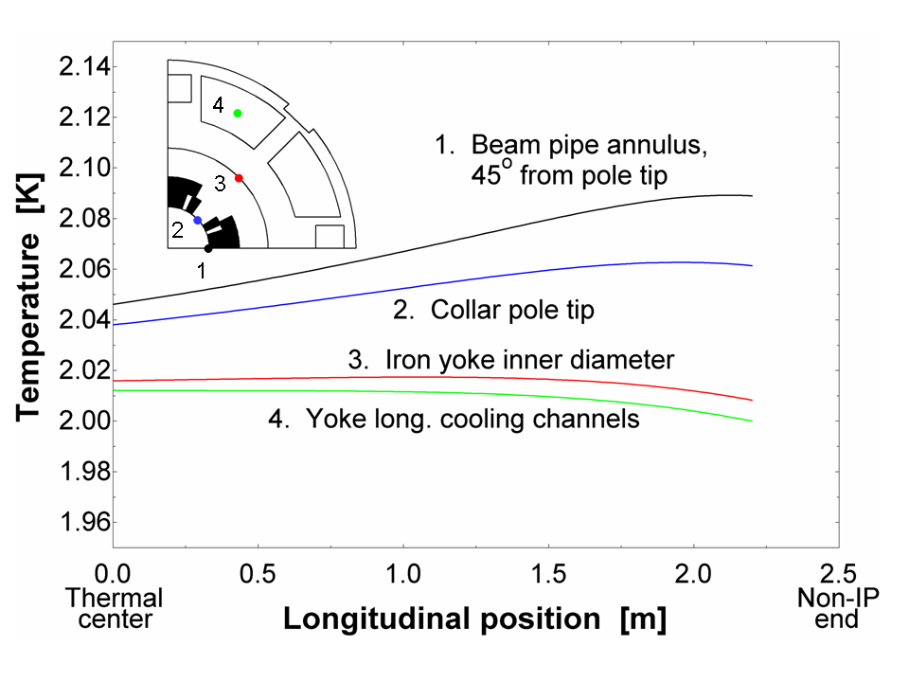
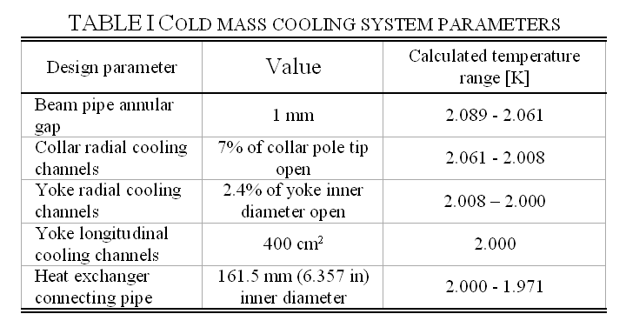
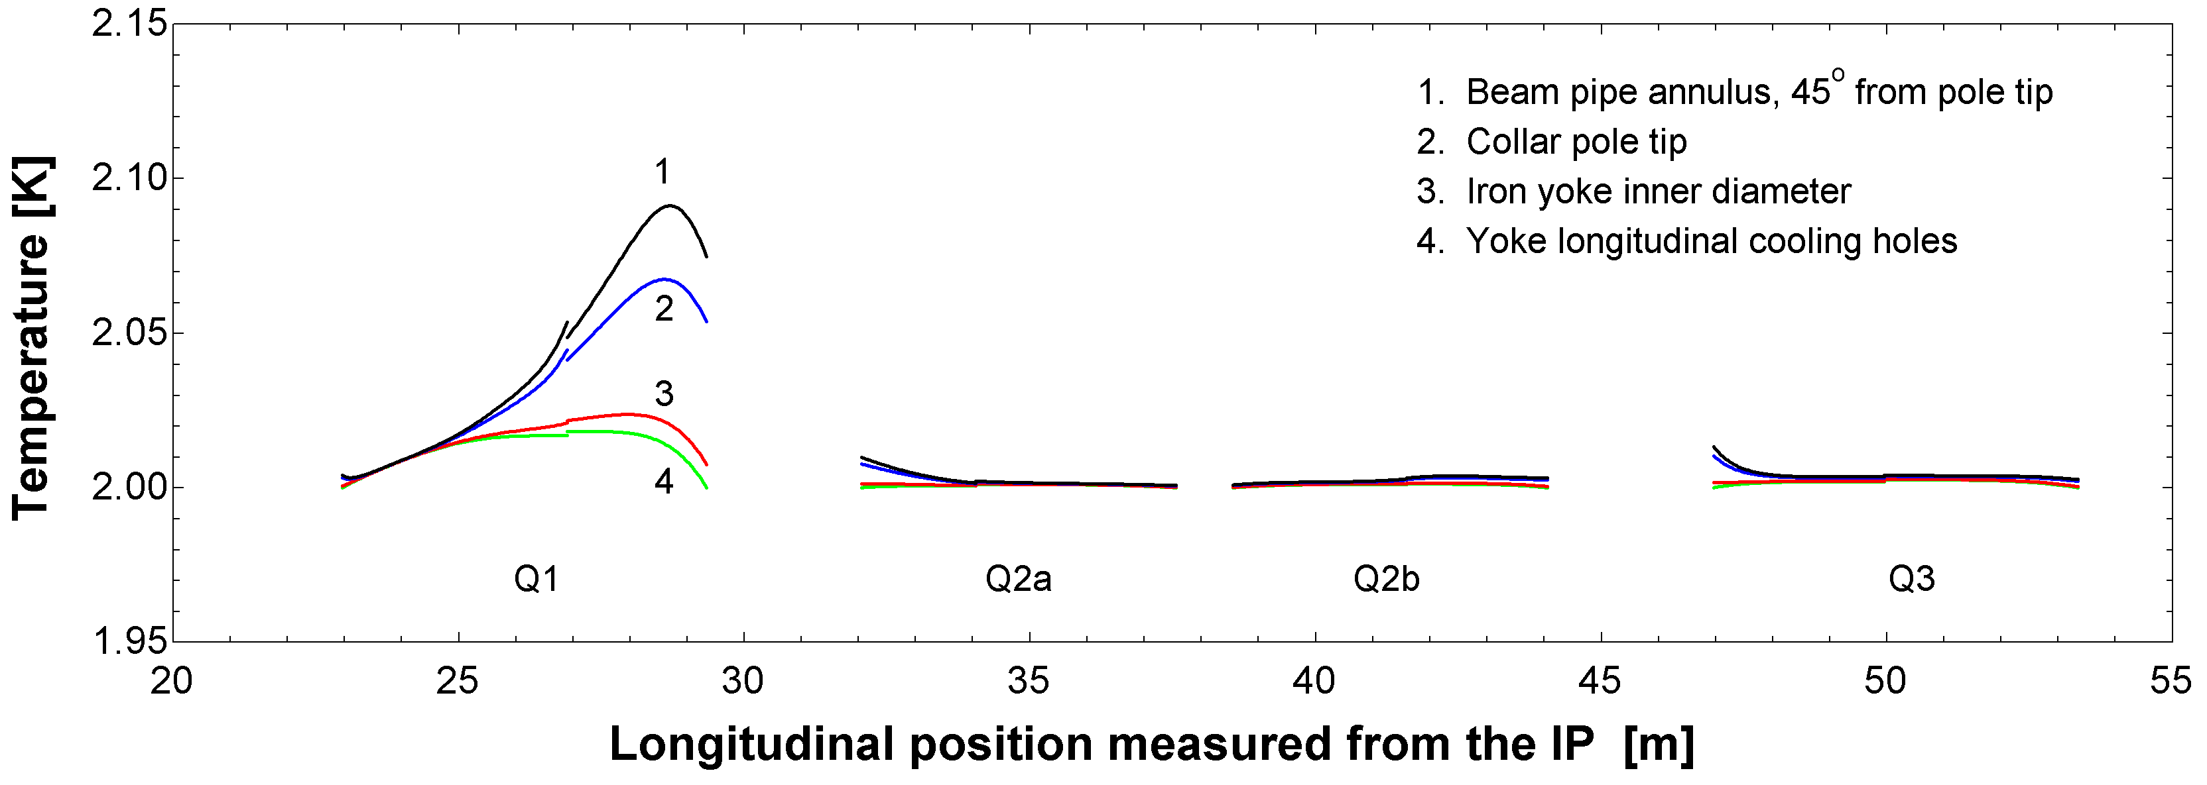
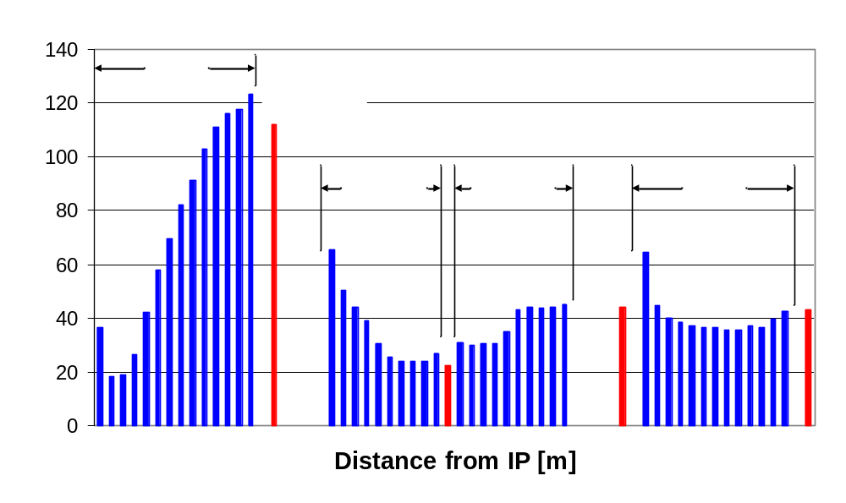
Cold Mass Cooling Design Studies for an LHC Inner Triplet Upgrade
R. J. Rabehl
Fermi National Accelerator Laboratory
Batavia, Illinois 60510, USA
ABSTRACT----A luminosity upgrade of the CERN Large Hadron Collider (LHC) is planned to coincide with the expected end of life of the existing inner triplet quadrupole magnets. The upgraded inner triplet will have much larger heat loads to be removed from the magnets by the cryogenics system. As part of the LHC Accelerator Research Program (LARP), a design study has been completed to investigate the required characteristics of the cold mass cooling system within the framework of a design temperature profile. These characteristics are the beam pipe annulus, collar radial cooling channels, yoke radial cooling channels, yoke longitudinal cooling channels, and heat exchanger connecting pipe. Using these parameters in conjunction with energy deposition calculations, longitudinal and radial temperature profiles for an entire inner triplet are calculated and presented.
IV. DESIGN PARAMETERS
There are a number of critical parameters that must be determined in order to adequately remove heat from the cold mass coils: beam pipe annulus, collar radial cooling channels, yoke radial cooling channels, yoke longitudinal cooling channels, and heat exchanger connecting pipe. The sensitivity and effect of each individual parameter can be studied.
One possible combination of parameters is summarized in the table below. The value of each parameter is noted along with the calculated radial temperature drop near the non-IP end of Q1, where the heat loads are largest. The maximum calculated temperature is 2.089 K, leaving a significant temperature drop (~80 mK) available from the coil to the He II bath.
b
III. THERMAL CENTER AND HEAT REMOVAL DISTRIBUTION
A first estimate of the longitudinal position of the thermal center of a cold mass is calculated assuming the longitudinal temperature drops from the thermal center to each end of the cold mass are equal.
Based on the calculated location of the thermal center of each main quadrupole cold mass, the figure above shows the amount of heat to be removed from each end of each cold mass. The numbers in parentheses are the heat loads deposited in the corrector magnets. The numbers without parentheses are the heat loads deposited in the main quadrupoles.
I. DESIGN TEMPERATURE PROFILE
A design temperature profile was established as a starting point for the cold mass cooling design studies. A number of inputs went into arriving at the design temperature profile:
Study of the existing inner triplet
Consideration of possible LHC cryogenic system upgrades
Similar work being done by CERN for the Next European Dipole (NED) project and IR upgrades.
The resulting design temperature profile allocates 150 mK (2.15 – 2.00 K) from the beam pipe annulus to the heat exchanger connecting pipe and 50 mK within the heat exchanger connecting pipe.
V. MAGNET TEMPERATURE PROFILE
Using these parameters, the longitudinal and radial temperature distribution of one half of the cold mass (from the thermal center to the cold mass end) can be calculated. A finite difference model using temperature-dependent properties of He II was constructed to calculate the temperature profiles. The resulting temperature map of the non-IP half of Q1 is shown above. The heat loads are highest at this location, resulting in substantial temperature gradients within the magnet.
CONCLUSION --- A methodology for calculating longitudinal and radial temperature profiles of an inner triplet has been presented. A complete thermal analysis also requires consideration of the heat exchanger and heat transfer between the coil and the He II.
While results for one specific inner triplet configuration and cold mass geometry are detailed here, this approach can be used to investigate other inner triplet configurations. Convergence on a magnet design will ultimately required iteration on both thermal and mechanical analyses.
* Heat deposition data courtesy of N. Mokhov and I. Rakhno, Fermilab
HEAT DEPOSITION
A required input to calculate temperature profiles is the longitudinal heat deposition. The figure above shows the calculated dynamic heat load to the He II as a function of distance from the IP. The heat deposition rates in the four main quadrupole cold masses are indicated by the blue bars, while the heat deposition rates in the four corrector magnets are indicated by the red bars. The heat is assumed to be deposited equally in the horizontal and vertical planes. Radial variations in heat deposition are not taken into account.
VI. TRIPLET TEMPERATURE PROFILE
These calculations were extended to calculate the radial and longitudinal temperature profiles of the entire inner triplet. The finite difference model was applied to each half of each cold mass to calculate the temperature profiles after additional iterations to more precisely locate the cold mass thermal centers and generate better curve fits of the longitudinal heat load distribution. Discontinuities in the temperature curves are the result of small errors in determining the exact thermal center of the magnet.

