Slide 1
Remote Participation US LHC Hardware Installation and Commissioning
Installation and Commissioning Project
Present Participation
How we might participate remotely

Slide 2
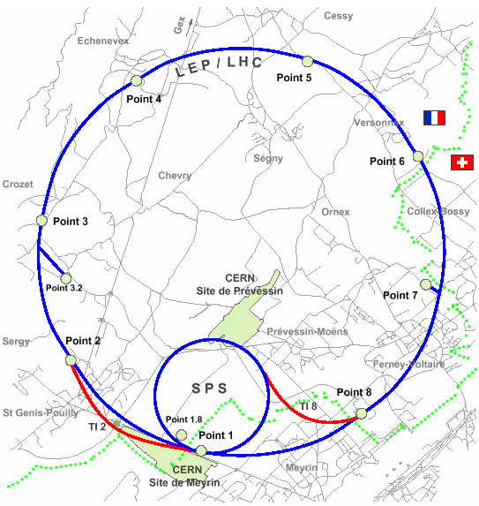
LHC
LHC Accelerator Hardware Overview
CMS
4 Interaction Regions (with US IR magnets)
RF Section with US separation Dipoles
Several Sectorized Subsystems: Cryo, Magnet, Power, Protection, Vacuum….
ALICE
LHC-B
ATLAS

Slide 3

US Components in 5 IR’s
In IR1,2,5, 8
Cryo, Powering, Vacuum etc. tied into the sector
To IP →
MBX
MCBX/MQSOX
MQXA
MQSXA
MQXB
MCBX
MQXB
MCBX
MQXA
DFBX
TAS
“D1”
“Q3”
“Q2”
“Q1”
BNL
LBNL
CERN
KEK
FNAL
IR 2,8 only
Other important components
Hadron and neutral absorber for IR1, 5(LBNL)
Other separation dipoles in IR 1,2,4,5,8 (BNL)

Slide 4
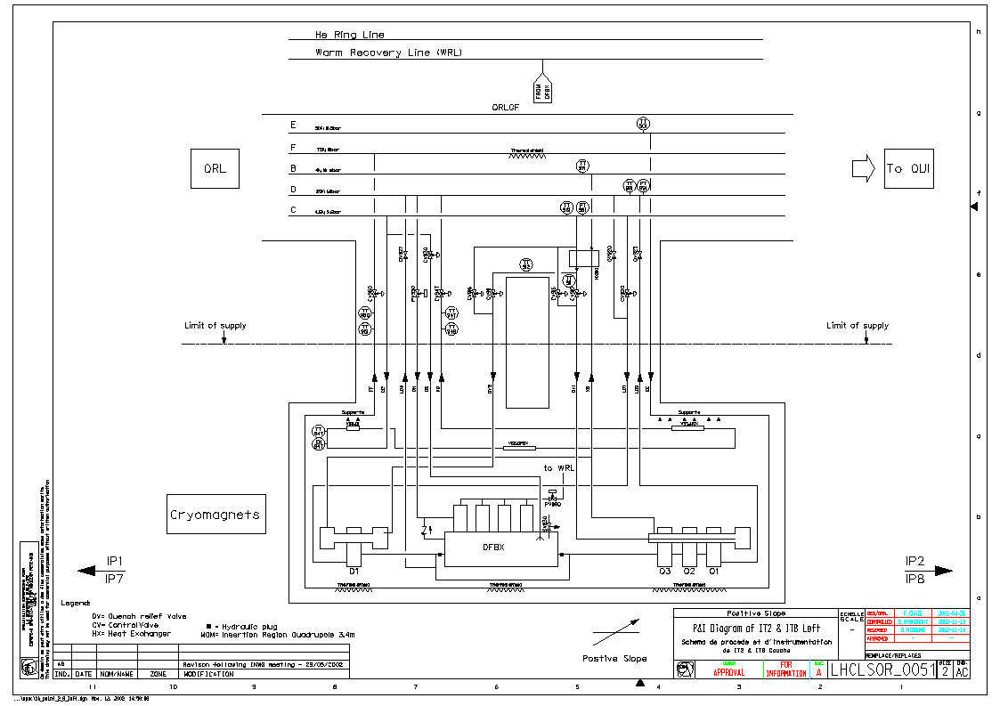
We are vitally interested in the performance of these sub systems
Inner Triplet Cryogenics
USLHC played a major role in the design
Commissioned along with sector
Control Loop complicated by large dynamic heat load and interplay with Sector cooling
Paper studies at CERN on operational parameters

Slide 5
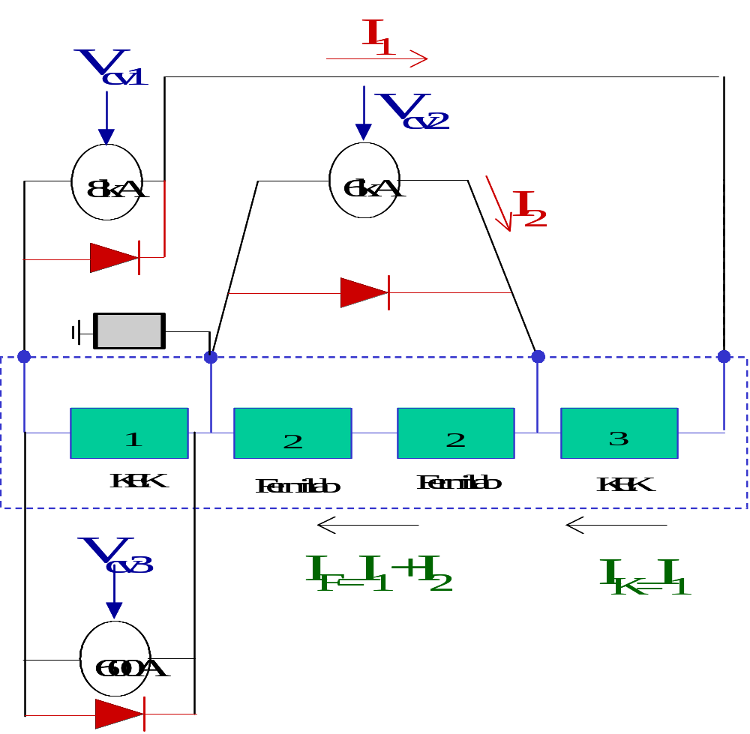
Powering of Inner Triplet
Nested Power Loop
600 amp Trim
Most complicated
circuit in the LHC
Also 12 independently powered
corrector circuits
We are a small but complicated spot on the LHC landscape!!

Slide 6
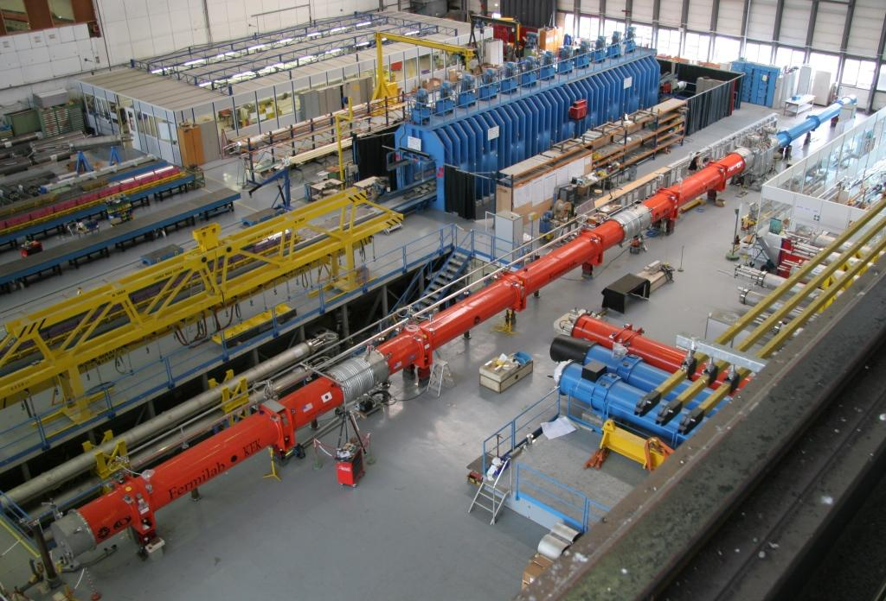
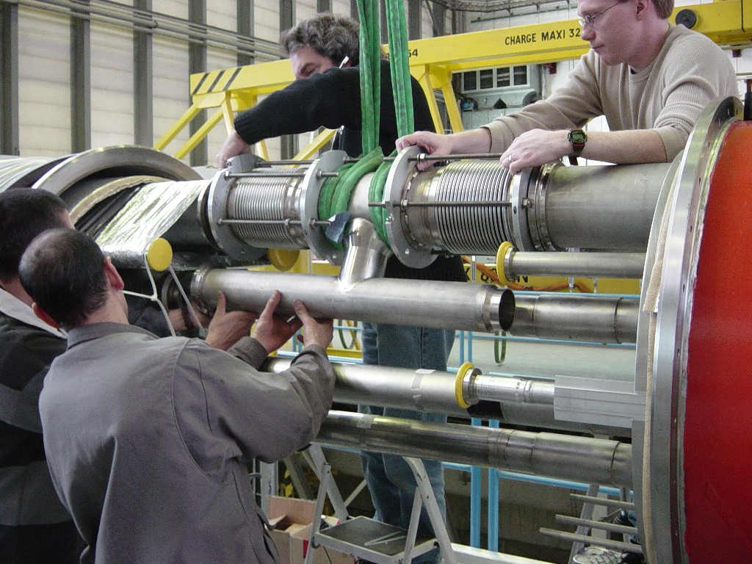
Installation Procedures Proved during Mechanical Fitup at CERN in April 2005
Interconnect region

Slide 7
Installation of US Deliverables
Time Frame: First Inner Triplet Fall 2005 (November)
  Train CERN contractors on installation procedures
  Review mechanical, vacuum, electrical and alignment data
For rest of installation, we have do not anticipate a large US presence at LHC for installation
  Touch labor performed by CERN contractors
  Oversight from CERN and US staff
  Main Participants are Engineers from FNAL, LBNL and BNL
    1-3 week visits only
However….. Low/High Luminosity, Tunnel Geometry makes each interconnect unique! Potential for trouble despite our “best laid plans”

Slide 8
Commissioning of US Deliverables
Start Fall 2005 (Right after installation)
  Participation at first through short visits and possibly through LHC@FNAL
Full Commissioning Task Starts Spring 2006
  3 Long term IR Hardware Commissioners with staggered start dates
    Cryogenic Expert
    Powering and Quench Protection Expert
    System Design
Other US participants may be available TBA

Slide 9
How We Might Participate Remotely In Installation
Each IR magnet string, each interconnect is different
They will be a large US participation for first string only , afterwards…1-3 week durations visit by one or two installation efforts only.
Focus on interconnect details and electrical quality assurance

Slide 10
How We Might Participate Remotely In Installation
  Electrical QA
  Work with LHC QA to review installation data, compare to construction and test data etc…
  “Real time” not necessary, however need access to
    Telephone or instant messaging
    Electronic Logbook
    QA data base
    …accomplished through high speed internet (lots of data, plots ,photos etc)

Slide 11
How we might participate Remotely In Installation
Interconnect problems (don’t expect very many problems however…)
  Problems will likely be ones of “detail” not easy to spot without visual inspection or rapid turnaround/high resolution video
  Useful media devices to allow rapid resolution of problems
    WEB CAM
      Pros
        Rapid communication and direction to problem
      Cons:
        Security issues?
        Resolution (problems will be in the details)
    Cell Phone and Digital Camera (picture or short movie)
      Pros
        Easy to use
      Cons
        Harder to converge on complex problem
  Again high speed internet connect is a must

Slide 12
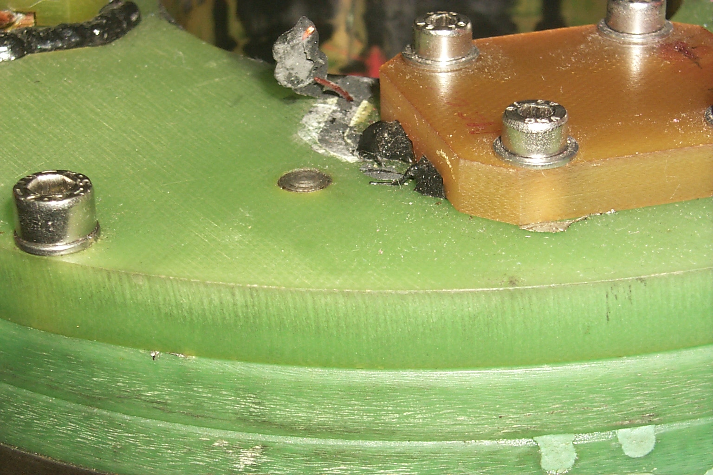
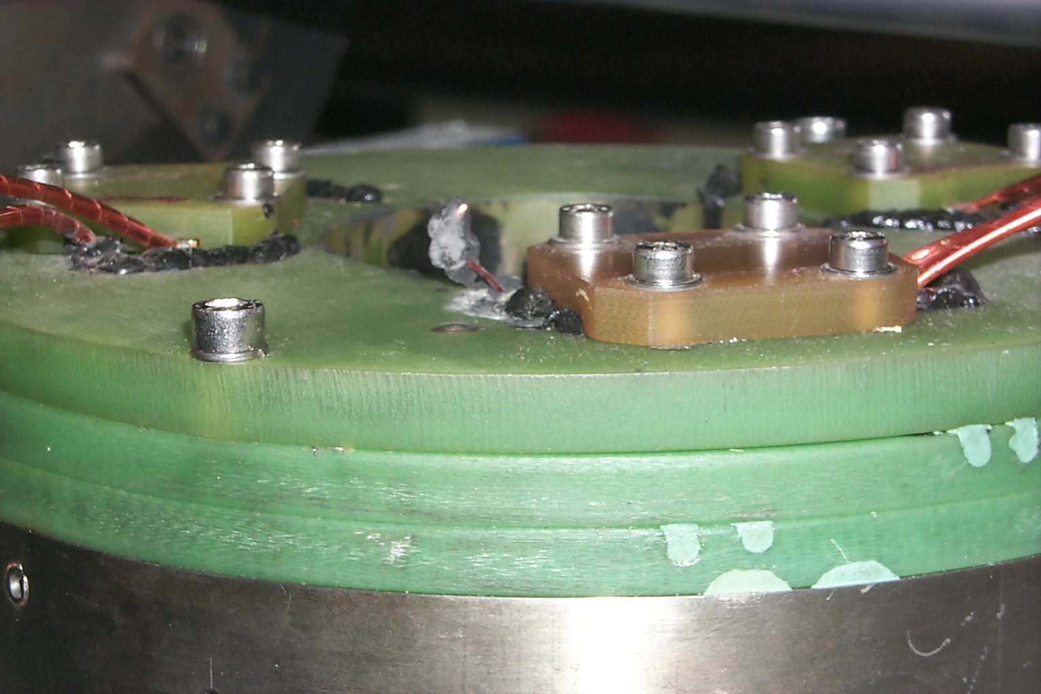
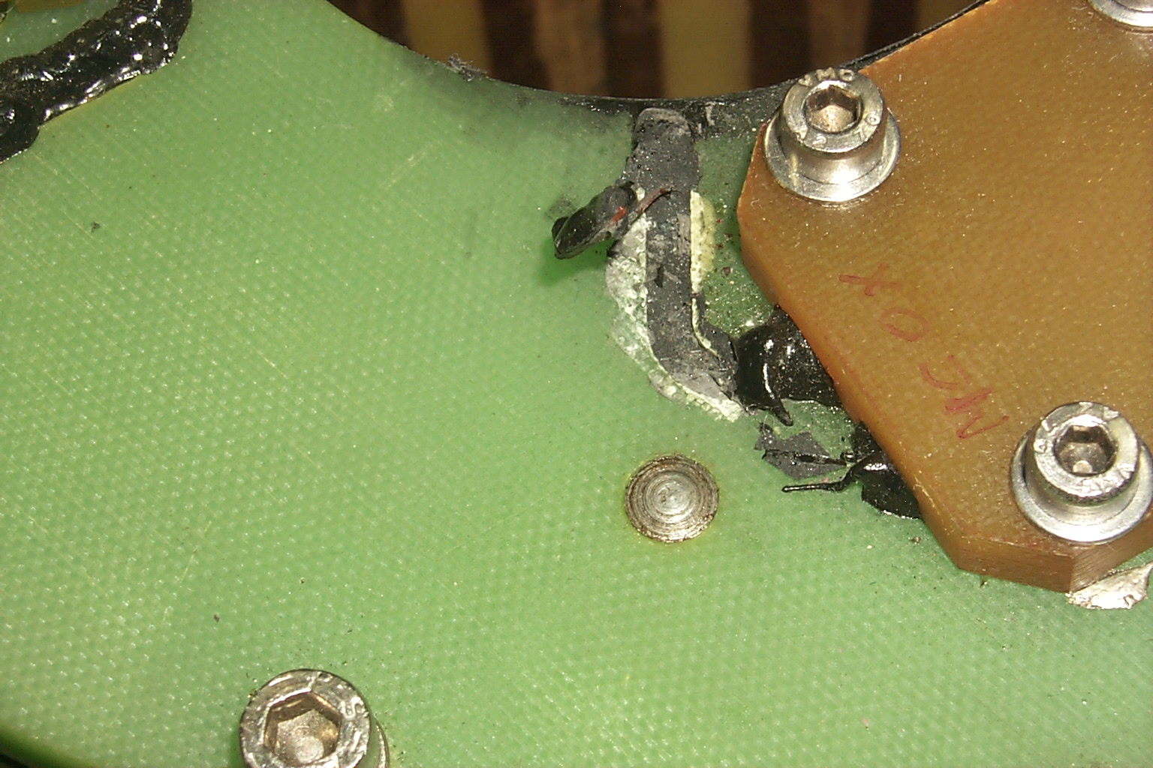
Hi-res pictures
Problem on LHC supplied corrector solved by sending photos and information via email (took several hours)
~2 cm

Slide 13
How We Might Participate in Remotely in Hardware Commissioning
Scenario 126 Illustrates possibility
  Operation Problem that local CERN or US person cannot immediately solve
  LHC@FNAL staffed by US personnel staff during the day in the US (evening at CERN)
  Requirements
    Read/write access to E log books
    Read access to cryo and power data (need not be real time)
    Excellent communication (phone, instant messaging)

Slide 14
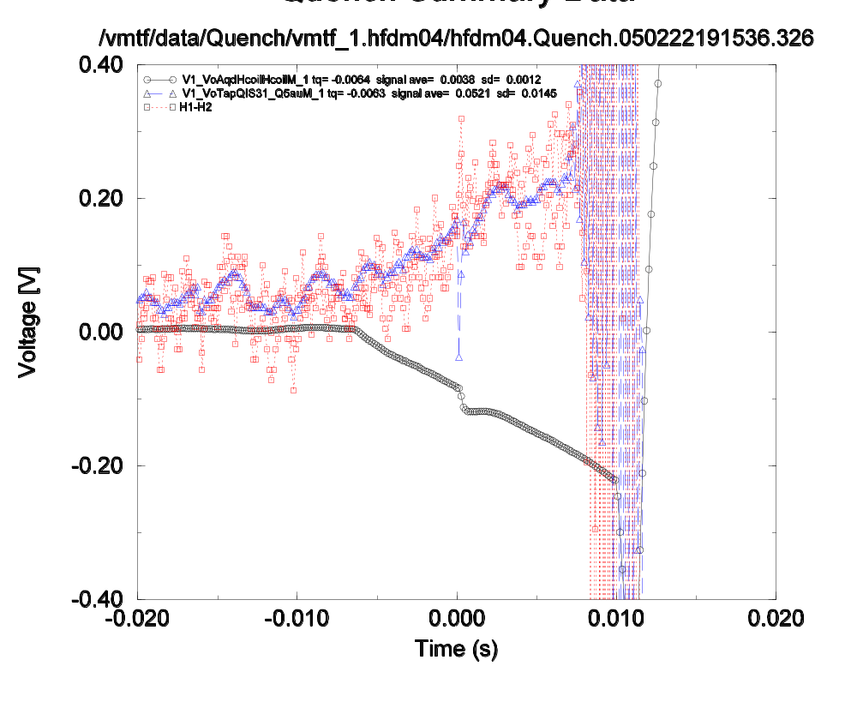
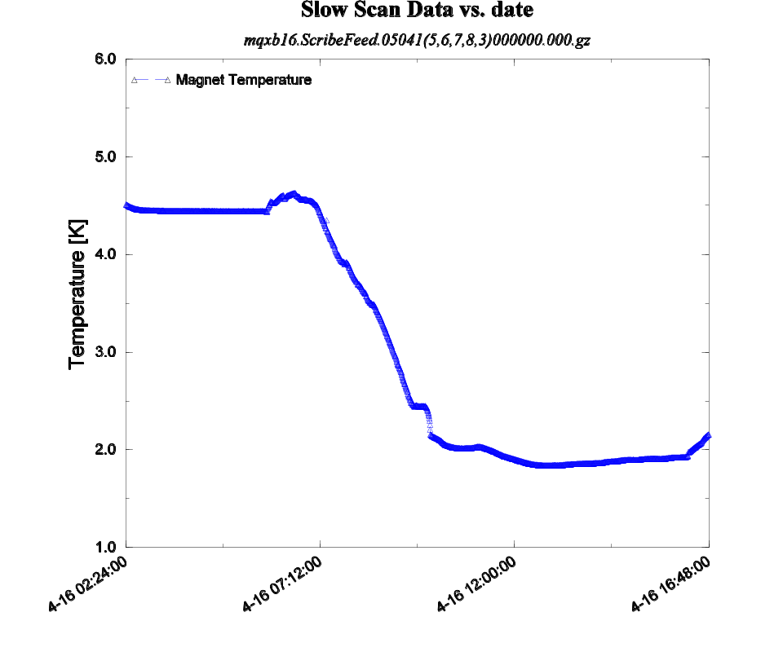
Typical event displays (these were generated in our test facility)
Quench Detection (time resolution at LHC will be much lower 5 ms)
Thermometry

Slide 15
Problems and Concerns
Using LHC@FNAL vs. ones own desk desktop
  Expect better resolution, more screens, better communication, focal place for people to congregate
When will “basic” LHC@FNAL be operational? Note:
  Installation starts in November
  Commissioning will start in December 2005-January 2006
Will it be used regularly ?
  Needs to be easy for both sides to use
    Be able to easily view data, preferably using common applications
    Very good communication, phone, internet
    Visual connection is not essential but with be greatly facilitate.

Slide 16
Conclusion
HC is an important way for the US to contribute to the LHC project
LHC@FNAL could increase impact of US participation, although probably not as much as with CMS and Accelerator Operations
  …although in a few instances it might be a life saver
  Will be very useful for solving hardware problems during operation
Installation and commission is on the near horizon,
  can’t wait for full facility
  could be used to get prototype LHC@FNAL started.

