Slide 1
SNAP vs. Ground-based
Supernova Missions
Alex Kim
For the SNAP collaboration
Lawrence Berkeley National Laboratory
January 2003

Slide 2
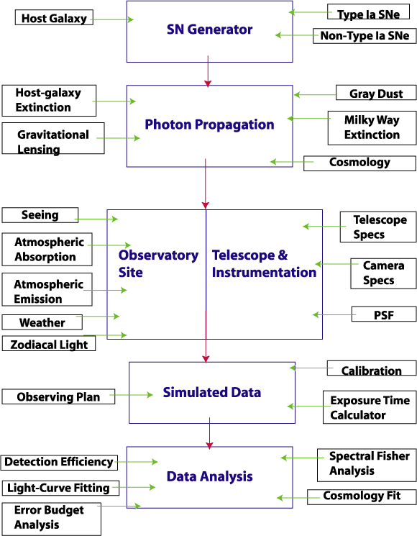
Supernova Mission Simulator

Slide 3
Telescope Specifications
We adopt the specified SNAP mission.
LSST information is primarily from the Dark Matter Telescope website, an LSST candidate.
SNAP 0.7 sq deg FOV, LSST 7 sq deg FOV
 | SNAP | LSST – class WITH NIR CAMERA
Aperture (m) | 2 | 8.5
Secondary Aperture (m) | 0.4 | 5.48
Obscuration | 0.16 | 0.55
Spot diagram RMS (arcsec) | 0.05 | 0.22
Jitter RMS (arcsec) | 0.01 | 0
Throughput | 0.98⁴ (Silver coating) | 0.86³*0.98⁴ (Aluminum coating + corrector + window)
Observatory | Space | Mauna Kea or Paranal

Slide 4
Ground Observing Grid
We specifically examine the possible depth of ground missions.
How well can very high-z supernovae be observed from the ground?
Site Seeing and weather statistics taken from observatory websites and ESPAS Site Summary Series | Mauna Kea | Paranal
Number of fields | 1 All year and full night observations of a single field at a equatorial pole | Multiple Choose fields with low E(B-V) and χ but limited visibility throughout the night and year
Cadence | 4-6 Realistic for one telescope | Every night Assumes 4-6 dedicated telescopes

Slide 5
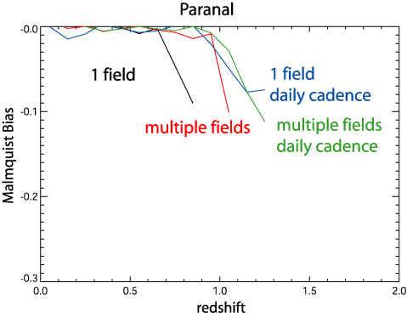
Malmquist bias
1-2 hour exposures at low airmass deeper than all-night observations at the equatorial poles
Saturated observations give a common detection limit

Slide 6
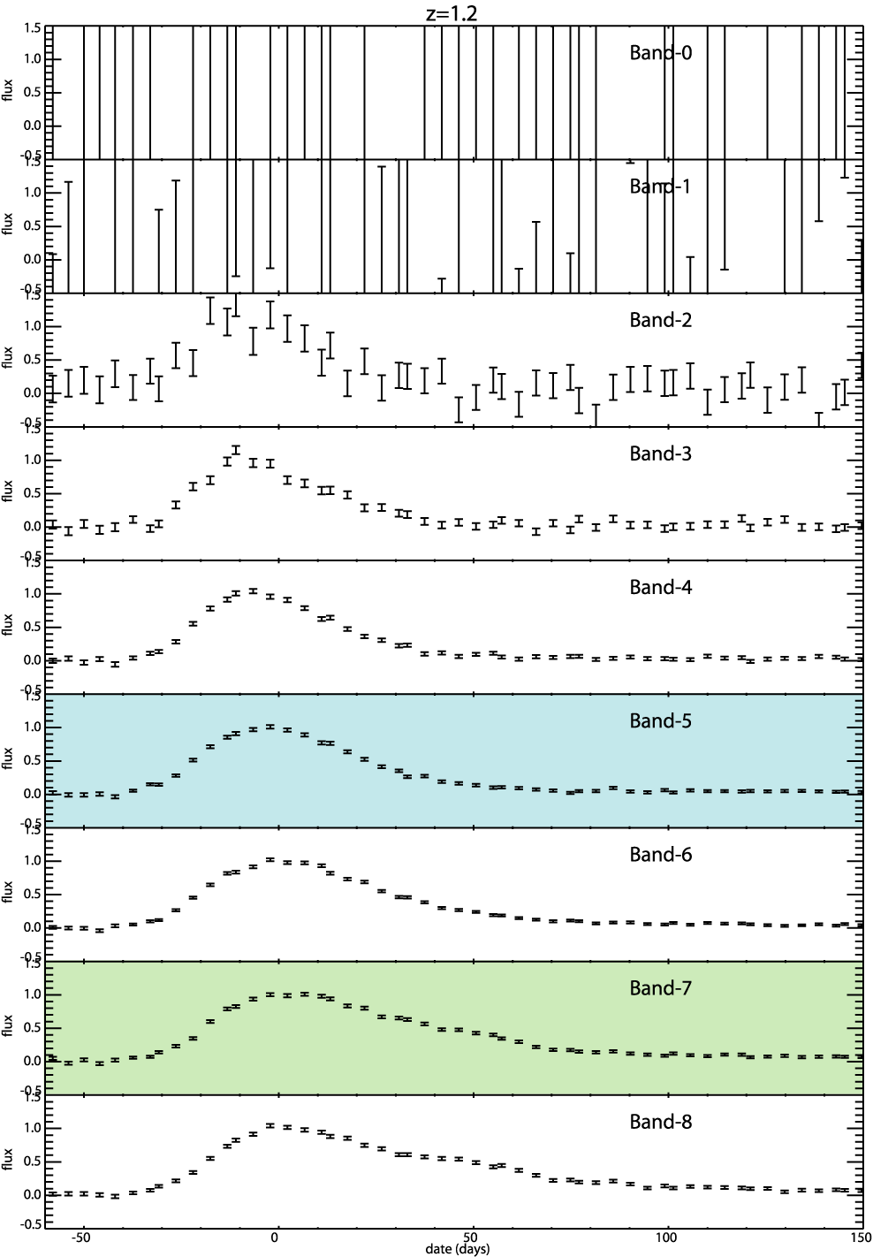
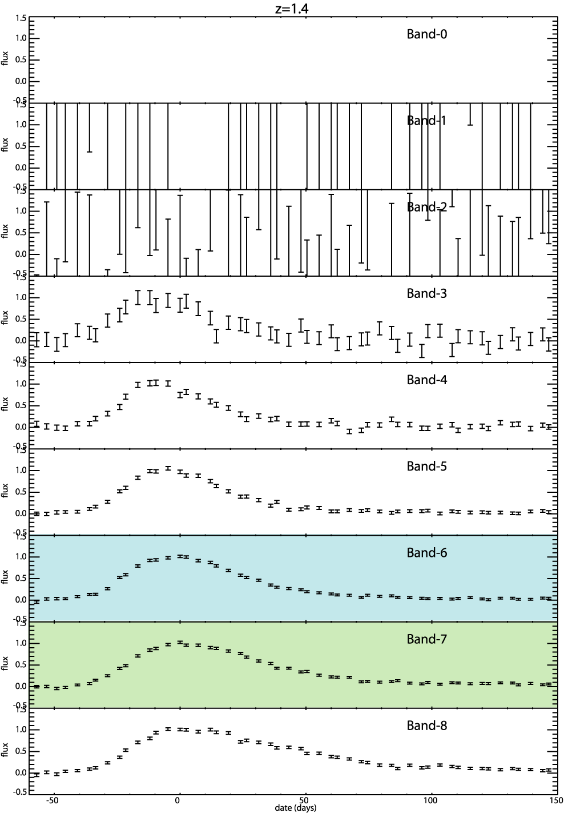
Simulated SNAP Light Curves
z=1.2
z=1.4
Rest B-band
Rest V-band

Slide 7
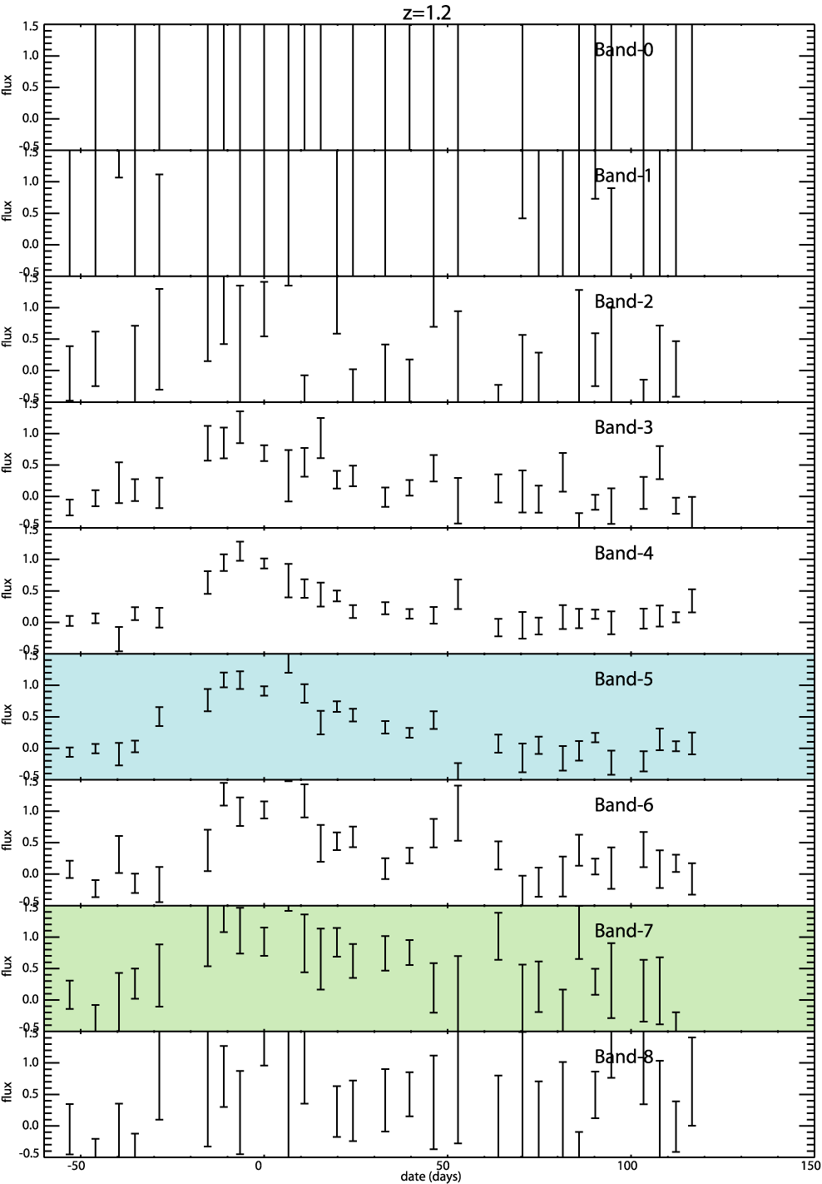
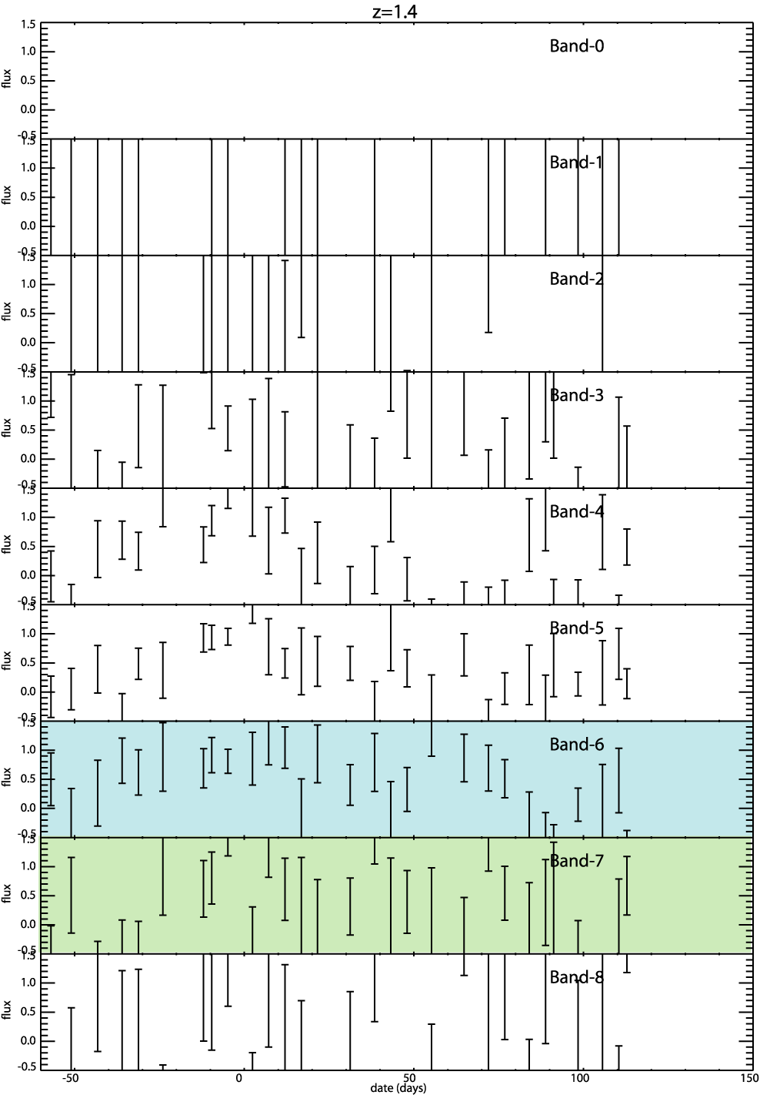
Simulated Multiple-field Light Curves
z=1.2
z=1.4
Rest B-band
Rest V-band

Slide 8
Analysis of Simulated Data
Fit each light curve
Rest-frame B through V filters are fit for peak brightness and stretch.
Other filters are fit for peak brightness
The distance modulus and host-galaxy dust extinction are simultaneously determined from light curve parameters for each supernova

Slide 9
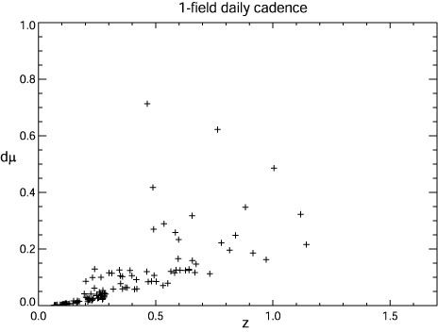
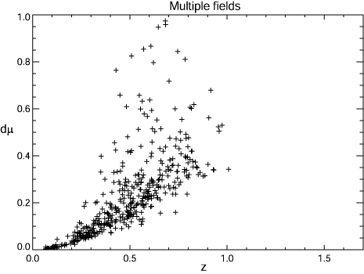
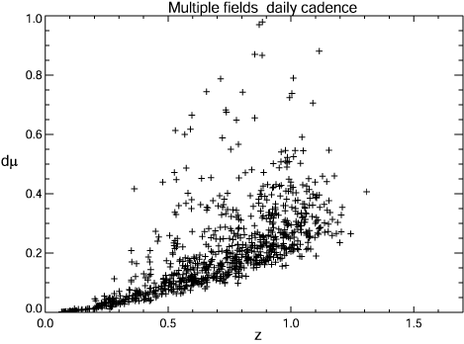
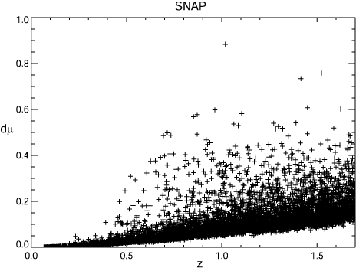
Determination of distance modulus
Assuming a Cardelli, Clayton, & Mathis dust model and Rv=3.1

Slide 10
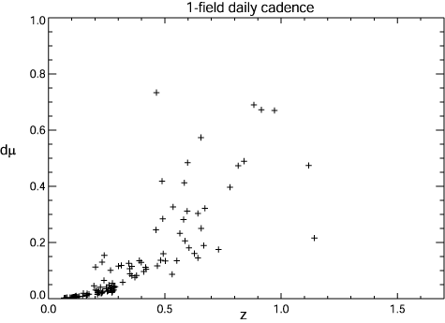
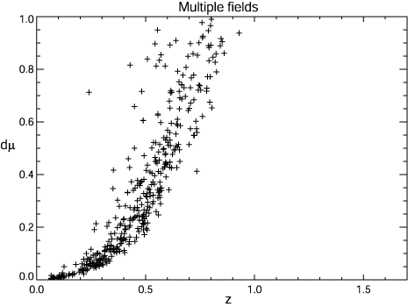
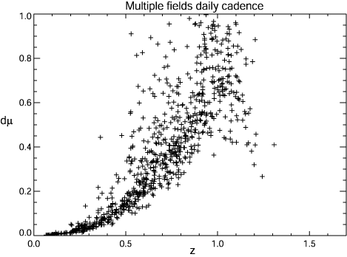
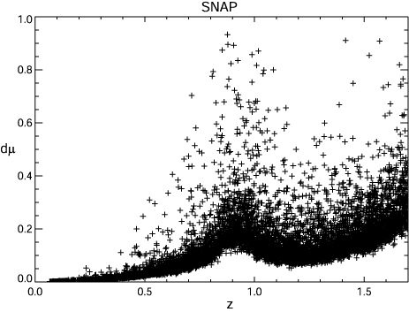
Determination of distance modulus
Assuming a Cardelli, Clayton, & Mathis dust model

Slide 11
Summary
Ground-based wide-field surveys are limited in redshift depth
  In the best case considered, discovery Malmquist bias will be significant at z > ~1
  Host galaxy dust measurement will introduce extremely large extinction uncertainty from the ground at z>0.8
Other possible light-curve parameters (rise-time, plateau level) will be more difficult to measure from the ground

