Slide 1
LAUC Proposal:
Feedboxes and System Engineering
US LHC Accelerator Research Program
bnl - fnal - lbnl - slac
  Proposal
  Motivation
  What the present IR looks like
  System Ideas for new IR
  How we could participate
  Conclusion
Michael Lamm
LARP+LAUC DOE Review
June 21, 2008

Slide 2
Proposal Summary
Play a lead role in the Phase 1 IR System Design
    Cryogenic engineering
    Powering/Quench Protection
    AP support
  Supply all or part of the cryogenic/power distribution boxes

Slide 3
Motivation to Participate in Phase I IR Upgrade
  Benefit to CERN is our unique experience/expertise
    U.S. responsible for much of the existing IR system components and system design
    Major contributor to ongoing LHC program via LARP Hardware and Beam Commissioning
  Benefit to U.S.
    Supports LARP goals (general and Nb3Sn Magnet)
    State-of-the-art accelerator component design
    Modest investment, sizable contribution
    Support US HEP (higher luminosity, faster)

Slide 4
Present High Luminosity IR Layout
To IP →
MBXW
MCBX/MQSOX
MQXA
MQSXA
MQXB
MCBX
MQXB
MCBX
MQXA
DFBX
TAS
Resistive “D1”
“D1”
“Q3”
“Q2”
“Q1”
BNL
LBNL
CERN
KEK
FNAL
Two styles of IR Quads, MQXA(KEK) and MQXB(FNAL): same aperture and operating gradient; different inductance and powering
Resistive D1 (SC D1 in low luminosity regions supplied by BNL)
Distributed correctors built into Quad coldmass
In-line cryo/Power Feedbox (DFBX)
No extraction circuit, all heaters fire under quench condition

Slide 5
Latest Ideas from CERN for Phase I IR
IR Quadrupoles: Wider aperture, lower gradient, longer length: New Layout!
D1 wider aperture magnets (superconducting)
Local corrector magnets may be incorporated into a single box
Quads operate in 1.9K, D1/correctors 4.2 K TBD
Layout argues for new cryo/power distribution boxes
Large stored energy argues for new powering scheme including extraction circuits

Slide 6

Present idea for Powering New IR Quads
Identical Magnets powered in series
Extraction Circuit
Bybass diodes
Trim PS
Presentation by K.H Mess (Dec. 2007)

Slide 7
Powering Issues
Extraction Circuit ?
    Benefit depends on propagation of quench energy through helium vs. energy extraction efficiency
      Analysis of phase I IR quad thermal model
      Quench analysis of Cryogenic/power feedbox
      Data collected now during commissioning provides insight

Slide 8
Powering Issues II
Cold vs. Warm diodes
    Less reliable/less accessible but would reduce number of high current leads
      Experience with diodes in present LHC
        Cold in arcs, warm in IR’s
      Experience with HTS lead design
        Effect of transient high current

Slide 9
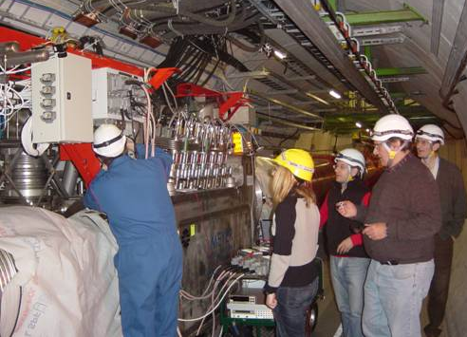
Existing feedboxes not matched to phase I needs
  Phase I requires 12kA power leads
  Phase I needs SC D1 power distribution
  Space is very cramped with existing boxes
  No spare power boxes, no spare leads…
Electrical QA Tests on DFBX
  Existing cryostat and power interfaces don’t match new system requirements

Slide 10
New Feedbox strategies
While many solutions are being considered the favored solution is to build new boxes, placed in a low radiation-accessible alcove
    Easy access to feed box and power leads
    All boxes built ~the same (no need for L/R, uphill, down hill)
    SC link from feedbox to magnets. Highly desirable to use HTS or MgB2 since it can be cooled by He gas and therefore need only room temperature gas outlet
    HTS leads (MgB2 or 2G YBCO considered)

Slide 11
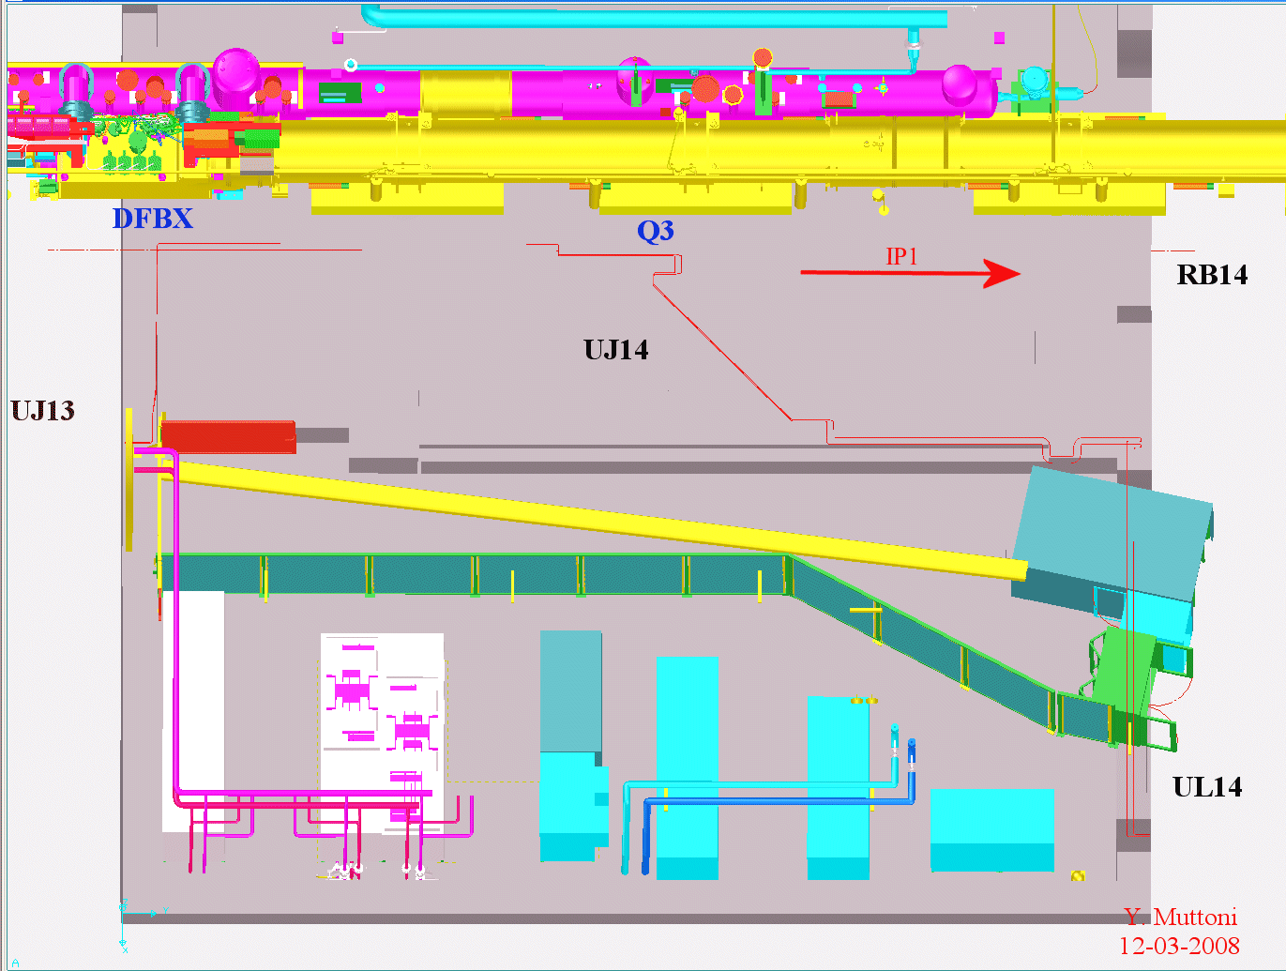
HTS leads ~ 30 Meters from beam line
Offline box with Λ plug transition to SC link
Access control
Removable
SC Link is Vapor Cooled
SC transition box with HTS Vapor Cooled gas leads

Slide 12
In position to take lead in system design
  USLHC was responsible for the Cryogenic Design of the existing IR
    Provided existing DFBX including HTS leads!
  Electrical design including, heater specs, buswork and expansion loops
  Leadership position in LHC HC
    Responsible for CERN DFB cryo commissioning as well as DFBX retrofits.
    Presently responsible for both cryo and electrical commissioning of DFBX

Slide 13
Cryogenic Contributions
  US would take a lead role in the cryogenic design of Phase I IR
    Evaluate performance of existing system
    Calculate static/dynamic heat loads
    Review magnet thermal design
    Review heat exchanger location efficiency
    Propose cryogenic instrumentation

Slide 14
Cryogenic Effort/Schedule
  Cryo must be determined early in the IR design!
    No major mods to cryoplant envisioned
    Magnet environ. (mass, cooling req., oper. temp)
    Powering scheme
  Will require expensive effort starting no later than Fall FY09 (preferably ASAP)
    Will require extended stays at CERN (2-3 weeks, 3-4 times over the next 12 months)
    Mostly cryo engineers not presently working on LARP

Slide 15
System Powering/Quench Protection
Proposed areas of concentration:
    Quench protection integration
    Quench protection studies
    Power supply specifications
    Feedbox powering especially, SC link and SC power leads
    Design/specification of internal bus work, internal wiring
Interesting engineering and magnet science task

Slide 16
Proposed Quench/Powering Effort
Two LARP quench protection experts stationed at CERN till January 2009 for HC
    Propose to CERN that some effort be diverted to this task starting in the Fall
    This work must be done in close conjunction with CERN powering/quench protection group so task is well matched
  Expect extended visits to CERN beyond January 2009 is needed
  Segue from HC to Upgrade

Slide 17
Accelerator Physics Issues
Based on our experience with the present IR Quads, there are several IR related AP topics beyond the basic optics design:
Strength and Location of Corrector Magnets
Effect of Internal Alignment of IR quadrupoles
    Expect to be more critical in Phase I
Energy deposition studies
    Impact on IR absorber design
Propose ~0.5 FTE AP effort
Redirection on LARP JIRS?

Slide 18
Propose to supply cryogenic feedbox
  CERN plans for phase I feedboxes are being discussed now as part of the LHC IR working group
  Detailed plan depends on results of cryo, powering and quench protection system TBD
  Most of the effort in the next 12 months will go towards making a design and detailed cost and schedule analysis, however…
  Based on present feed boxes, cost of HTS and cryo distribution lines, we estimate ~$1500k/complete feedbox. (not including EDIA)

Slide 19
Cryo/power feedbox issues
  Feedbox schedule will be challenging concept➔design➔delivery by 2013
    Do-able based on our extensive experience with existing feedboxes
      In some ways simpler device because there are less space constraints
      Institutional memory; will benefit from lessons learned in existing DFBX
    CERN must commit to functional specs within 6 months

Slide 20
Cryo/power feedbox issues
  SC link will be a challenge but do-able
    Tight space, 40 m run with brittle material
    Part of mission is to consider all reasonable options including resistive or LTS links
    Ongoing discussion with MgB2 vendors in U.S. and Europe
    U.S. supported YBCO transmission lines
    Expect collaboration with CERN power lead expert along with our own experts
    Build 10 meter prototype in FY10

Slide 21
Summary of Required Effort in FY09
Goal: Feedbox design for CD02
  Experience shows in house design must be well beyond concept for real cost estimate
  SC link and SC power leads is not off the shelf
    Design 10 meter prototype link and test
    System design closely linked!
Effort in FY09: ~3 FTE’s (1.5 FTE drafter, 1.5 FTE Cryoengineer, 0.5 FTE physicist)

Slide 22
Summary of Required Effort in FY09 II
  To make an impact and meet our delivery schedules, the system design must be solved in some detail prior to the CERN TDR. For FY09
    Cryo design (0.75 cryo engineer)
    Powering Scheme (0.5 FTE physicist)
    AP studies (0.5 FTE physicist)
  ~2 FTEs

Slide 23
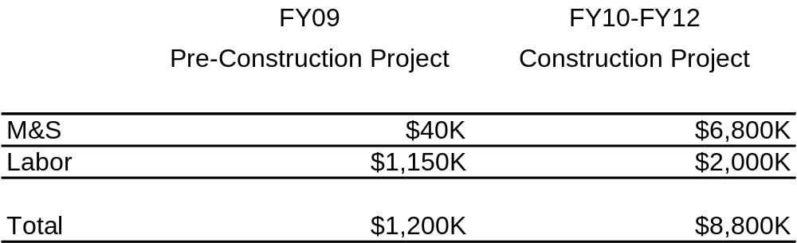
Cost Estimate and Milestones Summary
Functional and Interface specs for IR: January 2009
  CD2 summer 2009
  Order Feedboxes: No later than January 2011
  String test at CERN (deliver first DFBX) Jan 2012
  Start installation: Jan 2013

Slide 24
Conclusion
  U.S. is in a unique position to contribute to the phase I IR System Design and Feedbox
  Tasks aligned with U.S. long term goal for Nb3Sn IR quads and advanced accelerator technology
  New feedboxes with HTS/MgB2 is a technically interesting project with high success probability
  Only modest effort required, should not have major effort impact on Nb3Sn program.
  System design needs to start NOW. Feed box design needs to start this year; construction in 2010-12

