Slide 1
LHC Commissioning Task Force
US LHC Accelerator Research Program
bnl - fnal- lbnl - slac
Vladimir Shiltsev
for the LHC Commissioning Task Force
(W.Fischer, G.Ganetis, M.Lamm, A.McInturff, T.Raubenheimer, V.Shiltsev, M.Zisman)

Slide 2
General Info on the CTF
Induced by S.Peggs Letter of Feb 16, 2005
Charge:
  Present a working draft of a ``white paper'' recommending an
  integrated plan for the organization of LARP participation in LHC
  commissioning, at the LARP collaboration meeting April 6-8, 2005.
  Present a final draft of the white paper to the CERN-U.S. Committee
  when it meets next (summer 2005).
  Evaluate LARP planning for involvement in LHC beam commissioning, in
  consultation with Mike Syphers and Elvin Harms.
  Recommend the extent of any additional scope* of LARP involvement in
  Hardware Commissioning, assuming formal endorsement and support by DOE and U.S. lab directorates of a LARP role in its organization. Evaluate the desirability of merging commissioning components 2 and 3, into a single Task addressing broad hardware commissioning of just the interaction regions.
  Recommend the appropriate role of ``Toohig fellows'' -- defined, for example, as new or recent PhD accelerator physicists or engineers hired by LARP to serve for 12 months of their 2 or 3 year post-doc terms at CERN.
  * currently, the LHC hardware commissioning is not in scope of US-LARP

Slide 3
CTF (cont’d)
CTF members represent the US-LARP labs :
  Fermilab TD M.Lamm
  Fermilab AD V.Shiltsev
  Brookhaven CAD W.Fischer
  Brookhaven SMD G.Ganetis
  Berkely AFRD M.Zisman
  Berkeley AFRD A.McInturff
  SLAC T.Raubenheimer

Slide 4
CTF (cont’d)
Worked via :
  E-mailing
  Video-Conferencing (March-April)
  met at Port Jeff (April)
  met at PAC’05 (May)
Work to be finished by CERN-US Executive Committee meeting Sep.14, 2005

Slide 5
Participate in LHC Commissioning – Why?
Benefits to the US HEP program:
  overall benefit if the LHC turns on rapidly and successfully:
    support of the US investment in the LHC
    secure future accelerator based HEP projects in the US
  the information and experience gained will be available for:
    the LHC upgrades
    the ILC (e.g., on large 2K systems) and other future machines
    (possibly) for operating colliders, e.g. RHIC
  opportunities to
    train younger staff
    advance international cooperation
    conduct forefront accelerator physics R&D

Slide 6
Scale of US → LHC Commissioning
Hardware Commissioning (including installation):
  Recent count shows resources missing:
    100.5 people x ~14 mos commiss. period = 117 FTEs
    Approx ½ of them (~45 FTEs) Engineers and Physicists
    Expertise needed: Cryo Instr, Cryo Controls, Quench Protection, Interlocks, Elect-Eng, Commiss. Coordinators, Instrum. Controls
    FY’06—FY’07
Beam Commissioning:
  tentative goal ~1 US rep /LHC shift =~(6-7) FTEs/ yr
  start in FY’07, then FY’08+FY’09+? → 12-21 FTEs
    Pre-beam → Startup → Luminosity/MD Studies
    Longer term development and exploitation of US deliverables
    Areas of US interests (e.g. beam-beam, e-cloud, halo, etc)
    CERN planning on good track

Slide 7
CERN View On LARP Involvement in LHC BC
SPS extraction, transfer, injection and first turn
Multi turn losses and BIS dependability
Protection devices other than collimators
Collimation system and Halo cleaning
Clean Beam Extraction
Radio protection
Beam Instrumentation
Vacuum conditions during operation and electron cloud
Reference magnet system
RF systems and longitudinal beam dynamics
Transverse feedback
Experimental solenoids and compensations
Experimental equipment (Roman pots, velo)
Beam in the injectors
Ion beam in the injectors
Orbit feedback system
Filling efficiency and flat bottom conditions
Ramp and squeeze losses and overall quality
Machine protection system
Optics
Mechanical aperture
Machine Impedance and collective instabilities
Dynamic aperture
Lattice corrector settings
Triplet corrector settings
Lifetimes
Separation schemes
Crossing angle schemes
Collisions and luminosity steering
Experimental conditions
Ions
R.Bailey (2005):
“…In the present US-LARP proposal, resources are allocated for “Beam Commissioning and Accelerator Physics” activities from 2004 onwards, rising to significant numbers by 2007. In the discussions to date, we have made the point that the US-LARP commitment has to be made with long-term individual commitments of around 12 months, and that US staff should come to perform a specific role in the beam commissioning work. It has also been clearly said that CERN has to maintain sufficient expertise, particularly on shift, to ensure long-term exploitation of the machine
With this in mind, we feel that a very limited number of US-LARP resources could participate in the shift rota. Rather, they would be best suited to the accelerator physics and equipment group support activities”
Points to address for each system
  What is the specification with beam
  What measurements are needed
  What tools are needed
  What beam is needed
  How much time is needed

Slide 8
Possibilities of Participation Depend On:
Funding:
  Installation/Additional Hardware – not identified yet
  Beam/Deliverables Commissioning – by LARP
Schedule/Uncertainties
  HC in FY’06-07 + “tail”, BC in FY’08 and beyond
  no formal indication that CERN wants US help in HC
  US side uncertainty – RHIC&TeV operations, ILC efforts
Available Human Resources:
  CTF members approached management of corresponding labs and explained/discussed the issue
  estimated # of Eng and Phys possibly available for long (½ to 1 yr) and short (few weeks – few mos) commit-ment; got blessing from management to count on them
  have preliminary lists of names

Slide 9
US Resources Available for LHC Commissioning
Hardware Comms. Beam Commissioning
long-term FTE long-term FTE short-term
Laboratory min → max min → max est.visitors
Fermilab 4 → 7.5 5 → 12 12
Brookhaven 0 → 0 0 → 1* 10
Berkeley 1+1* → 2 + 2* 2* → 2 + 2* 8
SLAC 0 → 0 0 → 1 2
TOTAL 6 → 11.5 7 → 18 22
* to be hired

Slide 10
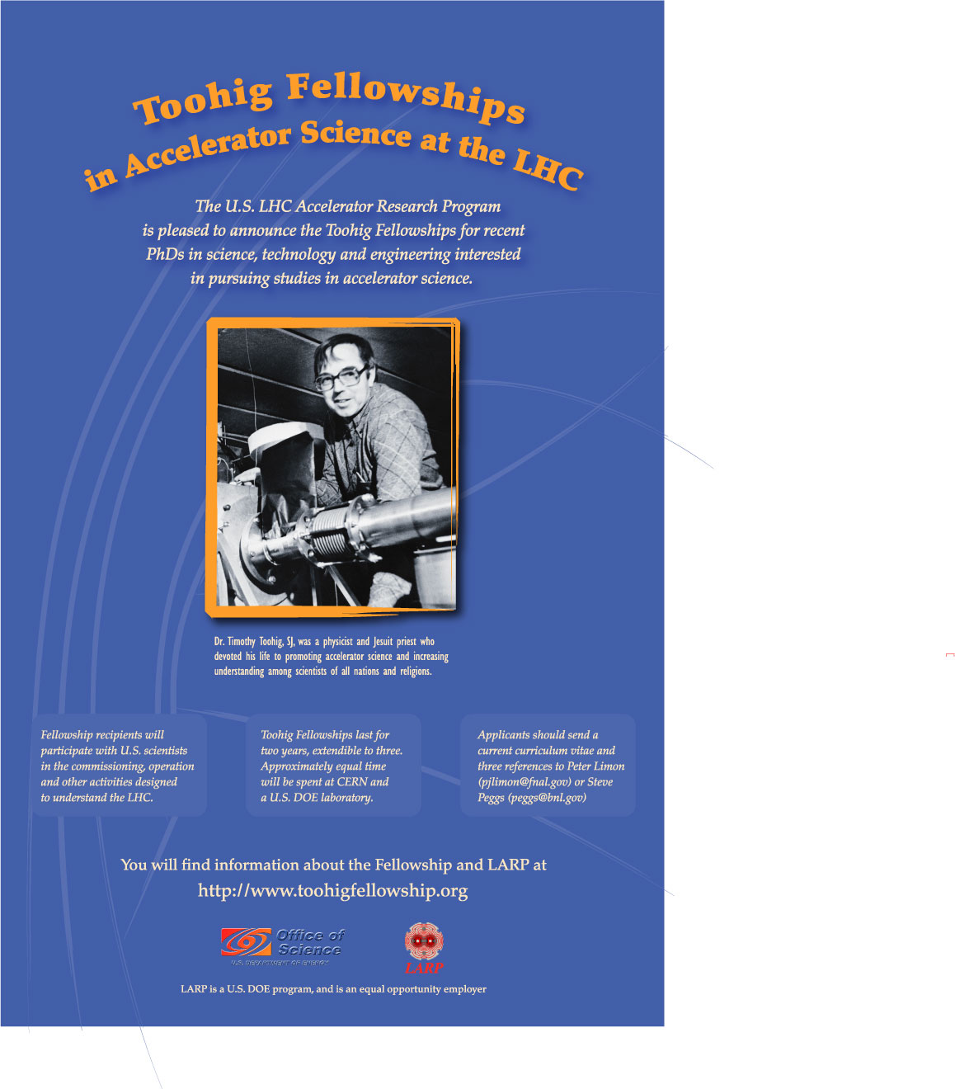
Younger People
“…Beginning in 2006, the U.S. LHC Accelerator Research Program (LARP) is looking for candidates with recent PhD's in Accelerator Physics or Accelerator Engineering to participate in LHC commissioning. Toohig Fellowships last 2 years, extendible by 1 year, with approximately equal time spent at a U.S. lab (BNL, FNAL, LBNL, or SLAC) and at CERN.”
Poster created, word is being spread at PAC’05 → USPAS → magazines
we feel it’s critical to select the first candidate(s) in 2005 and set the Fellowship on good track
the Fellows can greatly increase the number of US physicists involved in long-term LHC commissioning visits

Slide 11
Living Abroad Issues
Longer Term Visit Issues
  6 to 12 months
  Move family/schools
  Travel/Relocation expenses
  Salary adjustment to cost of living
  Insurance
  Extra money from CERN (“Project Associate”=5kCHF/mos HC)
  Taxation
The visits should look attractive in order to bring more people
We explored some of these issues:
  Memo from FNAL HR
  First look into taxation issues
  Studied and agreed with US-CMS guidances
  Another memo on issues for Green Card holders
  Discussion with B.Chrisman on fast(er) foreign travel approval

Slide 12
CTF Recommendations
We endorse the idea that LARP can be effectively used for organization of US involvement in the LHC commissioning. We recommend to form a Machine Commissioning Project (MCP) within LARP for that purpose:
  the MCP to include hardware(HC – if funding resolved) and beam commissioning (BC)
  the MCP leader(s) to approach individuals in the US labs. The CTF members can help.
Participation in LHC hardware commissioning desirable but
  a formal Request Letter is needed from CERN followed by the US response
  funding and Scheduling HC to be addressed ASAP
  urgency to organize HC to become effective in FY’06

Slide 13
CTF Recommendations
(cont’d)
Involvement of junior staff is important:
  Definetely, in Beam Commissioning
    May be less practical for HC
  We recommend “pairing” with more experienced people
    Short term visits to collaborate/supervise younger staff to be supported by LARP
    Remote Access Room in the US can be useful (E.Gottschalk)
  Full support for the Toohig Fellowship program
    needs to be launched in 2005
    many issues not addressed yet
To be further explored:
    how to combine commissioning of LARP deliverables with participation in “generic” beam commissioning
    balance between short and long-term visits

Slide 14
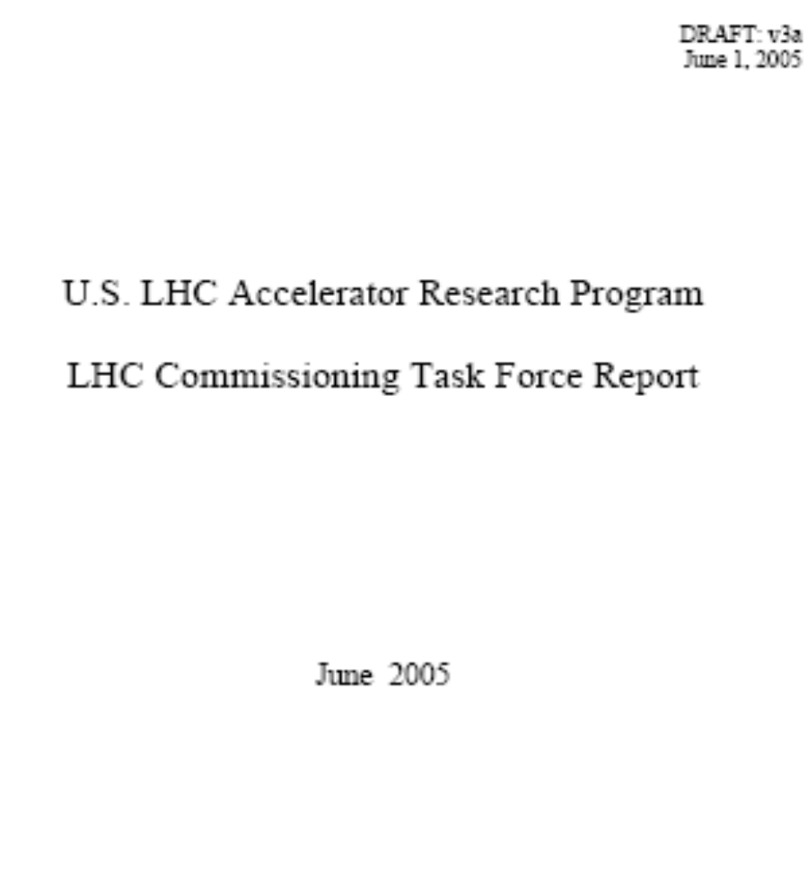
CTF Report (“White Paper”)
Will address:
  Resources missing
  MC organization within LARP
  Benefits to US
  Possibilities at 4 labs
  Funding Issues
  Living Abroad
  Universities participation
Recommendations
CTF Report status
  Now ver.3a exists
  Be finished in June
  US release in June
  Final ~July ‘05

Slide 15
General Conclusions
The CTF has been formed →worked→wrapping up
We found that:
    US labs can provide 1/7 to 1/4 of the manpower missed (and needed) for the LHC installation and hardware commissioning
    – if CERN wants it and if the US makes funding available, through LARP or separately
    Possibilities for the LHC beam commissioning are up to LARP manpower aspirations.
Organization of the US contribution to the LHC commissioning has to be energized:
    CTF recommendations has formed on that subject
    CTF members can be of further use, too
CTF to present comprehensive report in July’05

Slide 16
Back-up Slides

Slide 17
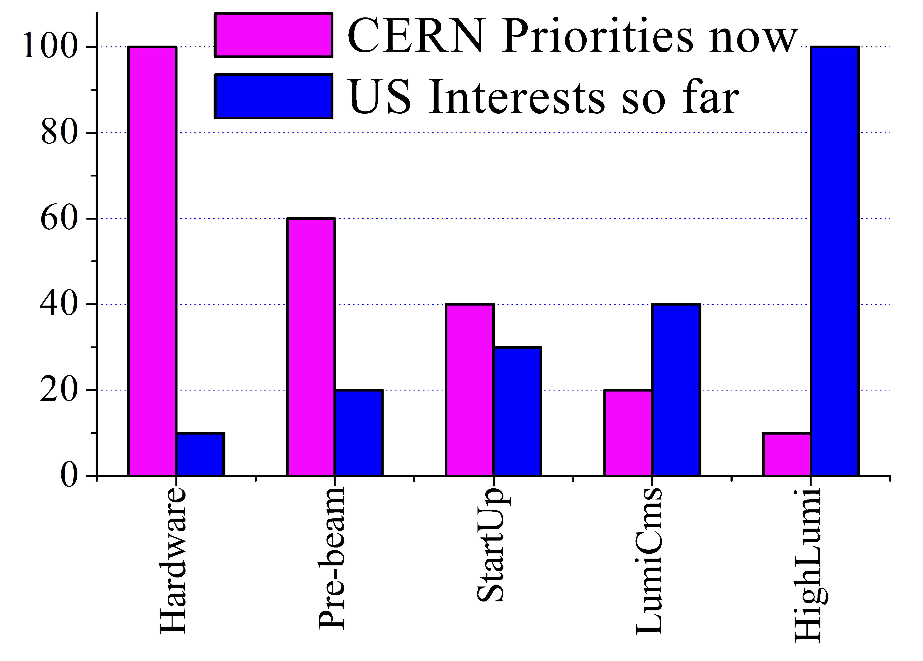
Priorities for CERN and US

