Slide 1
RHIC pp Status
http://www.agsrhichome.bnl.gov/AP/Spin2005/

Slide 2
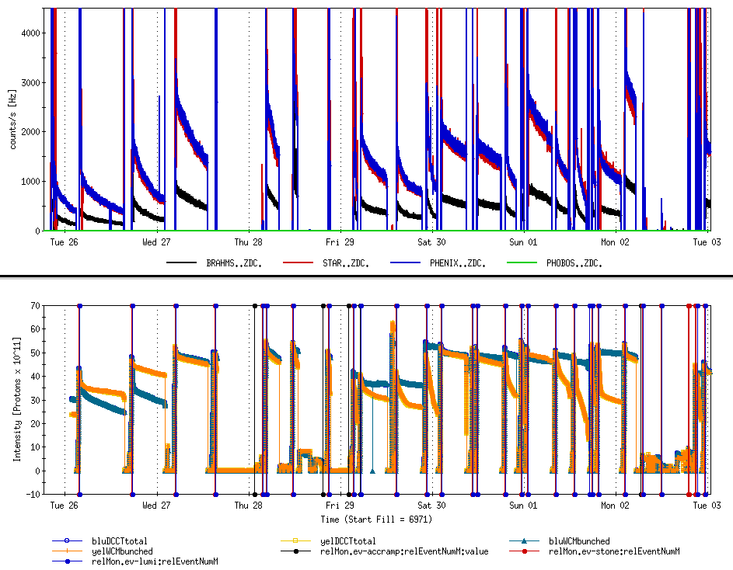
Beam experiment
Beam experiment
STAR ire Alarm
Cryo lead flow problem
Booster Main Magnet problem

Slide 3
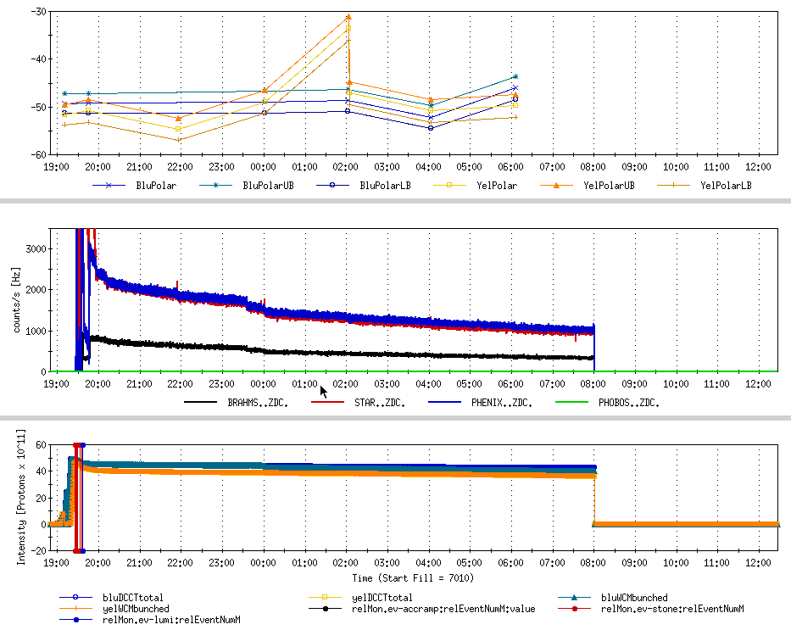

Slide 4
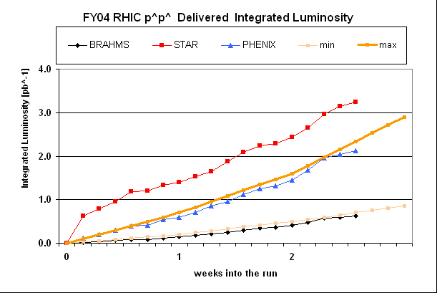

Slide 5
Status
Luminosity achieved:
  56x56, 1.0x10¹¹ bunch intensity
  Peak luminosity: ZDC 4kHz ~ 1.02x10³¹cm⁻²s⁻¹
  Good lifetime
Polarization achieved at store: ~45%
  CNI ready for 120 bunch mode

Slide 6
Remaining Issues
Emittance blowup during the ramp
  Instability along the ramp: negative chromaticity: corrected
Poor reproducibility of Yellow lifetime at store
  Different golden orbit for store
  Couple of good stores over weekend, but not reproducible

Slide 7
Plan
Machine development to improve the performance
  Peak Luminosity:
    bunch intensity maxed out at 1x10¹¹ for now
    Go beyond 56 bunches
    Eliminate emittance blowup during ramp:
      Correct the negative chromaticity along the ramp
  Integrated luminosity
    Solve the yellow lifetime issue at store
      Yellow aperture study
      Yellow non-linear corrector setting

Slide 8
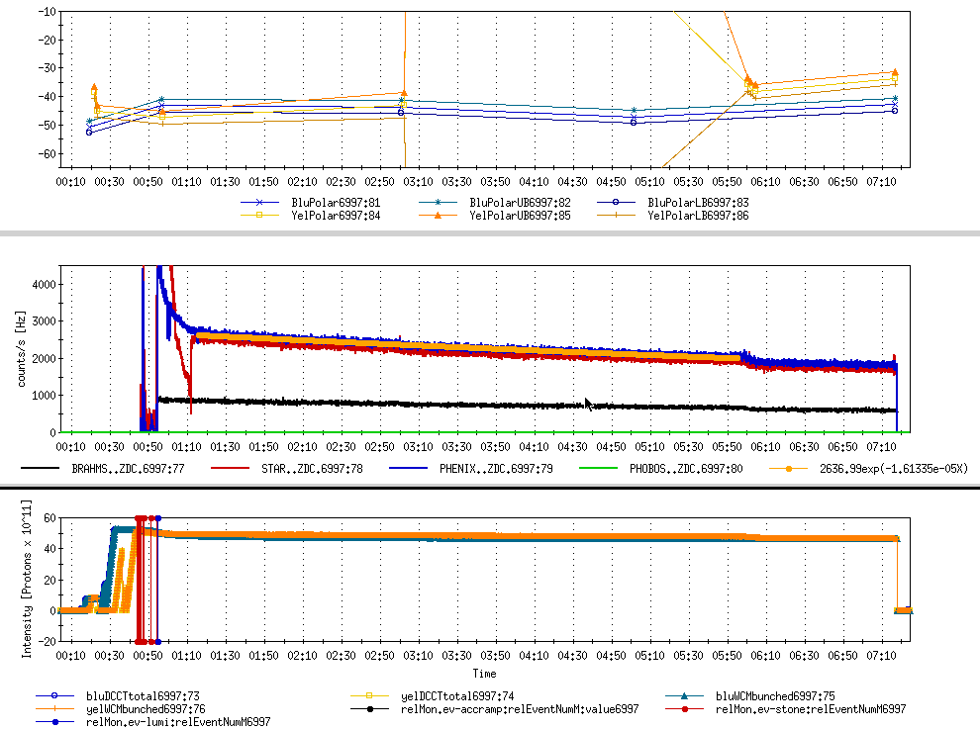
Best store: LP^4
Lifetime: 17 hours

Slide 9
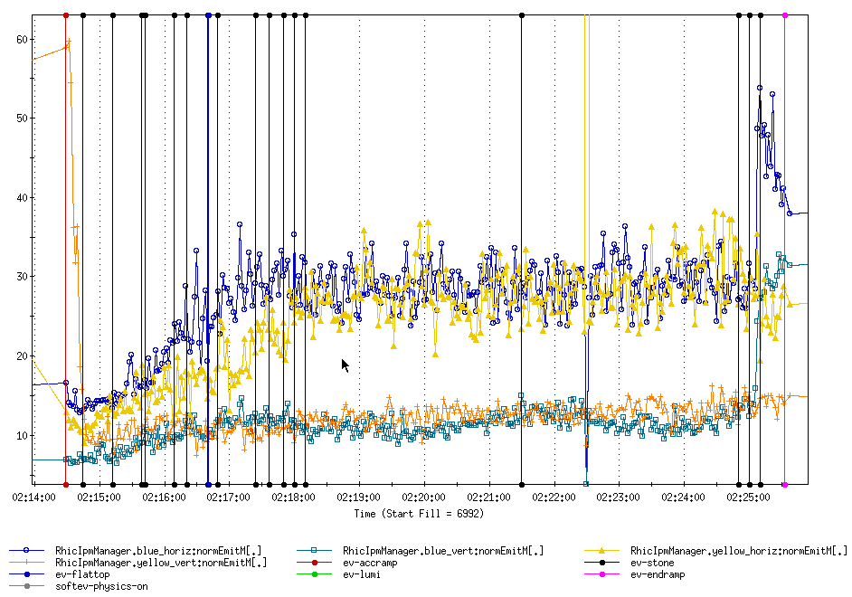
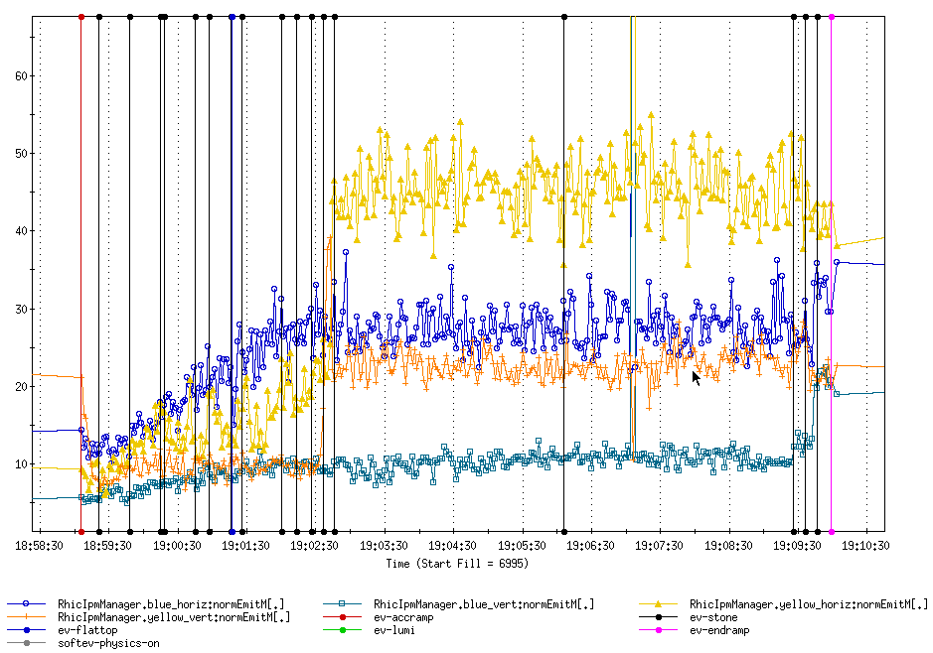

Slide 10
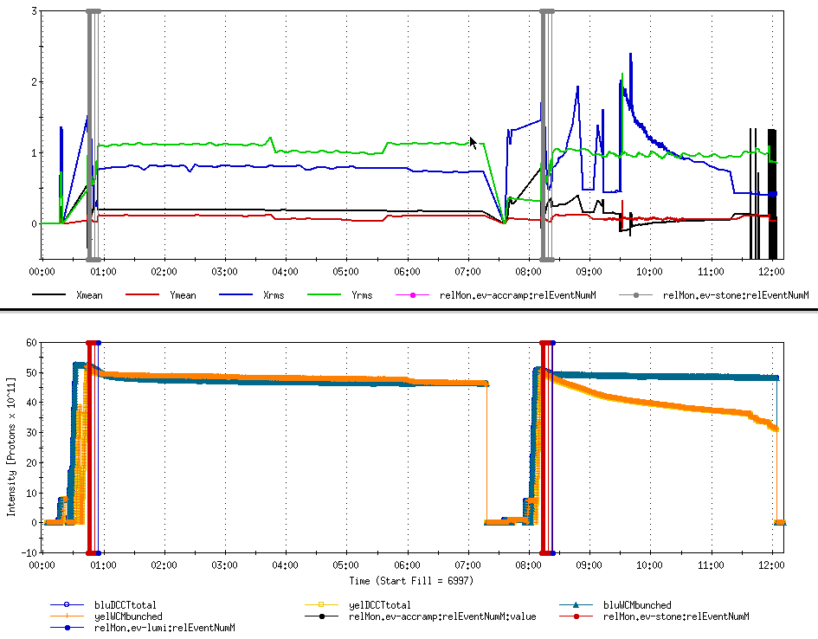
Fill 6997 and Fill 6998

Slide 11
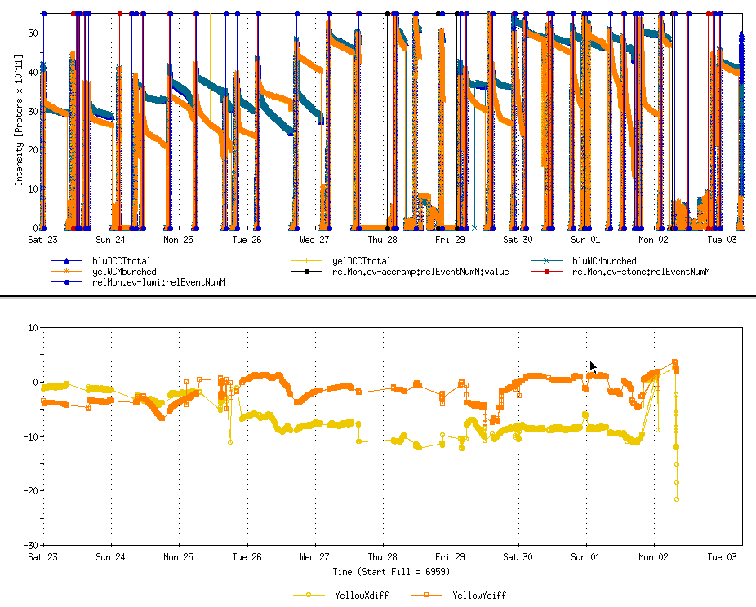
Angle bump at Store

Slide 12
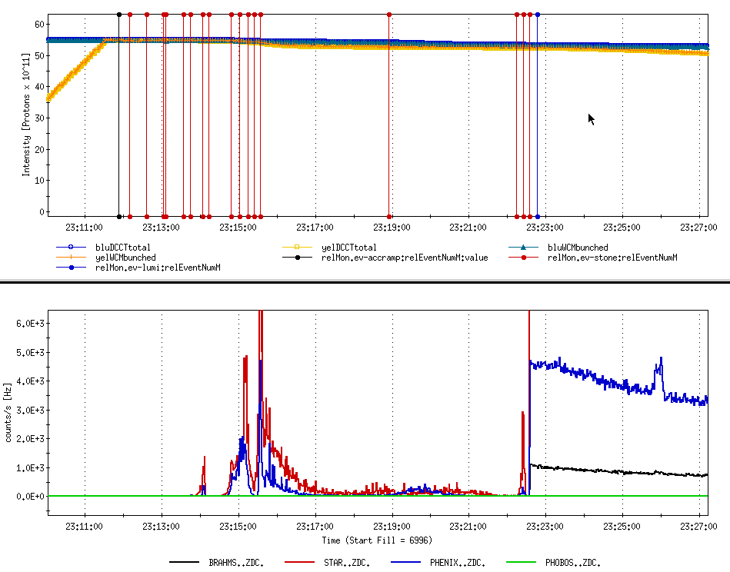
High peak luminosity

Slide 13
